Slide 1



a
The State Of UX In
2025
Table of Contents
Foreword From Our CEO
About The State Of UX In 2025 by Userlytics
Executive Summary
Key Statistics & Findings
Methodology
What We Asked Companies
Key Takeaways

Slide 2

Foreword from
our CEO
The origins of the User Experience research sector trace back to the 1940s and 1950s when the principles of human factors and ergonomics were applied to the dynamics of human-system interaction.
During the 1960s and 1970s, the discipline of Human Computer Interaction (HCI) emerged to refine computer systems for human application, establishing the basis for what would become known as usability.
The 1980s marked a significant increase in the adoption of usability terminology and principles, significantly influenced by Apple's success in enhancing the usability of its products, notably its Macintosh computer line.
It was in the early 1990s, during his tenure at Apple, that Dan Norman brought the term user experience into the mainstream, advocating for a perspective that extended beyond mere functionality or usability.
Since that time, the domain has seen a surge in popularity among product managers, UX designers, and user experience researchers. To echo a sentiment commonly expressed at Userlytics, and in the spirit of Peter Drucker, “User Experience Eats Strategy for Breakfast.”
The emergence of remote unmoderated testing and research, championed by platforms like Usertesting, Userlytics, and Userzoom, has significantly decreased the costs and time required to conduct UX studies—from weeks to mere days or hours—while also facilitating access to a global pool of participants.
More recently, the deployment of AI-driven systems for the automatic summarization and analysis of qualitative UX research sessions, such as Userlytics' AI UX system, is set to substantially reduce the overall time frame from initial hypothesis to testing, results, and insights.
Furthermore, the development of comprehensive user experience benchmarking metrics, such as the ULX® Benchmarking Score, which evaluates 18 attributes across 8 dimensions (including usability, appeal, distinction, adequacy, trust, performance, affinity, and appearance), enables immediate enhancements in user experience and competitive benchmarking.
This study aimed to explore the various approaches organizations are adopting towards user experience research, examining centralized versus distributed models, and the roles of UX researchers versus UX designers, to understand their impact on the industry.
Spanning 6 months and engaging over 100 participants from various countries, this report sheds light on the current landscape of the UX industry as it navigates through what could be the most significant shift in HCI, Usability, and UX in the past eight decades: the introduction of AI-enhanced user interfaces.
We trust you'll find this insightful!

Slide 3
About The State of UX In
by Userlytics
2025
Sarah, a UX Researcher at In.Novi in Palo Alto, has witnessed the company's remarkable growth. Starting with only 2 founders, In.Novi quickly expanded to hundreds of employees after a $290M Series A funding, eight years ago. Following a couple of additional funding rounds, their valuation has placed them among the top contenders to become the latest standout success story in Silicon Valley. In.Novi currently has a workforce of over one thousand employees.
Despite In.Novi's talent and investment in innovation, Sarah faces a persistent challenge as a UX Researcher: aligning departments on implementing research findings effectively across product, marketing, sales, and technology.
After a morning filled with intense discussions with various leaders, Sarah is rethinking her strategy for getting departments on board with her research insights. Her most recent debate was with the Chief Marketing Officer:
Sarah
We need to pivot our approach based on the latest user feedback. It's crucial for the product's success.
CMO
Sarah, I appreciate your input, but our current campaign is already in full swing. A pivot now would mean significant cost and time delays.
Sarah
But if we ignore these insights, we risk launching a product that doesn't resonate with our users. Our research is clear on this.
CMO
Listen, I respect your work, but you're not seeing the bigger picture. Marketing has its own metrics and targets to meet. We can't just change course on a whim.
Is this dialogue all too familiar to you?
This report arises from a similar quest for clarity. It explores how UX research is carried out in large firms, who benefit from these insights, and importantly, how departments like Product Management, R&D, and Marketing, which are traditionally outside the UX field, can use DIY UX tools to engage customers better.
Based on a survey of 100 professionals working in large companies, this report provides diverse perspectives on UX within big organizations. It covers variations between the US and EU markets and the influence of budgets on research teams.
In the end, this report is more than just data and analysis. It narrates the experiences of professionals like Sarah, who deal with the evolving world of UX daily, shedding light on the ‘why’ and ‘how’ behind UX practices in large companies.

Slide 4
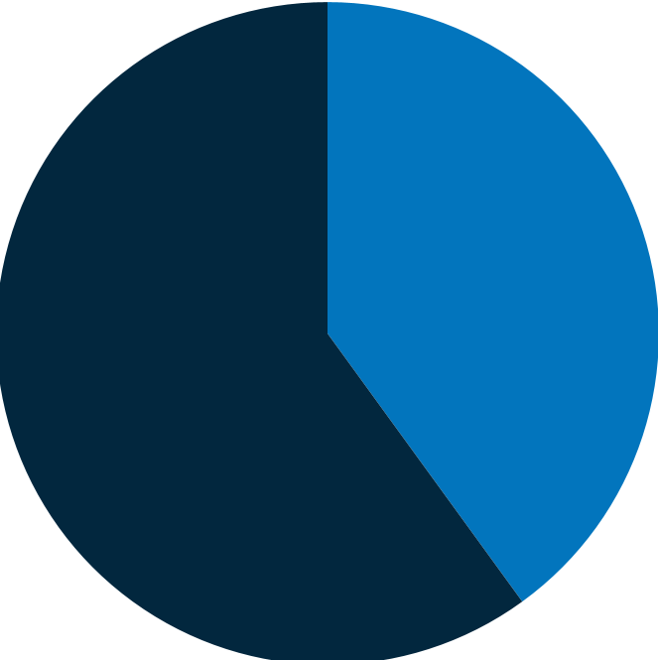
Executive
Key Statistics
Summary
This executive summary highlights key findings from UX research analysis within large companies, emphasizing the central role of product managers and the organization of UX teams either centrally or across departments. The insights from UX research primarily aim to improve user experience and product functionality, closely involving stakeholders and integrating with business objectives.
Product and Marketing teams play significant roles in initiating UX studies, which are crucial for developing marketing strategies, user personas, and customer journey maps. User involvement typically occurs during prototype testing, with internal databases being the main source for user recruitment.
The effectiveness of UX research is measured by its impact on user satisfaction, development speed, and conversion rates, with surveys and usability testing being the most common methods. Despite budgetary and resource challenges, companies are committed to enhancing UX research, seeing increased funding and formal training for UX designers as essential steps forward.
To conclude this summary, the study results highlight the growing recognition of UX research's value in enhancing user experiences and business outcomes, with companies actively investing in resources to bolster UX initiatives and expecting the field's continued expansion. This reflects the increasing importance of UX research in the competitive business environment.
& Findings
Some of the answers particularly caught our attention. A notable highlight of this study is the trend towards remote research, reflecting the evolving landscape of UX studies in an online and distributed work environment. The initial survey questions focused on the participants' work locations, with the majority indicating the United States. This geographical focus offers a nuanced view of UX practices within the context of this predominant market. The report also addresses the geographic dispersion of company headquarters, again with a significant focus on the United States.
Here are some of the most important findings of this study:
40% of the organizations included in the survey have been engaged in UX research for a period of 4 to 6 years.
60%
40%

Slide 5
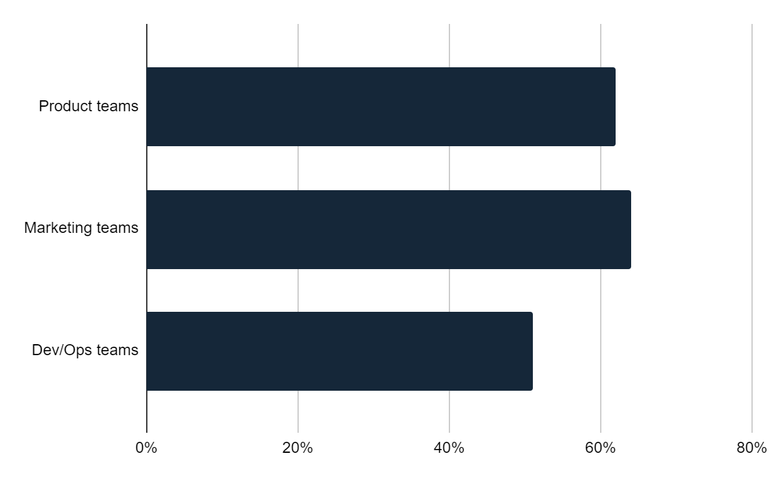
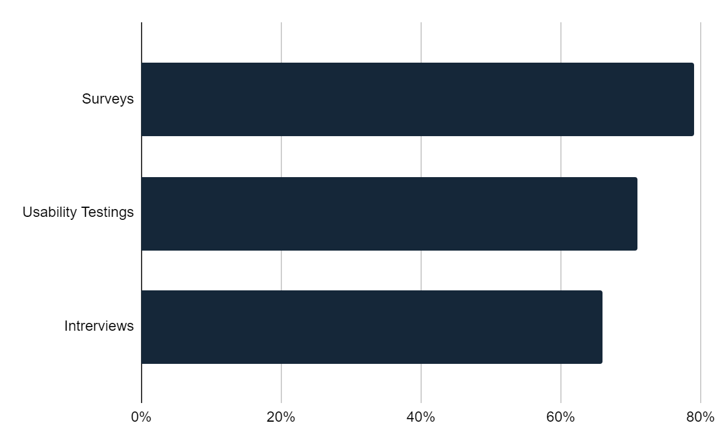



UX mainly serves product teams (62%), marketing teams (64%), and Dev/Ops teams (51%).
The most frequently used UX research methods include surveys (79%), usability testing (71%), and interviews (66%).
Over time, organizations are dedicating greater resources to UX research. Among the surveyed organizations, 42% reported a 10-30% increase in their expenditure in the last year, while 30% experienced increases exceeding 30%. Additionally, 56% of the respondents expressed the belief that enhancing their budget and resources would lead to improvements in their UX research process.
The primary challenge faced by organizations in conducting UX research remains recruitment. A majority of the surveyed organizations (55%) reported relying on an internal database of users for their recruitment efforts.
56% of the organizations included in the survey have employed artificial intelligence to help produce or uncover UX research insights.

Slide 6
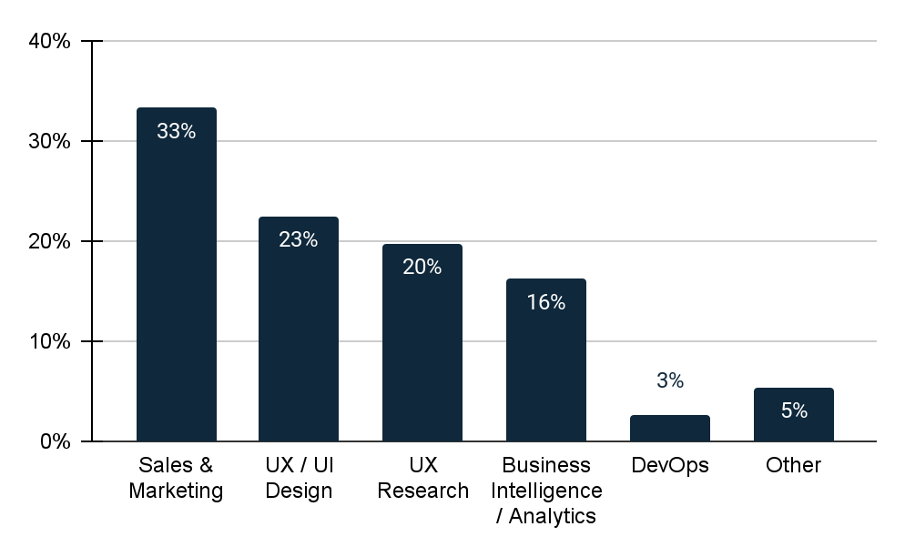
Methodology
What We Asked
Which of the following departments do you lead or participate in within your organization?
This study is based on a survey completed by 100 professionals. These participants are senior or managerial level employees from large organizations (1000+ employees) with over 5 years of experience in fields like user research, UX design, product management, and marketing. They work full-time in departments such as Product Management, R&D, Sales & Marketing, and UX/UI Design or Research.
The study offers detailed insights, including comparisons between the US and EU, budget allocations, tools used, and the link between the number of researchers and their budgets. It also examines specific survey responses (Q34 vs. Q35), screener questions, and how company size and industry type affect UX practices.
Companies
1
The majority of survey respondents, at 33%, were either leaders or team members in the Sales & Marketing department. This was followed by 23% from the UX/UI Design department, 20% from UX Research, and 16% working in Business Intelligence. A smaller portion, 3%, were in DevOps, with the remaining 5% spread across various other departments. Those categorized under "Other" were engaged in a range of departments, including Cybersecurity, Operations, Product Management, Product Development, Buying, and Data Processing.

Slide 7
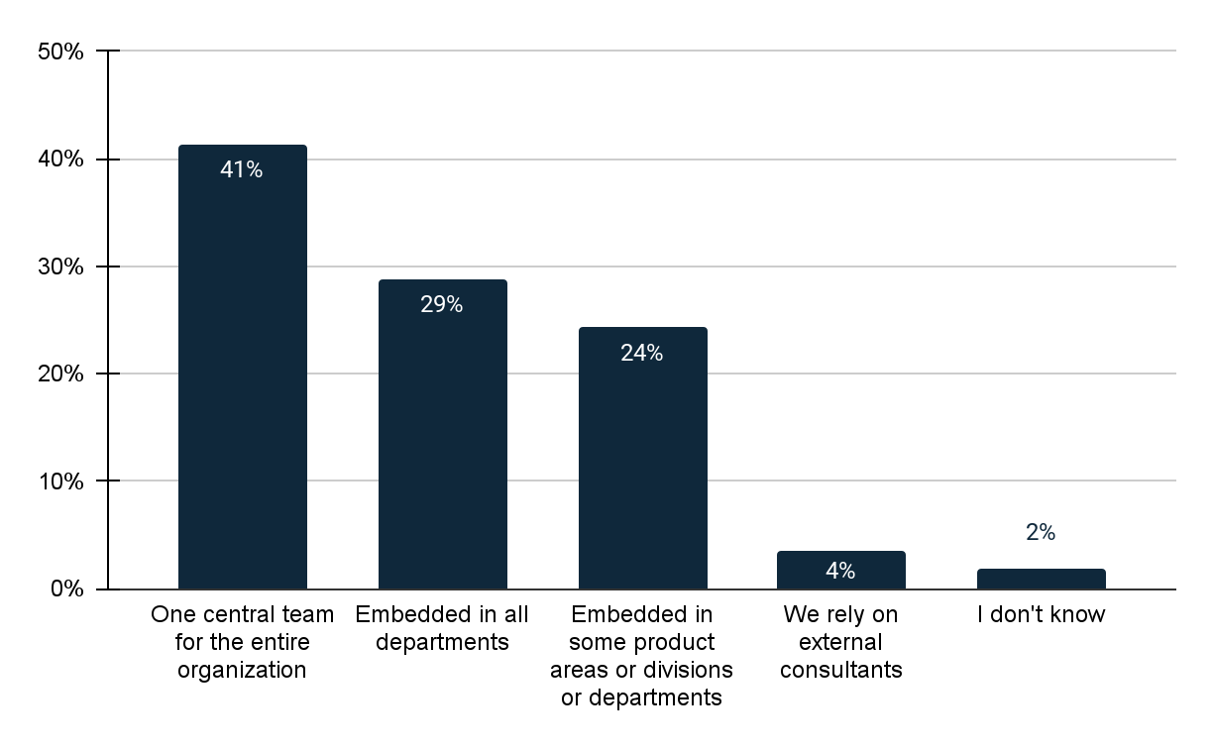
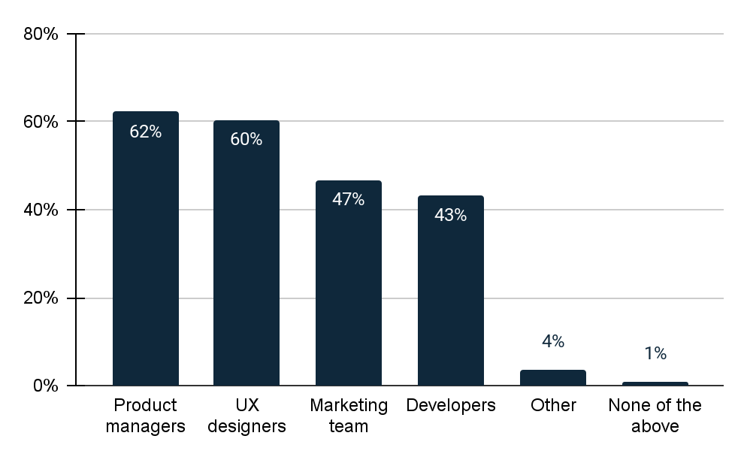
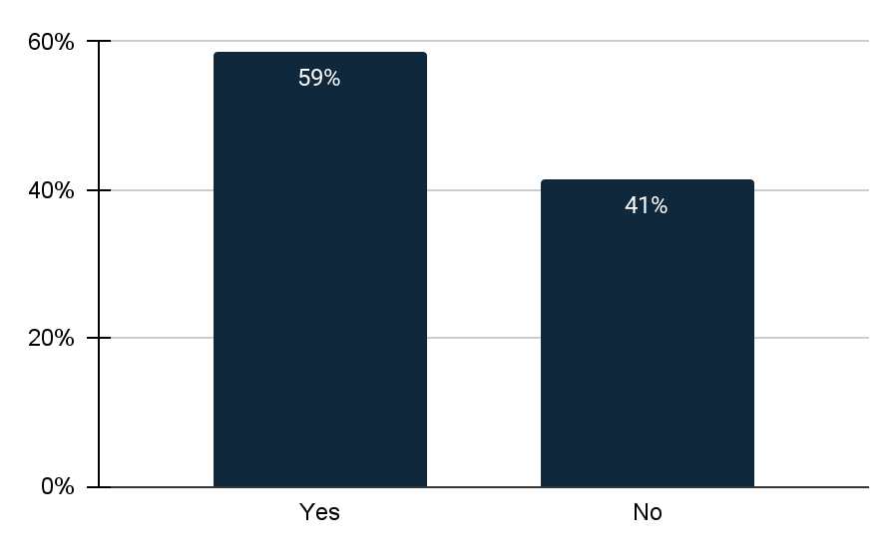
Within my organization, UX practitioners are organized by
Who are the primary stakeholders of UX research in your organization? (Select all that apply)
Do you allow non-UX Research departments to launch UX insight studies on their own initiative?
2
Most companies have one central team for the entire organization, chosen by 41% of respondents. Meanwhile, 29% of companies have UX practitioners integrated across all departments.
3
62% of respondents identify Product Managers and 60% UX Designers as the primary stakeholders in UX Research.
4% selected 'Other', including Retail Customers, IT Specialists, Internal Operations, and Production.
4
59% say they do allow non-UX research departments to launch UX insight studies while 41% do not allow non-UX research teams.

Slide 8
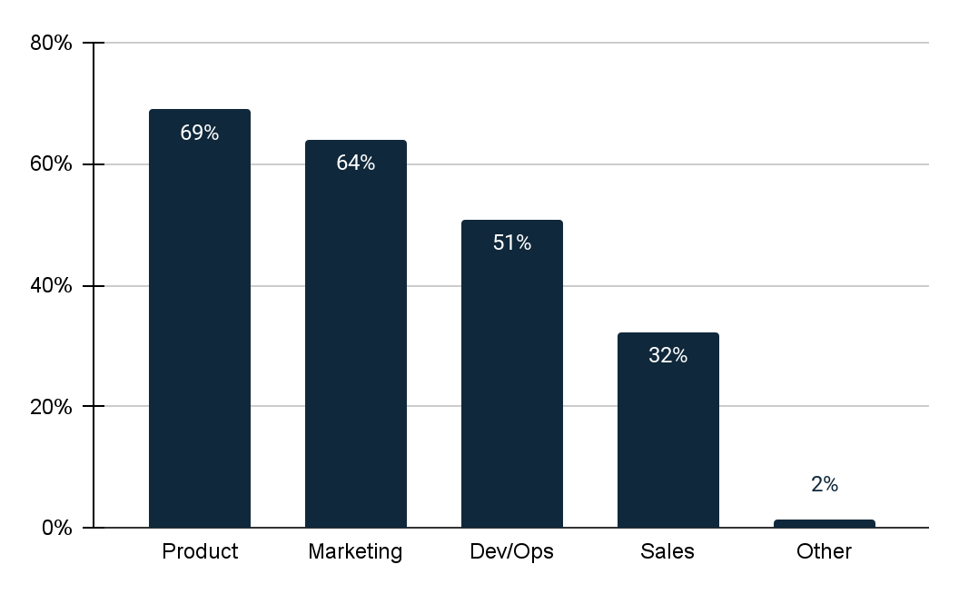
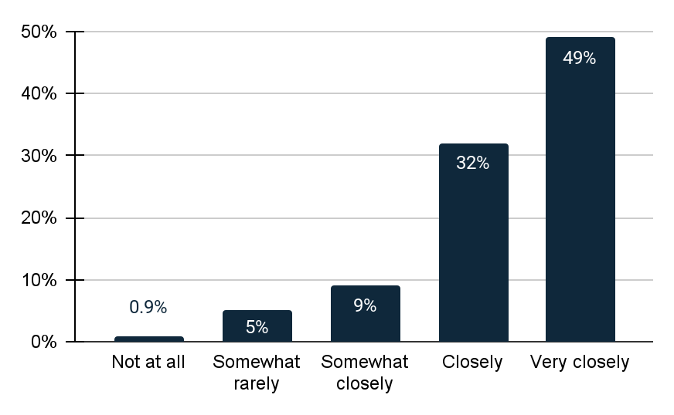
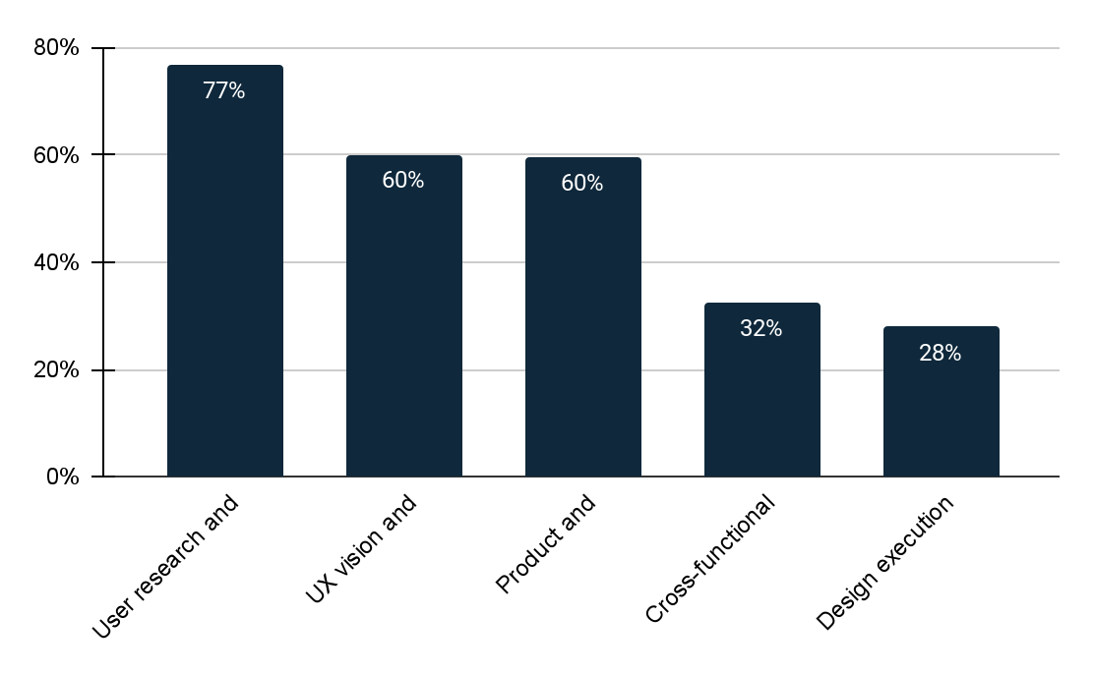
If yes, which departments? (Select all that apply)
How closely do UX researchers collaborate with other departments in your organization?
Which of the following formalized processes exist in your UX team? Please select all that apply.
5
In organizations where UX research extends to other departments, most studies are conducted in the Product department, followed by Marketing. The Sales department has the fewest studies, with only 32% conducting them.
6
It's observed that in most organizations, UX researchers work closely with other departments, with 49% of companies reporting this collaboration. Only 0.9% state that their UX researchers do not collaborate with other departments at all.
74
Among various processes, User Research and Testing is the most formalized in UX teams (77%), followed by UX Vision and Strategy at 60%.

Slide 9
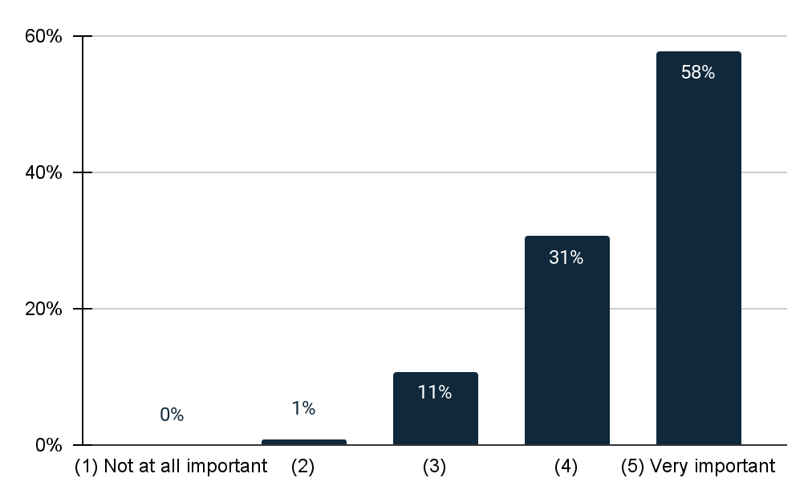
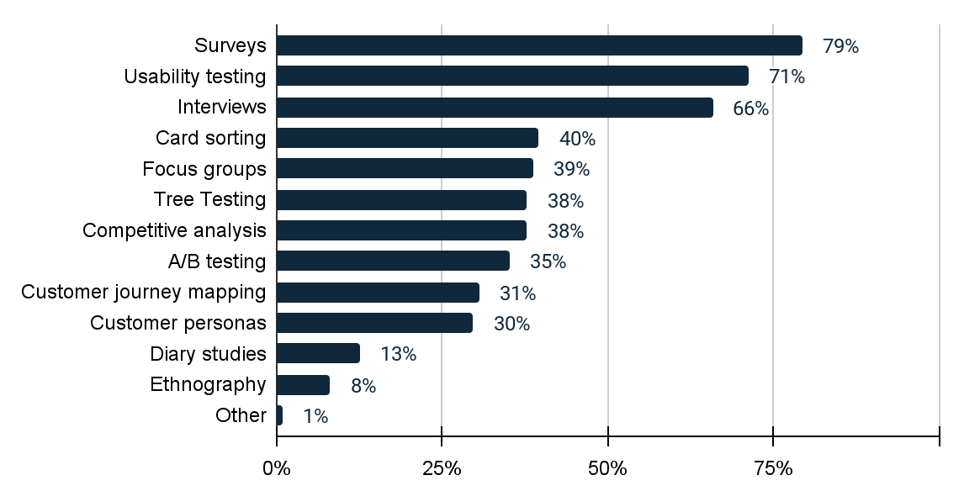
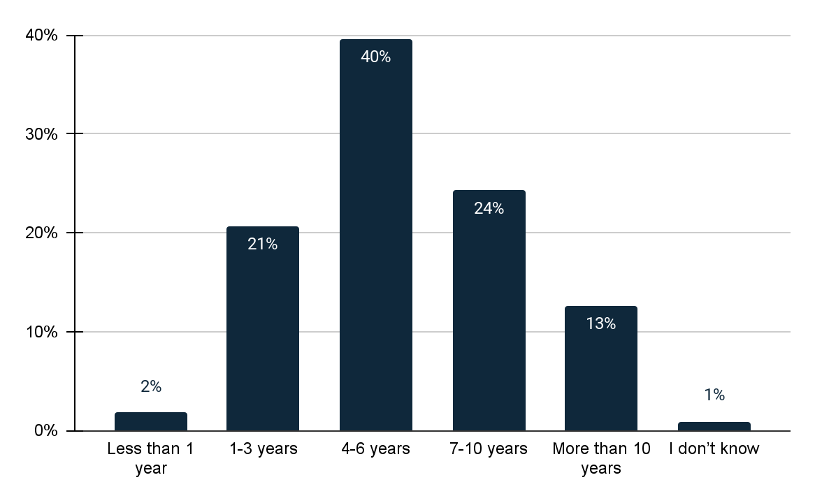
On a scale of 1-5, How important is conducting user research to your organization?
What types of UX research methods are commonly used in your organization? (Select all that apply)
How long has your organization been conducting UX research?
8
58% of respondents consider conducting user research extremely important, while only 1% view it as somewhat important.
9
Surveys are the most popular UX research method, used by 79% of respondents. Usability testing and interviews are the second and third most used methods, respectively.
10
40% of respondents have been conducting UX research for over 4 years, whereas only 2% are newcomers, having been involved in UX research for less than a year.

Slide 10
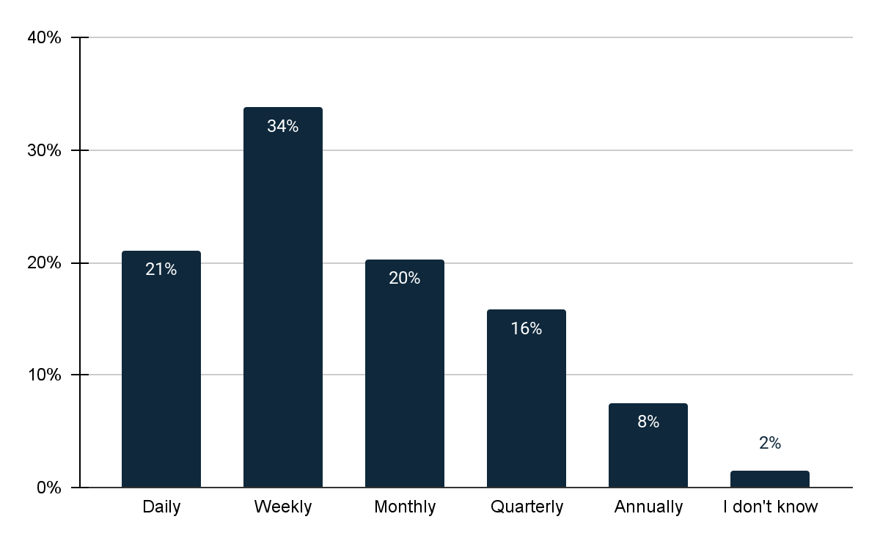
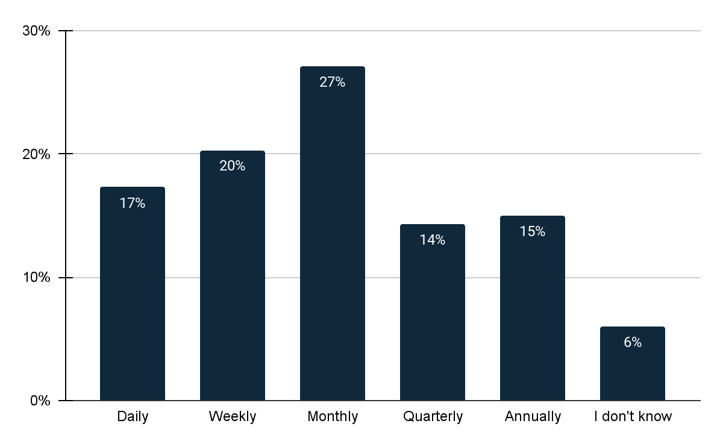
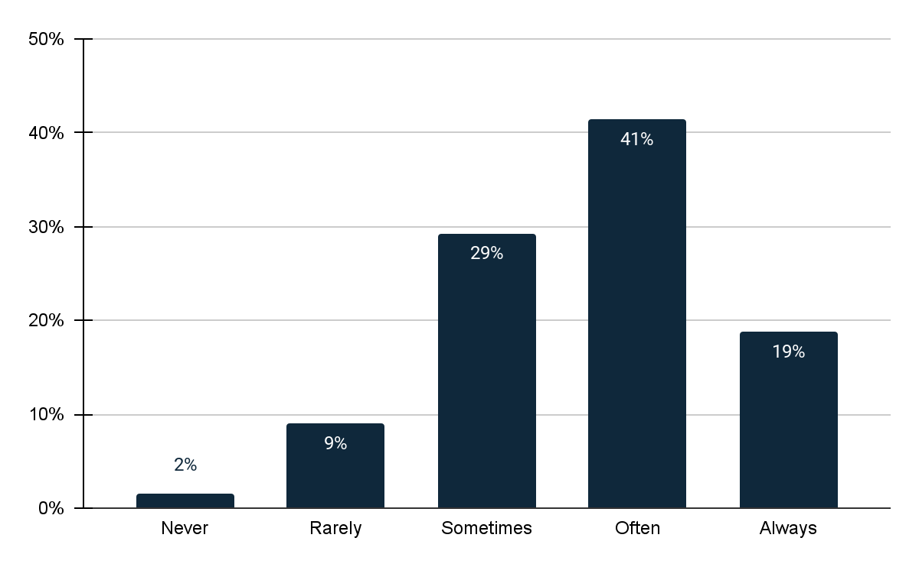
How often does your organization conduct UX research?
My organization conducts international UX research studies…
My organization conducts REMOTE user testing
11
Most companies carry out UX research weekly, with 21% conducting it daily and only 8% doing it annually, indicating the overall importance of UX research in organizations.
12
Most companies generally conduct international UX research studies monthly, and 20% report doing such research on a weekly basis.
13
41% of companies frequently conduct remote user testing, while only 2% never engage in remote user testing.

Slide 11
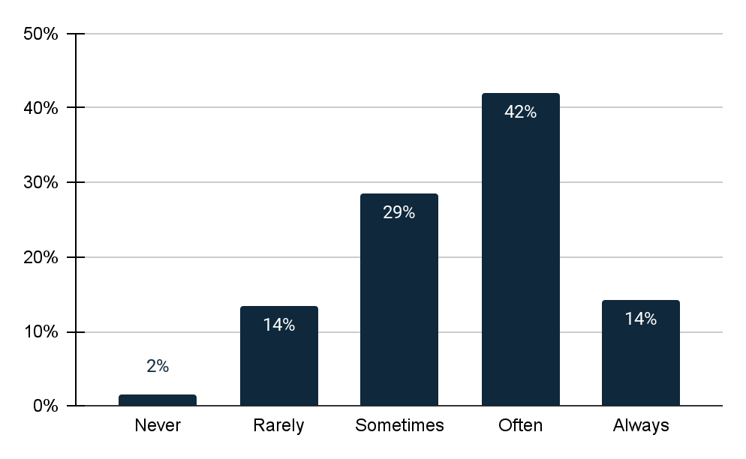
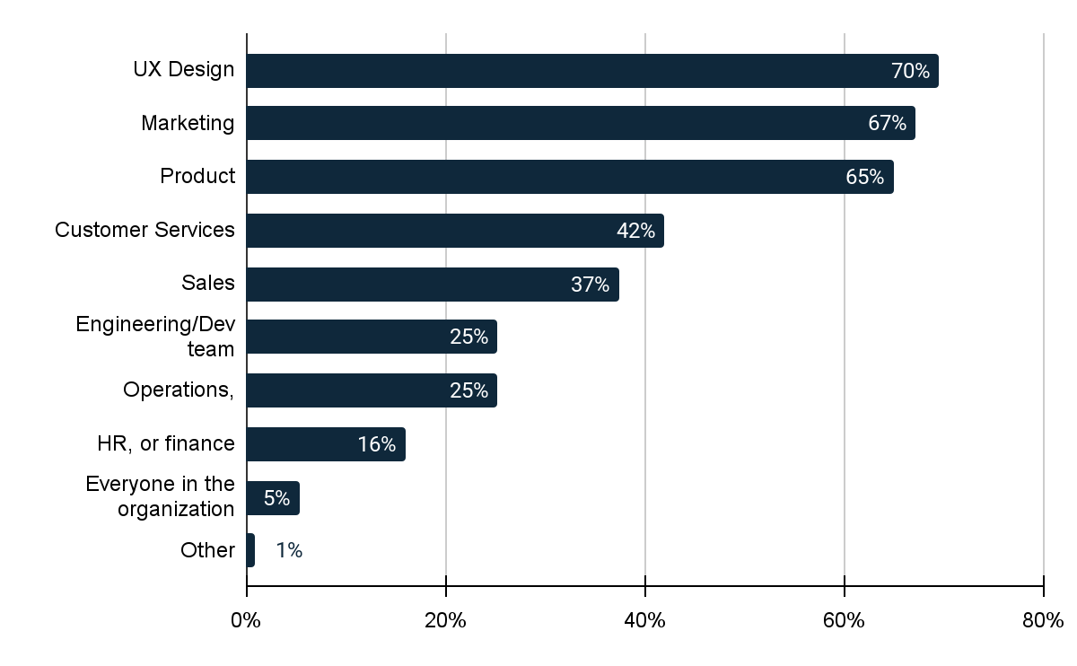
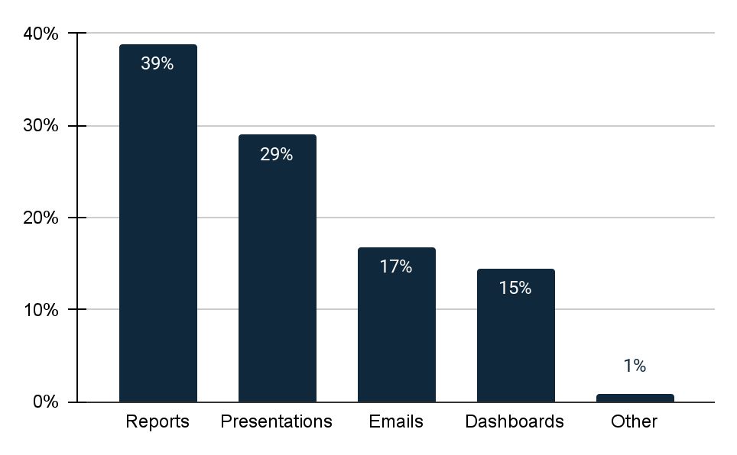
My organization conducts IN-PERSON testing
Please select all of the following teams or internal departments where UX Research is accessible.
How does your organization share UX Research insights?
14
Overall, 42% of organizations often conduct in-person tests, and 29% do so occasionally.
15
Besides the UX design team, 67% of organizations provide access to UX research for their Marketing team, and 65% make it available to the Product team.
16
In most organizations, UX research insights are primarily shared via Reports (39%) and Presentations (29%).

Slide 12
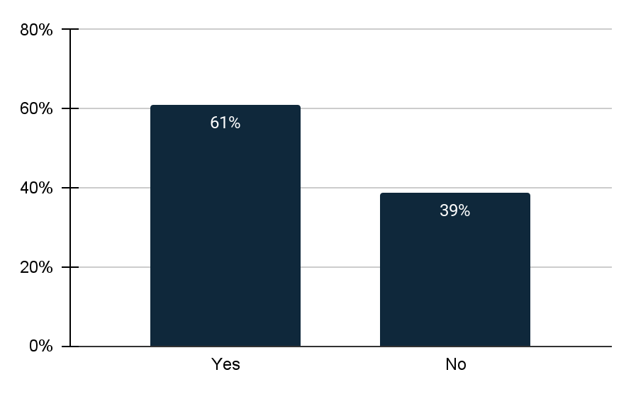
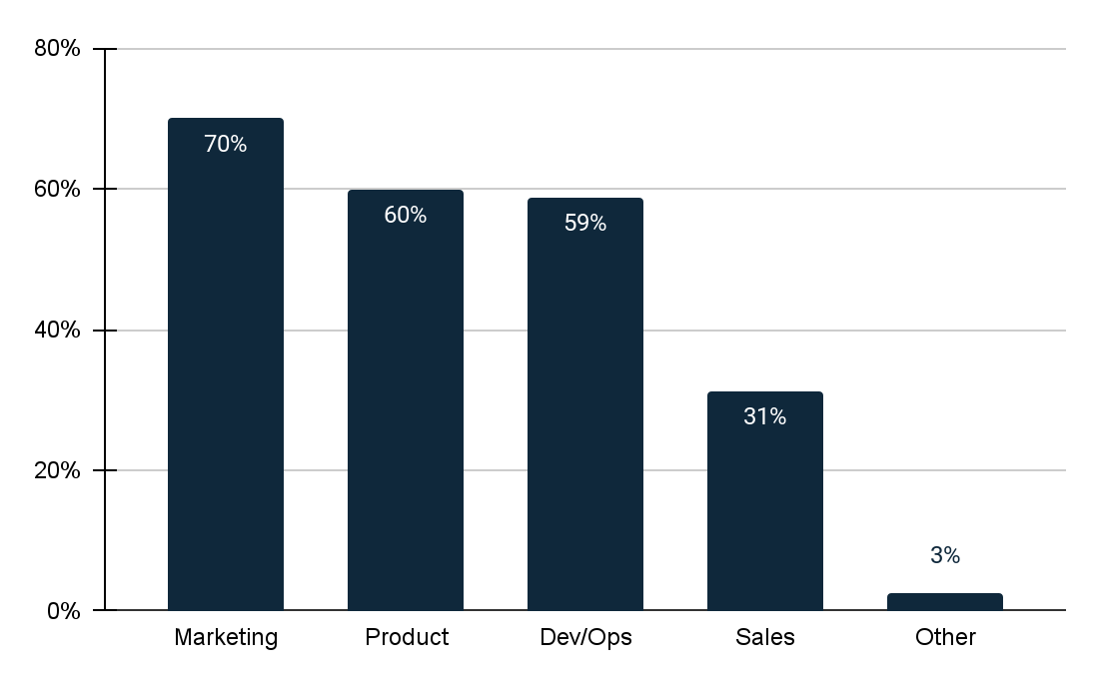
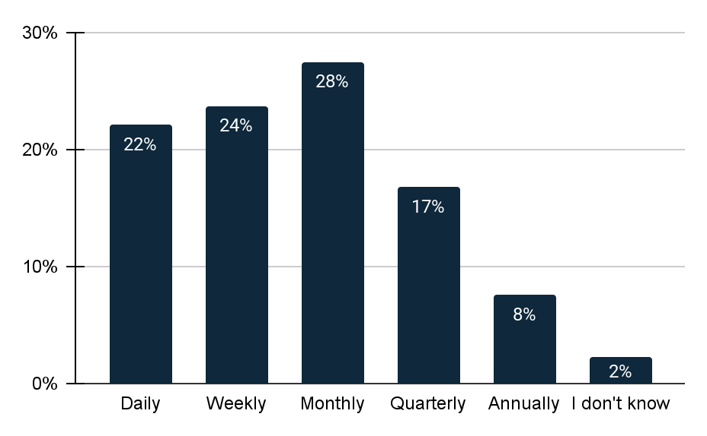
Do you allow non-UX Research departments to access the results and/or interpret the results of UX insight studies on their own initiative?
If yes, which departments? (select all that apply)
How often are UX insights shared with executives or senior leadership in your organization?
17
39% of organizations restrict non-UX research departments from accessing the results of UX insight studies.
18
In the 61% of companies that permit non-UX research departments to access results, the marketing department and product team are primarily involved.
19
Most companies share UX insights with their executives or senior leadership monthly (28%), while some do so weekly (24%).

Slide 13
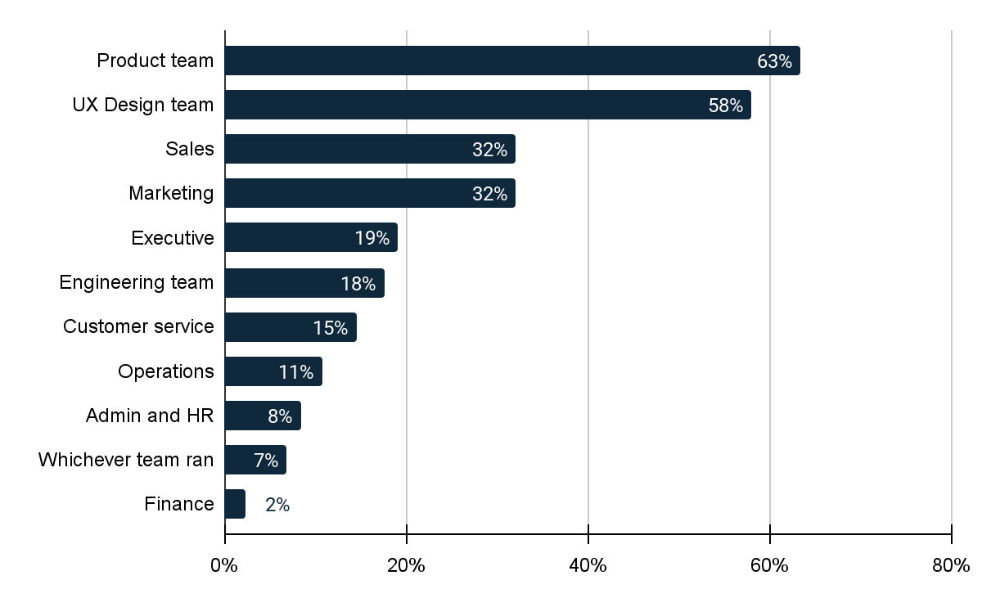
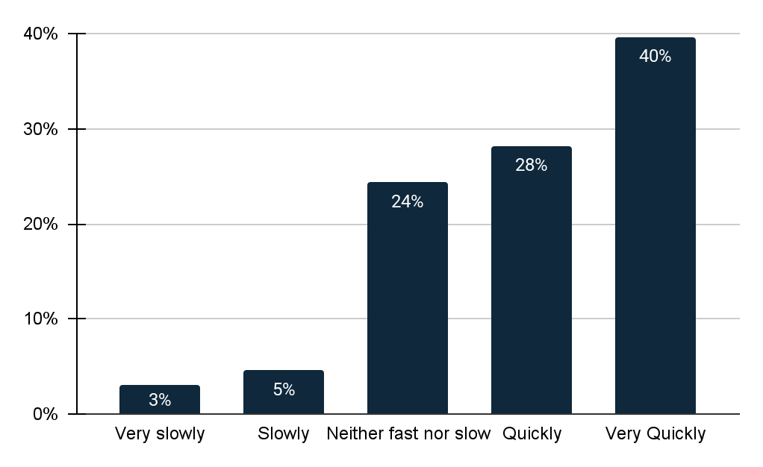
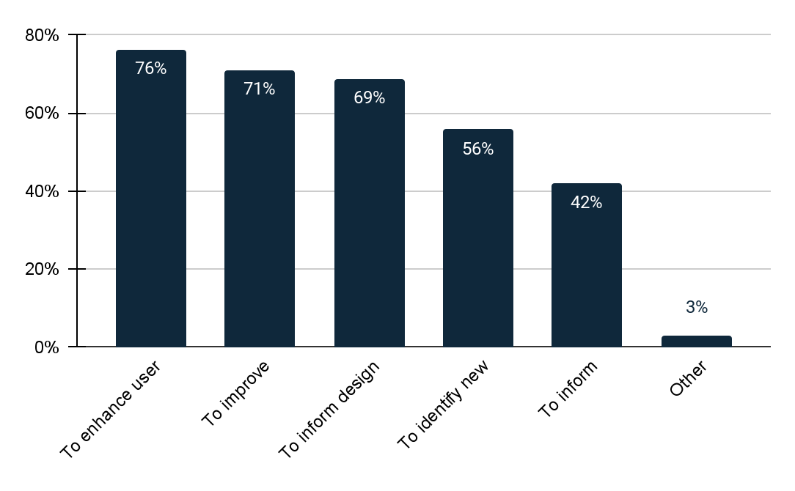
Who is responsible for implementing the insights from UX research in your organization? (select all that apply)
On a scale of 1-5, how quickly does UX research insight get implemented at your organization?
How are the insights from UX research used in your organization? (Select all that apply)
20
63% of companies assign the responsibility of implementing insights from UX research to their product team, 58% to the UX design team, and only 19% have executive management handle this task.
21
40% of companies report that UX research insights are implemented very quickly in their organization.
22
Most companies indicate that insights from UX research are used to enhance user experience, improve product functionality, and inform design decisions. Companies selecting 'Other' stated they use UX research insights:
For better conversions
To understand potential new customer bases
To inform about product preferences among target customers
To stay informed about competition

Slide 14
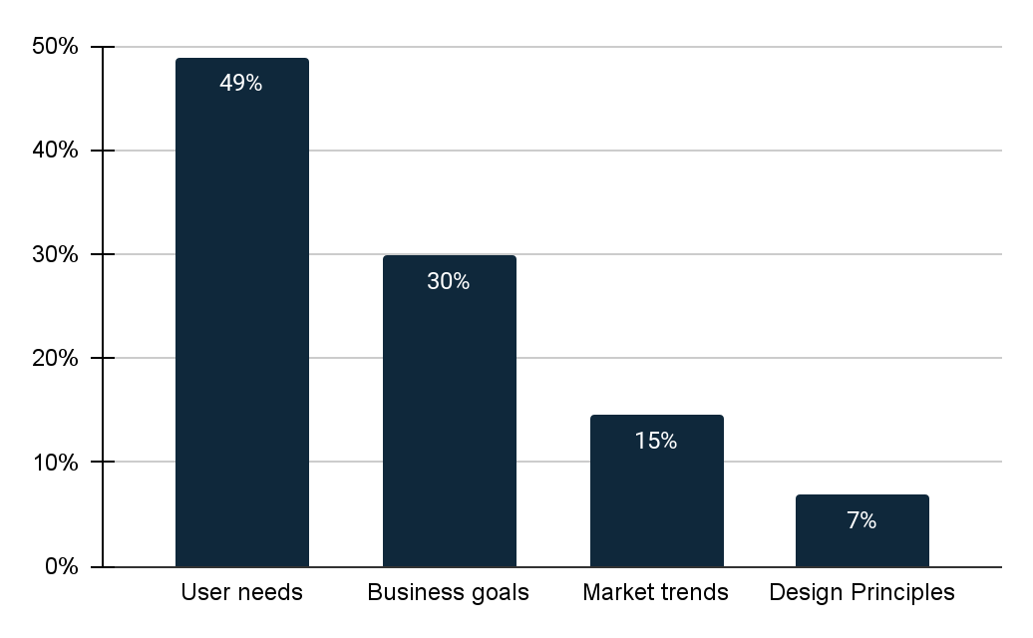
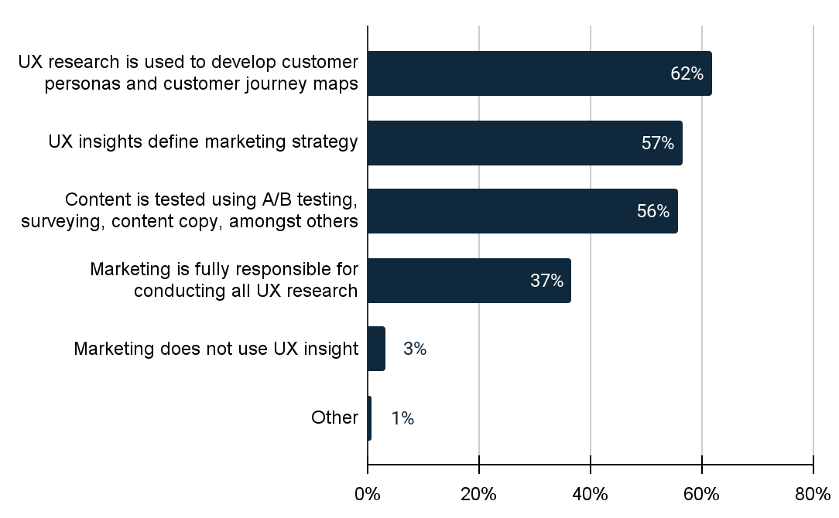
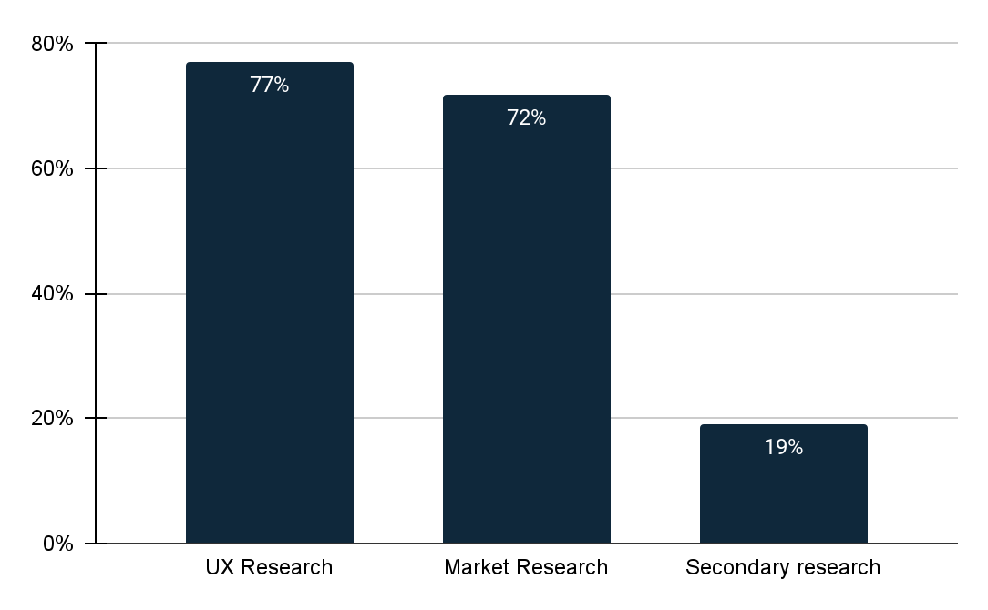
How do you typically prioritize which research questions to address first?
How is UX research harnessed within the marketing department? (select all that apply)
How, if at all, does your organization implement research into marketing decisions?
23
Most companies prioritize addressing questions about user needs and business goals, while a few focus on design principles as a priority question.
24
Most companies use UX research to create customer personas and customer journey maps within their marketing teams.
Others use it to define marketing strategies and test content through A/B testing, surveys, and content copy analysis.
25
77% of companies reported using UX research for making marketing decisions, while 19% rely on secondary research.

Slide 15
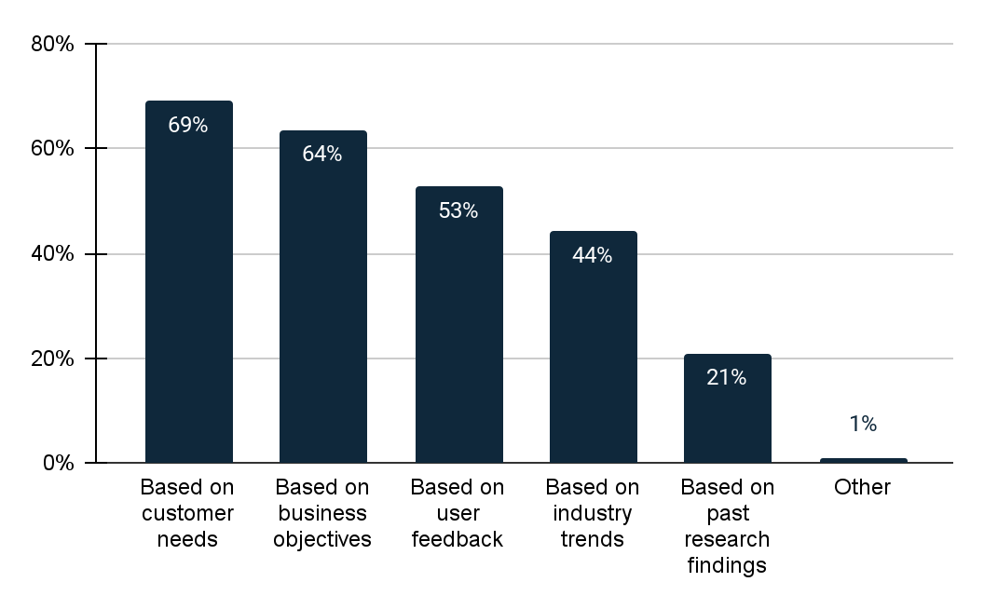
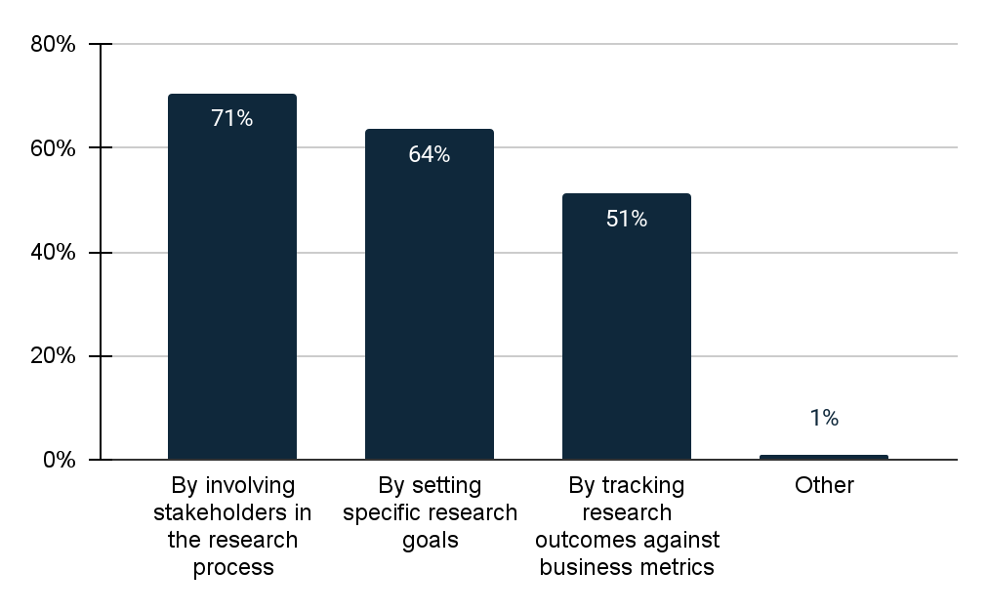
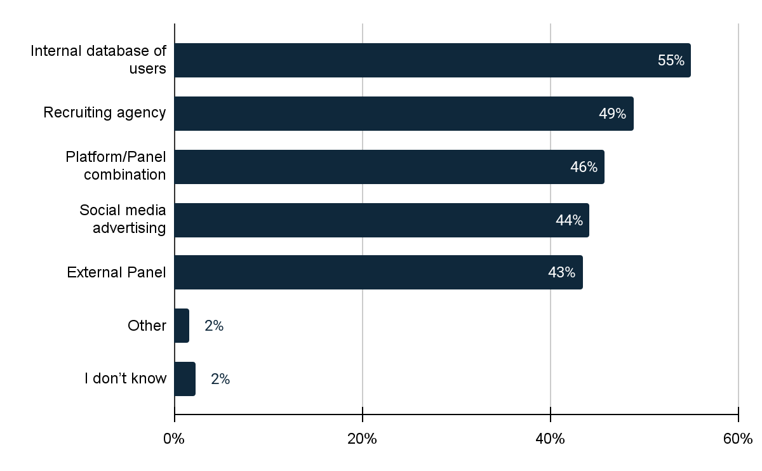
How does your organization prioritize UX research initiatives?
How does your organization ensure that the user research conducted aligns with business goals and objectives? (Select all that apply)
How does your organization recruit participants for user research studies? (Select all that apply)
26
Most organizations prioritize UX research initiatives based on customer needs, with 64% also focusing on business objectives.
27
71% of companies involve stakeholders in the research process to align user research with business goals, and 51% track research outcomes against business metrics to ensure this alignment.
28
55% of companies recruit research participants from their internal user databases, while 49% use recruiting agencies. A significant number also utilize a combination of platforms and panels for recruitment.

Slide 16
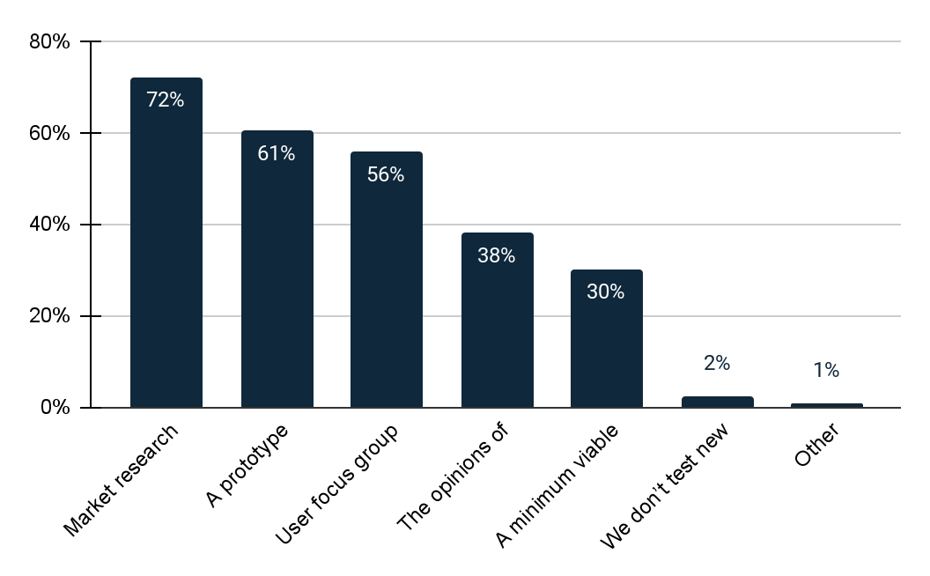
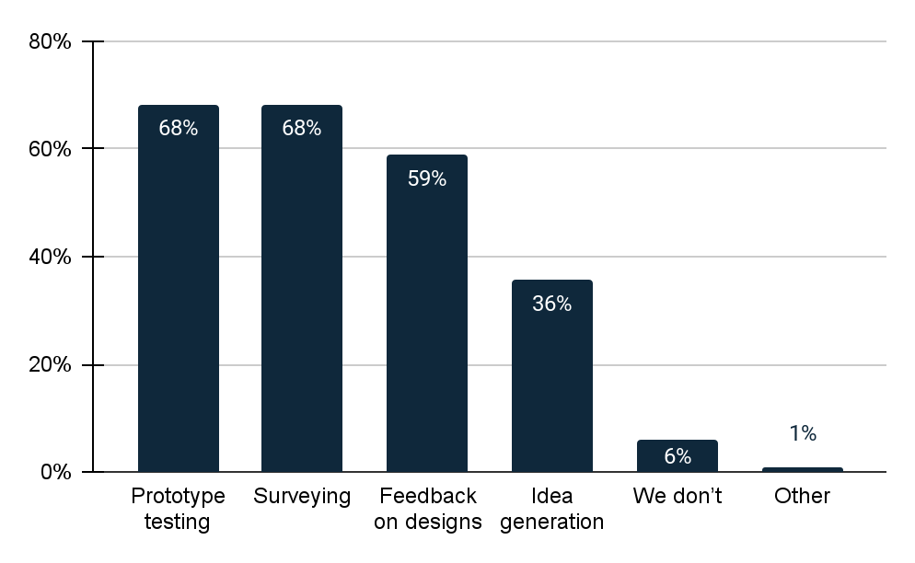
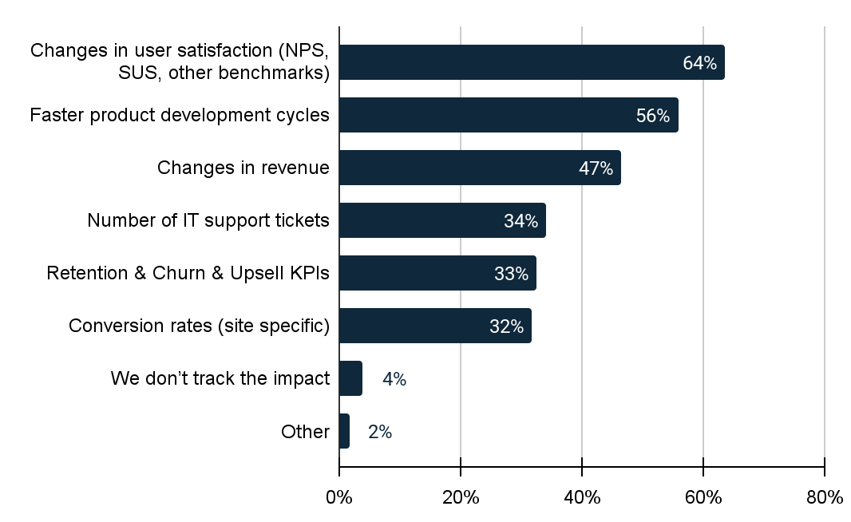
My organization validates new products or offerings using: (select all that apply)
Does your organization involve end users in the product development process? (select all that apply)
How does your organization measure the impact and success of UX research? (Select all that apply)
29
Most companies validate new products or offerings through Market Research (72%), with a significant number using Prototypes (61%). Additionally, 56% of companies employ user focus groups or studies for validation.
30
68% of companies include end users in prototype testing and surveys during product development, but only 36% involve them in the idea generation phase of this process.
31
64% of companies assess the impact and success of UX research by observing changes in user satisfaction, using metrics like NPS, SUS, and other benchmarks. Many also measure it by noting faster product development cycles.

Slide 17
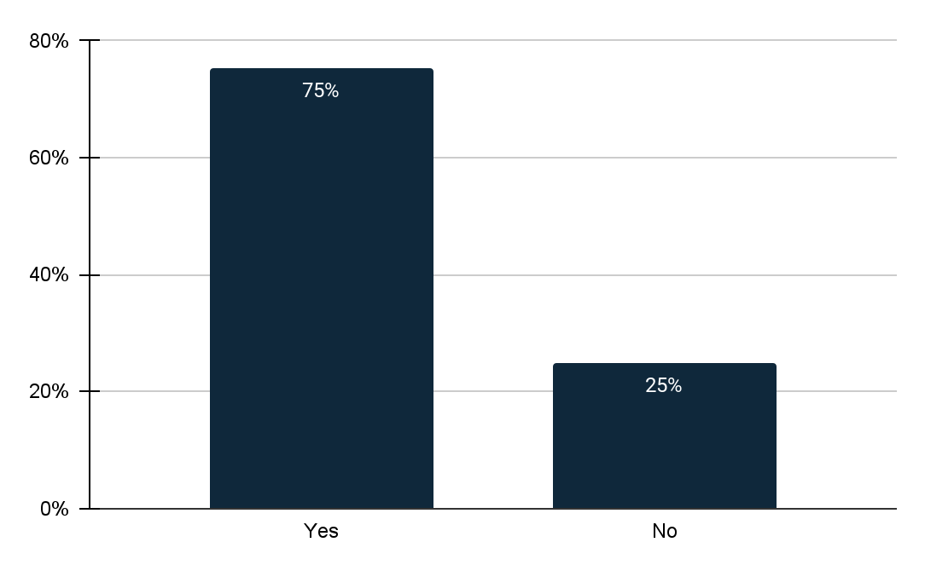
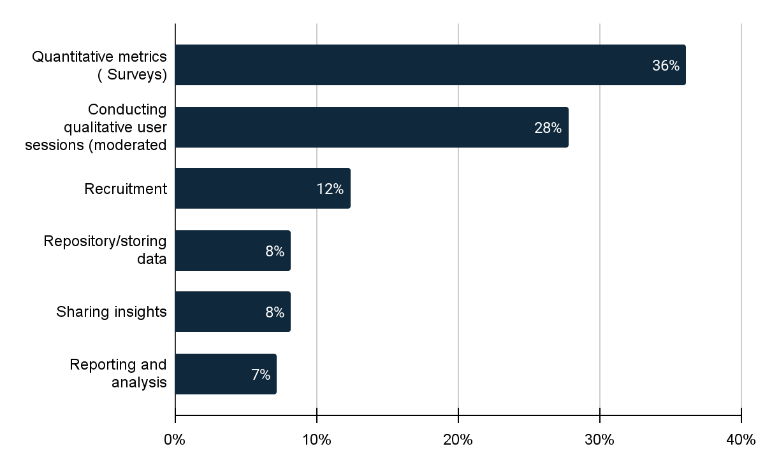
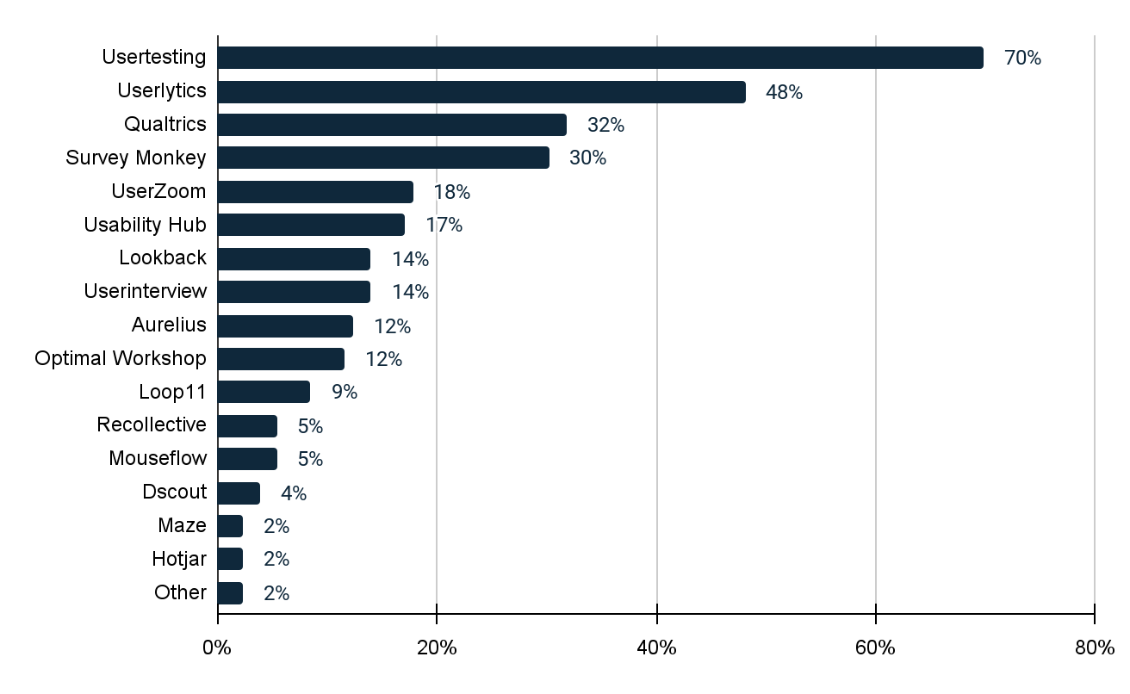
Does your organization use any tools or platforms to manage UX research (at any stage of research)?
If yes, what do you use the platforms for? (Select all that apply)
Which of the following platforms have you used to execute UX Research studies (Select all that apply)
32
75% of companies utilize tools or platforms to manage their UX research.
33
The majority of companies use platforms for quantitative measurement testing, and a significant number also employ these platforms for conducting qualitative user sessions.
34
70% of the companies have used Usertesting and 48% of them have used Userlytics.

Slide 18
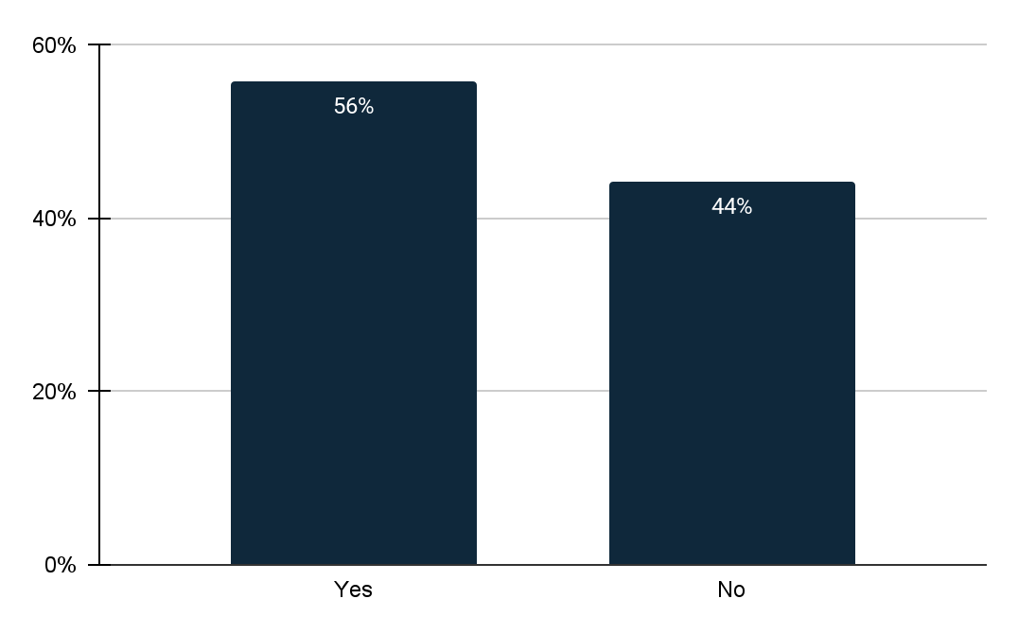
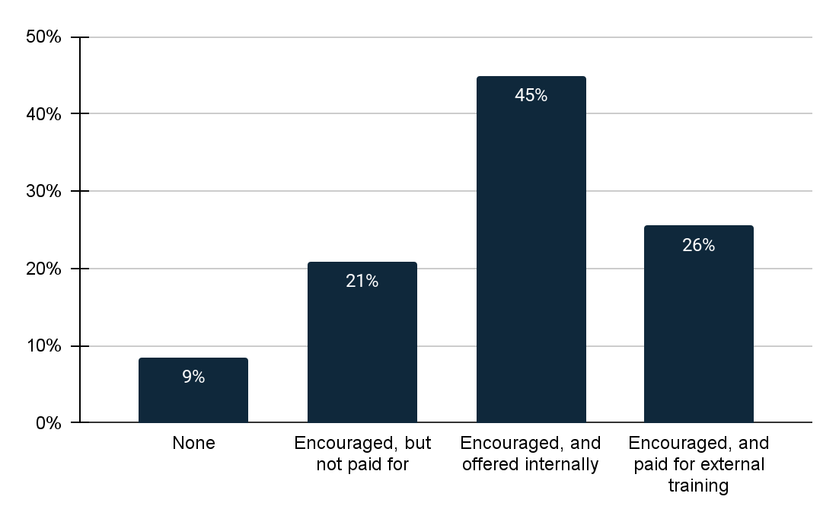
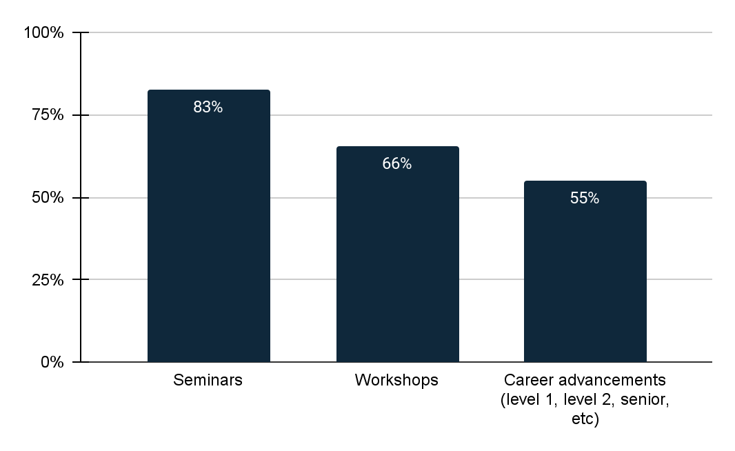
Has your organization utilized A.I to help produce or uncover UX research insights?
To what extent does your organization encourage formal training around UX Research and UX Design?
If encouraged, and offered internally, what kind of education is offered?
35
56% of organizations have utilized AI to assist in generating or uncovering UX research insights.
36
45% of companies promote and provide internal formal training for UX research and UX design. 26% support and finance external training opportunities.
37
In terms of training methods, 83% prefer seminars, and 66% use workshops for educating their teams.

Slide 19
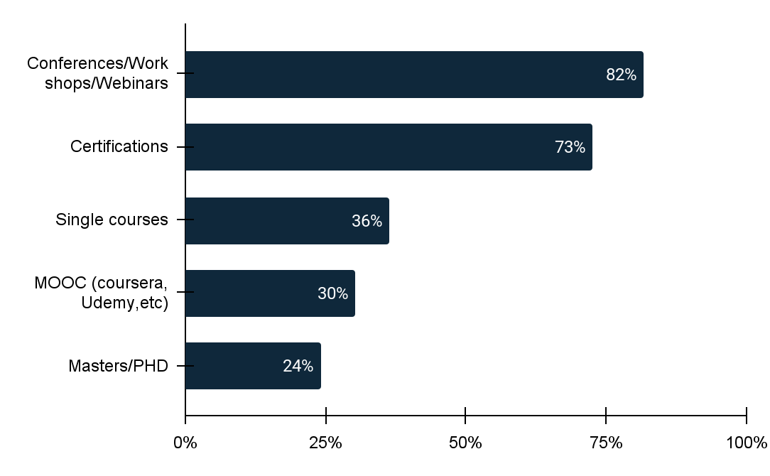
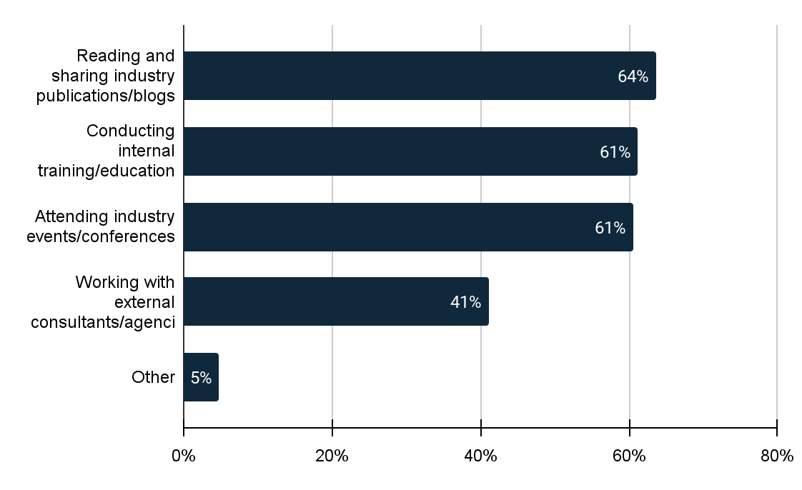
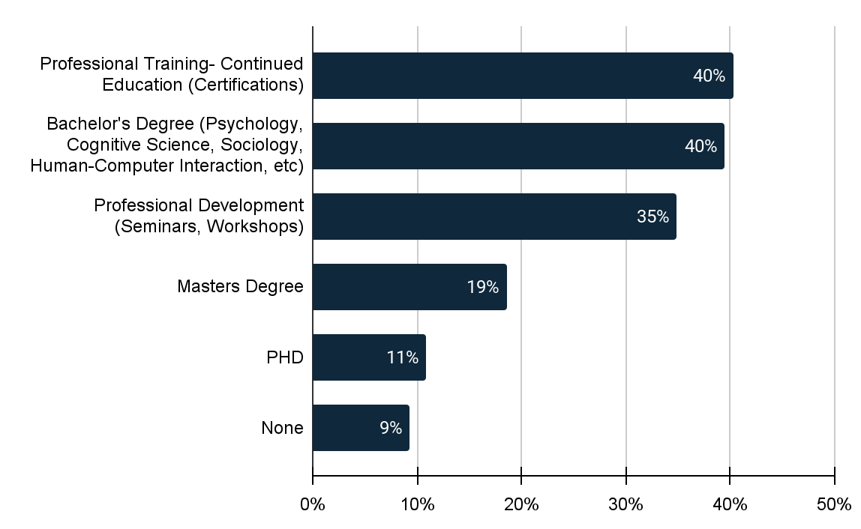
Which of the following educational offerings does this include?
How does your organization stay current with UX research best practices? (Select all that apply)
How have you personally obtained formal training in UX, if at all? (select all that apply)
38
Majority of the companies include conferences/workshops/webinars as the educational offerings and 73% of them provide this training via certifications.
39
The majority of companies offer conferences, workshops, and webinars as educational options, with 73% of them providing training through certifications.
40
40% of companies have acquired formal UX training through Professional Training (Continued Education) and Bachelor's Degrees in relevant fields like Psychology, Cognitive Science, Sociology, and Human-Computer Interaction.

Slide 20
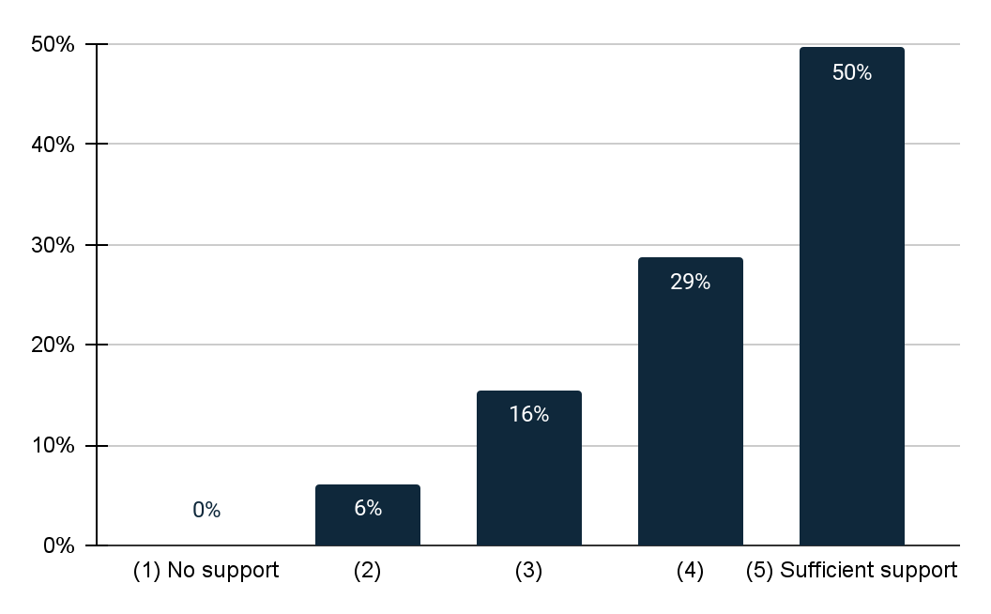
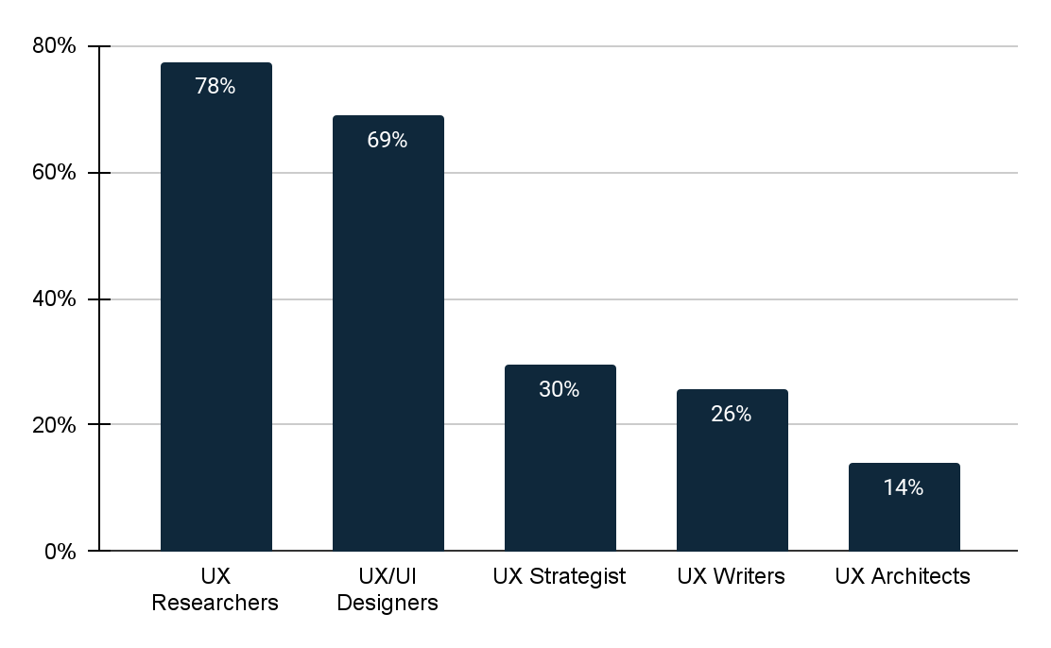
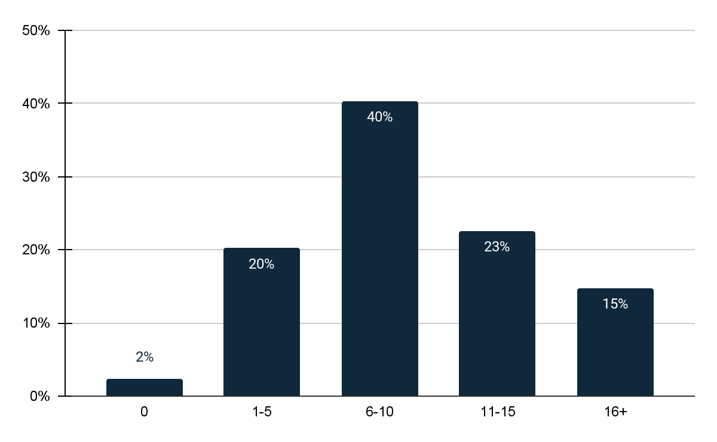
On a scale of 1-5, how much support does your organization provide for UX research?
What types of UX professionals are employed at your organization? (Select all that apply)
How many UX professionals in total are currently employed in your organization?
41
50% of the companies said they fully support UX research.
42
78% of the companies have UX researchers employed and 69% have UX/UI designers. 14% of the companies have UX architects employed as professionals.
43
In 78% of the companies, UX researchers are part of the workforce, while 69% employ UX/UI designers. Additionally, 14% of the companies have professionals specializing in UX architecture.

Slide 21
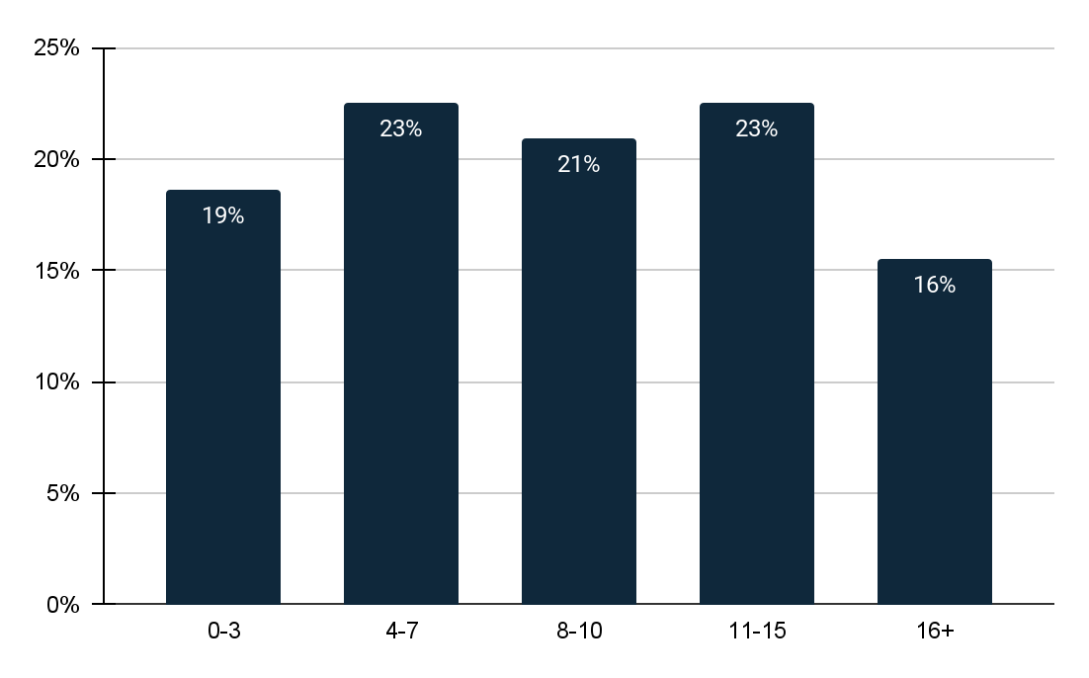
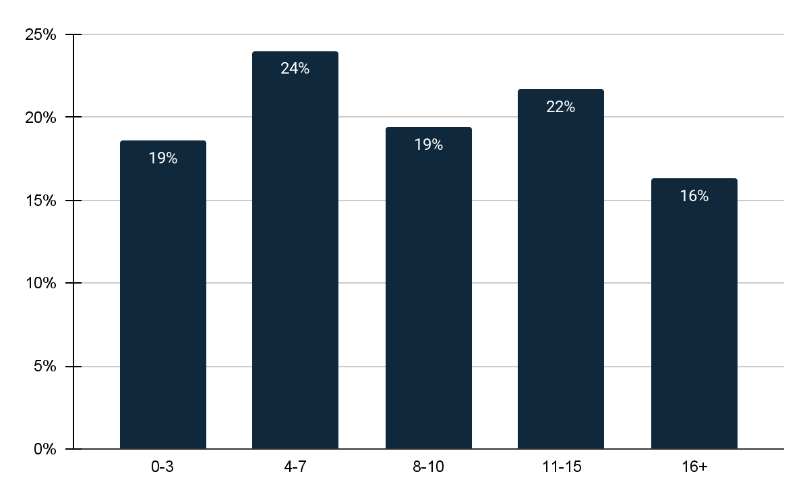
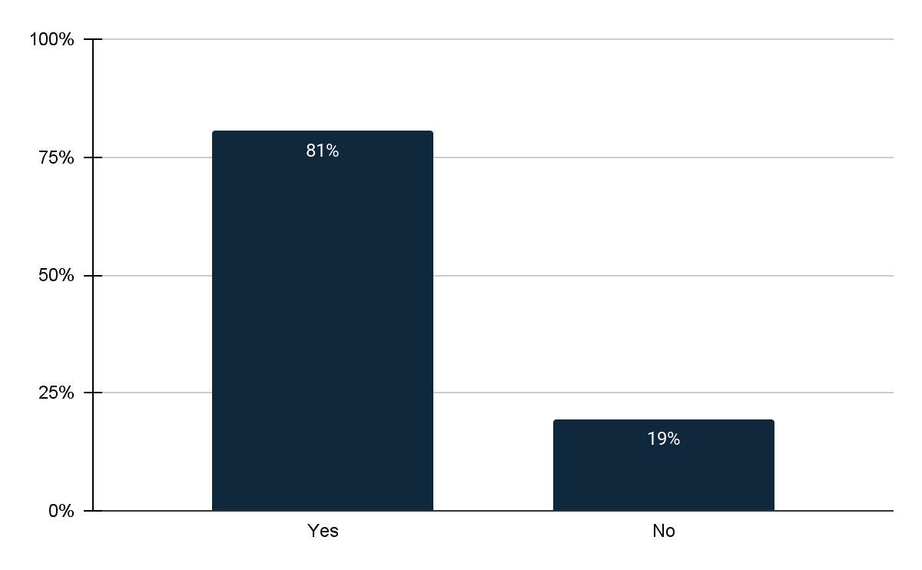
How many UX designers are employed in your organization?
How many UX researchers are employed in your organization?
Does your organization have a dedicated budget for UX research?
44
The majority of companies have 4-7 (23%) and 11-15 (23%) UX designers on their teams, while only 16% have 16 or more UX designers.
45
24% of companies have 4-7 UX researchers on staff, while only 16% have 16 or more UX researchers.
46
A total of 81% of companies allocate a dedicated budget for UX research.

Slide 22
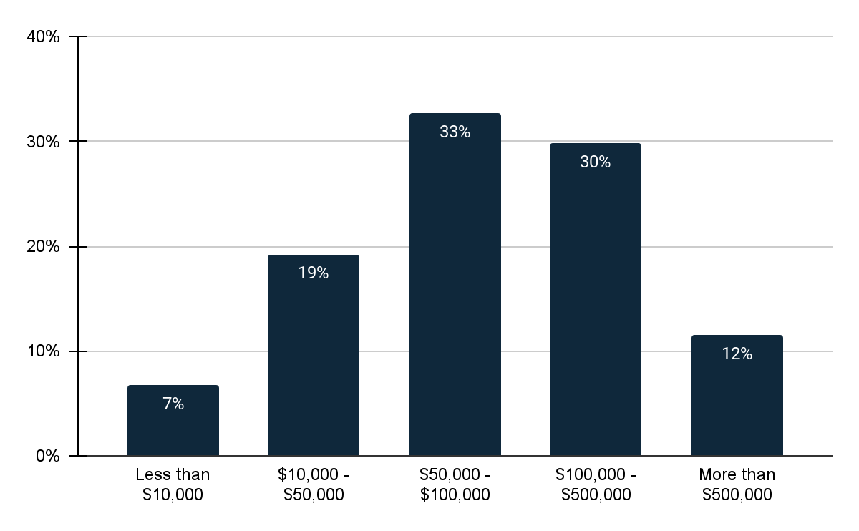


If yes, what is the approximate annual budget allocated to end user research?
If no, why doesn't your organization have a dedicated budget for end user research?
Over the last year, approximately how fast has your organization´s UX Research expenditure been growing?
47
33% of companies have an annual budget of approximately $50,000-$100,000, while 30% allocate a budget in the range of $100,000-$500,000.
48
40% of companies reported not having a dedicated budget for end user research, primarily due to unclear benefits, while 28% consider it a lower priority.
49
42% of companies experienced a growth rate of 10-30% in their UX research expenditure, while 30% saw it increasing by more than 30%.

Slide 23



Over the next year, approximately how fast do you think your organization's UX Research expenditure will grow?
How has the number of UX research projects conducted by your organization increased over the last year?
What are the biggest challenges that your organization faces when conducting UX research? (Select all that apply)
50
42% of companies believe that their organization's UX research expenditure will grow by more than 30% in the next year, while 36% anticipate a growth rate of 10-30%.
51
38% of companies report that the number of UX research projects conducted by their organization has increased by 10-30%, while 33% have seen an increase of greater than 30%.
52
The primary challenges reported are the difficulty in recruiting participants (46%) and a lack of resources (44%).

Slide 24



How satisfied are you with the current process for conducting and utilizing UX research in your organization?
How do you think your organization can improve the UX research process?
How do you think your organization can improve the UX design process?
53
53% of companies are satisfied with the current process of conducting and utilizing UX research, with 17% being very satisfied. Only 3% of companies are very unsatisfied.
54
56% of the companies think that increasing budget/resources can improve the UX research process and 47% of the companies say conducting research more frequently and improving participant recruitment methods can improve UX research process.
55
55% of companies believe that the UX design process can be improved through increased budget and resources, while 52% think that formal training for UX designers can enhance the process. Additionally, 40% believe that integrating UX research as a core discipline of UX design can lead to improvement.

Slide 25
Main Takeaways
In summary, the analysis of UX research within large companies reveals several significant trends and practices. One key finding is the prominent role of product managers as primary stakeholders in UX research across many organizations. UX practitioners are typically organized within a central team, although there is variation with some companies embedding them in all departments.
The primary purpose of UX research insights in these organizations is to enhance user experience and improve product functionality, with a strong emphasis on addressing user needs and aligning with business goals. Stakeholders, including non-UX teams, actively participate in the research process to ensure its alignment with broader business objectives. Notably, Product and Marketing teams are major contributors to launching UX insight studies.
UX research insights find extensive application in marketing strategies, particularly for creating user personas and customer journey maps. When it comes to involving users, organizations commonly engage them during the prototype testing phase, although fewer include users in the idea generation phase. Internal databases serve as a primary source for recruiting users.
Success in UX research is measured by its impact on changes in user satisfaction, faster development processes, and improved conversion rates. The most prevalent UX research methods include surveys and usability testing, with popular platforms such as Usertesting, Userlytics, and Qualtrics.
In terms of team size and budget allocation, most companies maintain teams of around 11-15 employees in UX research, with annual budgets typically falling in the range of $50,000-$100,000. However, it's worth noting that some organizations do not allocate a separate budget for UX research, often citing unclear benefits as the reason.
Despite challenges such as difficulty in recruiting participants, resource limitations, and budget constraints, organizations express confidence in their ability to improve their UX research and design methods. They see increased budget/resources and formal training for UX designers as key strategies for enhancing their UX initiatives.
Overall, large companies are increasingly recognizing the significance of UX research in driving user experiences and achieving business success. They are actively investing in education, training, and resources to support UX initiatives, and they anticipate continued growth in the field. These findings reflect the evolving importance of UX research in today's competitive business landscape.

