Slide 1
Meta skills: Problem solving
Slides by Dave Jarrold and Dr Mila Duncheva, Edinburgh Napier University

Slide 2
Learning outcomes

Slide 3
Learning outcome 1
Ability to analyse and evaluate information to identify and select the most appropriate solution.
Evaluate options, implement solutions and as a function of continuous improvement.

Slide 4
Learning outcome 2
Ability to deal with issues quickly and effectively to prevent slippage.
Ensure that the benefits of an accelerated build programme are realised.

Slide 5
Problem solving: a brief introduction

Slide 6
Why Problem Solving?
Why will being great at Problem Solving be useful for you?
What will it help you deliver?
Notes:
Facilitator Notes
It is useful to have the students link this skill to their programme of study or anticipated career.
In their groups, ask the students to discuss and come up with situations they are likely to face.
Once students have identified situations plenary this and capture on a flip chart/white board/post-its.

Slide 7
What is a Problem?
“When new action is required to resolve an issue, but the action you need to take isn’t known yet”
That’s a problem
That’s a challenge
Notes:
Facilitator Notes
Ask the group for their definition of a problem then, introduce the slide to establish a common definition that the group can work to.
There will be situations arising where the solution or approach required is simply not known and you may need to think creatively to find an appropriate way forward
Creativity is a mental or social process involving generation of new ideas or concepts, and is integral to problem solving

Slide 8
What Stops You?
When you are faced with a problem (or challenge) what are some common blocks that stop you solving that problem effectively?
Leaping to a quick-fix solution
Attitude – “I give up – let someone else solve it”
Seeing what you expect to see, not what is actually there
Failing to fully understand and evaluate the problem
Coming to snap decisions rather than generating ideas
Tradition – accepting that “it’s always been done this way!”
Attitude – “it must be someone else’s problem!”
Notes:
Facilitator Notes
Before getting into the tools for problem solving we want to identify some of the barriers that prevent us for solving problems effectively.
In their groups ask students to discuss the barriers to effective problem solving,
Give them a few minutes then plenary their answers on a flip chart/white board
Reveal the points on the slide as a recap after this exercise (and to cover anything that might have been missed)
Leave their list up to refer back to as workshop progresses

Slide 9
5 Simple Principles Of
Creative Problem Solving
Solve the right problem –
(define all aspects of the problem not just jump in)
Analyse exactly what needs to be done
Develop potential solutions
Decide and Implement your chosen solution
Evaluate your solution
Notes:
Facilitator Notes
All problem solving follows these 5 basic steps. Many models can be used to support that.
DON’T BE TEMPTED TO SOLUTIONEER – jump to a solution
In other words the problem you are trying to solve might actually be the effect of a deeper routed problem rather than the root (or cause) itself.
We’ll be thinking more about cause / effect later in the workshop

Slide 10
Creative Problem Solving
Model (CPSM)
Define
Evaluate
Analyse
CPSM
Do It!
Decide
Develop
Notes:
Facilitator Notes
(Animated slide – reveal and explain the model)
Here is a model to help you easily remember those 5 principles and help you follow them
Define – solve the right problem
Analyse – exactly what is going on and what needs solved
Develop – a number of potential solutions and options
Decide – identify optional solutions and pick the most appropriate one to solve your problem / meet your challenge
Evaluate – identify what success would look like and work out how you will measure this
Reveal ‘do it’
This model helps us to identify and evaluate the actions we are going to take…but we still need to take the action!

Slide 11
The problem for today
We will base this scenario on the building you see in the OFF-GRID MICRO DWELLING case study.
In this scenario, the team has planning approval they are about to start the detailed design stage.
The client wants your help as the project manager choose an offsite building system that can minimize:
waste materials and time onsite
Notes:
Facilitator Notes
This is an example problem which you can adapt to suit your module or subject. The words highlighted in blue can be changed over quickly to fit within your class.
Reminder of what the problem should allow students to do:
- Ability to analyse and evaluate information to identify and select the most appropriate solution. Evaluate options, implement solutions and as a function of continuous improvement.
Ability to deal with issues quickly and effectively to prevent slippage and ensure that the benefits an accelerated build programme are realised.
The trainer is provided with 4 different case studies you can choose from – this is the simplest one.

Slide 12
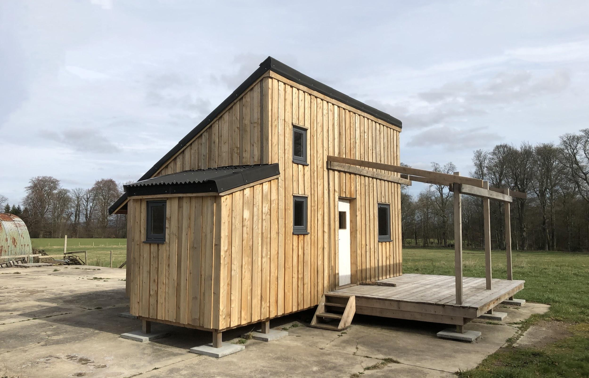
Notes:
Facilitator Notes
Image by Falkland Estate, substitute with your chosen case study if you change the case study.

Slide 13
Useful external resources
http://www.wrap.org.uk/sites/files/wrap/Timber%20Frame%20-%20Full%20case%20study.pdf
http://www.wrap.org.uk/sites/files/wrap/VOLUMETRIC%20-%20Full%20case%20study.pdf
http://www.wrap.org.uk/sites/files/wrap/PODS%20-%20Full%20case%20study.pdf
https://youtu.be/SWpfPwtfepI
https://youtu.be/evgMHodz9Lg
Notes:
Facilitator Notes
Provide these if the students are ‘stuck’, currently hidden from the slide deck

Slide 14
Define Your Challenge
Define
Read and discuss the case study
Use the ‘5 Why’s’ technique to drill down into the problem
Define, in your own words, what your case study problem is – capture this at the top of your flipchart
Notes:
Facilitator Notes
We want students to ensure they are addressing the right problem. To do this we use the ‘5 Why’s’ technique (it doesn’t need to be 5 – the point is to keep asking why so we drill down to the real problem – not the surface problem).
As the name suggest we discuss and consider the problem – and keep asking why – why is this a problem? why is it a problem for a particular group? Why are they unhappy with the situation?
(NB – Not why did it happen at this stage – but why is it a problem – who is it a problem for – what are the impacts)
If you have been very proscriptive in your case study this may be a very simple exercise – or you might want to build some ambiguity into your case study so they can drill down using this technique.
Ask students to discuss in their groups and define the precise problem they are going to address.
Allow time for them to complete this exercise and plenary if appropriate.

Slide 15
Example 5 Whys
Define
Why does the client want to consider an offsite building method of construction? – to reduce waste materials and time onsite
Why do they want to reduce waste materials? – to increase their environmental sustainability
Notes:
These are some example of how to apply the 5 Whys technique to the problem

Slide 16
Example 5 Whys
3) Why do they want to reduce time onsite? – to increase their economic sustainability
4) Why are they not considering social sustainability? – we don’t know maybe they should
5) Why don’t they consider a triple sustainability bottom line balancing economic, environmental and social impact?
Define
Notes:
Facilitator Notes

Slide 17
You have now
Defined your problem
…and can refer back to this if you get ‘stuck’ or side-tracked
Define
Notes:
Facilitator Notes
So now you have analysed your challenge and recorded some key points to refer back to – this saves having to re-read / re-define
Start with the end in mind – one of the 7 Habits of Highly Effective People created by Dr Stephen Covey

Slide 18
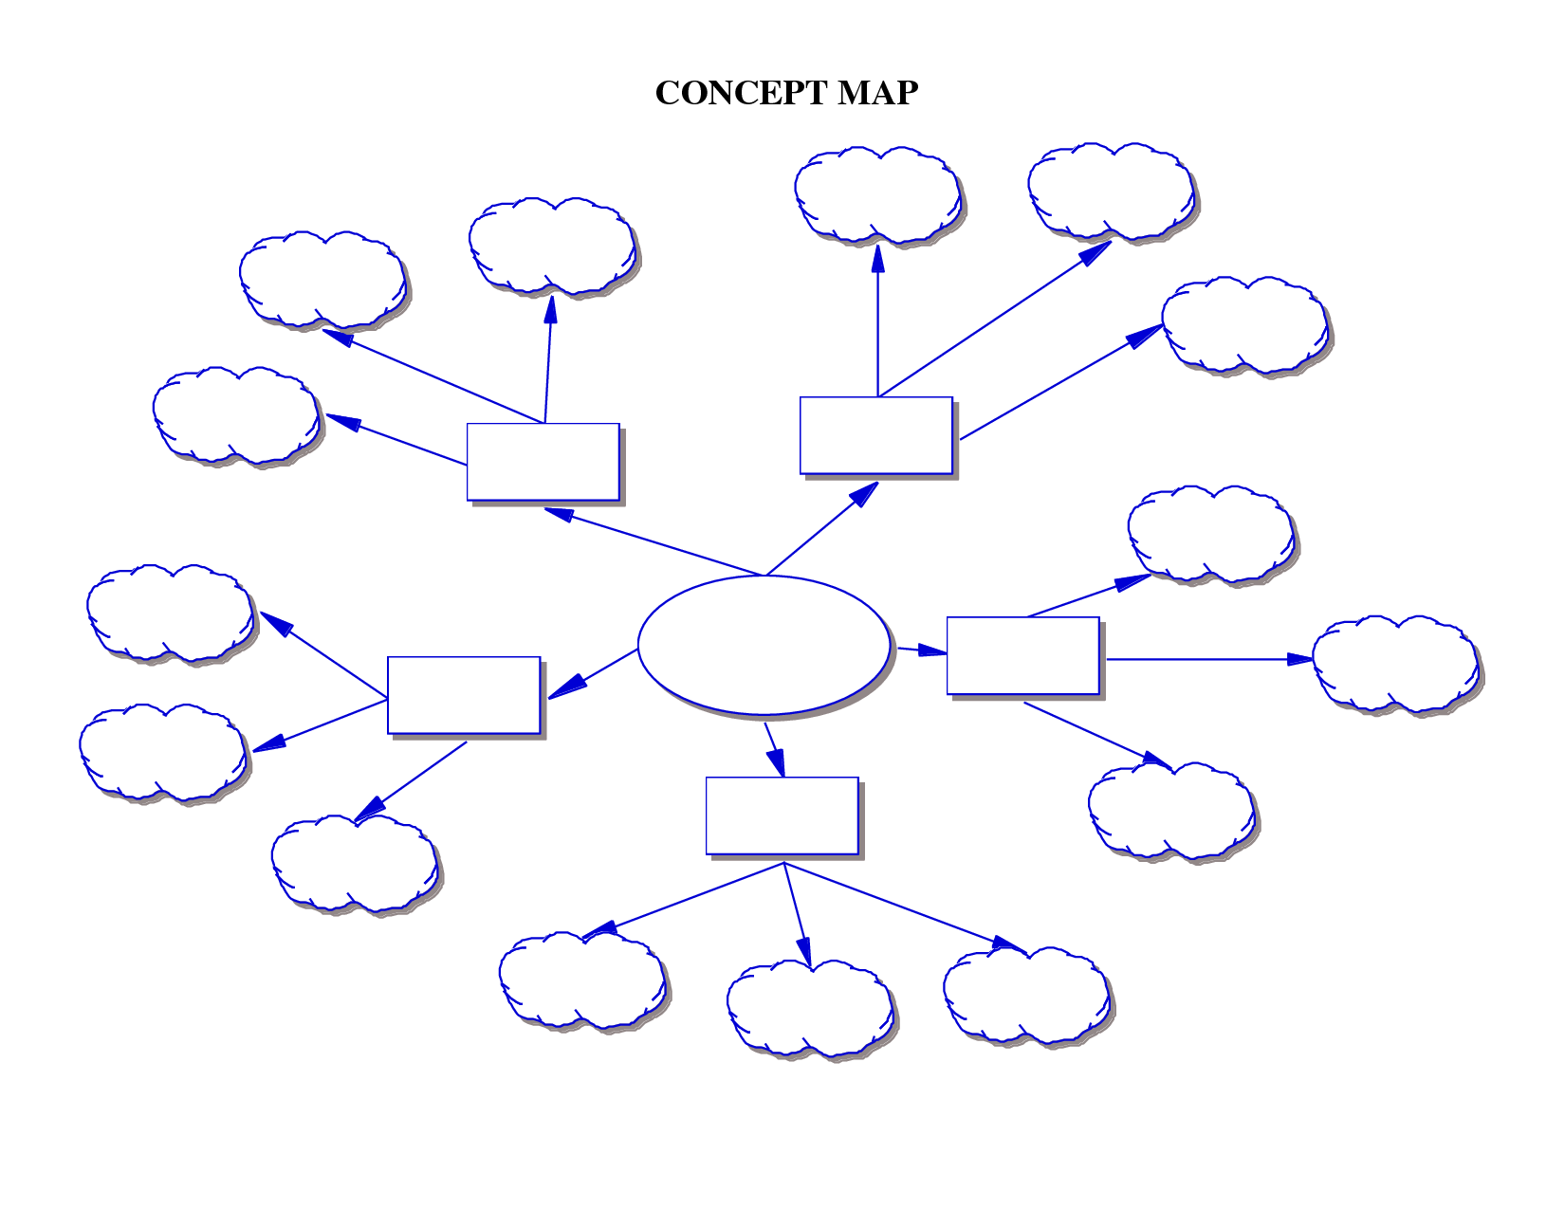
Mind Map Analysis
Analyse
Notes:
Facilitator Notes
Now we have defined the problem its time to drill down to the cause.
One way of doing this is a mind map – this allows free flowing thought to capture ideas and thoughts – and it might look something like this.
We are not using this approach today but it is a method you might want to consider.

Slide 19
Stakeholder mapping
Customer NEEDS
Analyse
STAKEHOLDER
STAKEHOLDER
STAKEHOLDER
STAKEHOLDER
CONCEPT
STAKEHOLDER
Notes:
Facilitator Notes
To strengthen your anaylis you can think of stakeholders that are involved, not only the client. What would the main contractor, or the architectural technologist, or the structural engineer think?
Any concept will have a variety of stakeholders – and these stakeholders will have differing needs.

Slide 20
Cause & Effect Analysis (Fishbone)
Machine
(technology)
Method
(process)
Materials
(including raw materials, consumables and information)
Car broke down
Forgot to set alarm
Accidently drank decaf coffee
Never change oil
Took a wrong turn
Packet
mislabelled
Late for
University
Causes
Snow affected
traffic
Lecturer told you
wrong time
Alarm clock
time incorrect
Mother Nature
(environment)
Manpower
(physical work, mind power, brain work)
Measurement
(inspection)
Notes:
Facilitator Notes
We are going to use a more structured model and process. Sometimes called the Ishikawa Model (after it’s creator) or the Fishbone (for obvious reasons) – this is a cause and effect analysis model.
EXPLAIN FISHBONE
At the head of the fish is our problem – and along the spine there are bones. These bones represent the groups/topics or headings under which specific problems have occurred.
(Reveal example headings)
In our example we have used the 6M headings commonly used in industry, science and manufacturing. Run through these are also give an example of the more office based headings (6Ps)listed below. Explain that we will use the 6Ms for the sake of our example – but students can pick whatever groupings are appropriate to them – even if they are completely different to these example groups – the key is to have groupings that are relevant to the problem.
Industry / Science / Manufacturing
Machine (technology)
Method (process)
Materials (including raw materials, consumables and information)
Manpower (physical work, mind power, brain work)
Measurement (inspection)
Mother Nature (environment)
Office
People
Process
Policy
Plant
Program
Product
Reveal our example problem (Late for University) and the potential causes under each grouping. Run through these on the slide and discuss with the group.
Explain that we can drill down further to the cause of the cause (reveal element of the slide)
The aim of this process is to get into the guts of the problem (no pun intended) and find out the real and underlying root cause.
Once you have explained the model ask students to work through this in their groups.
Stage One – Identify the groupings under which you want to drill down to causes.
Stage Two – Identify the causes (or potential causes) of the problem under each heading.
Stage Three – Drill down further to the causes behind the causes.
This is not a quick process and this is the heart of the workshop.
Allow adequate time for groups to work through this and you may need to provide support as they complete the exercise.

Slide 21
Topics you can consider:
Equipment needed for volumetric construction onsite assembly versus panels versus sub-assemblies
Labour and skills needed for different offsite construction systems
The estimated sizes of the panels and modules (read the ‘Design for Assembly’ part of the case study)
The opportunity to use a ‘flying factory’ for panelized and volumetric construction
Notes:
Facilitator Notes
These are some suggestions to give to the students in case they are ‘stuck’ – hidden from the slide deck and you can unhide

Slide 22
You have now
Analysed your problem
…and should be better prepared to start
developing some solutions
Notes:
Facilitator Notes

Slide 23
Brainstorming
A reminder of ‘the rules’
Develop
Don’t Play it safe
Nothing is ‘stupid’ at this stage
Look for many ideas
No detail at this stage
Listen to others’ ideas
Speak your mind
Record
everything
Notes:
Facilitator Notes
Now you have identified the root cause of the problem it’s time to work out what you are going to do about it.
Ask students to work in their groups and run a 5 minute brainstorming session – with the rules on the slide. Only ideas for 5 minutes – then the groups can evaluate them.
Once the 5 minutes are complete allow the group a little time to reflect on what has come out.
Ask each group to identify it’s top 5 ideas.
If useful or appropriate you could plenary across the room.

Slide 24
Compare and contrast
Analyse
Criteria | Solution 1 | Solution 2 | Solution 3
Time onsite
Waste materials
Lifting onsite
….
etc.
Notes:
Facilitator Notes
Another simple option will be to compare the performance of different offsite systems according to the key criteria you have identified

Slide 25
You have now
Developed your potential solutions
…and should now be ready to start
deciding on actions
Notes:
Facilitator Notes

Slide 26
Decision Making Graph
Decide
High
COST
Medium
Low
Low
Medium
High
IMPACT
Notes:
Facilitator Notes
Most decisions are a compromise and are evaluated according to cost (in terms of money, time, resources, energy, etc.) and impact (how far will this go to solving our problem)
In groups asks students to plot their top 5 ideas on this graph and then make a decision about what actions they will take.
Note – this graph give insight and some evaluation to the process – but we don’t have to discount anything just because of it’s place on the graph. Some divisions are based on more subjective criteria. For example a key stakeholder may insist on a particular action which you might accommodate to maintain their buy in – even if you think it will be ineffective.

Slide 27
You have now
Decided on a course
of action
…but there is one last important step
Notes:
Facilitator Notes

Slide 28
Success Criteria
Evaluate
What is your criteria for success or progress?
How will you measure this?
Notes:
Facilitator Notes
Our final stage – now that we have analysed the problem and calculated the best action to take – we need to evaluate it to ensure it is successful – and where it works as intended or not – what lessons we can learn.
Reveal the two questions and allow groups time to answer them for their chosen approach.
As before, you could plenary across the room if useful or appropriate.

Slide 29
Summary of tools
Stages of the Creative Problem Solving Model | Example of useful creative tools to use
DEFINE | 5 Whys
ANALYSE | Mind Mapping Cause & Effect Analysis (Fishbone)
DEVELOP | Brainstorming
DECIDE | Cost/Impact Grid
EVALUATE | Success Criteria
Notes:
Facilitator Notes
A recap side that brings the model back in and shows the tools and techniques under each section.

Slide 30
The twist

Slide 31
The project is now onsite!
Well done on solving the problem and making a decision on the construction method!
The selected offsite system is now onsite, and the door manufacturer has gotten in touch to say they are having supply chain problems – the doors will be delayed by 2 to 3 weeks.
Notes:
The simplest answer is to…

Slide 32
New problem
Your grand opening is scheduled for 2 weeks from now and you want to make sure you complete all the internal and external works onsite.
How can you ensure that the programme onsite does not over-run?

Slide 33
Apply the same tools
You should use the tools you have just learnt to solve this new problem and you are encouraged to think outside the box.
Take about 15 minutes and then nominate a person from your team to present using your sticky notes and sketches.
Notes:
Some example answers are:
Finish off the internal and external finishes in the mean time, and ask the door manufacturer to ensure the doors will be ready in 2 weeks exactly
Ask a local joiner if they can make some doors for you
Ask one of the hutters whether they know how to make doors, and train other hutters to do the same
Go and buy some off-the-shelve from a builders merchant

Slide 34
Questions?
Dave Jarrold and Dr Mila Duncheva,
Edinburgh Napier University

Slide 36

META SKILLS: PROBLEM SOLVING by DAVE JARROLD and DR MILA DUNCHEVA is licensed under a Creative Commons Attribution-NonCommercial-ShareAlike 4.0 International License

