Slide 1
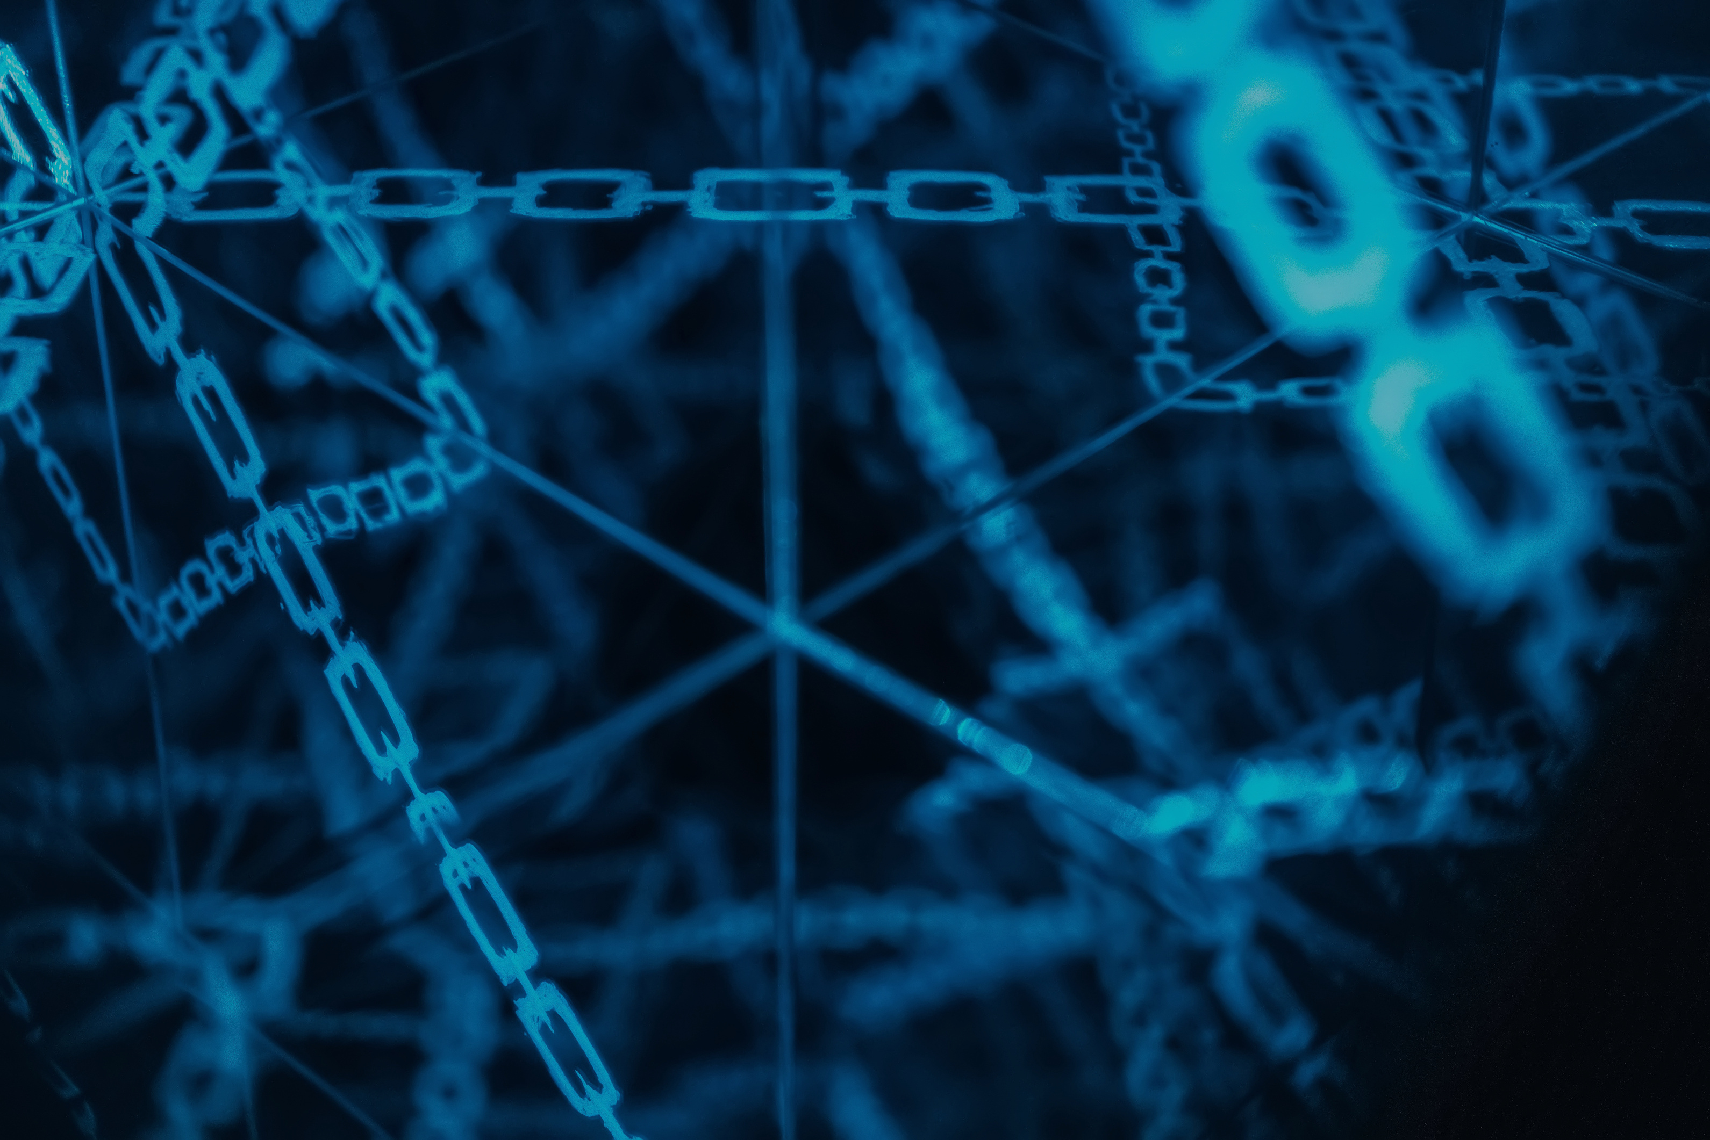


CYBER
SECURITY
“A CYBERATTACK HAPPENS EVERY 39 SECONDS”

Slide 2
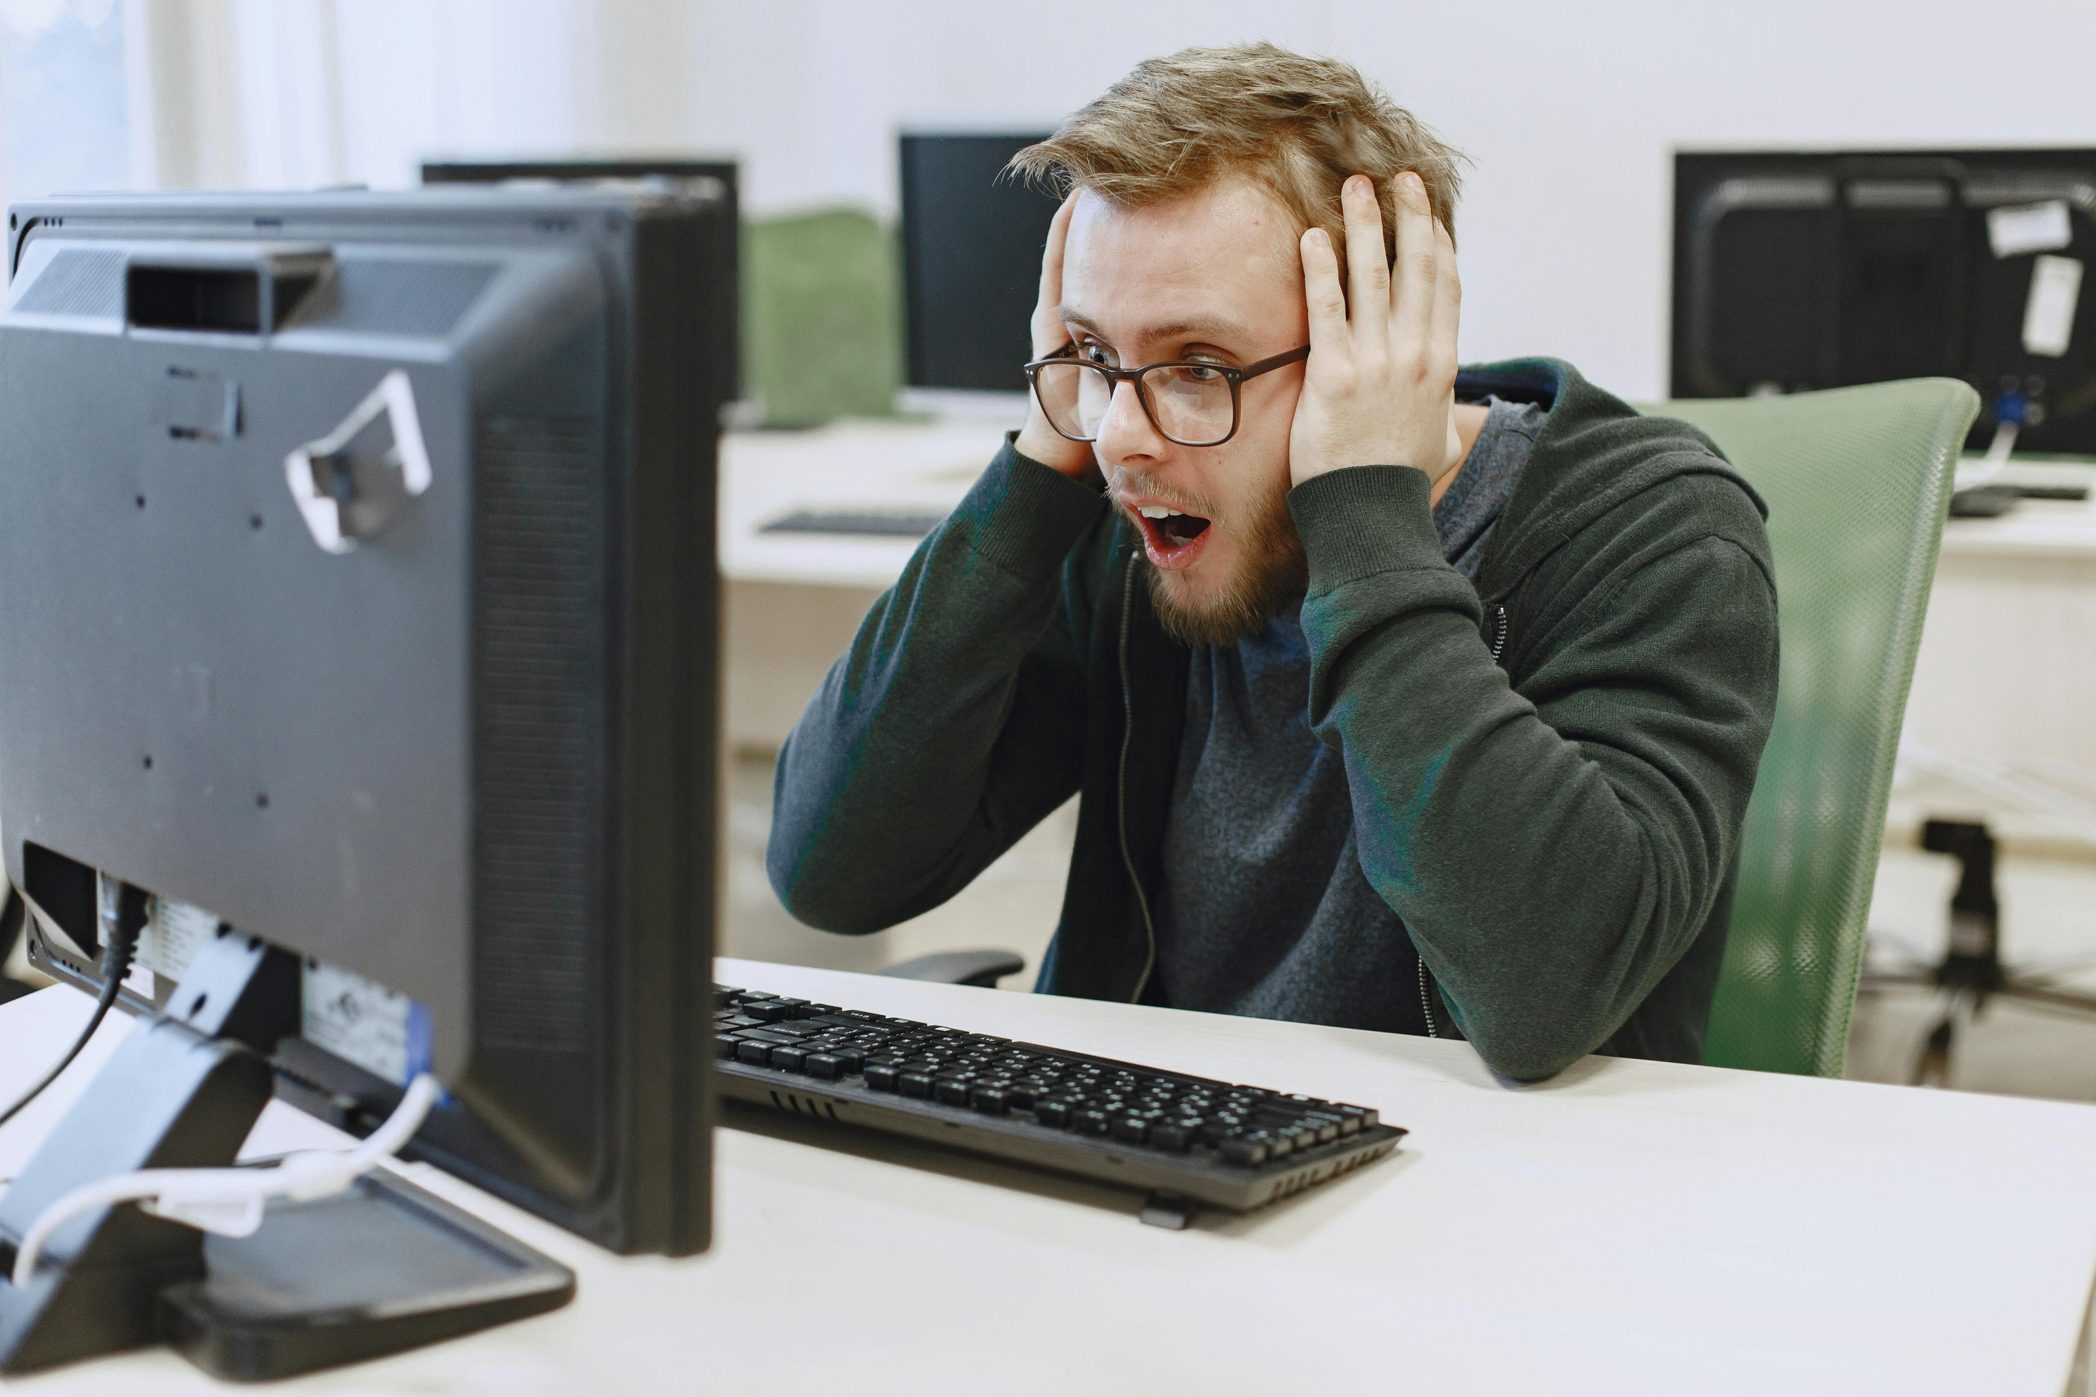
THE RISING THREAT
CYBERSECURITY IS NOW A NECESSITY, NOT A LUXURY. EVERY 39 SECONDS, HACKERS TARGET DEVICES WORLDWIDE, THREATENING PERSONAL AND ORGANIZATIONAL DATA. WITHOUT STRONG DEFENSES, SYSTEMS FACE EXPOSURE, DISRUPTION, AND FINANCIAL HARM. VIGILANCE IS NO LONGER OPTIONAL.
THE GROWING FREQUENCY OF DIGITAL THREATS SHOWS THE URGENT NEED FOR PROTECTION. BY STRENGTHENING DEFENSES AND EDUCATING USERS, WE REDUCE RISK. EVERYONE—AT HOME OR AT WORK—HAS A PART IN PROTECTING OUR ONLINE ENVIRONMENT.

Slide 3
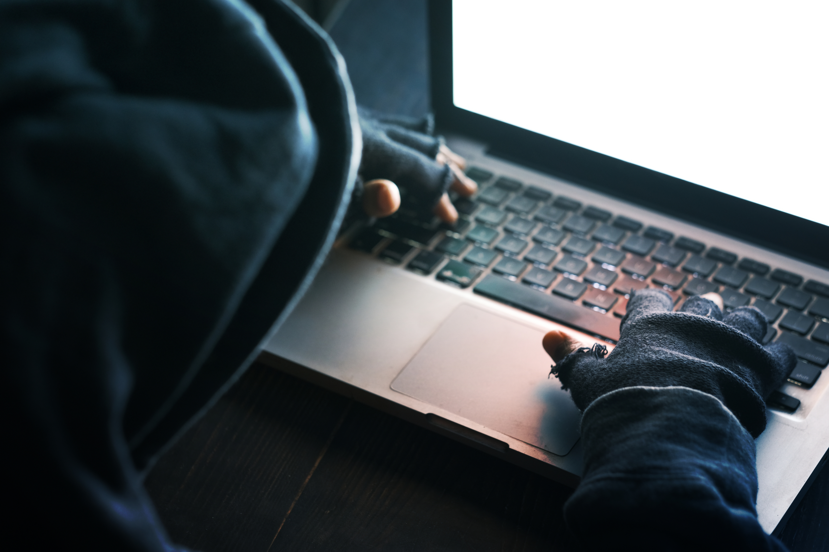
HOW HACKERS BREACH SYSTEMS
PHISHING SCAMS
CYBERCRIMINALS SEND CONVINCING FAKE MESSAGES TO STEAL LOGIN CREDENTIALS, BANK INFORMATION, OR PRIVATE DATA THROUGH DECEPTIVE TACTICS.
RANSOMWARE ATTACKS
THIS MALICIOUS SOFTWARE LOCKS ACCESS TO FILES OR SYSTEMS AND DEMANDS PAYMENT, OFTEN LEAVING CRITICAL DATA ENCRYPTED OR LOST.
ZERO-DAY VULNERABILITIES
HACKERS EXPLOIT SECURITY FLAWS BEFORE DEVELOPERS CAN FIX THEM, LEADING TO STEALTHY AND DANGEROUS BREACHES IN UNPATCHED SYSTEMS.
CONSTANT THREATS

Slide 4
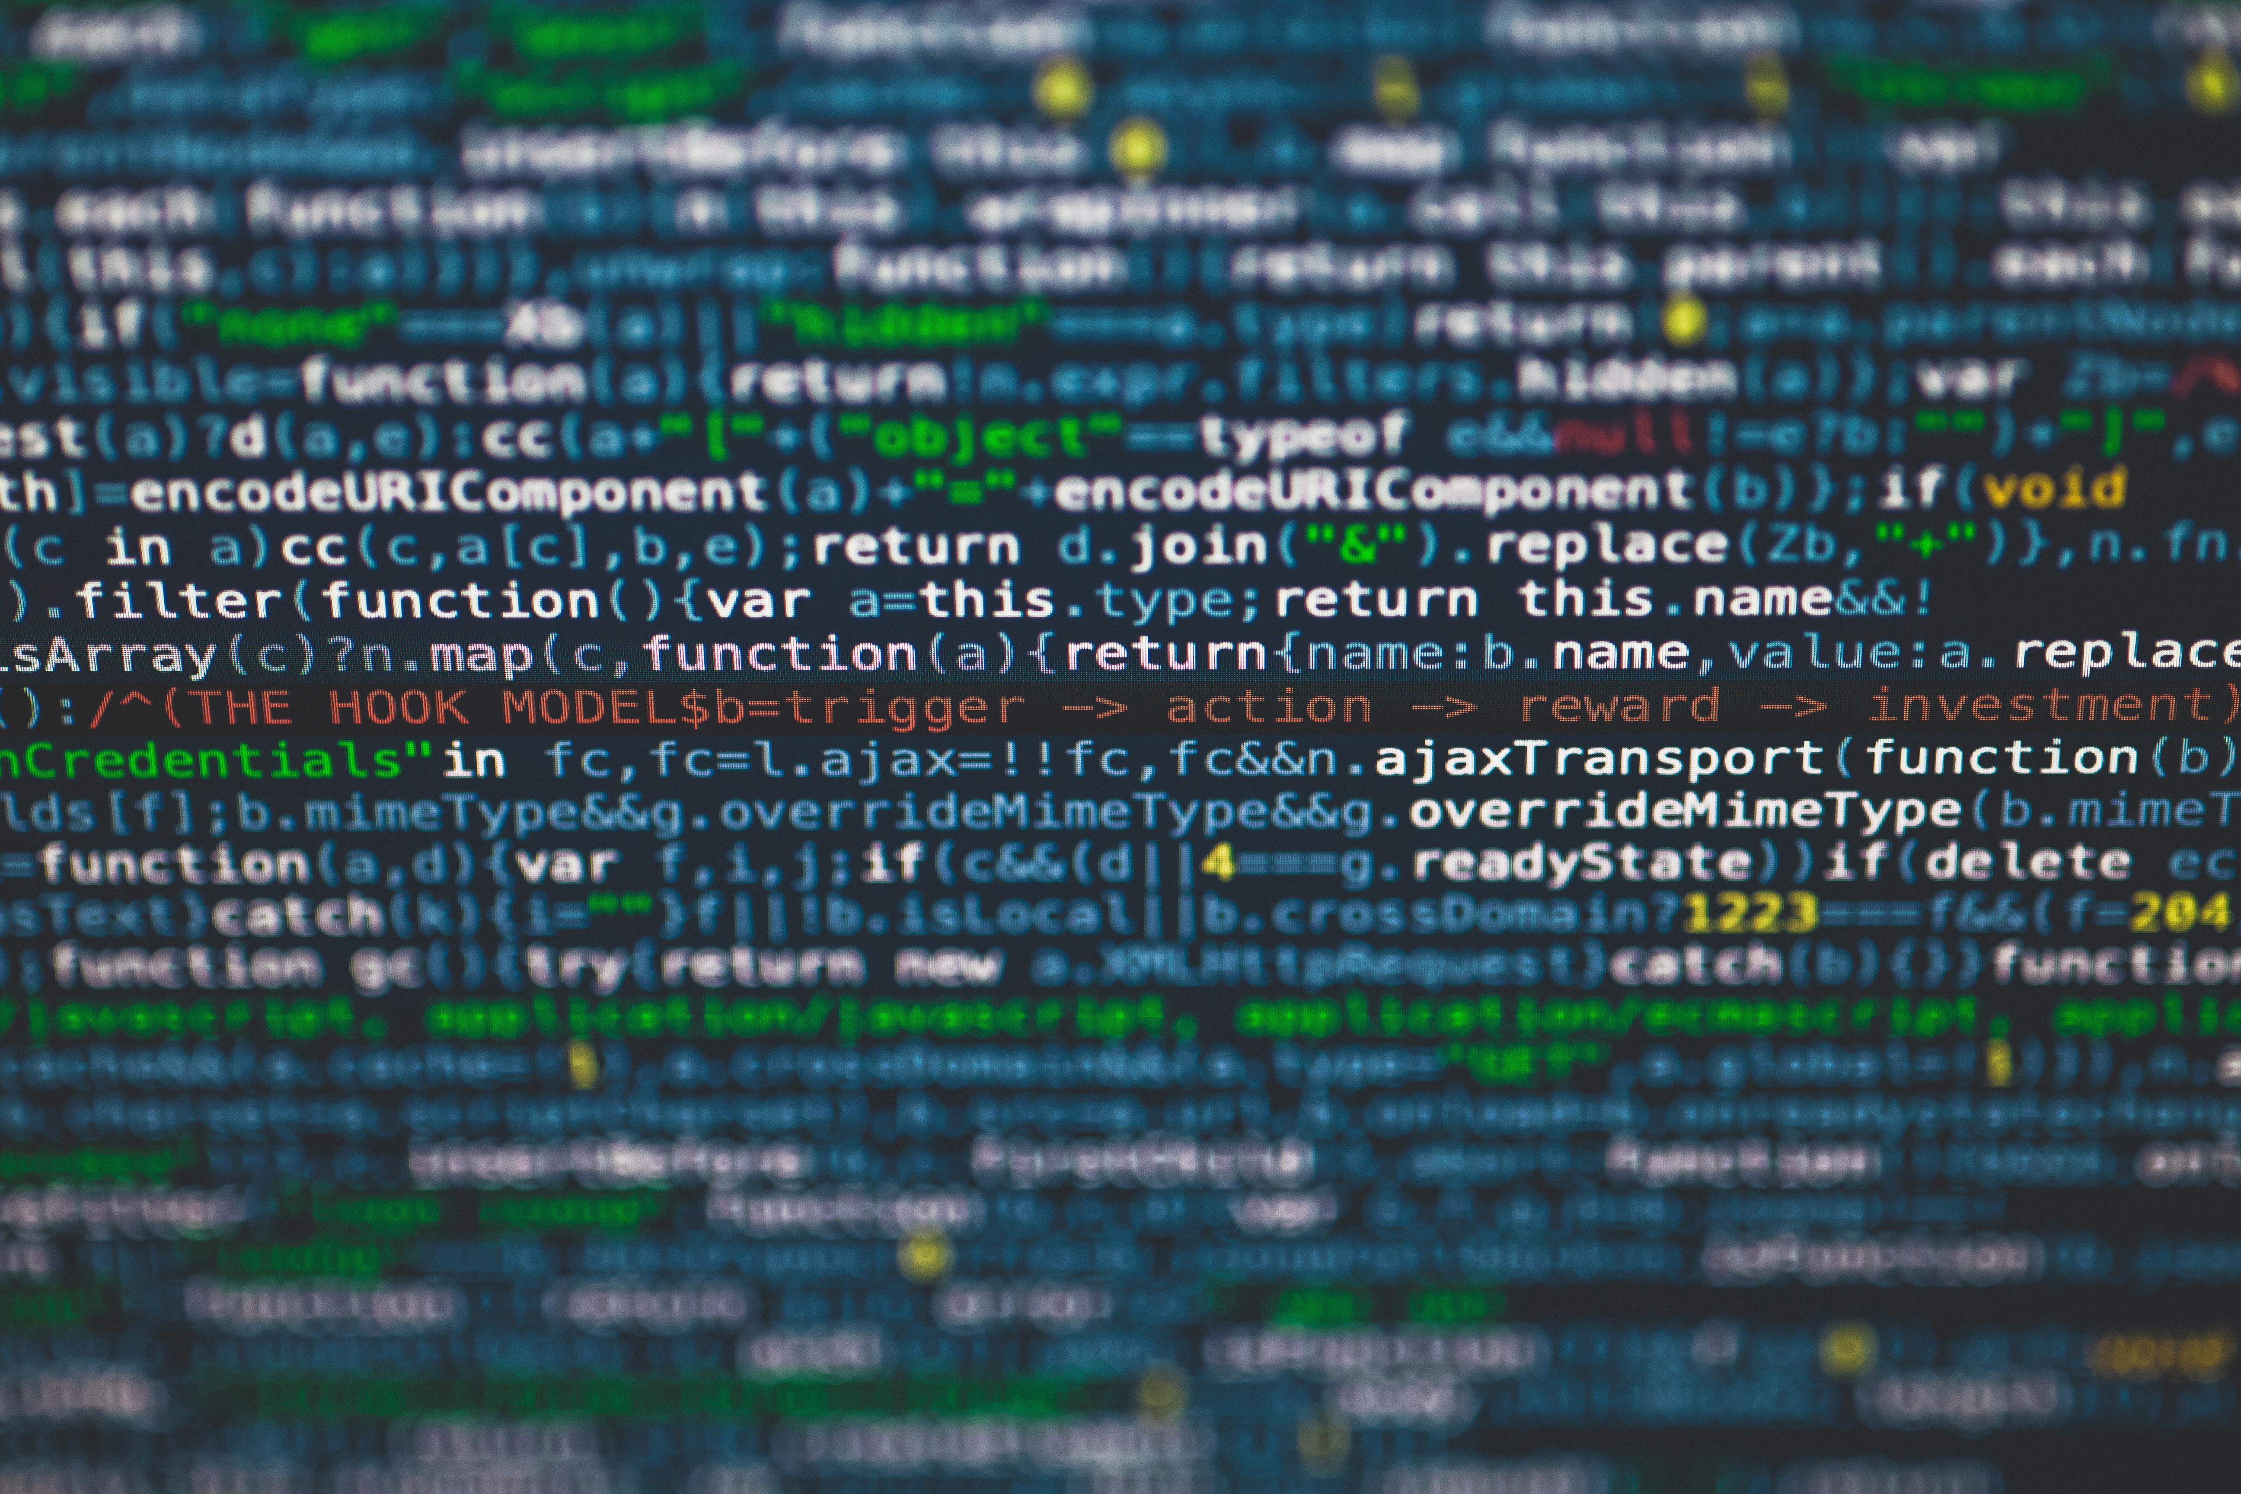
WHY PEOPLE ARE OFTEN THE WEAKEST LINK
HUMAN FACTOR
WEAK PASSWORDS
SOCIAL ENGINEERING
REUSED OR SIMPLE PASSWORDS ARE EASY TO GUESS USING BRUTE FORCE TOOLS.
ATTACKERS TRICK USERS INTO HANDING OVER SENSITIVE INFORMATION OR CREDENTIALS.
LACK OF AWARENESS
UNTRAINED STAFF
MANY USERS UNKNOWINGLY CLICK HARMFUL LINKS OR DOWNLOAD UNSAFE FILES.
EMPLOYEES UNAWARE OF RISKS MAY ACCIDENTALLY COMPROMISE INTERNAL SYSTEMS.

Slide 5
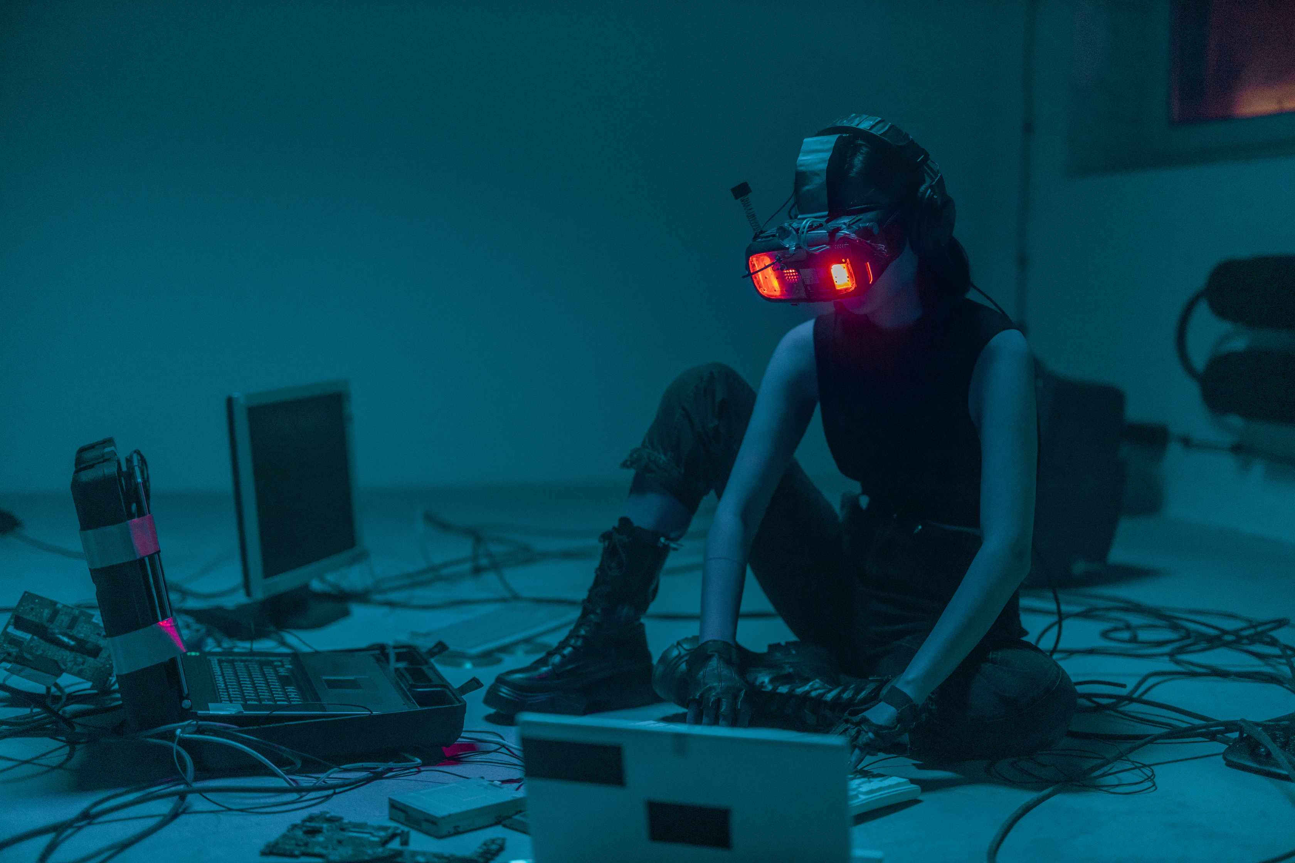

WHEN ATTACKS TURN INTO CRISES
COSTLY CONSEQUENCES
CYBERATTACKS CAN LEAD TO MASSIVE FINANCIAL LOSS, OPERATIONAL DOWNTIME, AND LOSS OF TRUST—ESPECIALLY WITHOUT A RECOVERY PLAN.
SERVICE INTERRUPTIONS
TARGETED ATTACKS ON VITAL SERVICES CAN PARALYZE OPERATIONS, AFFECTING COMMUNITIES, COMMUNICATION SYSTEMS, AND BASIC NEEDS.
REAL-WORLD IMPACT

Slide 6
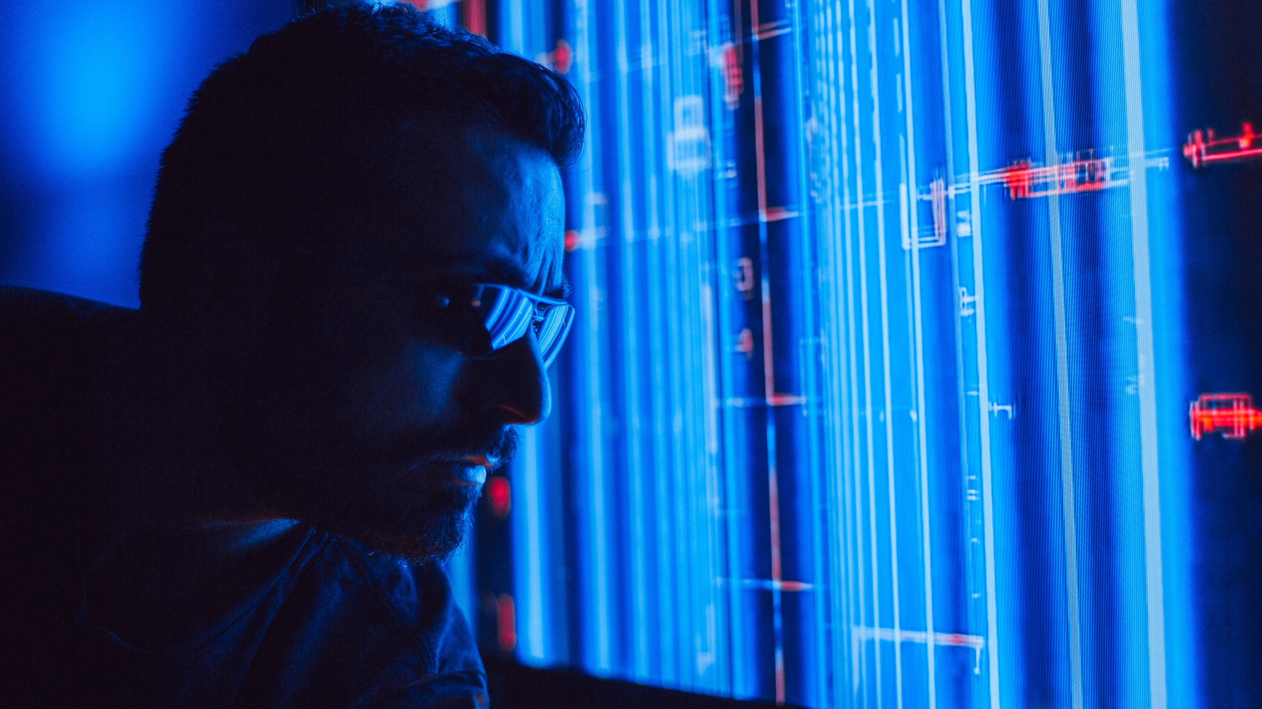
SECURITY LAYERS
TOOLS THAT FORTIFY YOUR NETWORK
FIREWALLS
THEY ACT AS DIGITAL BARRIERS, CONTROLLING INCOMING AND OUTGOING TRAFFIC BASED ON SECURITY RULES.
MULTI-FACTOR AUTHENTICATION
ADDS EXTRA VERIFICATION STEPS, SUCH AS DEVICE CODES OR BIOMETRICS, TO CONFIRM USER IDENTITY BEYOND PASSWORDS.
ENCRYPTION
DaTA IS SCRAMBLED TO PROTECT CONFIDENTIALITY, MAKING IT UNREADABLE WITHOUT THE CORRECT DECRYPTION KEY.

Slide 7

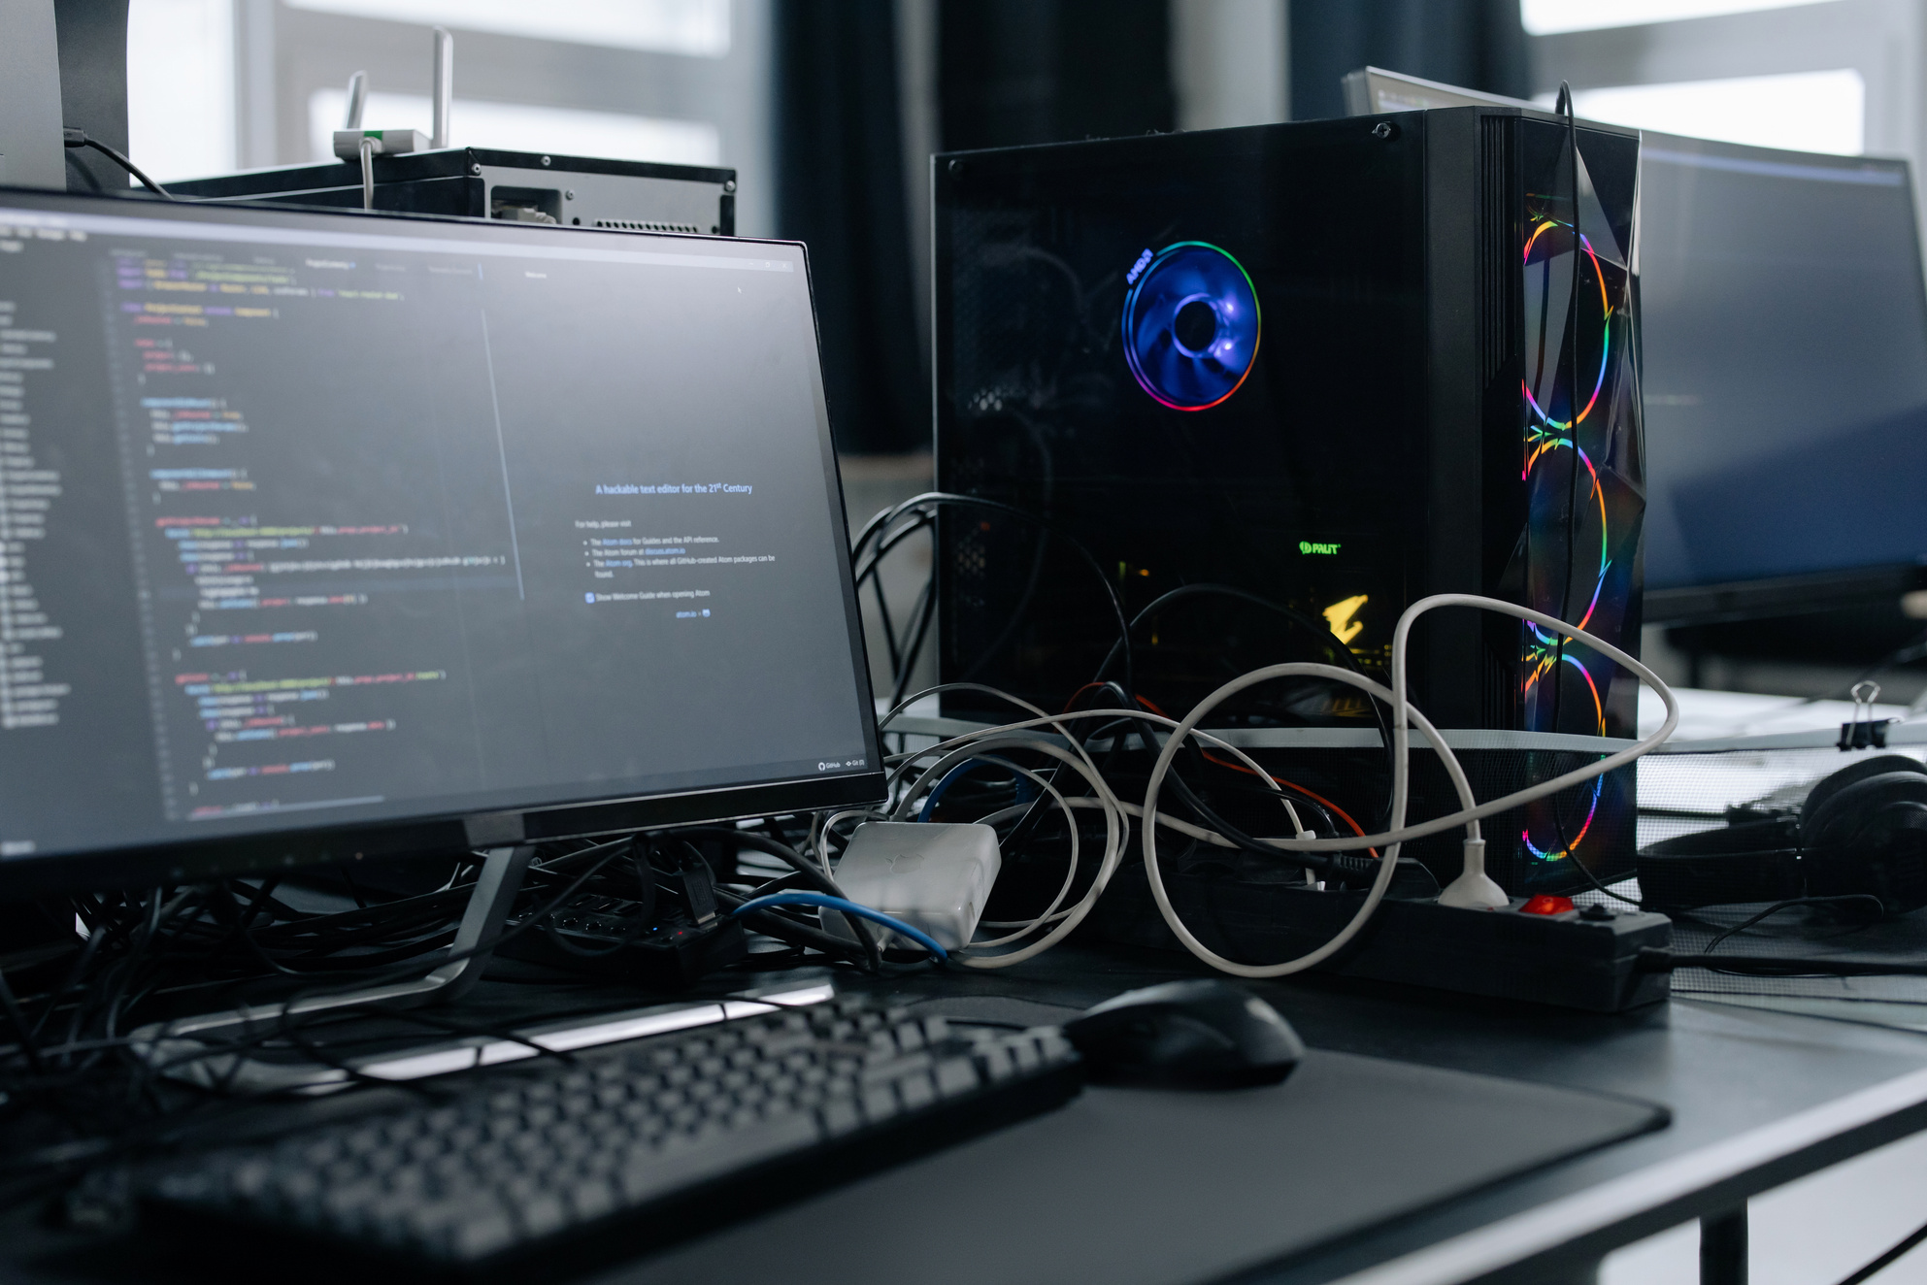
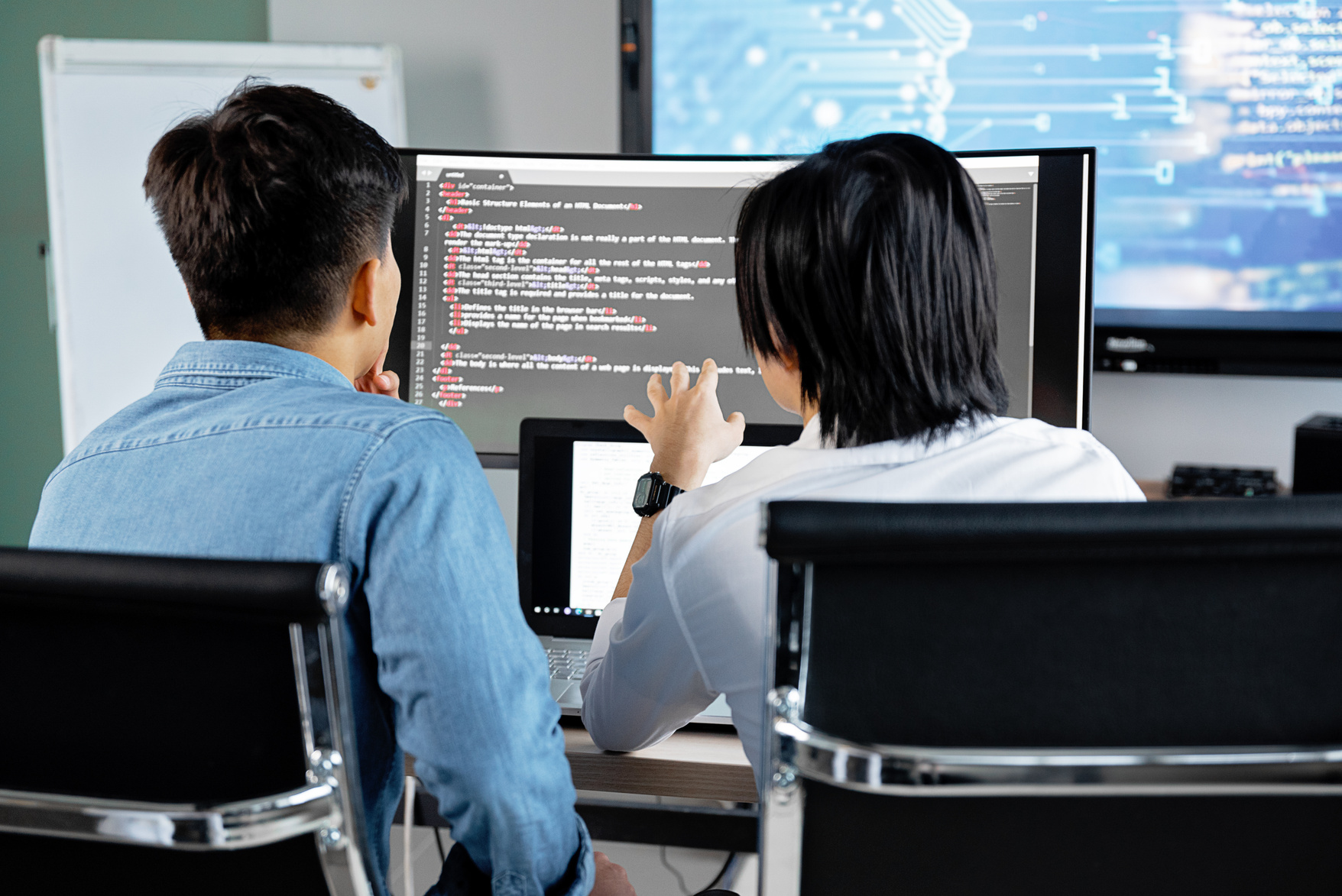
WHO’S BEING ATTACKED THE MOST
SMALL ENTERPRISES
SENSITIVE SECTORS
LIMITED RESOURCES MAKE THEM EASIER TO BREACH. MANY LACK DEDICATED SECURITY TEAMS OR ADVANCED PROTECTION TOOLS.
ORGANIZATIONS MANAGING PERSONAL, HEALTH, OR FINANCIAL RECORDS ARE COMMON TARGETS DUE TO THE VALUE OF STORED INFORMATION.
COMMON TARGETS

Slide 8
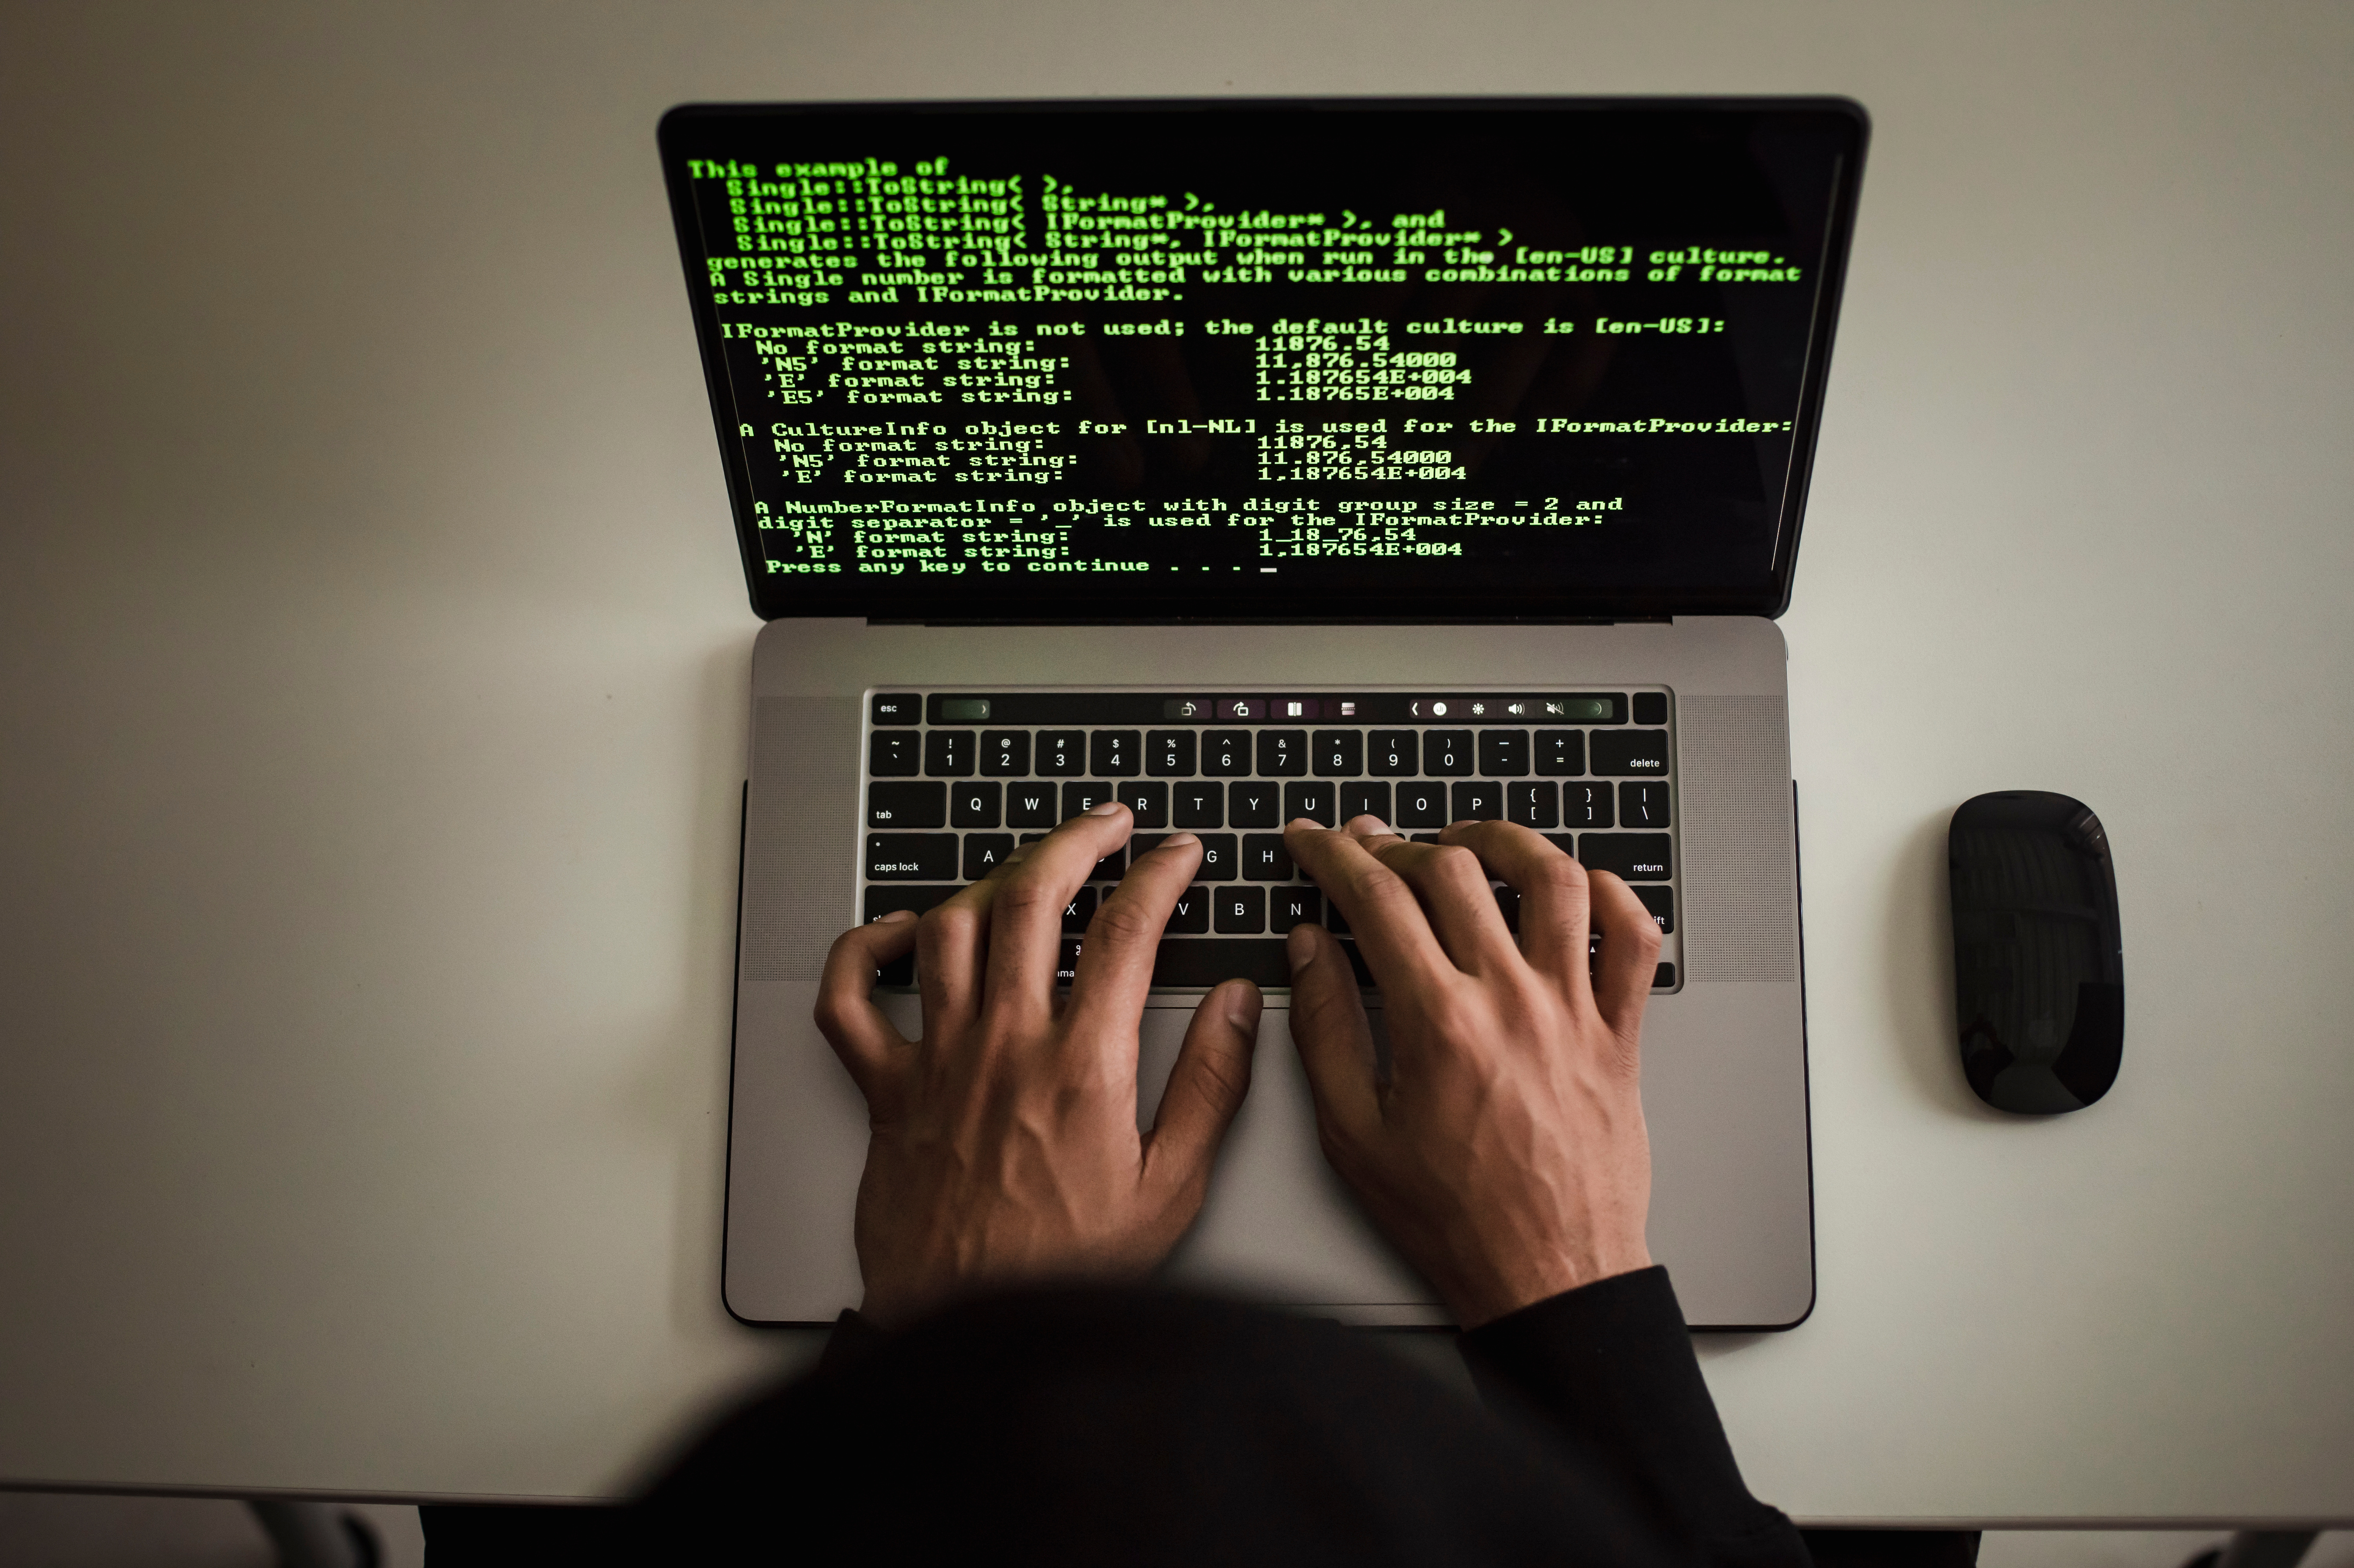
PREVENTION TACTICS
SMART STEPS TO PREVENT ATTACKS
EFFECTIVE CYBERSECURITY INVOLVES REGULAR SOFTWARE UPDATES, DEVICE MONITORING, AND USER TRAINING. LIMITING SYSTEM ACCESS, DISABLING UNUSED SERVICES, AND BACKING UP DATA STRENGTHEN DEFENSE.
AWARENESS CAMPAIGNS AND A STRONG CULTURE OF CAUTION CAN GREATLY REDUCE RISKS. PREVENTION IS ALWAYS CHEAPER AND SAFER THAN RECOVERY AFTER AN ATTACK.

Slide 9
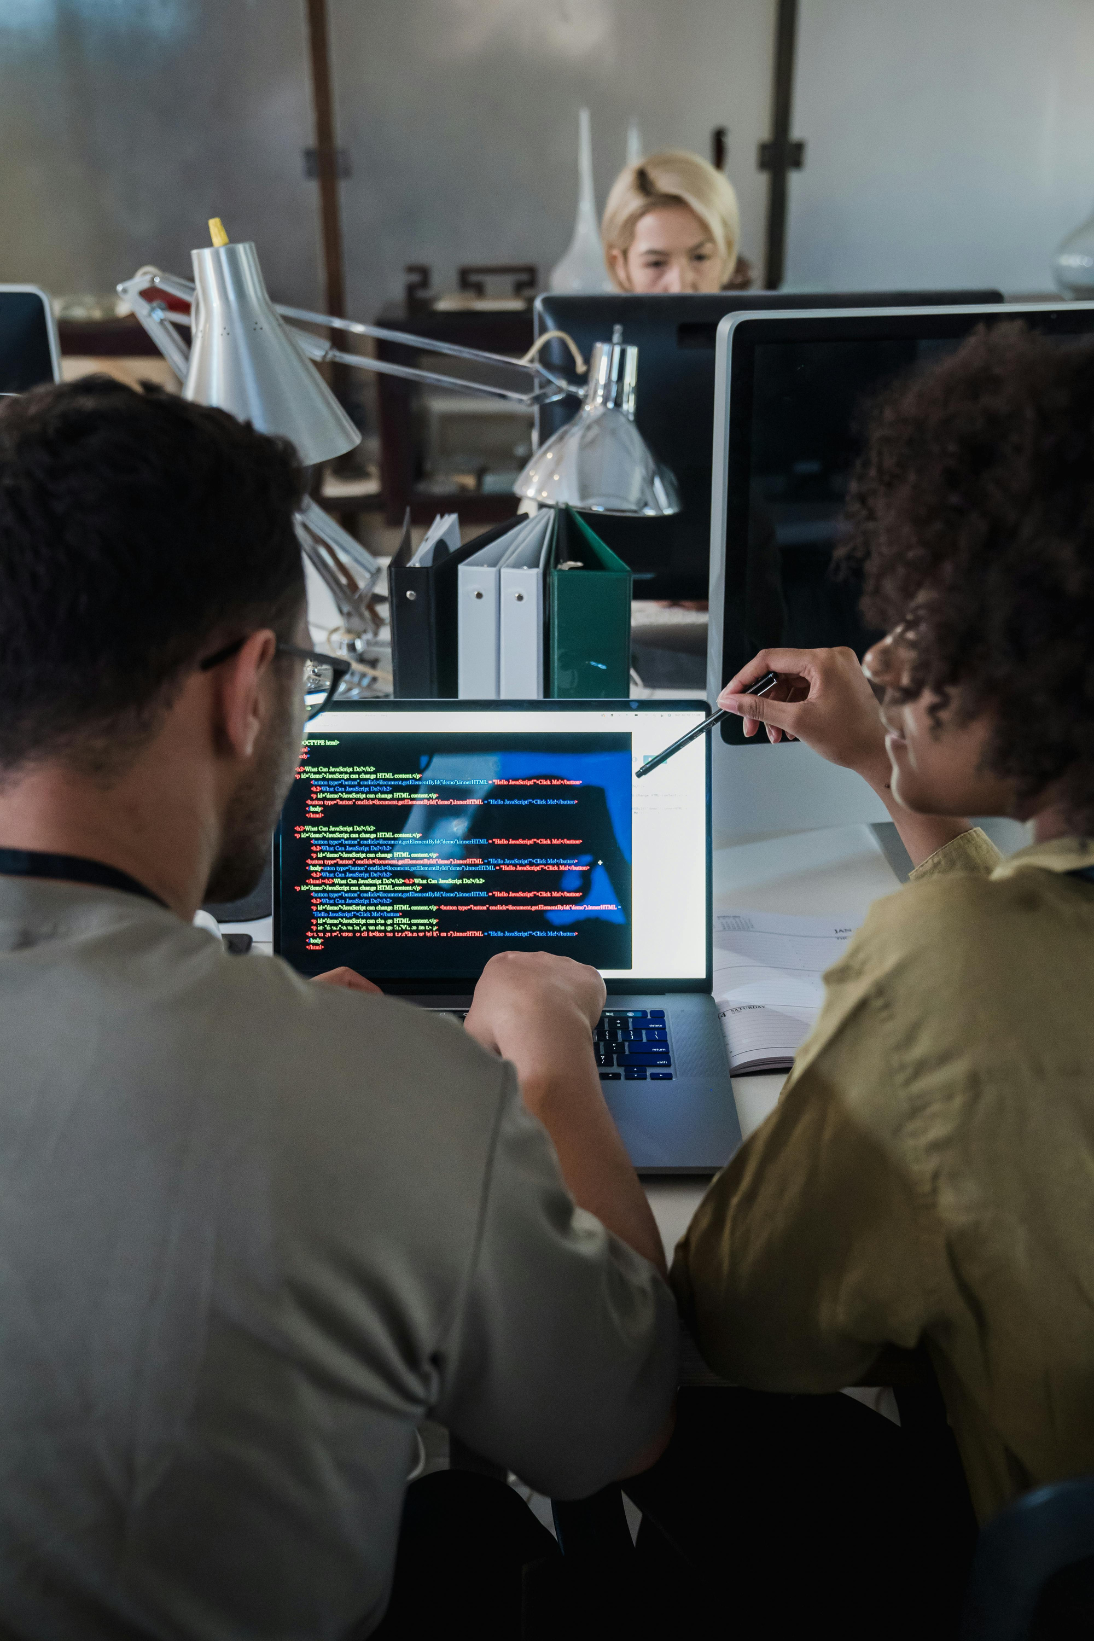
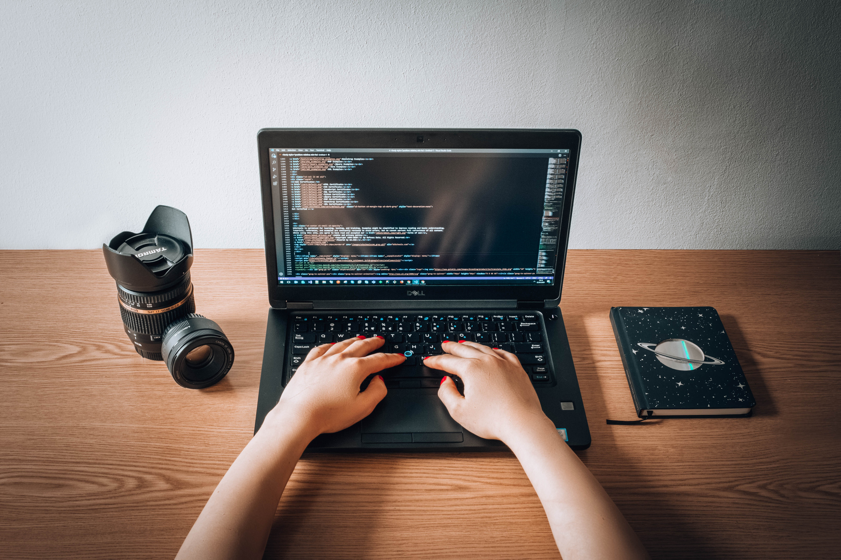
ROLE OF INDIVIDUALS
HOW INDIVIDUALS STRENGTHEN SECURITY
INDIVIDUAL HABITS GREATLY AFFECT CYBERSECURITY. CREATING UNIQUE, COMPLEX PASSWORDS AND VERIFYING UNKNOWN LINKS CAN STOP THREATS BEFORE THEY BEGIN. EVERYONE HAS THE POWER TO REDUCE RISK.
LEARNING BASIC SAFETY—LIKE AVOIDING SUSPICIOUS ATTACHMENTS, UPDATING DEVICES, AND ENABLING SECURITY SETTINGS—BUILDS A SAFER DIGITAL ENVIRONMENT FOR EVERYONE CONNECTED.

Slide 10
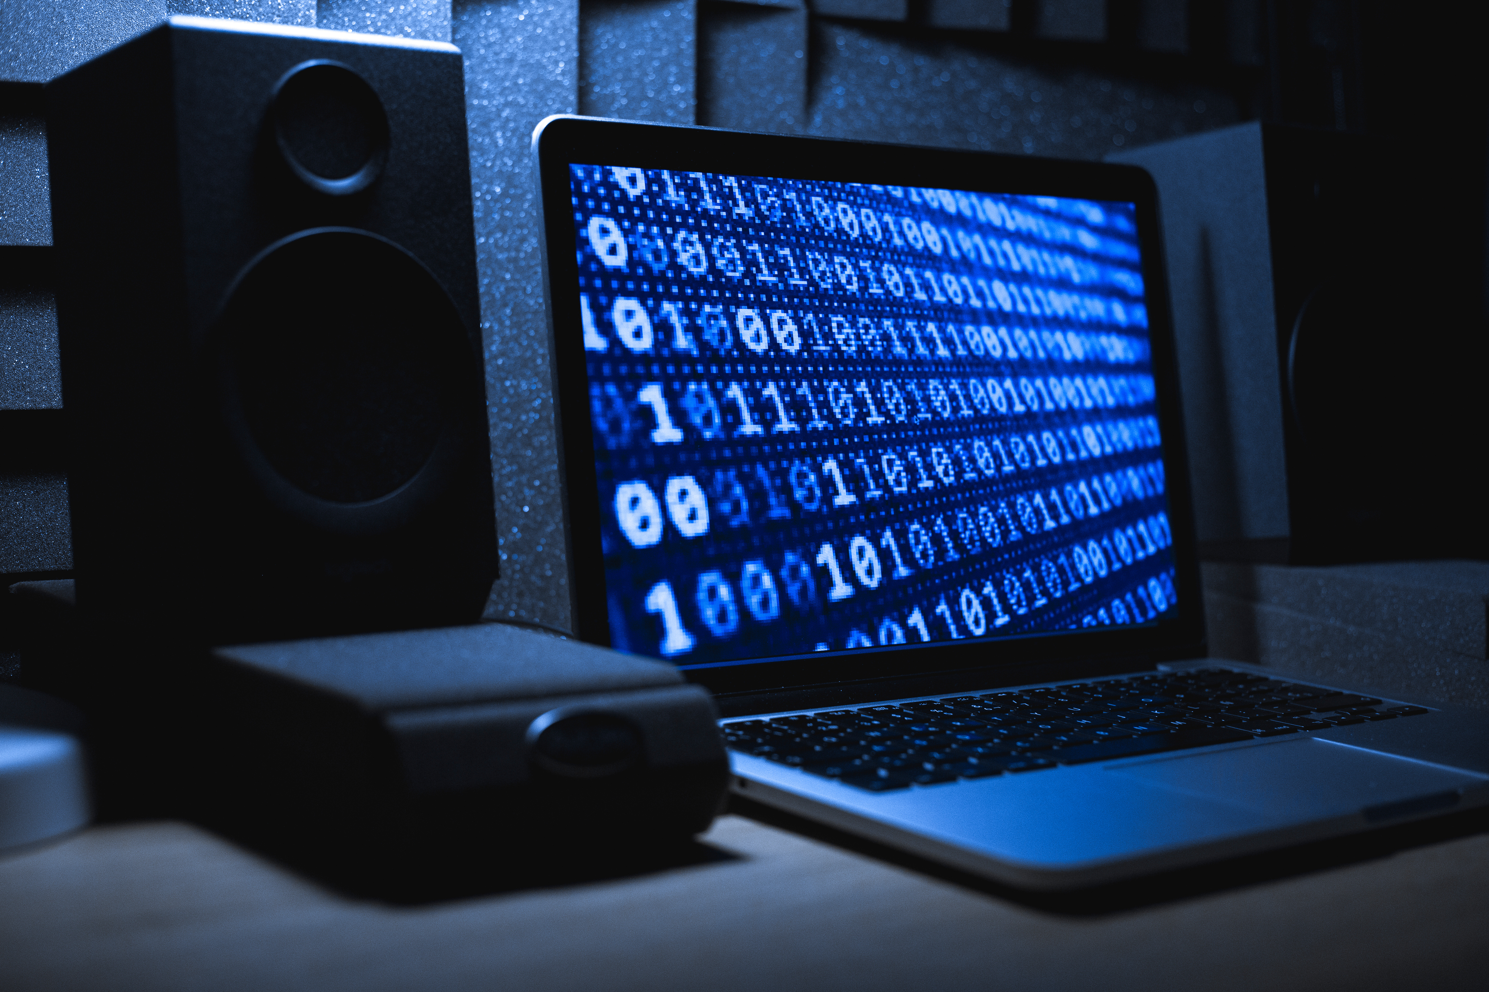
FUTURE OF CYBERSECURITY
INNOVATION, RISK, AND RESPONSE
EMERGING TECHNOLOGIES BRING BOTH NEW PROTECTIONS AND NEW THREATS. AUTOMATED THREAT DETECTION, BEHAVIOR-BASED ANALYSIS, AND IMPROVED STANDARDS WILL SHAPE THE FUTURE. CYBERSECURITY MUST EVOLVE WITH INNOVATION TO REMAIN EFFECTIVE. A SECURE FUTURE RELIES ON PREPARATION, ADAPTATION, AND GLOBAL COLLABORATION.

Slide 11
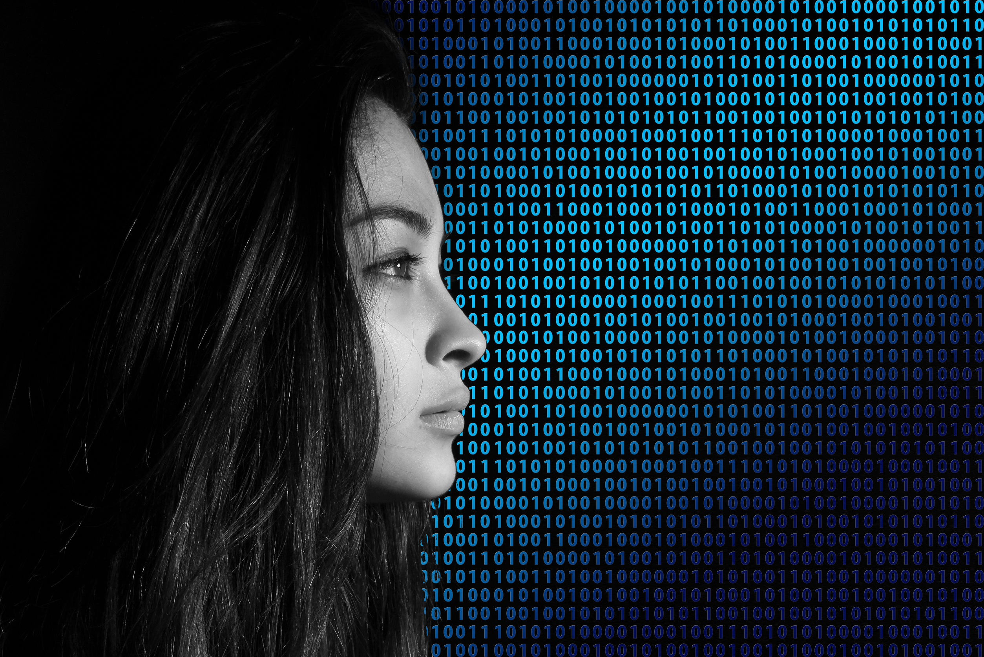




THANK YOU
GET IN TOUCH
+123-456-7890
WWW.REALLYGREATSITE.COM
HELLO@REALLYGREATSITE.COM
123 ANYWHERE ST., ANY CITY, ST 12345

