Slide 1

Sixth Annual Summit on
Evidence-Based Education
Performance Feedback:
Using Data to Improve Educator
Performance

Slide 2
1978 - 2004
Operated a large non-profit organization in SF Bay Area
six spec. ed schools adult programs
residential programs employment supportive services
public school consultation teacher training campus
Operated comprehensive performance feedback systems
student performance
staff performance
organizational performance
Notes:
How many worked for us ?

Slide 3
2004 - present
independent, non-profit operating foundation
promote evidence-based education policies and practices
act as a catalyst to facilitate communication, cooperation and collaboration between individuals and organizations currently engaged in evidence based education

Slide 4
The Wing Institute’s Strategic Vision
Identify exemplars in evidence-based education
Develop networks to facilitate collaboration
Provide support for new ideas, research, and publications
Facilitate cross-discipline cooperation
Engage in data-mining…
gather data
analyze data
disseminate data

Slide 5
SUMMIT Participants: professional disciplines
administrator
advocate
asst. superintendent
attorney
autism specialist
behavior analyst
case manager
clinical director
community outreach
consultant
curriculum designer
executive director
parent
professor
psychologist
researcher
resource counselor
school administrator
school psychologist
spec. ed director
speech therapist
superintendent
teacher
Notes:
How many never been to summit?
1,2,3,4,5?

Slide 6
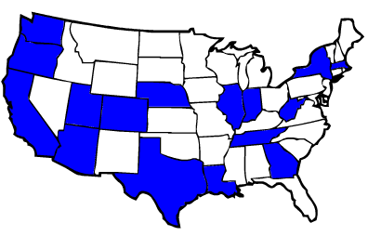

Slide 7
SUMMIT Participants: Organizations
59 different organizations
10 consumer / parent / advocacy / public organizations
parent groups advocacy groups CDE
service orgs Regional Centers
13 public school organizations
school districts SELPAs county office of ed
17 private education organizations
nonpublic schools nonpublic agencies private schools
16 universities
education school psychology pediatrics
social welfare special education disability services
3 research & policy organizations

Slide 8
Summit Housekeeping
Next Summit: April 22, 2012
Resource Packet (Flash Drive)
Knowledge Network
Schedule
Breaks
Lunch
Time management (groups, report outs)
Summit Feedback Survey
4:00 PM sharp!

Slide 9
Programme for International Student Assessment (PISA)
Organisation for Economic Co-operation and Development (OECD)
an internationally standardized assessment
- conducted every three years (2000, 2003, 2006, 2009)
- measures 15 year old student’s performance in reading, mathematics and science as compared to 34 participating OECD nations and 30 non-OECD nations
a thorough analysis of participating country’s educational systems, policies, and practices
- consistently high performers
rapid improvement in outcomes over past decade

Slide 10
Programme for International Student Assessment (PISA)
Volume I: What Students Know and Can Do: Student Performance in Reading, Mathematics, and Science
Volume II: Overcoming Social Background: Equity in Learning Opportunities and Outcomes
Volume III: Learning to Learn: Student Engagement, Strategies, and Practices
Volume IV: What Makes a School Successful? Resources, Policies and Practices
Volume V: Learning Trends
PISA 2009 Results: What Makes a School Successful
Lessons from PISA for the United States

Slide 11

Programme for International Student Assessment (PISA)
Organisation for Economic Co-operation and Development (OECD)

Slide 12
CAVEATS
“Performance Feedback from a Global Perspective:
contains:
• macro indicators
• correlations
• business terminology
• graphic violence data!

Slide 13
PISA “benchmarks” for high performing
education systems:
1. HIGH QUALITY
(student achievement)
2. HIGH EQUITY
(educational equity)
3. HIGH EFFICIENCY
(educational productivity)
4. HIGH ENGAGEMENT
(staff engagement)

Slide 14
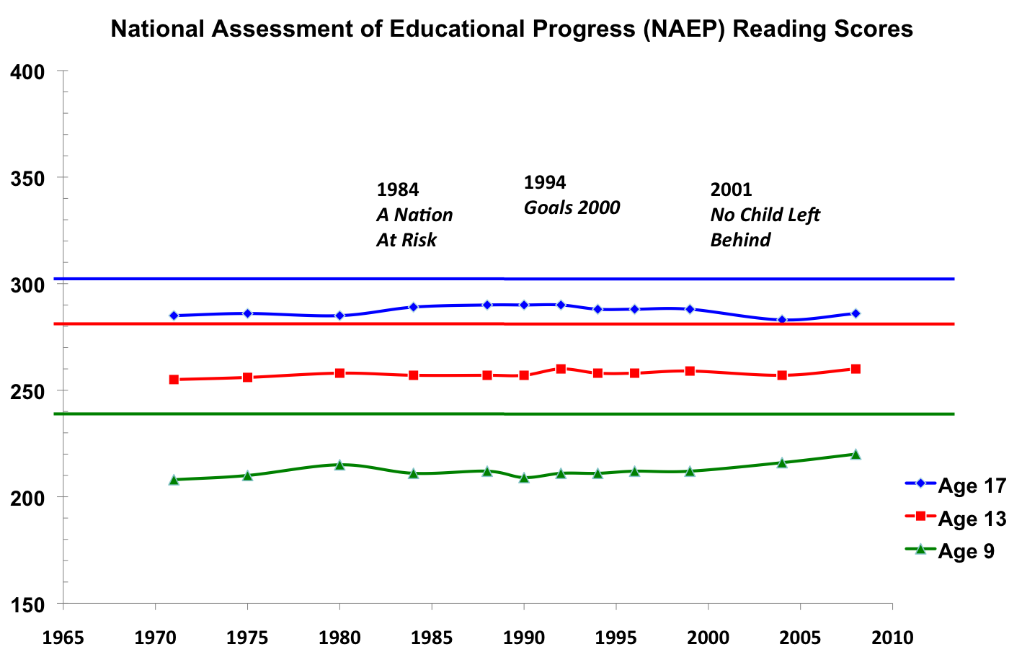
Benchmark: Quality
NAEP Data
Grade 12
Grade 8
Grade 4
SOURCE: U.S. Department of Education, Institute of Education Sciences, National Center for Education Statistics, National Assessment of Educational Progress (NAEP), 1992, 1994, 1998, 2000, 2002, 2003, 2005, and 2007 Reading Assessments.

Slide 15
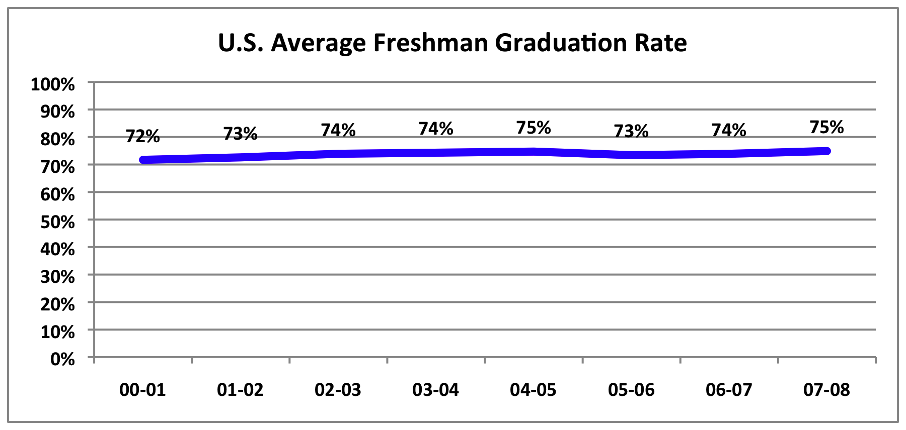
Benchmark: Quality
Graduation Rates

Slide 16
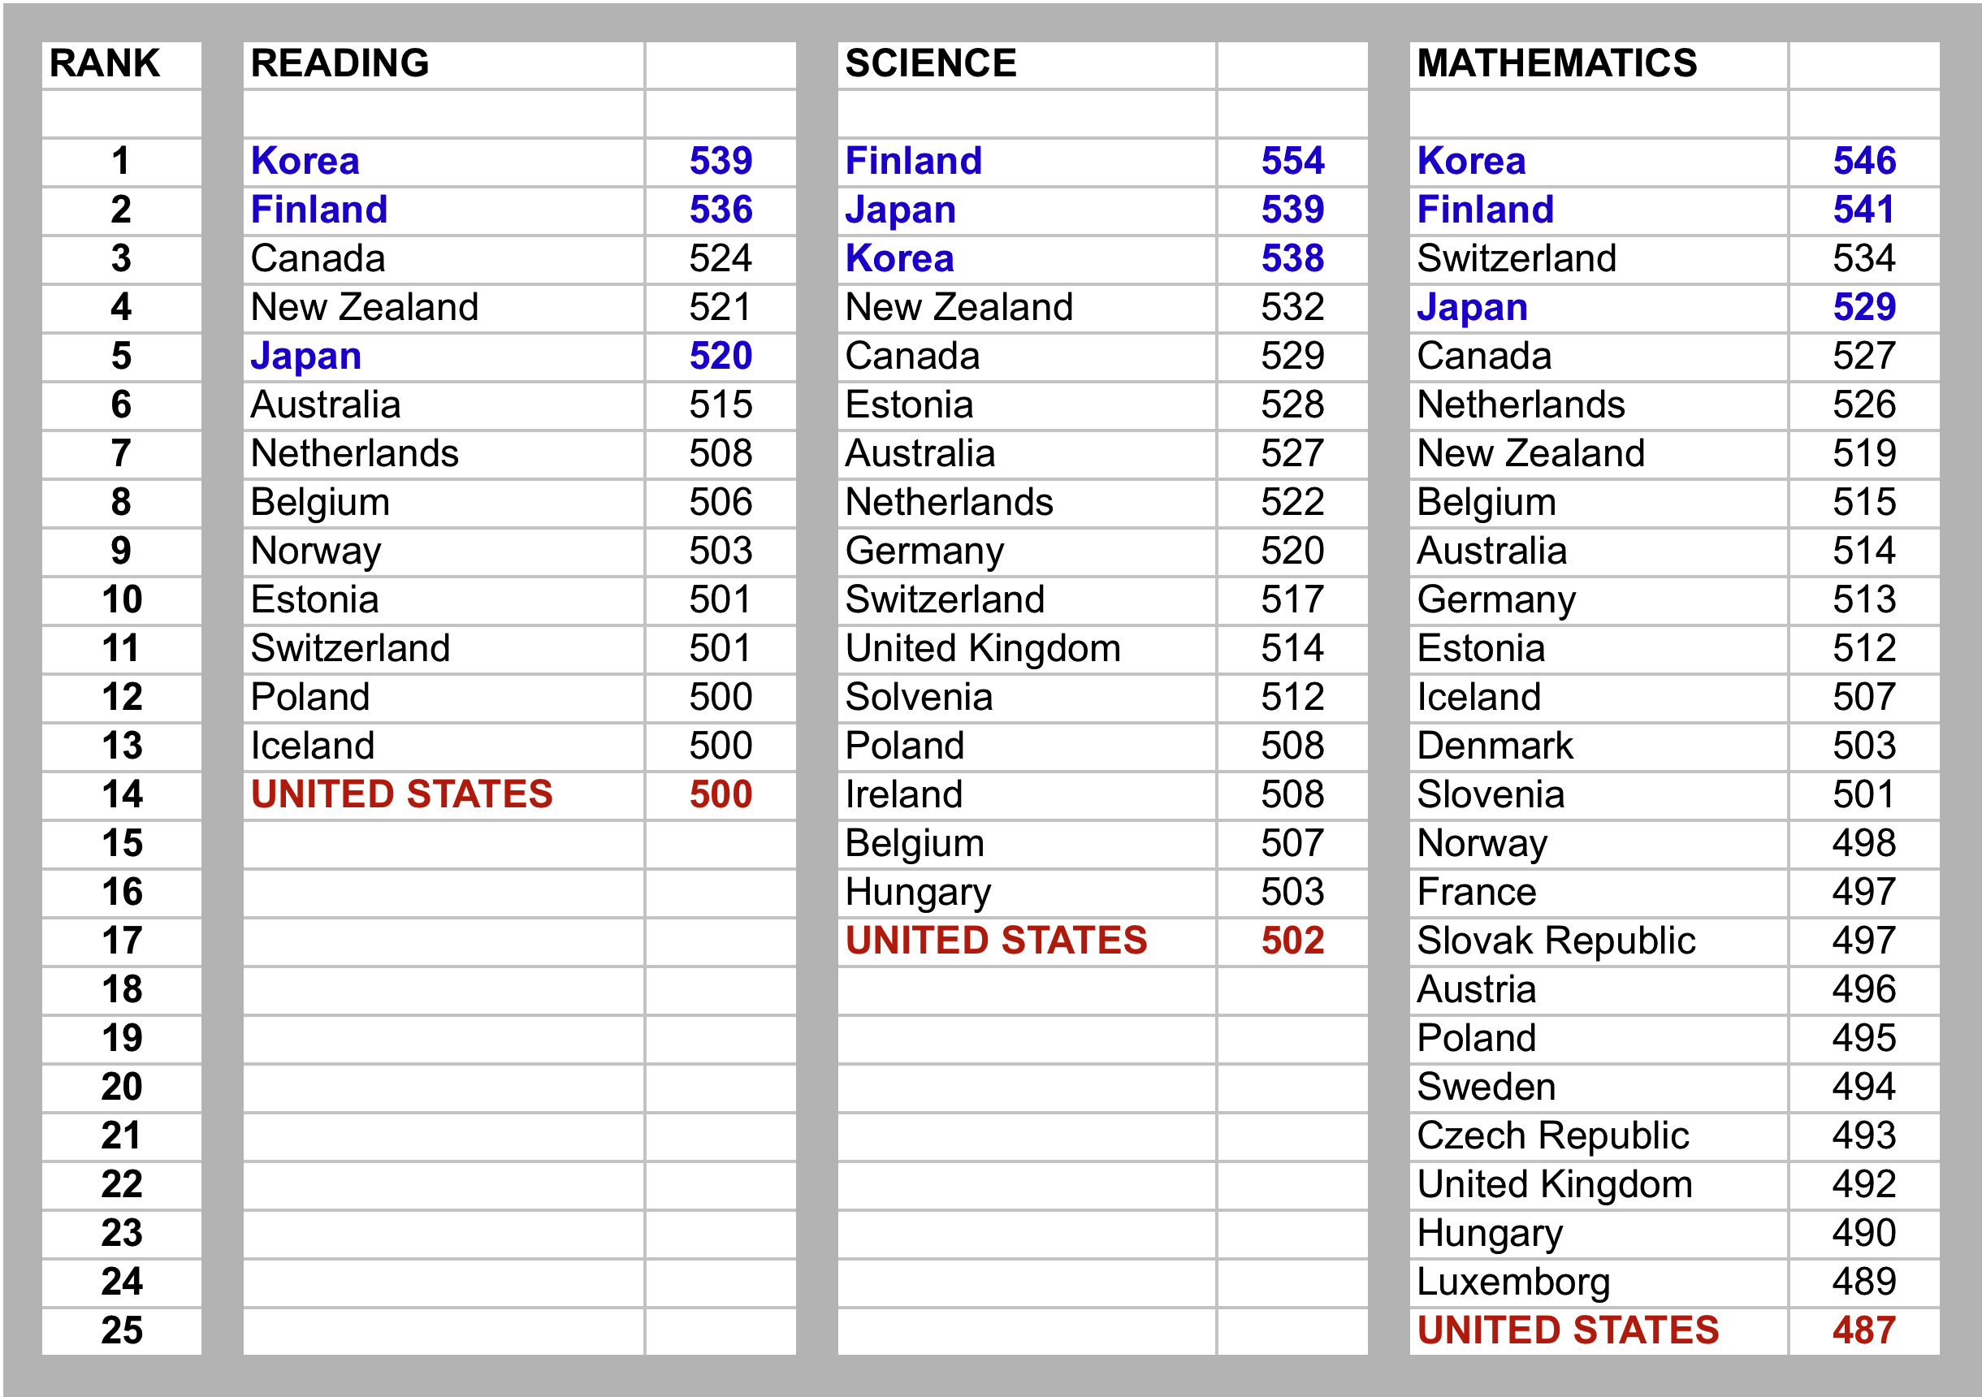
Benchmark: Quality
PISA SCORES

Slide 17
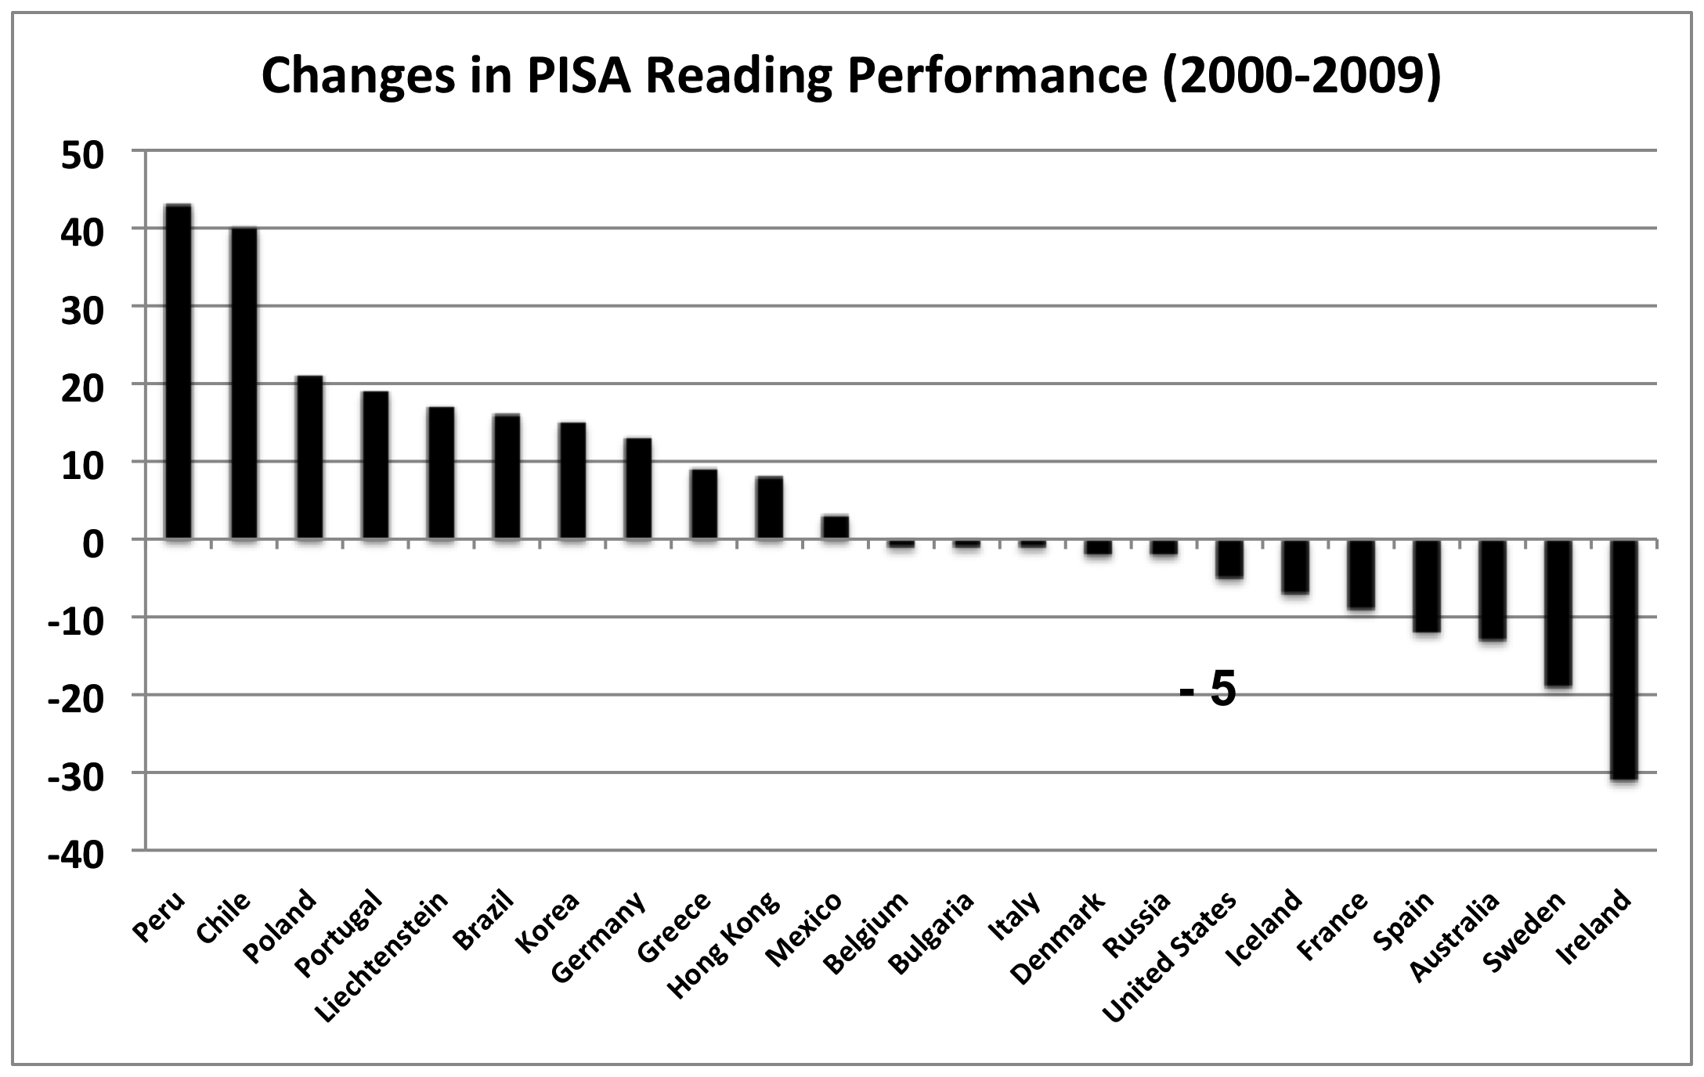
Benchmark: Quality

Slide 18
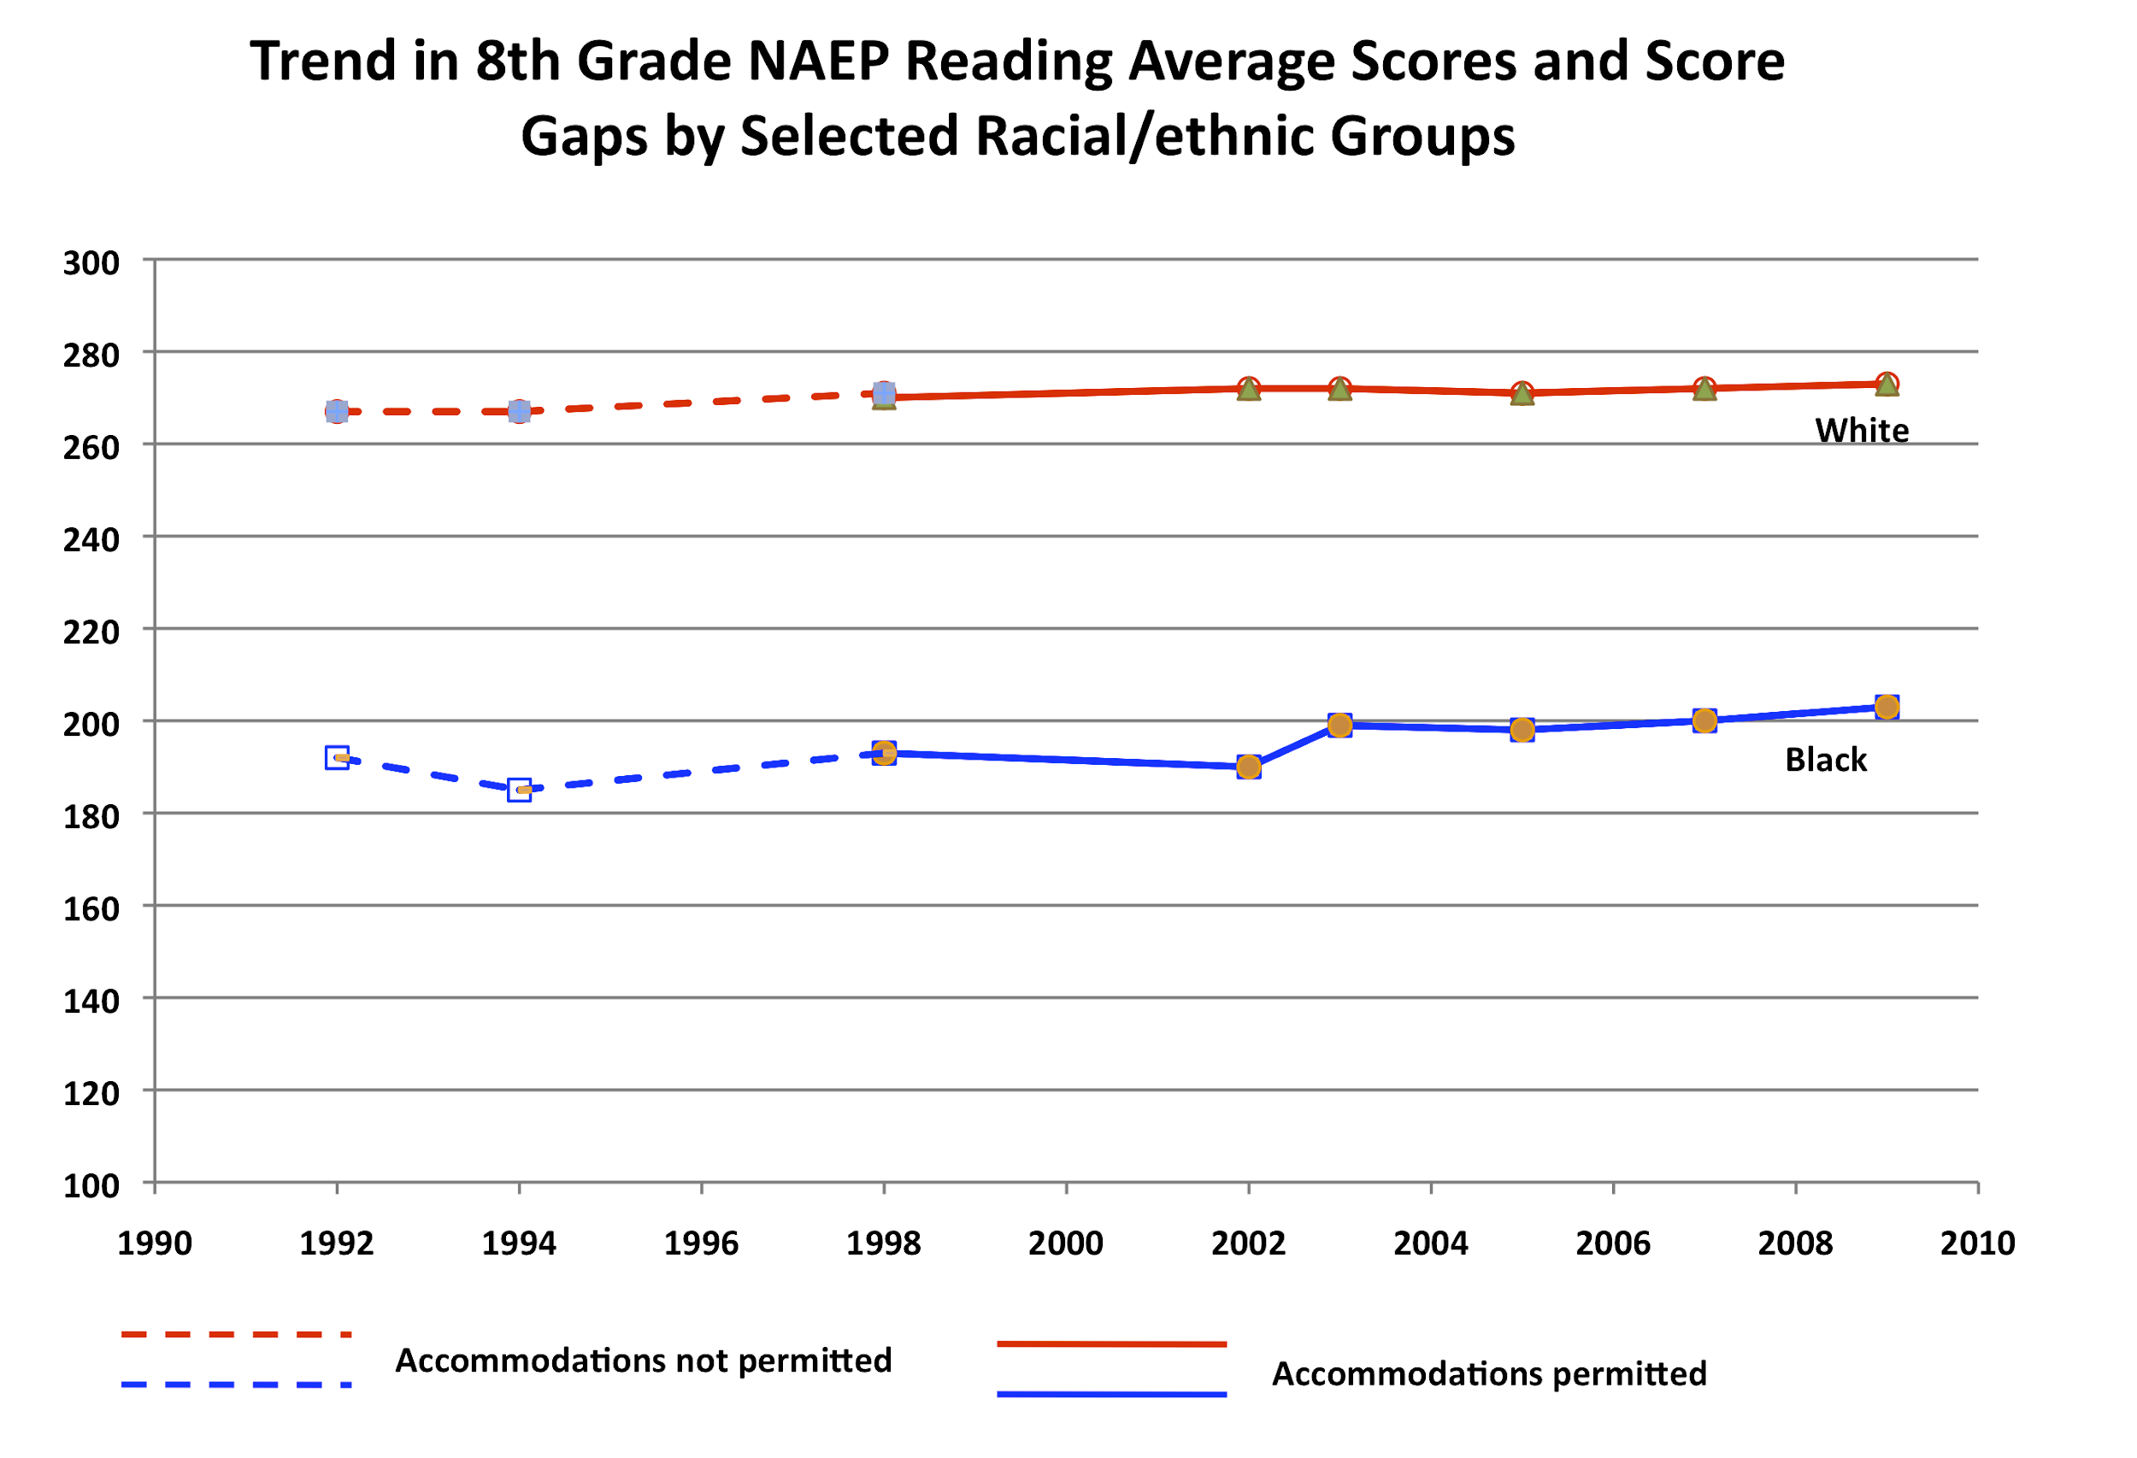
Benchmark: Equity

Slide 19
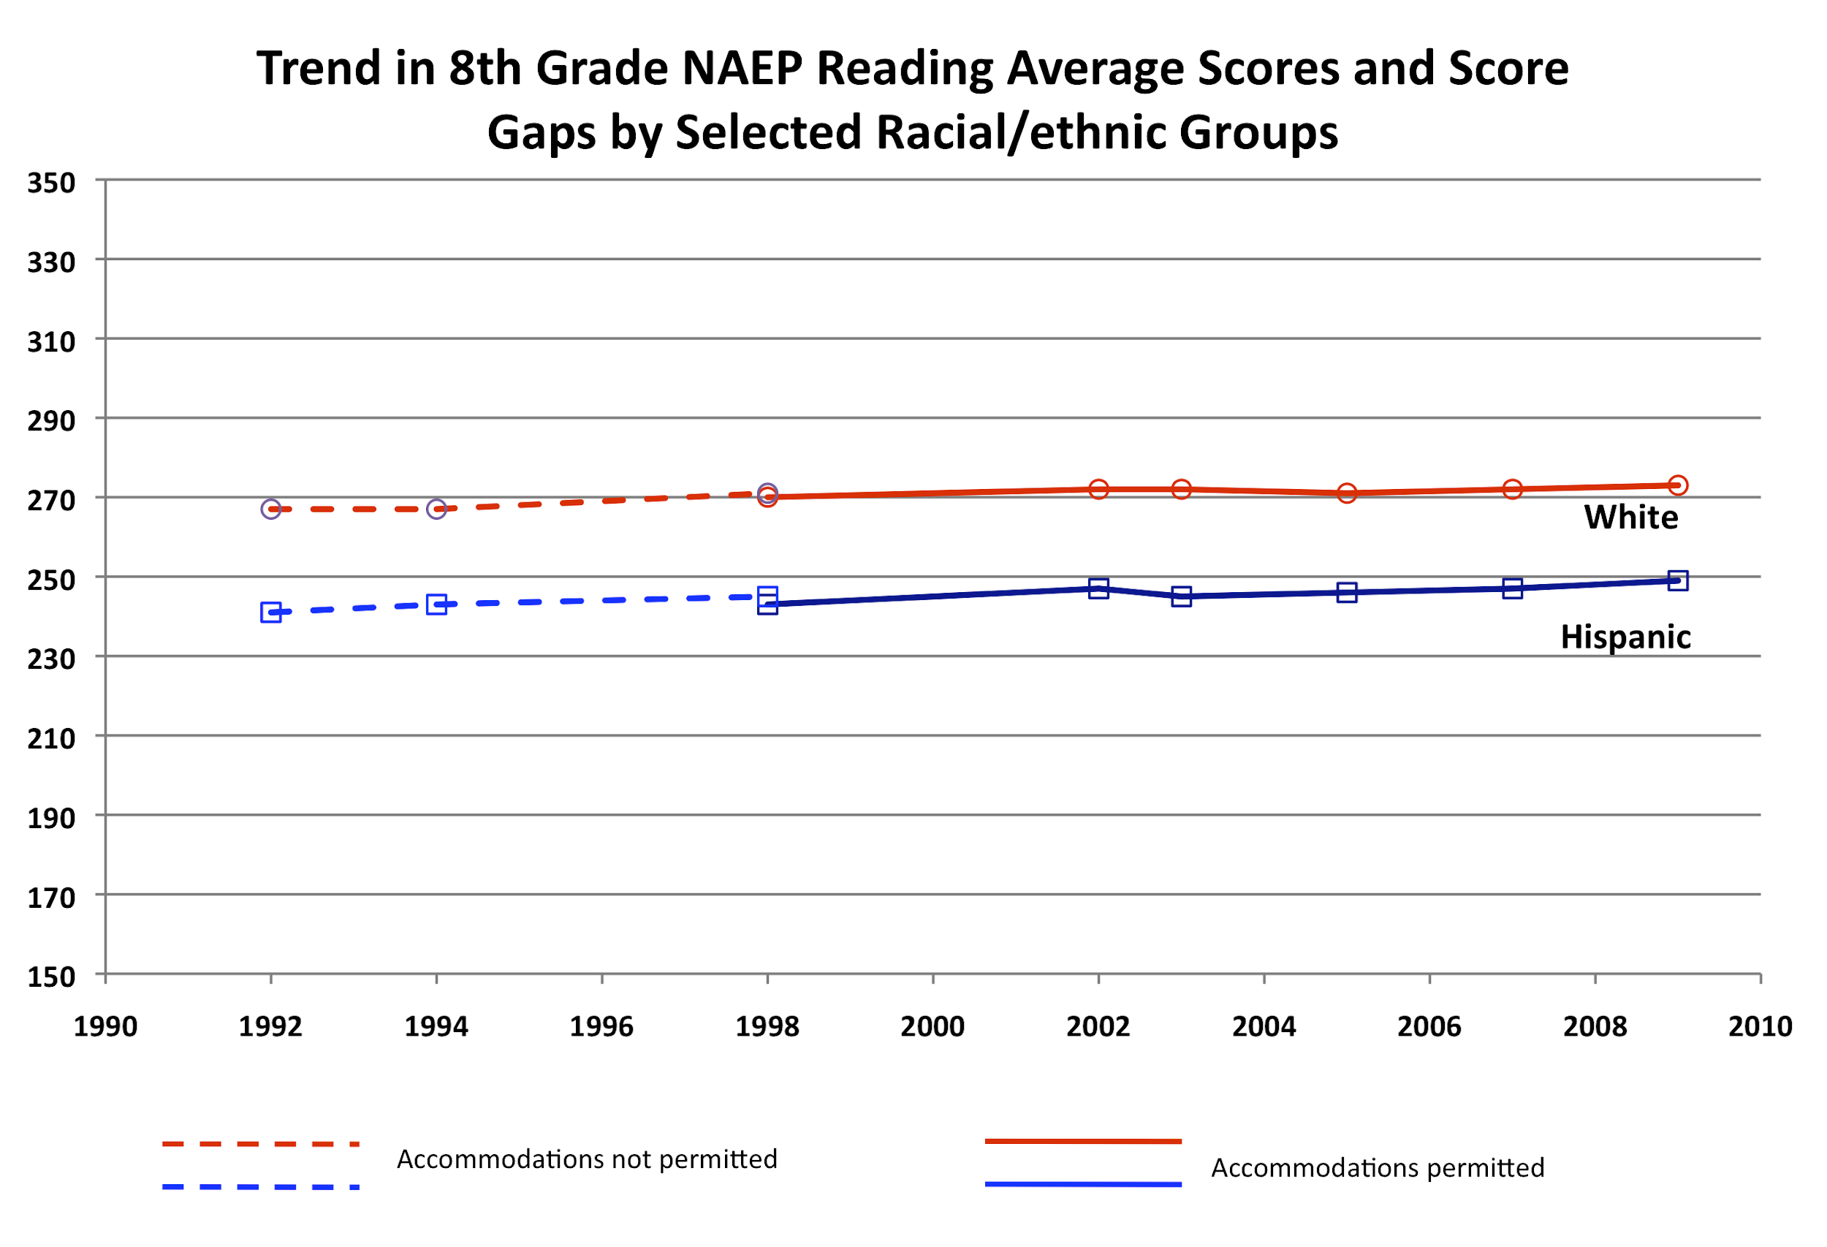
Benchmark: Equity

Slide 20
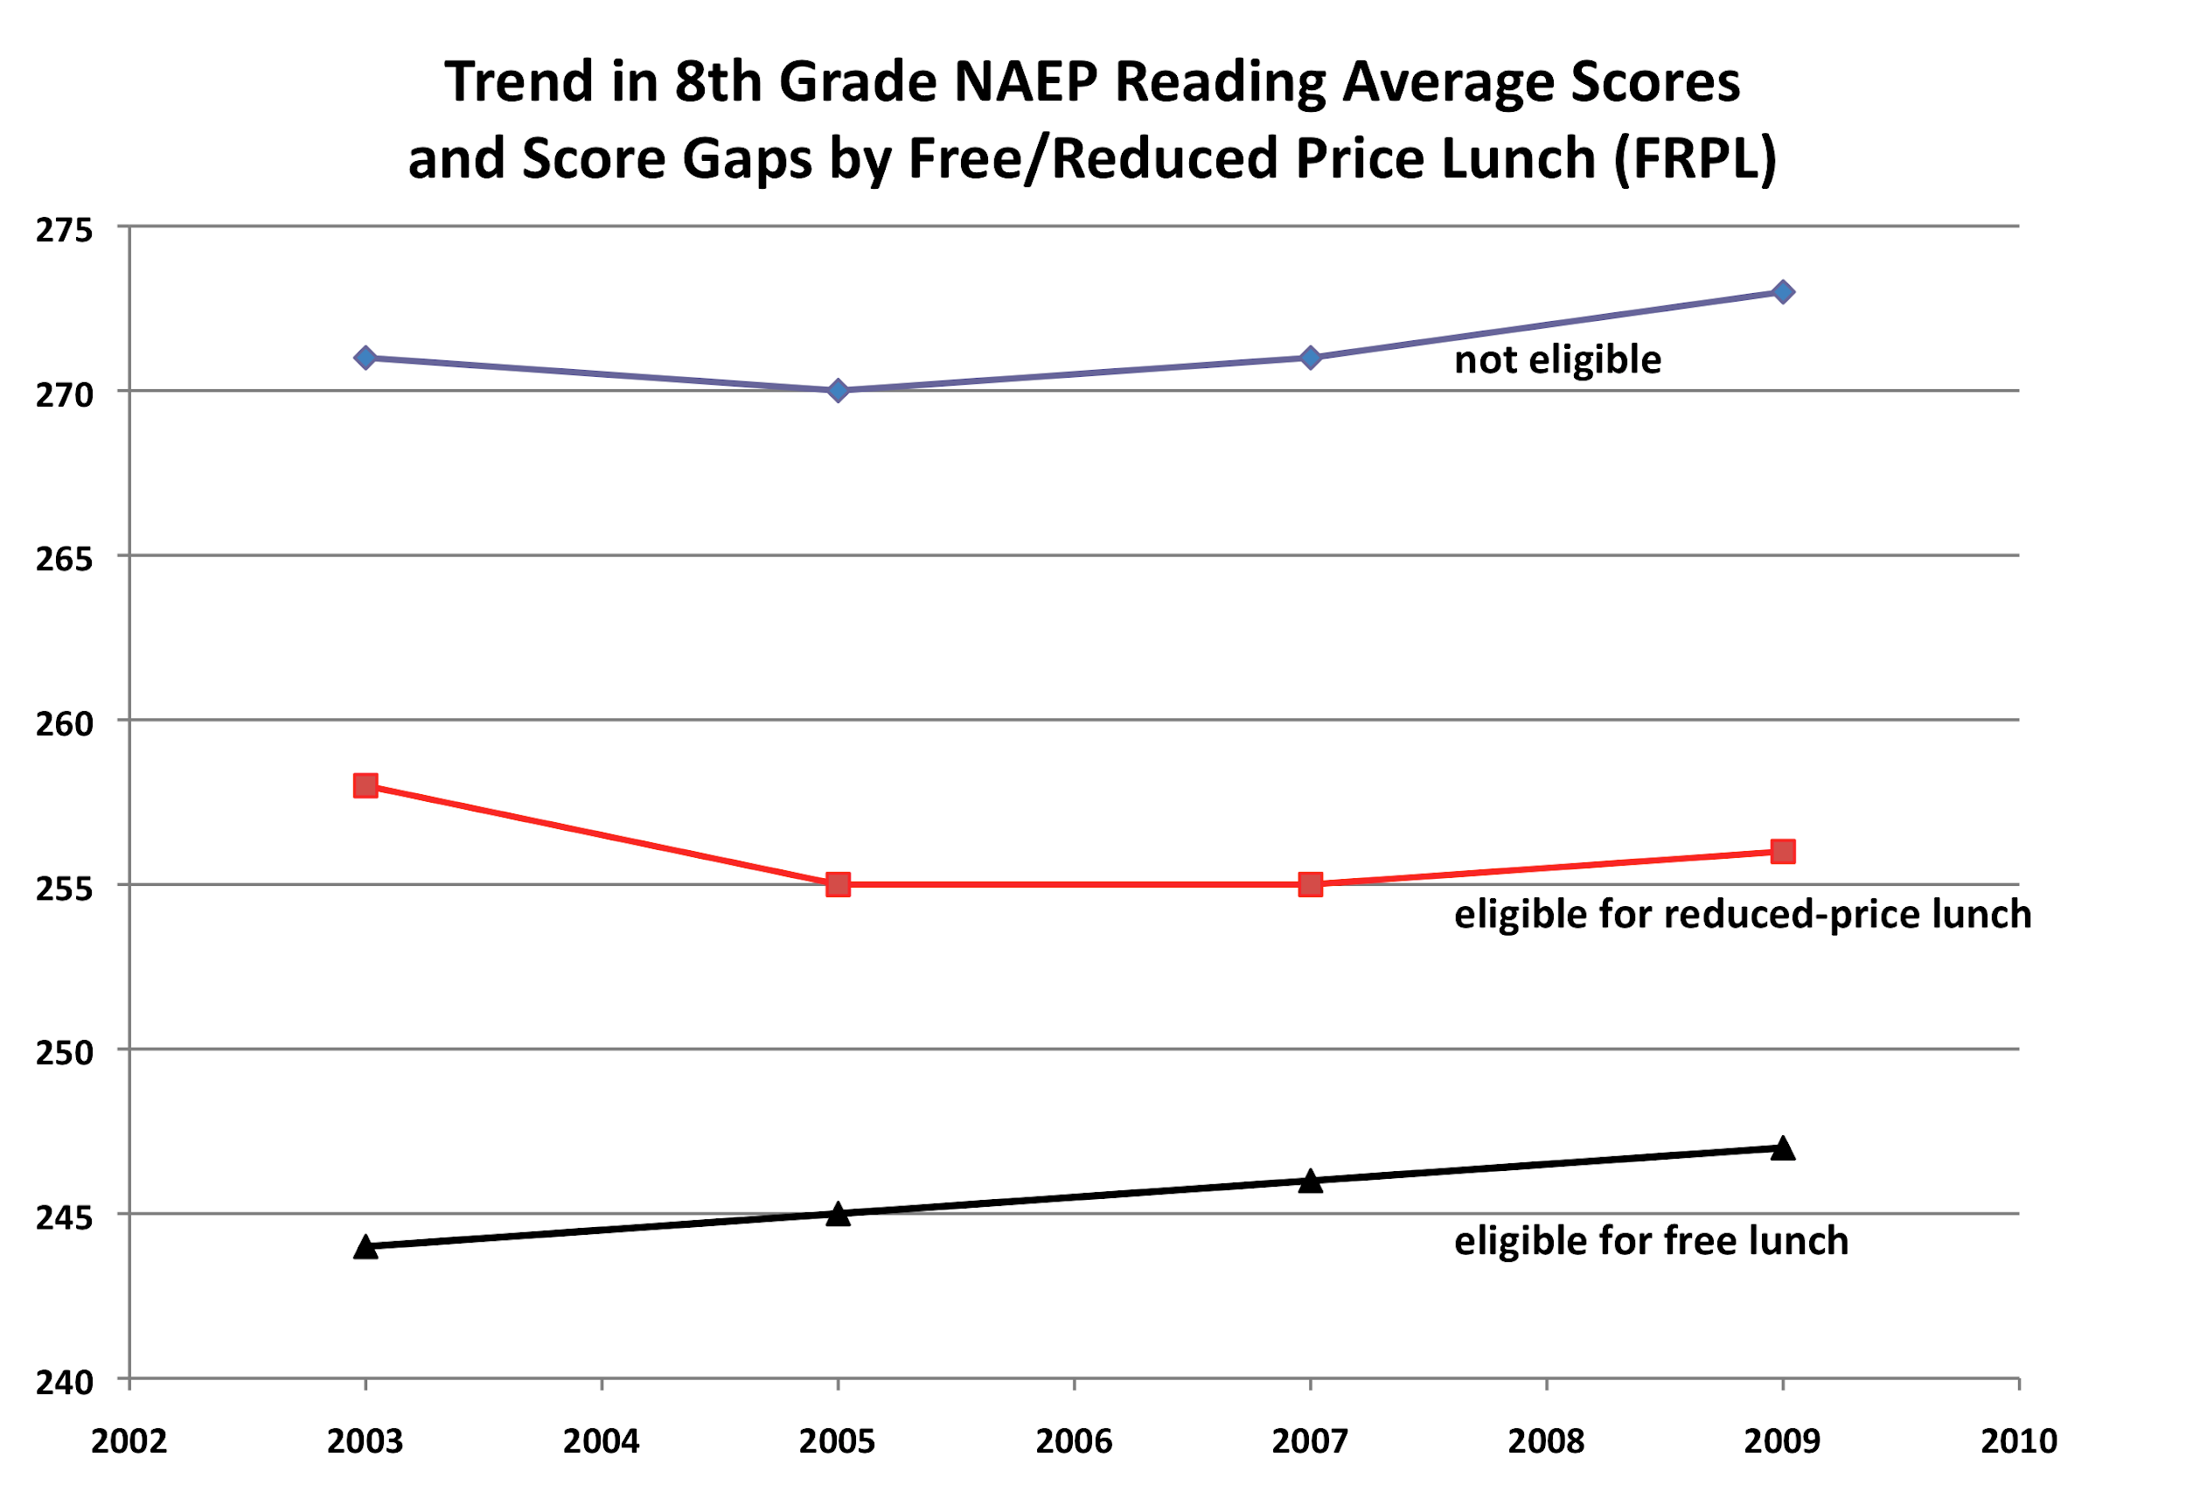
Benchmark: Equity

Slide 21
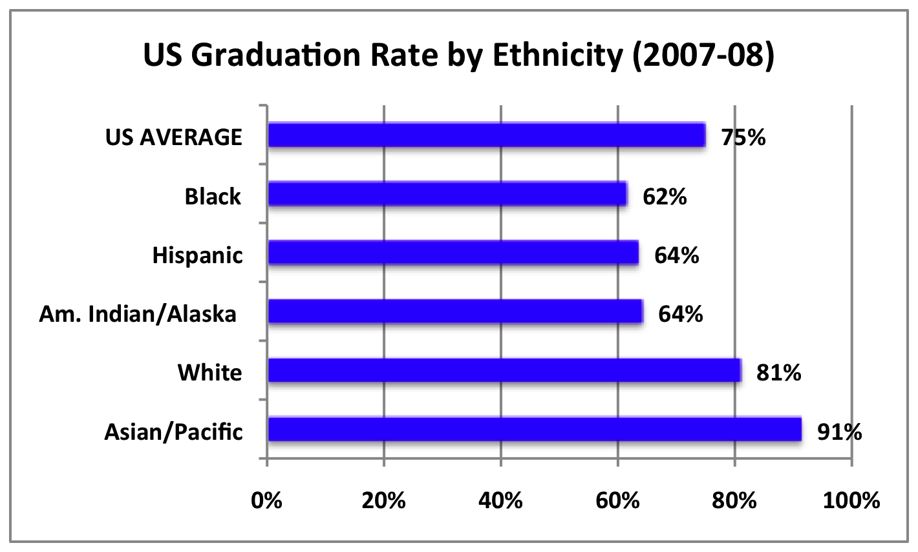
Benchmark: Equity
National Center for Education Statistics

Slide 22
Benchmark: Equity
PISA Measures of Educational Equity
Variance in student performance explained by students’ socio-economic background:
U.S. Ranks 25th of 34 OECD countries
Variance in performance explained by schools’ socio-economic background between schools:
U.S. Ranks 31st of 34 OECD countries
Equity in access to resources (allocation of increased teachers per students to disadvantaged schools):
U.S. Ranks 30th of 34 OECD countries
Percentage of 15 yr olds enrolled in education (82% in U.S.)
U.S. Ranks 32nd of 34 OECD countries
Notes:
17% of variation in test scores due to socio-economic…vs.9%
15 yr old….Mexico and Turkey lower

Slide 23
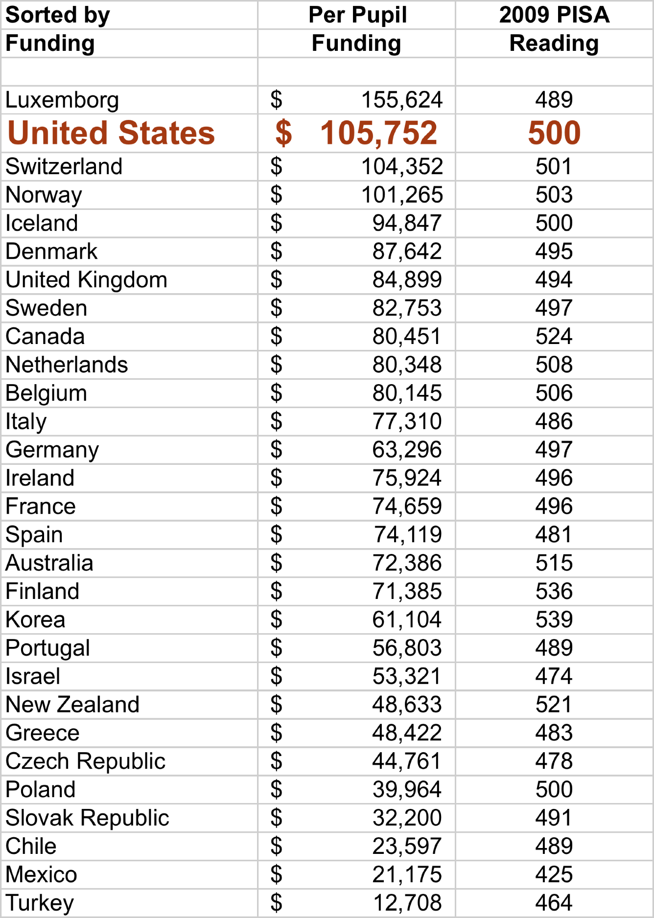
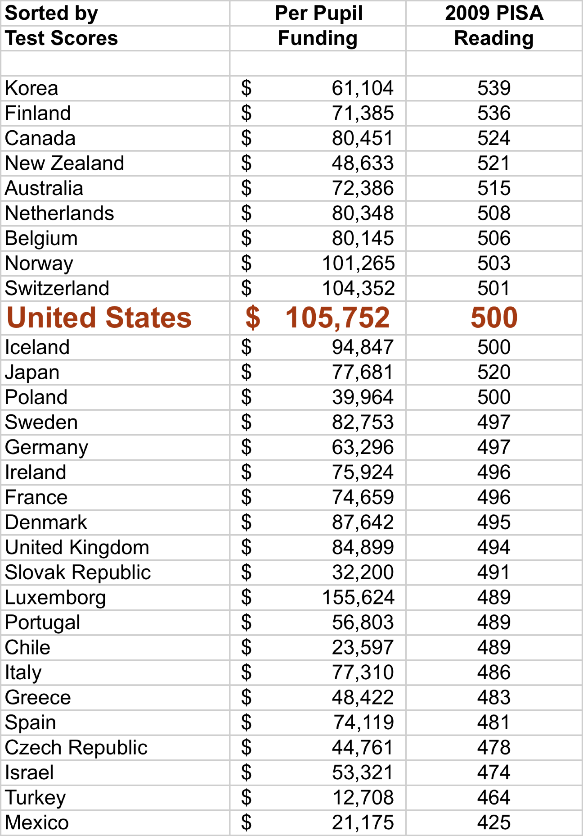
Benchmark: Efficiency

Slide 24
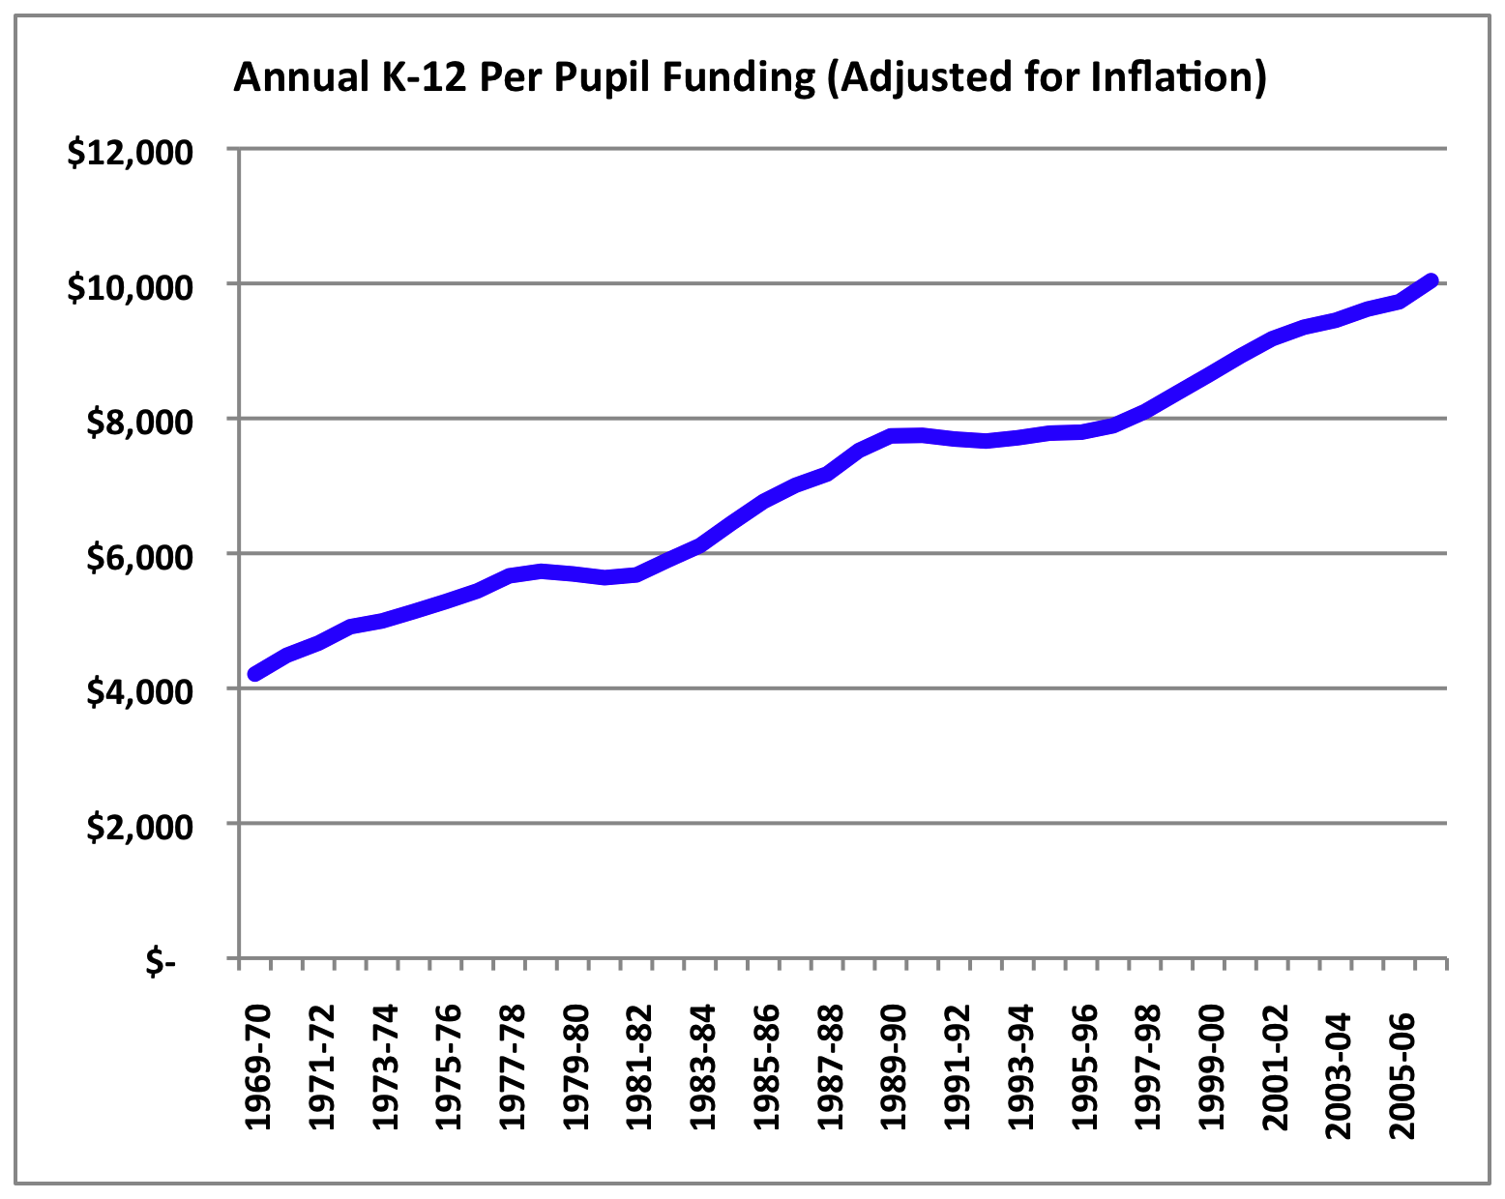
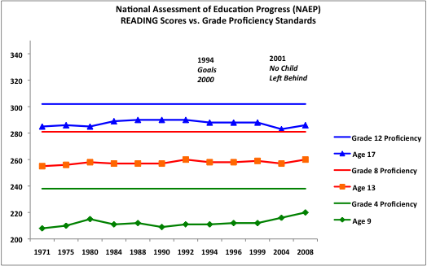
Benchmark: Efficiency
1970-2007:
Funding increased by 139%
1998-2007:
Funding increased by 24%

Slide 25
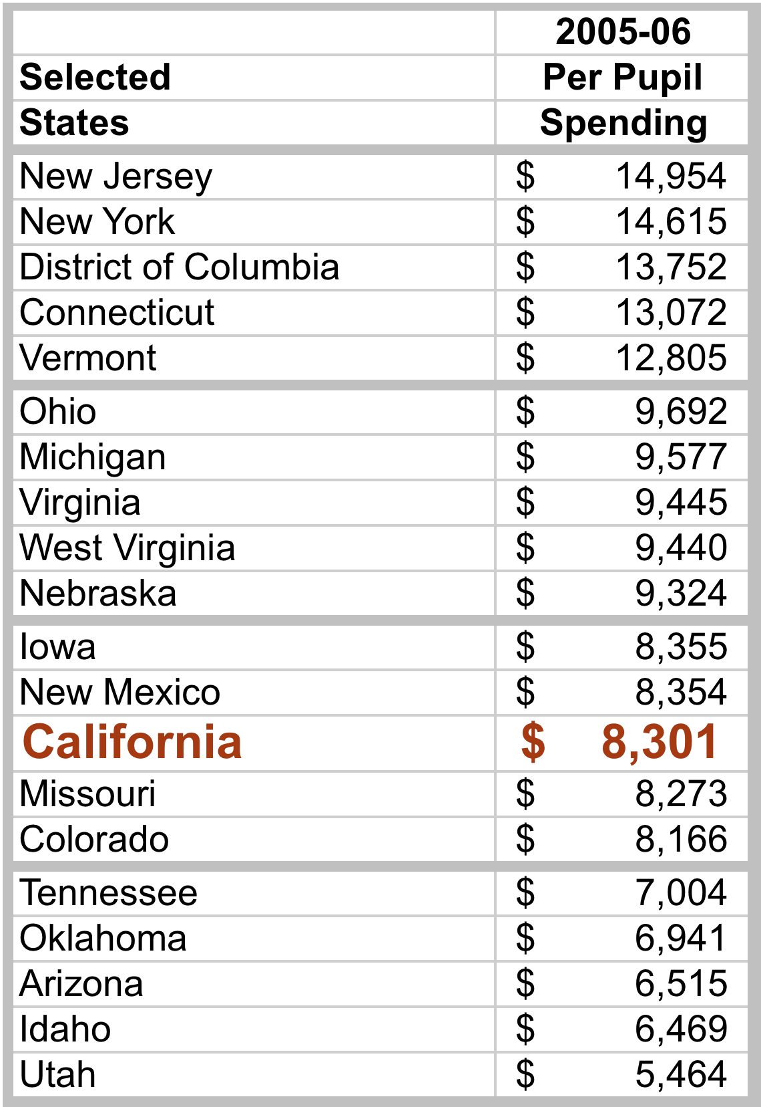
Benchmark: Efficiency

Slide 26
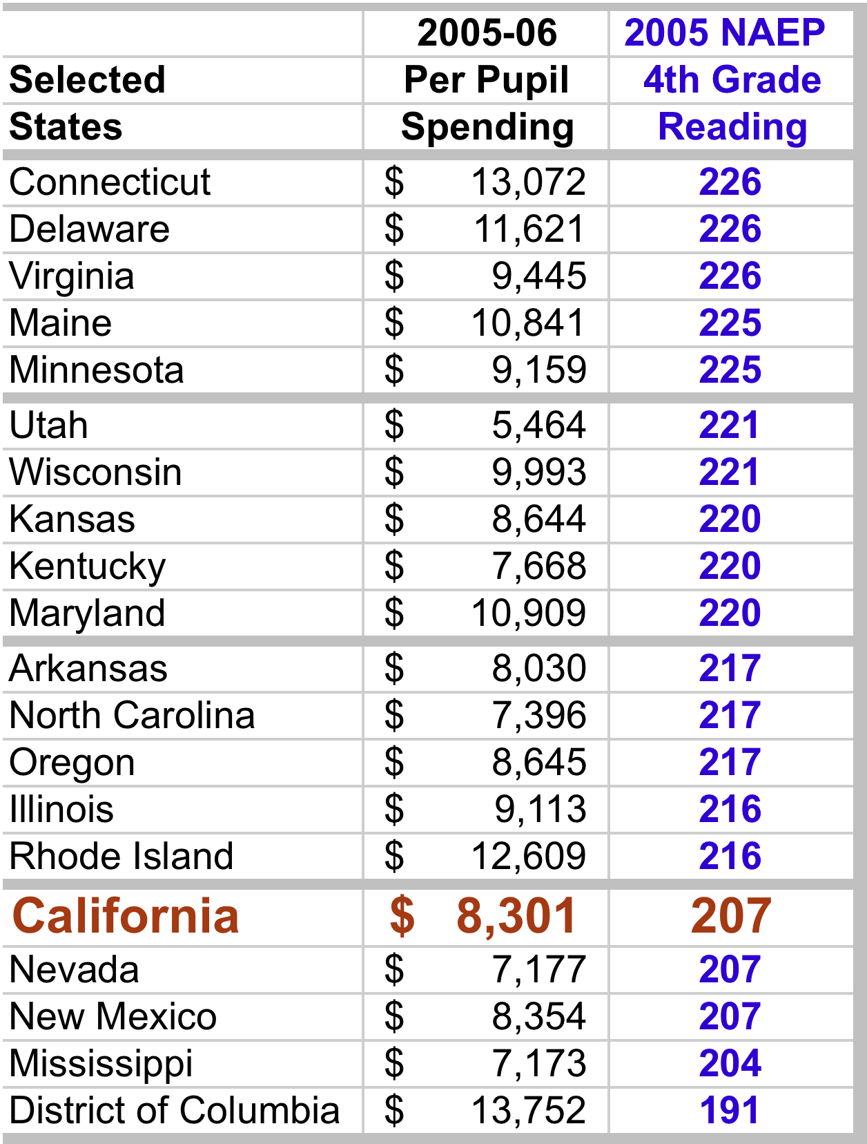
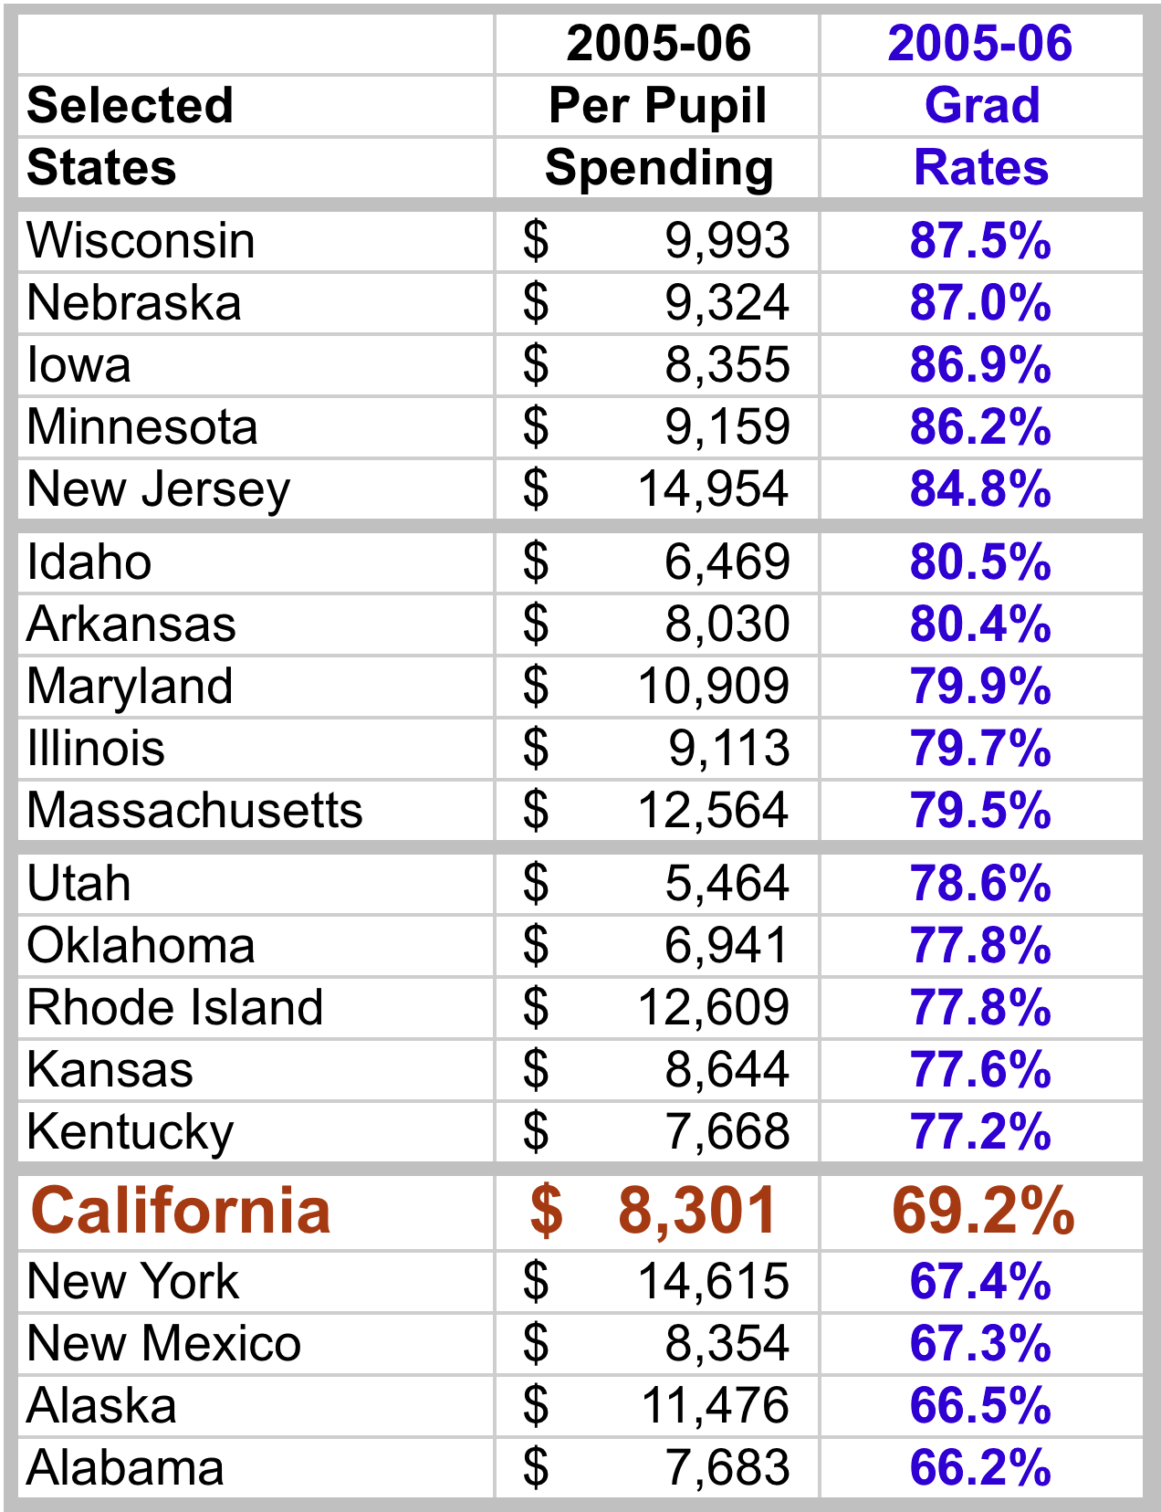
Benchmark: Efficiency

Slide 27
Benchmark: Efficiency
Return on Educational Investment: A district-by-district evaluation of U.S. educational productivity (January 2011)
Academic achievement index: average of the percent of students across grades designated proficient or above on the state assessments in reading and math
Cost: “current expenditures” category (salaries, services, supplies)
(excludes capital expenses)
controlling for factors outside a district’s control, such as cost-of- living and students with special needs (English-language learners, special education, low income)

Slide 28
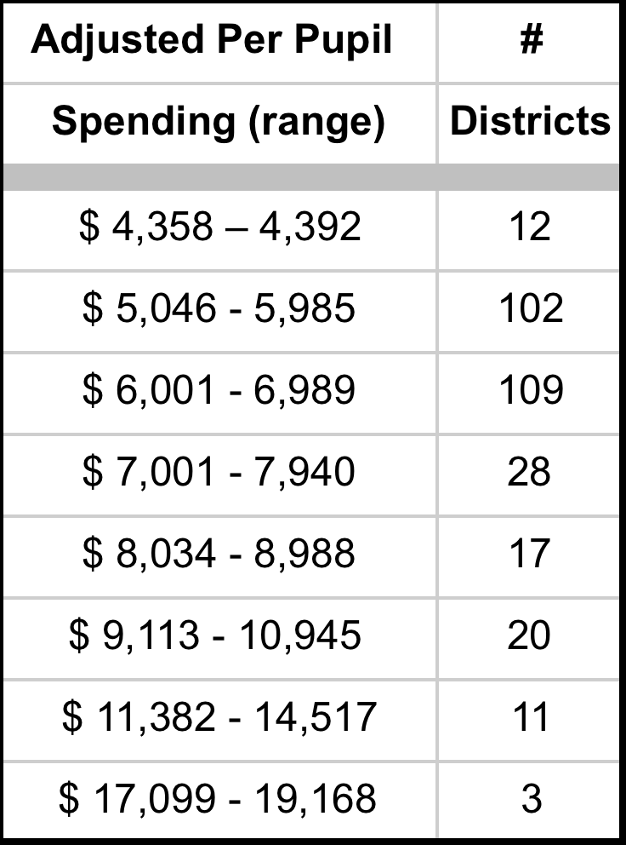
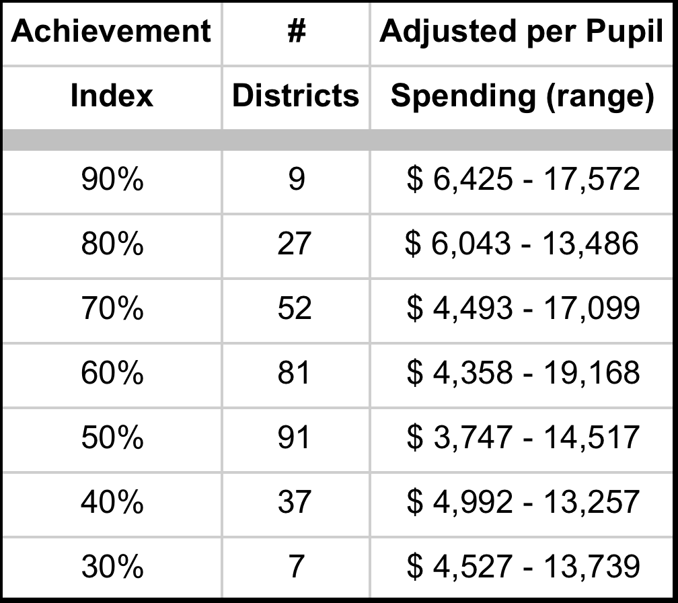
Benchmark: Efficiency (CA districts)

Slide 29
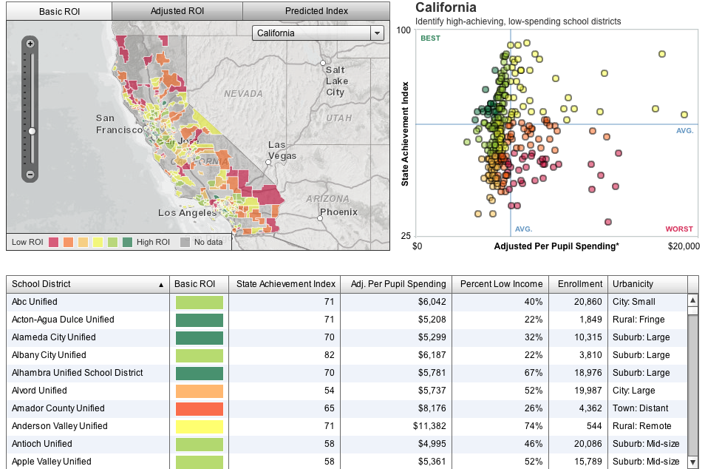
www.americanprogress.org/ROI.

Slide 30
PISA Benchmarks
High Engagement
The quality of an education system cannot exceed the quality of its teachers and principals.
Highly professionalized role for teachers
“clinical” function
formative assessment
diagnose student problems
customize instructional techniques and curriculum
contribute to the knowledge base (action research)
mentor other teachers

Slide 31
PISA Measures of Teacher Compensation
Salary after 15 years of experience/minimum training
U.S. Ranks 12th of 34 OECD countries
Ratio of salary after 15 years of experience (minimum training) to GDP per capita
U.S. Ranks 23rd of 34 OECD countries
Ratio of salary after 15 years of experience (minimum training) to earnings for full-time full-year workers with comparable education
U.S. Ranks 30th of 34 OECD countries
Notes:
15 yr old….Mexico and Turkey lower

Slide 32
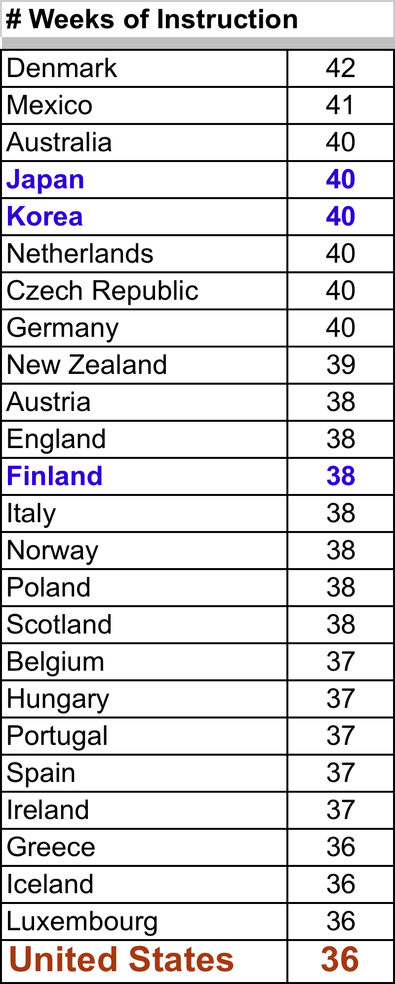
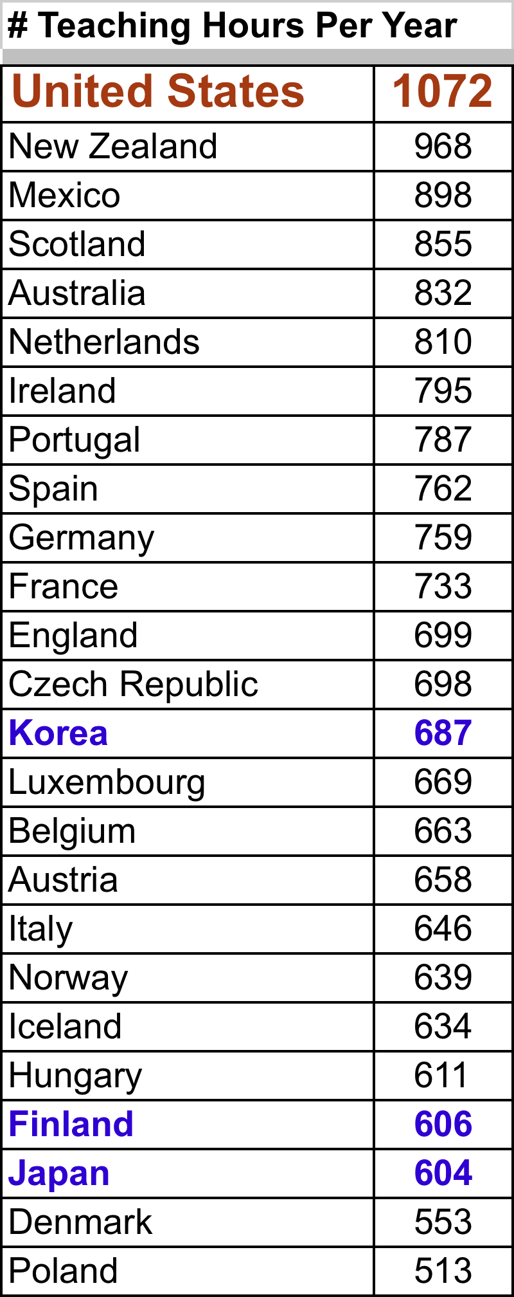

Slide 33
PISA Benchmarks for High Performing Education Systems
HIGH QUALITY
overall our system is performing poorly and not improving
HIGH EQUITY
there are significant inequities
HIGH EFFICIENCY
there are significant inefficiencies
HIGH ENGAGEMENT
there are significant barriers to engagement

Slide 34
Evolution is chaos with feedback.
John Ford, In Clifford A. Pickover, Computers, Pattern, Chaos, and Beauty (), 203.

Slide 35
Dramatic Shift Towards Feedback
We are finally starting to implement feedback systems.
2. We have enormous incentives for becoming more effective and efficient.
The greater the inefficiencies, the greater the potential for reform.
4. Race to the Top

Slide 36
Race to the Top
adopting internationally benchmarked standards and assessments that prepare students for success in college and the workplace.
recruiting, developing, rewarding and retaining effective teachers and principals
3. building data systems that measure student success and inform teachers and principals how they can improve their practices
4. turning around the country’s lowest-performing schools.

Slide 37
Today’s Presentations
Feedback as Education Reform: What We Know Jack States
Treatment Integrity as Focus for Feedback Ronnie Detrich
Seeking the Magic Metric: Using Evidence to Identify
and Track School System Progress Mary Beth Celio
Performance Feedback in Education:
On Who and For What Aubrey Daniels
Using Data to Improve Teacher Effectiveness Amanda VanDerHeyden

Slide 38
Thanks for Coming!

Slide 39
Benchmark: Equity (resources: California districts)
Return on Educational Investment: A district-by-district evaluation of U.S. educational productivity (January 2011)
“current expenditures” category (salaries, services, supplies)
excludes capital expenses
Adjusted Per Pupil Spending Range
$ 4,358 - $ 19,168

Slide 40
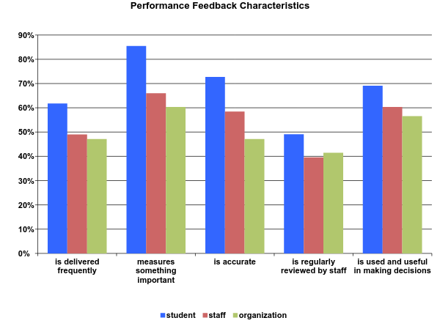

Slide 41
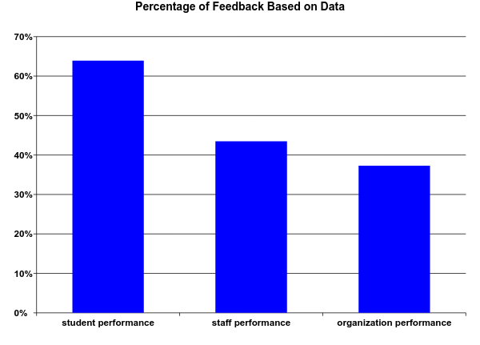

Slide 42
