Slide 1

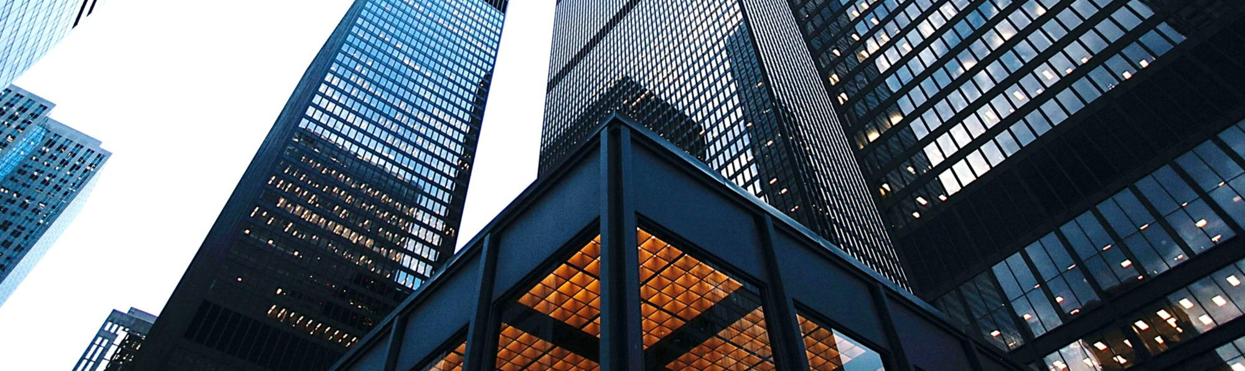
HOLDING
We use well-known development methodologies to create a customized approach for each of the projects. This allows us to achieve high quality outcomes and full transparency towards. Your content to play here, or through your copy,
We use well-known development methodologies to create a customized approach for each of the projects. This allows us to achieve high quality outcomes and full transparency towards. We use well-known development methodologies to create a customized approach for each of the projects. This allows us to achieve high quality outcomes and full transparency towards.
CORPORATION

Slide 2
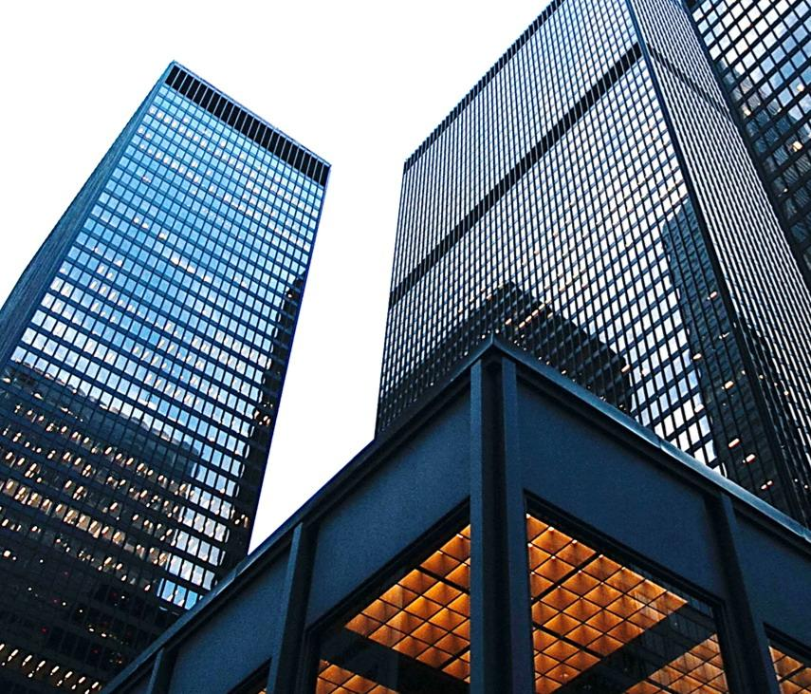
CONTENT
1
CITY
2
COUNTRY
3
REGION
4
WORLD

Slide 3
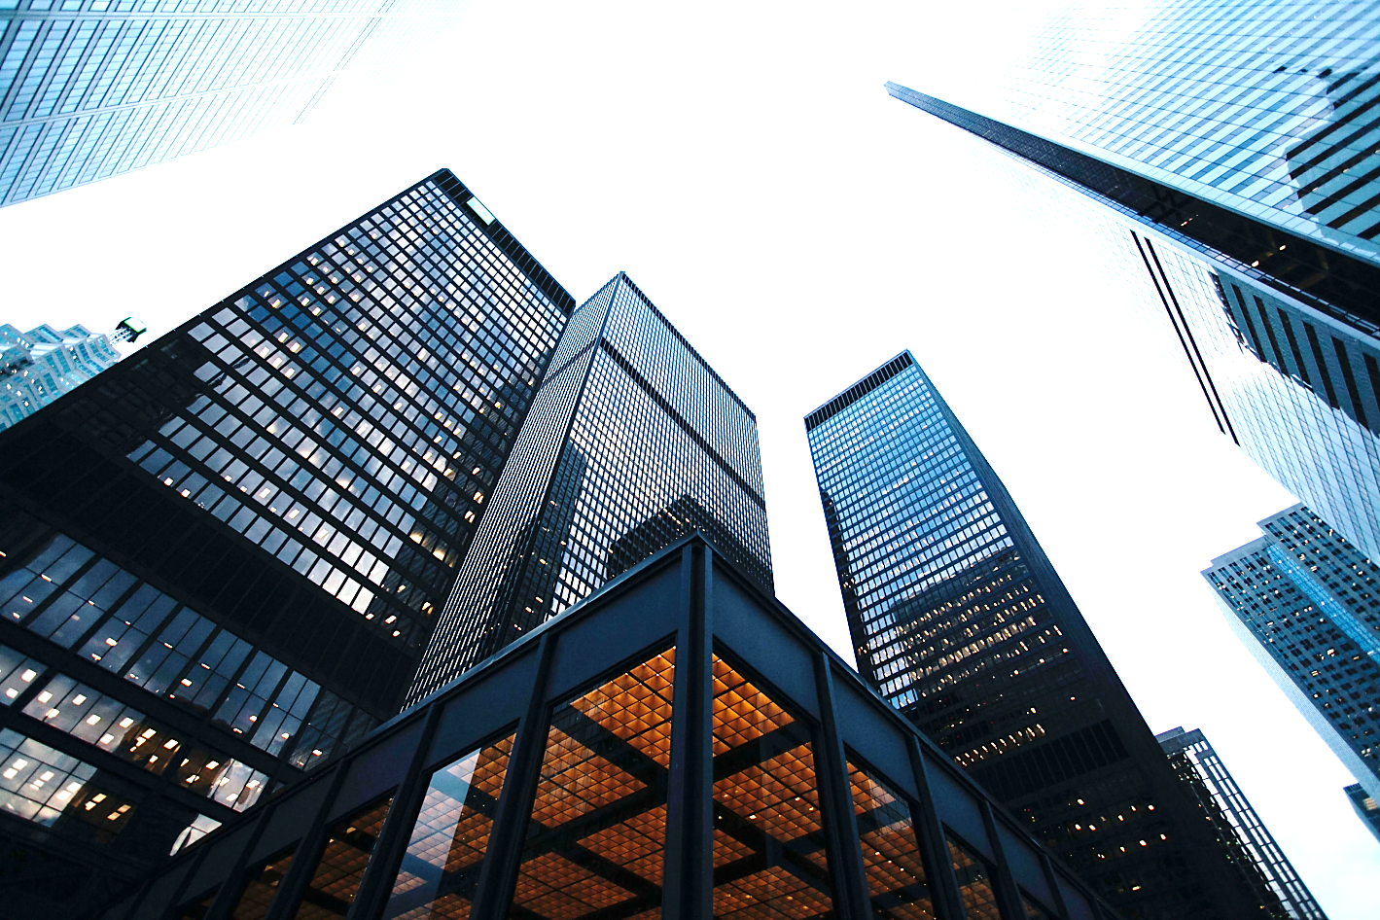
ONE
LOGO
CITY
THE SCENERY DESIGN
We use well-known development methodologies to create a customized approach for each of the projects. This allows us to achieve high quality outcomes and full transparency towards. We use well-known development methodologies to create a customized approach for each of the projects. This allows us to achieve high quality outcomes and full transparency towards.
We use well-known development methodologies to create a customized approach for each of the projects. This allows us to achieve high quality outcomes and full transparency towards. We use well-known development methodologies to create a customized approach for each of the projects. This allows us to achieve high quality outcomes and full transparency towards.

Slide 4
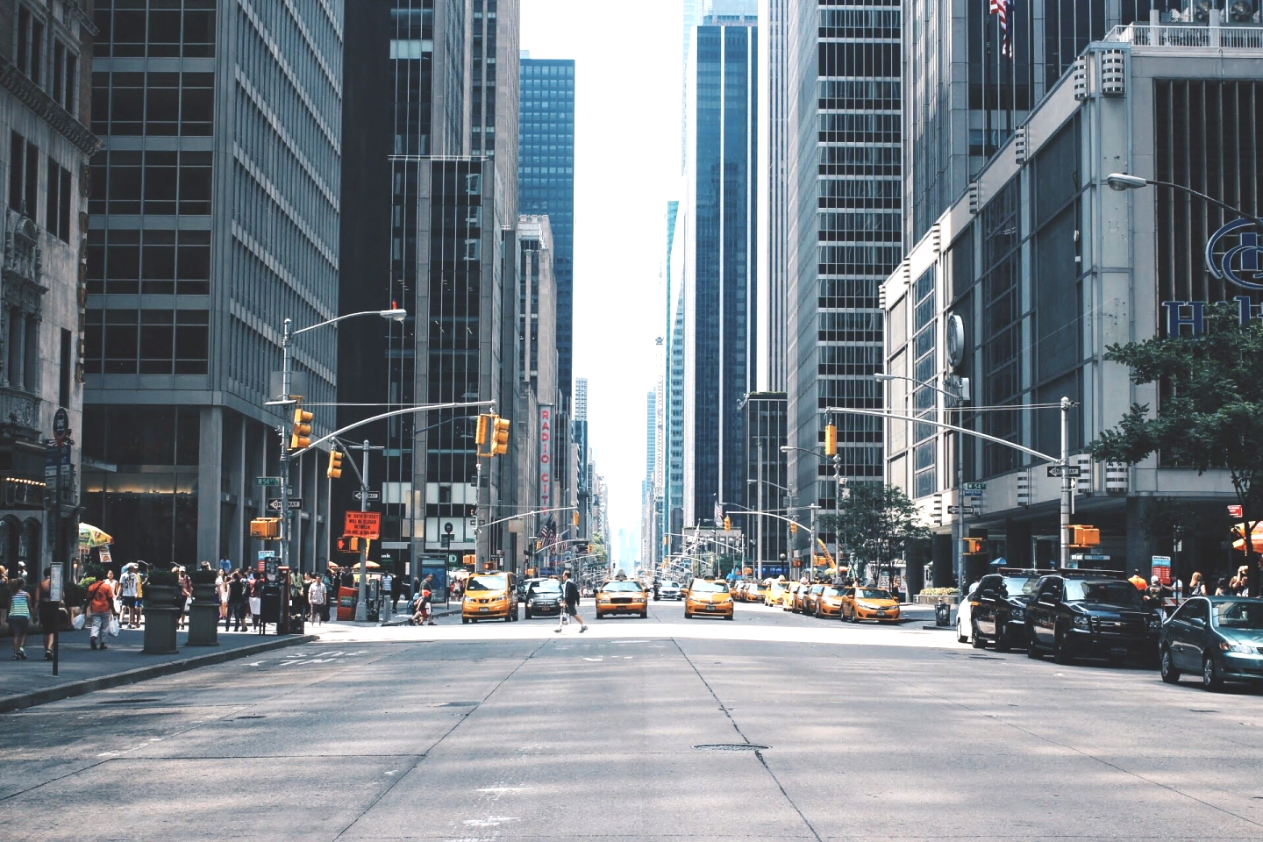
  TITLE HERE
We use well-known development methodologies to create a customized approach for each of the projects. This allows us to achieve high quality outcomes and full transparency towards. We use well-known development methodologies to create a customized approach for each of the projects. This allows us to achieve high quality outcomes and full transparency towards. We use well-known development methodologies to create a customized approach for each of the projects. This allows us to achieve high quality outcomes and full transparency towards. We use well-known development methodologies to create a customized approach for each of the projects. This allows us to achieve high quality outcomes and full transparency towards.
TITLE 01
We use well-known development methodologies to create a customized approach for each of the projects. This allows us to achieve high quality outcomes and full transparency towards.
TITLE 02
We use well-known development methodologies to create a customized approach for each of the projects.

Slide 5
  TITLE HERE
76%
48%
22%
22%
RATE
RATE
RATE
RATE
STEP 01
STEP 02
STEP 03
STEP 04
Go ahead and replace it with your own text.
Go ahead and replace it with your own text.
Go ahead and replace it with your own text.
Go ahead and replace it with your own text.
Go ahead and replace it with your own text.
Go ahead and replace it with your own text.
Go ahead and replace it with your own text.
Go ahead and replace it with your own text.
Go ahead and replace it with your own text.
Go ahead and replace it with your own text.
Go ahead and replace it with your own text.
Go ahead and replace it with your own text.

Slide 6
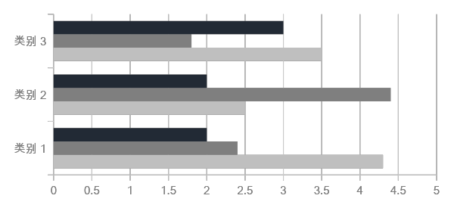
  TITLE HERE
A complex idea can be conveyed with just a single still image, namely making it possible to absorb large amounts of data quickly. A complex idea can be conveyed with just a single still image, namely making it possible to absorb large amounts of data quickly.
HEADER NAME
A complex idea can be conveyed with just a single still image, namely making it possible to absorb large amounts of data quickly.

Slide 7

  TITLE HERE
ADRESS
Add Content
1.
A complex idea can be conveyed with just a single still image, namely making it possible to absorb large amounts of data quickly.
2.
A complex idea can be conveyed with just a single still image, namely making it possible to absorb large amounts of data quickly.
3.
A complex idea can be conveyed with just a single still image, namely making it possible to absorb large amounts of data quickly.
TITLE HERE
A complex idea can be conveyed with just a single still image, namely making it possible to absorb large amounts of data quickly. A complex idea can be conveyed with just a single still image, namely making it possible to absorb large amounts of data quickly.

Slide 8
  TITLE HERE
  IMAGE 01
  IMAGE 02
  IMAGE 03
  IMAGE 04
I hope and I believe that this Template will your Time, Money and Reputation.
I hope and I believe that this Template will your Time, Money and Reputation.
I hope and I believe that this Template will your Time, Money and Reputation.
I hope and I believe that this Template will your Time, Money and Reputation.

Slide 9
TWO
LOGO
COUNTRY
THE SCENERY DESIGN
A complex idea can be conveyed with just a single still image, namely making it possible to absorb large amounts of data quickly. A complex idea can be conveyed with just a single still image, namely making it possible to absorb large amounts of data quickly.
A complex idea can be conveyed with just a single still image, namely making it possible to absorb large amounts of data quickly. A complex idea can be conveyed with just a single still image, namely making it possible to absorb large amounts of data quickly.

Slide 10
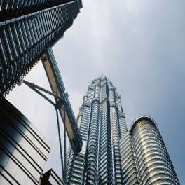
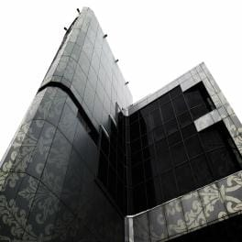

  TITLE HERE
Text
Text
Text
IMAGE 01
IMAGE 02
IMAGE 03
A complex idea can be conveyed with just a single still image, namely making it possible to absorb large amounts of data quickly.
A complex idea can be conveyed with just a single still image, namely making it possible to absorb large amounts of data quickly.
A complex idea can be conveyed with just a single still image, namely making it possible to absorb large amounts of data quickly.

Slide 11
  TITLE HERE
01
TITLE
02
TEXT
TEXT
A complex idea can be conveyed with just a single still image, namely making it possible to absorb large amounts of data quickly.
A complex idea can be conveyed with just a single still image, namely making it possible to absorb large amounts of data quickly.
TEXT
03
04
TEXT
A complex idea can be conveyed with just a single still image, namely making it possible to absorb large amounts of data quickly.
A complex idea can be conveyed with just a single still image, namely making it possible to absorb large amounts of data quickly.

Slide 12
  TITLE HERE
TEXT HERE
TEXT HERE
Go ahead and replace it with your own text.
Go ahead and replace it with your own text.
04
03
02
01
TEXT HERE
TEXT HERE
Go ahead and replace it with your own text.
Go ahead and replace it with your own text.

Slide 13
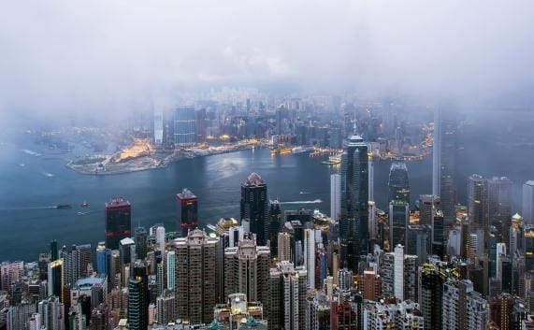
  TITLE HERE
STEP 01
Go ahead and replace it with your own text.
STEP 02
Go ahead and replace it with your own text.
STEP 03
Go ahead and replace it with your own text.
A complex idea can be conveyed with just a single still image, namely making it possible to absorb large amounts of data quickly. A complex idea can be conveyed with just a single still image, namely making it possible to absorb large amounts of data quickly. A complex idea can be conveyed with just a single still image, namely making it possible to absorb large amounts of data quickly.
STEP 04
Go ahead and replace it with your own text.

Slide 14
  TITLE HERE
TITLE HERE
TITLE HERE
TITLE HERE
TITLE HERE
A complex idea can be conveyed with just a single still image, namely making it possible to absorb large amounts of data quickly.
A complex idea can be conveyed with just a single still image, namely making it possible to absorb large amounts of data quickly.
A complex idea can be conveyed with just a single still image, namely making it possible to absorb large amounts of data quickly.
A complex idea can be conveyed with just a single still image, namely making it possible to absorb large amounts of data quickly.

Slide 15
THREE
LOGO
REGION
THE SCENERY DESIGN
A complex idea can be conveyed with just a single still image, namely making it possible to absorb large amounts of data quickly. A complex idea can be conveyed with just a single still image, namely making it possible to absorb large amounts of data quickly.
A complex idea can be conveyed with just a single still image, namely making it possible to absorb large amounts of data quickly. A complex idea can be conveyed with just a single still image, namely making it possible to absorb large amounts of data quickly.

Slide 16
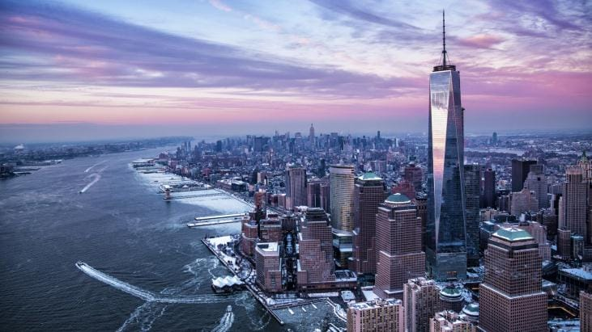
  TITLE HERE
CONTENT 01
A complex idea can be conveyed with just a single still image, namely making it possible to absorb large amounts of data quickly.
CONTENT 02
A complex idea can be conveyed with just a single still image, namely making it possible to absorb large amounts of data quickly.
CONTENT 03
A complex idea can be conveyed with just a single still image, namely making it possible to absorb large amounts of data quickly.
PROJECT NAME
CONTENT 04
A complex idea can be conveyed with just a single still image, namely making it possible to absorb large amounts of data quickly.

Slide 17
  TITLE HERE
TEXT
HERE
TEXT
HERE
TEXT HERE
I hope and I believe that this Template will your Time, Money and Reputation.
I hope and I believe that this Template will your Time, Money and Reputation.
TEXT
HERE
I hope and I believe that this Template will your Time, Money and Reputation.

Slide 18
  TITLE HERE
01
02
03
04
TITLE 01
I hope and I believe that this Template will your Time, Money and Reputation.
TITLE 02
I hope and I believe that this Template will your Time, Money and Reputation.
TITLE 03
I hope and I believe that this Template will your Time, Money and Reputation.
TITLE 04
I hope and I believe that this Template will your Time, Money and Reputation.

Slide 19

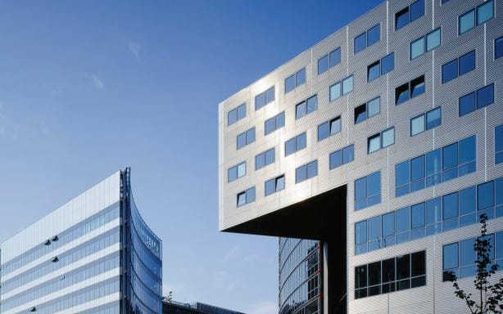

  TITLE HERE
We use well-known development methodologies to create a customized approach for each of the projects. This allows us to achieve high quality outcomes and full transparency towards.
IMAGE 01
We use well-known development methodologies to create a customized approach for each of the projects. This allows us to achieve high quality outcomes and full transparency towards.

Slide 20
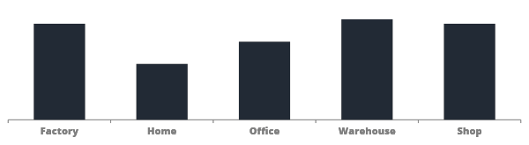
  TITLE HERE
45%
50%
48%
35%
30%
We use well-known development methodologies to create a customized approach for each of the projects. This allows us to achieve high quality outcomes and full transparency towards. We use well-known development methodologies to create a customized approach for each of the projects. This allows us to achieve high quality outcomes and full transparency towards.

Slide 21
FOUR
LOGO
WORLD
THE SCENERY DESIGN
We use well-known development methodologies to create a customized approach for each of the projects. This allows us to achieve high quality outcomes and full transparency towards.
We use well-known development methodologies to create a customized approach for each of the projects. This allows us to achieve high quality outcomes and full transparency towards.

Slide 22
  TITLE HERE
STAGE 02
I hope and I believe that this Template will your Time, Money and Reputation.
STAGE 04
I hope and I believe that this Template will your Time, Money and Reputation.
STAGE 01
I hope and I believe that this Template will your Time, Money and Reputation.
STAGE 03
I hope and I believe that this Template will your Time, Money and Reputation.

Slide 23
  TITLE HERE
67%
1,258
379
84%
NOTE 01
I hope and I believe that this Template will your Time, Money and Reputation. I hope and I believe that this Template will your Time, Money and Reputation.
NOTE 02
I hope and I believe that this Template will your Time, Money and Reputation. I hope and I believe that this Template will your Time, Money and Reputation.
NOTE 03
I hope and I believe that this Template will your Time, Money and Reputation. I hope and I believe that this Template will your Time, Money and Reputation.
NOTE 04
I hope and I believe that this Template will your Time, Money and Reputation. I hope and I believe that this Template will your Time, Money and Reputation.

Slide 24
  TITLE HERE
STAGE 01
STAGE 02
I hope and I believe that this Template will your Time, Money and Reputation.
I hope and I believe that this Template will your Time, Money and Reputation.
1
2
STAGE 04
4
3
STAGE 03
I hope and I believe that this Template will your Time, Money and Reputation.
I hope and I believe that this Template will your Time, Money and Reputation.

Slide 25
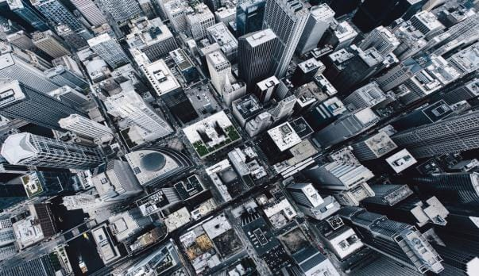
  TITLE HERE
”
We use well-known development methodologies to create a customized approach for each of the projects. This allows us to achieve high quality outcomes and full transparency towards.
”
I hope and I believe that this Template will your Time, Money and Reputation.
Go ahead and replace it with your own text.
Go ahead and replace it with your own text.

Slide 26
  TITLE HERE
TITLE 01
Go ahead and replace it with your own text.
TITLE 02
Go ahead and replace it with your own text.
TITLE 03
Go ahead and replace it with your own text.
TITLE 04
Go ahead and replace it with your own text.

Slide 27

THANKS!
Thanks to Freepptbackgrounds.net

Slide 28
FreePPTBackgrounds.net
Powerpoint Templates
Free Powerpoint Presentation Template (.PPTX)
You can upload Google Slides..
Google Slides
Select slide and edit your presentation
You can download and share your presentation!
Free Powerpoint Templates: https://www.freepptbackgrounds.net/browse
Abstract Powerpoint Templates: https://www.freepptbackgrounds.net/abstract
Animal and Wildlife Presentation: https://www.freepptbackgrounds.net/animals-wildlife
Love Powerpoint Templates: https://www.freepptbackgrounds.net/love
Business & Finance Google Slides: https://www.freepptbackgrounds.net/business-finance
Music Powerpoint Slides: https://www.freepptbackgrounds.net/music
Christmas Google Slides: https://www.freepptbackgrounds.net/christmas
Education Google Slides: https://www.freepptbackgrounds.net/education
Flowers Powerpoint Templates: https://www.freepptbackgrounds.net/flowers
Food and Drinks Slides: https://www.freepptbackgrounds.net/food-drink
Flags Powerpoint Templates: https://www.freepptbackgrounds.net/flags
Medical Google Slides: https://www.freepptbackgrounds.net/healthcare-medical
Nature Powerpoint Templates: https://www.freepptbackgrounds.net/nature
Religious Google Slides: https://www.freepptbackgrounds.net/religious
Sports Powerpoint Slides: https://www.freepptbackgrounds.net/sports
Technology Google Slides: https://www.freepptbackgrounds.net/technologies
Transportation Powerpoint Templates: https://www.freepptbackgrounds.net/car-transportation

