Slide 1



MENU
Free presentation template

Slide 2




MENU
APPETIZERS
SPECIALTIES
DESSERTS
Dish name
$56
Dish name
$56
Dish name
$56
The Extraordinary
The Extraordinary
The Extraordinary
Dish name
$56
Dish name
$56
Dish name
$56
The Extraordinary
The Extraordinary
The Extraordinary
Dish name
$56
Dish name
$56
Dish name
$56
The Extraordinary
The Extraordinary
The Extraordinary
Dish name
$56
Dish name
$56
Dish name
$56
The Extraordinary
The Extraordinary
The Extraordinary

Slide 3








MENU
Cake
Ice cream
Dish name
Dish name
$56
Many
$56
The Extraordinary
The Extraordinary
Dish name
Dish name
$56
$56
The Extraordinary
The Extraordinary
Dish name
$56
Smoothie
The Extraordinary
Dish name
$56
Dish name
$56
Dish name
$56
The Extraordinary
The Extraordinary
The Extraordinary
Dish name
$56
Dish name
$56
Dish name
$56
The Extraordinary
The Extraordinary
The Extraordinary

Slide 4



MENU
Top Beer
Our Special
Bottled Beer
Dish name
$56
Dish name
$56
Dish name
$56
The Extraordinary
The Extraordinary
The Extraordinary
Dish name
$56
Dish name
$56
Dish name
$56
The Extraordinary
The Extraordinary
The Extraordinary
Dish name
$56
Dish name
$56
Dish name
$56
The Extraordinary
The Extraordinary
The Extraordinary
Dish name
$56
Dish name
$56
Dish name
$56
The Extraordinary
The Extraordinary
The Extraordinary
Dish name
$56
Dish name
$56
Dish name
$56
The Extraordinary
The Extraordinary
The Extraordinary

Slide 5
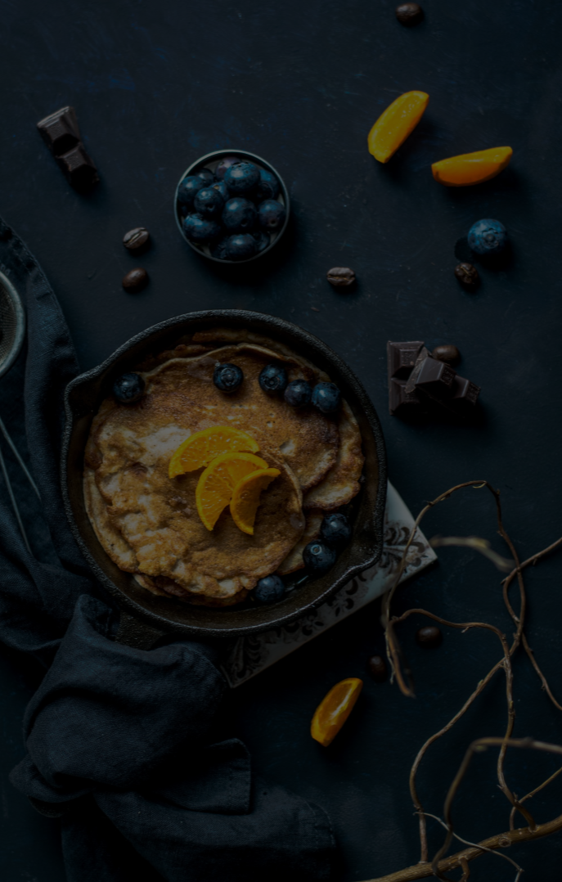



Appetizer
Dishes
Menu
Dish name
$56
Dish name
$56
The Extraordinary
The Extraordinary
Dish name
$56
Dish name
$56
The Extraordinary
The Extraordinary
Dish name
$56
Dish name
$56
The Extraordinary
The Extraordinary
Dish name
$56
Dish name
$56
The Extraordinary
The Extraordinary
Dish name
$56
Dish name
$56
The Extraordinary
The Extraordinary

Slide 6
MENU
MENU
FRESH
FROM
PRODUCTS
12PM - 10PM
123 Rustic Street, +11 234 567 890
APPETIZERS
DISHES
DRINKS
DISH NAME
$56
DISH NAME
$56
DISH NAME
$56
The Extraordinary
The Extraordinary
The Extraordinary
DISH NAME
$56
DISH NAME
$56
DISH NAME
$56
The Extraordinary
The Extraordinary
The Extraordinary
DISH NAME
$56
DISH NAME
$56
DISH NAME
$56
The Extraordinary
The Extraordinary
The Extraordinary
DISH NAME
$56
DISH NAME
$56
DISH NAME
$56
The Extraordinary
The Extraordinary
The Extraordinary
DISH NAME
$56
DISH NAME
$56
DISH NAME
$56
The Extraordinary
The Extraordinary
The Extraordinary

Slide 7

MENU
APPETIZERS
DISHES
DISH NAME
$56
DISH NAME
$56
The Extraordinary
The Extraordinary
DISH NAME
$56
DISH NAME
$56
The Extraordinary
The Extraordinary
DISH NAME
$56
DISH NAME
$56
The Extraordinary
The Extraordinary
DISH NAME
$56
DISH NAME
$56
The Extraordinary
The Extraordinary
DISH NAME
$56
DISH NAME
$56
The Extraordinary
The Extraordinary
DISH NAME
$56
DISH NAME
$56
The Extraordinary
The Extraordinary

Slide 8
Thank you for choosing EaTemp
We offer free and high-quality slides templates for your presentations. We appreciate you choosing us and hope our templates have been helpful.
As a new website, we rely on your support to grow, so please help us by sharing our site with your friends and colleagues.
Credit | Image: Unsplash

