Slide 1
Emerging Technologies and Accessibility: What’s Next?
Notes:
Good afternoon, everyone! Welcome to today’s session, Emerging Technologies and Accessibility: What’s Next? We’re so glad you’re here with us. My name is Terisa ODowd, and I’ll be kicking things off before turning it over to my amazing co-presenters.
In this session, we’ll explore how emerging technologies—especially artificial intelligence—are opening new doors for improving digital accessibility in higher education. We’ll focus on how faculty and staff can better support students with a range of disabilities by using these tools to create materials that are both inclusive and compliant with WCAG standards.
This is a 50-minute session, and each of us will speak for about 10 minutes. After our final presentation, we’ll reserve a few minutes for wrap-up and questions, so feel free to jot down anything you’d like to ask as we go.

Slide 2
Zoom Engagement Instructions
💬 Chat
👍 Reactions
📊 Polls
Notes:
Before we get started, a quick reminder about how we’ll be using Zoom:
💬 Chat – If you have comments, thoughts, or resources to share during the presentation, please use the chat! We encourage conversation.
👍 Reactions – Feel free to use the reaction icons—like thumbs up or clapping—to respond and show engagement.
📊 Polls – We won’t be using Zoom polls in this session, but we’d still love to hear from you in the chat.
And if at any point you have tech issues or need help, feel free to drop a message in the chat—we’ll do our best to assist you.
With that, let’s dive in. I’d like to welcome our first presenter, Audrey Lundahl, who will be sharing how AI technologies support accessibility for Neurodivergent Learners. Audrey, take it away!

Slide 3




Supporting Neurodiverse and Cognitive Learners
Audrey Lundahl, PhD
Instructional Designer
10 Minutes
Focused learning session
Cognitive Accessibility
AI tools that support attention, memory, and executive functioning

Slide 4
Neurodiversity
Neurodivergence: refers to divergence from what we assume is “typical.”
There is no “correct” way for the brain to function. The term neurodiversity supports the idea that there are diverse neurological structures and processes.

Slide 5
Neurodivergence
Autism Spectrum Disorder
ADHD (Attention Deficit Hyperactivity Disorder)
Dyslexia, dysgraphia, and dyscalculia
Tourette’s Syndrome
Obsessive Compulsive Disorder
Certain mental health conditions
Intellectual and developmental difference

Slide 6
Neurodivergence Considerations
(via Claude AI)
Neurodivergence is not inherently problematic: These are natural variations in human neurology, not deficits or disorders that need "fixing."
Strengths-based perspective: Neurodivergent individuals often possess unique cognitive strengths and perspectives that can be valuable in academic settings.
Social model of disability: Challenges faced by neurodivergent individuals often arise from environmental barriers rather than inherent limitations.
Individual variation: There's tremendous diversity within neurodivergent populations; no two individuals present exactly the same way.

Slide 7
Poll
Type in chat:
What do you think some of the most common barriers are for students who are neurodivergent?

Slide 8





Barriers Faced by Neurodivergent Students
EXECUTIVE FUNCTIONING
BARRIERS
INSTRUCTIONAL
BARRIERS
ENVIRONMENTAL
BARRIERS
ADMINISTRATIVE & STRUCTURAL
BARRIERS
SOCIAL & COMMUNICATION
BARRIERS
Rigid teaching methods that don’t accommodate different learners.
Fast-paced lectures without pauses for processing or clarification.
Heavy reliance on verbal instruction without visual supports.
Timed assessments that may not accurately measure knowledge.
Assumption of neurotypical social skills for group work or participation.
Sensory overload from noisy classrooms, bright lighting, or crowded spaces.
Physical classroom setups that dont’ accommodate sensory needs.
Lack of quiet spaces for decompression or focused work..
Unpredictable changes in routines, schedules, or expectations.
Complex bureaucratic processes for obtaining accommodations.
Stigma and skepticism when requesting support, especially for “invisible” conditions.
Inconsistent implementations of approved accommodations across courses.
Limited understanding of neurodivergence among faculty and staff.
Complex bureaucratic processes for obtaining accommodations.
Stigma and skepticism when requesting support, especially for “invisible” conditions.
Inconsistent implementations of approved accommodations across courses.
Limited understanding of neurodivergence among faculty and staff.
Complex bureaucratic processes for obtaining accommodations.
Stigma and skepticism when requesting support, especially for “invisible” conditions.
Inconsistent implementations of approved accommodations across courses.
Limited understanding of neurodivergence among faculty and staff.

Slide 9
How can AI help us better support neurodivergent students?
Help us understand different neurodivergences and accommodations
Customize content delivery (visuals, audio, text-based resources)
Create alternative assignments or assessment options
Enhance feedback or make it more accessible
Organize content with chunking or different structures
Scaffold assignments

Slide 10
Demonstration
Using Claude to turn a research assignment into a scaffolded assignments:
Starting Prompt: I am an instructor for an undergraduate women’s and gender studies intro-level class. For their final project, students must complete a social justice action project proposal. I would like to break the assignment into 3 scaffolded milestones that students will complete throughout the course. Please help me create 3 milestone assignments based on the final assignment.
Follow-up: Can you help me create alternative assignments for each of these milestones that would be accessible to neurodivergent students?

Slide 11
AI Tools to Support Neurodivergence
Claude AI: generates alternative assignments with simplified steps
Khanmigo: Offers scaffolded, structured tutoring in real-time
ChatGPT: Rewrites confusing instructions and offers structured outlines or step-by-step guides

Slide 12
Drawbacks and Considerations when using AI
Limited emotional intelligence
Missing cultural and individual context
Rigid communication
Lack of intuitive problem-solving
Ethical concerns around privacy and consent
May reinforce normative expectations

Slide 13

Supporting Deaf & Hard-of-Hearing Learners
Denise Arellano, PhD
Instructional Designer
10 Minutes
Focused learning session
Auditory Accessibility
Real-Time AI tools for Captioning and Transcriptions

Slide 14
Why Captions Matter
Captions are not ‘extra’ – they are essential for some students and useful for everyone!
They assist students who:
  Are D/deaf or hearing-impaired
  Study in noisy – or quiet – environments
  Learn better with text-support
  Need help with note-taking
  Are Non-native speakers

Slide 15
Real-time Captioning Tools
User-friendly and no-cost tools for real-time captions:
  Zoom
  Google Meets
  Microsoft Teams
  Otter AI
Webex, GoTo Meeting, and Skype also have auto-captioning

Slide 16
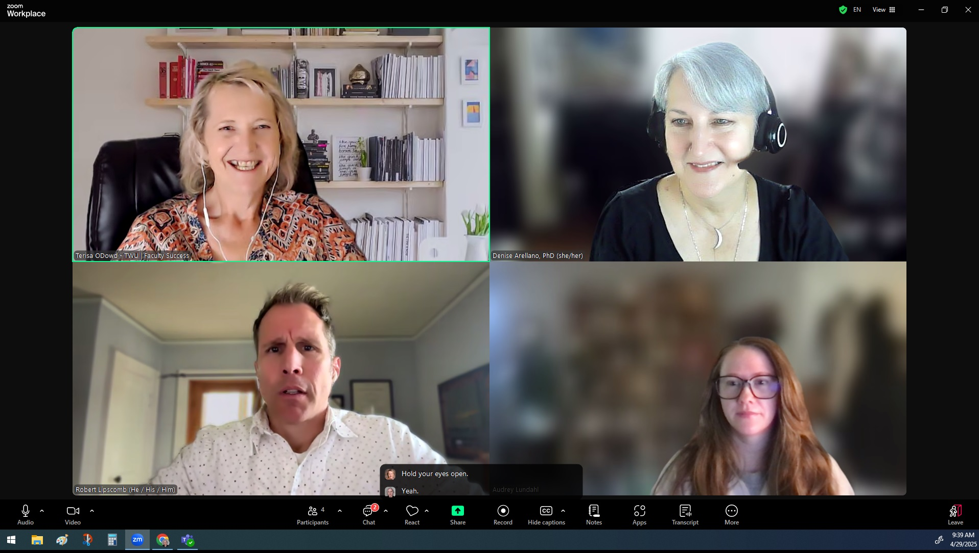
Zoom Live Captions

Slide 17
Otter.AI
Free version allows
Full transcriptions and summaries (online and F2F)
300 monthly transcription minutes
30 minutes per conversation
Import and transcription of 3 audio or video files per user (total)
Translations – English French, and Spanish

Slide 18
Captioning Video Recordings
Zoom Cloud Recordings
Microsoft Stream (in Teams)
YouTube auto-captions
Most video software has editable auto-captioning (Panopto, Kaltura, ScreenPal, CapCut, etc.)

Slide 19
Transcribing Audio
Upload recordings
Otter.ai – upload (monthly limit)
Microsoft Word Online: Dictate> Transcribe – upload (monthly limit)
YouTube auto-captioning – upload
Google Docs hack – use Tools>Voice Typing

Slide 20
Real-time Captions In-person
What if your student’s ASL interpreter is not in class?
Google Live Transcribe (Android)
iOS Live Captions (Apple; iOS 16+)
Otter.ai
Webcaptioner.online

Slide 21
Real-time Captions WITH Translations
Microsoft Translator
Google Translate – Conversation Mode
Zoom Live Translated Captions (paid)
Otter.ai (English, Spanish, French)
Webcaptioner.online (English, Spanish, Portuguese)

Slide 22
How to choose a tool
Live event or recorded media
Online or in-person
Temporary or saved
Captions or translated captions
Who is making the arrangements?

Slide 23
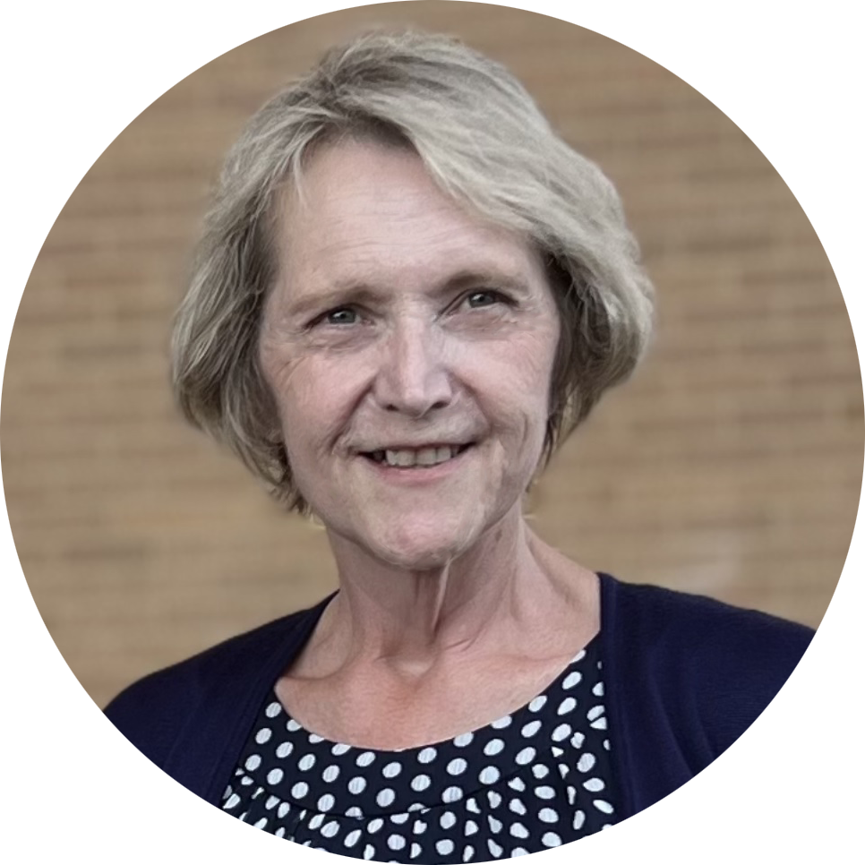

Supporting Blind and Low-Vision Learners
Terisa O’Dowd, PhD
Instructional Accessibility Designer
10 Minutes
Focused learning session
Visual Accessibility
AI tools that read content aloud, generate alt text, and support screen reader and text-to-speech access
Notes:
Thank you, Denise. Well, hello again everyone. I am Terisa ODowd. In the next 10 minutes, I’ll introduce AI tools that support visual access for students — not just those who are blind or have low vision, but also learners with cognitive, language, or attention-related challenges. We'll go beyond just 'what AI can do' and focus on how faculty can use these tools in smart, inclusive ways.”

Slide 24





What We’ll Cover
AI Tools for Alt Text
Explore cutting-edge technologies that generate descriptive alt text.
Text-to-Speech Solutions
See real examples of AI-powered audio alternatives.
Universal Benefits
Discover how these tools help all types of learners.
Actionable Strategies
Learn practical approaches you can implement immediately.
Notes:
What We’ll Cover
This slide outlines our roadmap for today’s session. In the first section, I’ll introduce AI tools that generate high-quality alt text — helping translate visual content into inclusive language. Next, we’ll explore how AI-powered text-to-speech tools support audio-based learning. From there, I’ll show how these technologies benefit not just students with visual disabilities, but learners with diverse needs. And finally, we’ll end with practical, low-lift strategies you can take back to your courses — no tech background required.
Alt Text, OCR & Scene Description
"First, we have AI tools that translate visual information into accessible content. These include technologies like alt text generators, optical character recognition or OCR, and scene description tools. For example, Microsoft’s Alt Text Generator can describe an image in a Word or PowerPoint document, while Adobe OCR can extract readable text from a scanned PDF. Tools like Seeing AI and Be My AI go even further by interpreting scenes, people, and objects in real time to support learners who are blind or have low vision.“
Text & Video Narration Tools
"Next are tools that give voice to both static and moving content. Text-to-speech tools like Microsoft Immersive Reader or Google Text-to-Speech help students hear written content. When it comes to videos, platforms like Panopto and Cielo24 support audio descriptions that narrate key visual elements, helping students who can’t see the screen still follow along with instructional videos. Murf.ai even provides natural-sounding narration for custom audio needs.“
Navigation & Object Detection
"These AI technologies help students interpret their physical surroundings. Apps like Be My Eyes and Google Lookout provide real-time guidance for moving through spaces or identifying objects in the environment. TactileNet can even convert images into tactile graphics, making diagrams accessible to touch. These tools open up classrooms, campuses, and digital spaces in ways that were once unimaginable.“
Voice Navigation & Control
"Finally, voice-enabled tools allow students to interact with content and technology without needing to touch a screen or keyboard. Assistants like Siri, Alexa, and Google Assistant can answer questions, launch apps, or even read content aloud. Paired with tools like IFTTT, students can automate tasks, access learning platforms, and control smart environments using only their voice—supporting independence and accessibility."

Slide 25
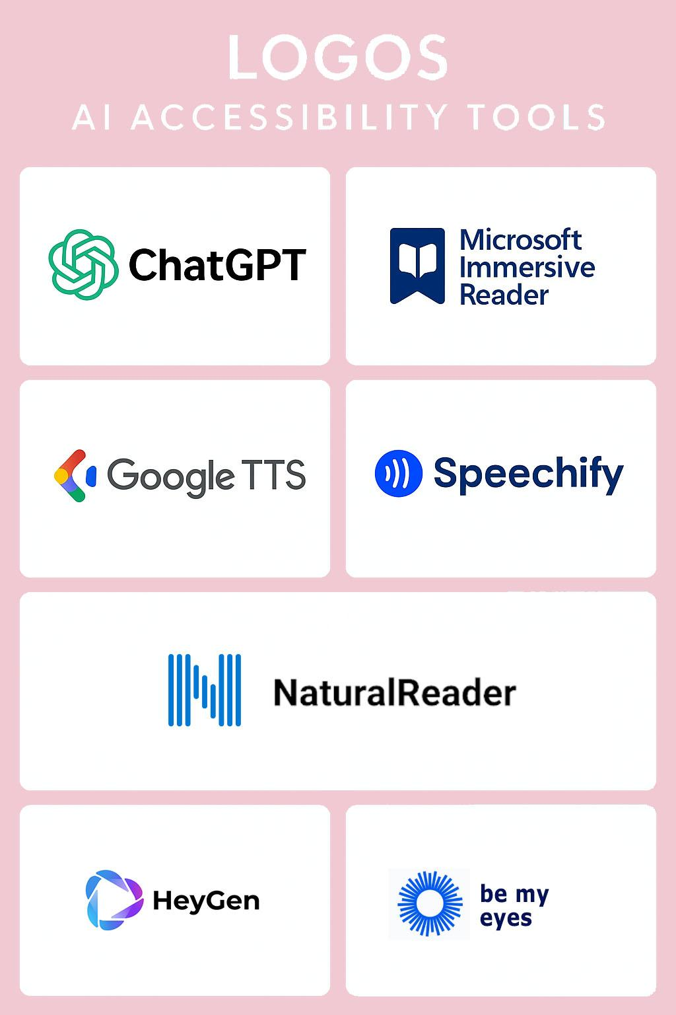
AI Tools & What They Do
Tool | Function | Type of AI
ChatGPT | Generates alt text, explains visuals | Generative LLM
Immersive Reader | Reads aloud text, spacing, grammar tools | Azure AI
Be My Eyes + GPT-4 | Real-time image description | Visual LLM (GPT-4 Vision)
Google TTS | Text-to-speech synthesis | Speech AI
Speechify / NaturalReader | Coverts documents to audio | Speech synthesis
HeyGen | AI avatars for verbal and visual delivery | Generative video AI
Notes:
This grid can feel overwhelming, so here’s the shortcut: think use-case first. For example, want to convert text to speech? Immersive Reader does that instantly. Need real-time object descriptions? Try Seeing AI. Looking for narrated videos with accessibility baked in? Cielo24 captions, transcribes, and describes scenes. Think less about the tool's name and more about what barrier it removes for your learner.

Slide 26
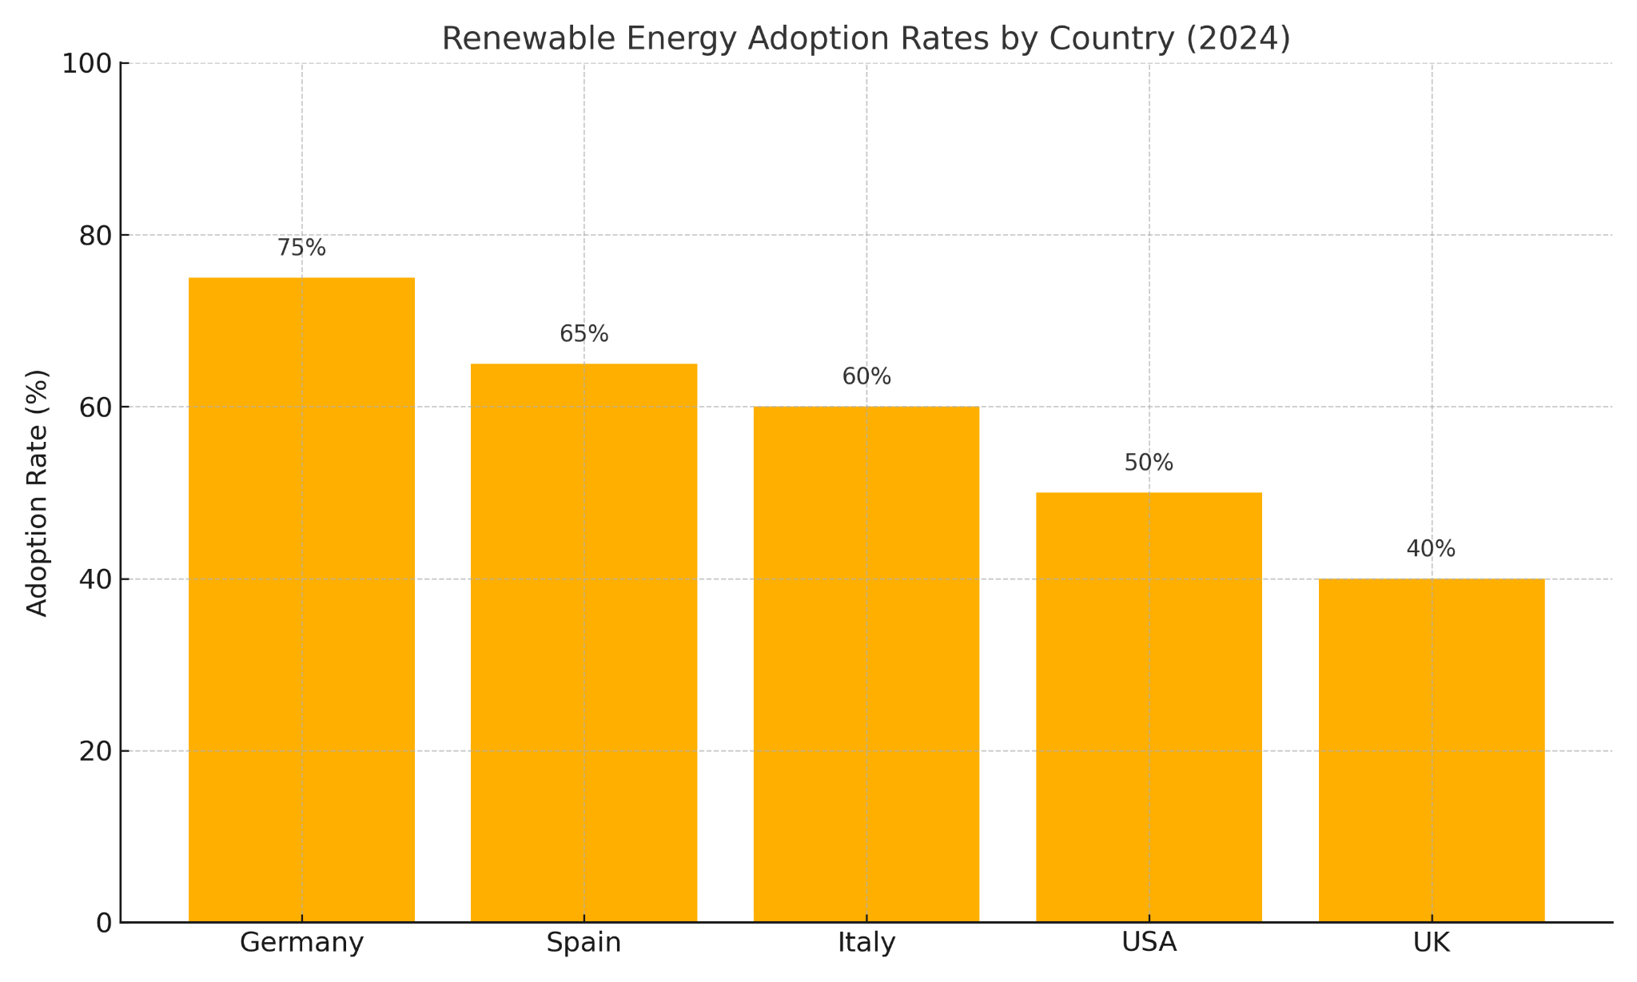
Demo: AI for Alt Text
Notes:
Let’s look at alt text — where AI both shines and stumbles. Let’s start with this image (image of graph). I will copy this image into ChatGPT and ask it to help me write a description for this image for alt text.
Here is what we get: ‘Graph showing data.’ No detail. No insight. A blind student hears this and moves on confused.
Now lets’ try a little prompt engineering: I have attached an image of a graph to this message. Can you help me write a helpful, engaging, and visually descriptive image alt tags for this image. The description should meet WCAG 2.1 AA-standards. You need to describe the contents of the image so that a blind student using a screen reader will understand the purpose of the image. The description in the alt text should be 120 characters or less. If any text appears in the image, please include that in the alt text description.
Now contrast that with: ‘Bar graph comparing renewable energy adoption across 5 countries.’ Specific. Informative. AI like ChatGPT or Adobe OCR can help us get closer to that, but it still needs a human editor. The trick? Ask: Would I understand this if I couldn’t see it?
Poor: Graph showing data
•Lacks specific details
•Misses key information
•Excludes visually impaired users
Effective: Bar graph comparing renewable energy adoption across 5 countries
•Describes content completely
•Includes relevant data points
•Maintains context and meaning
Mind: “Bar graph of five countries showing Germany (75%) leads in renewable energy, followed by Spain (65%), Italy (60%), the US (50%), and the UK (40%).”

Slide 27
Final Alt Text
Bar graph of five countries showing Germany (75%) leads in renewable energy, followed by Spain (65%), Italy (60%), the US (50%), and the UK (40%).
Notes:
And this slide shows my final alt text for the image which combines the prompt engineering, and my inputBar graph of five countries showing Germany (75%) leads in renewable energy, followed by Spain (65%), Italy (60%), the US (50%), and the UK (40%).

Slide 28
Beyond Visual Impairment: Universal Access
ESL Students
Improve comprehension through read-aloud features and text highlighting.
Dyslexic Students
Supporting decoding and retention with customized text spacing and audio.
ADHD Students
Allow self-pacing and focus via audio mode and visual simplification.
Cognitive Disabilities
Simplify reading demands with clear speech and structured content.
Students in Challenging Environments
Access content without relying on audio or high-speed connections.
Notes:
These tools aren’t just for students with vision disabilities. Text-to-speech supports ESL learners by reinforcing language patterns. Dyslexic students benefit from audio plus custom spacing. For ADHD, narration helps with focus. Even in noisy dorms or low-bandwidth areas, these tools make content accessible. That’s the universal design mindset: design for one, benefit many.

Slide 29








Let's Reflect Together
Visual Support
Where could alt text help visual learners?
Audio Learning
When would text-to-speech benefit your students?
Cognitive Support
How might these tools aid information processing?
Language Support
Which ESL scenarios could these tools address?
Notes:
“Let’s make this interactive! I’ll ask four quick questions — just give a thumbs-up 👍 or thumbs-down 👎 in Zoom if you agree or not:
1.Could your content use better alt text?
2.Have you used TTS in your teaching yet?
3.Can you see these tools helping ADHD or ESL learners?
4.Will you try one of these tools in your next course?
Thanks for participating — that feedback shapes what we share!

Slide 30
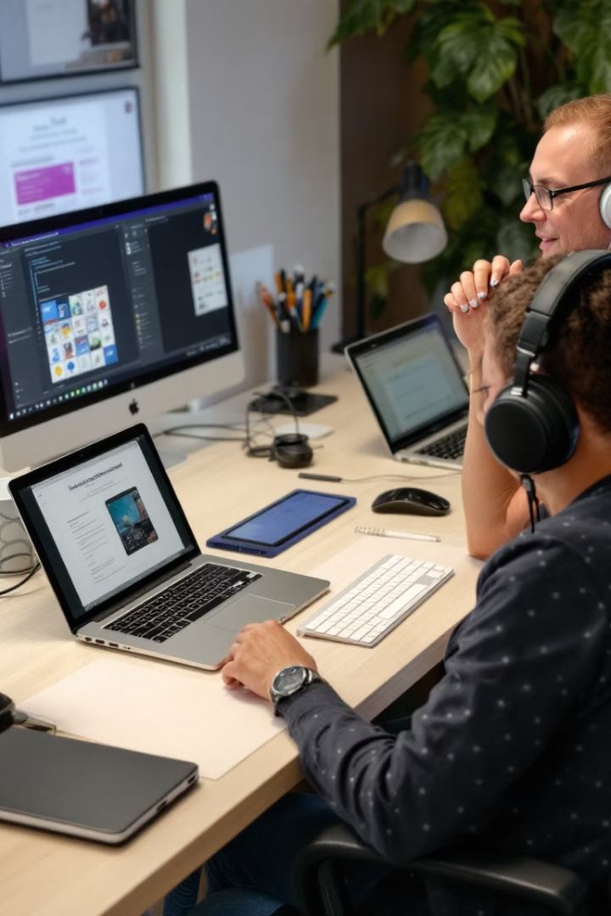




Visual Accessibility AI Cheat Sheet
Tools You Can Explore Today
ChatGPT
Generate descriptive alt text for complex images
https://chat.openai.com
Be My Eyes
Real-time visual assistance with GPT-4 integration
https://www.bemyeyes.com
Microsoft Immersive Reader
Text-to-speech and reading assistance tools
Microsoft Learn
Download our quick reference guide
Notes:
Here are tools you can try now. ChatGPT can write alt text for complex images — just paste the image description or file. Be My Eyes uses AI vision to help blind users in real time. Immersive Reader reads aloud, highlights, and simplifies text. Think of this as your ‘starter pack’ — pick one and test it with your course content this week.

Slide 31




AI Accessibility Pitfalls to Avoid
Inaccurate Alt Text
Robotic Text-to-Speech
AI tools may mislabel images or miss important context in alt text.
TTS voices often lack clear emotion or clarity.
Inaccessible AI Tools
Avoid the Auto-Pilot Trap
MSome AI tools themselves are not accessible, limiting usability. This creates barriers for those who need them most.
Avoid over-reliance on AI to preserve human nuance and insight. Always verify AI content for accuracy and inclusiveness.
Notes:
Let’s be honest: AI isn’t perfect. It can mislabel images or give vague alt text. TTS voices can be robotic. And some tools aren’t accessible themselves — ironic, right? The key: don’t set it and forget it. Faculty need to review AI output, test it with students, and supplement it with human insight.

Slide 32
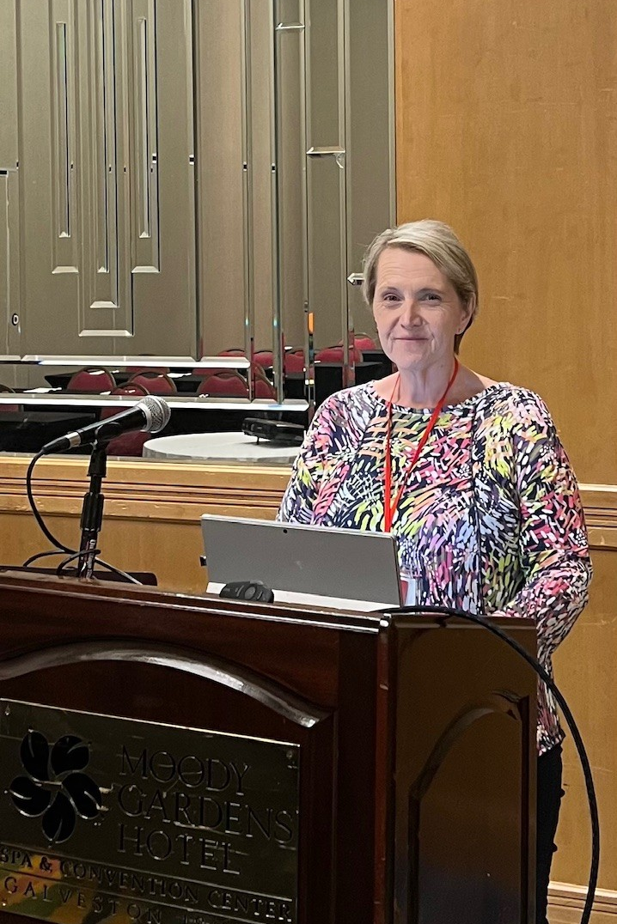
Stay Connected
Reach Out
Contact Terisa O’Dowd with your questions
and insights.
Implement Tools
Start using one accessibility tool in your next lesson plan.
Share Results
Let us know how these tools impact your students' learning.
Continue Learning
Join our upcoming accessibility workshops throughout the year.
Notes:
If something today sparked a new idea, I’d love to hear about it. Try one tool. Tell me what you find. And if you want to go deeper, we host accessibility workshops year-round. Let’s keep the momentum going.
Now, we will hear from my colleague Robert Lipscomb about AI Tools that can help students with learning disabilities.

Slide 33

Supporting Students with Text Comprehension Needs
Robert Lipscomb
Instructional Designer
10 Minutes
Focused learning session
Text Accessibility
AI tools that simplify complex text for better understanding
Notes:
Good afternoon! My name is Terisa O’Dowd, Instructional Accessibility Designer. In the next 10 minutes, I’ll introduce AI tools that support visual access for students — not just those who are blind or have low vision, but also learners with cognitive, language, or attention-related challenges. We'll go beyond just 'what AI can do' and focus on how faculty can use these tools in smart, inclusive ways.”

Slide 34
What?
Chunking: Breaking long or complex texts into smaller pieces to make them more manageable for students.¹
  Text: Break into sections and subtopics with short paragraphs and headings
  Video: Create short (<15 min) videos, each addressing a specific concept or skill.²
  Module, Activity, or Project: Break into separate, focused tasks or activities with their own instructions, due dates, rubrics, etc.
Simplifying: Using clear, concise language to reduce cognitive load, especially if information matters more than style of delivery.
Summarizing: Condensing content to highlighting key points.
Notes:
REDUCES COGNITIVE OVERLOAD (FACILITATES Short-Term Memory Storage and Transfer to Long-Term).
If style, academic jargon are not the priority, but only concepts and information.
1 Barrera et al., 2006; Gilchrist & Cowan, 2012; Thalmann, Souza, & Oberauer, 2018.
2 Berg et al., 2014.
Note: “Chunking and Questioning Aloud” (CQA) “bears a strong resemblance to what is commonly known in the teaching literature as a ‘Directed Reading Thinking
Activity’ or DRTA…. In the DRTA, the teacher chooses a text at the student’s instructional level and divides it into chunks of varying lengths to maintain reader interest. The students then set the purpose for reading by making predictions about the individual chunks of text…. The DRTA and a teacher-led variant, Directed Listening and Thinking Aloud (DLTA) are widely recommended in the popular teaching literature. Organizations as diverse as the National Urban Alliance for Effective Education (n.d.); The Education Alliance (n.d.); The Northwest Educational Laboratory (NWREL, n.d.); and the United Nations Educational, Scientifc and Cultural Organization (UNESCO, n.d.) mention DRTA on lists of recommended instructional strategies” (Barrera et al., 2006).

Slide 35
For Whom? Why?
Students with disabilities:
Dyslexia
  Chunking prevents cognitive overload and stress.
  Simplifying facilitates comprehension.³
Dysgraphia
  Simplifying and organizing instructions reduces frustration.⁴
ADHD/Executive Functioning Challenges
  Chunking large multi-step activities or projects allows these students to begin, focus on, and complete each step at a time.
Visually Impaired
  Heading structure allows keyboard navigation and screen reader functionality.
Notes:
Dyslexic students struggle with decoding and processing written language. Chunking prevents overload and stress; simplification facilitates comprehension.
Dysgraphic students struggle with written expression. Simplified, structured instructions reduce frustration.
ADHD / EF students have trouble organizing, prioritizing, and completing multi-step tasks due to focusing challenges. Chunking supports task initiation and sustained attention.
3 Thalmann, Souza, & Oberauer, 2018; Durand, 2023, p. 56 (“Part of implementing the Universal Design for Learning approach is preparing tutors to accommodate a range of learning disabilities, exceptionalities, and cultures. It is important for tutors to understand common characteristics of dyslexic writers and strategies for working with them. Effective strategies include repeating explicit instruction, emphasizing phonetics, and mind mapping/chunking information. This project is focused on helping secondary writing center tutors and faculty to feel they have enough knowledge about dyslexia to help students who choose not to disclose their disability and offer strategies that they may utilize when working with dyslexic students. Furthermore, this project affirms the importance of creating an equitable learning environment for all students who seek the support of a writing center.”)
4 The chunking of a research paper or large project—or the clearly delineated and focused steps required to successfully complete it—is the idea behind scaffolding concepts, skills, and activities to ensure success. “Scaffolding is a similar concept addressing the pedagogy of your assignments and assessments: breaking them into smaller, cooperative pieces that provide opportunities for formative assessment and facilitate students achieving the learning goals you intend” (Chunking, 2025).

Slide 36
Who Else Benefits?
English Language Learners (ELLs)
  Chunking and simplifying academic vocabulary and concepts accelerates learning.⁵
1st Gen and Underprepared College Students
  Modeling how to manage complex academic tasks promotes equity and success.
Neurodivergent Students
  Explicit, highly structured presentation of content and tasks promotes success.
High-Achieving Students
  Chunking helps students who are overwhelmed or struggling with unfamiliar academic content.⁶
Notes:
ELLs: Simplified language and clear structure make academic vocabulary and concepts easier to understand.
1st Gen/Underprepared: Chunking and summarizing skills model effective study strategies for managing complex academic tasks with which they may be unfamiliar, promoting equity.
Neurodivergent: Autistic learners who process information differently, for example, may benefit from explicit, highly structured presentation of content and tasks.
High-Achieving: Any students experiencing stress, burnout, or unfamiliar academic content.
5 Barrera et al., 2006; Lin, Yang, & Huang, 2023.
6 Generative AI tools that chunk, simplify, and summarize content align perfectly with UDL principles by providing multiple means of engagement, representation, and action/expression:
It can be used to personalize learning. AI can help you tailor your content to individual student needs and learning styles, based on AI-driven analytics that give you insight into student performance and learning trends. In this way, AI helps students be more engaged and motivated.
It can be used to create and supplement content. Through AI-powered platforms, you can create lessons, activities, assessments, discussion prompts, and presentations simply by providing a short prompt with keywords.
It can result in more inclusive lessons. AI has powerful tools that make previously inaccessible material available to students with special needs. Tools that offer text-to-speech, visual recognition, speech recognition, and more can help teachers adapt resources so that all students have an equal learning opportunity.
It can provide greater access to resources. Educators can access a wealth of AI-powered platforms to facilitate and enhance the learning that takes place in their classrooms (“AI in Schools,” 2024).

Slide 37
How? FREE Gen AI Tools
Open AI’s ChatGPT
  Free Tier
  All of these, for reading/studying as well as writing assistance.
Google’s NotebookLM
  Students need Google Account/Institutional Access, but most should have that.
  Summarizing, synthesizing articles/research and organizing notes.
Explainpaper
  Highlight text in a scholarly article and it explains it in simpler language. (DL/EF)
TLDR This
  Reading/Summarizing assistance. (DL/EF)
Perplexity AI or Scite AI
  RAG or Grounded tools that are best for researching a topic and synthesizing and organizing information with citations and links to sources. (EF/ADHD)⁷
Notes:
These are especially useful and beginner-friendly for university students to chunk, simplify, and summarize complex academic texts and instructions.
Perplexity AI is less formal but has a good free version; Scite AI has a paywall but uses and compiles more scholarly sources.
7 RAG/Grounded definition is from Boston University’s Libraries website: library.bu.edu/gen-ai/comparing-gen-ai-tools (Comparing Generative AI Tools, 2025).

Slide 38
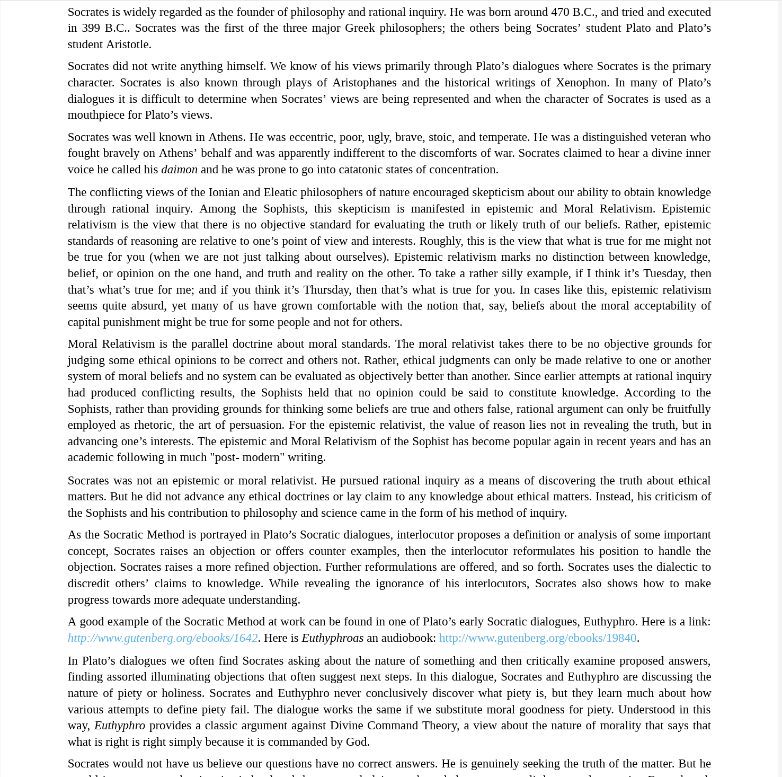
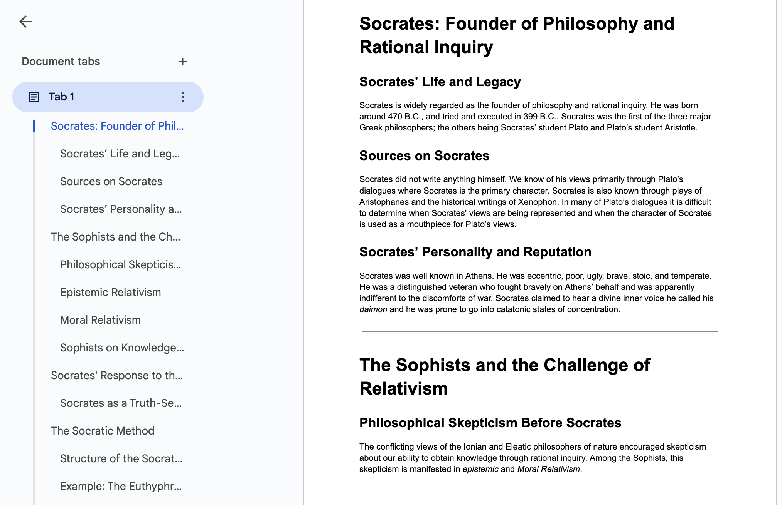
ChatGPT to Chunk: “Below is a lecture on [Socrates]. Would you please chunk it with section and/or subsection headings, like textbooks often do but without removing any sentences or words, to make it more digestible and navigable for students with learning disabilities? Here is the lecture:”
Heading Structure
Notes:
Prompt Engineering Tip: Use words or phrases like “verbatim,” “word for word,” or “without removing any words or sentences.”

Slide 39
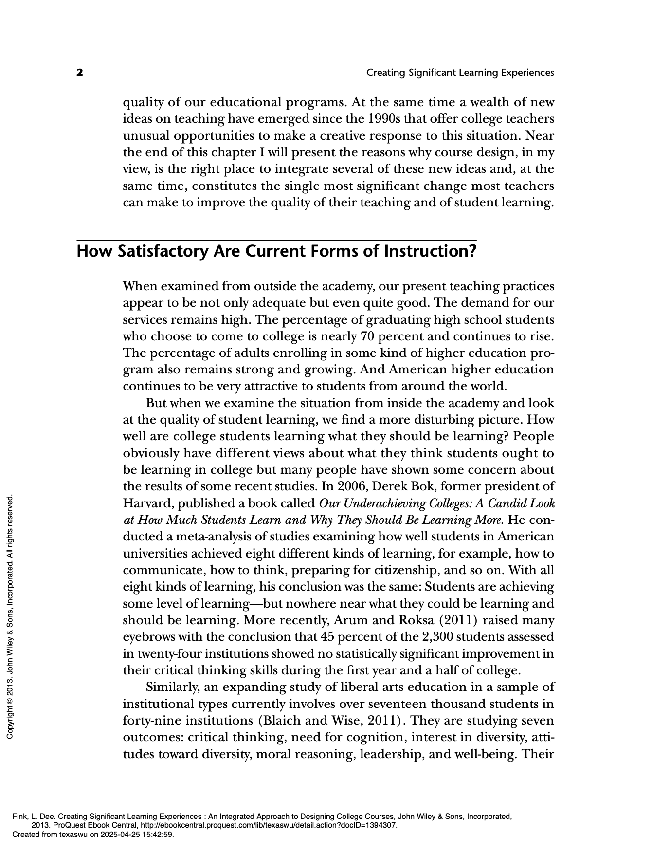
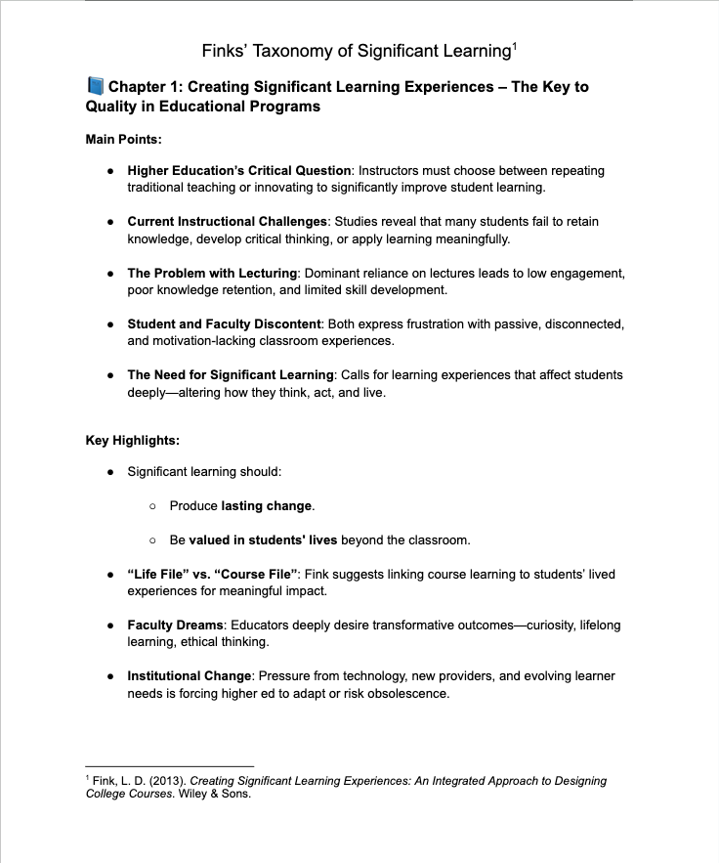
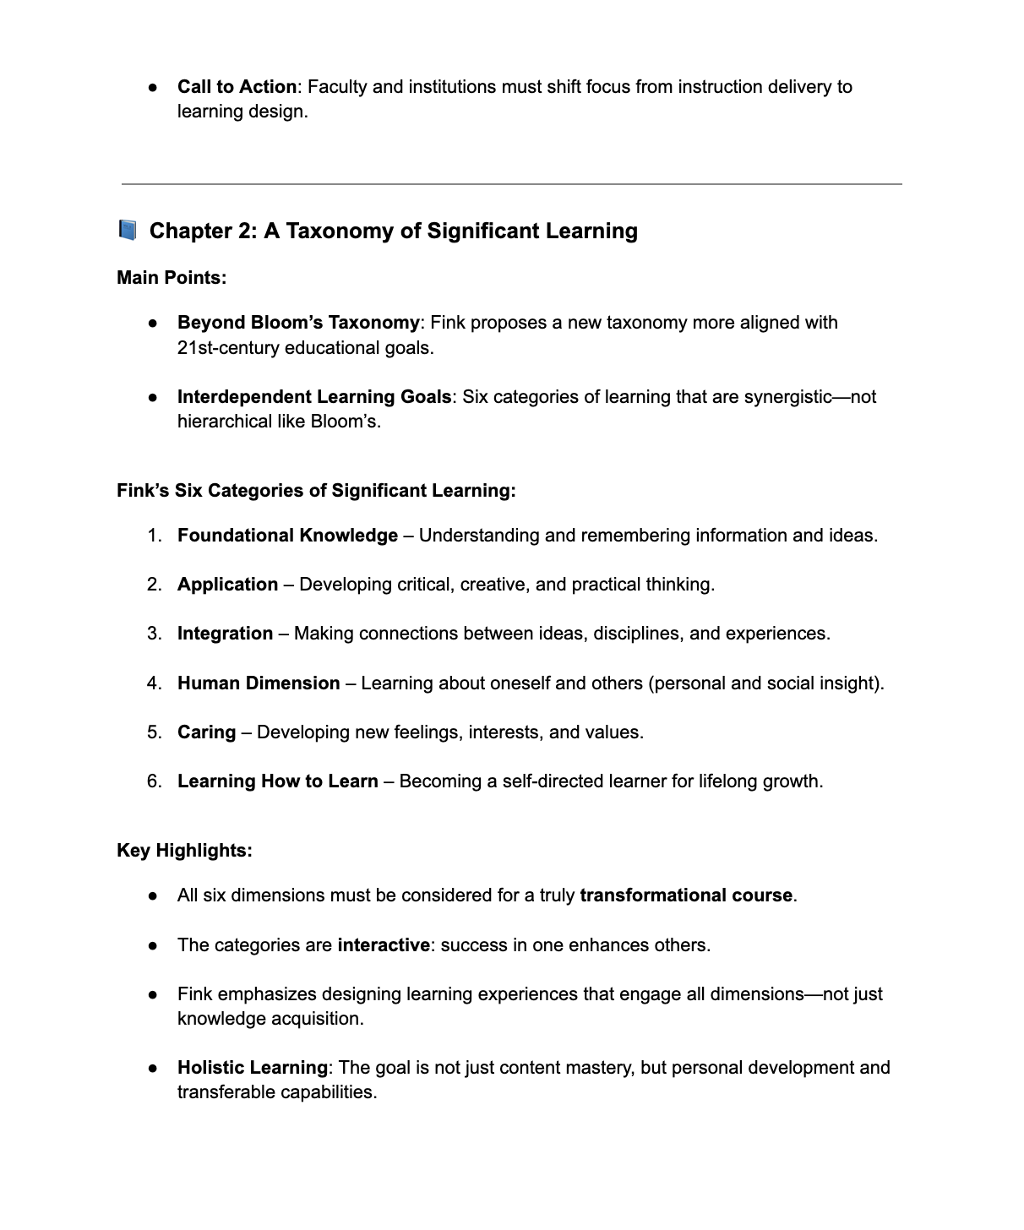
Summarizing
ChatGPT to Summarize: “Hi! Can you please read these two chapters and create a page of notes for each listing the author's main points and key highlights?
Notes:
Fink, L. D. (2013). Creating Significant Learning Experiences : An Integrated Approach to Designing College Courses. John Wiley & Sons. ProQuest Ebook Central. http://ebookcentral.proquest.com/lib/texaswu/detail.action?docID=1394307.
COPYRIGHT CONSIDERATION: This particular use scenario, an instructor or student’s use of AI generation tools to summarize two chapters of an academic textbook, broaches the subject of copyright concern. Please see Legal Considerations for Using Copyrighted Material with AI Tools. Basically, Fair Use Doctrine and court precedent regarding use of copyrighted material with AI for chunking, summarizing, and simplifying, as well as even for intentional AI LLM training, appears to permit this. The key sticking points seem to be whether and to what degree AI tools are citing the works from which they draw outputs (which they should) and the unlikely output that very closely matches copyrighted work with no acknowledgement.

Slide 40
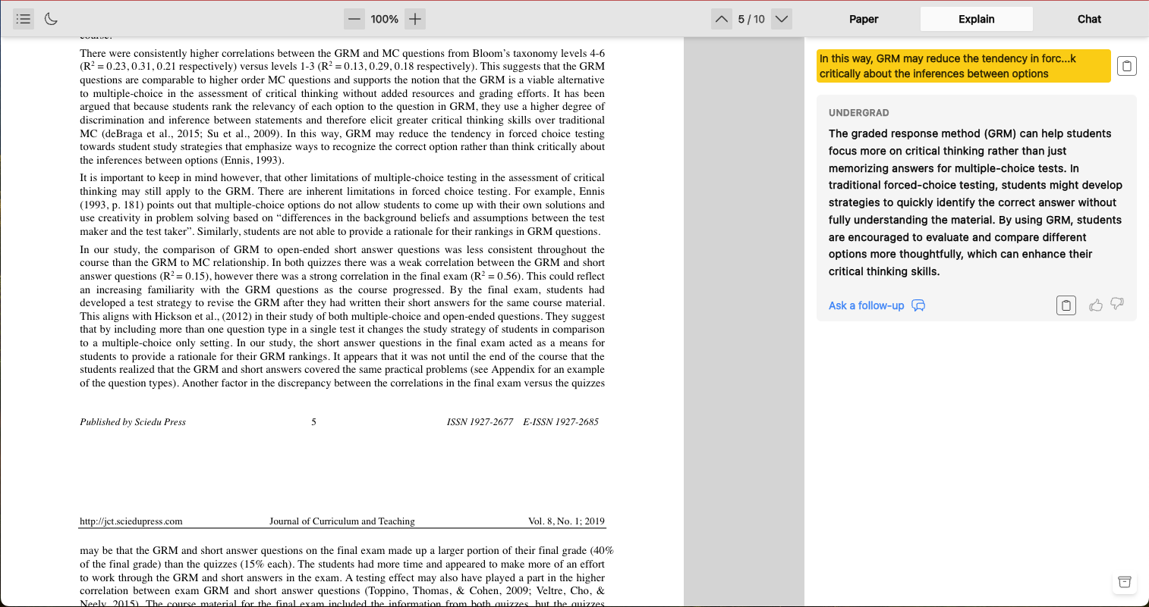
Simplify
Explainpaper to Simplify: Highlight confusing or difficult passages
Notes:
Re: Other AI Tools:
Key Point: Use AI to find AI Tools.
Chunker AI
Finding and pasting in an OpenAI account’s API Key is a significant pain point.
QuillBot
Writing focus; Simplifying challenging academic text or language.
Paraphrase.io
Scite AI
excellent for academic purposes and may be worth the subscription expense.
3 free prompts; sign up for “free trial” required. Paywall.
SMMRY
Login required and a 15 MB max restriction on file upload size.

Slide 41
Advantages
Disadvantages
[Same]
[Same]
Beware of Copyright Issues (Fair Use Doctrine)
What I found with Chunking tools:
  Chunking requires careful prompting
  Financial or Technical Hurdles
    ex. Chunker AI
    ex. Scite AI
Notes:
MY POINTS specific to Chunking, Sum, Simp tools:
Chunking requires careful prompting
Financial or Technical Hurdles: If allowing or encouraging students to use it, equitable access is still a concern because of paid tiers of service or output quality, even with free tools. But some just aren’t practical:
Ex. Scite AI allows only 3 free uses before subscription;
Ex. Chunker AI requires students to obtain and paste an OpenAI API key—an extra technical step that may create a barrier to access, especially for neurodiverse learners.
Same Advantages:
Personalized Learning
Enhanced Engagement with Content
Reduced Cognitive Load
Emphasized metacognition and autonomy
Same Disadvantages:
Overreliance: in that students need to eventually learn how to chunk text themselves, and not always with AI to do it, if the analytical process rather than the information is what is the object of the learning.
Privacy/Account Vulnerability: The more student information is submitted to log in or establish accounts, the greater the risk of identity theft, not to mention submitting private information.
Copyright: issues possible if copying and pasting instructor content with (instructors themselves) or without (students) permission.

Slide 42

Specific follow-up questions?
Notes:
These are especially useful and beginner-friendly for university students to chunk, simplify, and summarize complex academic texts and instructions.

Slide 43
Works Cited
AI in Schools: Pros and Cons, (2024, Oct 24). Office of Communications, College of Education. University of Illinois Urbana-Champaign. https://education.illinois.edu/about/news-events/news/article/2024/10/24/ ai-in-schools--pros-and-cons
Comparing Generative AI Tools, (2025, April 15). Research Guides, Boston University Libraries. https://library.bu.edu/gen-ai/comparing-gen-ai-tools
Chunking, Scaffolding, Pacing, (2025). Digital Learning, University of Washington. https://www.tacoma.uw.edu /digital-learning/chunking-scaffolding-pacing#:~:text=Chunking%20course%20materials%20means%20breaking,the%20pacing%20of%20your%20course.
Berg, R, Brand, A., Grant, J., Kirk, J. S., and Zimmerman, T. (2014). Leveraging recorded mini-lectures to increase student learning. Online Classroom. Academia.edu. https://www.academia.edu/?h=6778520
Barrera, M., Liu, K., Thurlow, M., and Chamberlain, S., (2006). Use of chunking and questioning aloud to improve the reading comprehension of English language learners with disabilities. ELLs with Disabilities Report 17. National Center on Educational Outcomes, University of Minnesota.
Bor, D., and Seth, A. K. (2012). “Consciousness and the prefrontal parietal network: insights from attention, working memory, and chunking.” Frontiers in Psychology 3. https://doi.org/10.3389/fpsyg
Notes:
These are especially useful and beginner-friendly for university students to chunk, simplify, and summarize complex academic texts and instructions.

Slide 44
Works Cited 1
Dandurand, R. N. (2023). Destigmatizing Working with Dyslexic Learners. The Writing Center Journal, 41(2), 56–64. https://doi.org/10.7771/2832-9414.2015
Gilchrist, A. L., & Cowan, N. (2012). Chunking. Encyclopedia of Human Behavior, 476–483. https://doi.org/10.1016/B978-0-12-375000-6.00089-6
Graf, D. (2004). Do You Chunk? You Should. Distance Learning, 1(3), 39–40. Bingley: Emerald Group Publishing Limited.
Lin, T., Yang, C., & Huang, B. (2023). Going beyond language learning: a microlearning instructional design to promote efl learners’ collaboration competency. International Journal of Emerging Technologies in Learning (iJET), 18(12), 224-251. https://doi.org/10.3991/ijet.v18i12.38443
Loftus, T. (2009). Supporting Students with Dyslexia: Practical guidelines for institutions of further and higher education. Ahead.
Payne, R. W. (2021). Socrates. In An Introduction to Philosophy. https://human.libretexts.org/@go/page/17576
Thalmann, M., Souza, A. S., & Oberauer, K. (2019). How does chunking help working memory? Journal of Experimental Psychology: Learning, Memory, and Cognition 45(1), 37–55. https://doi-org.ezp.twu.edu /10.1037/xlm0000578
Notes:
These are especially useful and beginner-friendly for university students to chunk, simplify, and summarize complex academic texts and instructions.

Slide 45
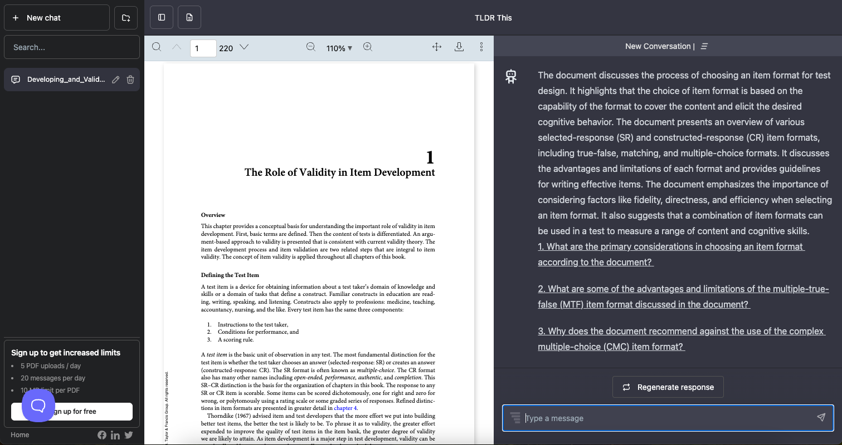
TLDR This to Summarize
Notes:
TLDRThis.com

Slide 46
Questions or Reflections?
We’d love to hear from you!
Unmute or use chat.
Notes:
Thank you so much to all of our presenters for those insightful overviews of how emerging technologies are helping make higher education more accessible for everyone. And thank you to all of you for attending and being part of this important conversation.
We have just a few minutes left, so we’d love to take any questions you might have. You’re welcome to unmute and ask questions or just drop your question in chat.
As we wrap up, we hope you’ll leave today’s session with a few practical ideas you can bring back to your own campuses—whether that’s a new tool to try, a fresh perspective on accessibility, or a strategy for helping others adopt inclusive practices.
Thanks again for joining us today. Enjoy the rest of the conference!

