Slide 1
GLYCOSIDES
OKPAKO ESEOGHENE

Slide 2
WHAT ARE GLYCOSIDES?
They are organic compounds from plants or animal sources which on enzymatic or acid hydrolysis give one or more sugar moieties (glycone) along with the non-sugar moiety (aglycone / genin)
Chemically they are acetals or sugar ethers formed by the interaction of hydroxyl group of each of non-sugar and sugar moiety with the loss of water molecule
R.OH+H.OX ↔ R.OX + H2O
the hydroxyl group of the aglycone may be alcoholic or phenolic or amines
the sugar mainly involved is glucose among many others; it facilitates the aglycone to the site of action
The glycone and aglycone are linked by a glycosidic linkage, this reaction is reversible
in plants are synthesized and hydrolysed under the influence of more or less specific enzymes thus will reduce Fehling’s solution under hydrolysis with the precipitation of red cuprous oxide

Slide 3
NAMING GLYCOSIDES
The old system just requires using the termination of “-in” the “ –oside” is however a modern method of naming since other compounds like inulin and pectin end with in
CLASSIFICATION OF GLYCOSIDES
Based on the type of aglycone in glycoside
E.g anthraquinone, sterols and saponin glycosides
Based on the type of sugar (aglycone part)
E.g glucose-glucoside, rhamnose rhamnoside
Based on the type of linkage between glycone and aglycone
i.e. the linkage between the –OH-group of the glycone and the H- group of radicals like –CH, -OH, -SH, -NH of the aglycone glycoside is named by prefix like C, O, S and N- glycosides respectively
Based on the therapeutic effect
E. g Cathartics, cardiotonics, anlgesics, rheumatics etc
Botanical source
Digitalis glycoside and Senna glycosides

Slide 4
Nature of Glycosides
1º glycoside: originally present in the plant
2º glycoside: resulted from the removal of one sugar from the primary glycoside e.g. digitoxin
Type of glycoside linkage
α- glycoside
β - glycoside
Number of sugars
One sugar | Holosides/monosides | salicin
Two sugars | Biosides | diosmin
Three sugars | Triosides | digoxin
2 – 7 sugars | Oligosides | digoxin
polysaccharides | polysides

Slide 5
PHYSICAL AND CHEMICAL PROPERTIES
They are colourless, solids, amorphous, non-volatile; flavonoids and anthraquinones may be yellow, red/orange respectively
Give positive
reaction to Molisch’s and Fehling’s test after hydrolysis
they are water soluble in polar organic solvents/compounds though insoluble in organic solvents
Most of them have bitter taste except populin, glycyrrhizin, steroside
Odourless except saponin (glycyrrhizin)
When a glycoside has a lot of sugars its solubility in water decreases

Slide 6
Stability of Glycosides
Effect of acid hydrolysis: acids splits sugars from the aglycone, the acetal linkage is more readily cleaved than the sugar chain. C- glycosides are resistant to acid hydrolysis
Effect of alkaline hydrolysis: strong and mild alkalis hydrolyse ester groups (lanatoside A to Purpurea A and opening of lactone rings (cardiac glycosides)
Enzymatic hydrolysis: split the sugars stepwise, starting from terminal sugars. All plants have enzymes that can hydrolyse their glycosides. Enzymes are specific for the type of glycosidic linkages; emulsin, invertase and myrosin can hydrolyse α, β and S - glycosides respectively

Slide 7
EXTRACTION AND ISOLATION
Since glycosides have a wide range of physical and chemical properties and other constituents associated with them , no common general method for their isolation is recommended
Water, methanol, water-ethanol and ethanol are the most common solvents for extraction of glycosides

Slide 8
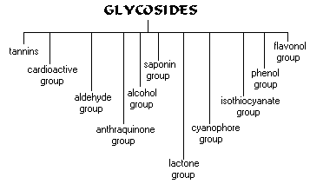

Slide 9
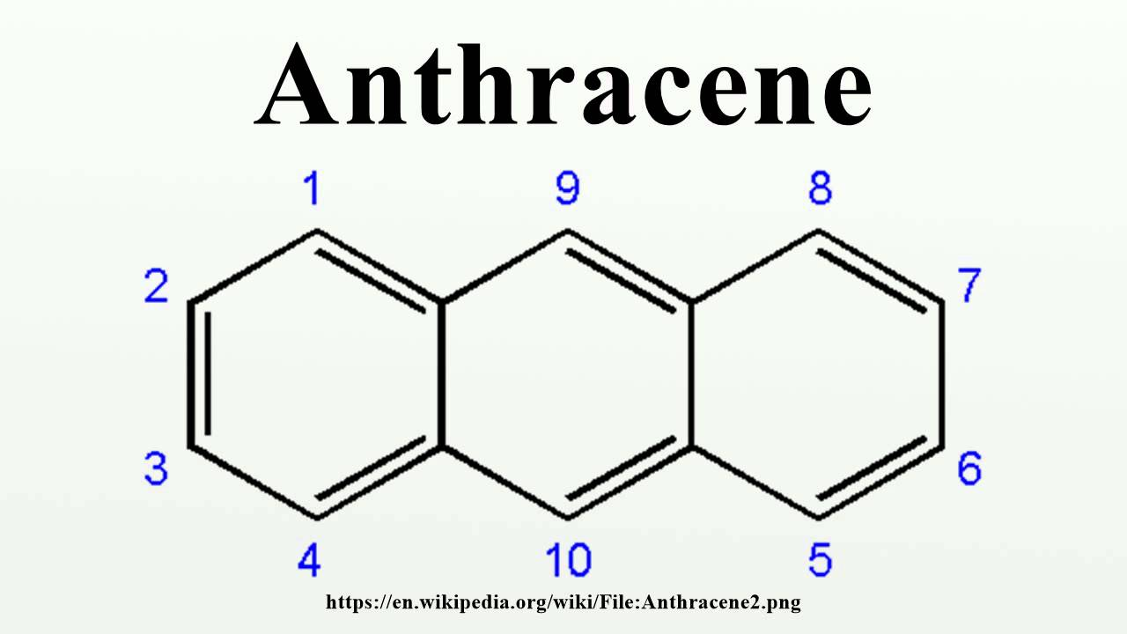
ANTHRAQUINONES/ANTHRACENE
The aglycone part of these glycosides is formed by the head to tail condensation of acetate units. Consists of three fused benzene rings.
The anthraquinone moieties are 5 general groups and these are derived from

Slide 10
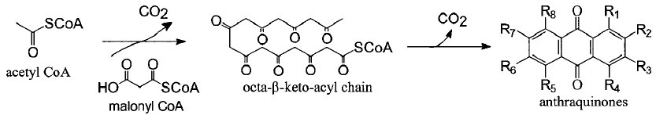
Biosynthesis
They are derived from the acetate pathway which usually starts from the acetic acid units which will form acetyl co-enzyme A which will form malonyl co-enzyme A by the addition of another acetate unit.

Slide 11
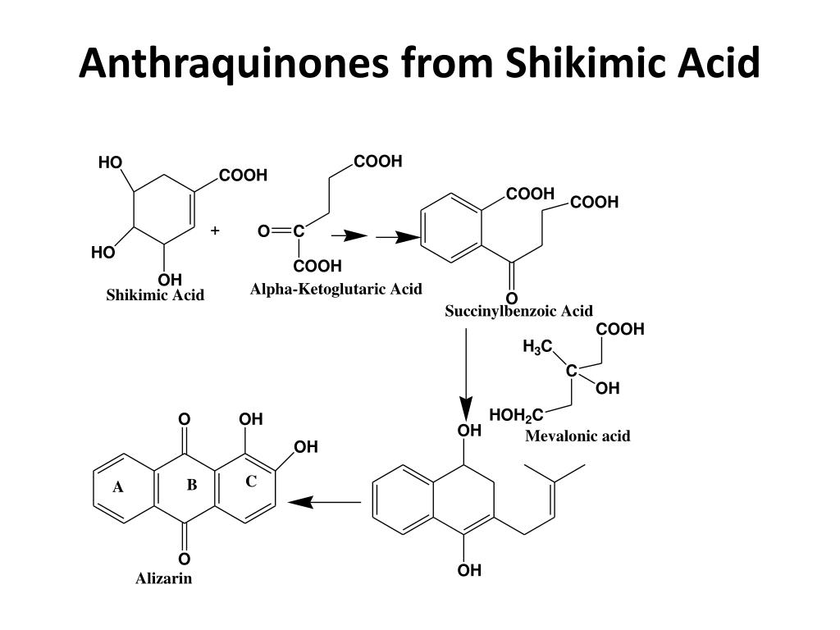

Slide 12
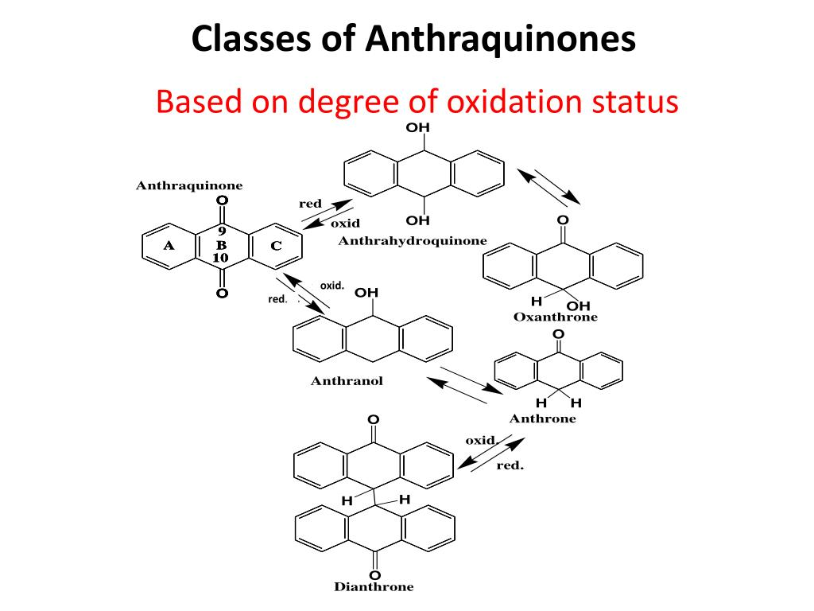

Slide 13
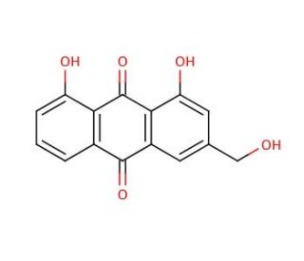
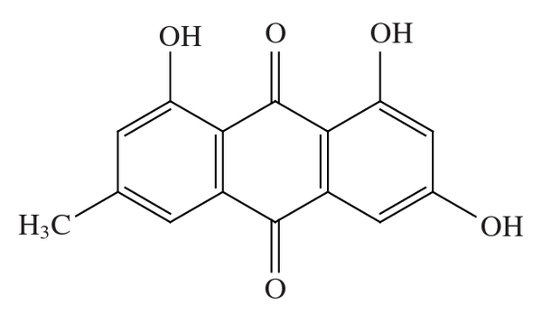
Types of anthaquinone
Aloe - emodin
emodin

Slide 14
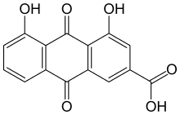
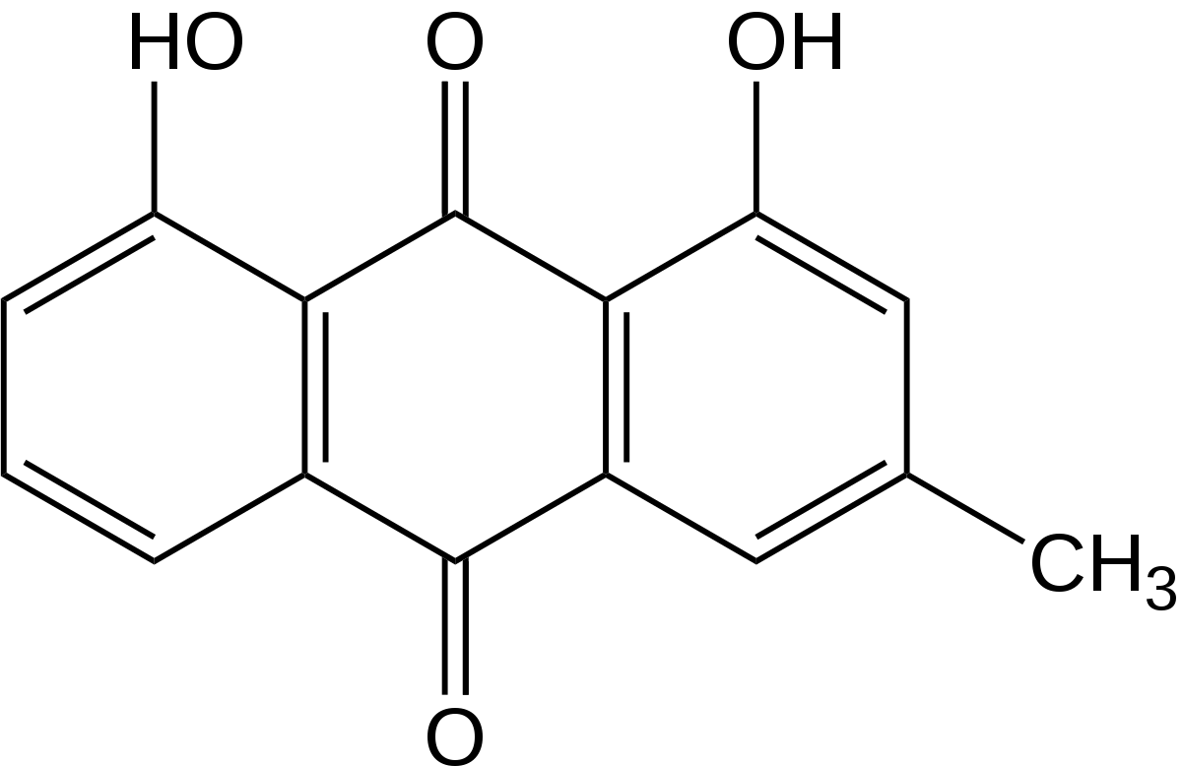
chrysophanol
rhein

Slide 15
The free anthraquinone aglycone exhibit little therapeutic activity; the reduced ones are more active and are present in the fresh drug but are hydrolysed and oxidised during storage
They are present with sugars like glucose, rhamnose, arabinose, primeverose. The sugar residue facilitates absorption and translocation of the aglycone to the site of action.
The anthraquinone and related glycosides are stimulant cathartic and exert their action by increasing the tone of the muscle in the wall of the large intestine.

Slide 16
Drugs containing Glycosides
DRUG | BOTANICAL SOURCE | FAMILY | ANTHRAQUINONE | TYPE OF GLYCOSIDE
cascara | Cascara purshina | rhamnaceae | Cascarosides A, B, C and D | O&C glycosides Aloe emodin
Rhubarb | Rheum officinale | polygonaceae | rhein | C - glycoside
Aloe | Aloe barbadensis | Liliaceae | Barbaloin Alloinoside A&B | C-glycoside O- glycoside of barbaloin
Senna | Senna alexandrina Mill. | fabaceae | Sennosides A – D (aloe emodin & rhein) | O - glycoside
John Wort | Hyperium perforatum | clusiaceae | Hypericin | 2 molecules of emodin anthrone

Slide 17
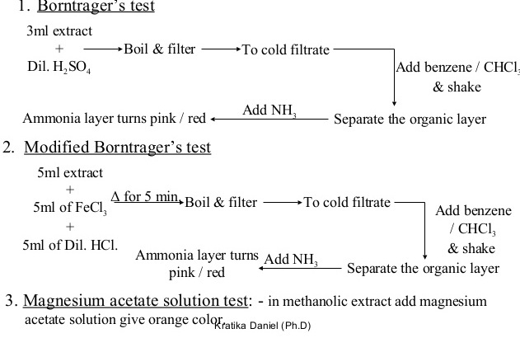
Test for Anthraquinone Glycosides

Slide 18
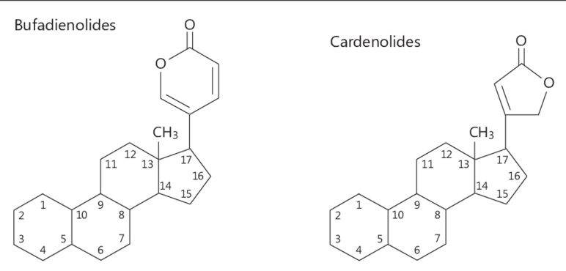
STEROLS & CARDIAC GLYCOSIDES
Aglycone part of cardiac glycosides is a steriodal moiety i.e. 5-membered or 6-membered lactone rings (cardenolides & bufadenolides respectively)
The sugar moieties are attached to the sugar moiety which may be mono, di, tri or tetra saccharide
The most sugars that are found in cardiac glycosides are the uncommon deoxy sugars e.g. digitoxose, cymarose

Slide 19
Cardenolides
They are more prevalent in nature, they are are C₂₃ steriods have an α, β – unsaturated 5-membered lactone ring in position C_{17 .}
They are of two main types viz:
Digitalis glycosides from Digitalis sp.,Plantinginaceae
Strophanthus glycosides
From the structure given previously where at
C₁₀: R = CH₃, C₃ = O, C₁₁= OH, C₁₃ = CH₃, C₁₄ = OH (Digitalis glycosides)
But where C₁₀, R = CHO or CH₂OH (Strophanthus glycosides) all others remaining constant
Chemical constituents of cardenolides include: digitoxin, gitoxin, digoxin

Slide 20
Bufadenolides
They include the following:
squill glycosides (scillarins); from the bulb and varieties of squill; Family Liliaceae
toad poison (bufotoxin); derives name from the generic name from toad bufo. It possesses doubly unsaturated 6-membered ring in position C₁₇, They are C₂₄ steriod
Where C₁₁=OH, C₁₄=OH,C₁₅ =H (squill glycoside) e.g Scillarin A and Scillarin B
C₁₁=OH, C₁₄&C₁₅= ester grp. (bufotoxin)

Slide 21
Uses of Cardiac glycosides:-
potent cardiotonic, an expectorant especially in chronic bronchitis, stimulant, may possess anti-cancer, produces diuresis, causes emesis in relatively high doses
Test for cardiac glycosides
Keller-killani, Kedde’s test etc
(refer to PCG341 manual)
Medicinal importance of cardiac glycosides
Cardiotonics, CHF, rheumatic heart dx, atherosclerosis, diuretics
Official cardiac drugs
Digitalis leaf (tablets), digitoxin tablets, digoxin injection

Slide 22
SAPONIN GLYCOSIDES
Derived from the latin name soap
Plants containing saponin and saponins as such produce frothing in aqueous solution known as natural detergents
Their aglycones are known as sapogenins
Characteristics / Properties
have bitter and pungent taste so limited utilisation takes place as feed by animals
Drugs containing saponins are stimulatory and cause irritation of mucous membrane
They cause haemolysis of blood
Taken by mouth and are harmless
They have high molecular weight thus their isolation poses difficulties
They give precipitates with alcoholic solutions , emulsify oils and cause complex formation with cholesterol
They are responsible for producing toxicity in lower organisms
They produce colloidal solution s in water, soluble in alcohol, but insoluble in ether&petroleum
Biological Importance
Possess strong biological activity
They are the plant active immune system
Saponins act as toxins
Chemistry
They consist of a polycyclic aglycone (steroid/triterpenoid) attached via a C₃ to sugar side chain

Slide 23
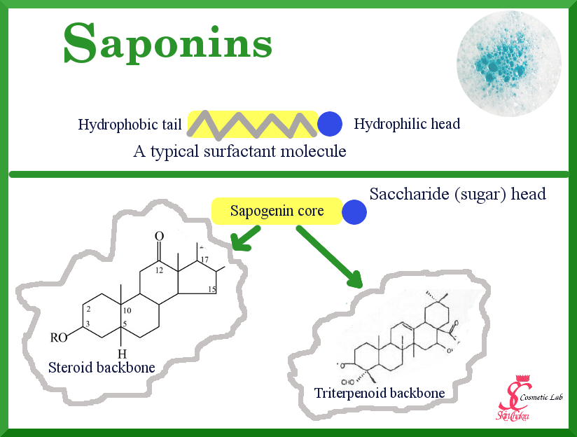

Slide 24
Types steroidal saponins triterpenoid saponins
Steroidal Saponins
They are tetracyclic, cyclopentano derivatives
Occur less commonly in nature
useful starting material for chemical conversion to steroidal drugs (hormones) e.g progesterone, cortisone etc are obtained from these glycosides by partial hydrolysis
Examples: dioscin, O-glycoside from Dioscorea sp, Dioscoreaceae, roots and rhizome
Triterpenoid saponin
They are pentacyclic linked with either sugar/uronic acid (glucouronic acid)
They are used as sweetening agents, bronchial agents, anti-TB, reduce chronic inflammation, anti-pyretic etc
Examples: glycyrrhizic acid, Glycyrrhiza glabra Fabaceae
Test for Saponins
Refer to the PCG 341 manual

Slide 25
CYANOGENETIC GLYCOSIDES
Cyanogenesis is the ability of certain living organisms to produce HCN; in plants it is a chemical defence mechanism against organisms damaging or feeding on plant tissue
These compounds in the presence of enzymes(β-glucosidase) loose their sugar portion to form cyanohydrinwhich in the presence of water hydroxynitrile lyase can undergo hydrolysis to give benzaldehyde & the highly toxic HCN.
The sugar portion may be a mono, di such as gentiobiose. If di-, enzyme present in the plant may bring about hydrolysis in two stages as in the case of amygdalin.
They are derivatives of α – hydroxynitrile or 2- hydroxynitrile(cyanohydrins)
In all cases the Ist sugar attached to the aglycone is the β-D glucose
They are biosynthetically derived from amino acids viz valine, leucine, tyrosine, isoleucine and phenylalanine

Slide 26
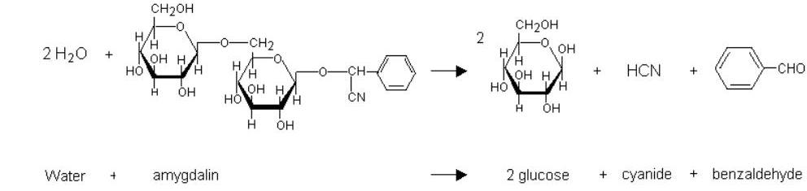
Examples
Amygdalin, Prunus amygdalus, Rosaceae
Prunasin, Prunus serotina, Rosaceae
Test
Refer to lab manual

Slide 27
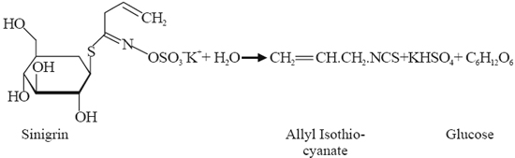
ISOTHIOCYNATE GLYCOSIDES
These glycosides upon hydrolysis yield mustard oil (allylisothiocynate)
Plants containing these glycosides possess non-specific resistance against infection
They possess properties such as vessicant and rubefacient
Example: sinigrin from the dried seeds of Brassica nigra/juncea, Brassiaceae

Slide 28
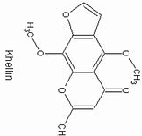
COUMARINS/FURANOCOUMARINS
Coumarins
A coumarin is a derivative of benzo-α-pyrone, a phytochemical with a vanilla like flavour,
it is a oxygen heterocycle
Occurs freely or as a glycoside
They are used as anticogulants, antifungal, antitumor, anti-inflammatory, skimmin protects the skin from U.V light, food additive, treat skin dxs and ingredients in perfume
Furanocoumarins
derivatives of coumarins; the parent compound is psoralene
They are resistant to alkalis
Examples
Xanthonin and khellin Ammi sp. Apiaceae

Slide 29
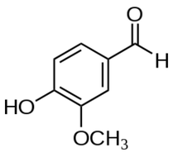
ALDEHYDE GLYCOSIDE
E.g. vanillin, Vanilla plantifolia, Orchidaceae
It contains 2 glycosides viz: glucovanillin, glucovallic acid both on hydrolysis yield vanillin
It is commonly used as a flavouring agent
The aglcone part is aldehydic

Slide 30
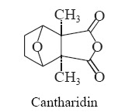
LACTONE GLYCOSIDE
E.g cantharidin, Lytta vesicatoria, Meloidae
It is used as a vessicant, a rubeficiant and counter irritant in vetinary practice

Slide 31
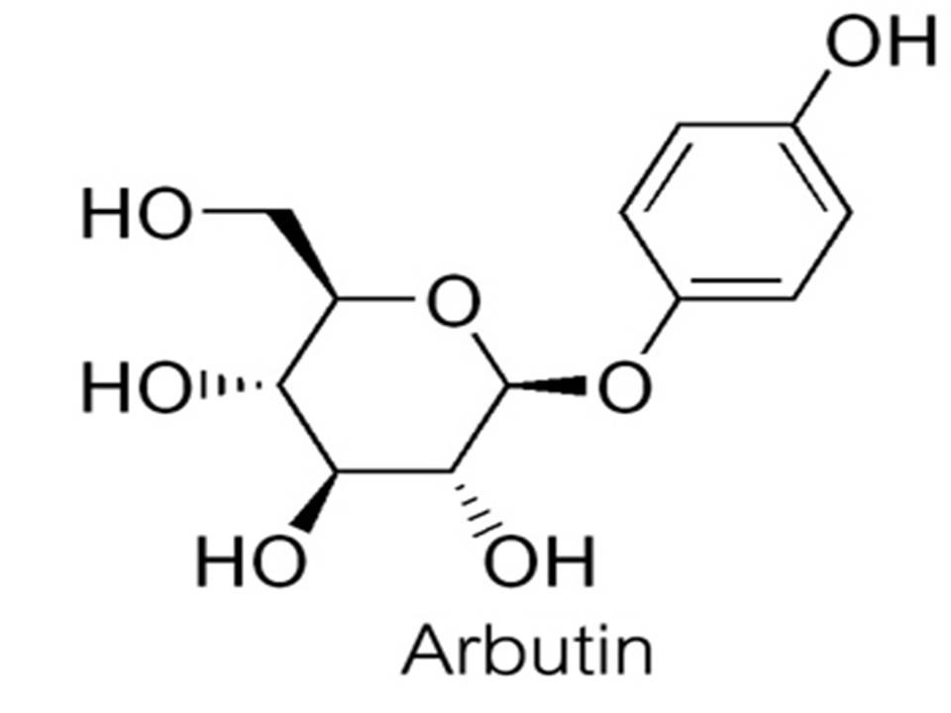
PHENOL GLYCOSIDE
The aglycone part is a phenol
E.g arbutin, Acrostaphylos sp, Ericaceae
A glycosylated hydroquinone extracted from Bearberry plant
It is used for UTI and as a skin lightening agent

Slide 32
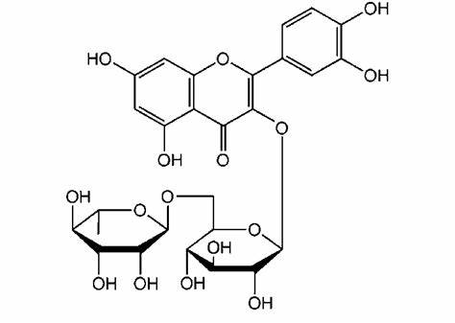
FLAVONOID GLYCOSIDE
They are 2-phenylchroman derivatives
Universal plant pigments responsible for the colours of flowers, fruits and sometimes leaves
The sugar moiety may be mono, bi, tri/ linear or branched
Mono; D-glucose, galactose, allose, rhamnose, glucuronic, galacturonic
Glycosidic bond may be established throgh any of the phenolic OH-group on the aglycone
C-glycosidic bonds can be established also between the assymetric carbon on the sugar and C-6, C-8 of the aglycone
E.G rutin Carpobrotus edulis (L.) N.E. Br, Aizoaceae

Slide 33
STEROIDAL ALKALOIDS
These are alkaloids with a steroidal nucleus and N-atom. The steroidal nucleus refers to the carbon skeleton of 4 rings (cyclopentano per hydrophenanthrene ring)
N-atom in the alkaloids may be in closed ring or as side chain substituent ; they occur in the plant kingdom as glycosidal combination with CHO moieties aka glycoalkaloids
E.G Cervaratrum & jervaratrum alkaloids though not found yet. Glycoalkaloids of the solanaceae family. Lycoperisicum and Solanum genus however have been isolated.
They are used as antihypertensives, emetics and treatment of toxemia in pregnancy

Slide 34
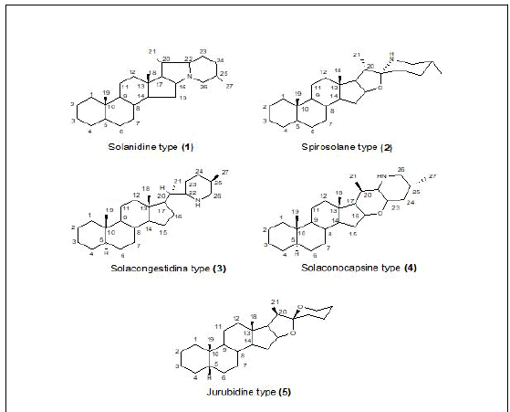
Types of glycoalkaloids from the Solanaceae family

Slide 35
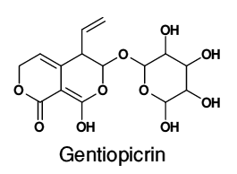
GLYCOSIDAL BITTERS
They are glycosides of monterpenes and iridoids
They act as digestive stomachic, febrifuge, used as anti-tumor and anti-malarial agents
E.g gentiopicrin, Gentiana lutea L., Gentianaceae

Slide 36
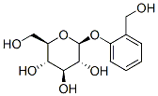
ALCOHOL GLYCOSIDES
The aglycone part is an alcohol
E.g salicin Salix alba L.; Saliaceae
an alcoholic β-glucoside which on oxidation of the alcohol functional group yields salicylic acid
Used as an analgesic, anti-inflammatory and antipyretic

Slide 37
AMINO SUGAR DERIVED DRUGS

Slide 38
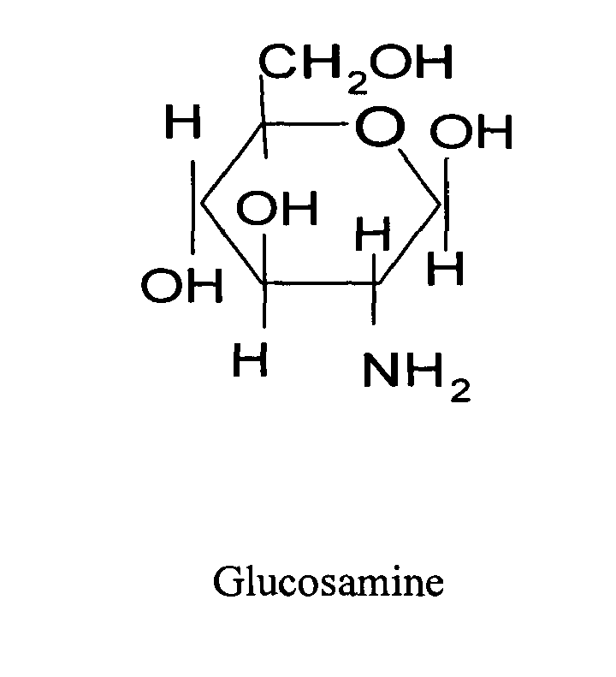
What is an amino sugar?
an amino sugar (or more technically a 2-amino-2-deoxysugar) is a sugar molecule in which a hydroxyl group has been replaced with an amine group

Slide 39
Derivatives of amine containing sugars, such as N-acetylglucosamine and sialic acid, whose nitrogens are part of more complex functional groups rather than formally being amines, are also considered amino sugars
Aminoglycosides are gram negative antibacterial compounds that inhibit bacterial protein synthesis and are conjugates of amino sugars and aminocyclitols.
Aminoglycosides that are derived from bacteria of the Streptomyces genus are named with the suffix -mycin, whereas those that are derived from Micromonospora are named with the suffix -micin.
Examples of aminoglycosides include: amikacin, gentamicin, kanamycin and streptomycin

Slide 40
Properties
All are used as sulfate salts which are highly soluble in water which is stable
Do not inhibit anaerobes
They ionize in solution
Excreted unchanged in urine
More active in alkaline environments
Partial cross resistance among them
Low margin of safety
Exhibit ototoxicity and nephrotoxicity

Slide 41
Classification of Aminoglycosides
Systemic
Topical
Streptomycin
Amikacin*
Gentamicin
Kanamycin
Netilmicin*
Tobramycin
Sisimicin
Neomycin
Framycetin

Slide 42
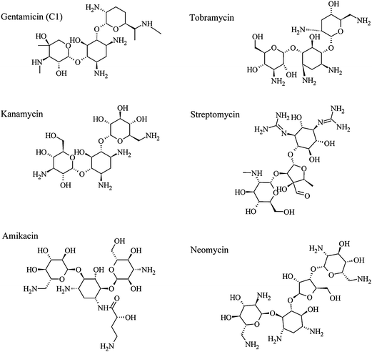

Slide 43
THE END

