Slide 1
BABY SHOWER
Free Template
Here is where your presentation begins

Slide 2
01
02
03
04
ABOUT MY BABY
ABOUT MY BABY
MARKET ANALYSIS
Here you can describe the topic of the section
Here you can describe the topic of the section
GOALS & STRATEGY
CONTENT PLAN
Here you can describe the topic of the section
Here you can describe the topic of the section

Slide 3
05
06
07
OUR BUDGET
Here you can describe the topic of the section
KPI OVERVIEW
YOUR INVITATION
Here you can describe the topic of the section
Here you can describe the topic of the section

Slide 4
01
ABOUT MY BABY
You can enter a subtitle here if you need it

Slide 5
HISTORY ABOUT BABY SHOWER DAY
DAY 1
Mercury is the closest planet
DAY 2
Venus has a beautiful name
DAY 3
Mars is a very cold place, not hot
DAY 4
Neptune is the farthest planet

Slide 6
WHAT SETS US APART
You can state one of your qualities here
You can state one of your qualities here
You can state one of your qualities here
You can state one of your qualities here
You can state one of your qualities here
You can state one of your qualities here
You can state one of your qualities here
You can state one of your qualities here
You can state one of your qualities here
You can state one of your qualities here
You can state one of your qualities here
You can state one of your qualities here

Slide 7
GUIDING PRINCIPLES
MERCURY
Mercury is the closest planet to the Sun
VENUS
It has a beautiful name and is the second planet

Slide 8
BUYER PERSONA
INTERESTS
GENDER
PRODUCT EXPERIENCE
Female
35%
Despite being red, Mars is a cold place. It’s full of iron oxide dust
Male
65%
Saturn is a gas giant, composed mostly of hydrogen and helium

Slide 9
—EDA J. LESHAN
“
A new baby is like the beginning of all things— wonder, hope, a dream of possibilities”

Slide 10
02
MARKET ANALYSIS
You can enter a subtitle here if you need it

Slide 11
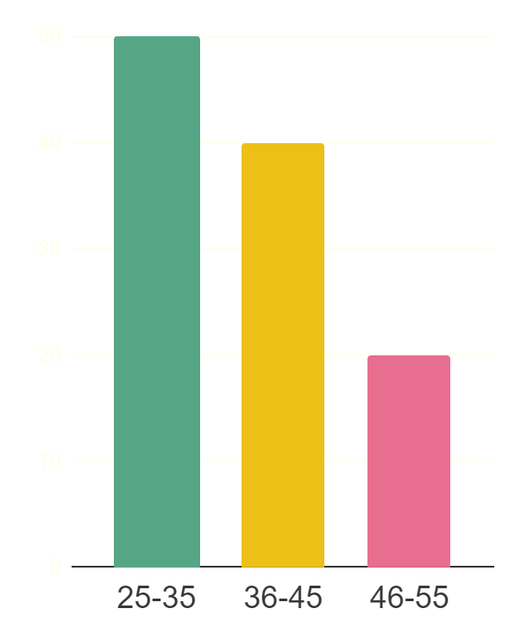
AUDIENCE DEMOGRAPHICS
BOY
GIRL
BABY’S GENDER
PARENTS’ AGE
60%
85%
65%
30%
Venus has a beautiful name
40%
Planet Mars is a cold place
Follow the link in the graph to modify its data and then paste the new one here. For more info, click here

Slide 12
AUDIENCE DEMOGRAPHICS
MARS
VENUS
Despite being red, Mars is a very cold place
Venus is the second planet from the Sun

Slide 13
TOP SOCIAL NETWORKING SITES
56%
80%
23%
Despite being red, Mars is actually a cold place
Jupiter is a gas giant and the biggest planet
Venus has a beautiful name, but it’s terribly hot

Slide 14
ANALYZING THE COMPETITION
MARS
NEPTUNE
Despite being red, Mars is a cold place
Neptune is the farthest planet from the Sun
MERCURY
VENUS
Mercury is the closest planet to the Sun
Has a beautiful name, but it’s terribly hot

Slide 15


A PICTURE IS WORTH A THOUSAND WORDS

Slide 16
03
GOALS & STRATEGY
You can enter a subtitle here if you need it

Slide 17
OUR GOALS
Mars is a very cold place
Mercury is the closest planet
MARS
MERCURY
VENUS
NEPTUNE
Venus has a beautiful name
Neptune is the farthest planet

Slide 18
OUR STRATEGY
Venus has a beautiful name
Mercury is the closest planet
DAY 3
DAY 1
DAY 4
DAY 2
Neptune is the farthest planet
Planet Mars is a very cold place

Slide 19
AWESOME PARENTS

Slide 20
04
CONTENT PLAN
You can enter a subtitle here if you need it

Slide 21
OUR AREAS OF EXPERTISE
SATURN
NEPTUNE
Yes, Saturn is the ringed one
Neptune is the farthest planet of them all
MERCURY
VENUS
Mercury is the closest planet of them all
Venus has a beautiful name, but it is hot
MARS
JUPITER
Mars is actually a cold place, not hot
Jupiter is the biggest planet of all them

Slide 22
WHAT CONTENT ARE WE GOING TO CREATE?
MARS
Despite being red, Mars is a cold place
VENUS
Venus has a beautiful name, but it is hot
JUPITER
Jupiter is the biggest planet of them all

Slide 23
WHAT TONE ARE WE GOING TO USE?
Mercury is the closest planet to the Sun and the smallest one in the Solar System—it’s a bit larger than the Moon

Slide 24
WHAT PLATFORMS ARE WE GOING TO USE?
INSTAGRAM
Despite being red, Mars is very cold
FACEBOOK
YOUTUBE
Jupiter is the biggest planet
Venus has a beautiful name

Slide 25
385,000
Number of babies are born each day in the world

Slide 26
CONTENT SHARING PLAN
MON | 1 story | 1 post | 1 video
TUE | - | 1 comment | 3 videos
WED | 2 stories | 3 post | -
THU | - | - | 1 video
FRI | 2 stories | 1 post | 2 videos

Slide 27
CALENDAR OF THE EVENT
FIRST WEEK | SECOND WEEK | THIRD WEEK | FOURTH WEEK
Mercury | Mars | Venus | Saturn
Ceres | Pluto | Earth | Sun
Saturn | Moon | Jupiter | Neptune
Sun | Neptune | Mercury | Ceres

Slide 28
05
OUR BUDGET
You can enter a subtitle here if you need it

Slide 29
OUR BUDGET
$45,000
$23,200
MERCURY
JUPITER
Mercury is the smallest planet in our Solar System
Jupiter is the biggest planet in our Solar System

Slide 30
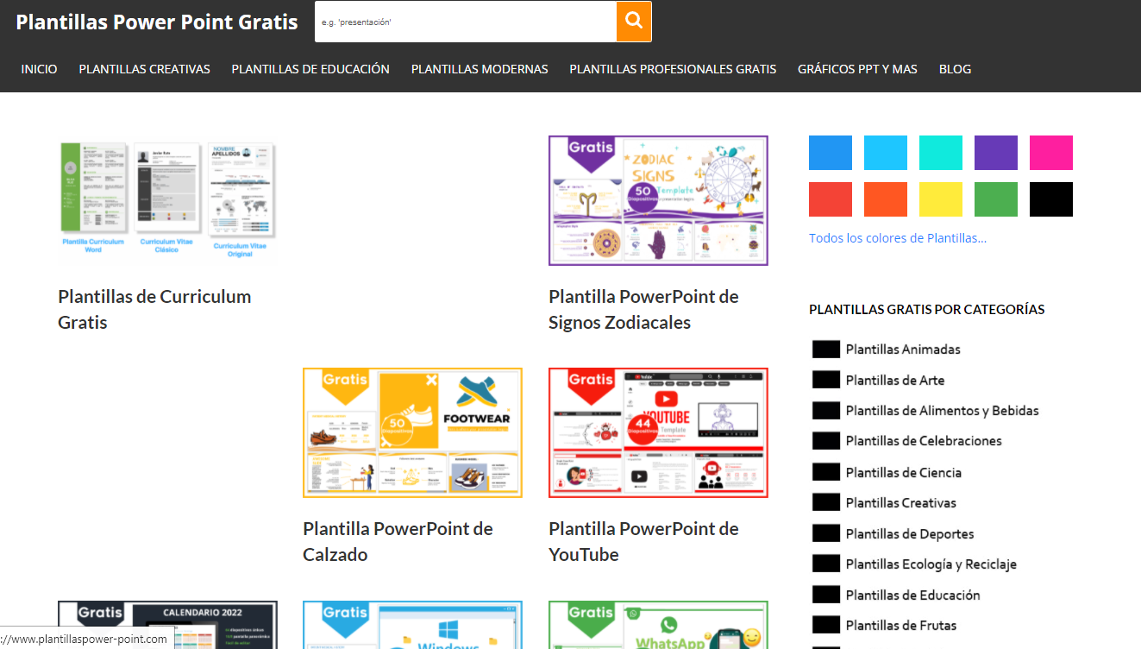
SNEAK PEEK
You can replace the image on the screen with your own work. Just right-click on it and select “Replace image”

Slide 31
06
KPI OVERVIEW
You can enter a subtitle here if you need it

Slide 32
KPI OVERVIEW
TOTAL LEADS
5,409
Saturn is a gas giant and the biggest one in the Solar System
GUESTS
223
Despite being red, Mars is a cold place. It’s full of iron oxide dust!
NEW FOLLOWERS
1,890
Venus has a really beautiful name, but It’s terribly hot

Slide 33

KPI OVERVIEW
10%
52%
38%
SATURN
VENUS
JUPITER
Saturn has many rings
Venus has a nice name
Jupiter is a gas giant
Follow the link in the graph to modify its data and then paste the new one here. For more info, click here

Slide 34
OUR FAMILY
MOTHER
Here you can talk a bit about this person
FATHER
Here you can talk a bit about this person

Slide 35
JOIN US FOR A
BABY SHOWER
HONORING
JOHANNA MATHISON
MARCH 16TH - 4:00 PM
1234 MEREDITH ROAD
GRAND RAPIDS, MI 34032

Slide 36
IT IS A
BABY SHOWER
FOR
AMELIA JACKSON
SATURDAY , APRIL 20TH I 3:00 PM
IN JACKSON’S PLACE

Slide 37
SMITH FAMILY IS WAITING A BABY
BOY OR GIRL?
JOIN US FOR A GENDER REVEAL PARTY
TERRY + ASHLEY HOUSE - 4:00 PM
2134 MULHOLLAND STREET
RSVP TO JENA AT (001) 456 4534 BY JUNE 1

Slide 38
OH BABY!
Please join us for a baby shower honoring
CLARICE THOMPSON
JUN 19 | CLARICE’S HOUSE 2102 WILSON AVENUE | 4 PM
RSVP TO JENA AT (001) 456 4534 BY JUNE 1

Slide 39
THANKS!
Do you have any questions?
youremail@freepik.com
+91 620 421 838
yourcompany.com

Slide 40
https://www.plantillaspower-point.com

Slide 41
ALTERNATIVE RESOURCES

Slide 42
ALTERNATIVE RESOURCES

Slide 43
ALTERNATIVE RESOURCES

Slide 44
ALTERNATIVE RESOURCES

Slide 45
ALTERNATIVE RESOURCES
1

Slide 46
ALTERNATIVE RESOURCES

Slide 47
Educational Icons
Medical Icons

Slide 48
Business Icons
Teamwork Icons

