Slide 1

CPaaS Platform
Platform Management Applications
Document Version: January 2024

Slide 2
Release Notes (January, 2024)
Item | Slide No: | Description
Domain Settings | 12 | Allow to remove Pending or Failed to verify sender domain

Slide 3
What’s In It For Me?
An introduction to the Platform Management Apps which allows Administrators to configure and manage the CPaaS Platform settings, namely:
Access Control App
Portal Settings App
Admin Audit App

Slide 4
Access Control
Allows the Telecom Operator’s management to decide who is granted access to which platform app within the Organization.

Slide 5
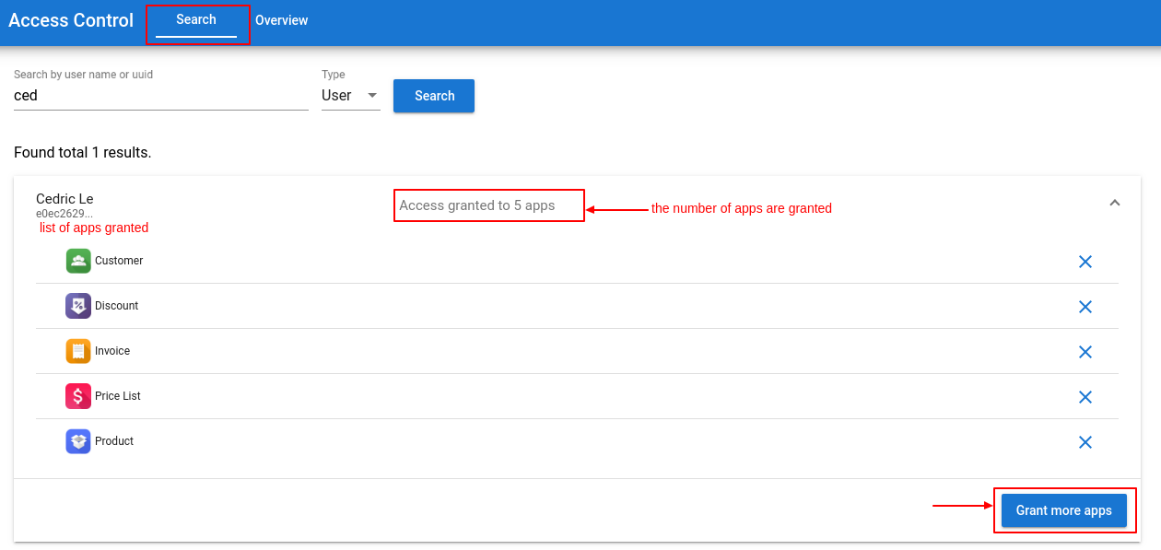
Search Tab: Grant access to 1 member at a time
Filter a member by name or identity UUID: Check the granted apps and grant them more access if needed.
Filter by Application: Check who has access to a specific app, and grant access to more users if needed.

Slide 6
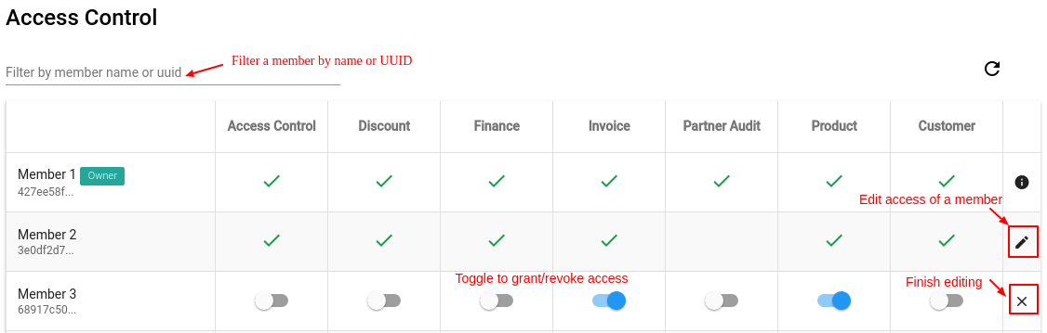
Overview: Grant access to multiple members at a time
Click the pencil icon to start. Toggle to grant/revoke access of a member to an app, then click X to finish editing. Change is saved automatically.

Slide 7
Portal Settings
Allows the Telecom Operator’s management to configure settings for the CPaaS portal and set different policies for customers.

Slide 8
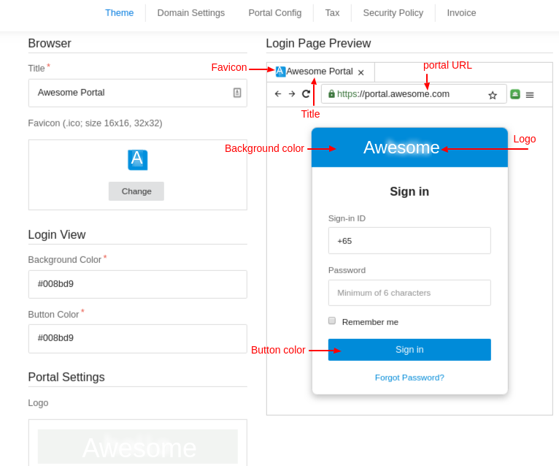
Login Page Modification
Theme : This is where you can modify how the log-in page looks like.
Browser Title
Favicon
Login View (Background, Button Color)
Logo

Slide 9
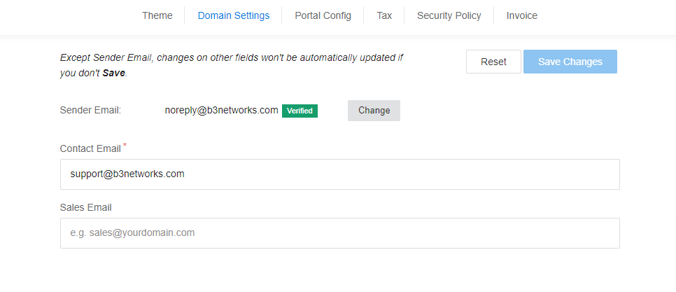

Domain Settings
Domain Settings: used to set up email used in the whole domain
Sender Email: the email used at sender name at the notification sent to the customers. When you want to change your sender email, the new email must be verified so that it can be applied.
Contact Email: the email used to replace all fields related to contact us or contact support.
Sales Email: the email used when your customer is on Store purchasing something and needs your help.

Slide 10
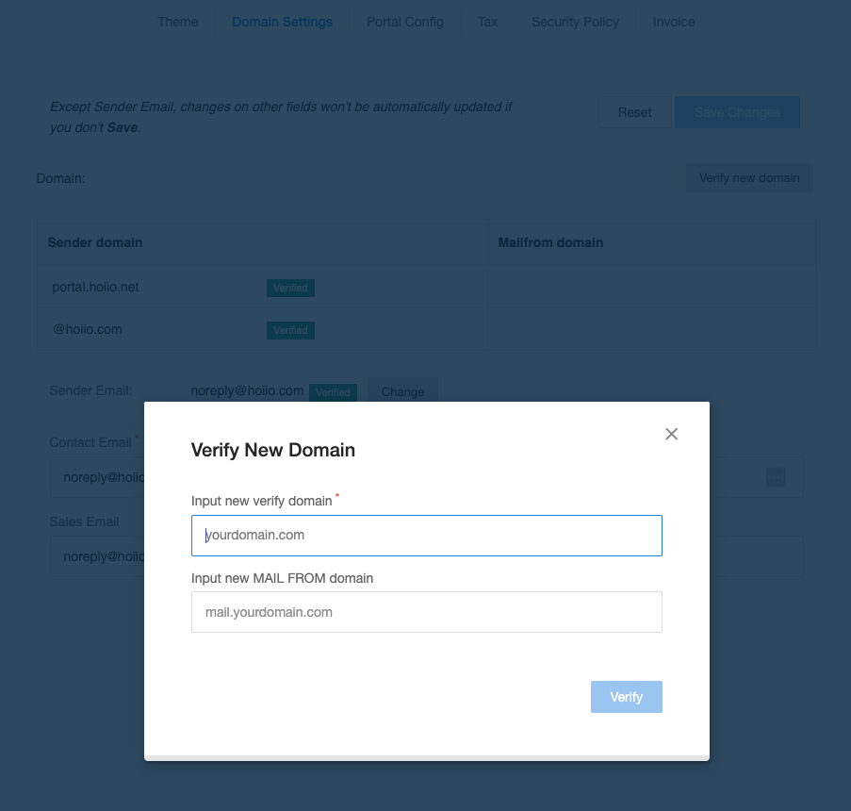
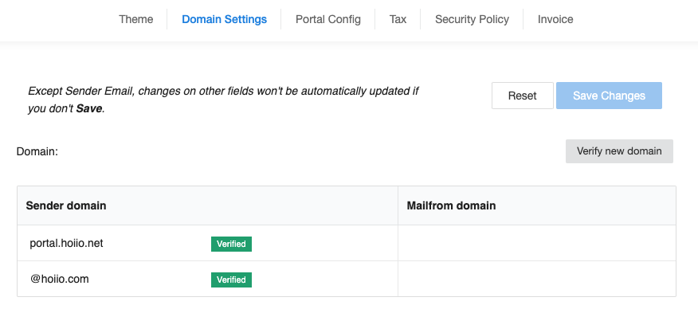
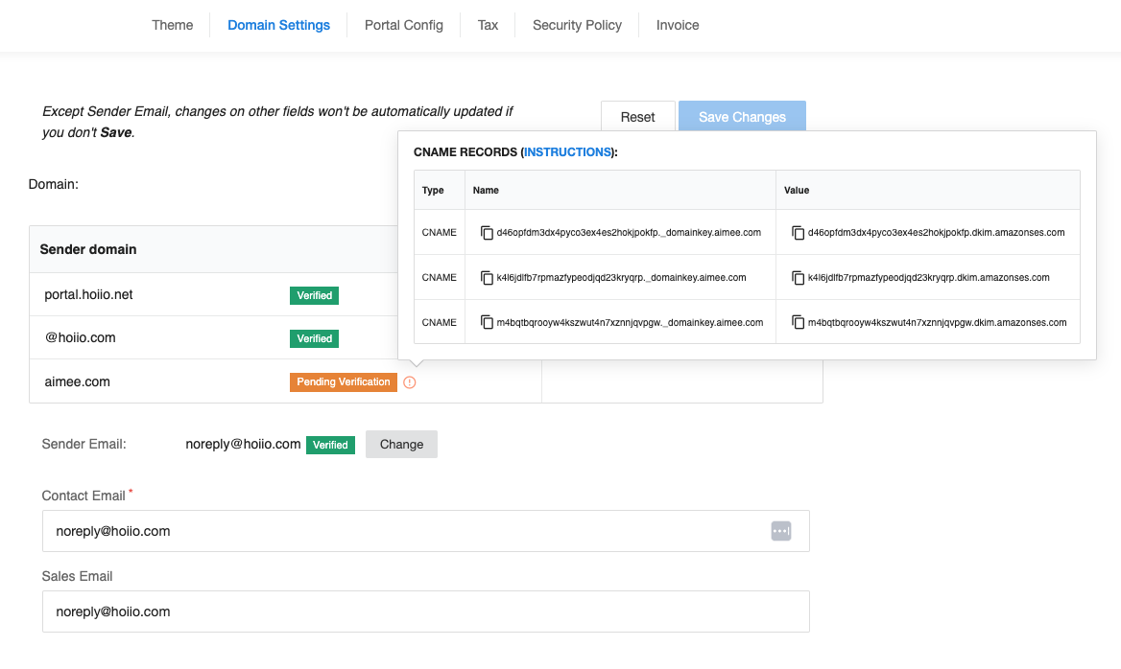
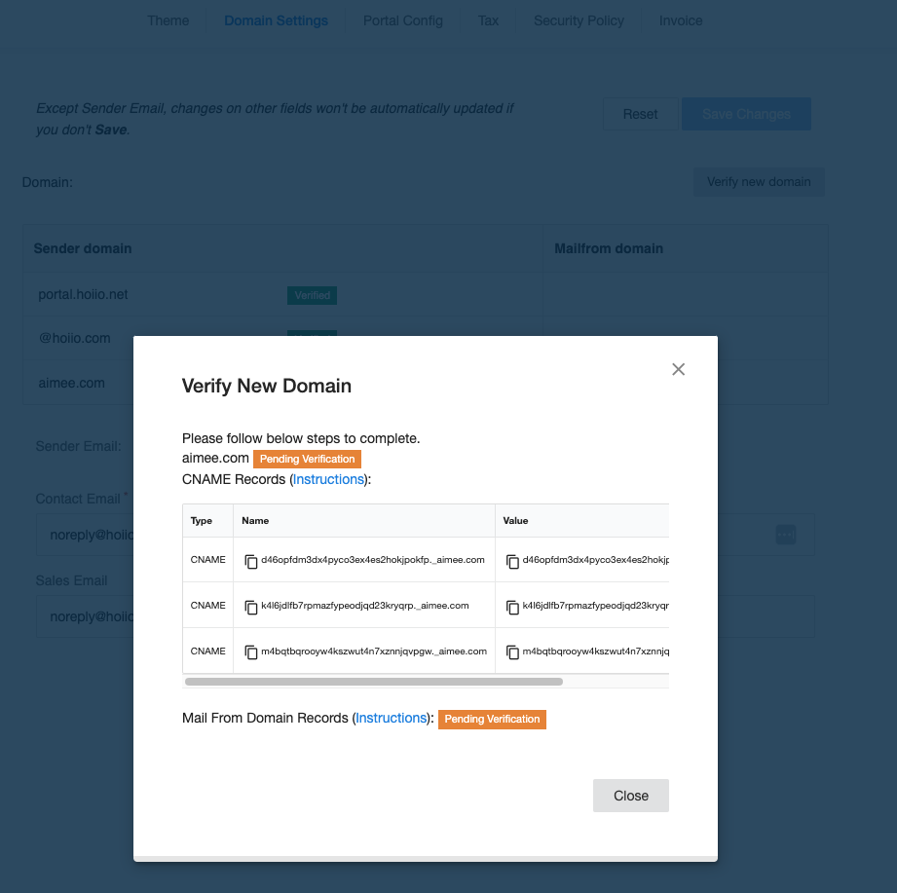
Verify New Domain
Verify a new domain:
You can add multiple sender domains and MAIL FROM domains
Click on “Verify new domain” and add sender domain (mandatory) and MAILFROM domain (optional)
Get the CNAME records and follow the instructions to create DNS records
Afterwards, the status will be changed to “Verified” from “Pending Verification”

Slide 11
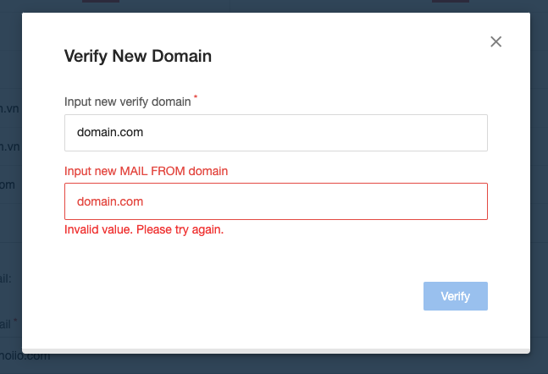
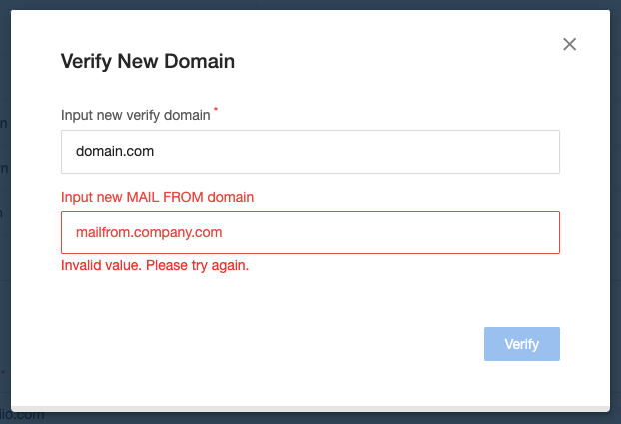
Verify New Domain
  Mailfrom value cannot be the same with Sender domain value. If users input the same value for both, UI show errors: Invalid value. Please try again.
    e.g. Sender domain is domain.com => Mailfrom domain cannot be domain.com
  Mailfrom value ending needs to be matching with Sender domain. If users input incorrect format, UI show errors: Invalid value. Please try again.
    e.g. Sender domain is domain.com => Mailfrom domain needs to be matching with Sender domain.

Slide 12
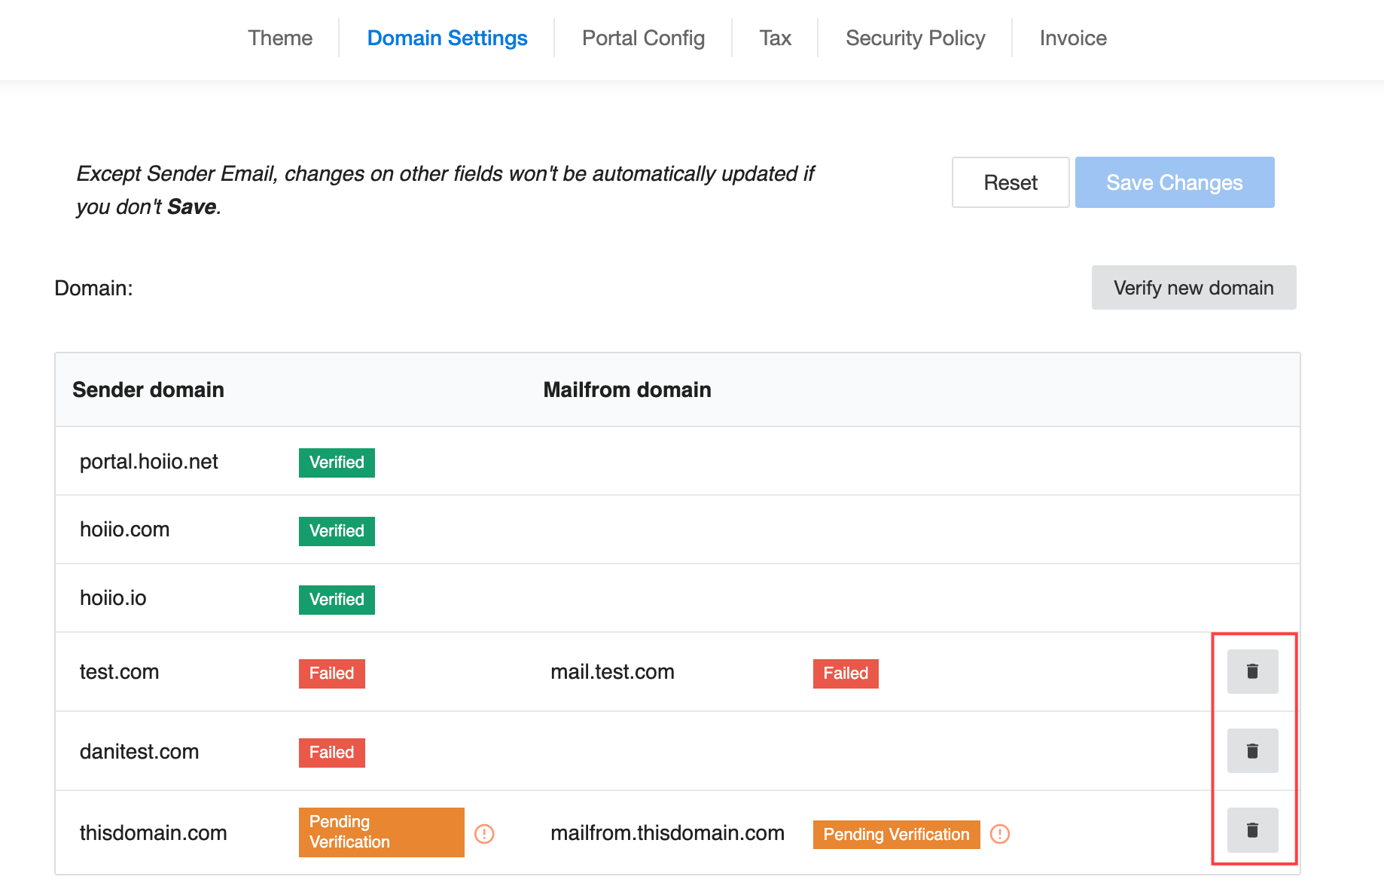
Pending or Failed Verification
  For Pending Verification or Failed status (failed to verify sender domain), users can click on the “Delete” icon to remove those respective sender domains from the user-interface.

Slide 13
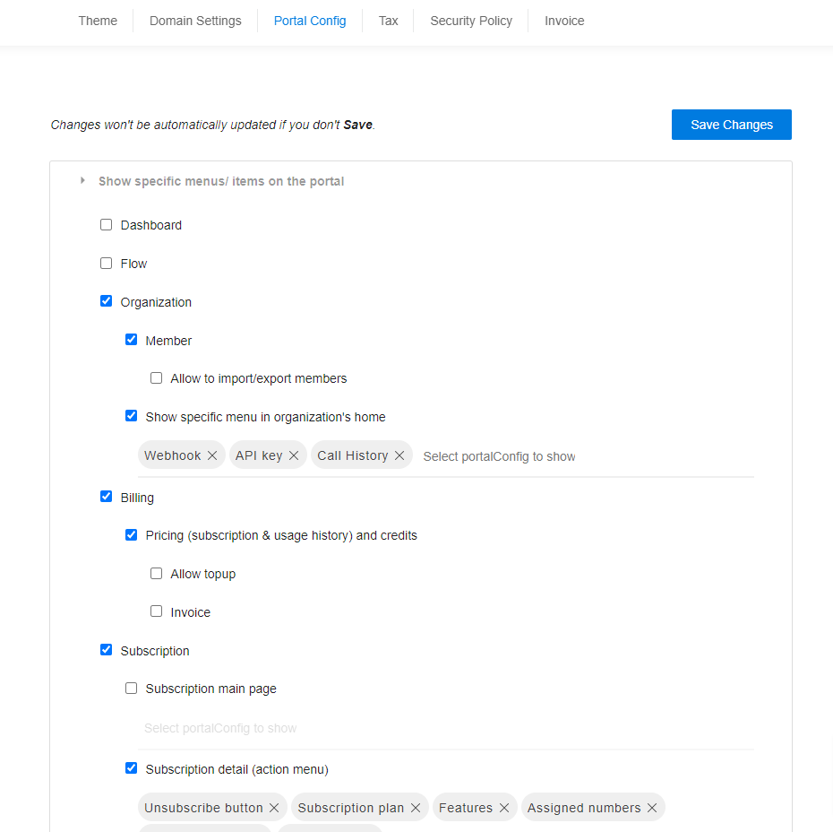
Portal Config: This is where you configure settings for the Customer Portal. You can determine:
What your customer would see on their portal
Customer interface configuration
Purchase Flow
Subscription Policy
Configure the Default Inbound / Outbound Rules for all organizations under a domain.
Keyword Blacklist
Note: The settings here will affect ALL users located on your domain.

Slide 14
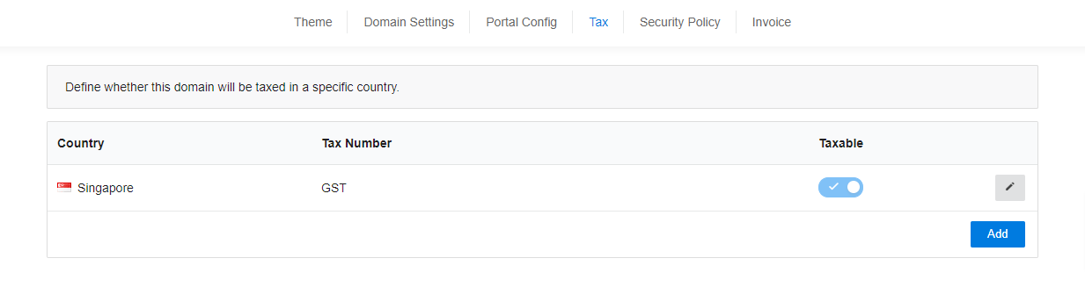
Tax: Set tax policies for the Domain
If a user (Customer) is located in a nation different from the taxed country, all their services purchased will NOT be taxed at all.

Slide 15
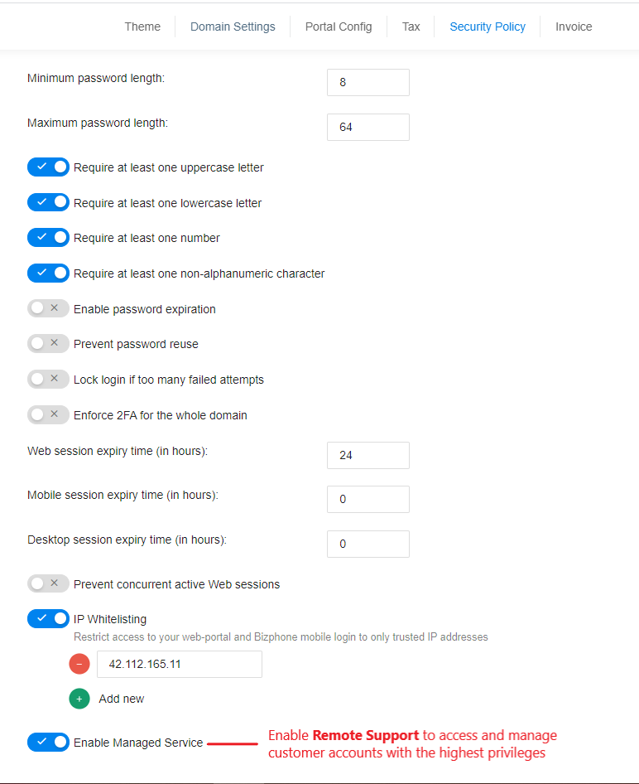
Security Policy: Each domain now has a domain security policy that allows the domain owner to:
Decide how their users set up a password and 2FA.
Configure IP Whitelisting: Restrict access to your web-portal and Bizphone mobile login to only trusted IP addresses
Enable Managed Service: Access and manage your customer accounts remotely with the highest privileges by using Remote Support in the Customer App.

Slide 16
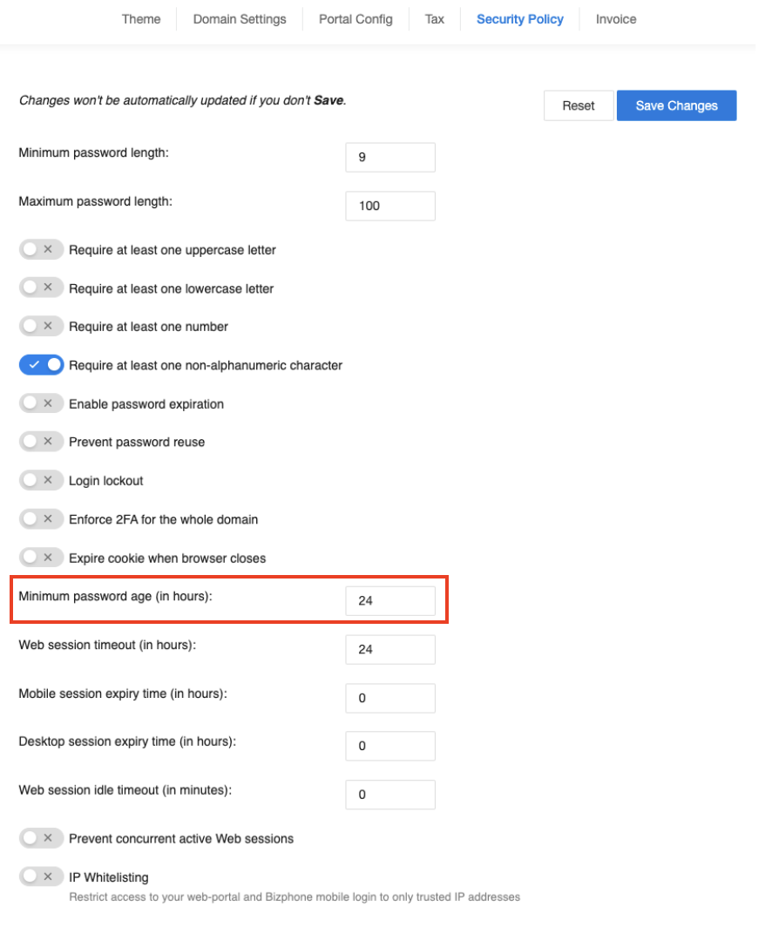
After users reset the password, they need to wait for a period of time (Default value: 24 hours) to change the password again.
For password reset (Forgot Password), the existing password reset email by user will continue to operate. There is no limit.
Note: Users can enter 0 to disable the functionality.

Slide 17
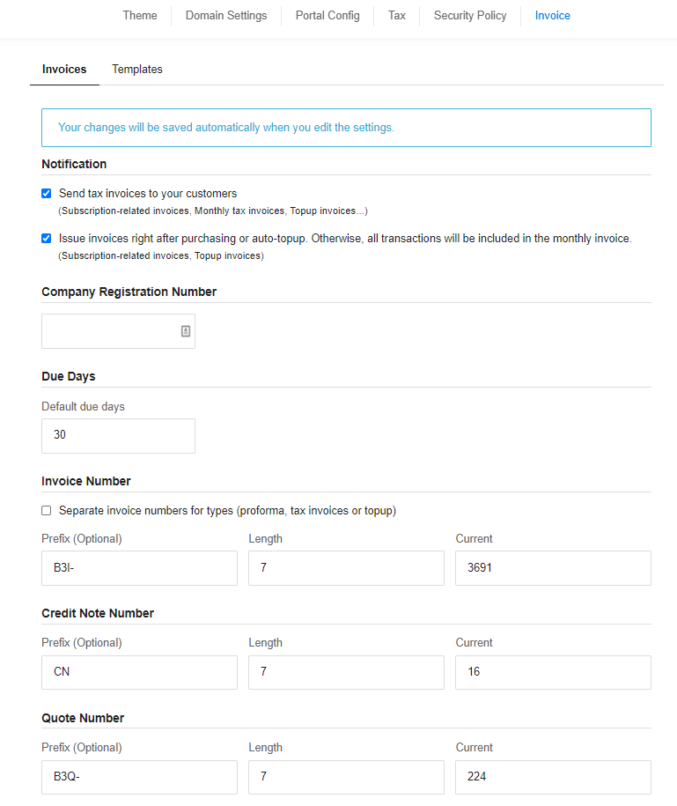
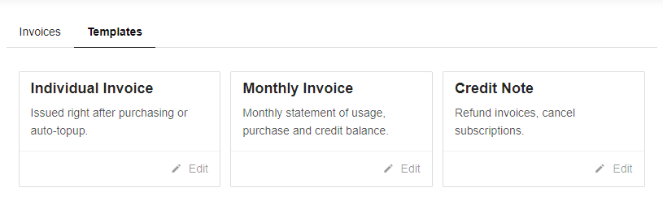
Invoice: This is where the management can configure the Invoice Settings and Templates if they are using the CPaaS Platform Invoicing system.
** Important note** The settings here will be applied to all your customers. Kindly be careful when enabling or disabling any feature.

Slide 18
Admin Audit
Allows the Telecom Operator’s management to audit all actions that have taken place within their portal.

Slide 19
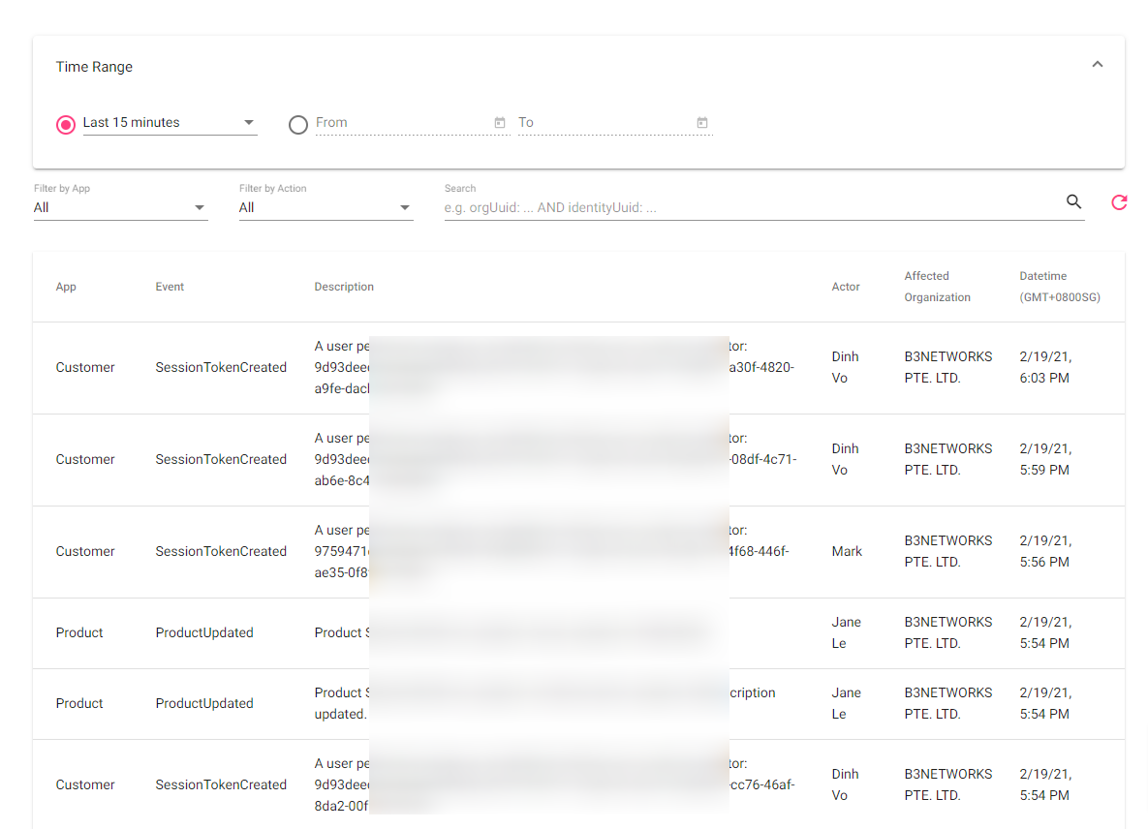
Management can select a time range or specify a date they wish to look into. From here, you can see details such as:
App: which app the change/activity took place
Event: what kind of event/action was done
Description: Details of the activity
Actor: who made the changes
Affected Organization: which organization was affected, and
Date/Time: the timestamp of the event/action.

Slide 20
Thank You
For comments and feedbacks please contact academy@b3networks.com

