Slide 1




QUICK HISTORY:
COURT OF JUSTICE OF THE EUROPEAN UNION (CJEU)

Slide 2

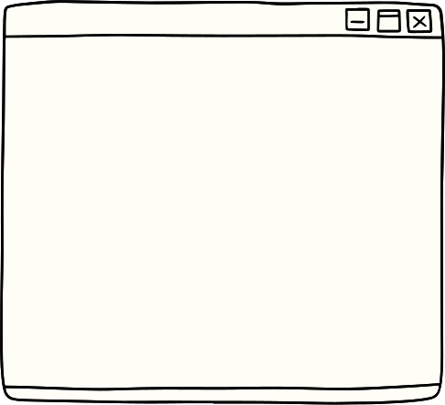
INTRODUCTION
  The CJEU, with its French acronym CJUE and Latin name Curia, stands as the judicial pillar of the European Union.
  It’s seated in in the Kirchberg quarter of Luxembourg City, Luxembourg.
  The CJEU is comprising two distinct courts: the Court of Justice and the General Court.
THE COURT OF JUSTICE
OF THE EUROPEAN UNION

Slide 3
  A look through history reveals the CJEU's roots in 1951 as the Court of Justice of the European Coal and Steel Communities.
  The 1957 integration of the Euratom and the European Economic Community resulted in a name change to the Court of Justice of the European Communities (CJEC).
Historical Evolution
In short:
  Established in 1951 as the Court of Justice of the European Coal and Steel Communities.
  Renamed to the Court of Justice of the European Communities in 1957.
  Requested the creation of a Court of First Instance in 1988.
  Added the Civil Service Tribunal in 2004.
  Treaty of Lisbon in 2009 renamed the court system to "Court of Justice of the European Union."

Slide 4
Historical Evolution
  A pivotal moment in 1988 when the Court requested the creation of a Court of First Instance, later materializing in 2004, including the addition of the Civil Service Tribunal for matters of public employment.
  The transformative Treaty of Lisbon in 2009 renamed the entire court system to the "Court of Justice of the European Union."
In short:
  Established in 1951 as the Court of Justice of the European Coal and Steel Communities.
  Renamed to the Court of Justice of the European Communities in 1957.
  Requested the creation of a Court of First Instance in 1988.
  Added the Civil Service Tribunal in 2004.
  Treaty of Lisbon in 2009 renamed the court system to "Court of Justice of the European Union."

Slide 5
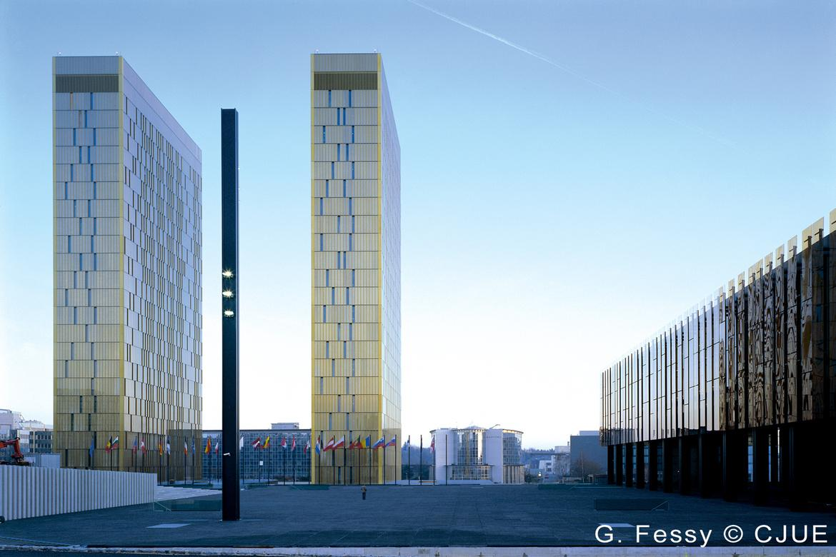
COMPOSITION OF CJEU
Delving into the composition of the CJEU reveals two pivotal courts:
Court of Justice (ECJ)
  Functioning as the court of final appeal, it hears applications for preliminary rulings, annulment, and appeals.
  It’s composed of one judge from each EU member country and 11 advocates general.

Slide 6

COMPOSITION OF CJEU
CJEU second pivotal court:
General Court
  Tasked with hearing applications for annulment, especially in areas like competition law, state aid, trade, agriculture, and trademarks.
  The court comprises 54 judges since 2020, though only 49 seats are currently filled.

Slide 7



Functions
Ensuring the observance of the law in the interpretation and application of the Treaties of the European Union.
Enforcing compliance by member states with their obligations under the Treaties.
Serving as the authoritative interpreter of European Union law.
Rigorous review of the legality of actions taken by EU institutions.

Slide 8


In short
  The CJEU plays a crucial role in ensuring the application and interpretation of EU law.
  Its evolution mirrors the changes within the European Union's legal framework, adapting to meet the challenges of a growing and diverse union.
  The working language of the CJEU is French.

Slide 9
Thank you for being here today!

