Slide 1

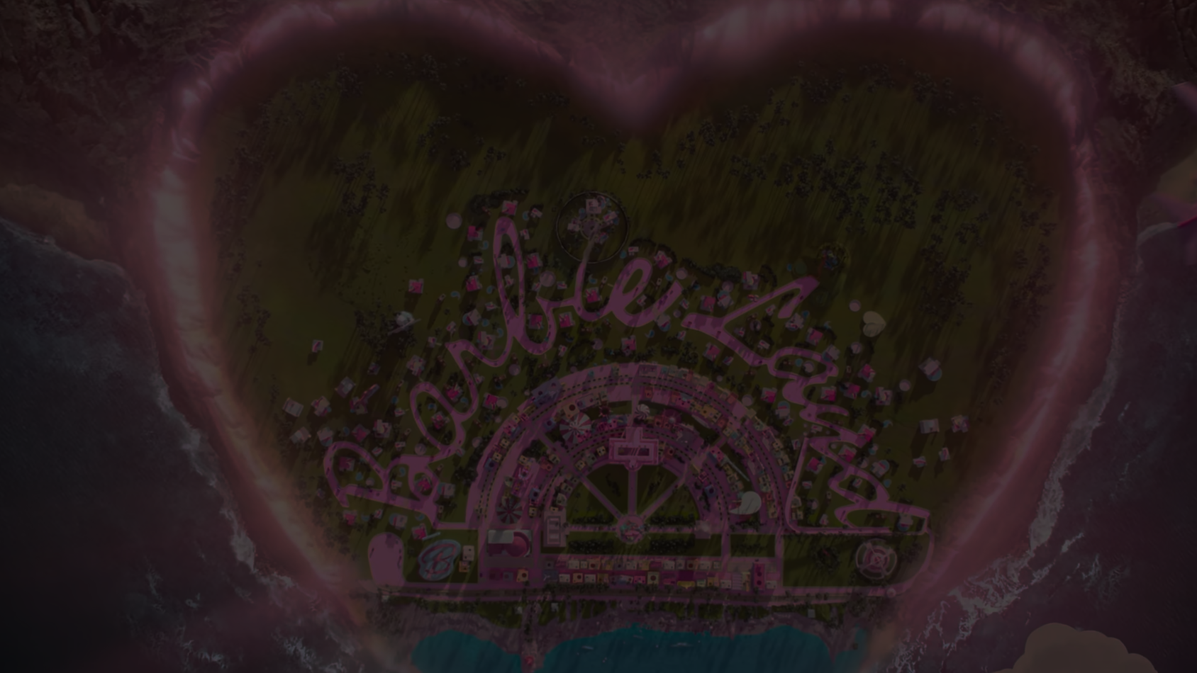



Barbie is an upcoming American fantasy comedy film directed by Greta Gerwig, who wrote the screenplay with
Noah Baumbach.
Based on the Barbie fashion dolls by Mattel and inspired by the 1994 non-fiction book Reviving Ophelia by Mary Pipher, the film is the first live-action Barbie film after several computer-animated direct-to-video and streaming television films.
PowerPoint
presentation

Slide 2
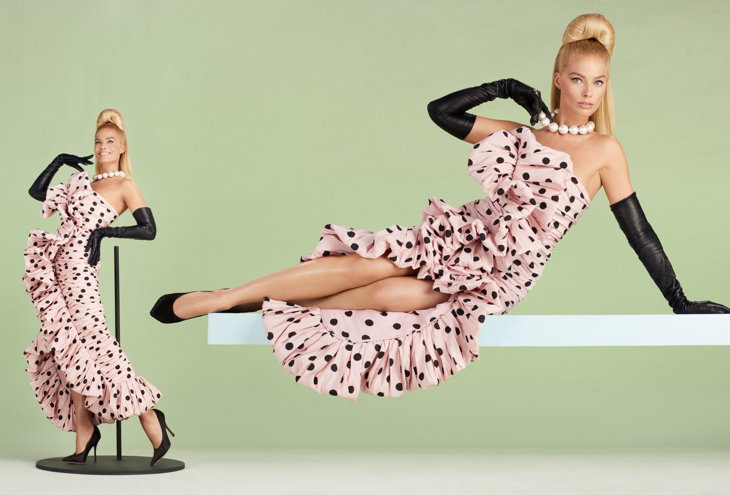

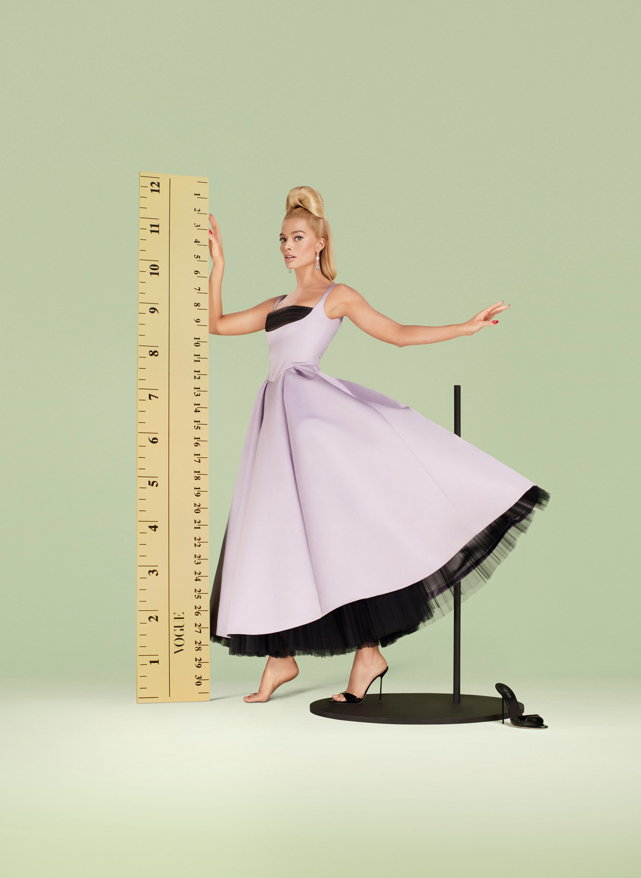
Barbie is an upcoming American fantasy comedy film directed by Greta Gerwig, who wrote the screenplay with
Noah Baumbach.
Based on the Barbie fashion dolls by Mattel and inspired by the 1994 non-fiction book Reviving Ophelia by Mary Pipher, the film is the first live-action Barbie film after several computer-animated direct-to-video and streaming television films.
Barbie is scheduled to be released in the United States on July 21, 2023, by Warner Bros. Pictures.
After being expelled from Barbie land for being a less-than-perfect doll, Barbie sets off to the real world to find true happiness.
PowerPoint
presentation

Slide 3

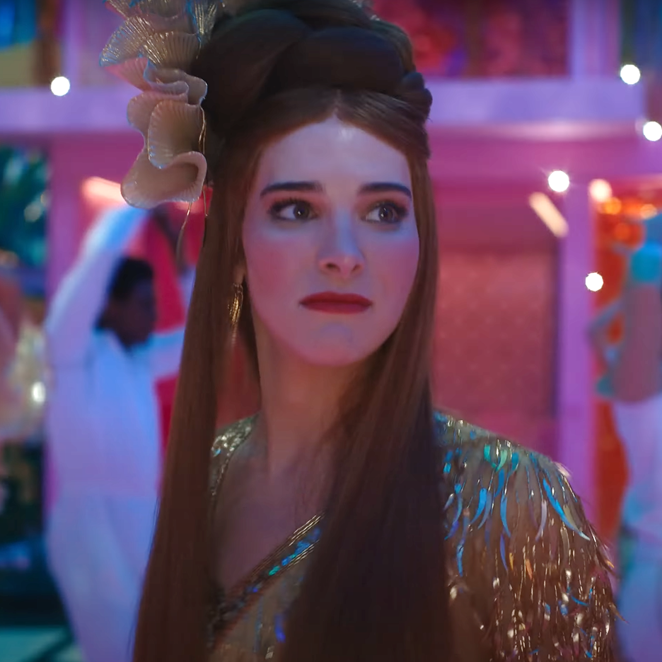
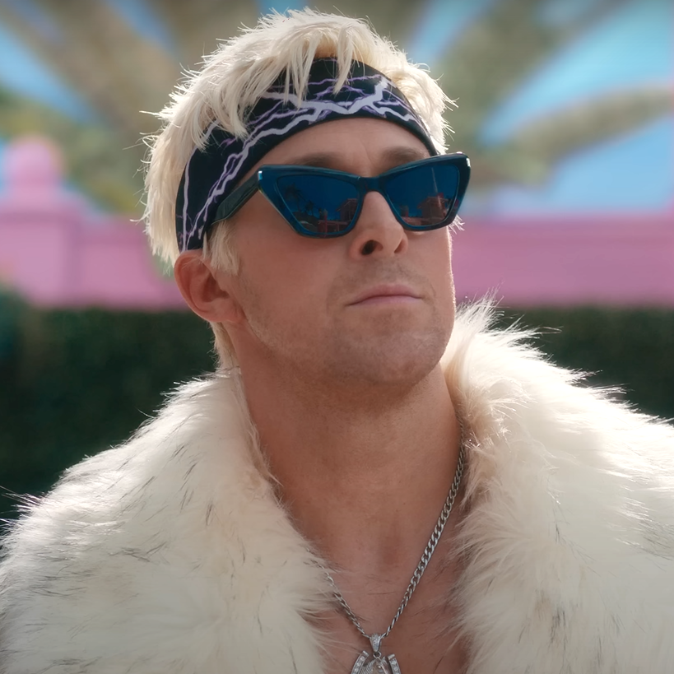
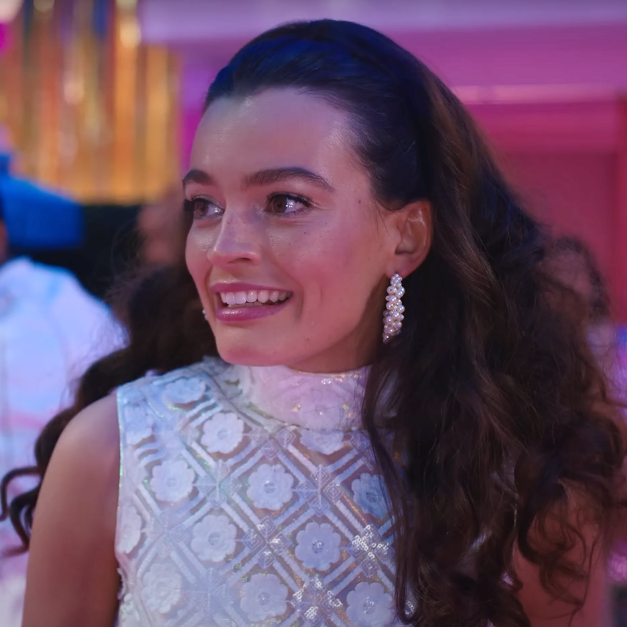
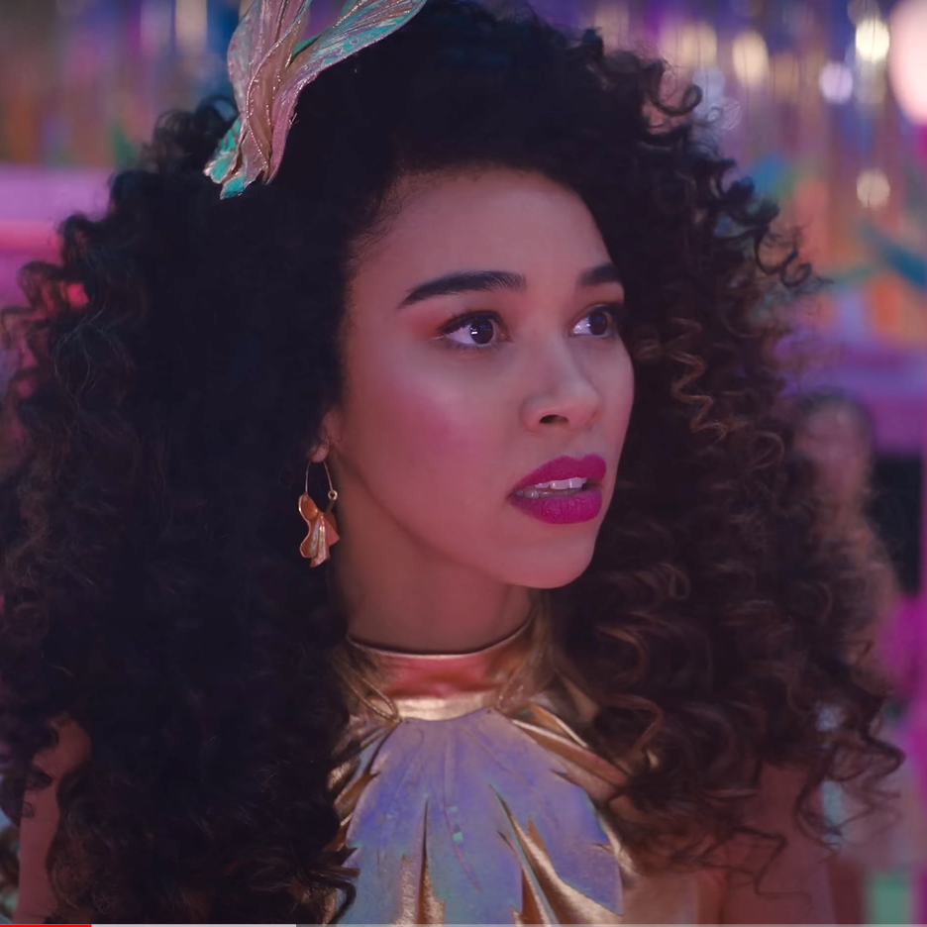
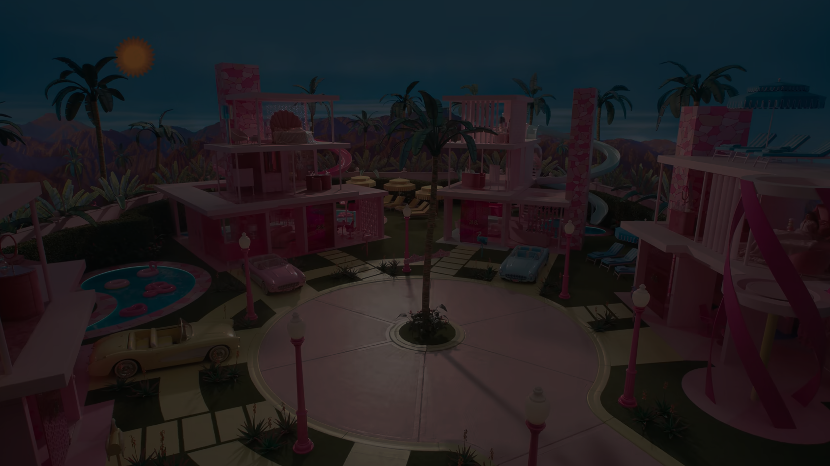
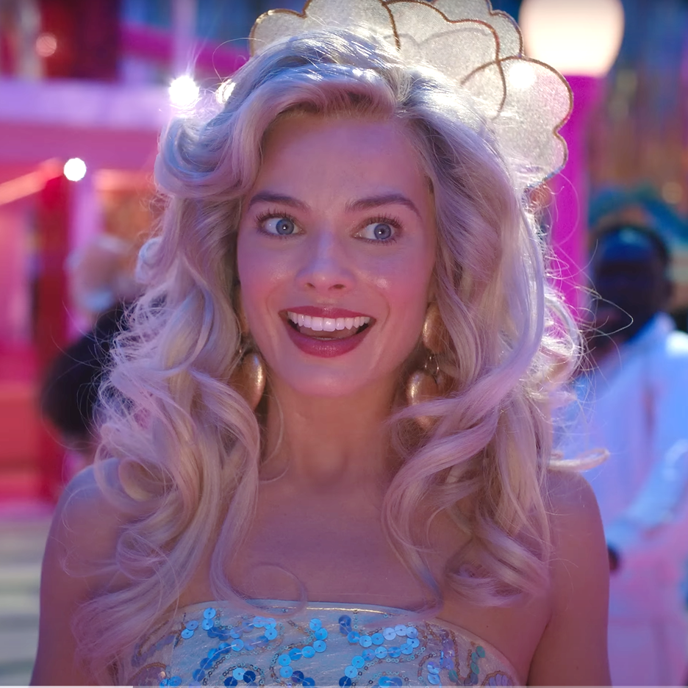
c a s t
Barbie is an upcoming American fantasy comedy film directed by Greta Gerwig, who wrote the screenplay with
Noah Baumbach.
Based on the Barbie fashion dolls by Mattel and inspired by the 1994 non-fiction book Reviving Ophelia by Mary Pipher, the film is the first live-action Barbie film after several computer-animated direct-to-video and streaming television films.
Barbie is scheduled to be released in the United States on July 21, 2023, by Warner Bros. Pictures.
After being expelled from Barbie land for being a less-than-perfect doll, Barbie sets off to the real world to find true happiness.

Slide 4
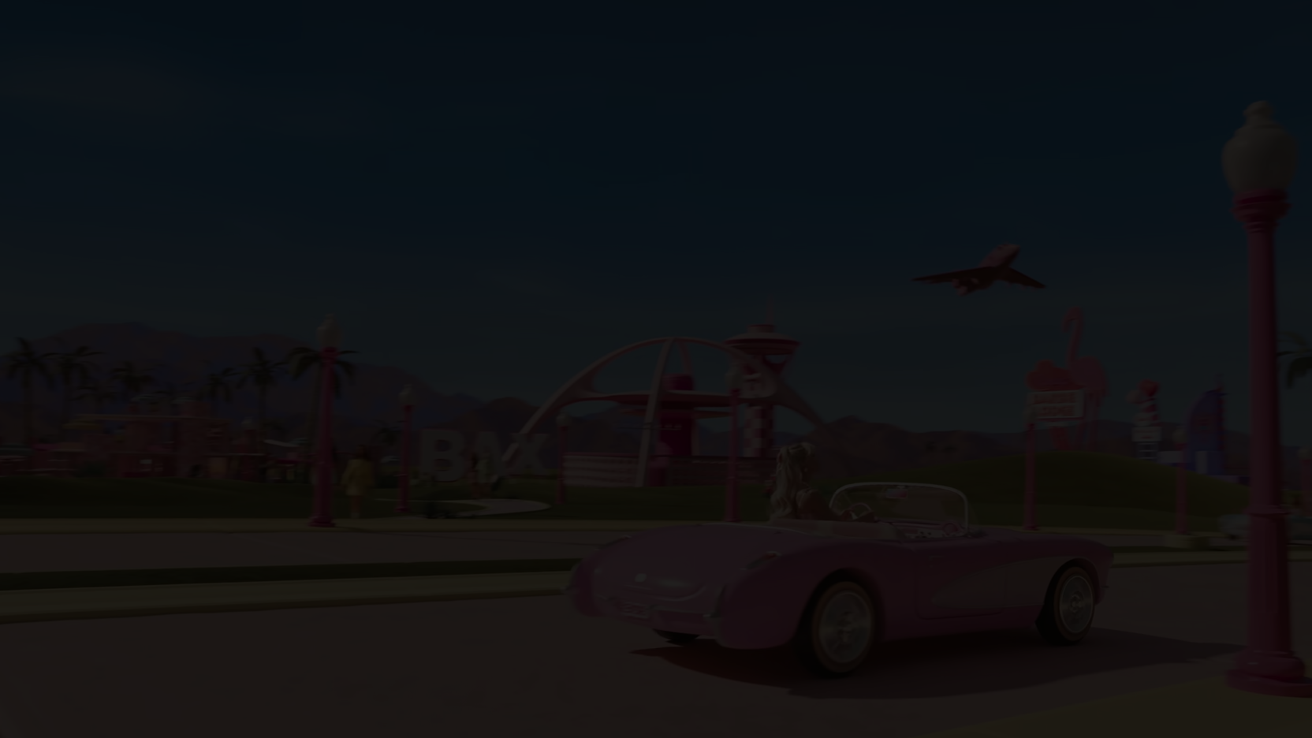
Barbie is scheduled to be released in the United States on July 21, 2023, by Warner Bros. Pictures.
c a s t
After being expelled from Barbie land for being a less-than-perfect doll, Barbie sets off to the real world to find true happiness.

Slide 5
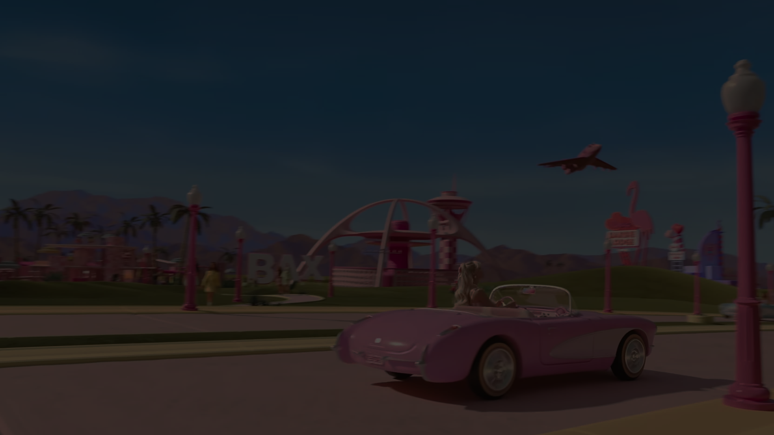

c a s t

