Slide 1


ECONOMY AND GOVERNMENT

Slide 2


In this chapter we will study
• Relation between Government and economy
• Planning in India • Five year plans and achievements
• Green Revolution

Slide 3
The main objective of economic system is human welfare government works towards human welfare
❖ with the end of 19th century government involved in national security justice and law and order
❖ with the rise of welfare state in 20 century government came forward to provide food, cloth, shelter, education, communication

Slide 4

❖ Economic fluctuations means fluctuation in national income production employment investment and price
❖ economic stability: Economy move towards progress without extreme fluctuation

Slide 5
Income and wealth generated in the country should be distributed as equally as possible to everybody without discrimination. It is called Social Justice
❖ In 1929 Soviet Russia implemented an economic plan to achieve faster economic development

Slide 6
Developing countries
Generally, in developing countries, many problems arise due to unemployment, poverty, agricultural backwardness, unequal distribution of income and wealth.
Government mediation becomes inevitable in solving such problems. Developing countries also lack basic amenities like transport, communication, electricity, education, health etc

Slide 7
Planning in India
‘The conscious and wise process through which, with certain specific objectives, utilizes the country’s resources in a profitable manner in order to secure maximum satisfaction of its people is called ' planning

Slide 8
In order to attain the people’s welfare, the Government keeping the available resources in mind, on a priority basis, takes various decisions relating to what should be produced? How much should be produced? and How should the product be distributed?

Slide 9
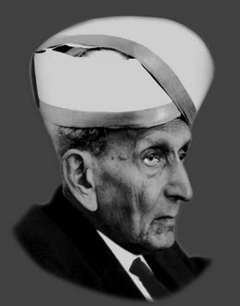
Modern planning was first conceived in India by Bharat Ratna Sir.M.Visvesvaraya.
In 1934, he published a book titled ‘Planned Economy for India’ in which he stressed the need for planning to achieve economic development in India. Hence, he is regarded as ‘Father of Economic Planning in India’

Slide 10
Government formed the National Planning Commission in 1950. The Prime Minister is its Chairman.
❖ The main objective of the commission is to precisely estimate the natural and human resources and capital in the country, and to prepare plans for effective utilization of these resources.

Slide 11
In 1952 the ‘National Development Council’ was established. The chief ministers of all the states are members of this board.
It approves the draft copy of the five-year plans prepared by the National Planning Commission.

Slide 12
Five year plans in India
India's First Five-year plan came to effect on 1st April 1951. Till now, eleven five-year plans have been implemented.
Eradication of poverty and improving the standard of living is one of the primary objectives of India's five year plans.

Slide 13
Objectives of five year plan
1. Increasing the production to the maximum extent possible.
2. Increasing the employment opportunities.
3. Reducing the economic disparities.
4. Ensuring economic stability.
5. Modernizing the economy etc

Slide 14
Achievements of five year plans
❖ the rate of growth of the national income has increased gradually
❖ The major contribution to the national income has been from the service sector at 59%.
❖ Self-sufficiency has been achieved in the production of food grains.
❖ Employment opportunities have increased with the expansion of industry and the service sector.

Slide 15
❖ Poverty alleviation and employment-generation program.
❖ Modern technology is being used in the agricultural, industrial and service sectors
❖ The exports of manufacturing and engineering products have increased to a great extent.
❖ Inclusive growth has become the priority of 11th and 12th five year plans

Slide 16
❖ Life expectancy and literacy rate of people have improved.
❖ Rate of infant mortality and post-natal mortality has reduced.
❖ Birth and death rates have reduced, and the rate of population growth is also decreasing

Slide 17
Green Revolution:
❖ ‘Revolution’ means ‘quick change or progress’.
❖ The drastic increase in food grain production during the period is called the Green Revolution.
❖ The Green Revolution was the consequence of using ‘high yielding seeds’. In the beginning of 1960

Slide 18

❖ Dr.Norman Borlaug a German agricultural scientist conducted many experiments in Mexico, the result of which was the discovery of high-yielding wheat grains

Slide 19
❖ Agricultural production dropped drastically in India in the year 1965-66 due to severe drought. There was a grave scarcity of food grains.
To resolve this problem, in 1966, the Indian government initiated the usage of high-yielding variety seeds of wheat in the states of Punjab,Haryana, Delhi, Rajasthan and Eastern parts of Uttar Pradesh

Slide 20
Growing crops using high-yielding grains involves
❖ providing specific nutrients,
❖ Regulated supply of water and protection from diseases.
❖ the use of chemical fertilizers and pesticides and
❖ Irrigation facilities were also initiated with the usage of high yielding variety seeds.
❖ Irrigation facilities were expanded. As a result, production of wheat increased immensely.
It is called Pre harvest technology

Slide 21
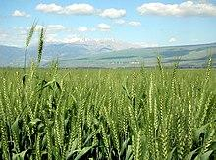






Slide 22
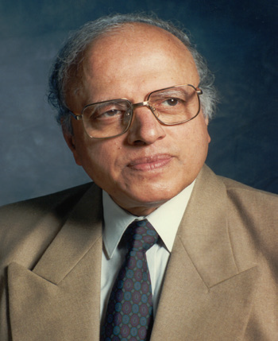
The role of Dr. M.S.Swaminathan, agricultural scientist in implementing the improved technology in Indian agriculture is significant. Hence he is called ‘the father of Green Revolution’.
He died on 28 September 2023. His contribution to the field of agriculture is ever remembered.
He is honored with the first World Food Prize in 1987.
Recognizing Sri M.S. Swaminathan’s contribution to the Green Revolution, the Government of India has conferred posthumously the highest civilian award ‘Bhrat Ratna’ to him in 2024

Slide 23
‘Post-Harvest Technology
It became necessary to construct granaries and cold-storage warehouses to store the surplus produce. The latest technology had to be implemented for providing all these facilities. The improved technology that is used to procure, process and market agricultural produce is called ‘Post-Harvest Technology

Slide 24
Second Green Revolution’ or ‘Perpetual Green Revolution
In order to solve the problems in the agricultural sector efforts are made to promote organic and natural farming in Indian agriculture.
The nature friendly techniques of productions are the need of the hour. Government is making efforts to further increase agricultural production through these techniques

Slide 25
NITI Aayog
National Institution for Transforming India was started on 1st Jan 2015 to replace planning commission
It is headed by the Prime Minister of the Country. But day to day administration is looked after by the vice - chairman.

Slide 26
Objectives:
1) to evolve a shared vision of national development priorities, sectors and strategies with the active involvement of states.
2) To faster cooperative federalism through structured support initiatives and mechanisms with the states on a continuous basis, recognizing that strong states make a strong nation

Slide 27
Features:
❖ NITI Aayog is developing itself as a state of the art resource center with the necessary knowledge and skills
❖ Provide strategic policy vision for the Government and deal with contingent issues.
❖ It is supported by two attached offices. Atal Innovation Mission and Development Monitoring and Evaluation organization and an autonomous body, National Institute of labor Economics Research and Development

Slide 28
NITI Aayog’s activities can be divided into four main heads
1. Policy and Programme framework
2. Co-operative Federalism
3. Monitoring and evaluation
4. Think and knowledge and innovation hub

Slide 29

Thank you
Prepared by:
Praveen Banakar

