Slide 1

Evidence-Based Education Policy:
An Oxymoron
Randy Keyworth, MSW
The Wing Institute

Slide 2
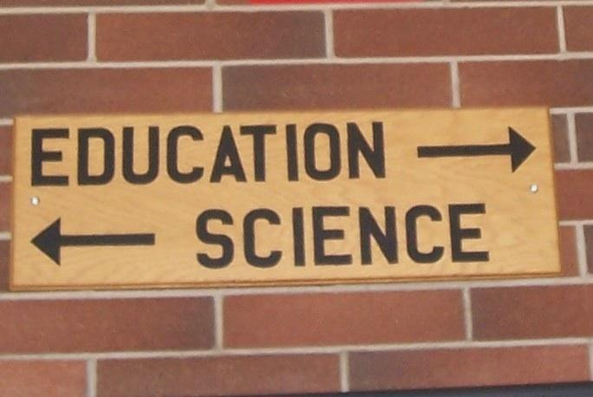

Slide 3
MSW, University of Michigan ’77
practice – policy - advocacy
Spectrum Center (1978 – 2004)
policy development, implementation, evaluation, advocacy
The Wing Institute (2004-present)
evidence-based education research and policy

Slide 4
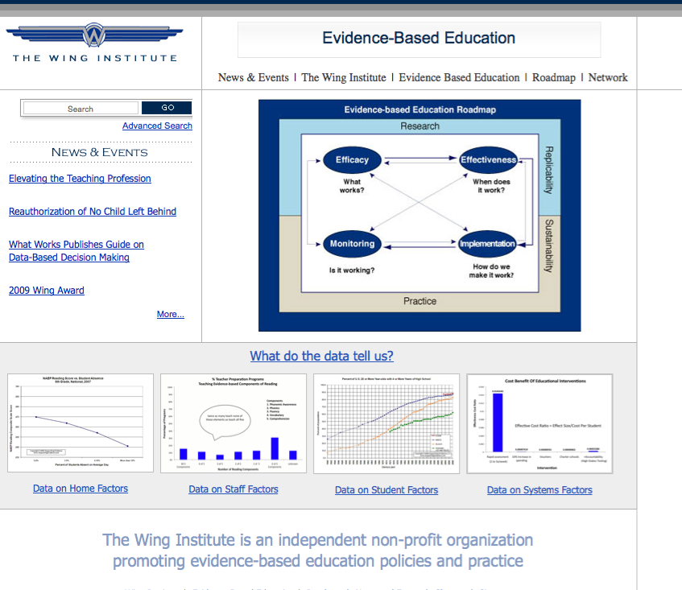

Slide 5
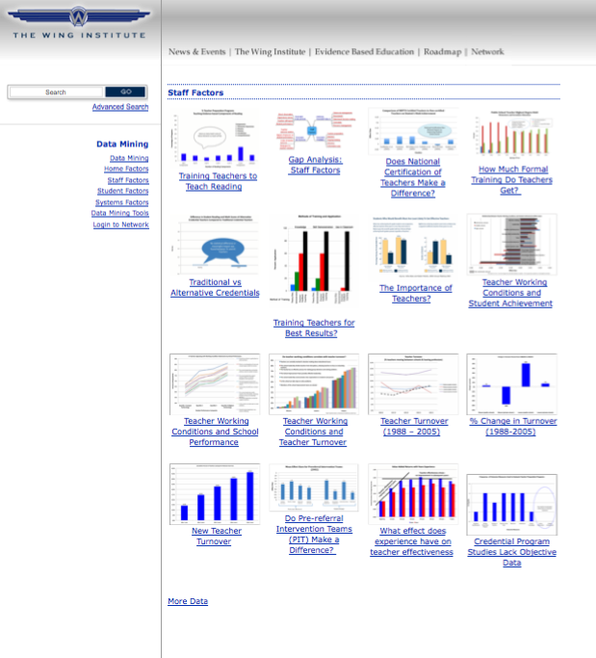

Slide 6
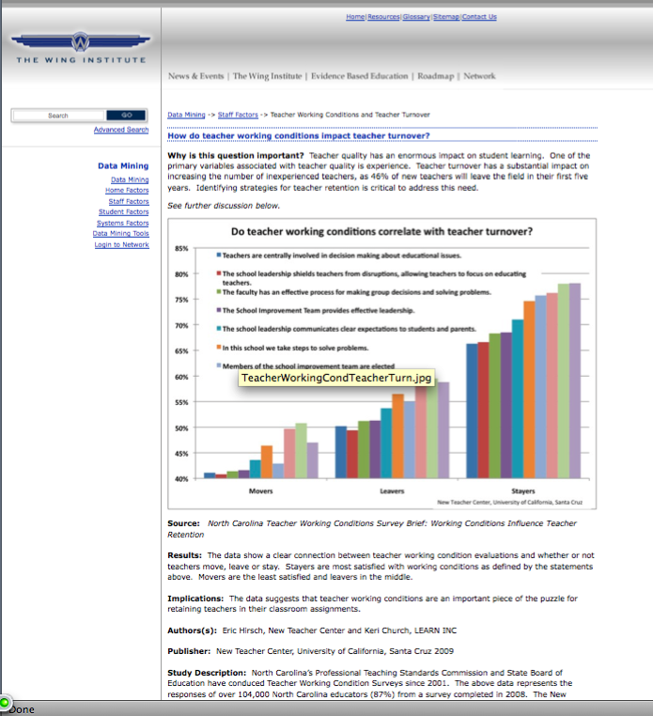

Slide 7
Today’s “Narrative”
Education policy is social policy.
Scientific evidence and performance feedback are a crucial component of effective social policies.
Education policy has failed to date due to its lack of adherence to evidence-based policy and performance feedback
Recent scientific evidence suggests education policy is in need of a radical overhaul.
There is hope.

Slide 8
National Assessment of Educational Progress (NAEP)
Only nationally representative and continuing assessment of what America’s students know and can do in: math, reading, science, writing, the arts, civics, economics, geography, and U.S. History.
Common metric for all states
Stays the same each year with carefully documented changes
Administered by National Center for Education Statistics (NCES) within the Institute of Education Sciences within the U.S. Department of Education
Provides a clear picture of student academic progress over time
Tests are continually scrutinized for reliability and validity by panels of technical experts within NCES and by external groups.

Slide 9
National Assessment of Educational Progress (NAEP)
Basic denotes partial mastery of prerequisite knowledge and skills that are fundamental for proficient work at each grade.
Proficient represents solid academic performance. Students reaching this level have demonstrated competency over challenging subject matter.
Advanced represents superior performance.
Grade 4 Grade 8 Grade 12
Basic = 208 Basic = 243 Basic = 265
Proficient = 238 Proficient = 281 Proficient = 302
Advanced = 268 Advanced = 323 Advanced = 346

Slide 10
Education Policy is Social Policy

Slide 11
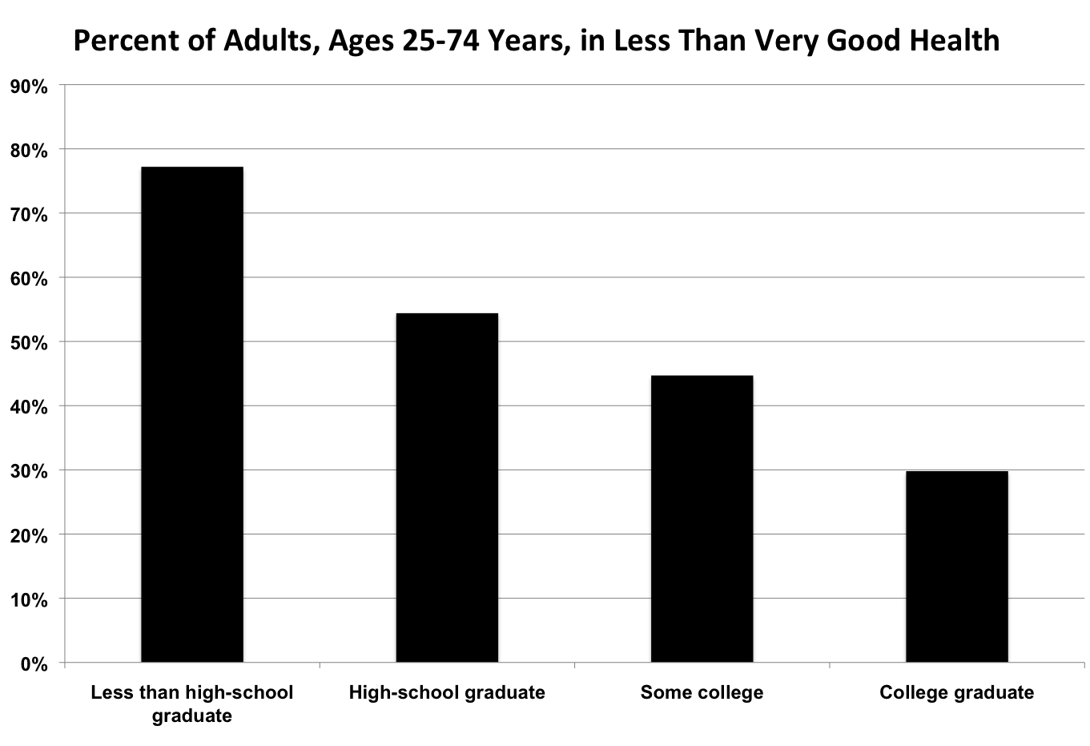
REACHING AMERICA'S HEALTH POTENTIAL: A STATE-BY-STATE LOOK AT ADULT HEALTH Commission to Build a Healthier America May 2009 U.S. Census Data: American Community Survey (2007) U.S. Census Data: Behavioral Risk Factor Surveillance System Survey Data (2005-2007)

Slide 12
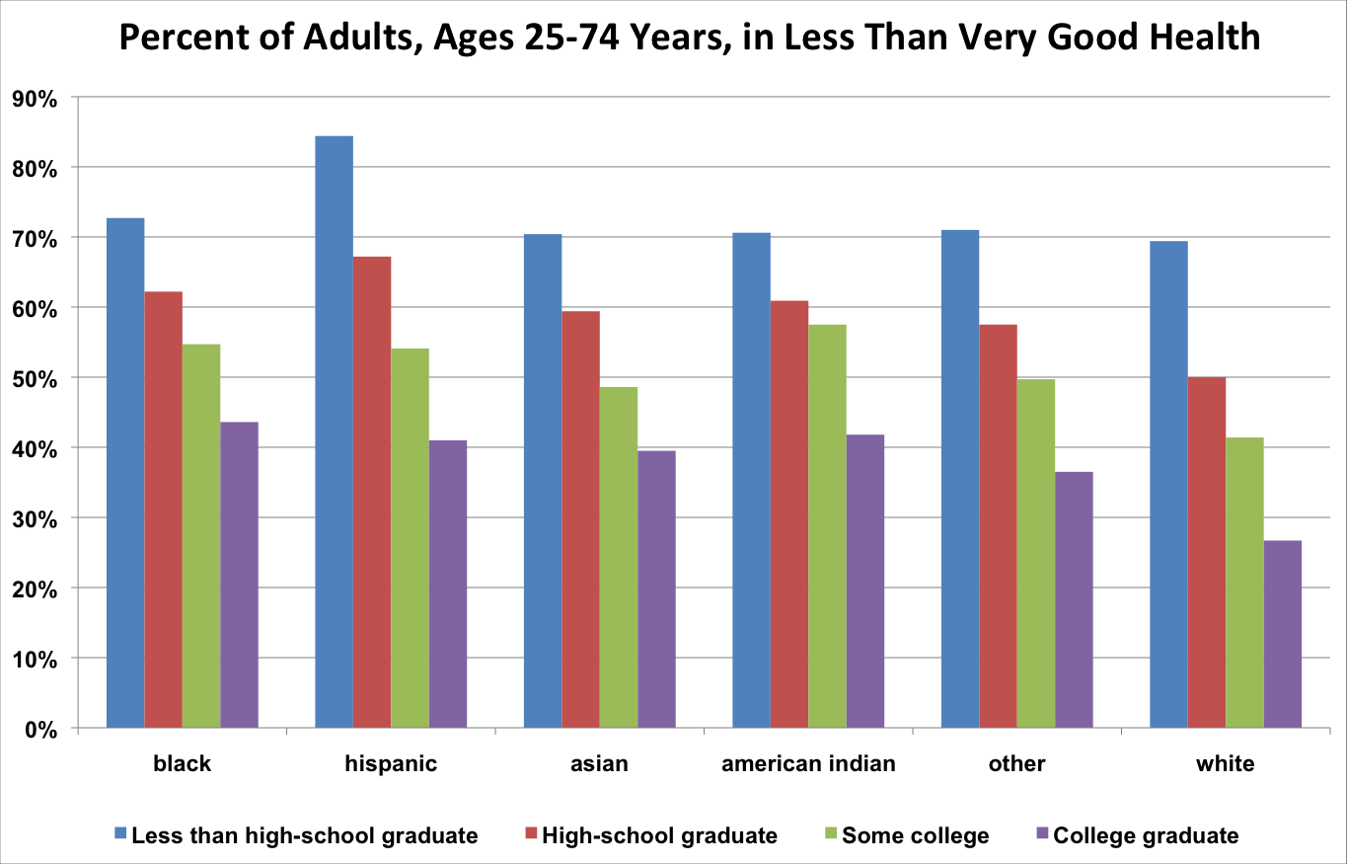
REACHING AMERICA'S HEALTH POTENTIAL: A STATE-BY-STATE LOOK AT ADULT HEALTH Commission to Build a Healthier America May 2009 U.S. Census Data: American Community Survey (2007) U.S. Census Data: Behavioral Risk Factor Surveillance System Survey Data (2005-2007)

Slide 13
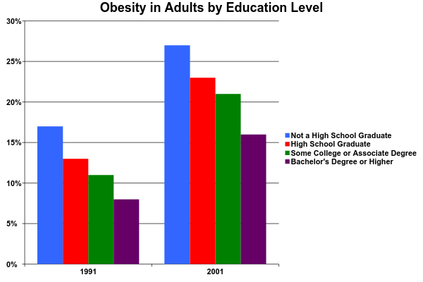
SOURCE:
Department of Health and Human Services (2003)
Notes:
Can’t find the linked file

Slide 14
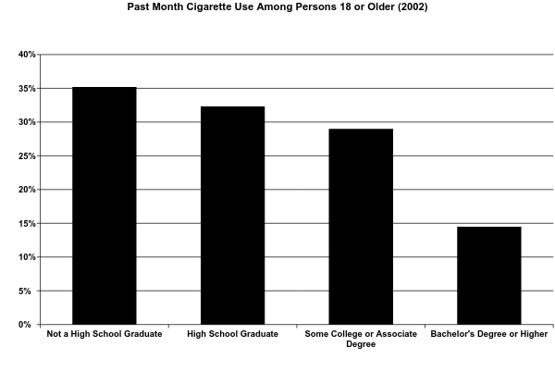
SOURCE:
Department of Health and Human Services (2003)
Notes:
Can’t find linked file

Slide 15
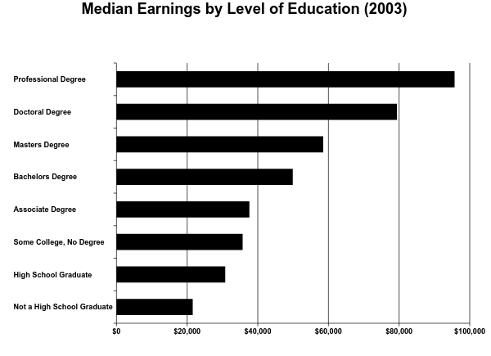
U.S. Census Bureau, 2004
Notes:
Can’t find linked file

Slide 16
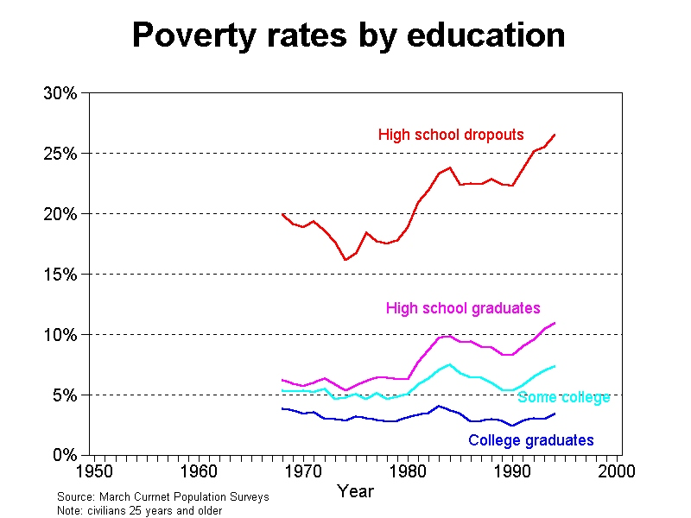
University of Maryland, Department of Sociology

Slide 17
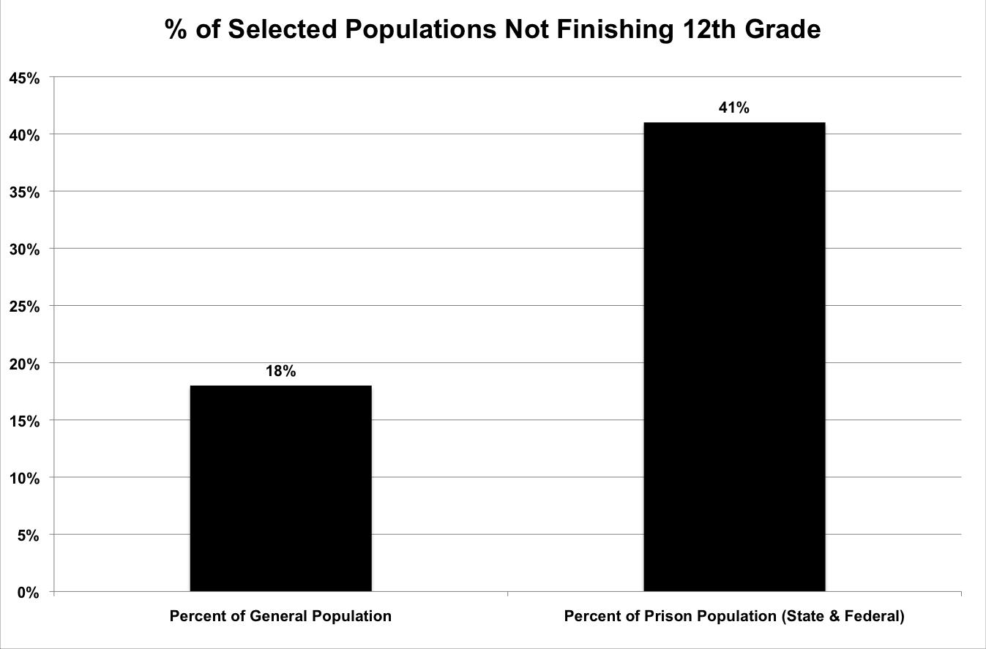
Source: U.S. Department of Justice (2003)

Slide 18
Education is the civil rights issue of our generation.
Arne Duncan Secretary of Education 2009

Slide 19
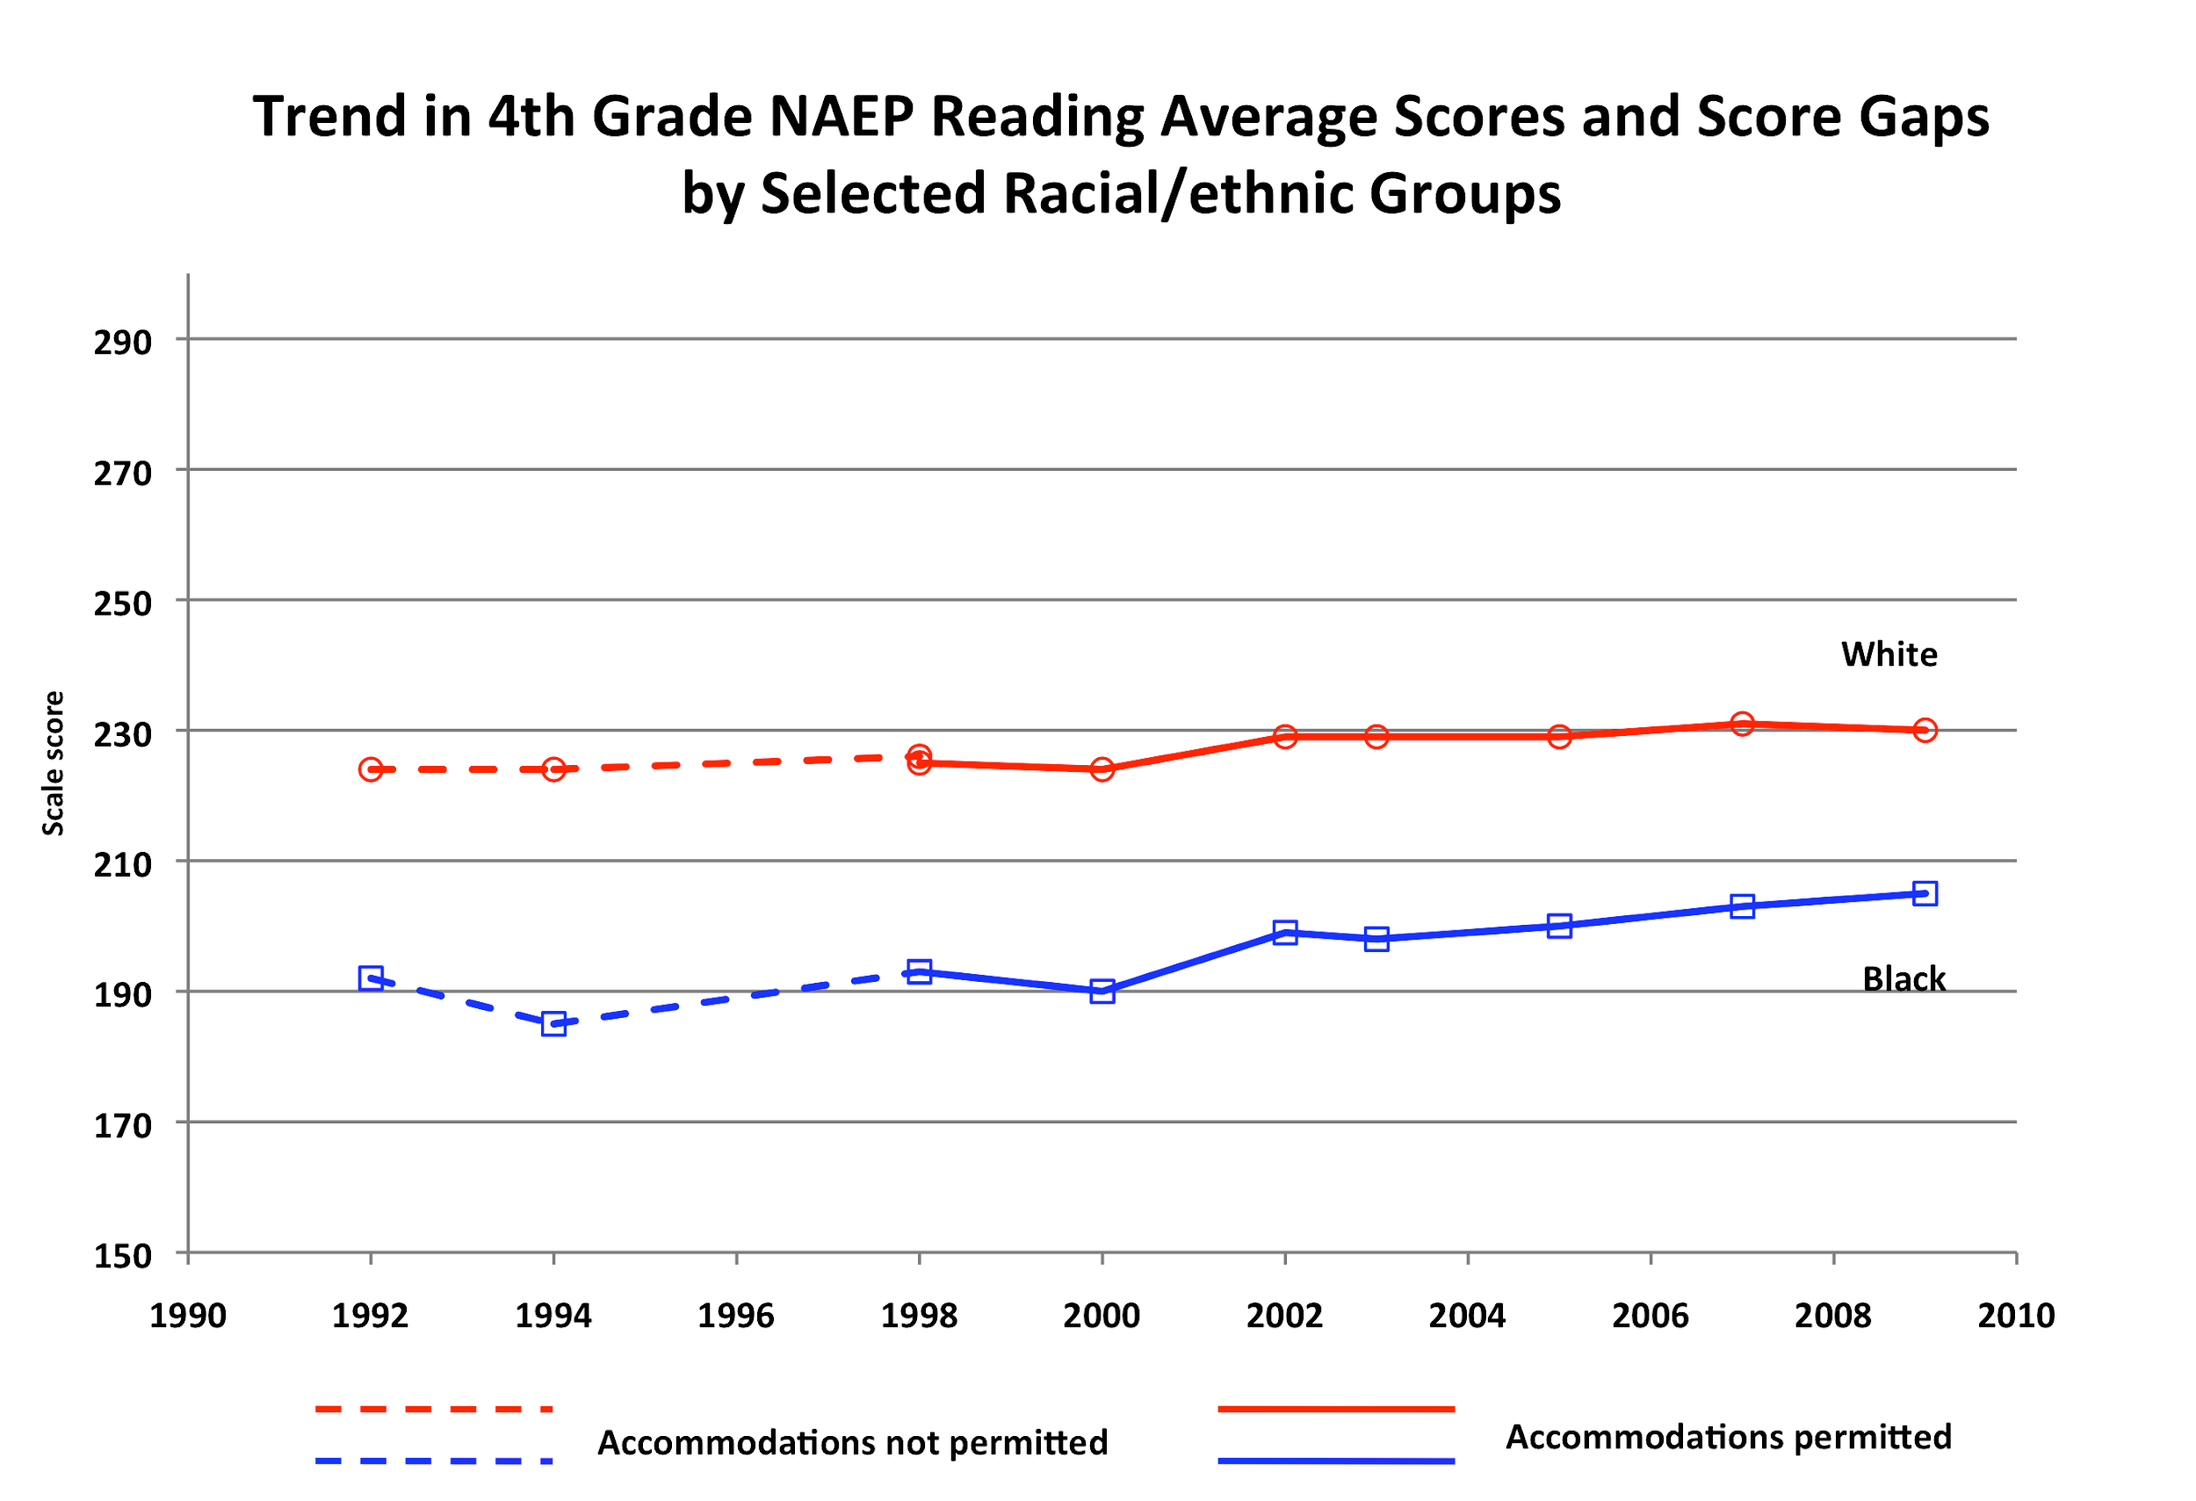

Slide 20
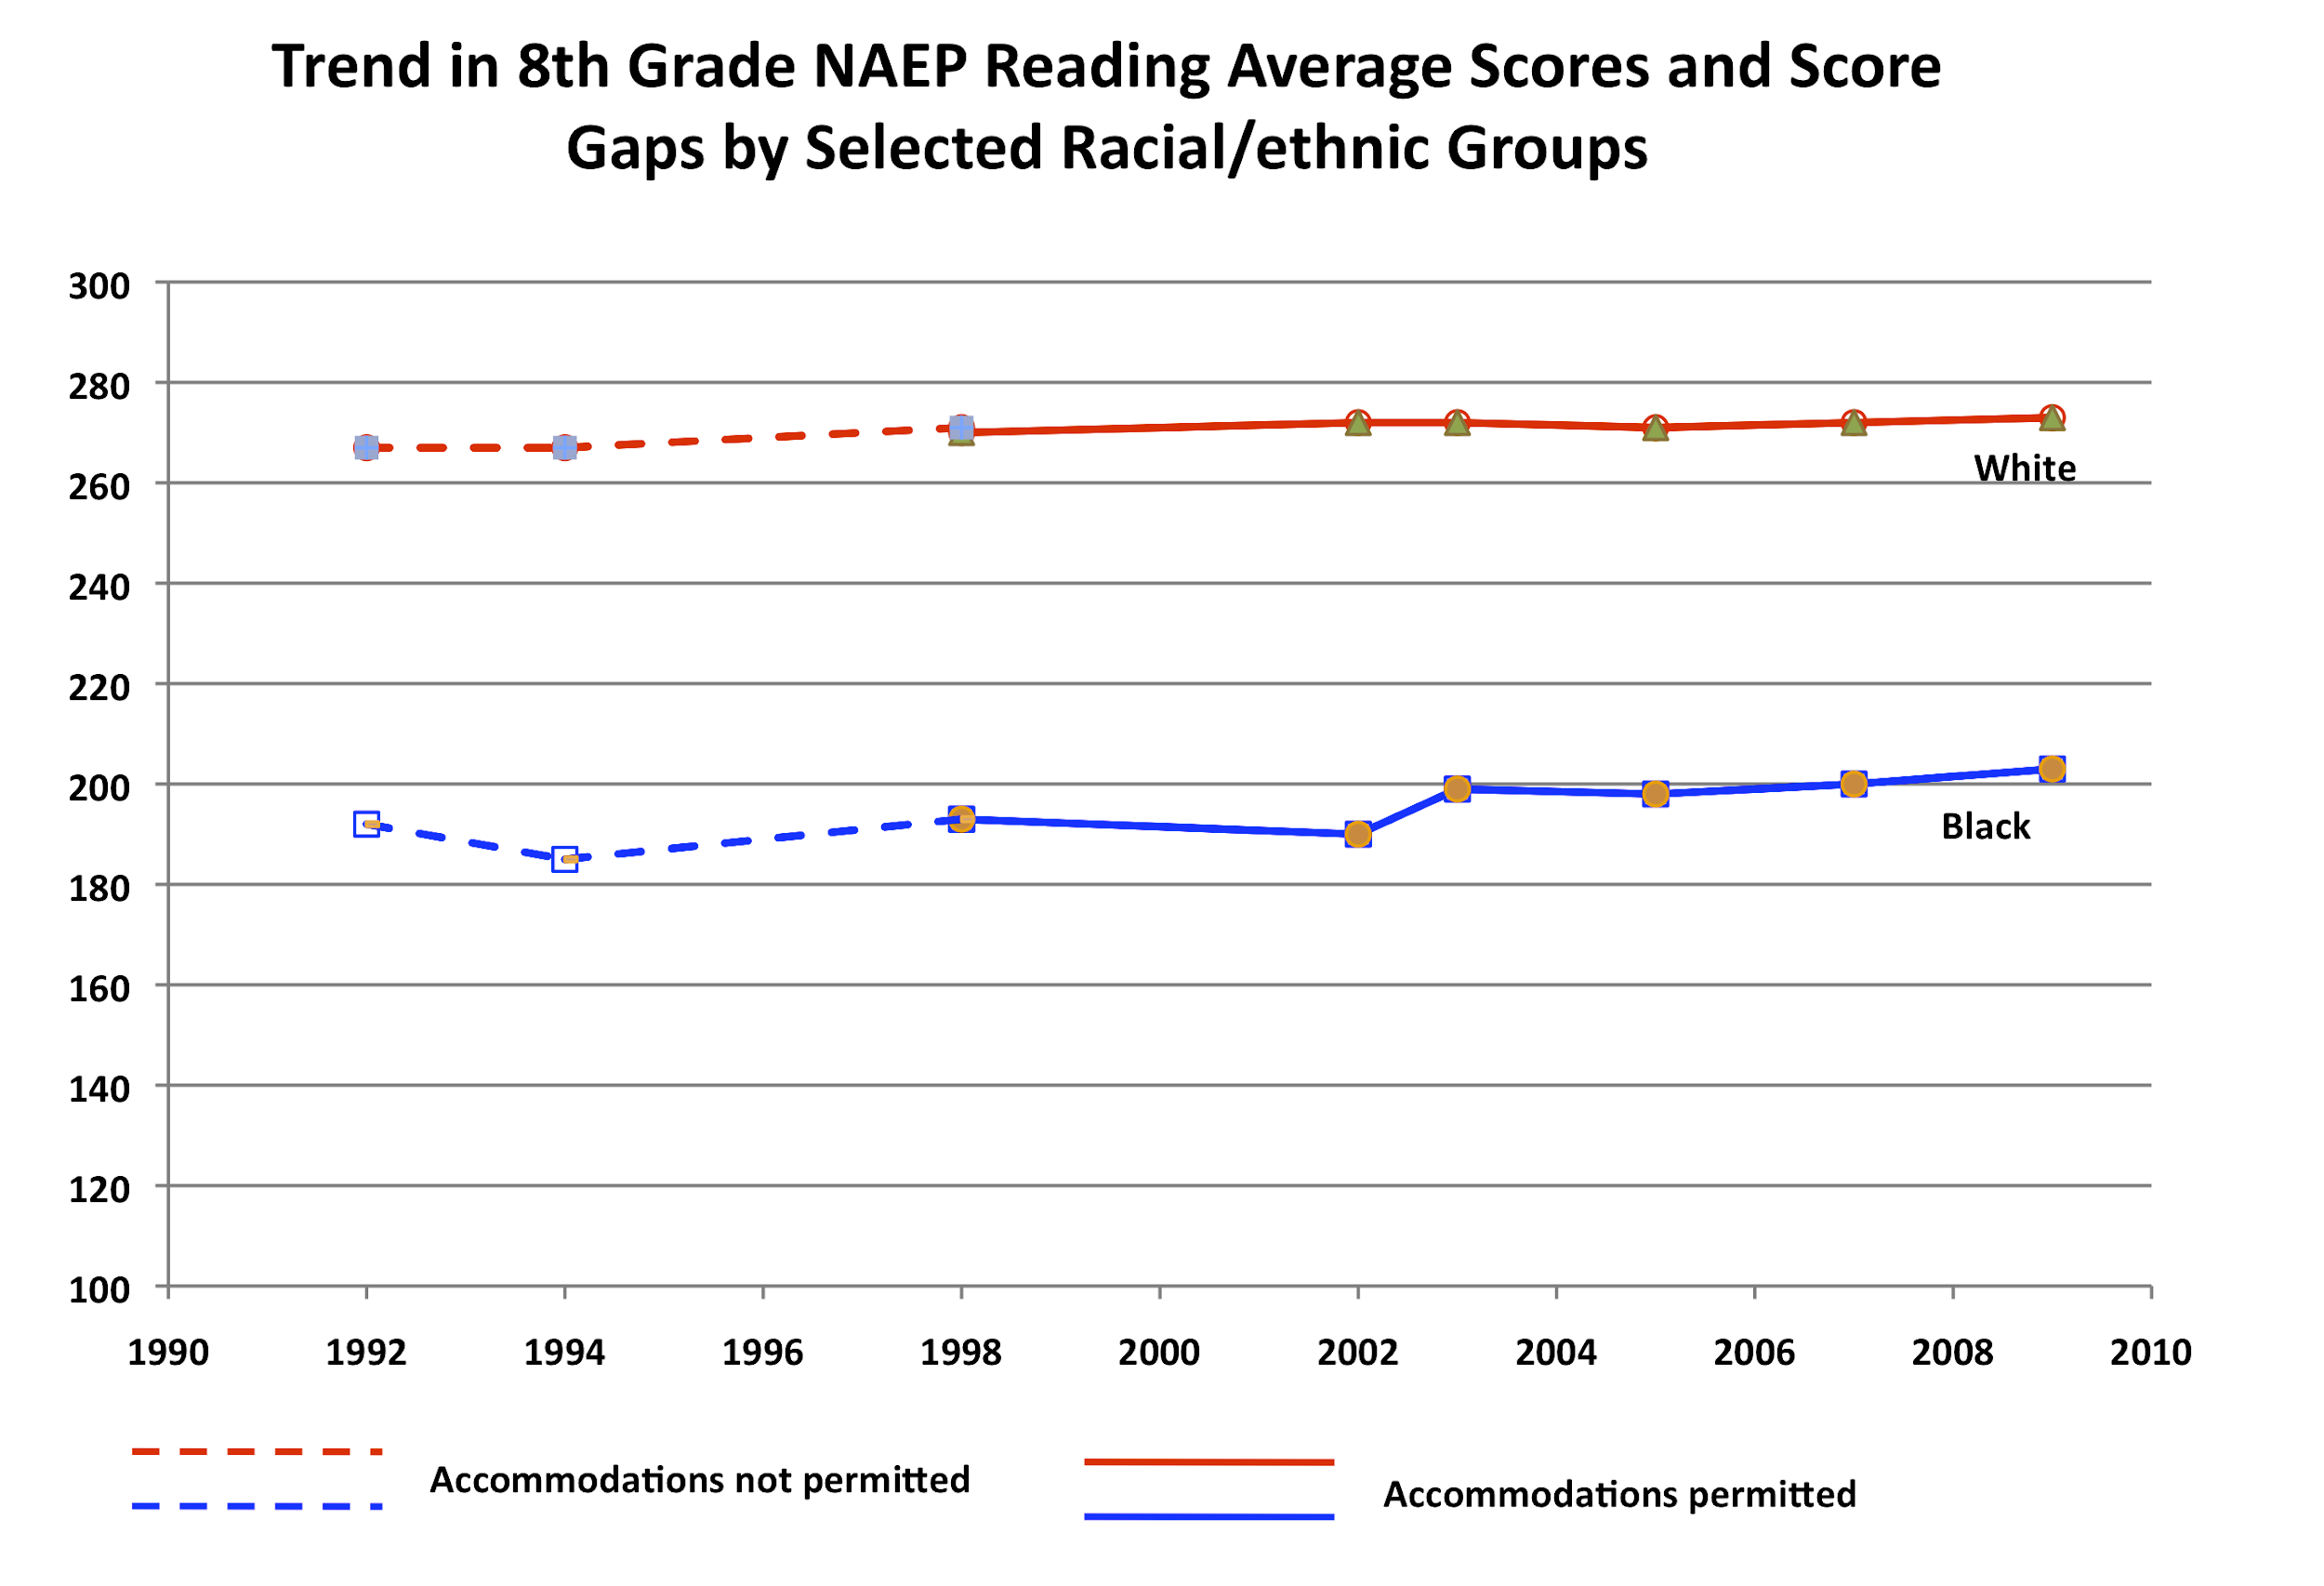

Slide 21
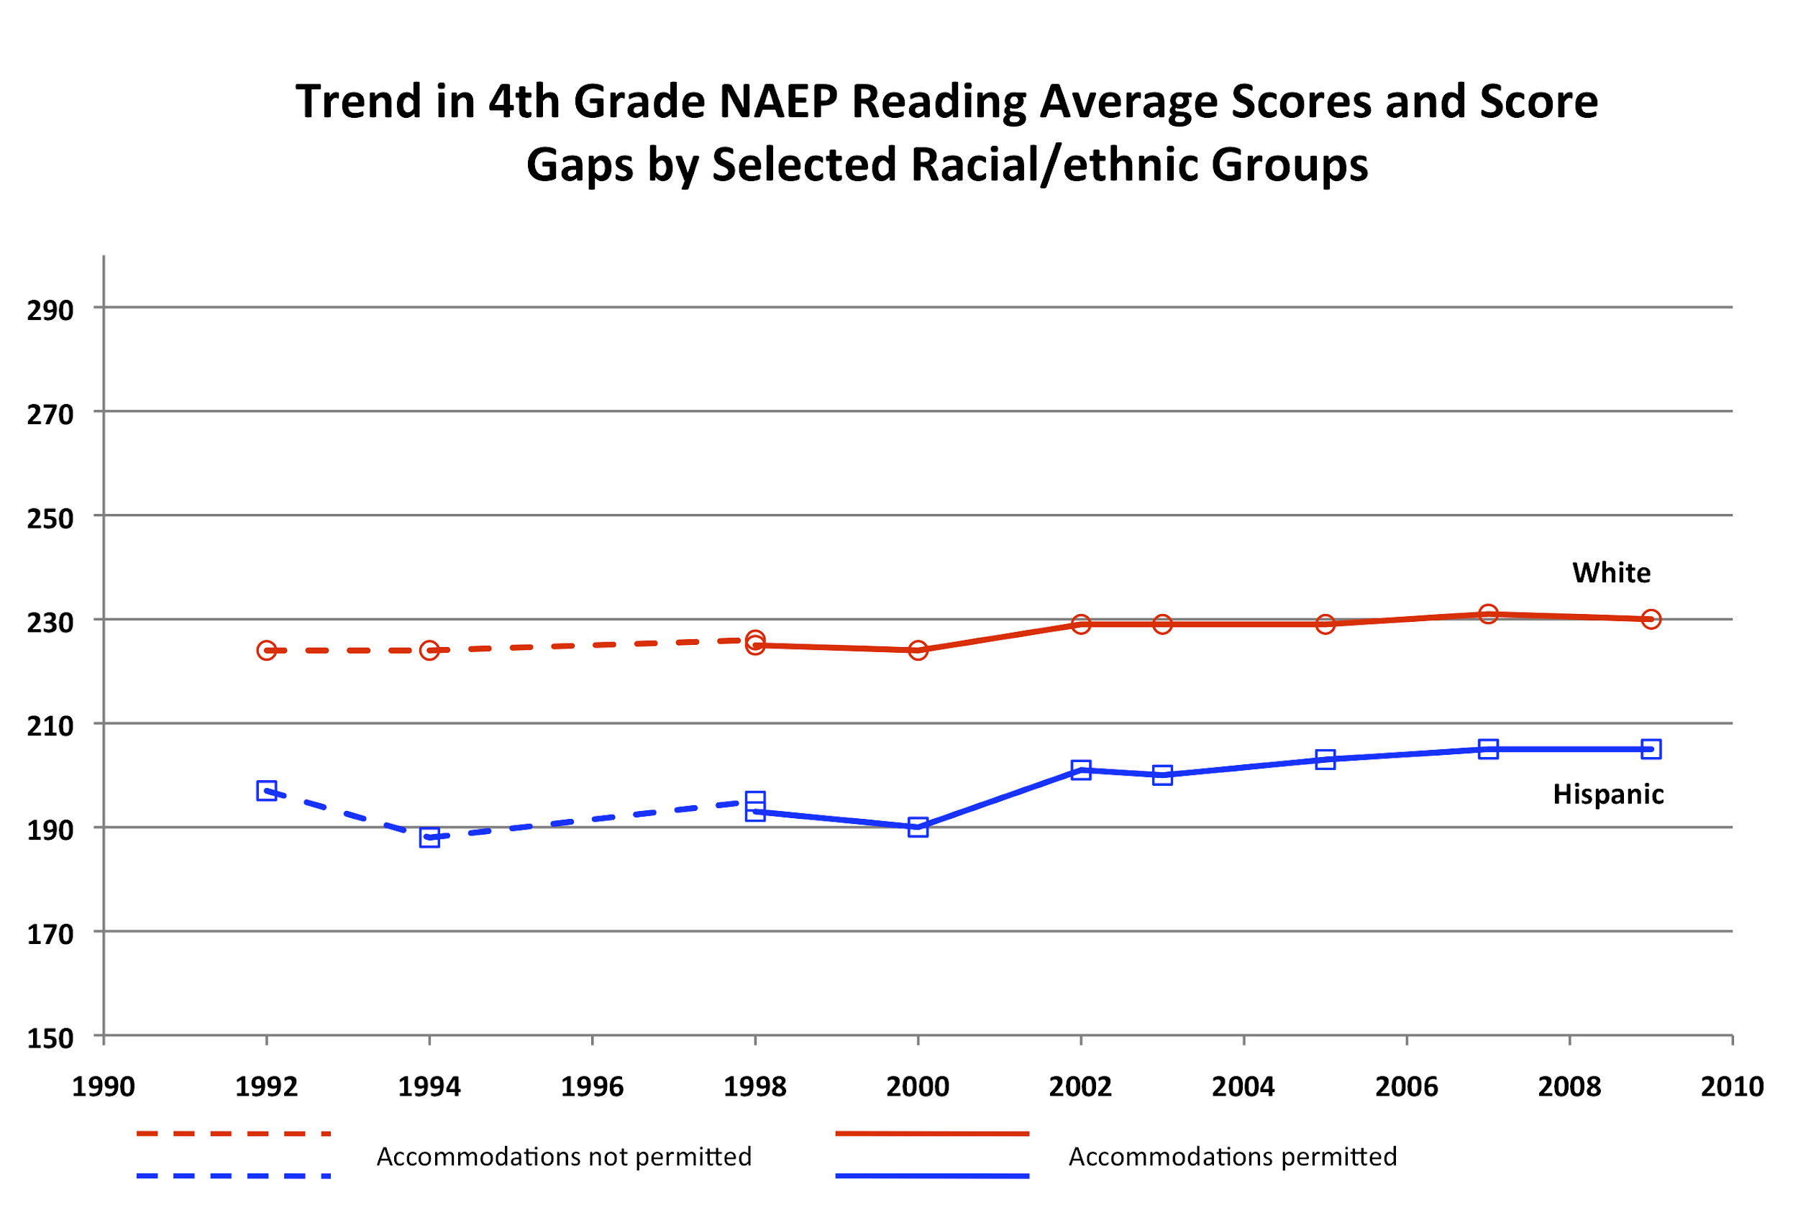

Slide 22
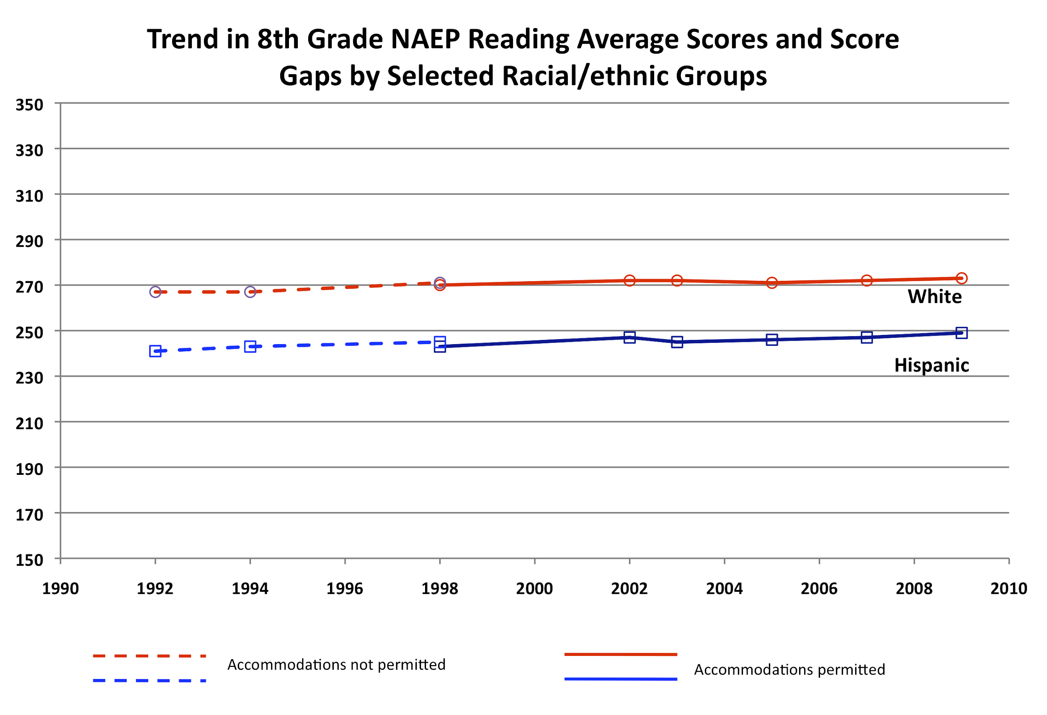

Slide 23
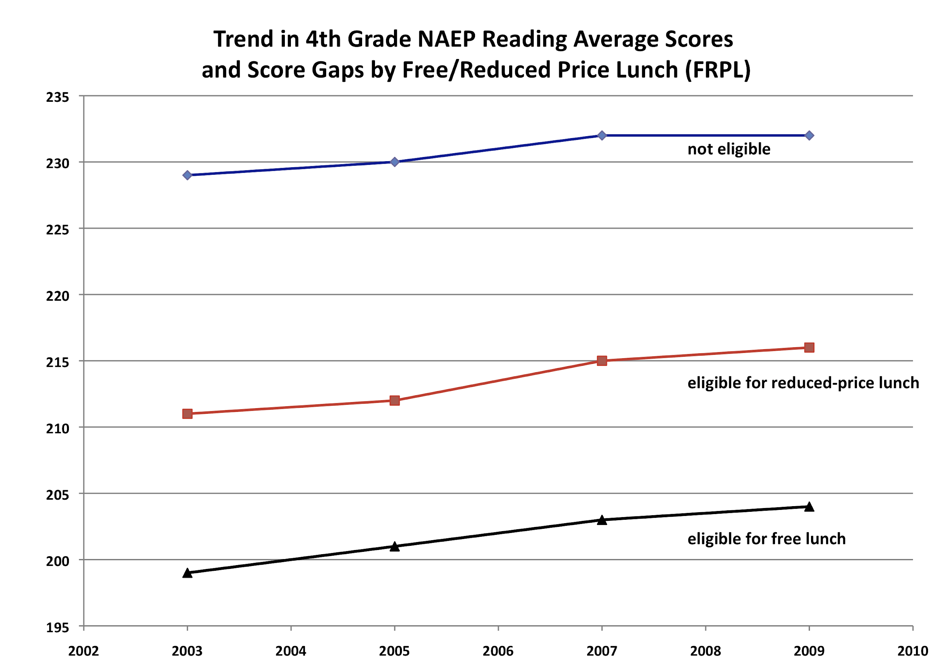

Slide 24
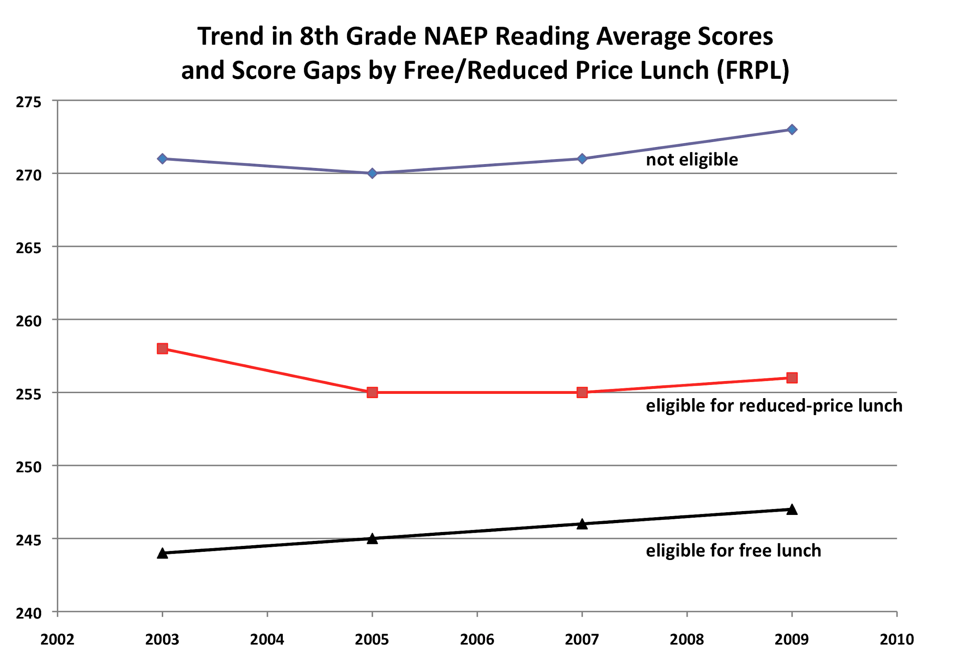

Slide 25
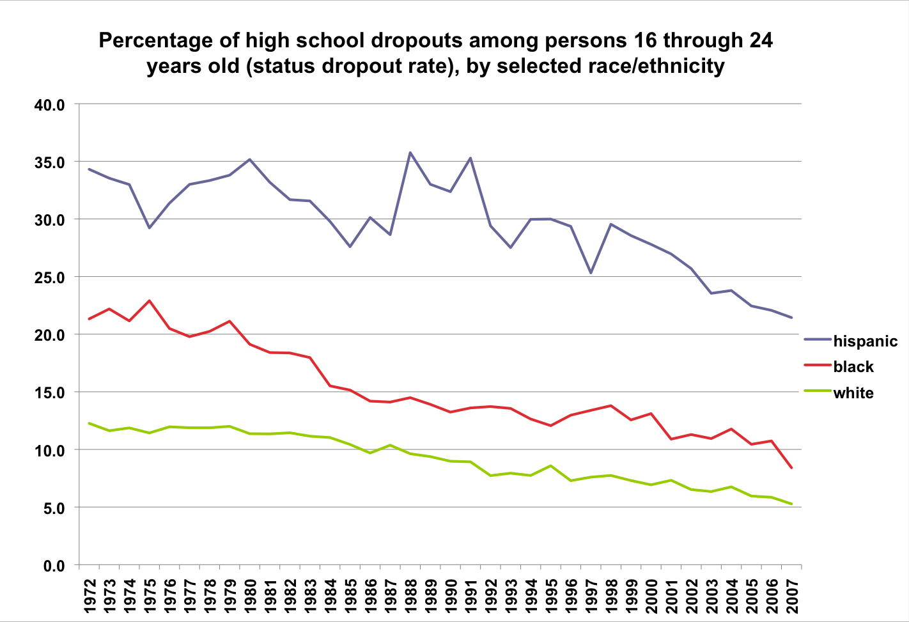

Slide 26
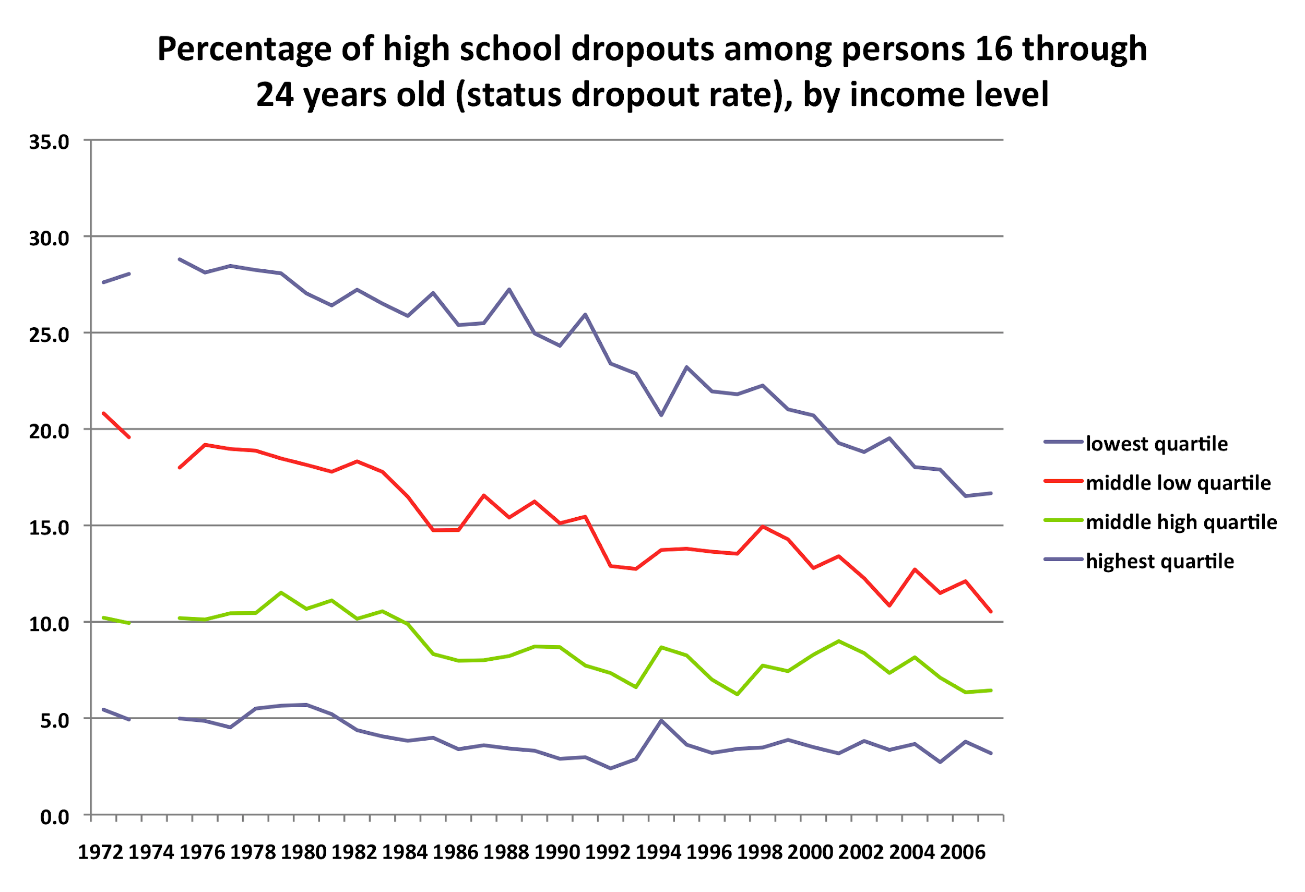

Slide 27
Scientific evidence and performance
feedback are crucial components of
effective social policies.

Slide 28
Why Evidence-Informed Policy and Practice?
Systems change through social policy is messy.
Professional judgment, while essential, is inherently fallible.
Implementation, without ongoing performance feedback, can undermine even scientifically validated policies and practices.
We have a legal mandate to use “scientifically based instruction” (NCLB and IDEA).
We have an ethical obligation to do everything humanly possible to increase the probability that socially valued outcomes will be achieved.

Slide 29
The Education Culture
Education has been a non-evidence-based culture:
Teaching is an “art”, not a “science”
Constructivism, anti-science, anti-measurement
Ruled by ideology, preferences, hunches, fads
The teaching profession has been stuck in a “guild” mentality
Teacher tenure
Resistance to performance appraisal
Most school reform strategies are not based on scientific evidence
Lack of fundamental research into teaching, curriculum, systems
Special interests drive initiatives
The culture drives simplistic, commonly held “beliefs”

Slide 30


Slide 31
Education “Solutions”….Commonly Held Beliefs
SCHOOL RESOURCES
increase funding for students
higher pay for teachers
TEACHER QUALITY
more “Highly Qualified Teachers” (NCLB)
more teachers with credentials
more teachers with advanced degrees
more teachers with professional certifications (NBPTS)
comprehensive induction for new teachers
SCHOOL MODELS
smaller class size
smaller schools
charter schools
SCHOOL REFORM INITIATIVES
standards
accountability
contingencies

Slide 32
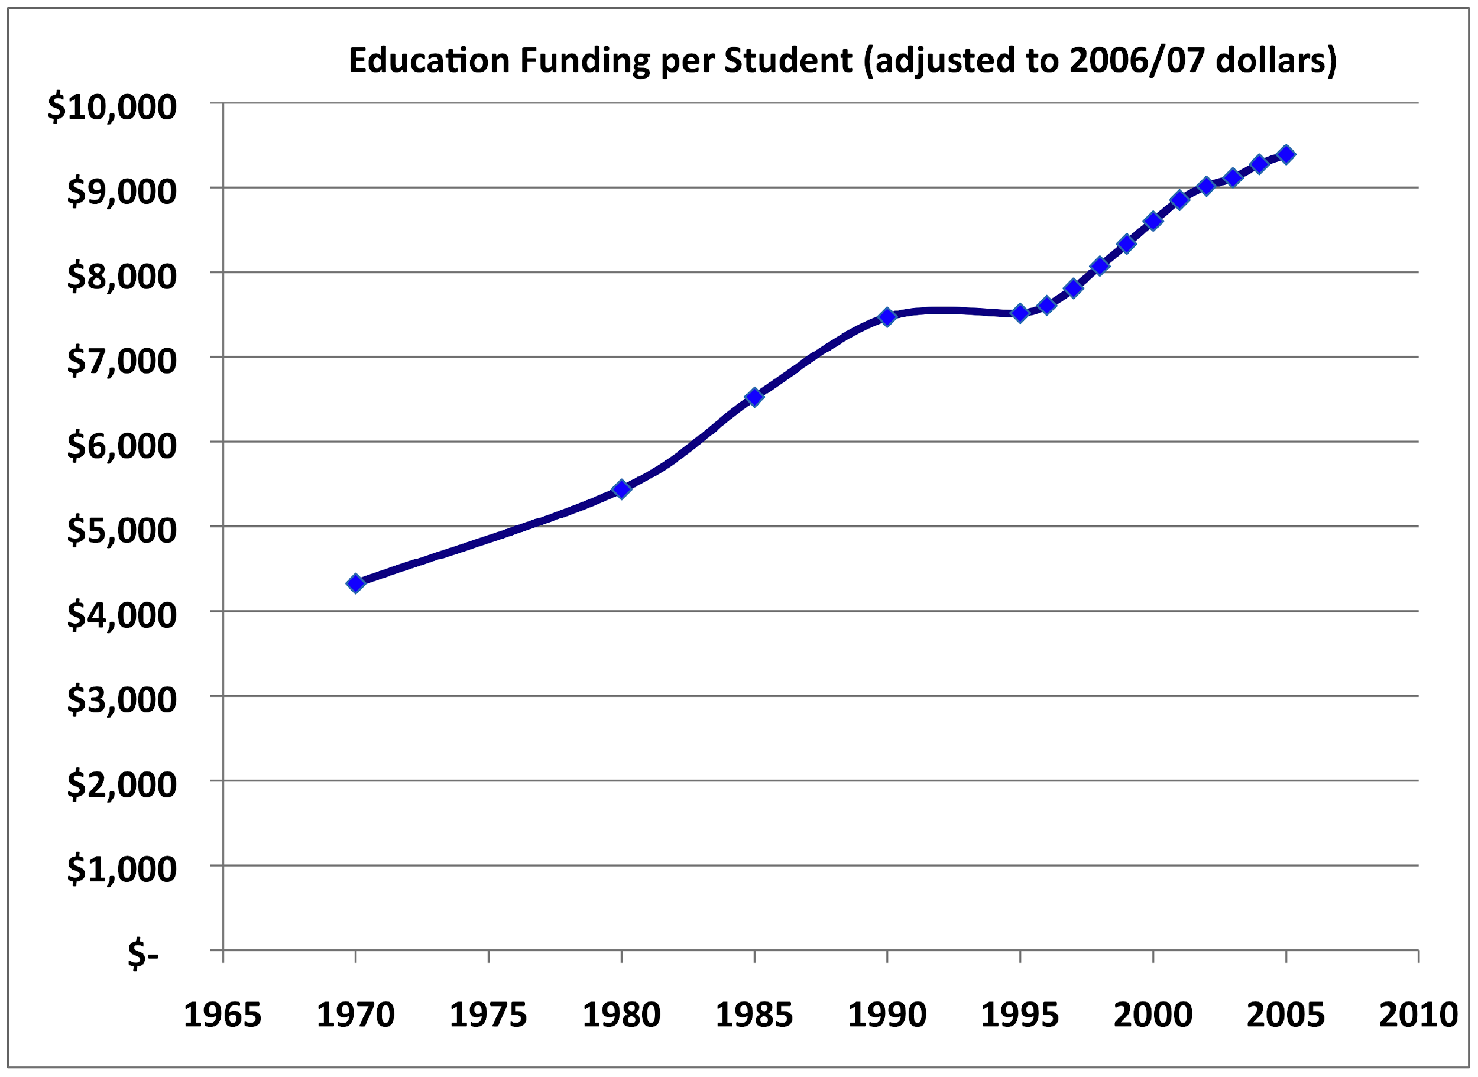
SOURCE: U.S. Department of Education, National Center for Education Statistics. (2009). Digest of Education Statistics, 2008 (NCES 2009-020), Chapter 2 and Table 179.

Slide 33
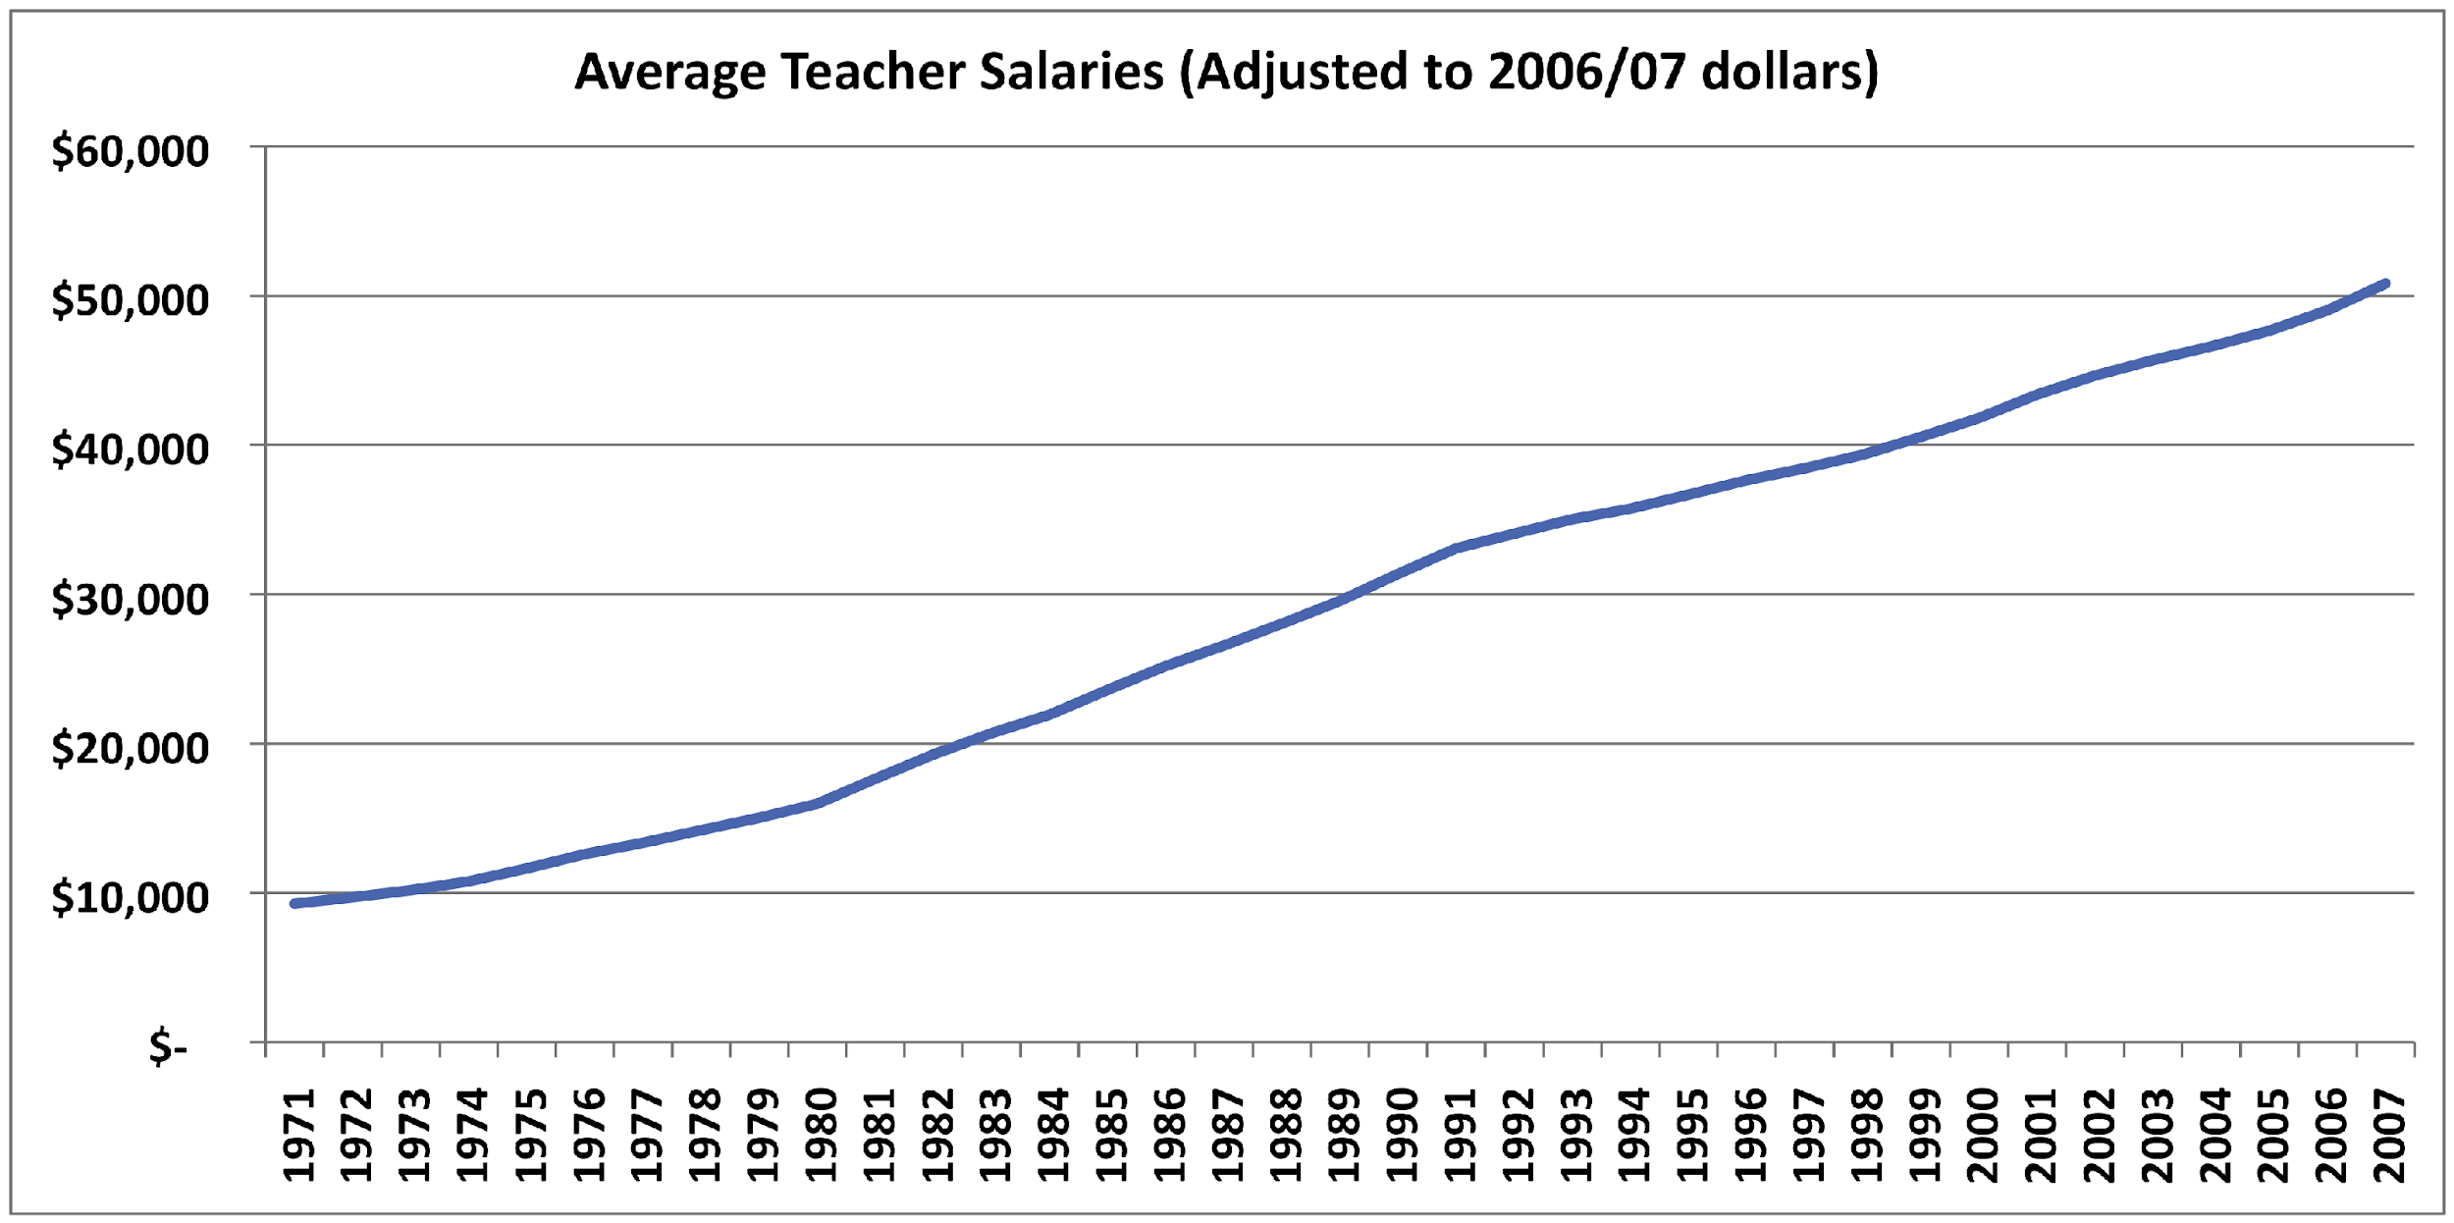
IES National Center for Education Statistics Digest of Educational Statistics: 2008

Slide 34
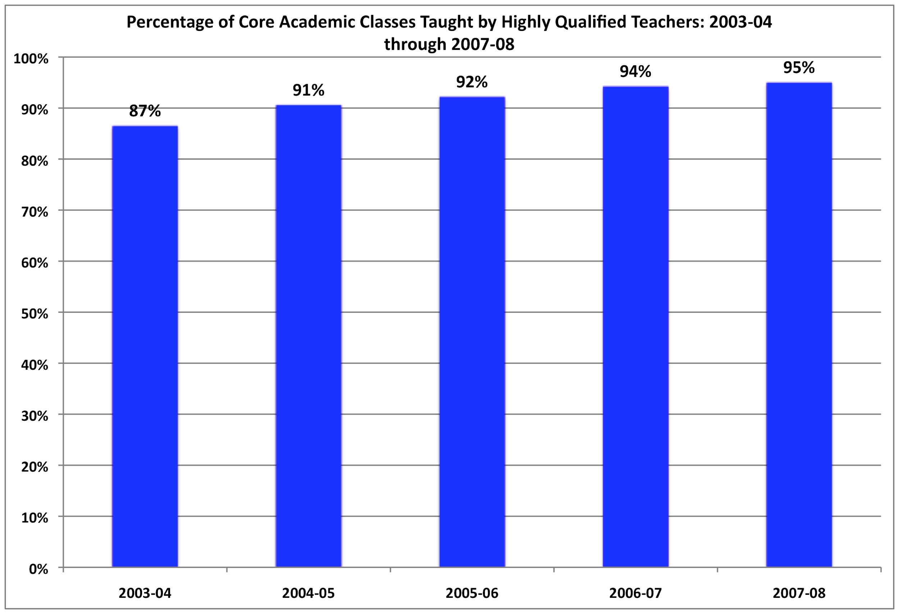
What’s the source

Slide 35
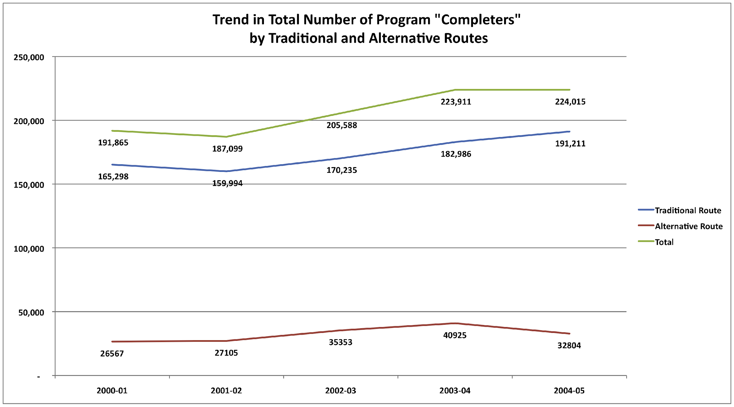

Slide 36
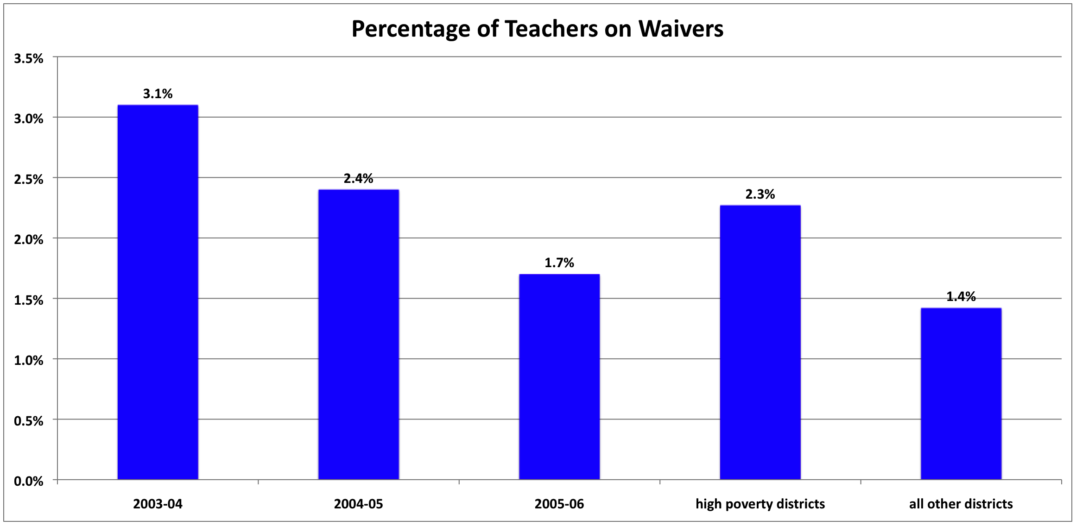

Slide 37
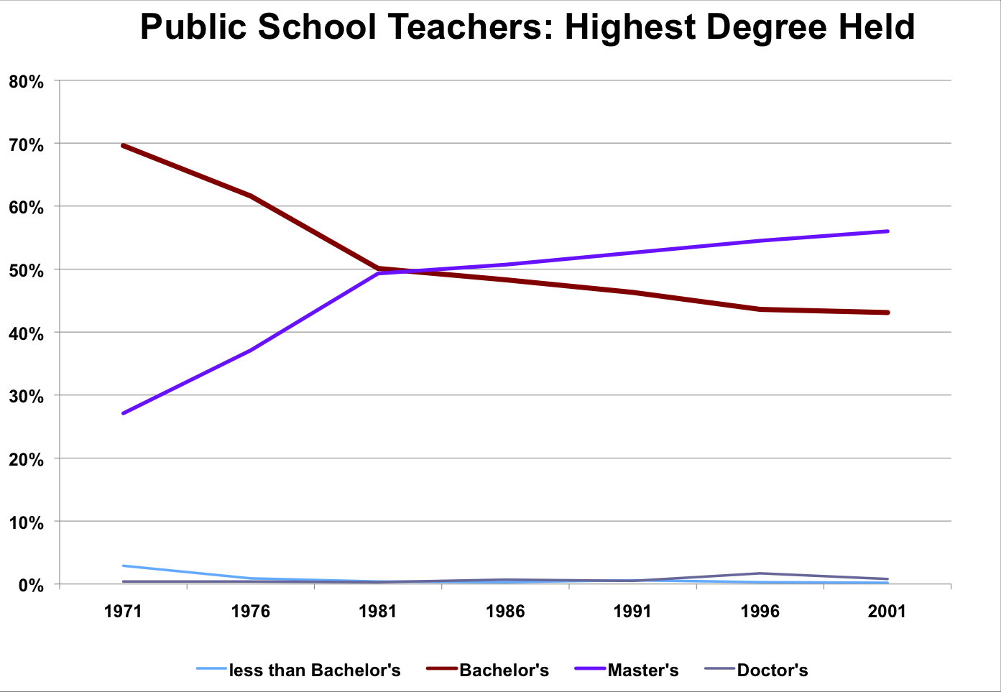
SOURCE: National Education Association, Status of the American Public School Teacher, 2000-01. (This table was prepared August 2003.)

Slide 38
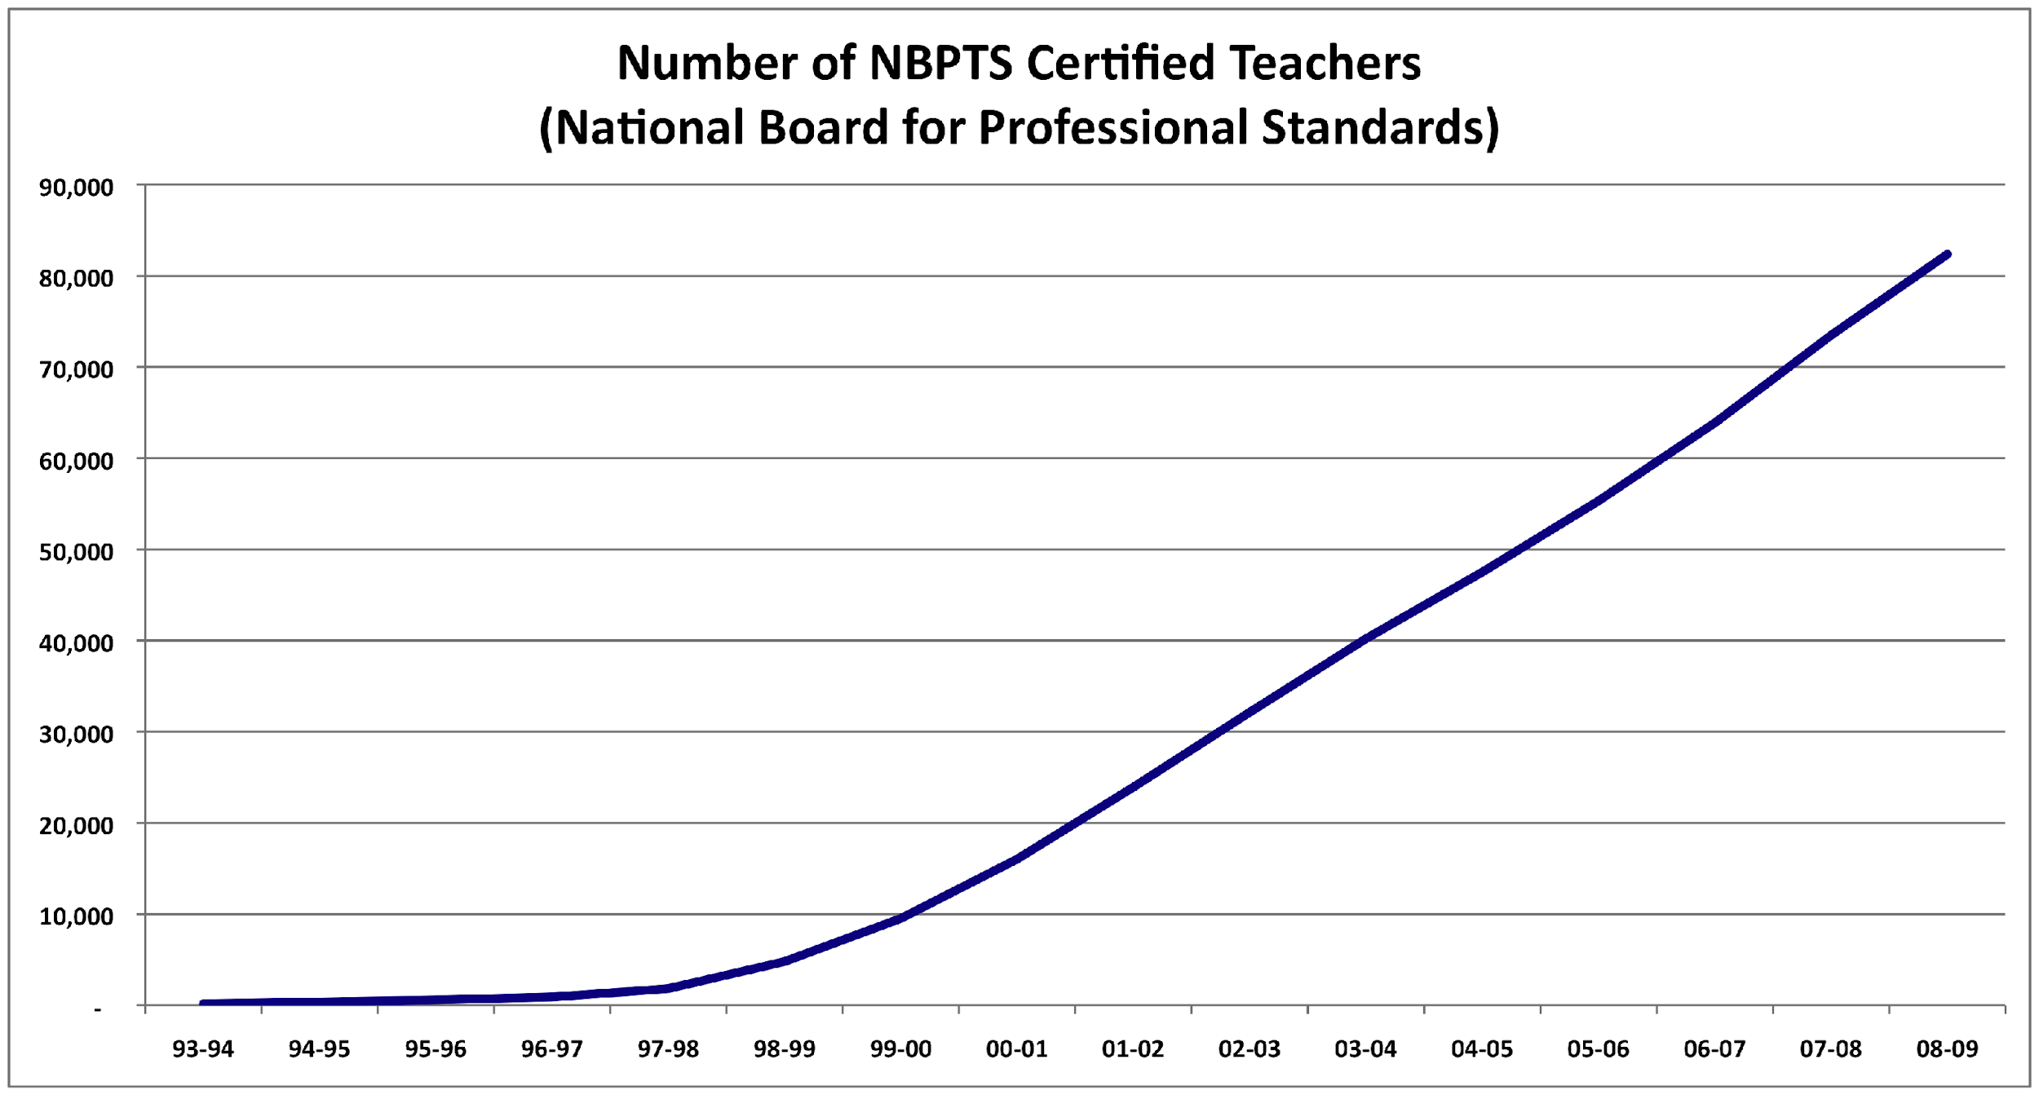

Slide 39
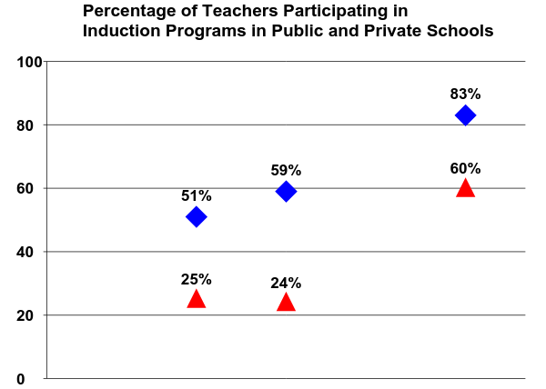
Public
Private
1993-1994
1999-2000
1990-1991
Smith & Ingersoll, 2004

Slide 40
Class Size Reduction
32 States now have class size reduction programs in law:
Texas (1983) California (1996)
Tennessee (1989) New York (1997)
Minnesota (1990) Florida (2002)

Slide 41
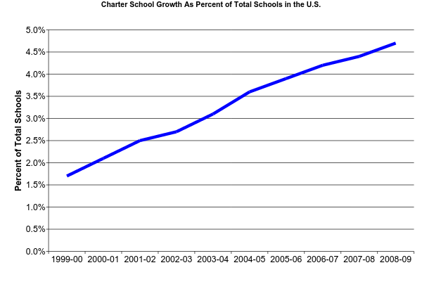
There are currently over 5,000 Charter schools in the United States
U.S. Department of Education, National Center for Education Statistics

Slide 42
School Reform Initiatives
A Nation at Risk (1984)
Goals 2000 (1994)
No Child Left Behind (2001)

Slide 43
Education “Solutions”….Commonly Held Beliefs
SCHOOL RESOURCES
increase funding for students
higher pay for teachers
TEACHER QUALITY
more “Highly Qualified Teachers” (NCLB)
more teachers with credentials
more teachers with advanced degrees
more teachers with professional certifications (NBPTS)
comprehensive induction for new teachers
SCHOOL MODELS
smaller class size
smaller schools
charter schools
SCHOOL REFORM INITIATIVES
A Nation at Risk
Goals 2000
No Child Left Behind
✔
✔
✔
✔
✔
✔
✔
✔
✔
✔
✔
✔

Slide 44
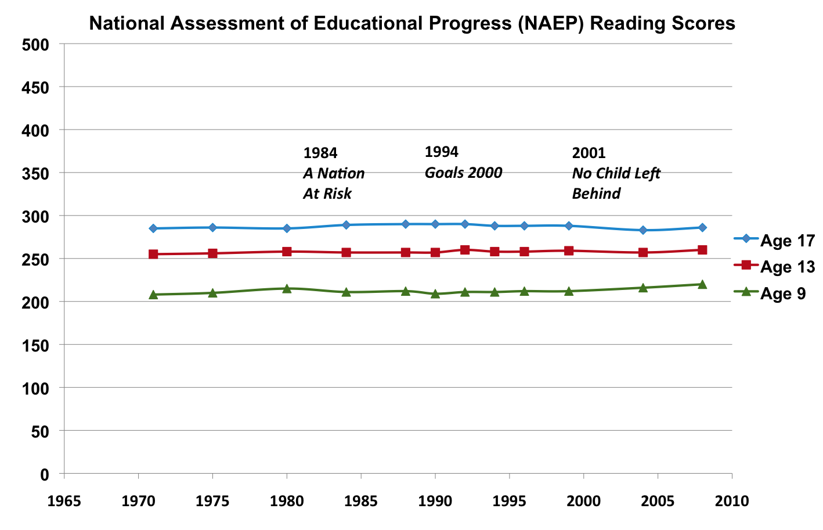
SOURCE: U.S. Department of Education, Institute of Education Sciences, National Center for Education Statistics, National Assessment of Educational Progress (NAEP), 1992, 1994, 1998, 2000, 2002, 2003, 2005, and 2007 Reading Assessments.

Slide 45
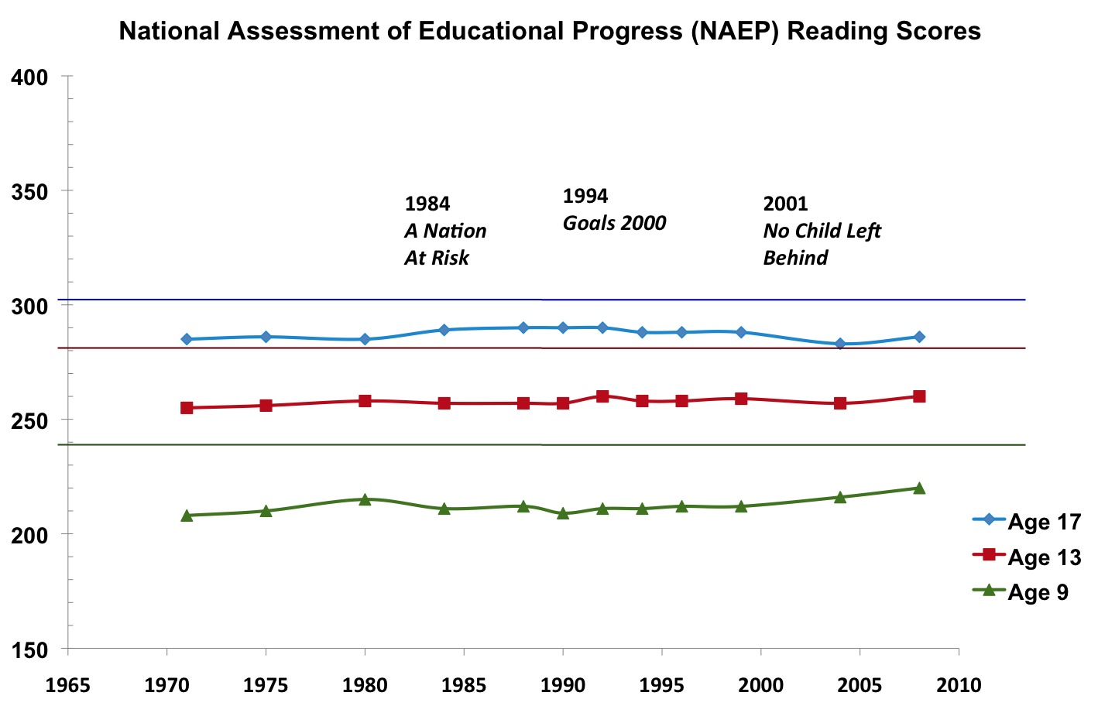
Grade 12
Grade 8
Grade 4
SOURCE: U.S. Department of Education, Institute of Education Sciences, National Center for Education Statistics, National Assessment of Educational Progress (NAEP), 1992, 1994, 1998, 2000, 2002, 2003, 2005, and 2007 Reading Assessments.

Slide 46
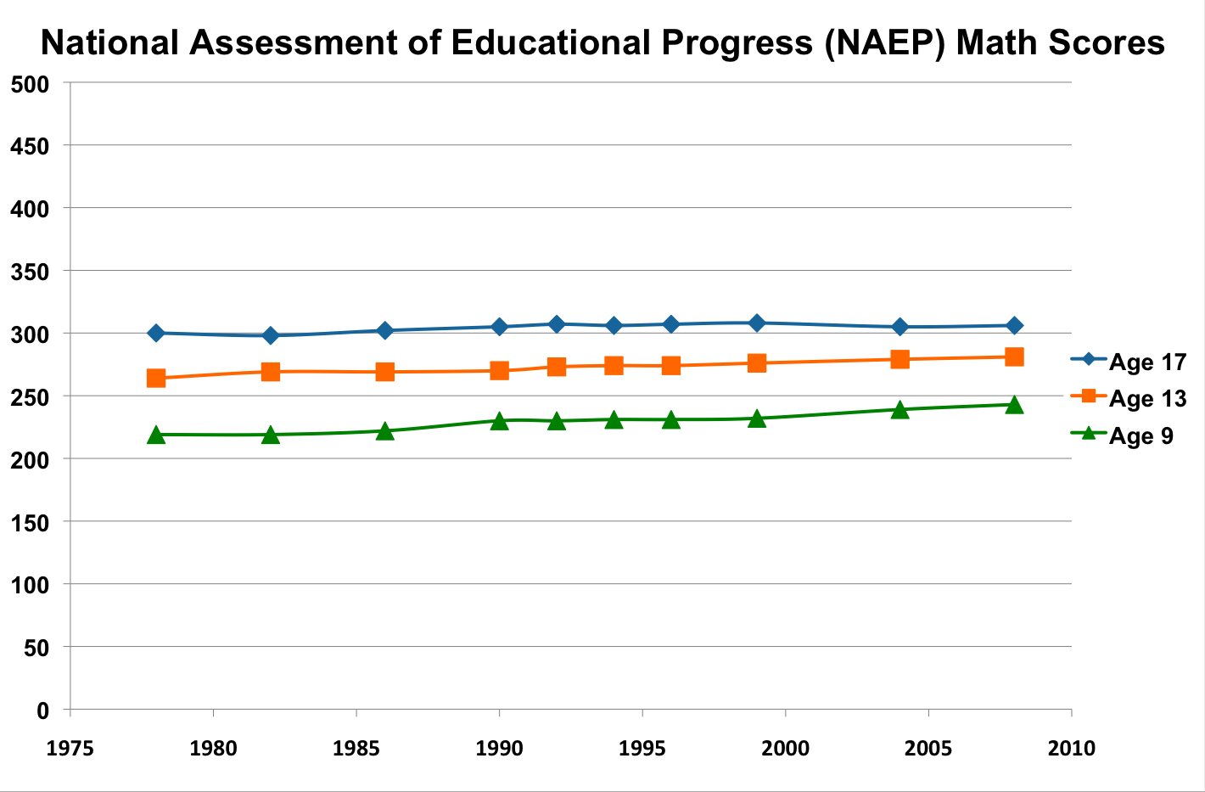
SOURCE: U.S. Department of Education, Institute of Education Sciences, National Center for Education Statistics, National Assessment of Educational Progress (NAEP), 1978, 1982, 1986, 1990, 1992, 1994, 1996, 1999, 2004, and 2008 Long-Term Trend Mathematics Assessments.

Slide 47
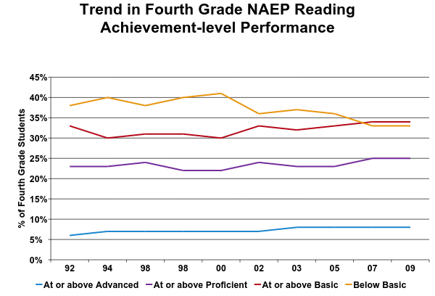
1.2 million students below basic
2.4 million students below proficient

Slide 48
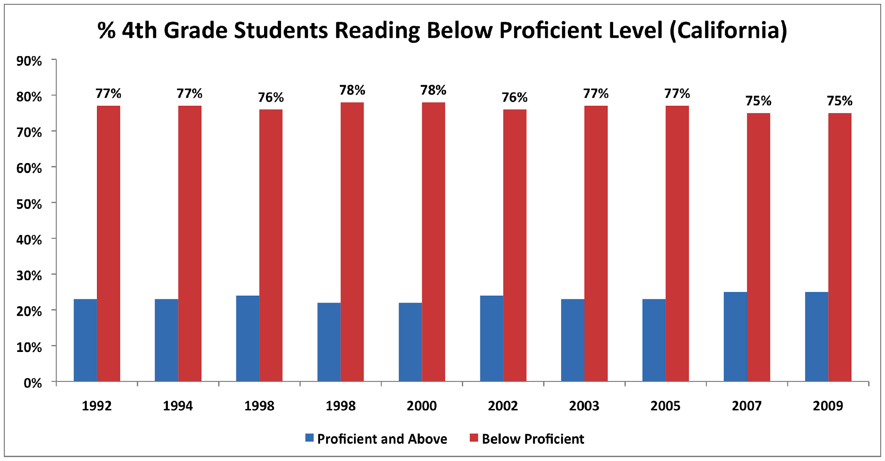
347,900 Students

Slide 49
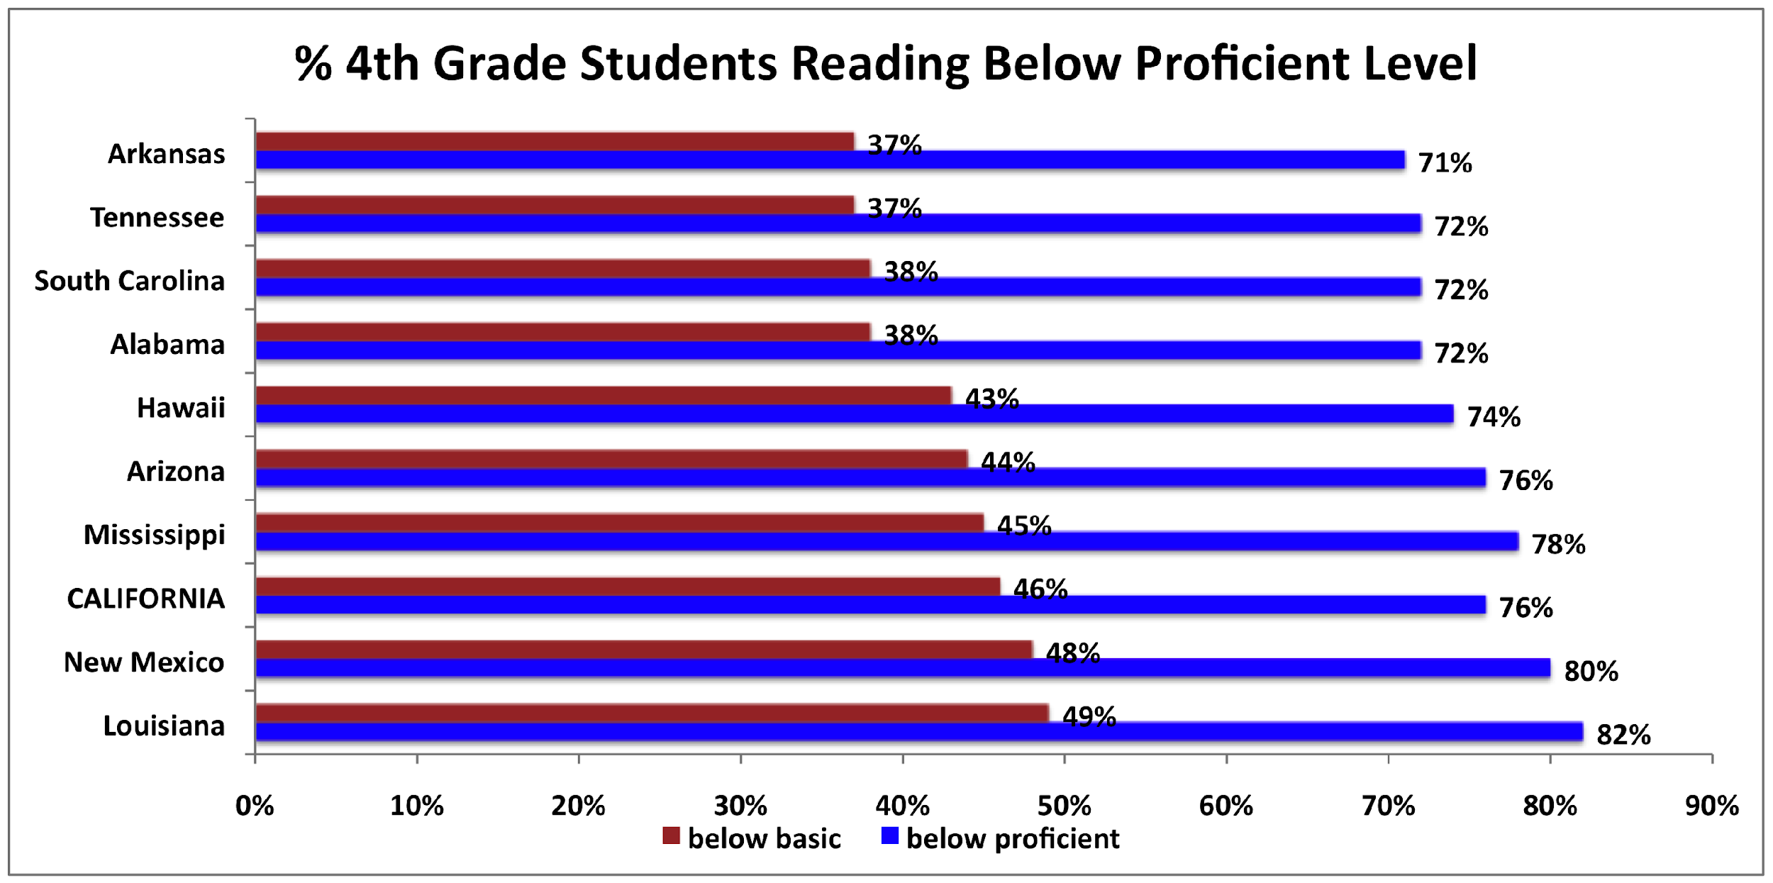

Slide 50
What’s going on????
KEYS TO EVIDENCE-BASED EDUCATION
EFFICACY RESEARCH: (selecting interventions)
we have had a dearth of evidence on what works
recent evidence suggests our assumptions have been incorrect
PERFORMANCE FEEDBACK (evaluating interventions)
we have lousy performance feedback systems
student performance
teacher performance

Slide 51
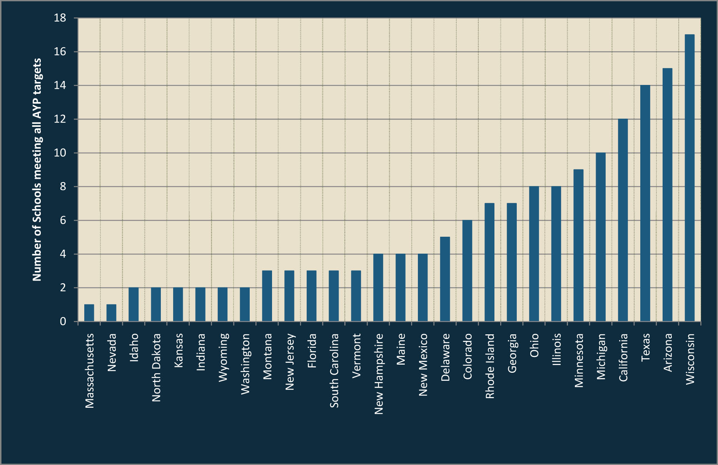
Comparison of State AYP Requirements
THOMAS B. FORDHAM I NSTITUTE (2008)

Slide 52
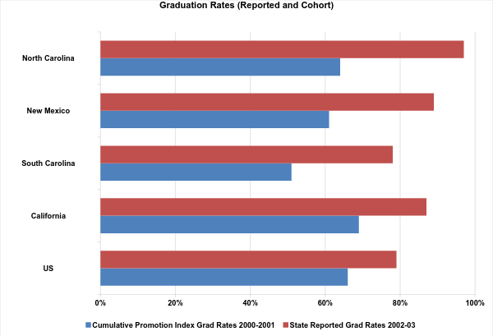
127,292 high school students dropped out....70% were black or hispanic
1,252,396 high school students dropped out....53% were black, hispanic, or native american
The Education Trust (2005)

Slide 53
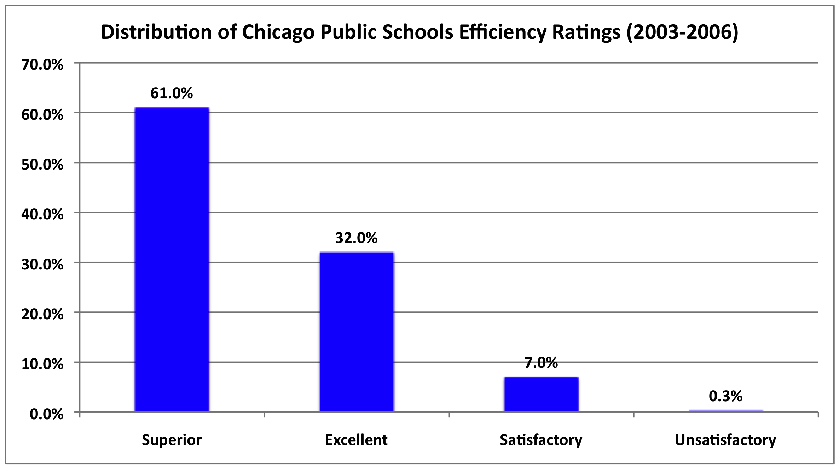
Hiring, Assignment, and Transfer in Chicago Public Schools Report from The New Teacher Project July 2007

Slide 54
87 Schools met criteria for being identified as “failing schools”
69 (79%) of these schools did not issue a single “unsatisfactory rating”
Hiring, Assignment, and Transfer in Chicago Public Schools Report from The New Teacher Project July 2007

Slide 55
CSRQ Center Report on Elementary School CSR Models (2005)
Evaluation of the effectiveness of 22 widely adopted comprehensive school reform models. (800 studies)
Evidence of Positive Effects on Student Achievement
3 (9%) Moderately strong evidence
5 (22%) Moderate evidence
8 (36%) Limited evidence
7 (32%) Zero evidence

Slide 56
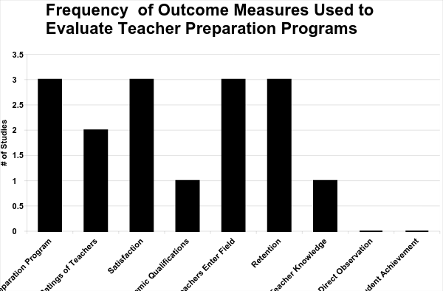
Andrew 1990 and Andrew and Schwab 1995
Notes:
Missing file to link and seems to be missing categories
Teacher Ratings
Teacher from 5 year programs:
remained in teaching longer
Had greater confidence in teaching skills
ranked their programs as better at preparing them
Had greater confidence in leadership ability
Principal Ratings
competence and leadership rated virtually the same for 4 and 5 years teachers

Slide 57
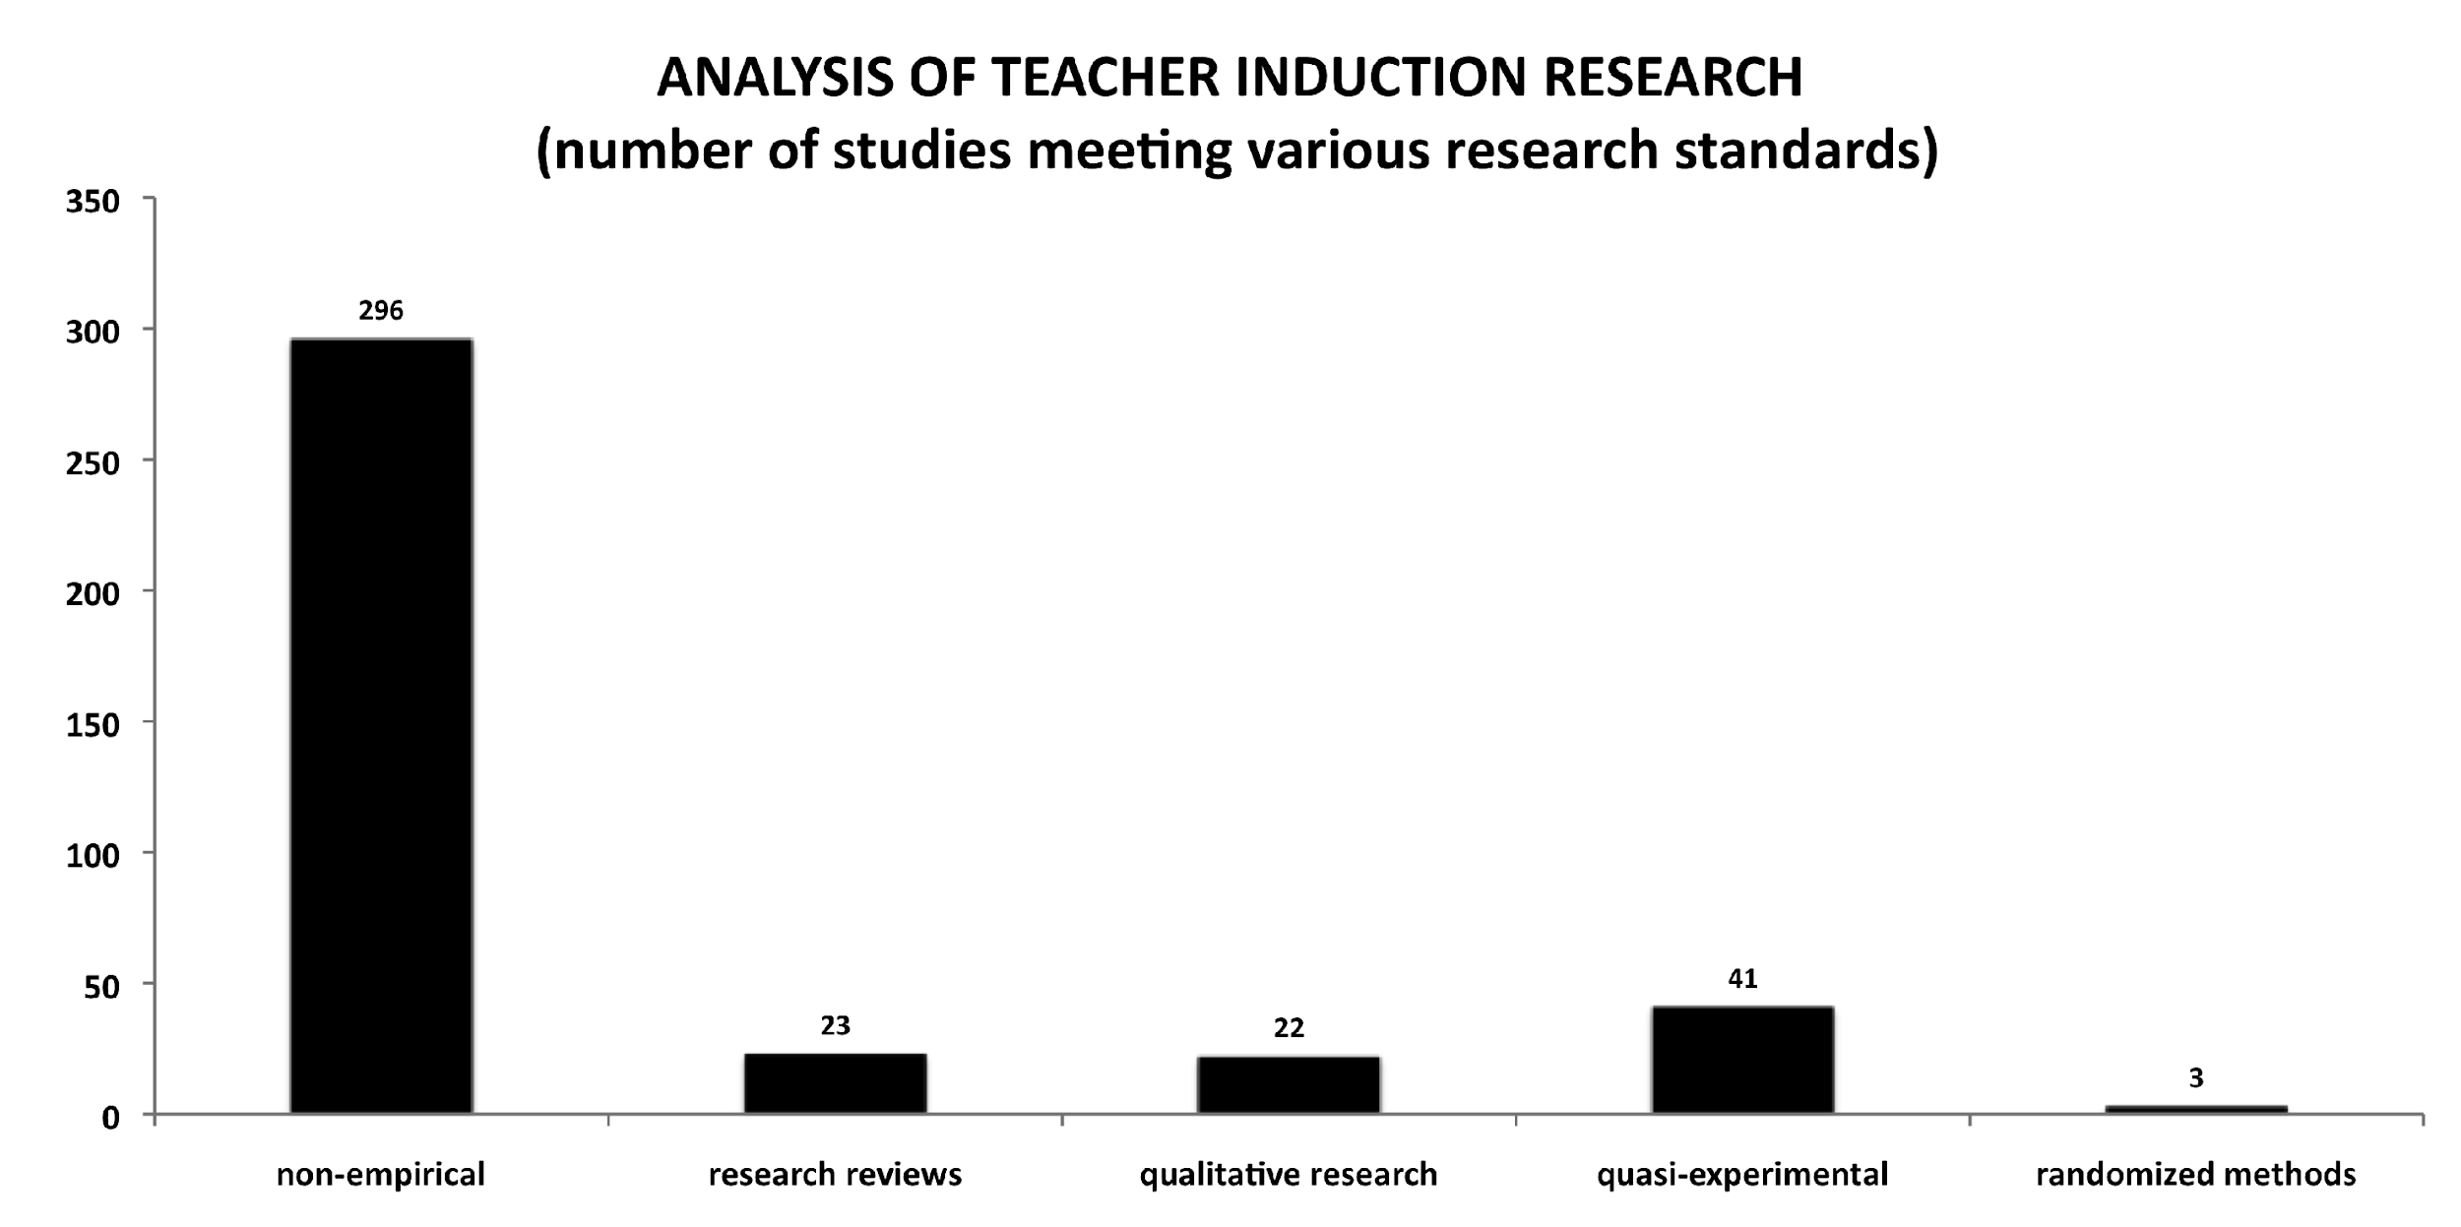
SOURCE: SRI (2004)

Slide 58
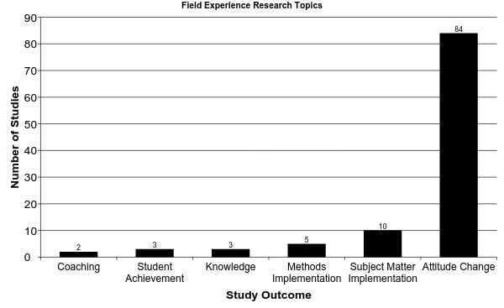
AERA Report : Studying Teacher Education, 2005

Slide 59
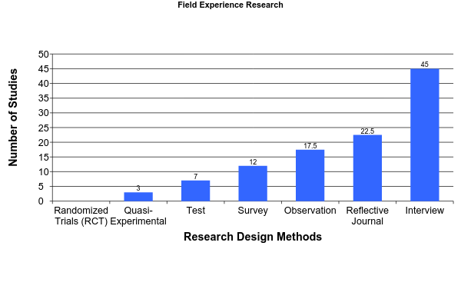
Research Designs
Assessment Methods
Notes:
Teacher Preparation and Student Achievement, Boyd, 2009:
Results: Teachers who came from programs that provided more oversight to student teachers and that was classroom skills and curriculum linked directly to entering classroom performed significantly better

Slide 60
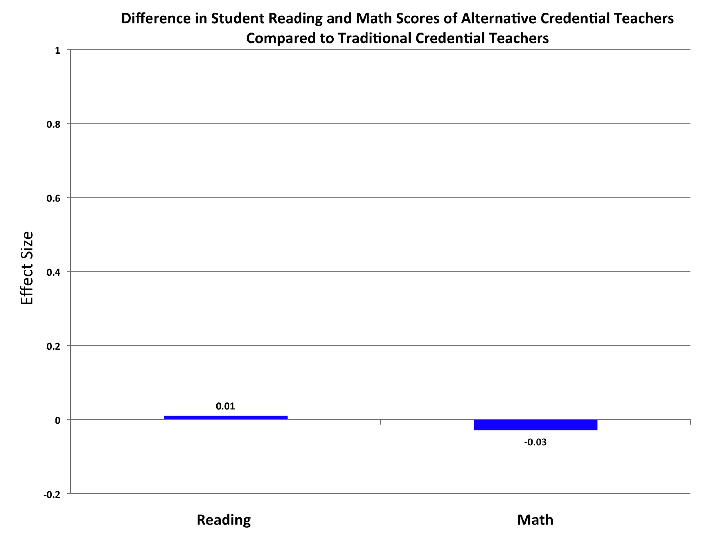
No statistical difference or meaningful impact was found between TC and AC Teachers
Constantine, J., Player D., Silva, T., Hallgren, K., Grider, M., and Deke, J. (2009). An Evaluation of Teachers Trained Through Different Routes to Certification, Final Report (NCEE 2009- 4043). Washington, DC: National Center for Education Evaluation and Regional Assistance, Institute of Education Sciences, U.S. Department of Education.

Slide 61
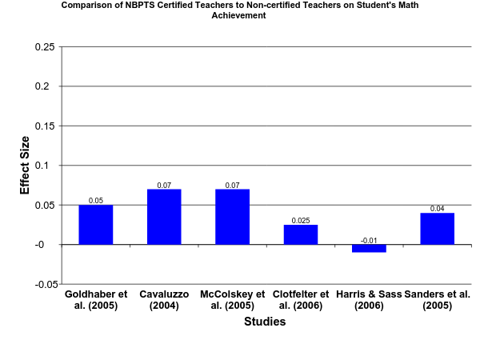
National Certification Has Minimal Impact on Improving Student Achievement
National Board Certification and Teacher Effectiveness: Evidence from A Randomized Assigned Experiment, December 2008

Slide 62
What is the Evidence on Teaching Reading?
National Reading Panel (2000)
Five core components of scientifically based reading instruction:
Phonemic awareness
Phonics
Fluency
Vocabulary
Comprehension
National Institute of Child Health and Human Development. (2000). Report of the National Reading Panel

Slide 63
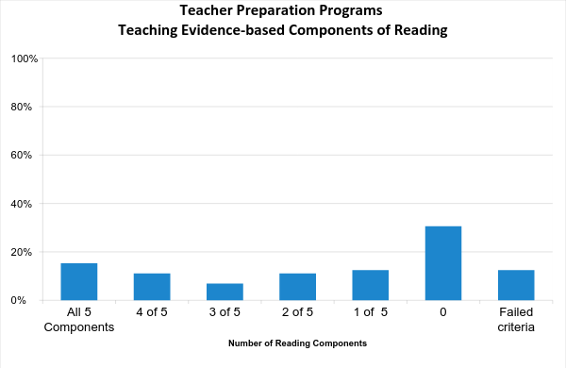
What Are Colleges Teaching?
Components
1. Phonemic Awareness
2. Phonics
3. Fluency
4. Vocabulary
5. Comprehension
What Education Schools Aren't Teaching About Reading and What Elementary Teachers Aren't Learning
Walsh et al. 2006

Slide 64
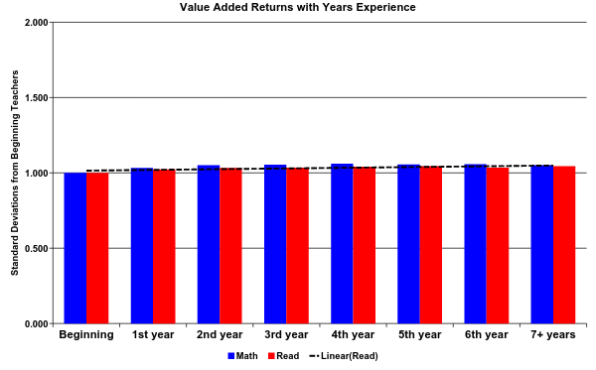
What is the Impact is Teacher Induction?
National Bureau of Economic Research (2006)
Notes:
No file to link

Slide 65
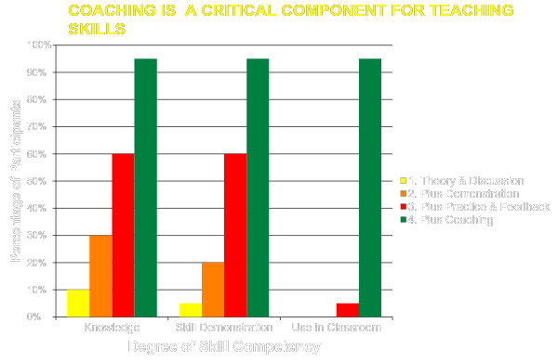

Slide 66
CA Class Size Reduction: A Case Study
Policies are ultimately related to values (philosophical issues) and political issues (power to distribute resources). (Gambrill)
Proposition 98: 40% of CA state revenues goes to education.
Spring 1996 Revenue Windfall: $ 1 Billion mandated for education
Political Landscape: Governor Pete Wilson (R)
Super. of Public Inst. Delaine Easton (D)

Slide 67
CA Class Size Reduction (CSR) : A Case Study
CSR launched out of governors office to keep it out of control of Eastin and CDE
CSR caught the department of education, school districts, educators by surprise
CSR passed in July 1996. Districts had until October 1996 to reduce K-3 class sizes to 20 or fewer students.
“use it or lose it” contingency
Overnight need for 18,000 additional classrooms
Immediate need for 12,000 new teachers in 96/97, 15,000 more over next two years

Slide 68
CA Class Size Reduction: A Case Study
Research on Class Size Reduction
Effectiveness Research: Tennessee STAR Project (1985)
various meta-analyses
Efficacy Research: virtually non-existent
Over 40 states have implemented CSR interventions without evaluation strategies
CSR remains an extremely “popular”

Slide 69
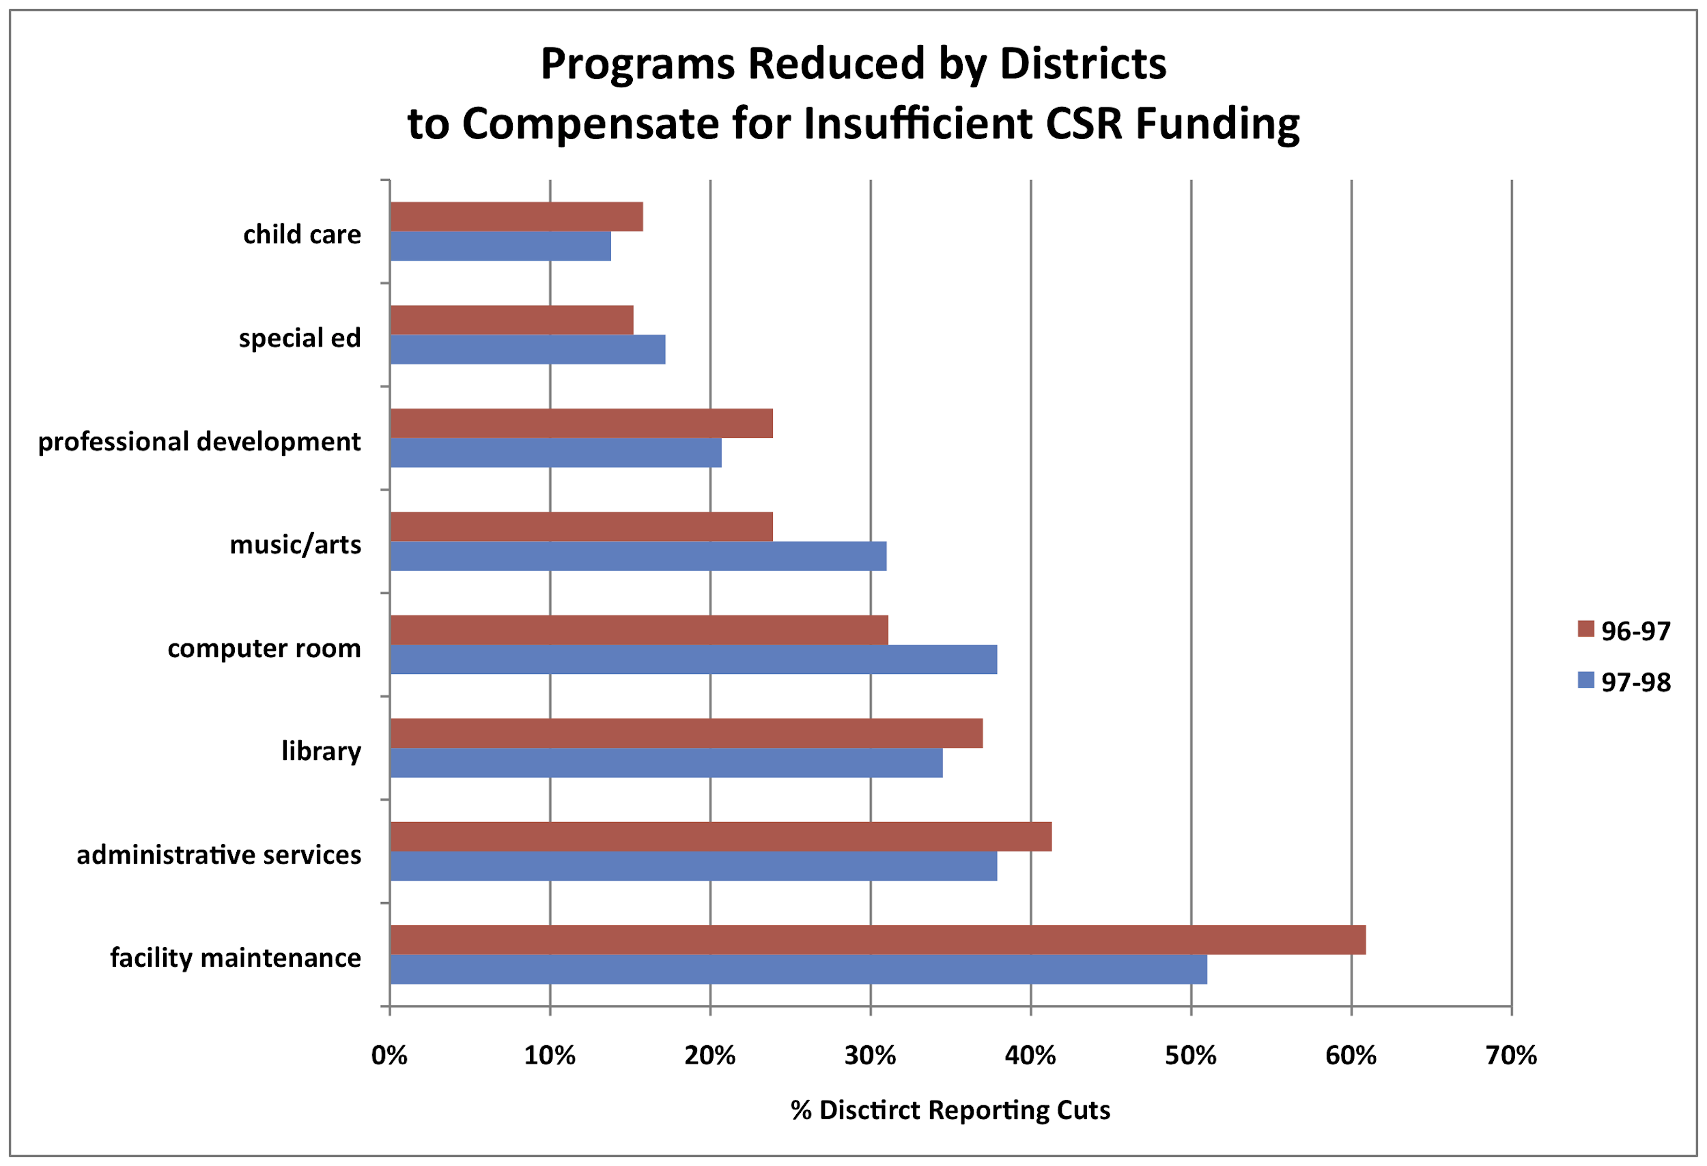
CA Class Size Reduction: Unintended Consequences
Capstone Report: CSR Research Consortium (2002)

Slide 70
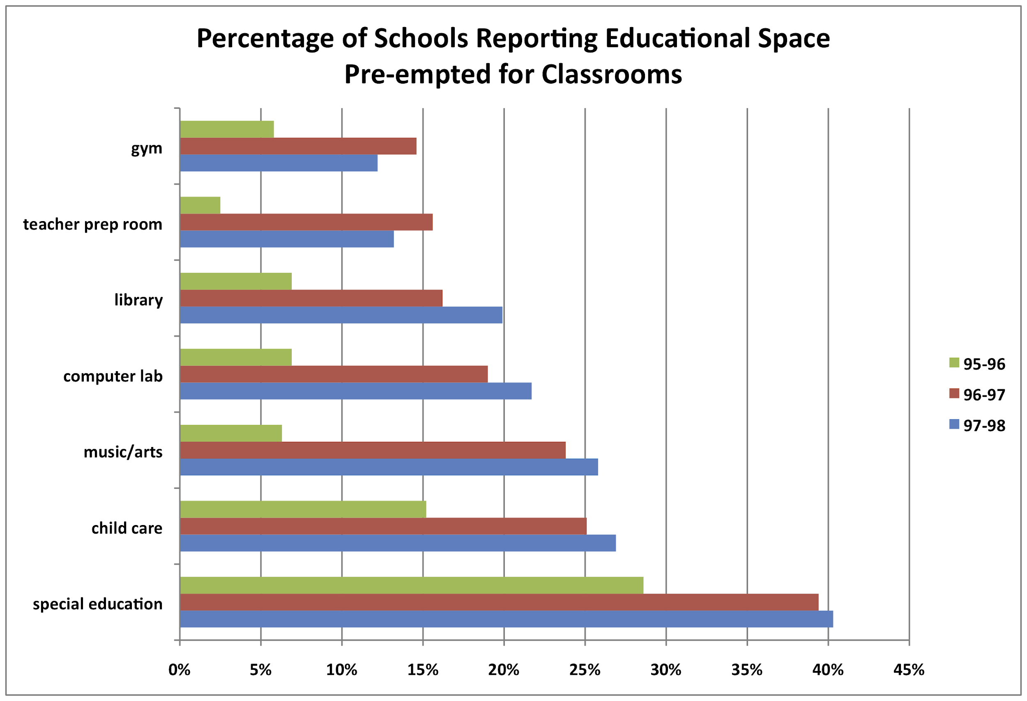
CA Class Size Reduction: Unintended Consequences
Capstone Report: CSR Research Consortium (2002)

Slide 71
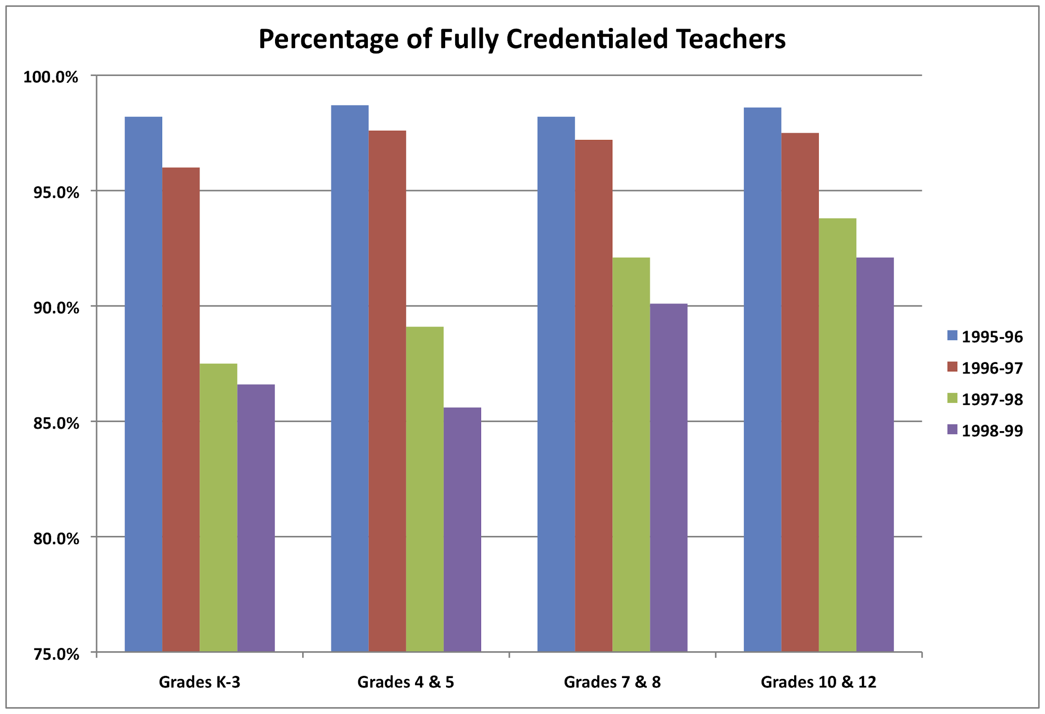
CA Class Size Reduction: Unintended Consequences
Capstone Report: CSR Research Consortium (2002)

Slide 72
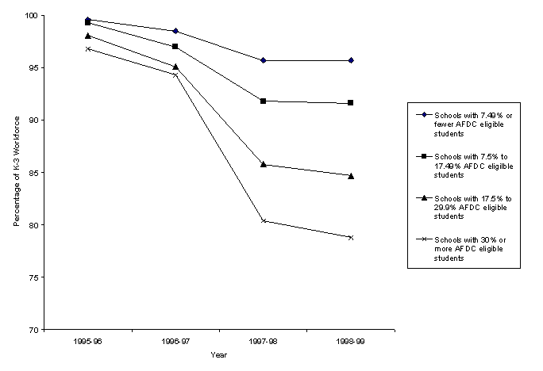
Percentage of K–3 Teachers Fully Credentialed In Schools with Different Proportions of Low-Income Students

Slide 73

Attribution of gains in scores to CSR is not warranted (CSR Capstone Report)
Cost of CSR = $ 1.5 Billion / year, not including additional resources at the district and school level. $ 20.3 Billion to date.
Bohrnstedt, G. W., & Stecher, B. M. (Eds.) (1999). Class size reduction in California: Early evaluation findings, 1996-1998. Palo Alto: CSR Research Consortium, Year 1 Evaluation Report, American Institutes for Research.

Slide 74

Charter schools are not a simple solution to education reform
Source: Center for Research on Education Outcomes, 2009

Slide 75

Charter Effects Compared to 2007 NAEP Score by State – Reading
Source: Center for Research on Education Outcomes, 2009

Slide 76

NAEP Scores - National Assessment of Educational Progress Data Explorer: http://nces.ed.gov/nationsreportcard/naepdata/dataset.aspx School Funding - 2003 U.S. Census: http://ftp2.census.gov/govs/school/elsec03_sttables.xls

Slide 77

Average Enrollment – 2006 Digest of Education Statistics, Education Statistics, National Center for Education Statistics, U.S. Department of Education Statistics -http://nces.ed.gov/programs/digest/d06/tables_2.asp#Ch2Sub4
Cost Per Pupil: 2008 Digest of Education Statistics, National Center for Education Statistics, U.S. Department of Education - http://nces.ed.gov/programs/digest/d08/tables/dt08_185.asp

Slide 78
Race to the Top Program
Adopting common standards and assessments
Building longitudinal data systems that measure student growth and success to support instruction
Recruiting, developing, rewarding, and retaining effective teachers and principals
Turning around our lowest-achieving schools.

Slide 79
Race to the Top
Improve quality of standardized tests and raise standards that are internationally benchmarked (national academic standards)
Common Core Standards Project
Currently, each state has its own Adequate Yearly Progress (AYP) standards for compliance with NCLB

Slide 80
Race to the Top
Build robust data systems to aggregate and disaggregate student outcome data
link teachers to students outcomes -- to distinguish between effective and ineffective teachers
to link effective teachers to their colleges of education – to distinguish between effective and ineffective programs

Slide 81
Race to the Top
Recruiting, developing, rewarding, and retaining effective teachers and principals
using performance data to drive
training
support
evaluation
compensation
promotion

