Slide 1
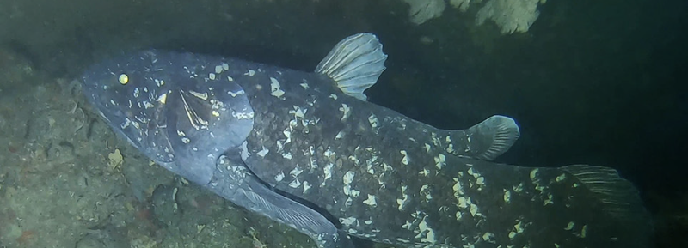


SURVEYING THE SAINT LAWRENCE
There's still huge knowledge gaps that we have about the St. Lawrence River that we're trying to fill in. Things like, where do you find species at risk? What's the movement of species that are invasive? Just even basic questions like what species actually live here?
Matt Windle
This Ocean School activity is licensed under
CC BY-SA 4.0
1

Slide 2
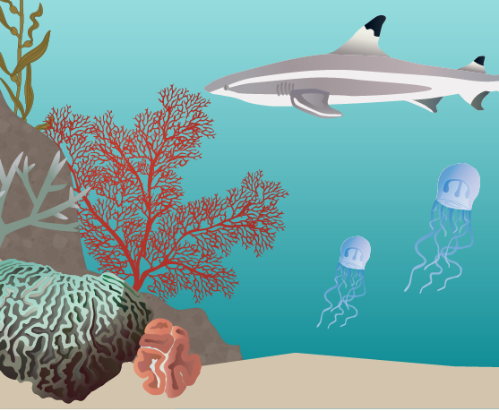
Here’s your challenge:
Create your own species of fish that is adapted to the Arctic Ocean, Caribbean Sea or Lake Ontario.
Here’s your to-do list:
Step 1
Learn about the four main taxonomic groups of fish.
Step 2
Learn what the shape of a fish's body can tell us about how it lives.
Step 3
Review three different environments where fish live.
Step 4
Design your fish for one of the three environments.
This activity was adapted from a River Institute resource.
Step 5
Describe your fish.
2

Slide 3
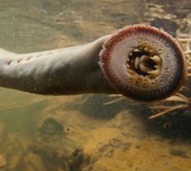
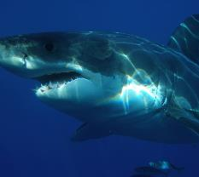
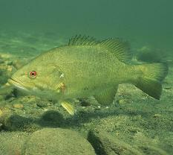
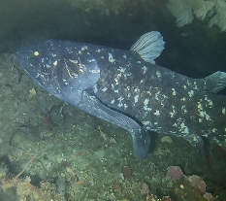
Fish taxonomy
In biology, taxonomy is the study of how to classify living things. For example, fish are vertebrates (animals with backbones) that live in water, have scaly skin, and use gills to breathe. We can sort all fish into four big taxonomic groups:
Petromyzontids (Peh-troh-my-zon-tids)
Chondricthians (Kon-dr-ik-th-ee-ans)
The lamprey is the only extant (living) member of this group. It does not have any jaws and is considered the oldest of the living vertebrates.
In this group, we find sharks, skates, rays and chimaeras. Their skeletons are cartilaginous, which means they are mostly made of cartilage instead of bone.
Actinopterygians (Ack-tin-awp-te-ridge-ee-ans)
Sarcopterygians (Sar-cawp-te-ridge-ee-ans)
This is probably the
group that you know best! These are the ray-finned fishes. It is the most diverse group of vertebrates.
These are the lobe-finned fishes. There are two members of this group that are probably the ancestors of terrestrial vertebrates.
3

Slide 4
Fish anatomy
Dorsal fins
Located on the back. They can be soft or spiny. They help the fish stay balanced, and can also be used for defence.
Scales
They are covered in a mucus layer, which helps protect the fish from bacteria and parasites in the water.
Lateral line
A sensory organ used in the detection of movement vibrations and changes of pressure in the water.
Nostrils
Located on the fish’s head. Sensory organs used for smelling.
Operculum
These bony plates cover the gills, which are used to extract oxygen from the water.
Caudal fin
Located on the end of the tail. It’s used for propulsion.
Pelvic fins
Located on the belly.
They’re used for equilibrium and direction.
Pectoral fins
Located on the side.
They’re used for equilibrium.
Anal fins
Located close to the anus. They’re used for equilibrium and direction.
4

Slide 5

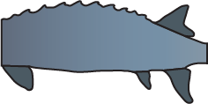



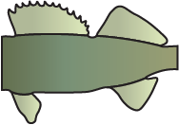






Morphological diversity
Fish morphology involves understanding the different parts of a fish and how they are adapted to help the fish survive in its environment.
Mouth
Body
Caudal fin
Superior
Ideal for feeding at the surface of the water.
Elongated
Ideal for short sprints and ambushing prey.
Forked
Ideal for really fast swimming.
Crescent
Ideal for swimming long distances.
Terminal
Ideal for chasing and catching food in fish’s path.
Fusiform
Ideal for fast swimming over long periods of time.
Truncated
Ideal for turning and accelerating.
Rounded
Ideal for turning and sprinting.
Inferior
Ideal for picking up food from the bottom.
Ovate/Compressed
Ideal for rapid maneuvering and hard for predators to eat.
Heterocercal
Ideal for continuous and fast swimming.
Pointed
Ideal for sneaking through crevices.

Slide 6
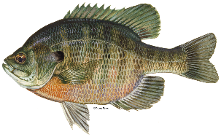

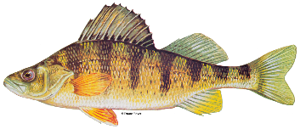
Now it’s your turn: How do these fish live?
Using the information on slide 5, try to identify where each of these fish eat, how they swim, and how they protect themselves.
Fish
Eating style
Swimming style
Mode of protection
Bluegill
Sturgeon
Yellow Perch
6

Slide 7
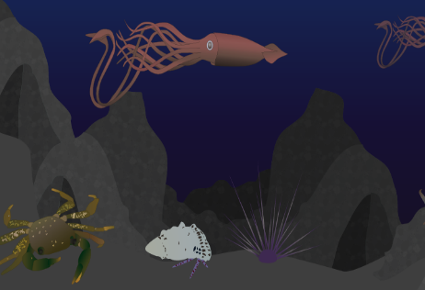
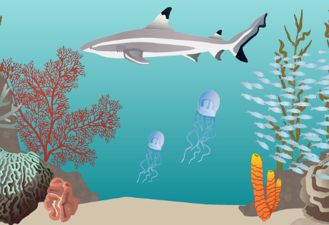
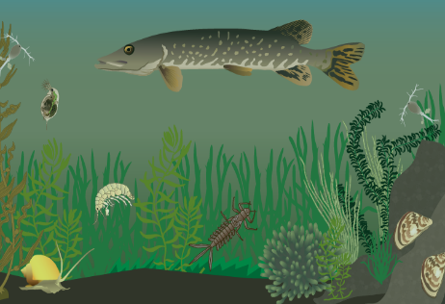
Learn about three different environments
Where a fish lives influences its morphology! Below are three examples of different environments.
The Arctic Ocean
In the Arctic Ocean, the water is cold, usually −1.8 °C. The seafloor is rocky and reaches 5,000m below the surface. This means there is very little light that reaches the sea floor and few to no plants can grow. Among the creatures that live here are crabs, giant squid, and many small more aquatic invertebrates.
The Caribbean Sea
In the Caribbean Sea, the water is clear and warm, usually around 27 °C. The bottom is sandy and spotted with coral and algae. Volcanic activity and heavy winds in the region bring strong marine currents. Among the creatures that live here are schools of brightly coloured fish, sharks, and some jellyfish.
Lake Ontario
In Lake Ontario, the water temperature varies between 4°C and 20°C. The water is cloudy because it is rich with organic material, from sediments brought to the water surface by big gusts of wind. The aquatic vegetation is dense and rich with micro algae. Among the creatures that live here are freshwater fish, zooplankton, and many more small aquatic invertebrates.
7

Slide 8
Design your fish
Using what you’ve learned about fish anatomy, morphology, and the environments where fish live, design your own fish that is adapted to either the Arctic Ocean, Caribbean Sea, or Lake Ontario.
Choose an environment from slide 7 for your fish to live in:
Build your fish here by copying and pasting fish parts from slide 5.
Give your fish a name:

Slide 9
Describe your fish
Using the information on slide 5, and the fish you created, answer the questions below.
Where does your fish eat?
How does your fish move?
e.g., My fish has an “inferior” mouth so it can eat food from the seafloor.
What does your fish eat?
How does your fish defend itself?
9

