Slide 1




How hurtful can it be?
How does hate speech make me feel? > SEL > How hurtful can it be?

Slide 2

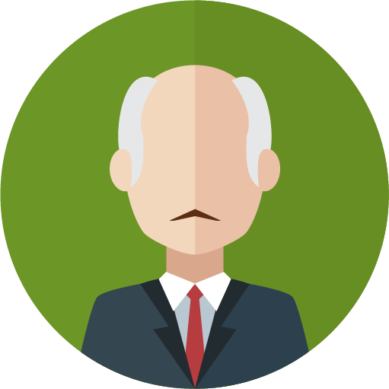


Speaker
Speaker
Mr Camstead
Speaker
Jada Hayes
A.K.A Haymaker
A politician.
Very active in the media and online
From a privileged background
Attended private school
Moderate views
Recent scandal about tax avoidance
Married
3 children
57 years old
Speaker
A YouTube vlogger.
Very active in the media and online
From a middle-class background
Attended state school
Moderate views
Recent criticism for social media posts mocking gay people and muslims
Single - in a relationship
29 years old
Simon James
A TV presenter, writer, commentator and journalist.
Very active in the media and online
From a working-class background
Attended state school
Extreme views
Recent scandal about attitude towards women
Known for holding scornful stereotypical opinions of others
Anti-regulation
Married
3 children
41 years old

Slide 3

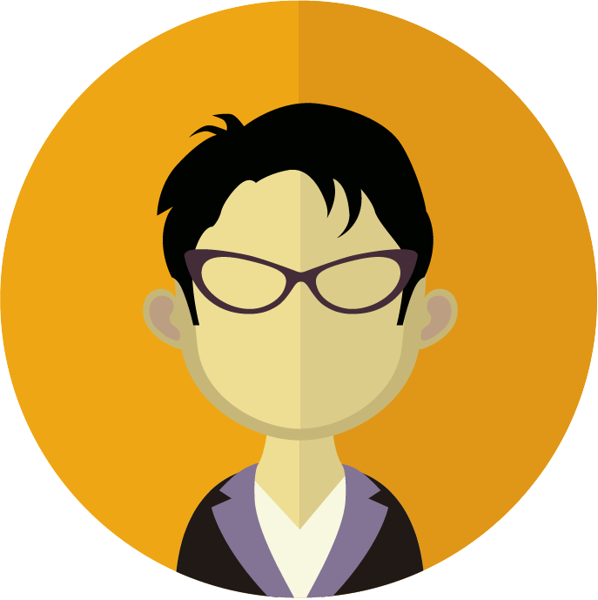
Speaker
Speaker
Carol Bellington-Smyth
Jin Chung
A media personality, journalist and broadcaster.
Sometimes in the media and online
From a working-class background
Attended state school
More extreme views
Activist and campaigner
Married four times
No children
73 years old
A student.
Very active in the media and online
From a privileged background
Attended private school
Moderate views
Extremely well known in media for strong view about LGBTQ and obesity issues.
Single
No children
20 years old
Speaker

Slide 4




Context
Context
Context
At a public event
Context
A private house
Over 500 people in a public space.
Like-minded and already aligned with the views of the speaker.
Police presence for crowd control.
No violence in the crowd.
TV crews filming and broadcasting the event.
In the lounge.
No public figures.
All people in the room are well known to the speaker.
Not a planned event.
A speech
In a private, ticket only event.
Attended by members of the same political party as the speaker.
Highly-charged political environment.
Several prominent social media commentators and influencers in attendance.

Slide 5


Context
Context
At the youth club
A ‘private’ online space
In a room at the club.
Lots of people there, lots unknown to the speaker.
A few people have YouTube accounts and accounts on other networks, with small numbers of followers.
Not a planned event.
Context
The speaker has invited the group to join the space a long time ago.
They are connected online and they all have a variety of public online accounts too.

Slide 6



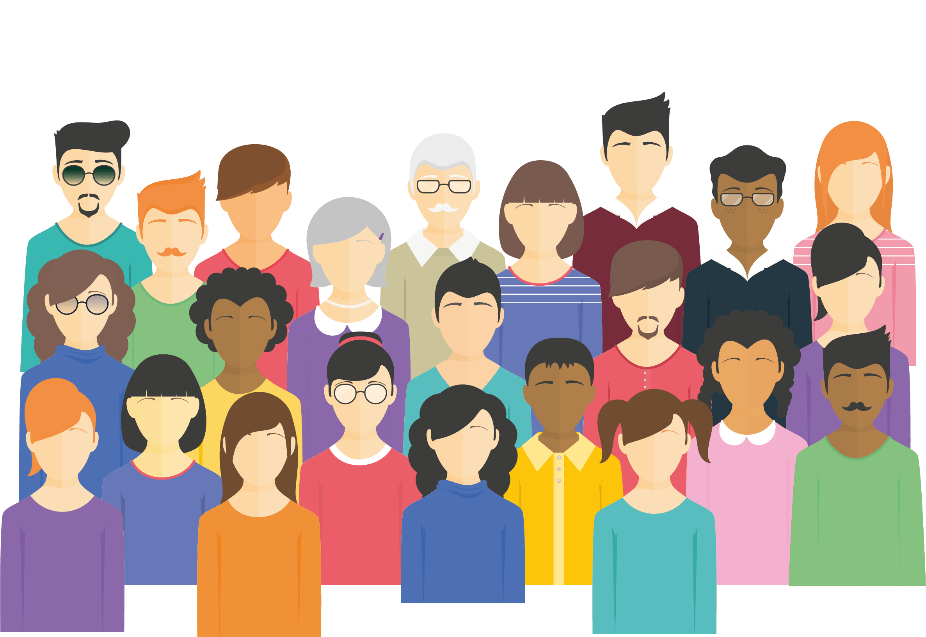
Audience
Audience
Audience
Activists
Audience
A loosely affiliated group
Already known for taking a public stand on the issue.
Very vocal about their cause.
Often in the media.
People that have liked the same social media page or are in the same group.
Generally people agree with the speaker, but come from a wide range of backgrounds.
Socially and racially diverse.
The general public
A mix of different perspectives, viewpoints and attitudes.
All would identify with being in either the same group as the speaker, or opposing.
Socially fragmented.

Slide 7
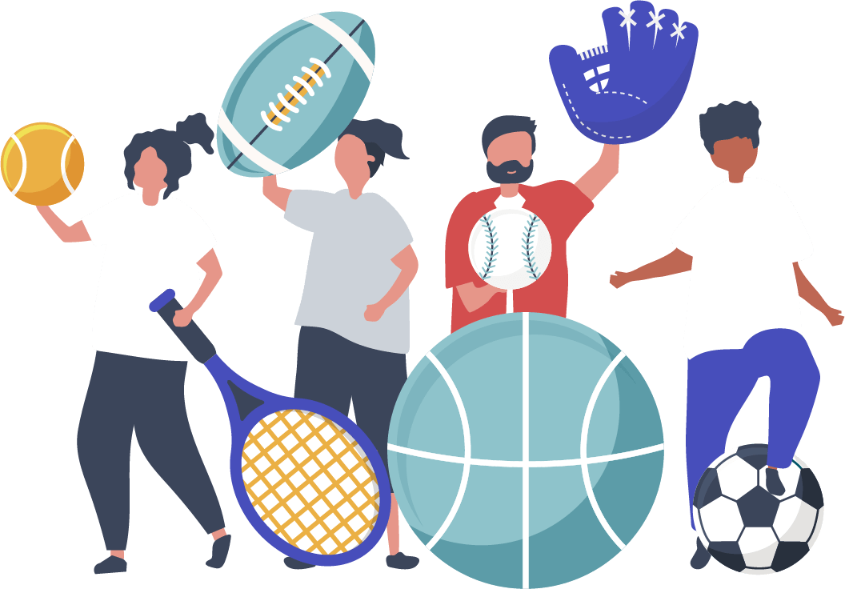

Audience
Audience
Members of a club
Friends of the speaker
All have an interest in the same thing, but this is unrelated to what the speaker is talking about.
A diverse mix of ages and backgrounds.
Audience
A well known group to the speaker.
They often spend lots of time talking about all sorts of things.
Broadly similar backgrounds.

Slide 8




Target
Target
Target
Target
A group in society
An individual known to the speaker
Linked by one or more characteristics.
This person often is outspoken about others, but volunteers for a local charity.
A figure in public media
Has recently expressed a strong opinion about particular topic.

Slide 9

Target
Target
?
An individual unknown to the speaker
The people of a particular country
Target
All their knowledge about this individual comes from what they have heard from others or in the media.
The people of a particular country.

Slide 10

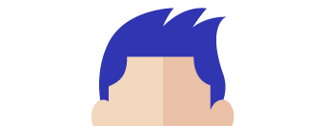


Characteristics
Characteristics
Characteristics
Blue hair
Characteristics
LGBTQ+
This characteristic includes all those individuals who identify as being:
Lesbian
Gay
Bisexual
Transgender
are questioning their identity
Or other
The characteristic includes all individuals that have blue hair. This can be long, or short, natural or dyed. The individuals that make up this group will have a high range of ages.
Geek
This characteristic includes all individuals that are a single-minded expert in a particular field. They may also display low social skills or have poor fashion sense. Individuals in this category often talk about their passion obsessively, or with great technical detail.

Slide 11






Characteristics
Characteristics
Religion
Disability
This characteristic includes all those individuals who identify as being part of a particular religion, or who do not believe, or question the existence of religion e.g.:
Jews (Judaism)
Muslims (Islam)
Atheist (lacking belief in god)
This characteristic includes those individuals who have a physical or mental impairment that has a long-term or significant impact on their life.
Characteristics

Slide 12








www.hackinghate.eu
#SELMA_eu

