Slide 1

Direct Line
July, 2022

Slide 2

Table of Contents
Introduction
Use cases
User guide

Slide 3
Product Introduction

Slide 4
What is the Direct Line Application?
Direct Line is a call forwarding app that allows you to stay connected with your business even when you are at home, on the road or overseas.
It can ring up to 6 local or international numbers at one time, assuring that you will never miss an important call.

Slide 5
Features
Simultaneous call forwarding to 6 numbers.
Customization of missed call message in multiple languages.
Missed call notification in SMS or email with voicemail.
Office hours customization and number blocking.
Mobile, landline local and international DIDs.
Other apps integration (Call Tracking, Call Recording).

Slide 6
Use Cases

Slide 7
Individuals & Businesses working from different locations
Virtual offices
Publicise your Direct Line number and setup to forward calls to up to 6 numbers simultaneously, regardless of their geographical locations.
Only 1 line can get connected to the call.
2 simultaneous calls at one time.

Slide 8
User Guide

Slide 9
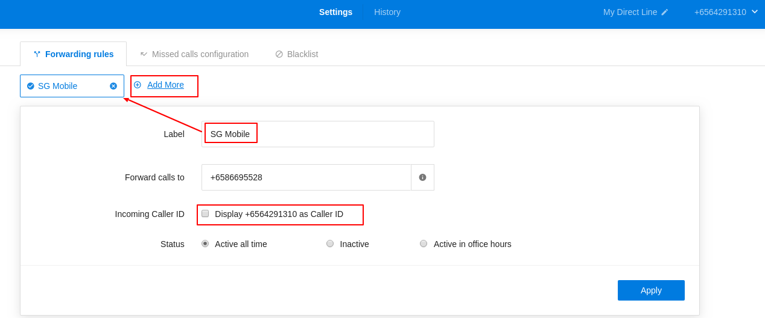
Set Up Call Forwarding
Go to Direct Line subscription > Settings
Forwarding Rules > Click the plus icon > Add a label and your real number to receive incoming calls
Enabling the Direct Line number as caller ID will help you recognize business calls before picking up.
If you do not tick Display the Direct Line number for incoming caller ID, actual caller numbers will be shown as caller ID.

Slide 10
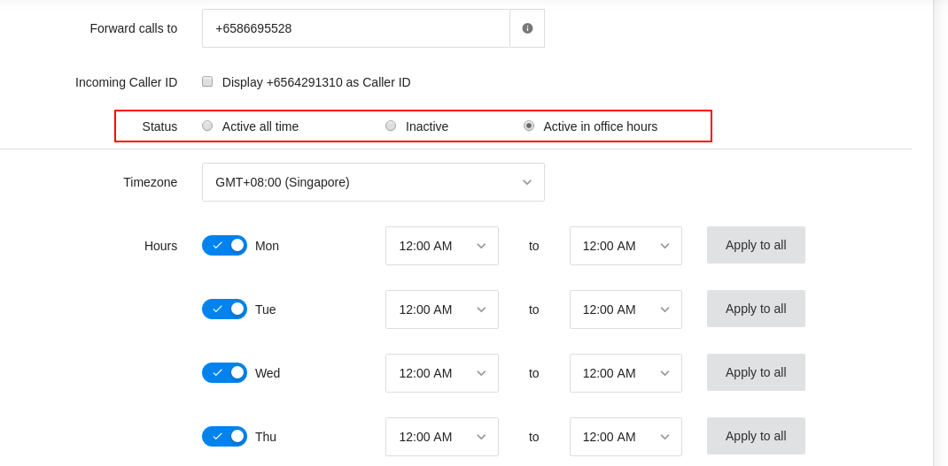
Set Up Call Forwarding (cont’d)
3. Set active time
You can set the number to be active all time or inactive or active in preset office hours.

Slide 11
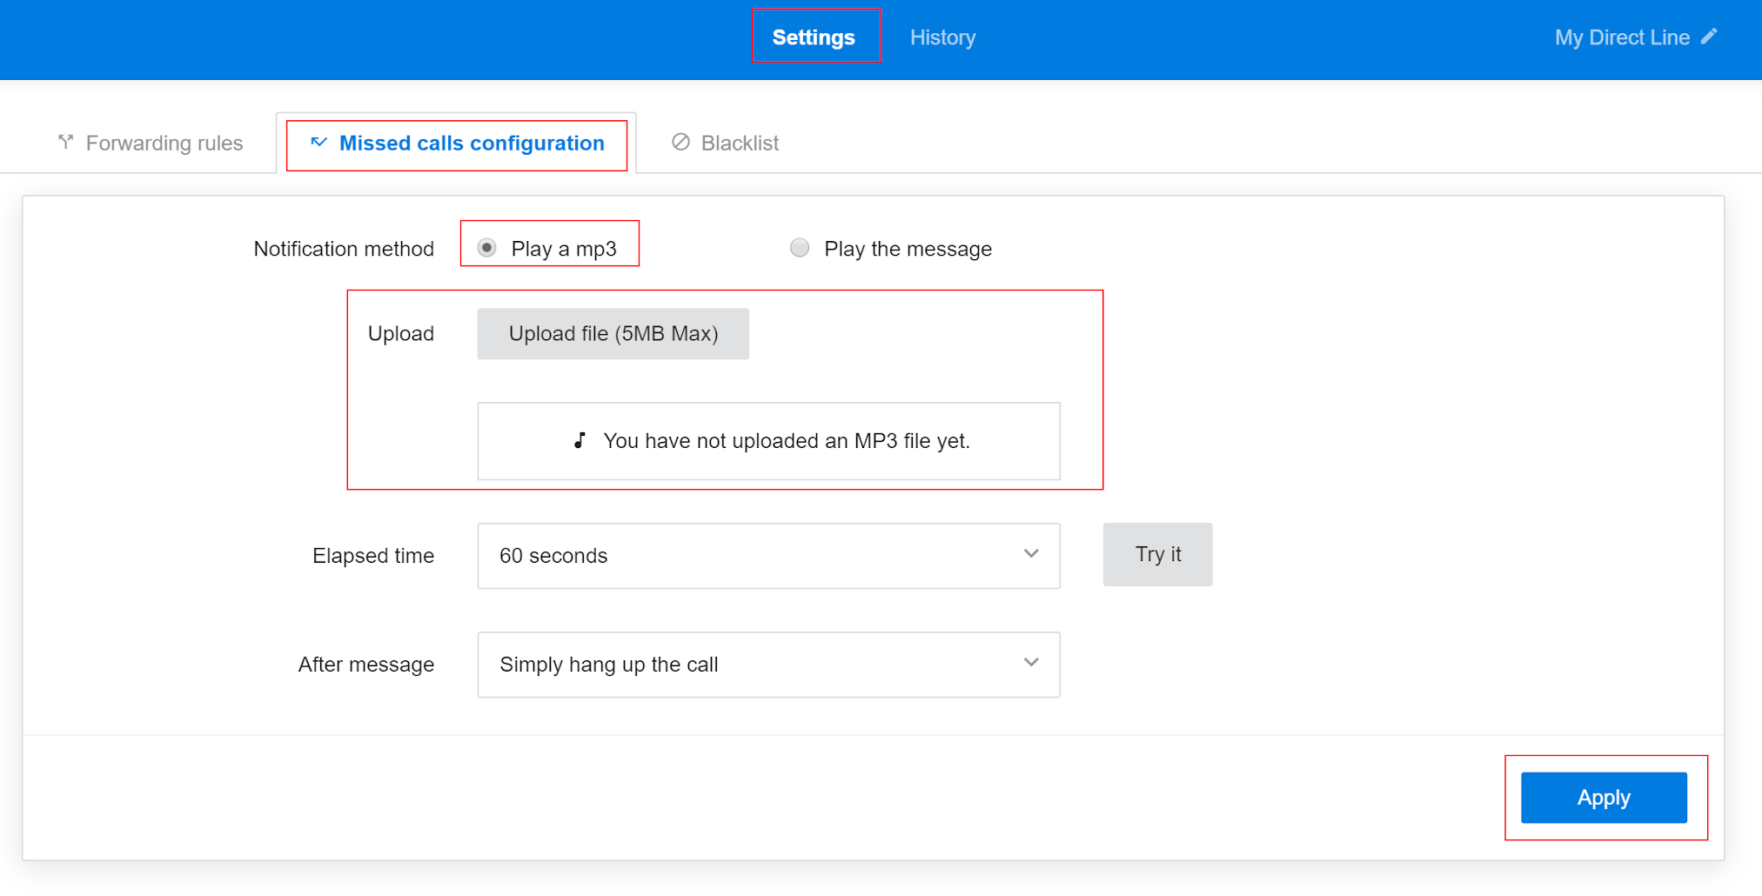
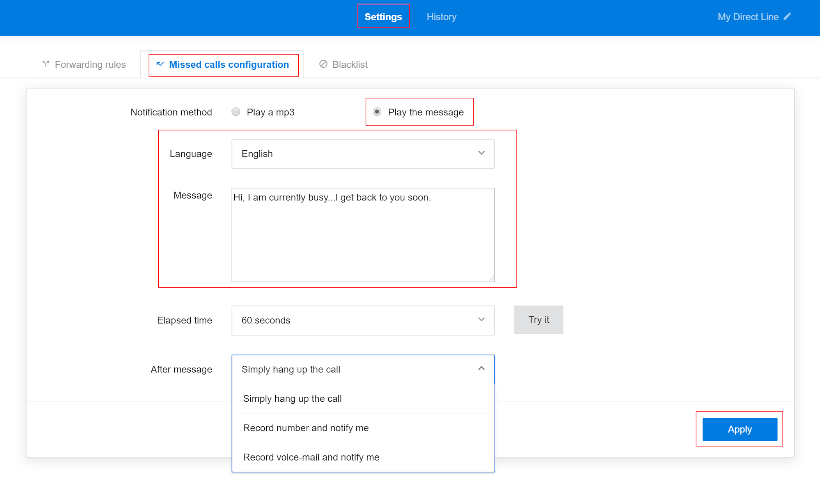
Set Missed Call Notification
Settings > Missed call configurations
Choose notification method > Add message or upload mp3 file

Slide 12
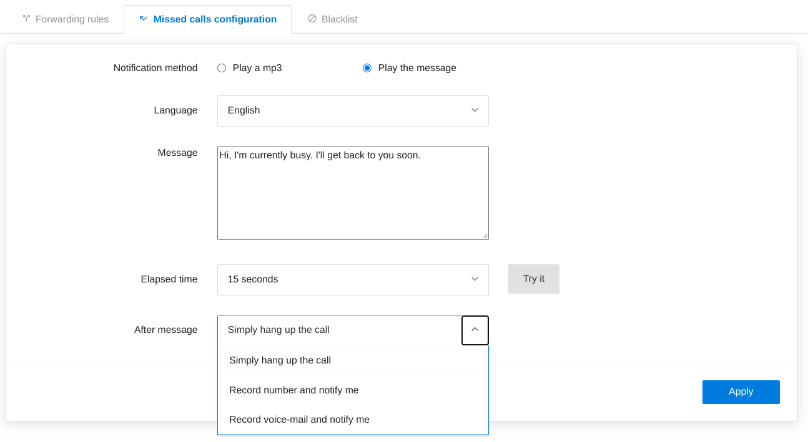
Set Missed Call Notification
3. Set elapsed time: the preferred ring time before a missed call is triggered
4. Select an option at After the message
5. Apply

Slide 13
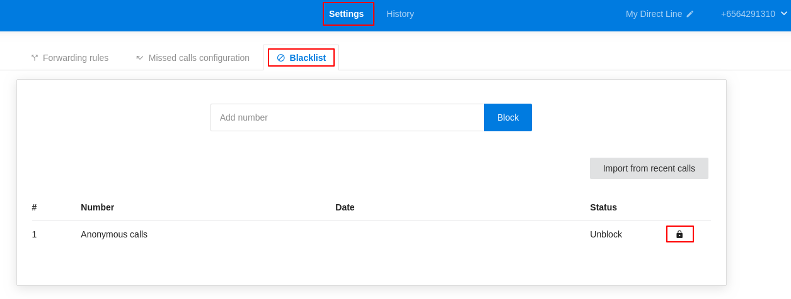
Block Unwanted Calls
Settings > Blacklist
Enter the number in the box
Block
Anonymous Calls: Anonymous calls are blocked by default. Otherwise, click the Unblock icon besides the Status.
Import from Recent Calls: View records of calls that were made to your Direct Line > select the numbers you wish to Block > then click Import.

Slide 14
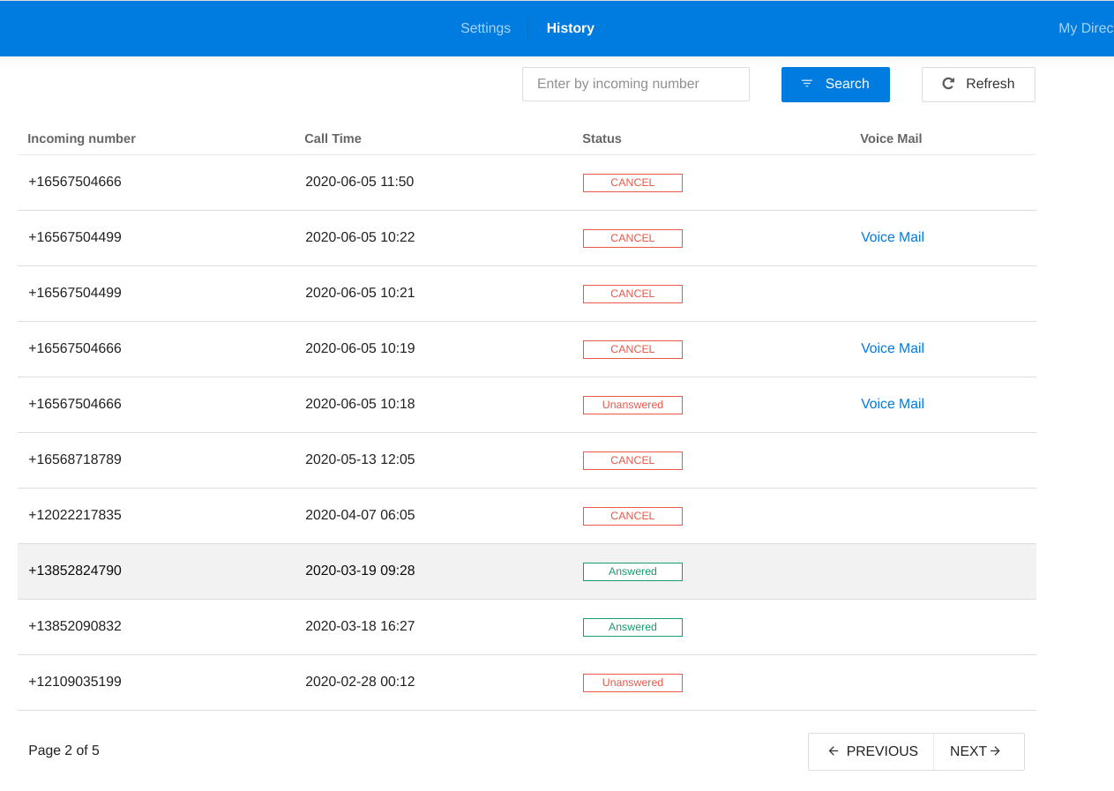
History
(Show incoming history of your Direct Line)

