Slide 1
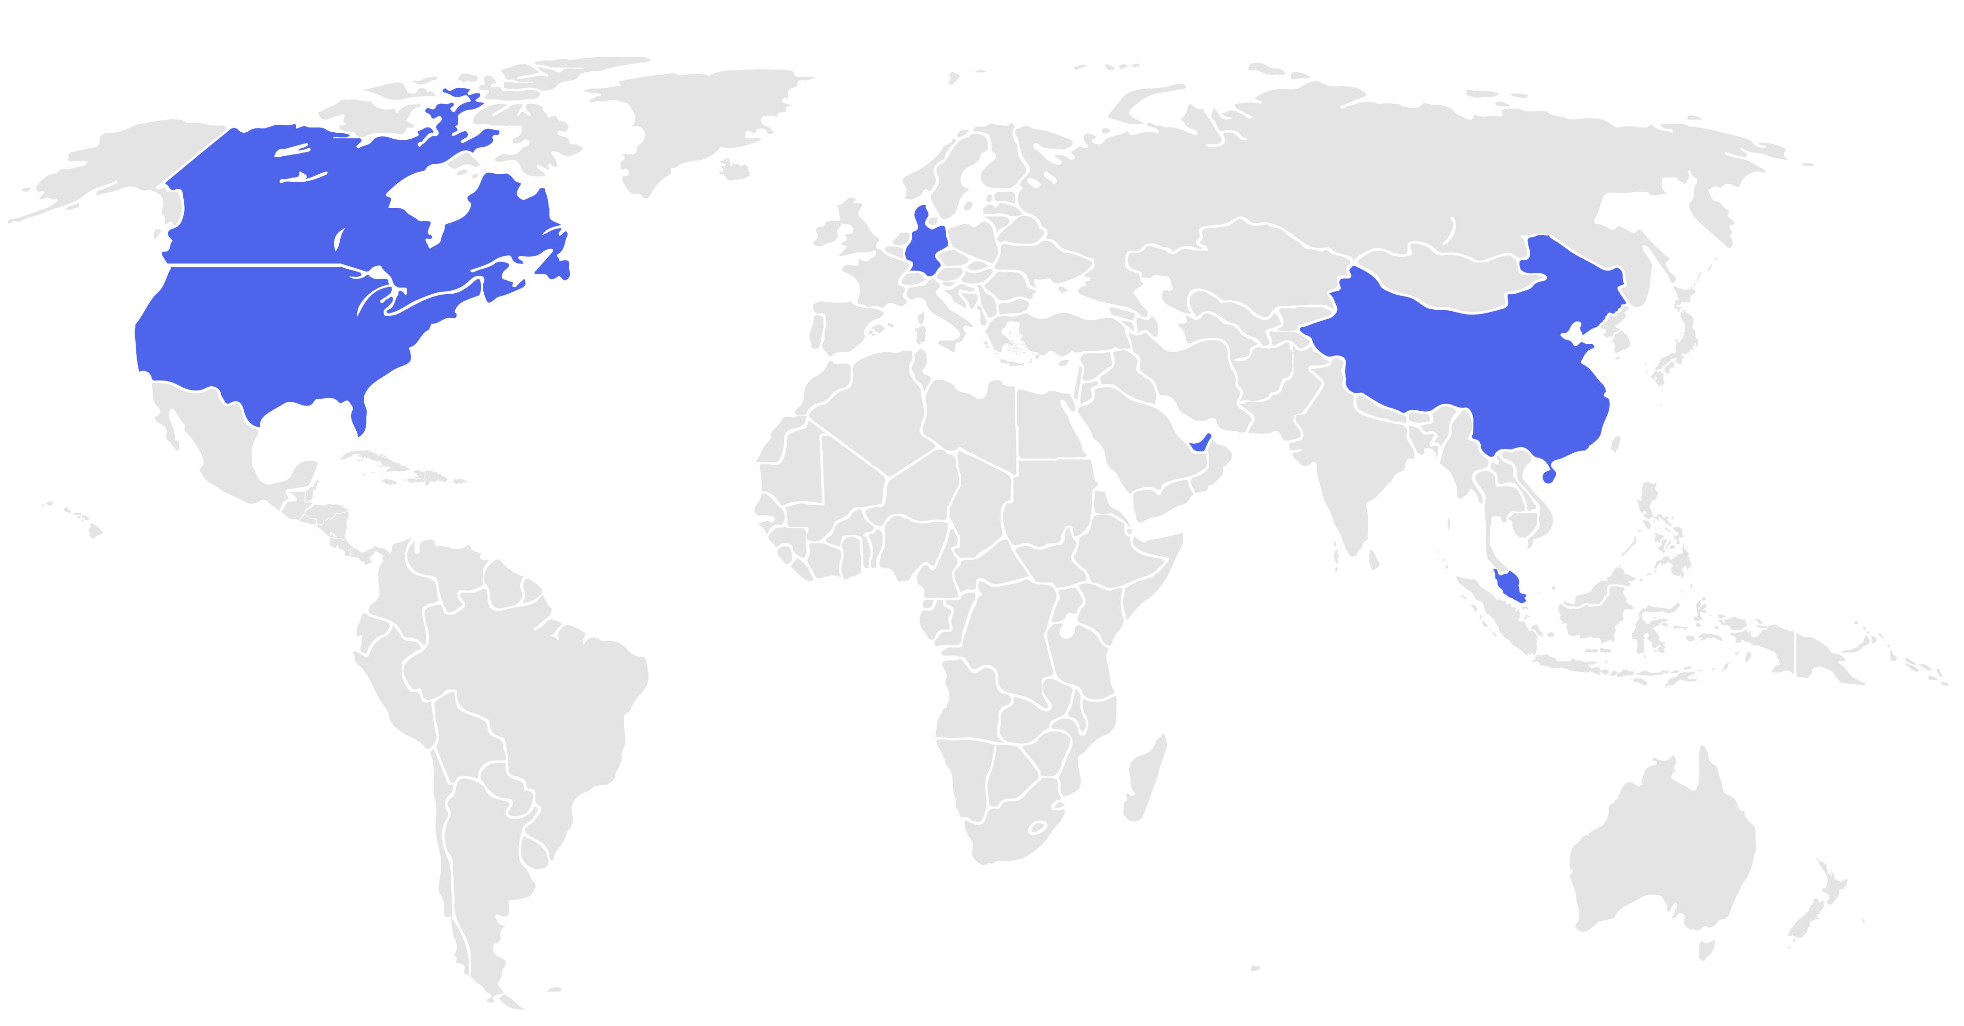
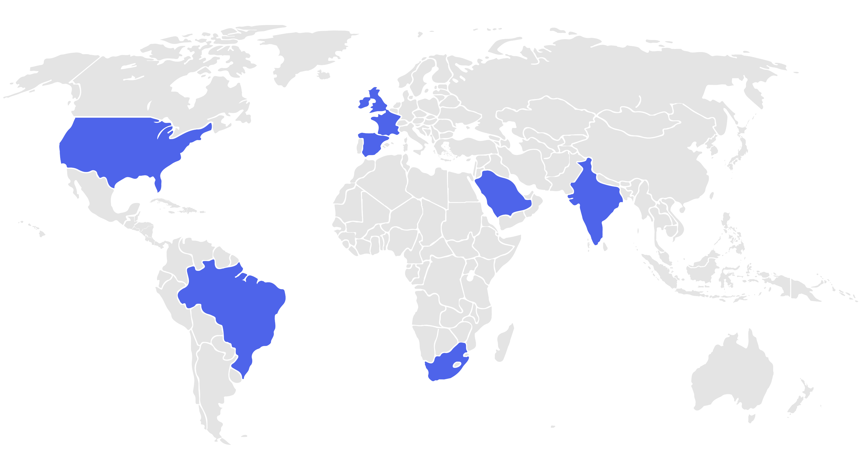
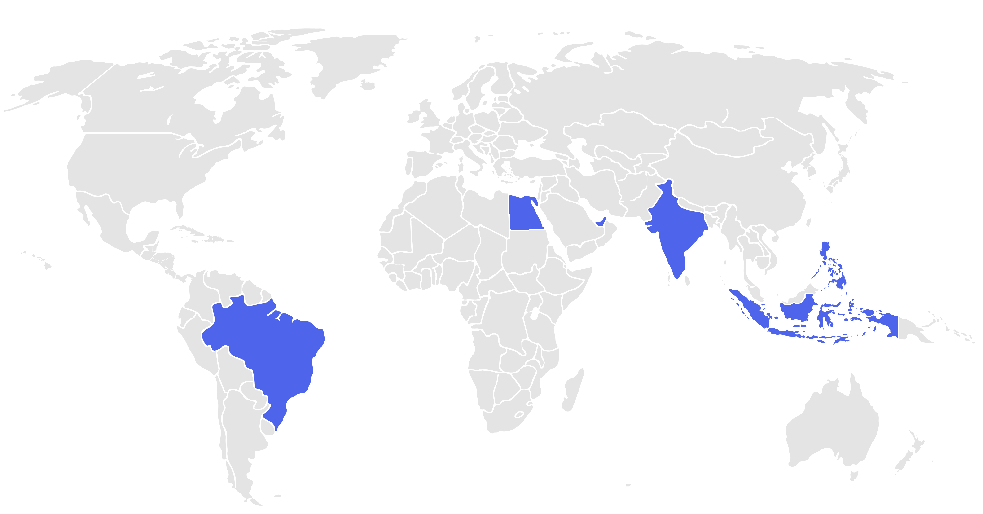

Global Focus Areas in Digital Transformation by Region
Mapping Regional Priorities Across Three Key Transformation Domains
Canada
Germany
China
United Kingdom
France
India
UAE
United States
UAE
United States
Egypt
India
Philippines
Saudi Arabia
Singapore
Indonesia
Brazil
Brazil
South Africa
AI & Automation Adoption
Cloud & Data Infrastructure Expansion
Customer Experience & Digital Services
Regions accelerating investment in AI, robotics, and automated processes to optimize operations and drive innovation.
Countries prioritizing cloud migration, data analytics, and scalable digital platforms to modernize enterprise capabilities.
Markets focusing on mobile-first services, digital banking, and seamless customer engagement platforms.
Digital transformation priorities differ globally. While North America and China lead in AI and automation, Europe and India are pushing cloud and data modernization. Meanwhile, emerging markets across Asia, South America, and the Middle East focus on enhancing digital services and customer experiences to drive growth and inclusivity.
01
Introduction
Global Focus Areas in Digital Transformation by Region

