Slide 1


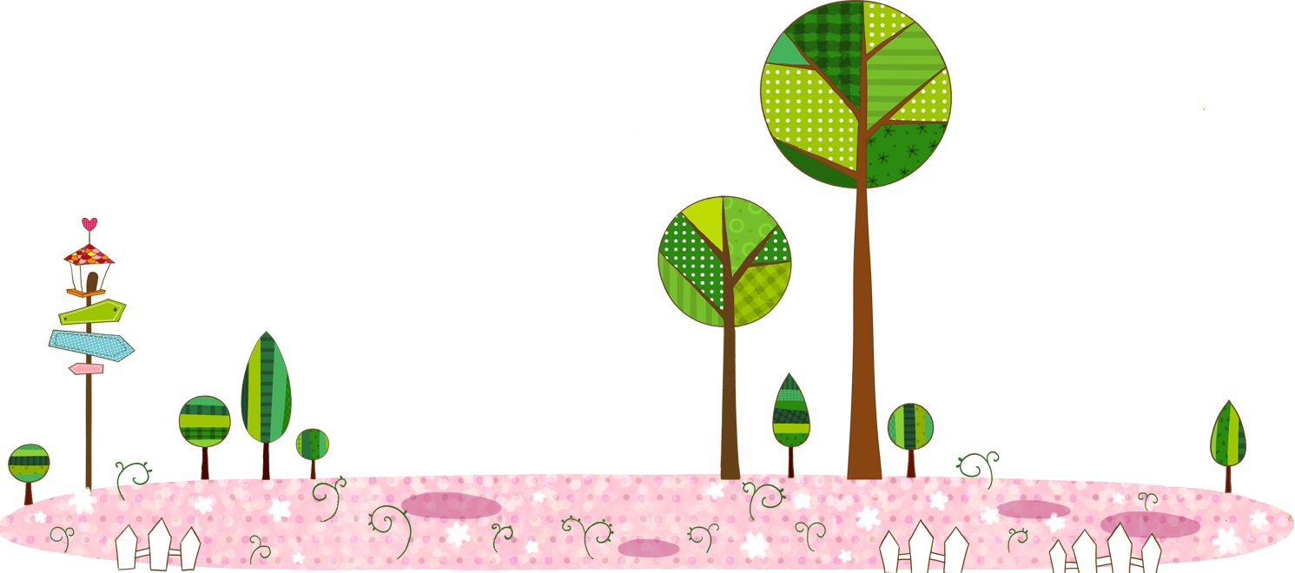

CHILDRENS PLAYROOM
Powerpoint Template
www.freepptbackgrounds.net

Slide 2

1
1
Goal
2
Growth
Contents
3
Hearing
4
Improve

Slide 3

01
GOAL

Slide 4

0
1
A large income
is the best
Inform
0
2
Woe be to him that reads but one book.
0
3
Be an encourager, the world has enough

Slide 5


01
02
03
Inventory
Instructions
Install
Always give your best never worry for results.
Be an encourager, the world has enough critics already.
Always give your best never worry for results.

Slide 6
Join
Always give your best
1
Inform
Knowledge
Invoice
3
2
Always give your best
Education is the most powerful

Slide 7

Solution
B
Enjoy the little
things in life
C
A
Content
Direction
God sometimes
removes people
Everyone wants,
happiness.

Slide 8

Editable
Do you wonder what the difference
Direction
Do you wonder what the difference
Visual
People who touch your heart are always with you.

Slide 9
02
GROWTH

Slide 10








Impress
Invectors
Raise
Be not afraid of going slowly
A torn jacket is soon mended
To see what is in front of one's

Slide 11

Company
Money
Money
Take calculated risks.
Take calculated risks.
Grow
Grow
There is only one difference
Company

Slide 12

Base
Business
Customer
Business
Enterprise
PPT模板下载：www.1ppt.com/moban/ 行业PPT模板：www.1ppt.com/hangye/
节日PPT模板：www.1ppt.com/jieri/ PPT素材下载：www.1ppt.com/sucai/
PPT背景图片：www.1ppt.com/beijing/ PPT图表下载：www.1ppt.com/tubiao/
优秀PPT下载：www.1ppt.com/xiazai/ PPT教程： www.1ppt.com/powerpoint/
Word教程： www.1ppt.com/word/ Excel教程：www.1ppt.com/excel/
资料下载：www.1ppt.com/ziliao/ PPT课件下载：www.1ppt.com/kejian/
范文下载：www.1ppt.com/fanwen/ 试卷下载：www.1ppt.com/shiti/
教案下载：www.1ppt.com/jiaoan/

Slide 13





To see what is in front of
one's nose needs a
Campaign
Media
There is only one difference
between
a madman and me
Events
A torn jacket is soon
mended
Social
Organic
Take calculated risks. That is
quite different from being rash.
George S. Patton

Slide 14






Powerpoint
Web Design
Service
Keynote
Development

Slide 15
03
HEARING

Slide 16
Check
Make
Circle
Think
Design
Meet
Solutions
Team
Team
Solutions
Team
Solutions
Devices
Team
Design
Meet
Introduction
Speakers
Cerenomy
Opening

Slide 17
1,000
800
Opening
600
I'm convinced that about half of what separates the successful entrepreneurs from the non-successful ones is pure perseverance.
400
200
0
820
620
500

Slide 18
I'm convinced that about half of what
When you feel in your gut
W
I
S
T
Take calculated risks. That is quite different
Skiing consists of wearing $3,000 worth

Slide 19

I'm convinced that about half of what separates the successful
There is only one difference between a madman and me. I am not mad.
There is only one difference between a madman and me. I am not mad.
I'm convinced that about half of what separates the successful

Slide 20
04
IMPROVE

Slide 21


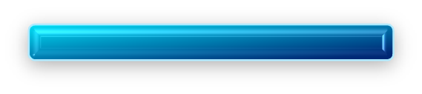

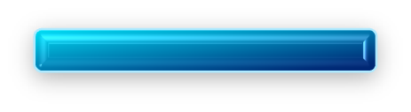

05
Free Time
04
Vision
03
Mission
02
Our Values
01
About us

Slide 22
Timeline
Future
I'm convinced that about
half of what separates the
successful entrepreneurs from
the non-successful ones is pure perseverance.
When you feel in your gut what
you are and then dynamically
pursue it - don't back down and
don't give up - then you're going to
mystify a lot of folks.
Pricing
What we do?
Services
Forum

Slide 23

Do you wonder what the
God sometimes removes people
Enjoy the little things
Everyone wants, happiness.

Slide 24




12%
Annual
20%
People who
touch your heart
are always with you.
20%
48%

Slide 25




Conferences
Be not afraid of going slowly,
be afraid only of standing still
Transport
Suggest
Split
Success

Slide 26
THANK YOU !
Childrens Playroom
Google Slides
www.freepptbackgrounds.net

