Slide 1
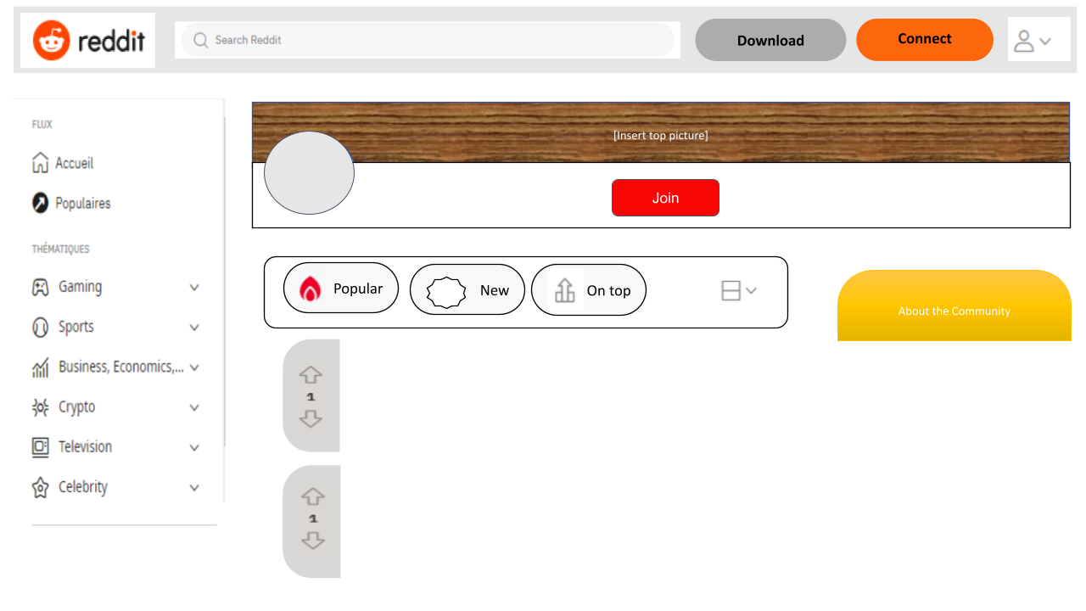


How to use this template:
1. Text
You can change the Sub-Reddit Name and description, and any place you see [text here]. Just highlight the text you want to change and start typing. (Note: If you delete all of the text and start typing, you might lose the formatting, like color and boldness.)
2. Images
You can change the image at the top and even the reviewer profile photo. Click the image and click “Replace image” in the menu bar at the top to select a different image.
When you’re done …
This template is intended to be done digitally. Do all of the work in edit mode. There’s no need to hit the “Present” button. It is standard U.S. letter size so it can be printed out.
This template was made by Bryan Robitaille, Québec, for Ditch That Textbook, a resource for creative teaching ideas for teachers. Find more FREE templates like this at DitchThatTextbook.com/templates.
[text here]
[Name of Sub-Reddit]
r/…….
[text here]
[text here]
[text here]

