Slide 1



Slide 2

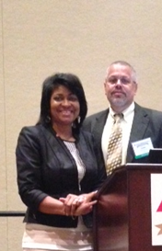
Dr. Olivia Newby, DNP, FNP-BC, CDE
Dr. James E. Newby II, MD, CDE
Primary Care Specialists, Inc.
Norfolk, Virginia 23504
Healthy Living Center
Norfolk, Virginia 23504

Slide 3
Disclosure to Participants
Notice of Requirements For Successful Completion
Learners must attend the full activity and complete the evaluation in order to claim continuing education credit/hours
Conflict of Interest (COI) and Financial Relationship Disclosures:
Olivia J. Newby, DNP, FNP-BC, CDE – Speaker’s Bureau Sanofi Pharmaceuticals; No Advisory Board disclosures
James E. Newby II, MD, CDE– No COI/Financial Relationship to disclose
Non-Endorsement of Products:
Accredited status does not imply endorsement by AADE, ANCC, ACPE or CDR of any commercial products displayed in conjunction with this educational activity
Off-Label Use:
Participants will be notified by speakers to any product used for a purpose other than for which it was approved by the Food and Drug Administration.

Slide 4
Learning Objectives
Define diabetes group shared medical appointments.
List the advantages and disadvantages of group shared medical appointments from the perspectives of the patient, diabetes educator and provider.
Explain the 4 W’s in planning a strategy of the group shared medical appointments.

Slide 5
Model for Delivering Patient Education in the Provider's Office Setting

Slide 6
Content Outline
Definition of Group Shared Medical Appointments
Background
Purpose: New model for education within health care reform
Interprofessional Collaborative Diabetes Education Team
Advantages and Disadvantages of Group Shared Medical Appointments
Patient
Diabetes Educator
Provider
The 4 W’s in Planning a Group Shared Medical Appointment
Who: demographics, interprofessional team members
What: curriculum
When: scheduling
Where: location

Slide 7
Educational Program Objectives
Establish novel and innovative programs as well as collaborate with a broad array of diabetes stakeholders to advance the role of diabetes educators and promote our involvement in chronic disease prevention and management in diverse populations.
Identify expansive opportunities for professional development, role enhancement and career advancement.

Slide 8
Learning Outcome
The purpose of this activity is to enable the learner to become more knowledgeable in planning effective diabetes self-management education within a collaborative and multidisciplinary team setting.

Slide 9
Definition of Group Shared Medical Appointments
Background
Purpose: New model for education within health care reform
Interprofessional Collaborative Diabetes Education Team

Slide 10
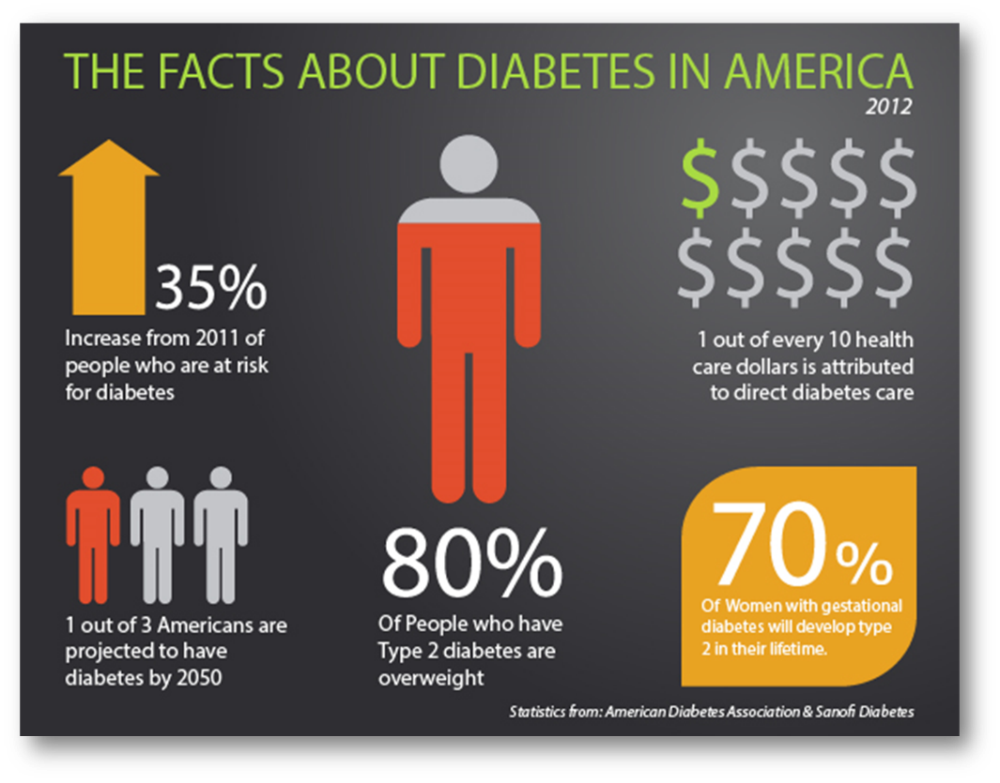
Diabetes
The facts about diabetes in America can be overwhelming to patients and health care providers. However, proactive treatment and preventive measures have significant potential to reduce the health and economic burden of diabetes.
Today’s presentation will provide evidence based research of improved clinical outcomes utilizing SMA approach at the provider’s office.

Slide 11

Group Shared Medical Appointments
Shared medical appointments (SMA) sometimes referred to as group visits, have shown great potential for people with diabetes because of its fundamental component and self-empowerment with education.
The SMA model is patient centered and embraces prevention

Slide 12

Type 2 diabetes (T2DM) Development
The associating risk factors for diabetes occurrence include
Genetic predisposition
Increased preventable risk factors
obesity
physical inactivity
poor nutrition

Slide 13
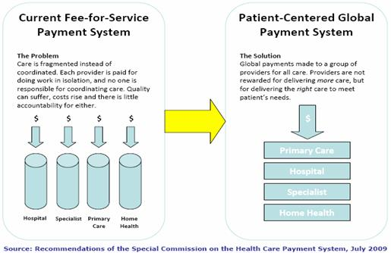
People with Diabetes Barriers to Improved Outcomes
Health care systems designed for:
Volume driven
Fee for service reimbursement
Limited allotted office visit time
Limited access to primary care providers

Slide 14

Diabetes Management in the Primary Care Practice (PCP)Setting
The traditional 15 minute PCP diabetes standard management of care consist of
Assess and examine the patient physical health.
Review relevant metabolic profiles, assess lab values such as A1C, LDL, glucose logs.
Review medications along with comorbidities assessment.
Provide health promotion and preventive education to the patient and / or family.
Document all relevant data in EMR.

Slide 15
What Do You Think?
How much time do you think the primary care health care provider is allocating to:
Diabetes self-management education
Diabetes self-management support
Diabetes medical nutritional therapy

Slide 16

The Provider: the Expert The Traditional Primary Care Setting
This approach to health behavior change is a technique called advice giving; the provider is seen as the professional expert who knows what is best for the patient. This approach takes for granted that patients
should change their behavior
want to change
their health and their prescribed regimen are major priorities for them.

Slide 17

Thought to Ponder
Multiple barriers exist during the traditional office visit, specifically the one to one isolation of the patient provider ratio format. This format can be intellectually intimidating for people with diabetes to improve their health literacy .

Slide 18
People with Diabetes Ethnic Minority People with Diabetes Traditional Educational Setting
Limited evidence indicates ethnic minority groups often do not benefit from traditional diabetes educational programs. Suggested barriers may include:
Cultural base dietary habits
Linguistic differences
Limited educational backgrounds
Religious, health and illness views

Slide 19

Purpose for New Model of Education and Interprofessional Collaborative Team

Slide 20


Purpose: New Model for Education
Proactive in prevention verses reactive to the disabilities incurred as a result of diabetes complications.
Diabetes contributed to a total of 231,404 deaths (CDC, 2012).
Diabetic complication

Slide 21

Promote Interprofessional patient education
Education for people with diabetes in the twenty-first century has evolved
from limited general knowledge to clinical outcomes that encourage behavior change.
from the simple distribution of information to the patient-centered education.

Slide 22

Advantages & Disadvantages
For the
Patients, Diabetes Educators, Providers

Slide 23
Advantages for the Patient
Organized group of people with diabetes in a single appointment
Provides advantage of a peer support group.
Provides peer education and motivation
Obtain more information, answers to question they never thought to ask
Opportunity to learn from the questions and comments of others.
Support from people with same concerns

Slide 24
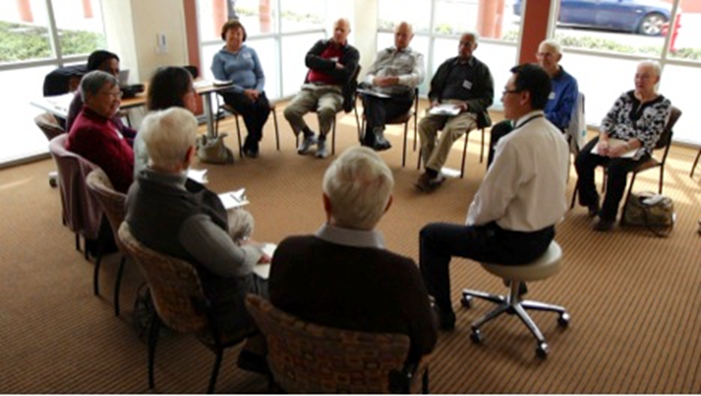
Advantage Patient
Provides a longer allotted time frame of 90 to 120 minutes.
Provides increased time with providers.
Improve better patient provider communication
Less isolation
Improves patient satisfaction

Slide 25

Advantages: Patient
Patients can address multiple questions in one visit
Self-empowered to ask questions without feeling isolated, discuss myths, fears and concern about diabetes
Notes:
Johnson & Johnson Inst. 2011

Slide 26

Advantages Certified Diabetes Educator
Improve teaching time of the diabetes language jargon (A1c)
Improvement with education promoting self-empowerment
Increase time with hands-on demonstrations such as
Reading food labels
Counting carbohydrates/calories
Reviewing self-monitoring

Slide 27




Slide 28

Advantages: Educator and Patient
Increased patient satisfaction
Enhanced understanding of the diabetes educator role within the interprofessional collaborative team.
Notes:
Mensing et.al 2012

Slide 29
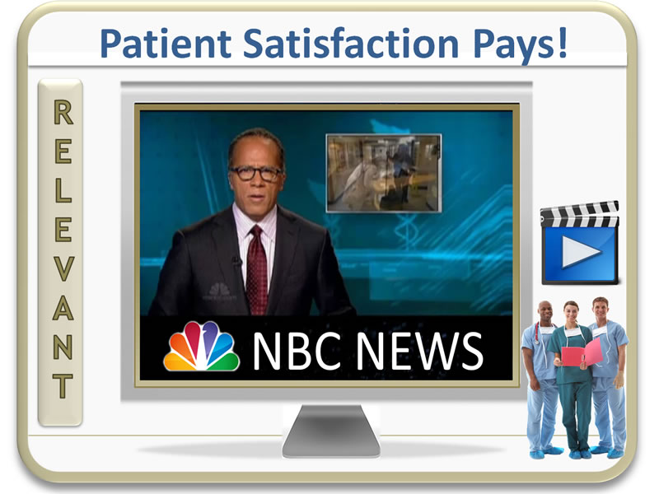
Advantages: Provider
Less isolation
Increase satisfaction
Patient retention
Fewer ER visits/admissions
Improve quality of care
Notes:
Johnson & Johnson Inst.2011

Slide 30
The 4 W’s in Planning a Group Shared Medical Appointments
Who, What, When, Where

Slide 31

Planning the 4 W’s of SMA
Develop the patient list
Gather data: prior A1C, LDL, weight, BMI, BP
Review roles and responsibilities
Establish timeline

Slide 32
Who: Patients
The number of patients range between 4-20 with most literature supporting 10-15 patients.

Slide 33

Who: Participating HCPs
Medical Doctor
Nurse Practitioner
Certified Diabetes Educator
Medical assistant

Slide 34

What : SMA Educational Format
First, participants undergo a brief physical exam that focuses on the key body sites that diabetes attacks.
Weight
Height
BMI
Pulse
Blood Pressure
Brief exam: heart, lung, feet/nail exam microfilament testing
Prior lab test information obtained HBa1c and Lipid Panel

Slide 35

What : SMA Educational Format
Second, participants are directed to the educational center where a chef will have a diabetic friendly meal prepared for their enjoyment.
It will also serve as an example that diabetic food choices can be extremely tasty.

Slide 36

What : SMA Educational Format
Third, participants will be given a 30 minute power point presentation
Participants learn the basics about diabetes in clear and simple terms. Learn some of the terminology and test results that are used during office visits.

Slide 37

Fourth, participants will be counseled by a certified diabetic educator to help understand why some foods are bad for diabetes and how to select healthier choices.
Learn how to read food labels, calculate calories and sodium in the foods eaten.

Slide 38

Lastly, participants undergo a review of glucose home monitoring by a certified diabetic educator.
Methods of testing blood glucose
how to record results in a daily log and
how to interpret glucose results.
For those needing it, insulin administration will also be reviewed and taught.

Slide 39


When?: SMA
Weekly
Monthly
Quarterly
Before, during, after office hours
Scheduling of staff
Scheduling of regular patients

Slide 40
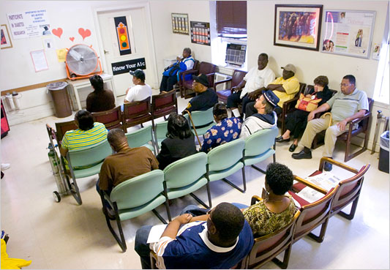
Where : SMA
Room size
Room location

Slide 41

Evidence Based Research Clinical Outcomes: SMA

Slide 42
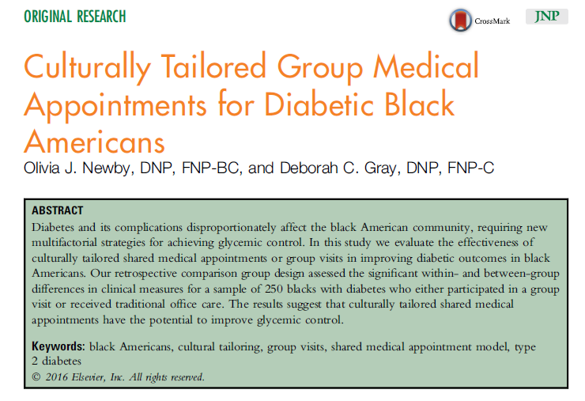

Slide 43

Research Study Purpose
To determine whether culturally tailored shared medical appointments within a primary care setting are an effective method of education and care as it relates to clinical outcome goals approved by the ADA for AA diabetic patients.

Slide 44


Research Questions
Is there a pre and post significant difference in clinical measures (including HbA1c, total cholesterol, blood pressure (BP) and body mass index (BMI) in a group of African American patients with type 2 diabetes that participated in a culturally tailored SMA program?
Is there a significant difference in clinical measures (including HbA1c, total cholesterol, blood pressure (BP) and BMI) outcomes between African American patients with type 2 diabetes that participated in a culturally tailored SMA program as compared to those that receive usual (office) care?

Slide 45
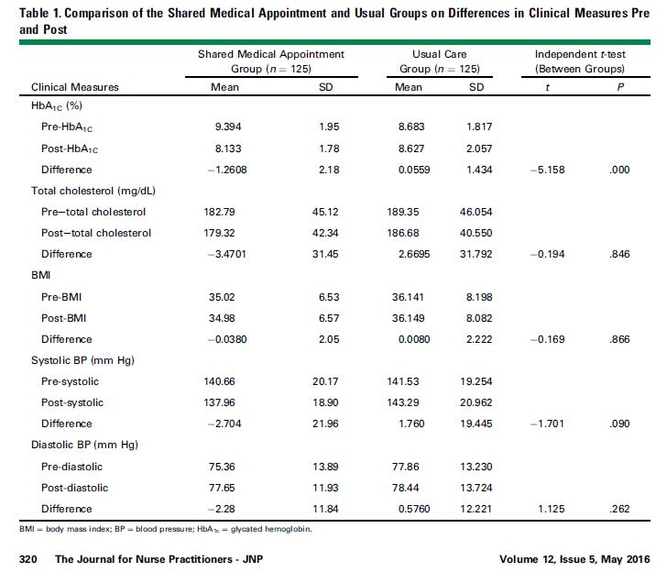

Slide 46
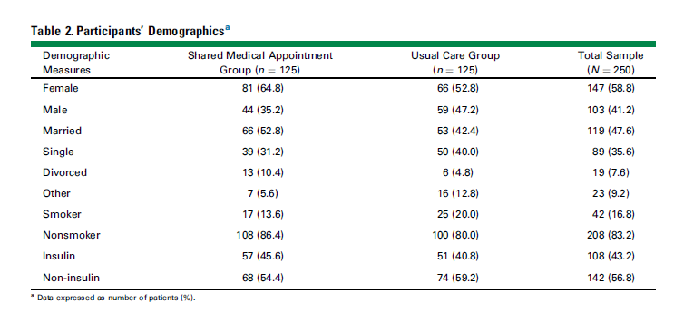

Slide 47
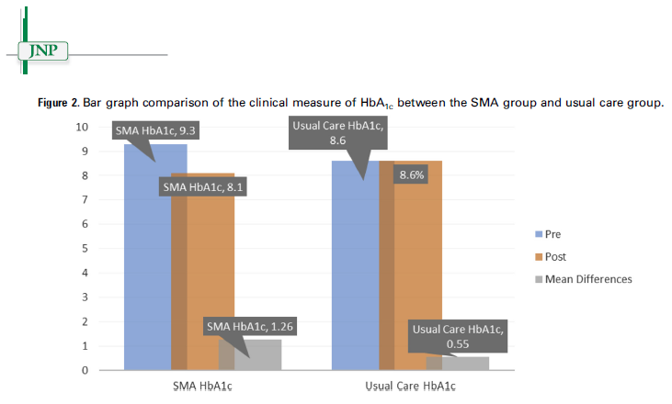

Slide 48
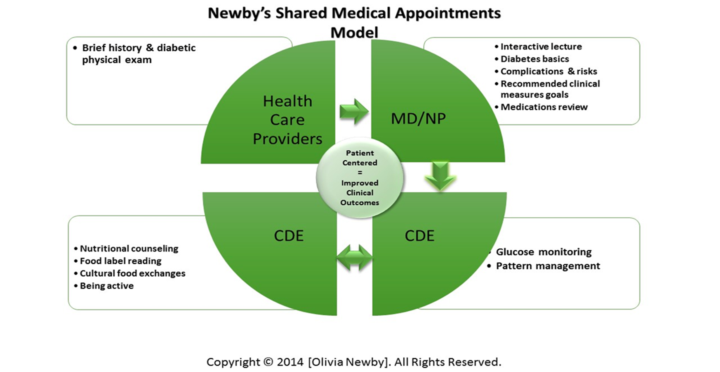





Slide 49
Statically Significance
A shared medical appointment model explicitly tailored for the African American patient that addresses cultural beliefs, language, norms, and behavioral patterns, can potentially help in reducing ethnic and racial health disparities related to diabetes.

Slide 50


Questions ?
DIABETES EDUCATORS

Slide 51
References
American Diabetes Association. (2013, January). Standards of medical care in diabetes 2013. Diabetes Care, 36, 11-66.
Burke, R. E., & O’Grady, E. T. (2012, January). Group visits hold great potential for improving diabetes and outcomes but best practices must be developed. Health Affairs, 31(1), 103-109. Retrieved from http://gx6ac7lq4l.search.serialssolutions.com.proxy.lib.odu.edu
Center for Disease Control and Prevention. (2011). National Diabetes Fact Sheet (CS217080A). Washington, DC: Government Printing Office.
Center for Disease Control and Prevention. (2012). Diabetes public health resource. Retrieved from http://www.cdc.gov/diabetes/consumer/learn.htm
Fitzner, K., Dietz, D., & Moy, E. (2011). How innovative treatment models and data use are improving diabetes care among older African American adults. Population Health Management, 14, 143-155.
Johnson & Johnson Diabetes Institute (2011), Participant guidebook (pp33-35). JJDDI Silicon Valley Milipitas, California.
Mensing, C., McLaughing, S., & Halstenson, C. (2011). Theoretical and behavior approaches to the self management of health. In Anderson B., Funnel M. Eds. The art and science of diabetes self management education desk reference (2nd ed.) (pp.71-76). Chicago, Illinois: American Association of Diabetes Educators
Newby O, Gray D. Culturally tailored group medical appointments for diabetic Black Americans Journal for Nurse Practitioners 2016; 12(5); 317-323.

