Slide 1

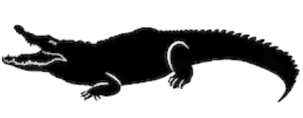
What makes roller coasters go so fast?
Name:_________________________
Collisions Experiments!
 | eaten safe | eaten safe | eaten safe | eaten safe
 | eaten safe | eaten safe | eaten safe | eaten safe
Did the Hill Marble get eaten?
(It’s ok if the Bumper Marbles got eaten.)
Always release the Hill Marble at the “High” mark:
Change the number of Bumper Marbles on the track:
Trial 1
Trial 2
Trial 3
Trial 4
High
44 cm
32 cm
High
44 cm
32 cm
20 cm
COLLISIONS RESULTS: Adding more Bumper Marbles (always / sometimes / never) kept the Hill Marble from getting eaten. Why do you think this happens? Explain your results in terms of energy:
____________________________________________________________________________________
____________________________________________________________________________________
What makes roller coasters go so fast?
Name:_________________________
Collisions Experiments!
 | eaten safe | eaten safe | eaten safe | eaten safe
 | eaten safe | eaten safe | eaten safe | eaten safe
Did the Hill Marble get eaten?
(It’s ok if the Bumper Marbles got eaten.)
Always release the Hill Marble at the “High” mark:
Change the number of Bumper Marbles on the track:
Trial 1
Trial 2
Trial 3
Trial 4
High
44 cm
32 cm
High
44 cm
32 cm
20 cm
COLLISIONS RESULTS: Adding more Bumper Marbles (always / sometimes / never) kept the Hill Marble from getting eaten. Why do you think this happens? Explain your results in terms of energy:
____________________________________________________________________________________
____________________________________________________________________________________

