Slide 1
CPaaS Portal General Settings
- Admin Guide -
Updated - June 2024

Slide 2
Release Notes (November 2023)
Item | Slide No. | Change Description
[Manage Org] - Audit | 19 | Allow to filter all applications & search actions within the “Action” field
[Manage Org] - Members Tab | 27 | Update placeholder from “Search” to “Search by name”

Slide 3

Table of Contents
General Portal Settings
Manage Account
Manage Organization

Slide 4
General Portal Settings

Slide 5
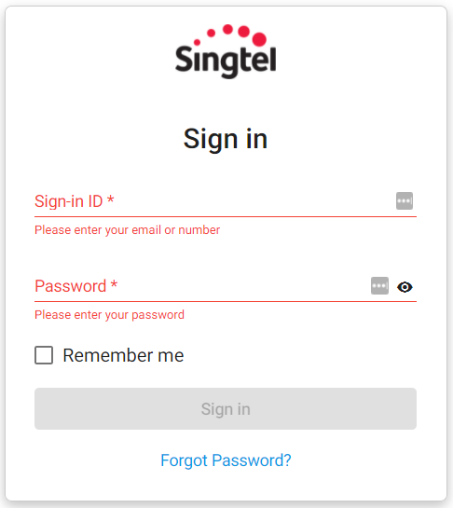

General Portal Settings <Login Portal>
Members who have been granted Portal Access can login by using:
Registered Email Address
Created Password.

Slide 6
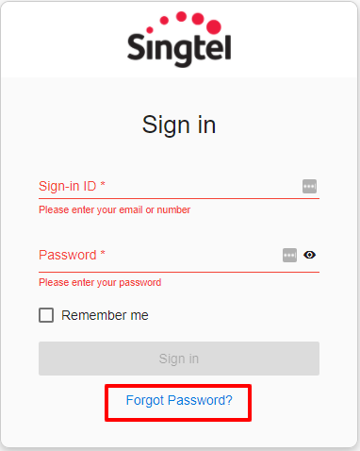
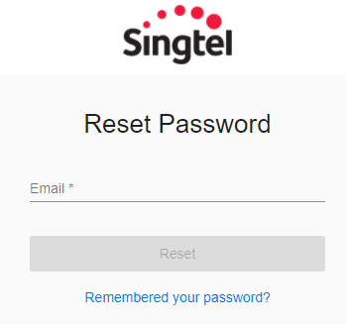
General Portal Settings <Password Reset>
In the case wherein members forget their Password and unable to log in to their account, they can trigger a Password Reset.
They will receive a link via their Registered Email to set a new Password for their respective account.

Slide 7
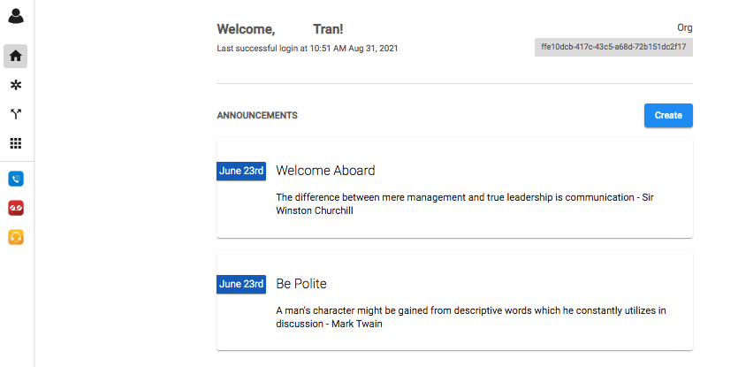
Homepage
[Homepage] is a tool for users to navigate to all subscribed subscriptions and organization’s announcements.

Slide 8
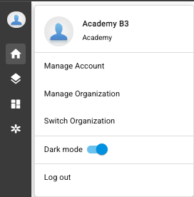
Account Navigation Options
By clicking on the User Icon, the following options can be selected:
Manage Account - Lets users edit certain settings for their account.
Manage Organization - Directs users to the Org Management tab wherein they can navigate and manage Organization related Settings.
Switch Organizations - Allows users to toggle between multiple Organizations they are added into.
Dark Mode - Allows users to switch colors on the sidebar (Dark/Light).
Log Out - Allows users to sign out of the account.

Slide 9
Manage Account

Slide 10
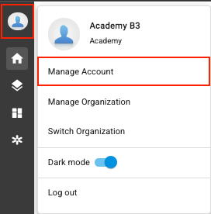
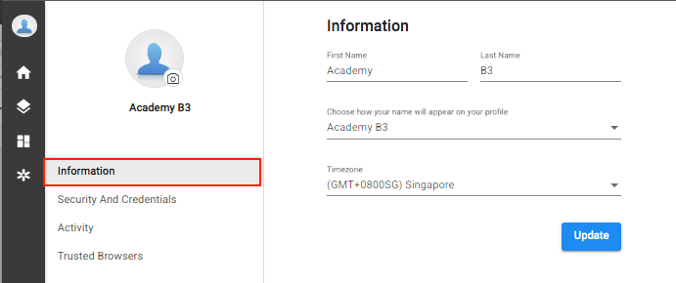
Manage Account <Information>
Owner/Admins can customize their:
Account Image
Account Name
Timezone

Slide 11
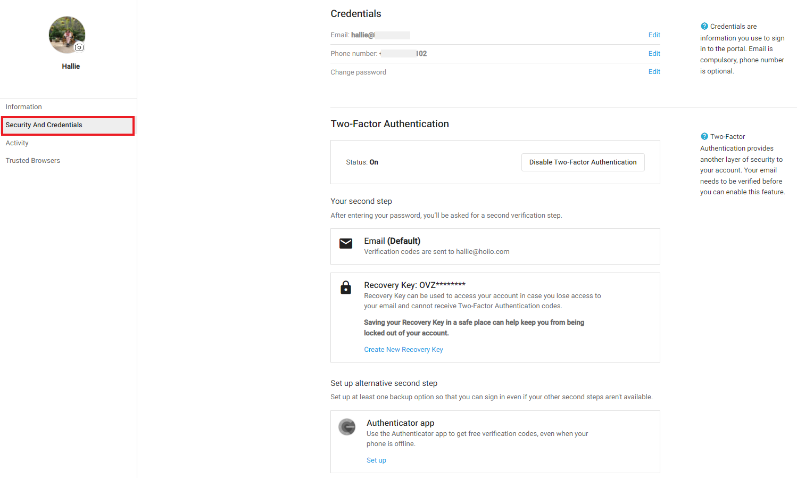
Manage Account <Information>
Allows Owner/Admins to manage their:
Account Credentials
Email Address
Phone Number
Password
Two-Factor Authentication
Recovery Key
Alternative Second Step

Slide 12
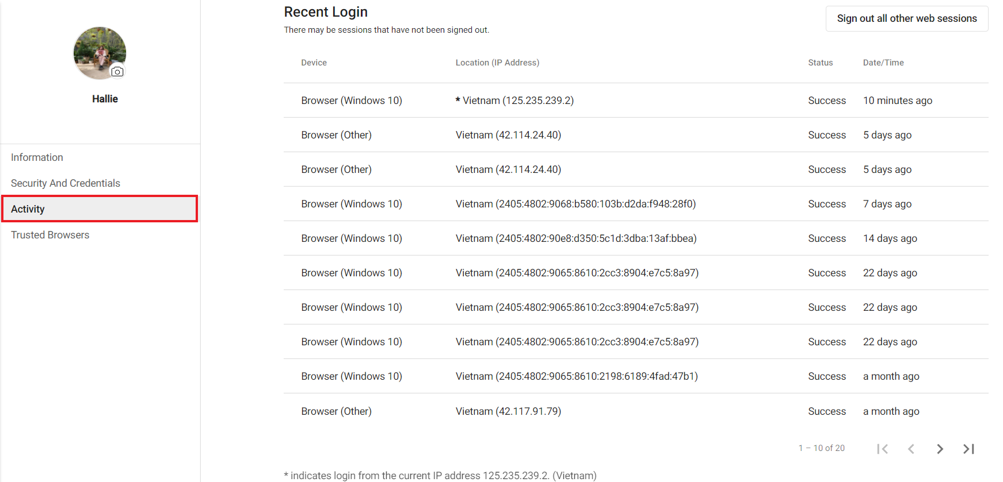
Manage Account <Activity>
Gives Owner/Admins visibility on login activity for their account.
The portal shows the twenty (20) most recent account activities.

Slide 13
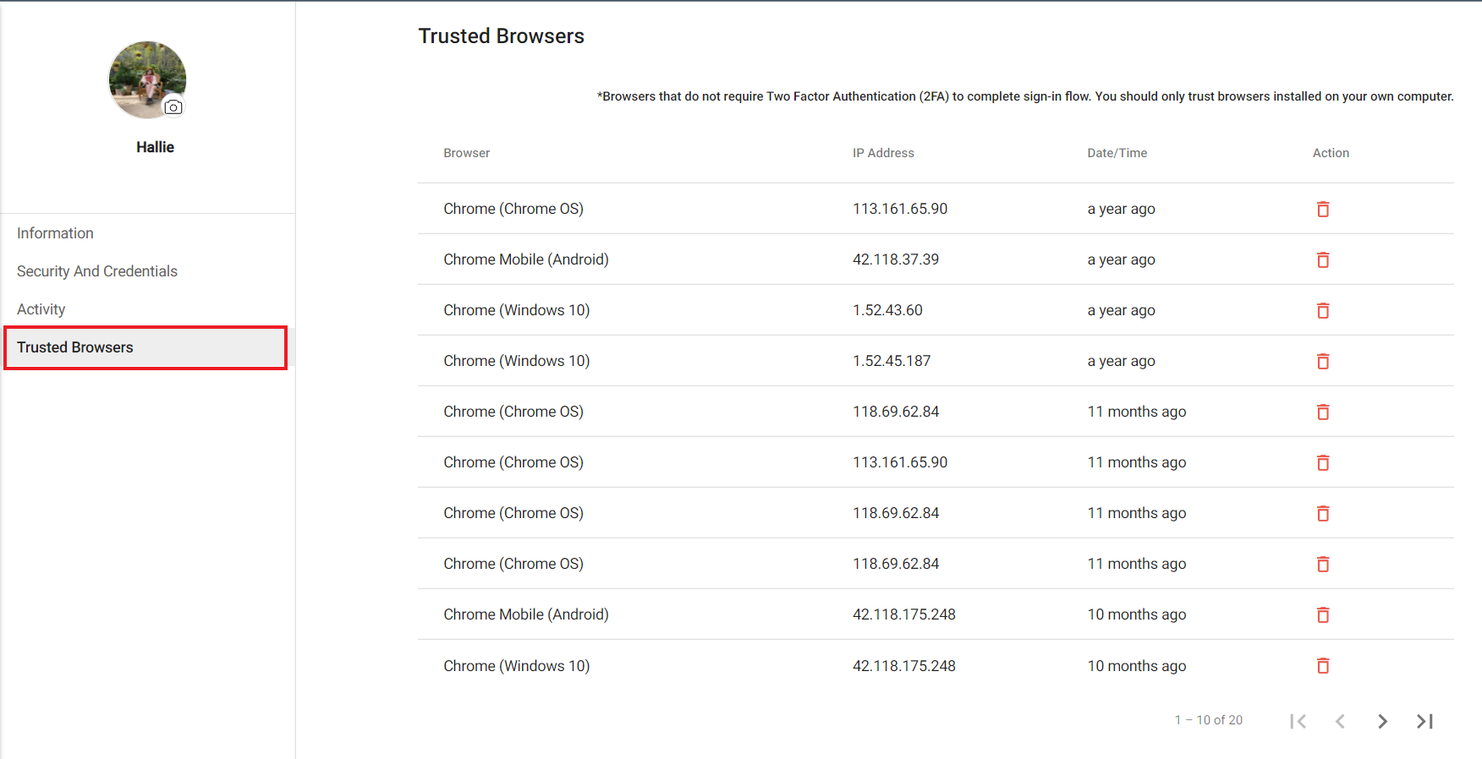
Manage Account <Trusted Browsers>
Shows the list of trusted browsers the Owner/Admins have accessed their accounts from.
*Trusted Browsers do not require Two Factor Authentication (2FA) to complete sign-in flow. You should only trust the browsers installed on your own computer.

Slide 14
Manage Organization

Slide 15
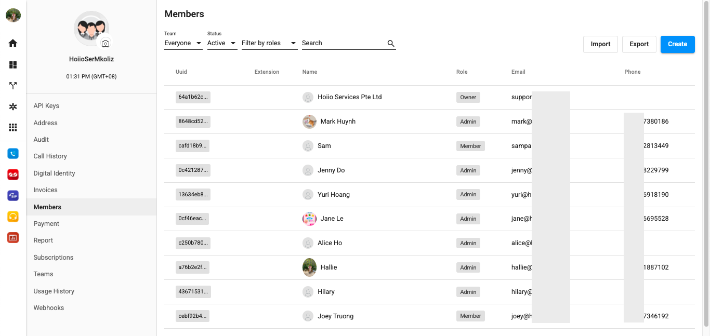
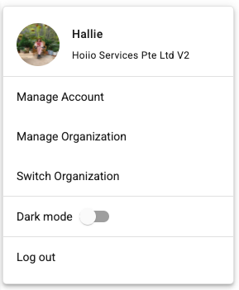
Manage Organization <Overview>
Manage Organization is a page for admins to easily manage and navigate to general organization information.

Slide 16
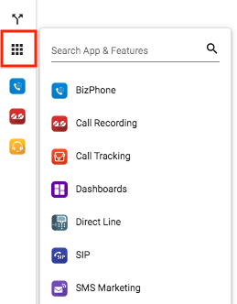
Manage Organization <Overview>
Navigate to a subscribed application
Click on the Rubik icon
Choose the application

Slide 17
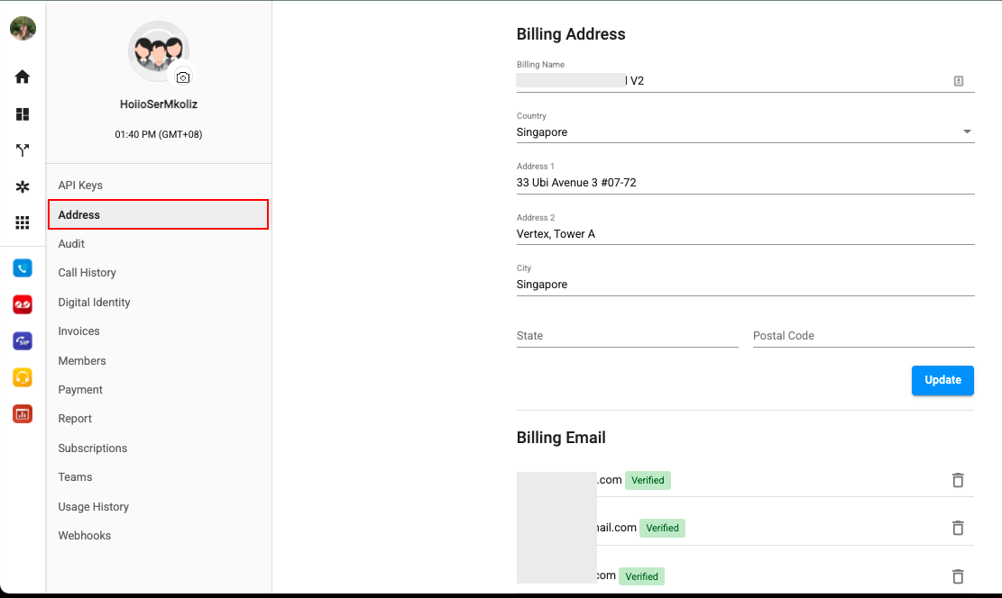
Manage Organization <Address>
Allows you to update:
Billing Address:
Choose [Address]
Change Billing Details
Update
Billing Email:
Fill in Email address
Add

Slide 18
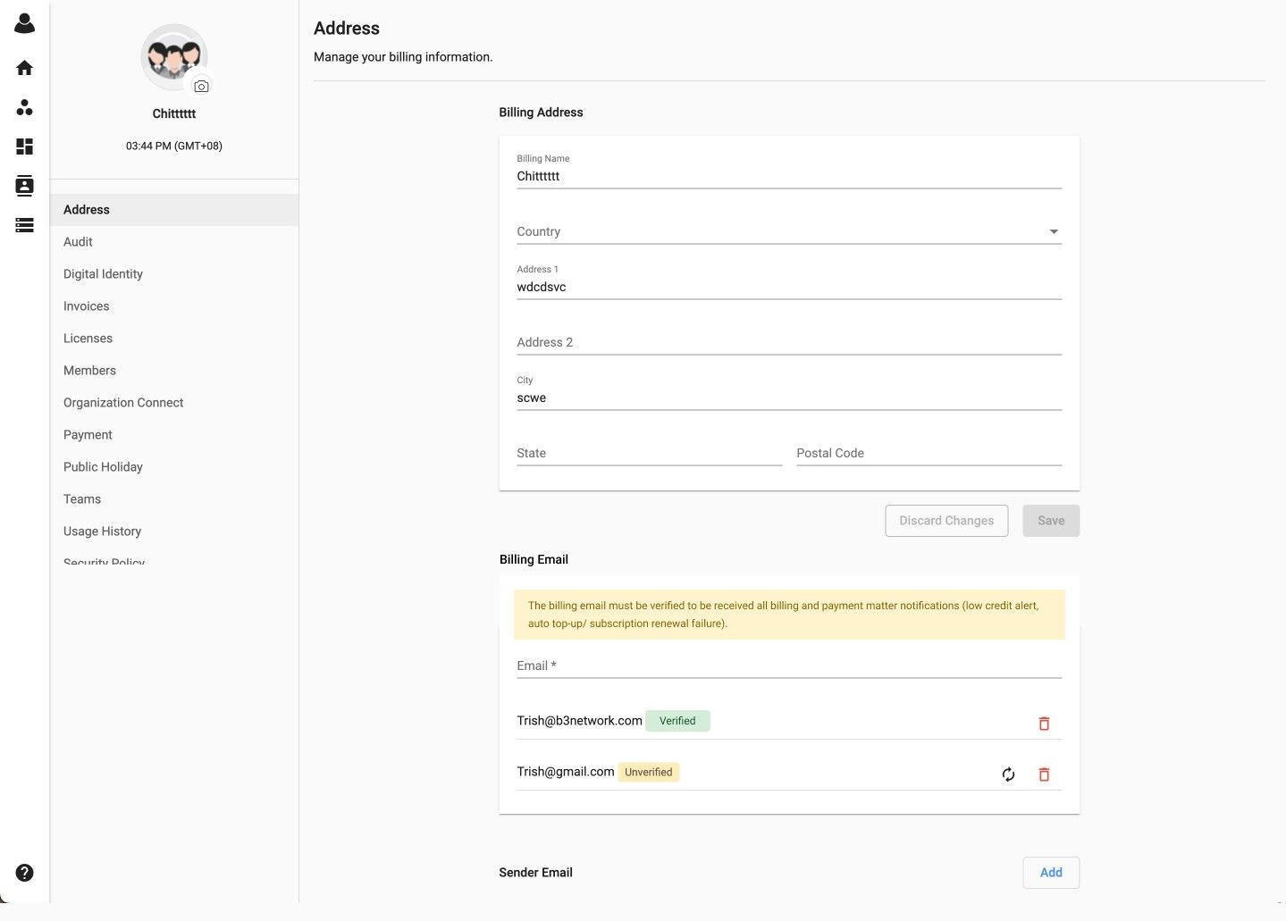
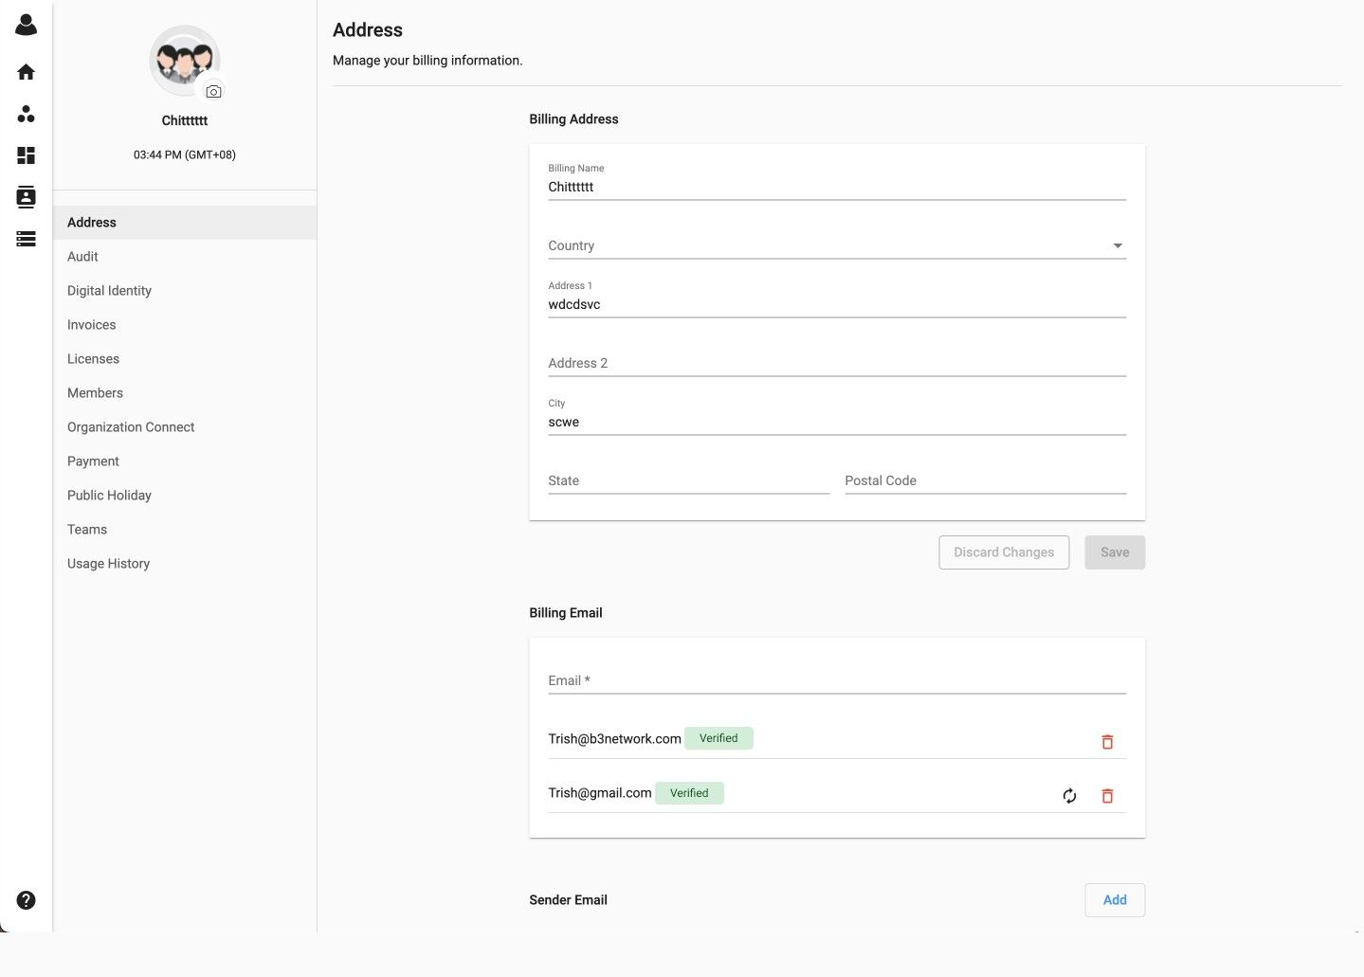
Manage Organization <Address>
For Stripe top-up, a warning message will be displayed if the billing email is unverified by the user. The email is used for alerting the customers when their credit runs low, or if autotopup/renewal fails.
If the billing email is unverified, users will see a highlighted warning message stating that the billing email must be verified in order to receive all billing and payment matter notifications
If every billing email is verified, then the warning message will not be visible

Slide 19
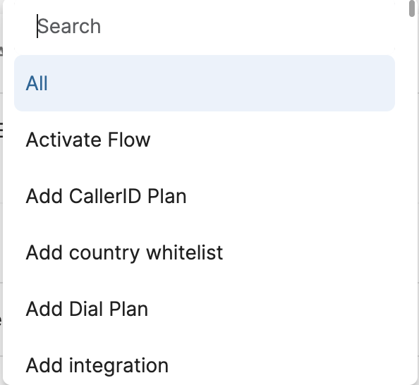
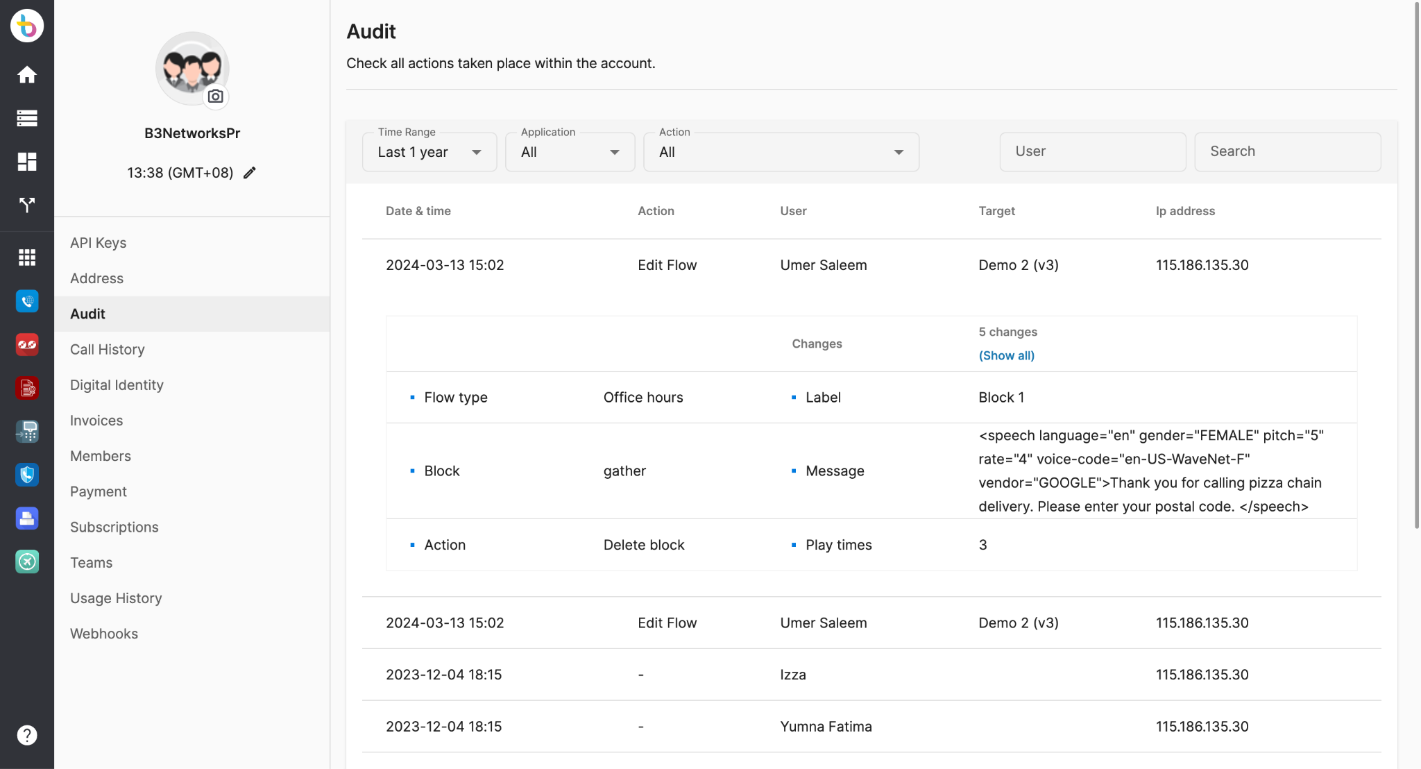
Manage Organization <Audit>
The app allows you to track all actions taken place within your portal.

Slide 20
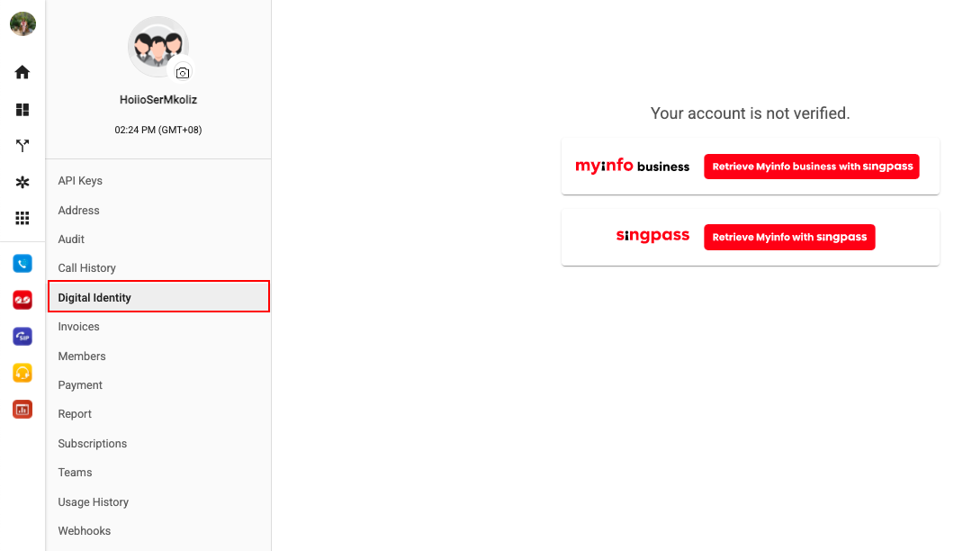
Manage Organization <Digital Identity>
Overview
MyInfo is a service that allows individual/corporate users to manage their personal data and pre-fill forms in digital services transactions.
This verification step is obligatory if users would like to purchase number from the system.

Slide 21


Manage Organization <Digital Identity>
2. Verify your account with MyInfo
For personal account, choose [SingPass] > a link will open, please insert SingPass ID, and Password before login
For company account, choose [MyInfo Business] > a link will open, please insert UEN ID, CORPPASS ID and Password to log in

Slide 22
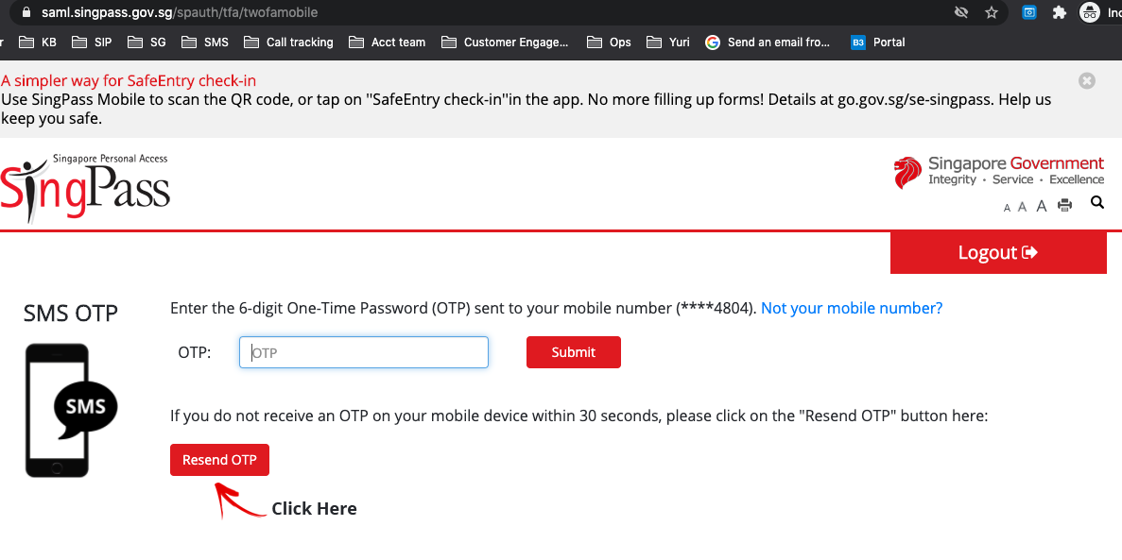
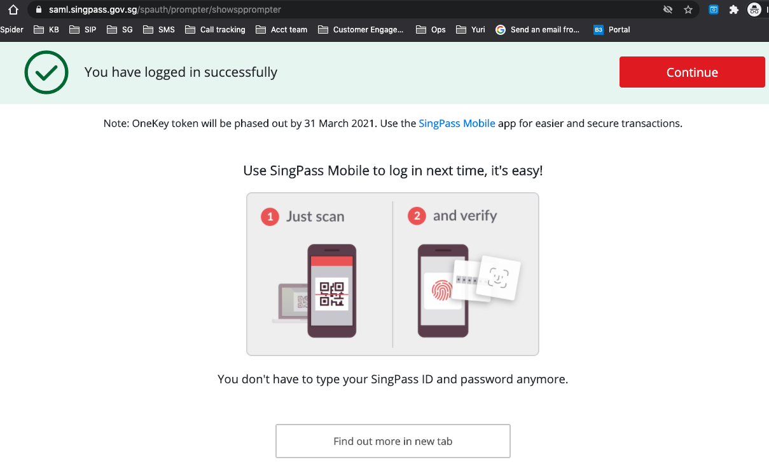
Manage Organization <Digital Identity>
2. Verify your account with MyInfo (cont’d)
Key in your OTP
2. Then press [Continue]

Slide 23
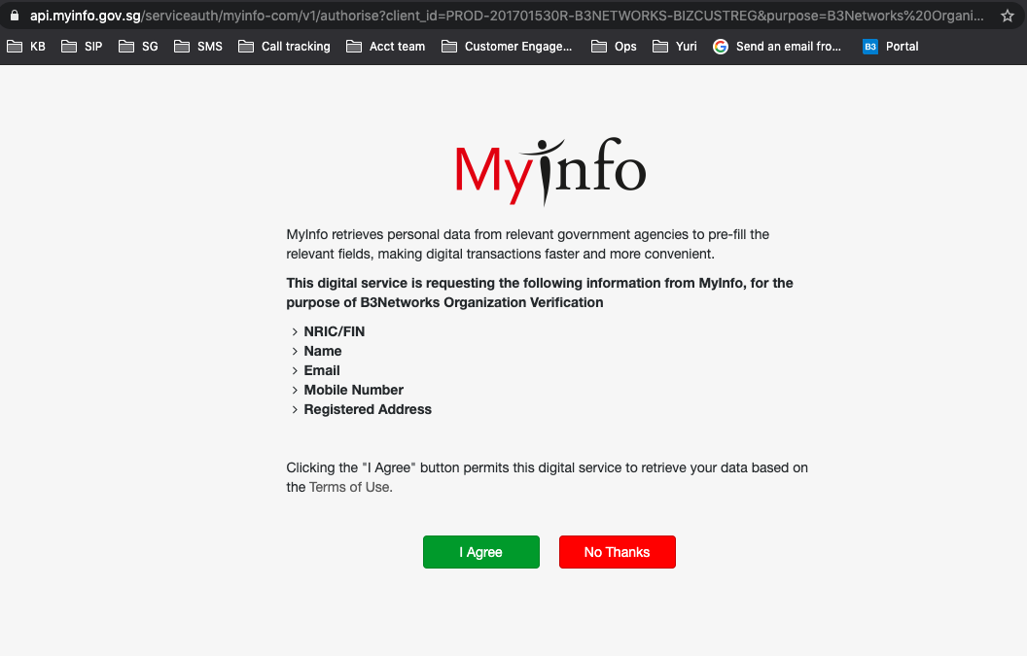
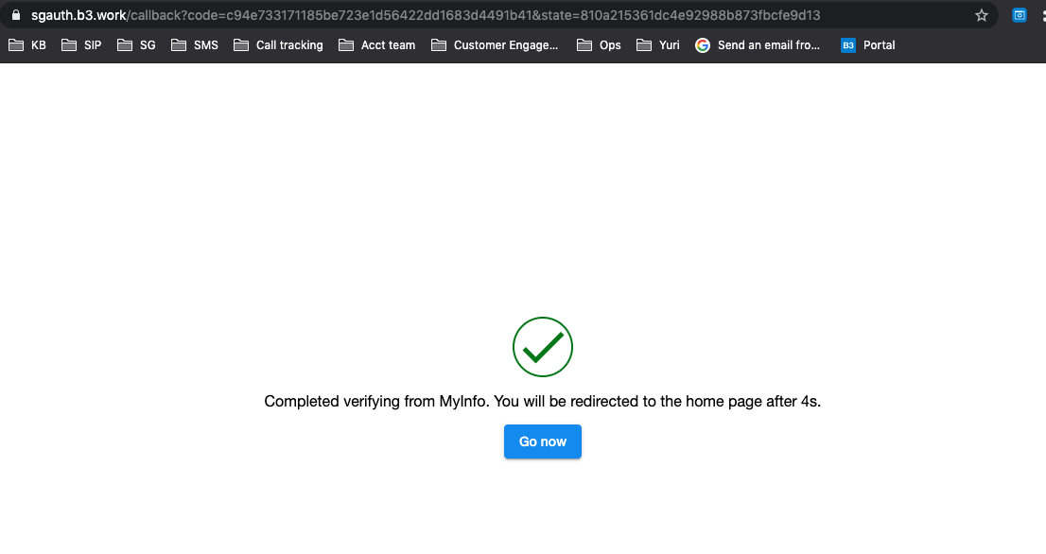
Manage Organization <Digital Identity>
2. Verify your account with MyInfo (cont’d)
3. Click [I Agree]
4. Complete the process

Slide 24
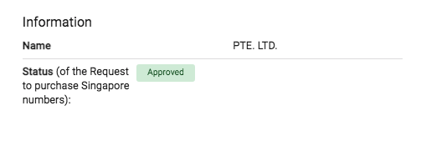
Manage Organization <Digital Identity>
2. Verify your account with MyInfo (cont’d)
5. Go back to the portal to check verified information

Slide 25
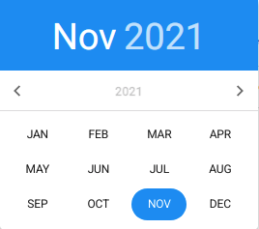
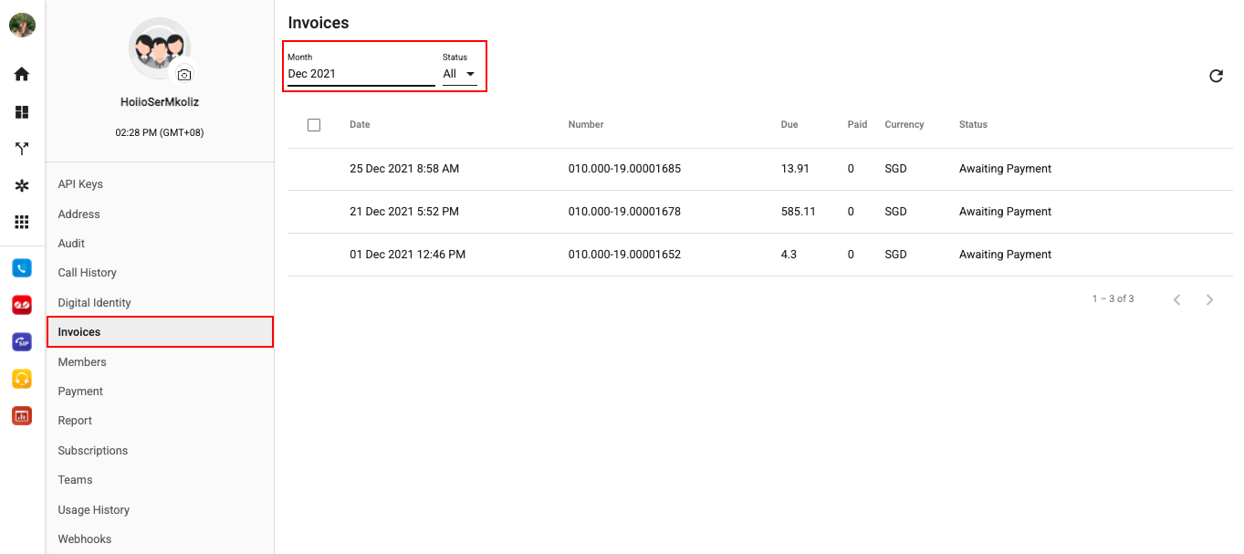
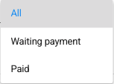
Manage Organization <Invoices>
Individual Tax Invoices will be sent right after all purchases, including topup, subscription, hardware.
Monthly Tax Invoices only include microtransactions items such as call, sms, DNC check, will be sent in the first week of the next month.

Slide 26

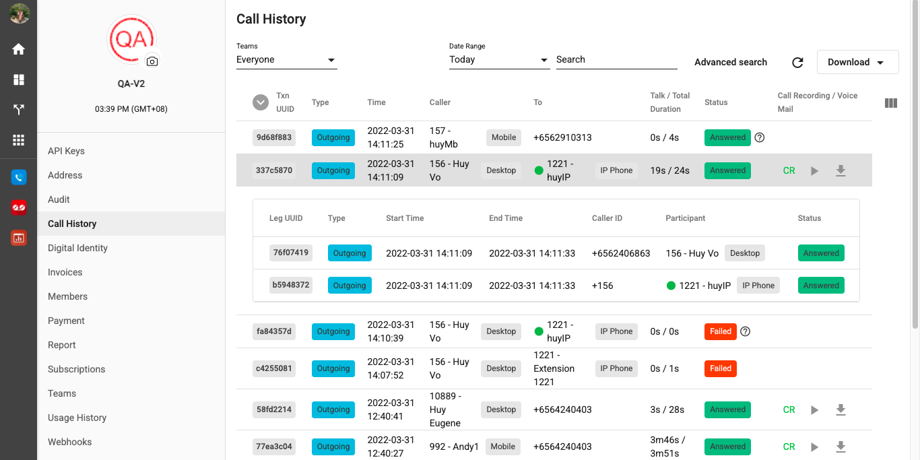

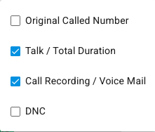
Manage Organization <Call History>
All incoming calls, missed calls, outgoing calls will be captured in the Call History tab with complete details.
Display information based on the admins given privileges (everyone/selected team/themselves).
Check/download call recordings and voicemails online.
Data will be stored on the portal for up to 1 year.
Failed Call Reasons

Slide 27
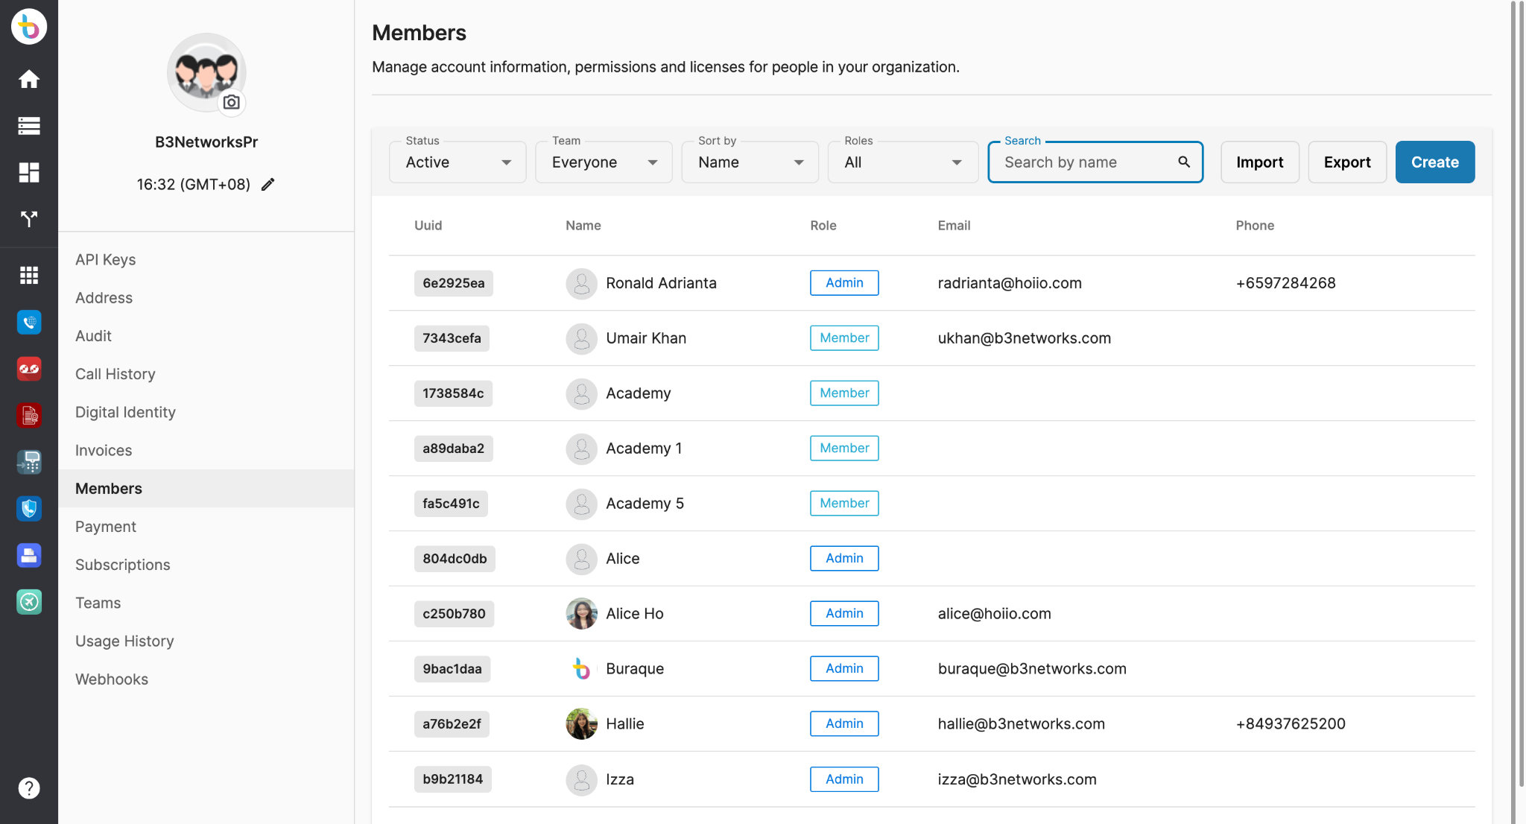
Manage Organization <Members>
Overview
Allows owner/admins to see the list of all their members and the roles they have been assigned to.
All the unverified users will be listed under Pending page regardless of they are added by Manual Creation or Bulk Creation.
Filter
Bulk Creation
Manual Creation

Slide 28
Manage Organization <Members>
2. Account Types & Privileges
Portal Access Matrix | Owner | Admin | Member
Number of users can be in this role | 1 | 100 | 10,000
Change personal account settings | ✅ | ✅ | ✅
Create Admins | ✅ | ❌ | ❌
Create Members | ✅ | ✅ | ❌
Change Role (Admin ⇄ Member) | ✅ | ❌ | ❌

Slide 29
Manage Organization <Members>
2. Account Types & Privileges (Cont’d)
Portal Access Matrix | Owner | Admin | Member
Disable/Enable Members’ Accounts | ✅ | ✅ | ❌
Delete Members’ Accounts | ✅ | ❌ | ❌
Create Teams | ✅ | ✅ | ❌
Assign Admins to manage Teams | ✅ | ❌ | ❌
Add Members to Teams | ✅ | ✅ (Only the teams that have been assigned to manage by the Owner.) | ❌
Manage Teams | ✅ (Every Teams in the account) | ✅ (Only the teams that have been assigned to manage by the Owner.) | ❌

Slide 30
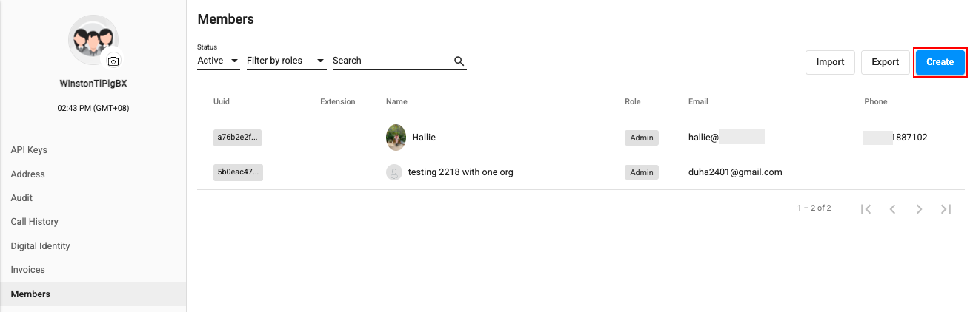
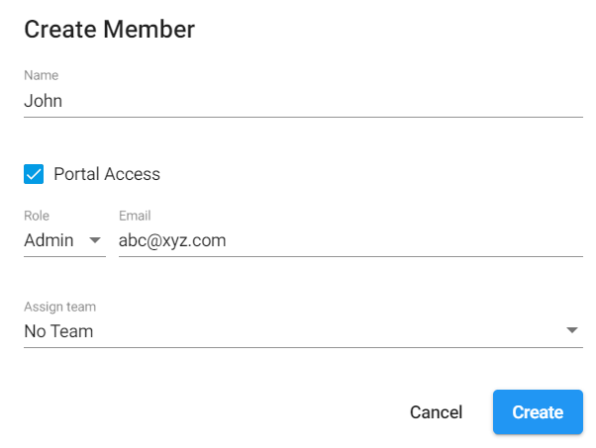
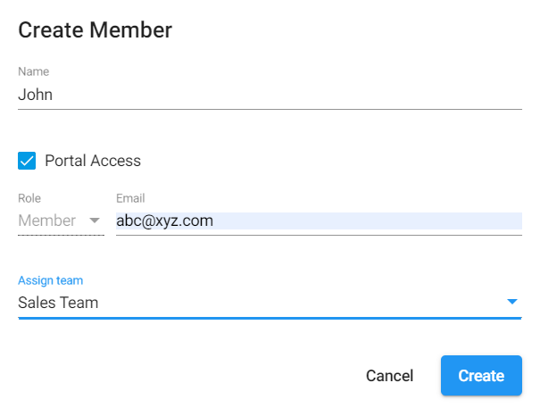
Manage Organization <Members>
3. Manual Creation
Go to Member tab
Select Create
Fill in the info
Select Role for user(s)
Assign user(s) to created team
Ask user(s) to check their inbox to verify email.
Owner can add Admins/Members
Admin can add Members

Slide 31
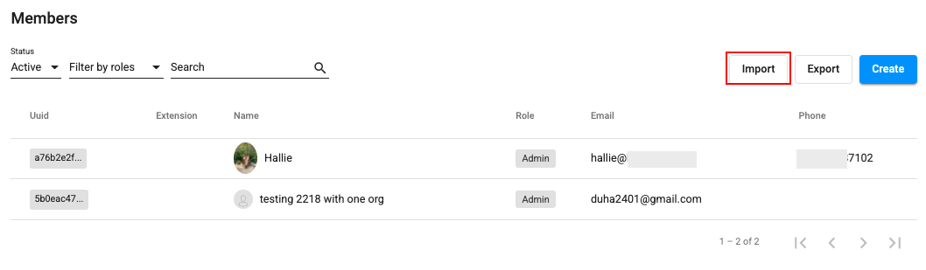
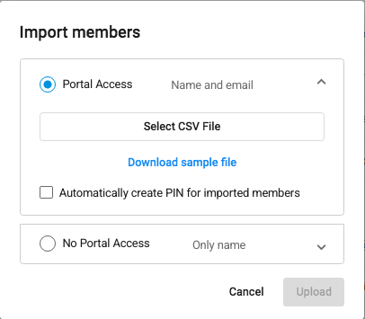
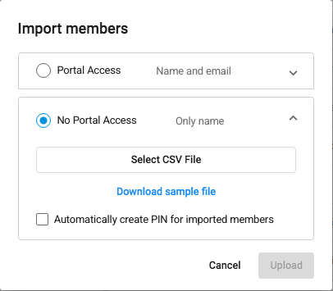
Manage Organization <Members>
4. Bulk Creation
Go to Member tab
Select Import
Select options:
Portal Access
No Portal Access
Download the Template
Fill in the info
Upload the File
Ask user(s) to check their inbox to verify email.
**By default, the account’s role of Bulk creation is Member.
Portal Access
No Portal Access

Slide 32
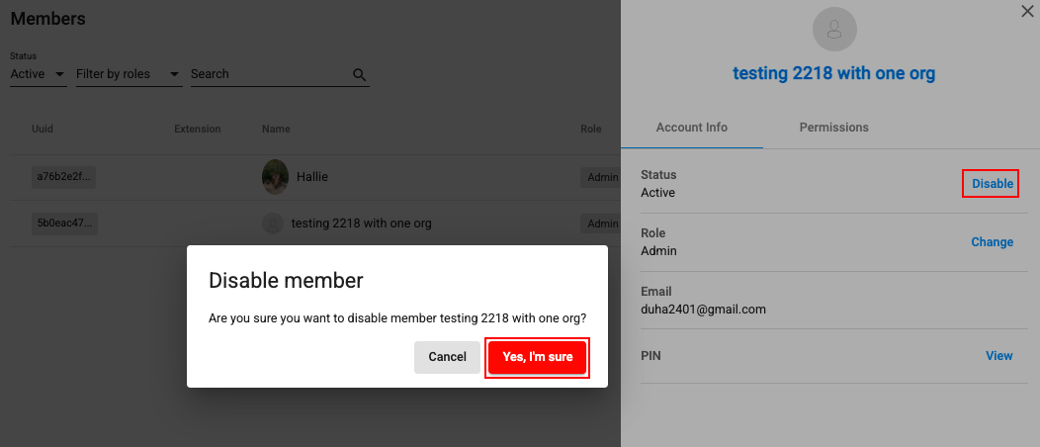
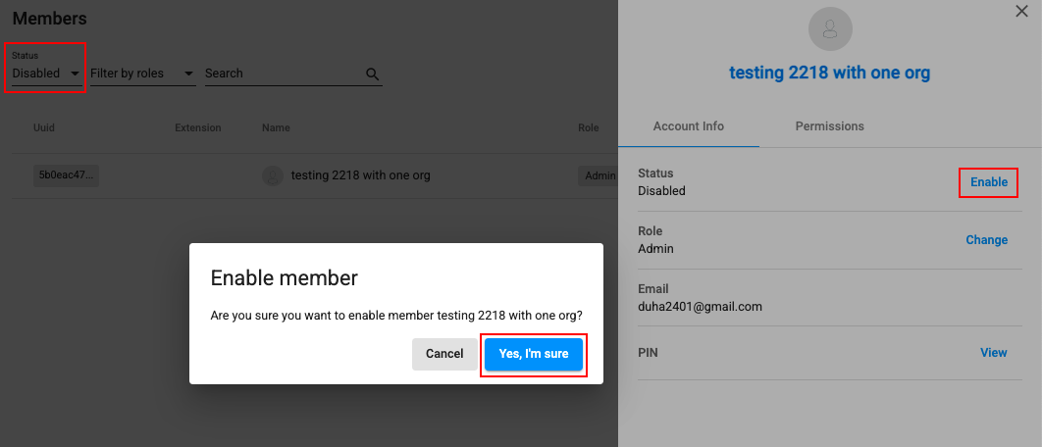
Manage Organization <Members>
5. Account Info - Disable/Enable an Account
Only Owner can disable and enable the accounts in the organization.
Disable:
At the Status section, choose Disable and confirm to proceed
Enable:
Filter in the Disabled status tab, choose the Member that you want to enable. At the Status section, choose Enable and confirm to proceed

Slide 33
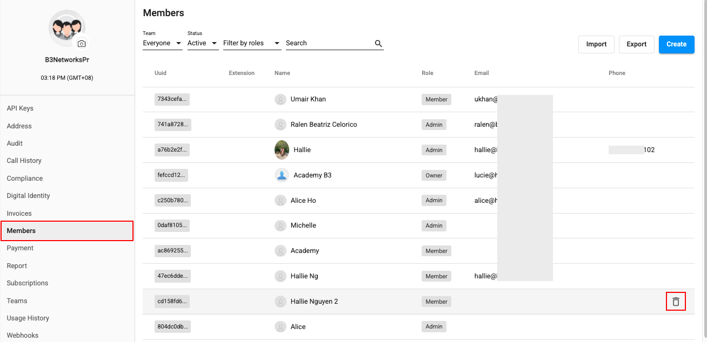
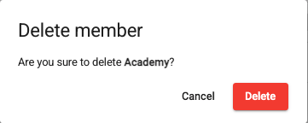
Manage Organization <Members>
5. Account Info - Delete an Account
Only the Owner can delete accounts in the organization.
Select the account that you want to delete.
Click the Trash icon
Confirm to proceed

Slide 34
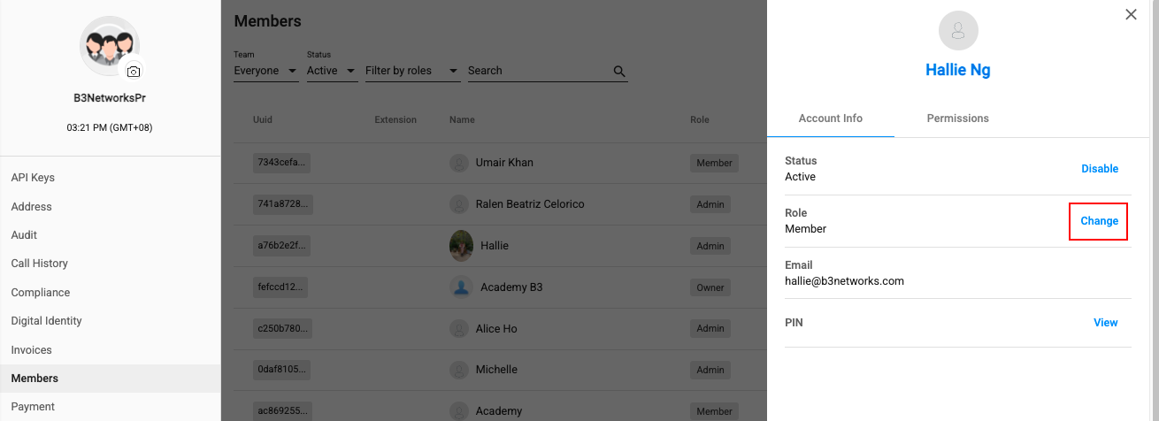
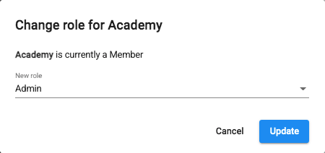
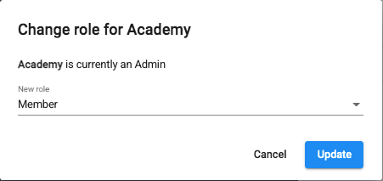
Manage Organization <Members>
5. Account Info - Change Account’s Role
Only the Owner can change the Account’s Role from Admin to Member and vice versa.
Select the account that you want to change role.
At the Role section, click Change.
Choose Role
Update

Slide 35
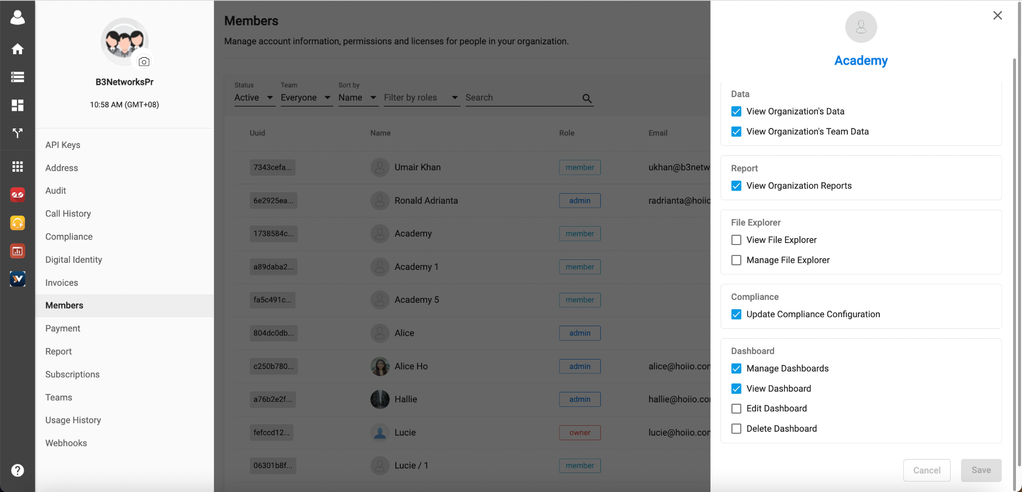
Manage Organization <Members>
6. Permissions
Data:
View Organization's Data: access everyone's call history
View Organization's Team Data: access teams' call history
File Explorer
View File Explorer
Manage File Explorer
Compliance:
Update Compliance Configuration
Dashboards:
Manage Dashboards
View Dashboards
Edit Dashboard
Delete Dashboard

Slide 36
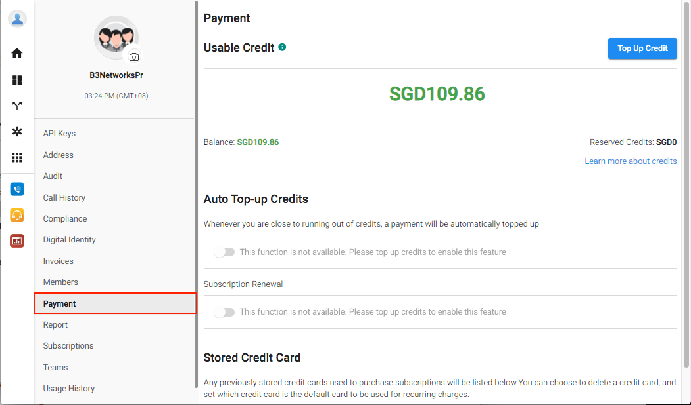
Manage Organization <Payment>
Overview
This tab allows users to manage their:
Account’s balance
Top-up
Subscription Renewal
Stored credit cards

Slide 37
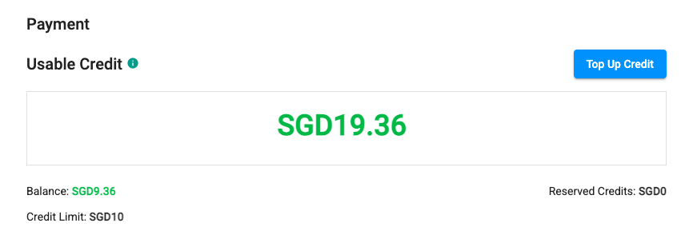
Manage Organization <Payment>
2. Prepaid account
Usable credit: the amount that account can spend on, i.e. credit transfer/ issue, usage and subscription renewal.
Usable credit = Balance - Reserved credit - Liability + Credit limit
Balance: the amount stored in this wallet.
Reserved credit is caused by an ongoing transaction. If the transaction is successful, Reserved credit is deducted; otherwise, it is returned to the Usable credit.
Credit limit: the maximum amount of money the service provider lets the account borrow.

Slide 38
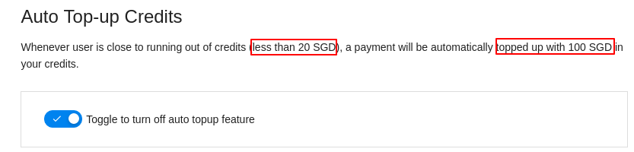
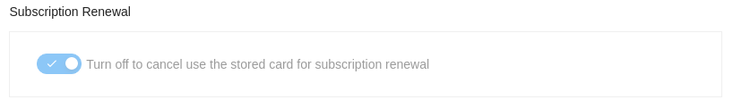
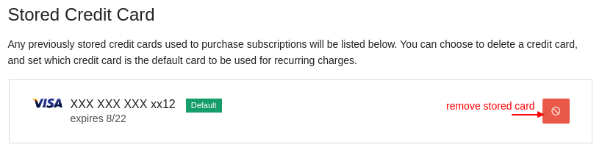
Manage Organization <Payment>
2. Prepaid account
View and adjust auto top-up settings
View and adjust auto subscription renewal settings using stored card
View and remove stored credit card (if any)

Slide 39
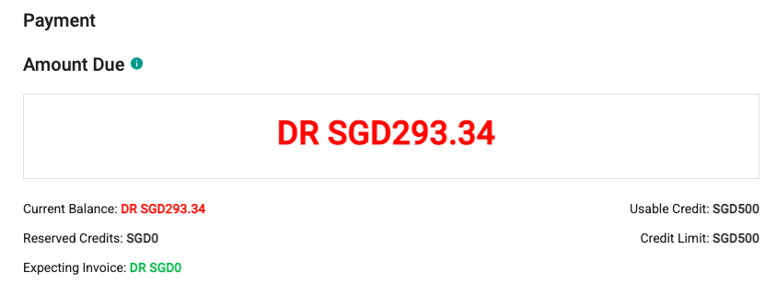
Manage Organization <Payment>
3. Postpaid account
Amount due: the sum of all costs that the account has been invoiced for, minus any payments that have been applied to those costs.
If it’s DR:
The amount that user needs to settle
Maximum Expecting invoice = Credit Limit
If it’s CR:
The amount that user has overpaid
Maximum Expecting invoice = Amount Due + Credit Limit
Current Balance: all the amount the customer needs to settle, including the billed and unbilled amounts.
Current Balance = Expecting invoice + Amount Due

Slide 40
Manage Organization <Payment>
3. Postpaid account
Reserved credits: caused by an ongoing transaction
Credit limit: the maximum amount of money that you let the user borrow.
Applied on the expecting invoice.
Reset every month.
Expecting invoice: the usage amount for the current bill period = the amount has not yet billed / invoiced.
Usable credits: the total credits that customer can use for this month

Slide 41


Manage Organization <Report>
Check [Members] to see if you are allowed access to Report App.
Only 2 roles Owner and Admin are allowed to access.

Slide 42




Manage Organization <Report>
To download a Report:
Click the profile icon > go to manage organization > reports
Select the template > select the From and To time range > Download CSV
Note:
The allowed selections for aggregate reports are as follows:
a. For 15 minutes: Up to 1 day (24 hours)
b. For 30 minutes: Up to 7 days (1 week)
c. For 1 hour: Up to 31 days (1 month)
d. For 1 day: Up to 366 days (1 year)
e. For 1 Month: Up to 12 months

Slide 43

Manage Organization <Subscriptions>
Manage Subscriptions
Manage subscriptions that are:
Active
Expired
Terminated

Slide 44


Manage Organization <Subscriptions>
2. Status of a Subscription

Slide 45

Manage Organization <Subscriptions>
3. Auto renew Date
If Auto renewal is ON, then the UI will display the Renew Date.
Otherwise, Renew date will be shown blank.

Slide 46

Manage Organization <Subscriptions>
4. Expiry Date
Users who have been granted access for “Expiry Date" in Portal Settings will be able to see the expiry date (for each subscription) in the Details section.

Slide 47



Manage Organization <Subscriptions>
3. Assign Subscription to Members
Click on the subscription that you want to assign
Click on Human icon
Assign to user(s)

Slide 48



Manage Organization <Teams>
By creating Teams for the account, admins will be able to view the Call History at team level.
Go to [Teams] > [Create] > Add Team Name
Choose members > Add

Slide 49


Manage Organization <Usage History>
Go to [Manage Organization] > [Usage History] > filter by month and type > Download.
All usage history of this month will be available in the first week of the next month.

Slide 50

Manage Organization <Webhooks>
Developers can receive HTTPS notifications on certain event occurrence.
For example, to receive notification after a call ends. The notification contained information like the talk duration of the call will be sent to Developer’s Webhook endpoint accordingly.
Click HERE for more information.

