Slide 1







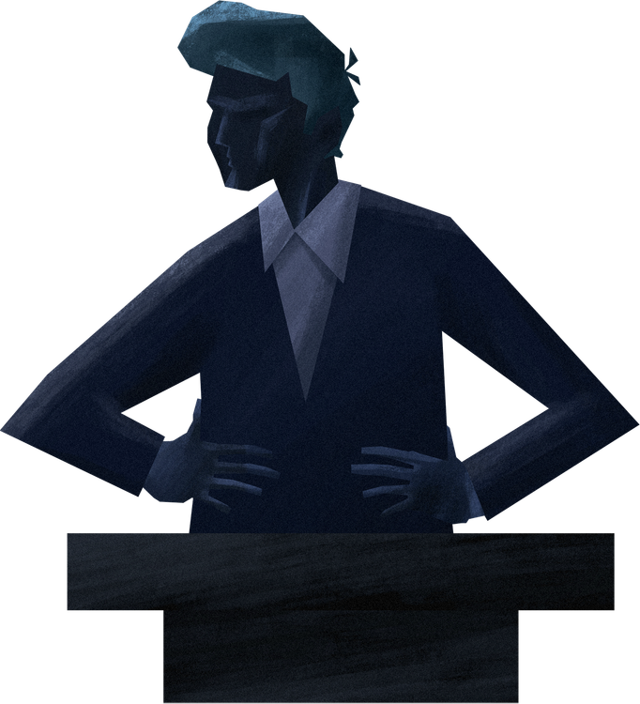
DEBATES
Argument and
Critical Thinking

Slide 2

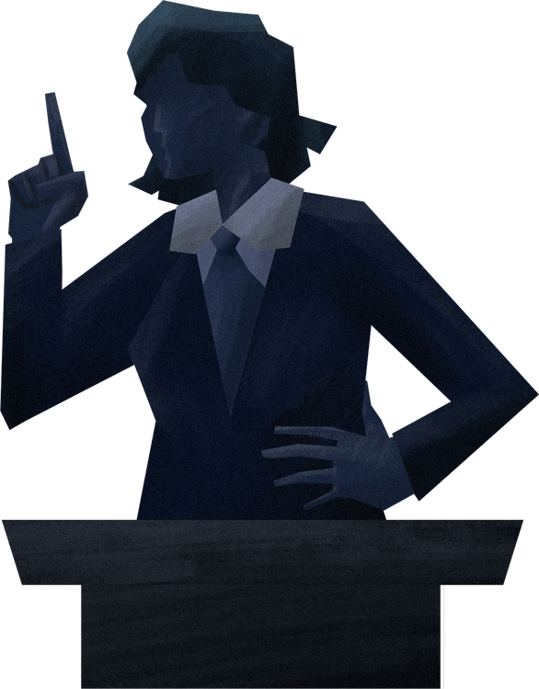
What is
DEBATE?
Debate is a structured discussion where participants present arguments for and against a particular issue, supported by evidence and logical reasoning.

Slide 3






Purpose of
DEBATE?
The purpose of debate is to encourage analytical thinking, improve communication skills, and develop confidence in expressing ideas publicly.

Slide 4




Types of
DEBATE?
Lincoln-Douglas Debate
Public Forum Debate
Formal Debate
Parliamentary Debate
There are many types of debates, each with its own structure and rules.

Slide 5



DEBATE
Structure
Opening Statement
Arguments Presentation
Closing Statement
Rebuttal

Slide 6
Key Elements of
DEBATE
The key elements of a debate are the motion or topic, the affirmative and negative teams, and the moderator who ensures the debate runs smoothly.

Slide 7

DEBATE
Skills
In debate, essential skills include the ability to research, build strong arguments, listen carefully, and persuade the audience effectively.

Slide 8
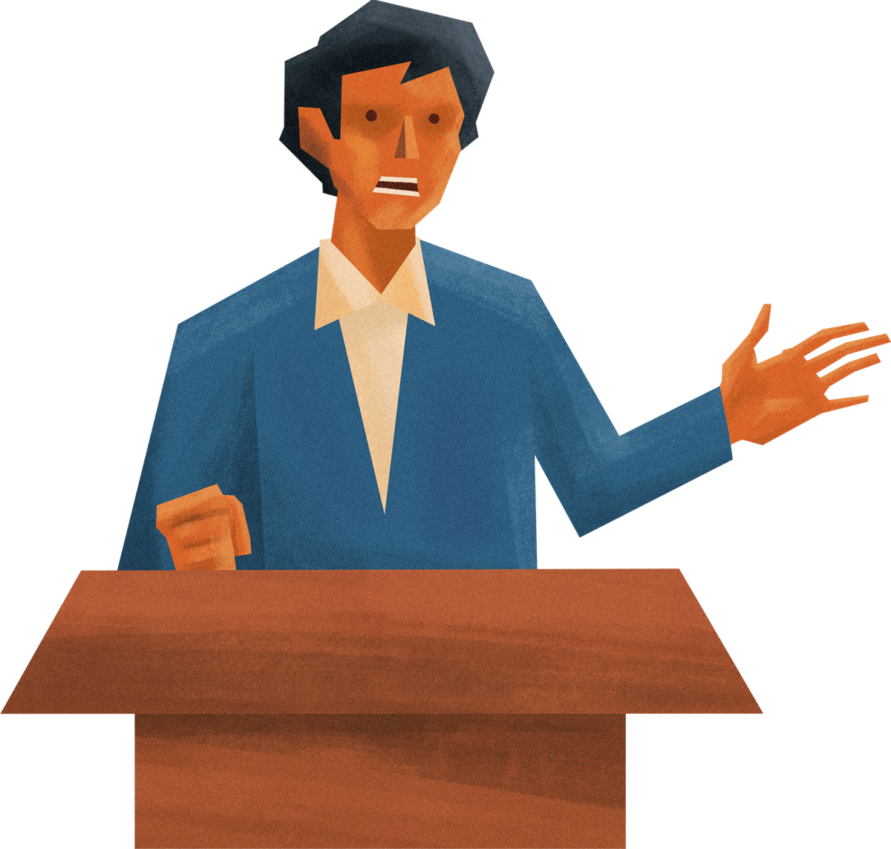


Tips for Successful
DEBATE
To be successful in debating, it's important to research well, respect differing opinions, speak clearly, and support arguments with facts.

Slide 9

Conclusion
In conclusion, debate is more than just winning arguments — it teaches respect, critical thinking, and communication skills essential for life. Keep practicing and keep learning.

Slide 10

THANK YOU
Present By
Olivia Wilson

