Slide 1
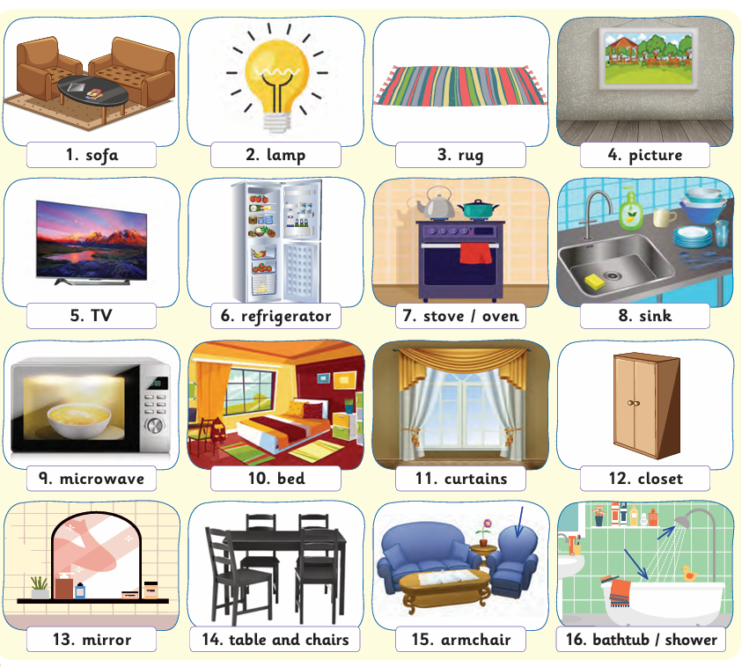

Slide 2
Definition of The Memory game
Memory game is about asking a number of students to come to the board, like four students, and then you show them the first picture, and student A has to name that picture. Then you move to student B, and student B has to name the second picture, but before he names the second picture, he has to first say the name of the first one and then the second one. And student C does the same thing. That's to say, before he names the third picture, he has to make mention of the first one, the second one, and the third one, and so on and so forth until there is a winner who is able to remember all of the items.

Slide 3
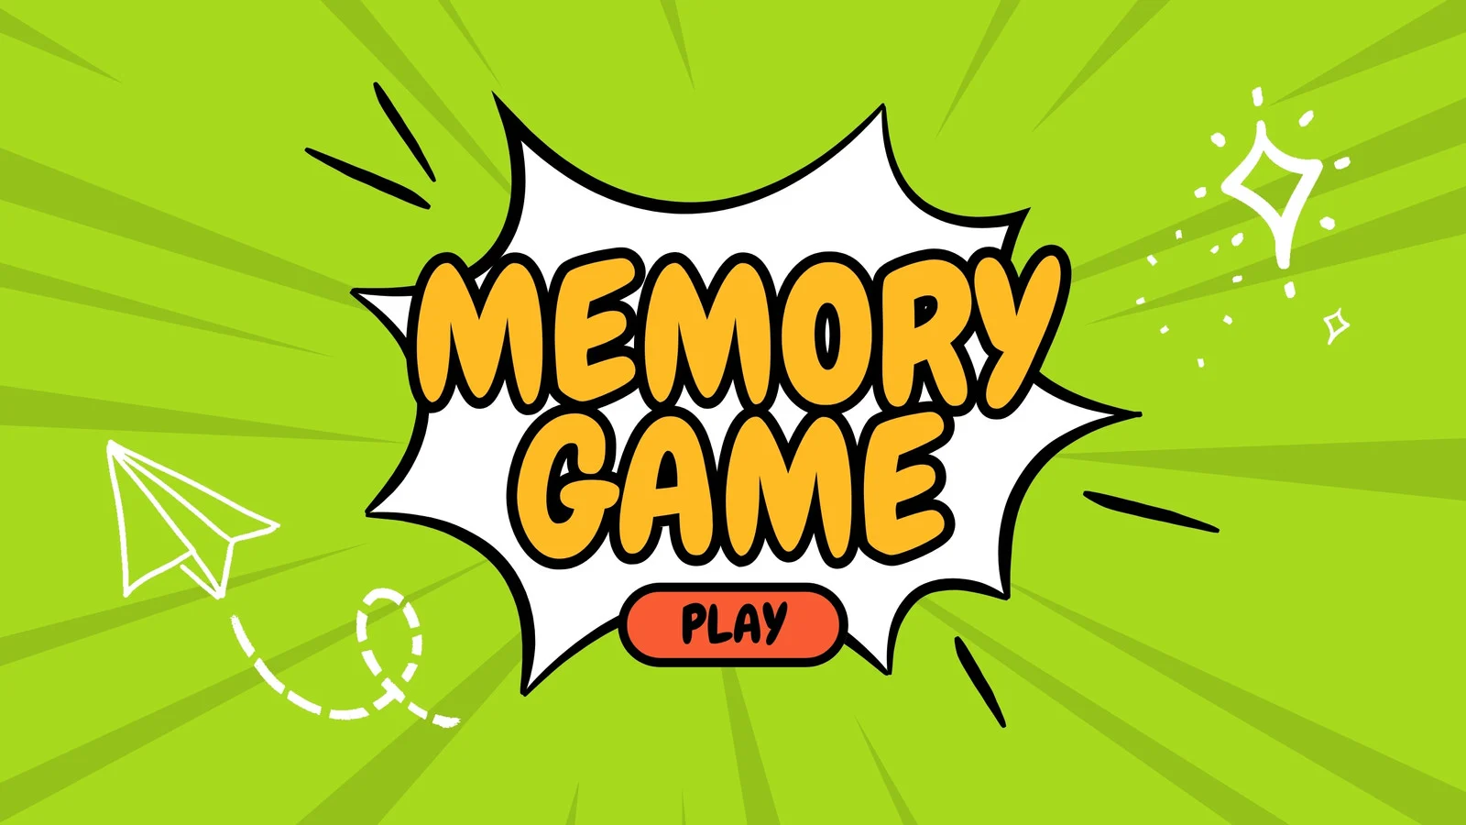

Slide 4
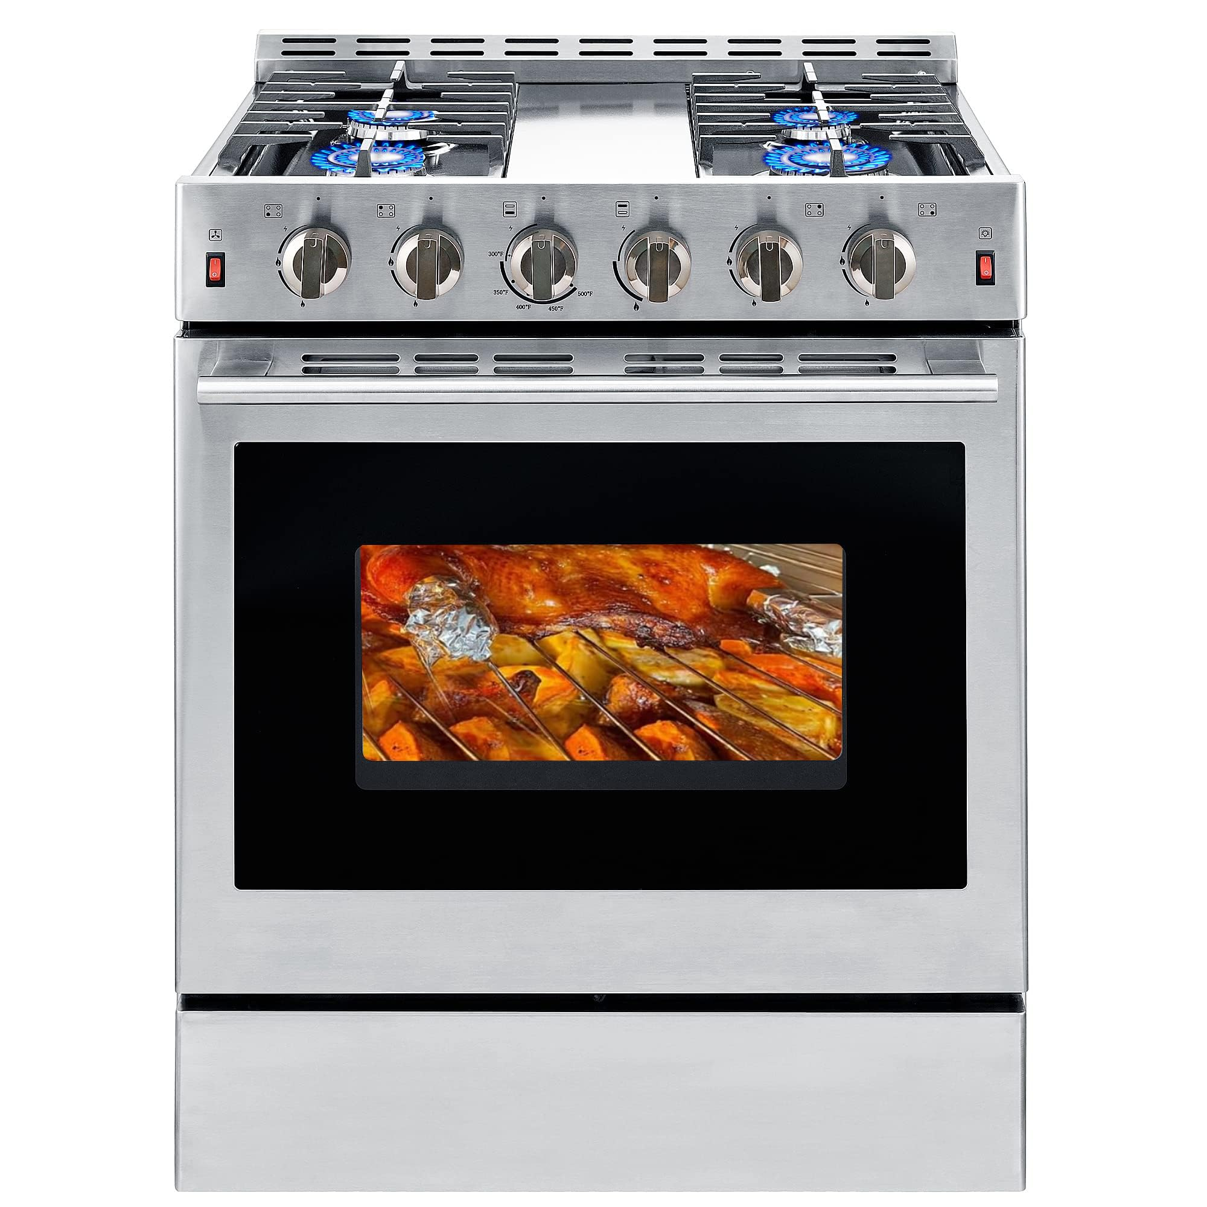






Slide 5

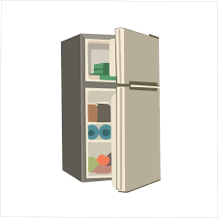

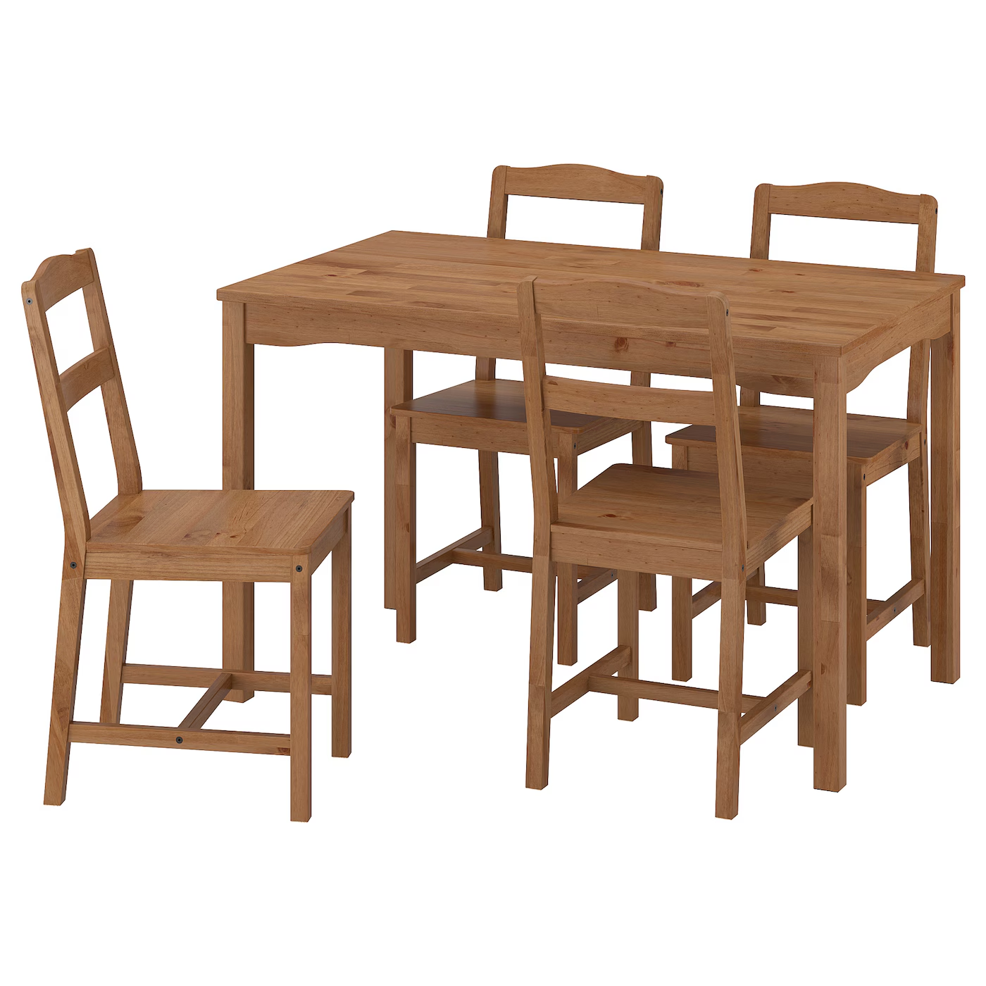


Slide 6
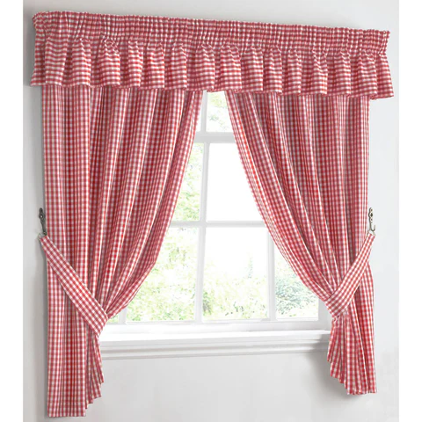





Slide 7


Slide 10

What’s in the kitchen?

Slide 11

What’s in the kitchen?

