Slide 1


Initiation to ScratchJr
Translated and adapted by the Service national du RÉCIT, domaine des langues
Réalisé par Julie Robidoux, RÉCIT au CSS des Chênes et adapté par SONYA FISET, RÉCIT MST est mis à disposition, sauf exception, selon les termes de la Licence Creative Commons Attribution - Pas d’Utilisation Commerciale - Partage dans les Mêmes Conditions 4.0 International.

Slide 2
What is ScratchJr?
01

Slide 3

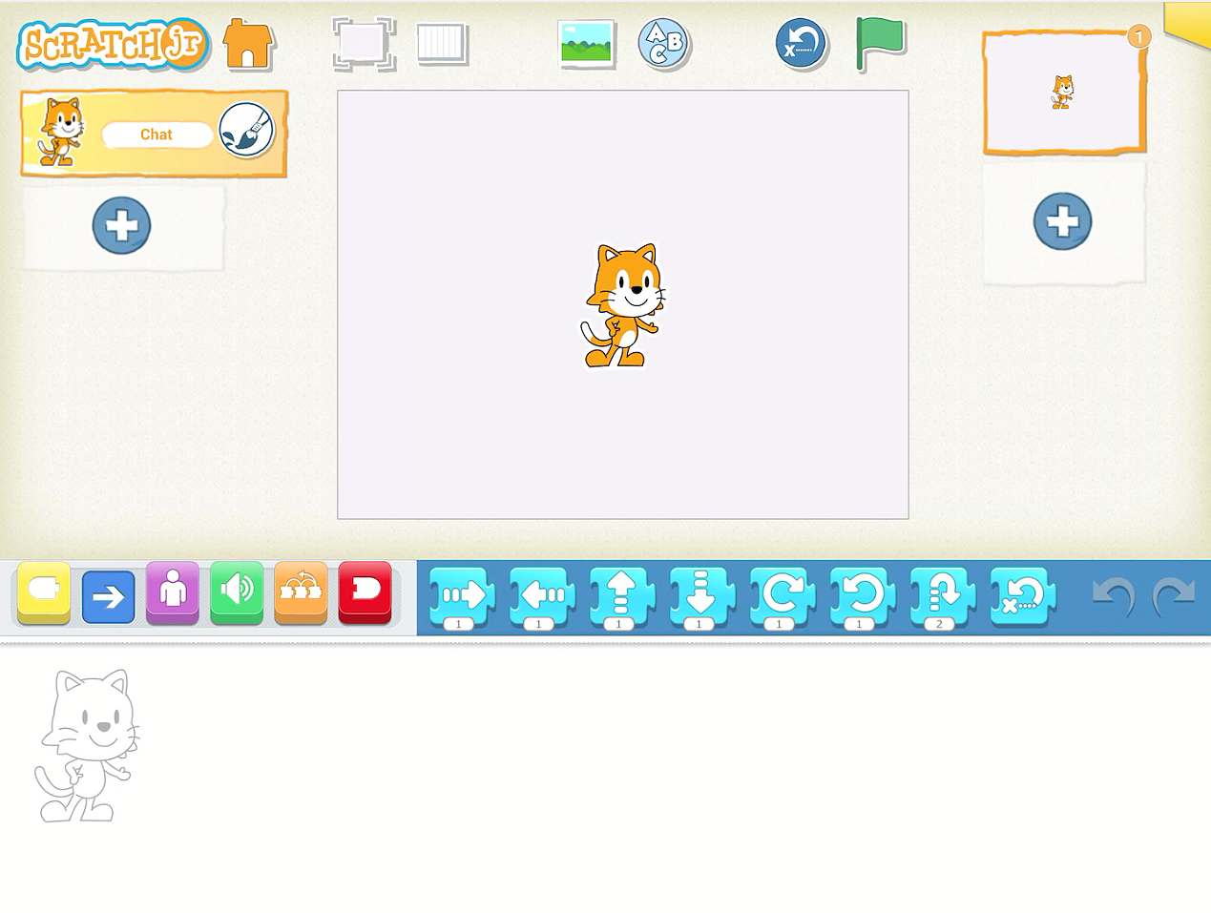

Presentation of ScratchJR
1
Do you know ScratchJr?
Observe the image.
What do you think we
can do with ScratchJr?
Stage
2
Blocks
3
Program

Slide 4
The ScratchJr Interface
02

Slide 5
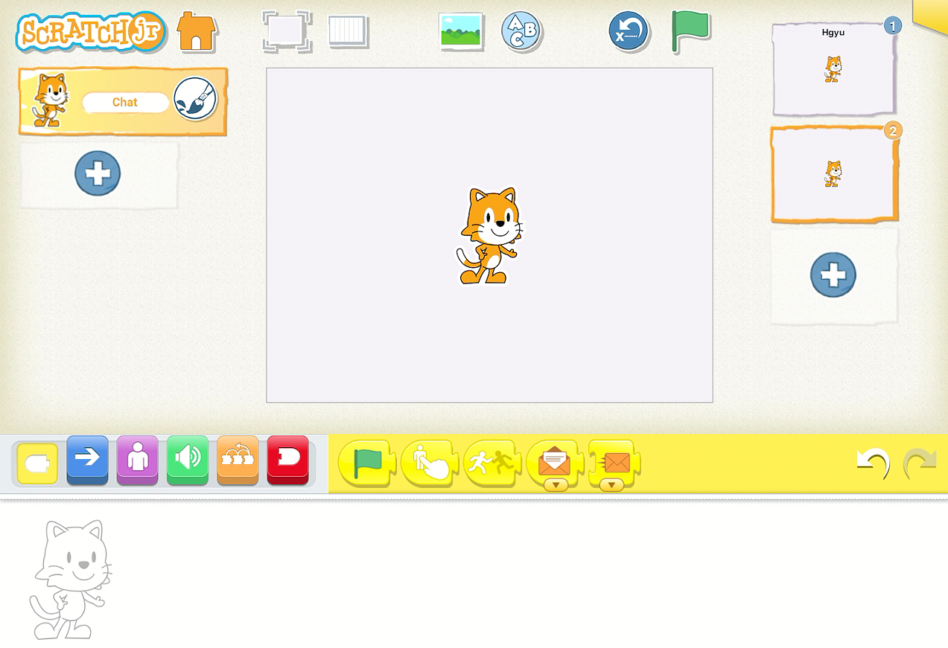
To learn about all the features, watch this tutorial.
Find the green flag. 🔍What do you think it does?

Slide 6
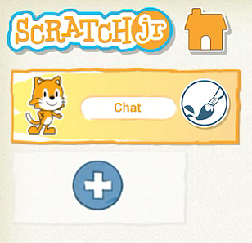
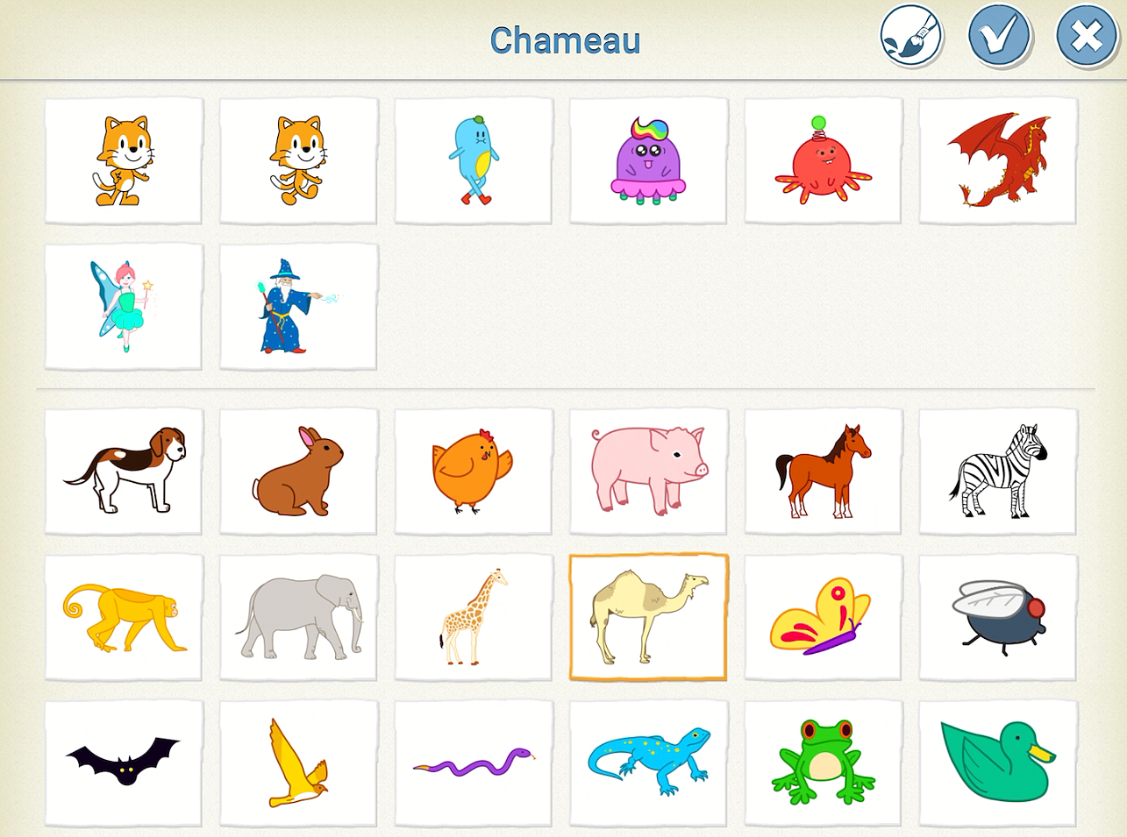
Characters
Camel
Cat
Choose and confirm
To add
Modify
Click and hold to delete

Slide 7
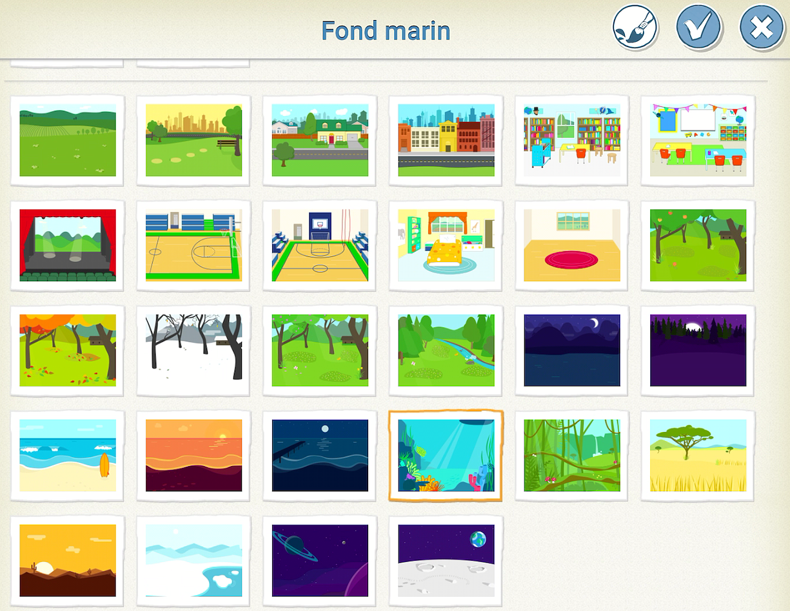

Backgrounds
Choose and confirm
Ocean
To add

Slide 8
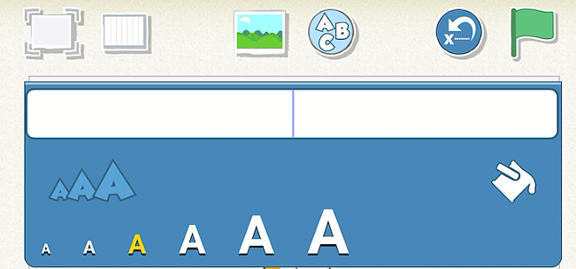
Title
To add
Change size and colour

Slide 9
Coding in ScratchJr
03

Slide 10

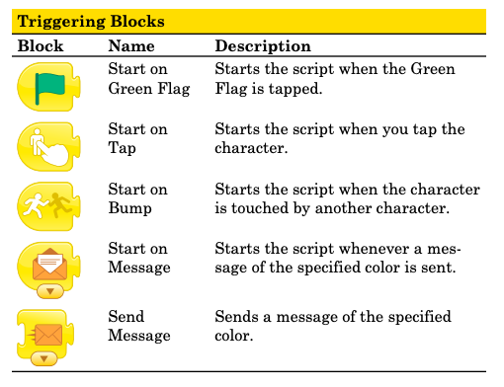

< Triggering Blocks >
To start a
program
.
Notes:
Source: https://scratched.gse.harvard.edu/sites/default/files/scratchjr-reference-page.pdf

Slide 11
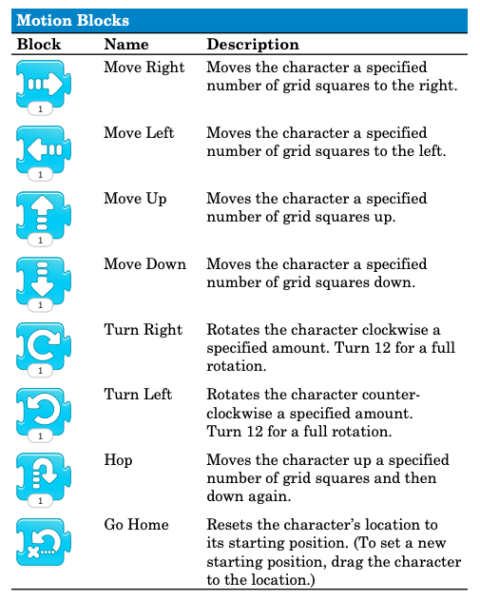
< Motion Blocks >
To make a sprite move
Notes:
Source: https://scratched.gse.harvard.edu/sites/default/files/scratchjr-reference-page.pdf

Slide 12
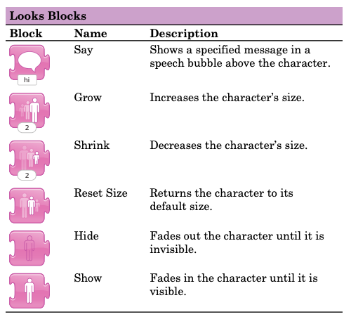
< Looks Blocks >
To say, grow or shrink and more
Discover the functions of the other blocks.
Notes:
Source: https://scratched.gse.harvard.edu/sites/default/files/scratchjr-reference-page.pdf

Slide 13

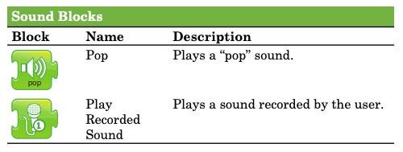

< Sound Blocks >
To record
and play a sound
Notes:
Source: https://scratched.gse.harvard.edu/sites/default/files/scratchjr-reference-page.pdf

Slide 14
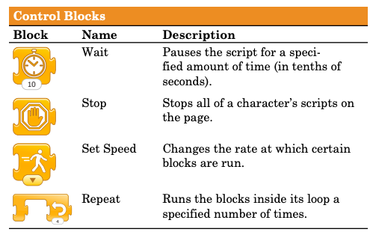

< Control Blocks >
=
To pause, stop or repeat a script…
Notes:
Source: https://scratched.gse.harvard.edu/sites/default/files/scratchjr-reference-page.pdf

Slide 15

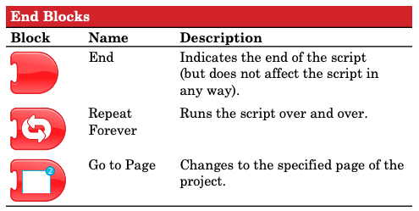

< End Blocks>
To end
a script or go to a different page…
Notes:
Source: https://scratched.gse.harvard.edu/sites/default/files/scratchjr-reference-page.pdf

Slide 16
Let’s practice!
04

Slide 17
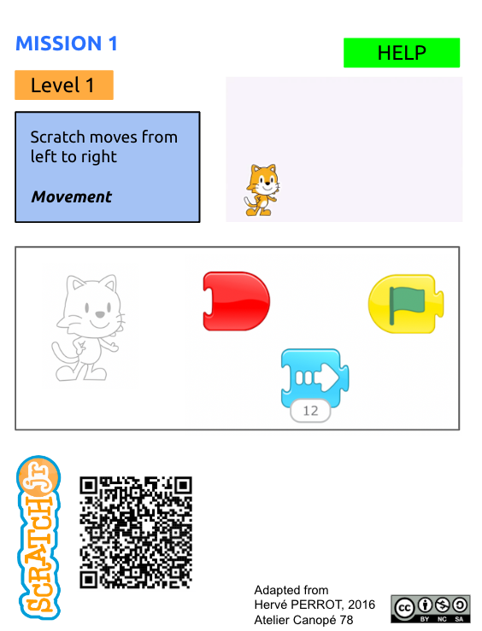
Watch this mission
video
What does the number 12 do?
2. Use these blocks to complete Mission 1.

Slide 18
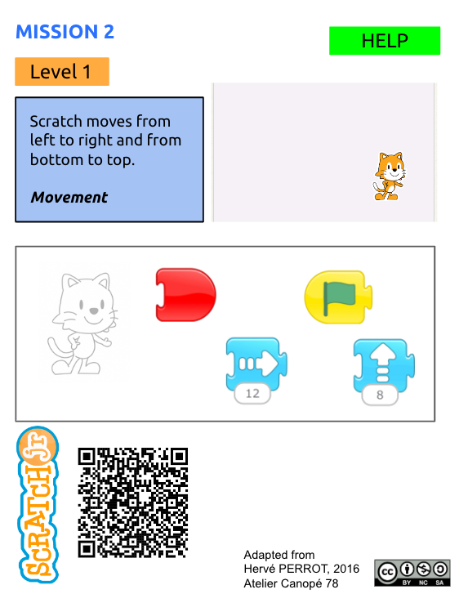
Watch this mission
video
2. Use these blocks to complete Mission 2.

Slide 19
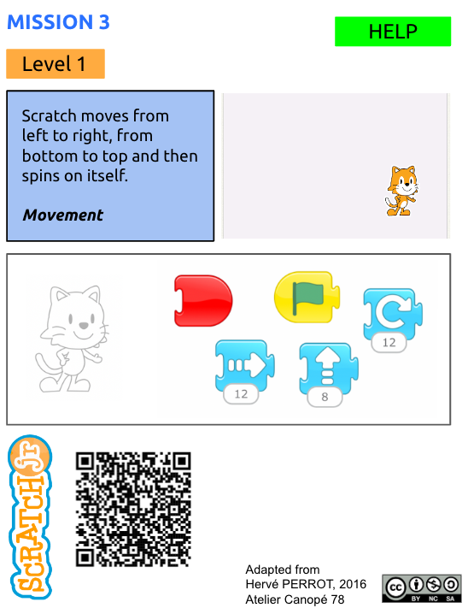
Watch this mission
-
video
2. Use these blocks to complete Mission 3.
Can you try other blocks?

Slide 20
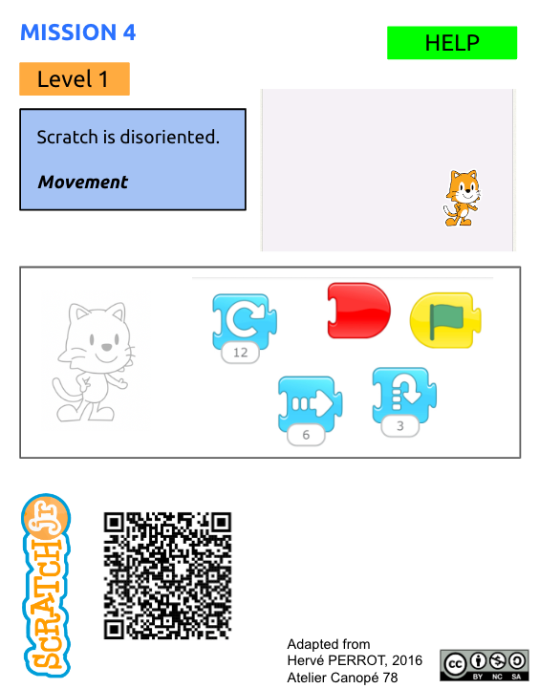
Watch this mission
video
2. Use these blocks to complete Mission 4.
Can you try other blocks?

Slide 21
Your Turn !
05

Slide 22
Take on other challenges
Level 1
Mission 1 video - help
Mission 2 video - help
Mission 3 video - help
Mission 4 video - help
Mission 5 video - help
Mission 6 video - help
Mission 7 video - help
Mission 8 video - help
Mission 9 video - help
Mission 10 video - help
Mission 11 video - help
Mission 12 video - help
Level 2
Mission 1 video - help
Mission 2 video - help
Mission 3 video - help
Mission 4 video - help
Mission 5 video - help
Mission 6 video - help
Mission 7 video - help
Mission 8 video - help
Level 3
Mission 1 video - help
Mission 2 video - help
Mission 3 video - help
Mission 4 video - help
Level 4
Mission 1 video - help
Mission 2 video - help
Source : site Canopé

Slide 23
It’s YOUR turn to create!
06

Slide 24
Create a program that includes at least…
one character and one background;
one “motion” for at least one character;
one recorded sound;
one other element of your choice.

Slide 25
Other challenges
07

Slide 26
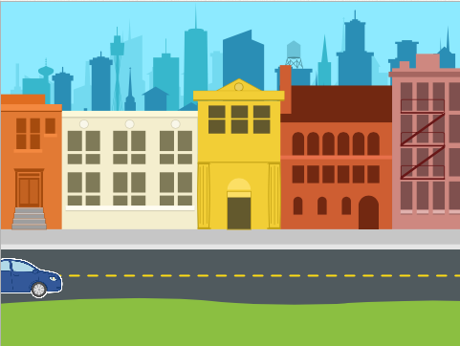
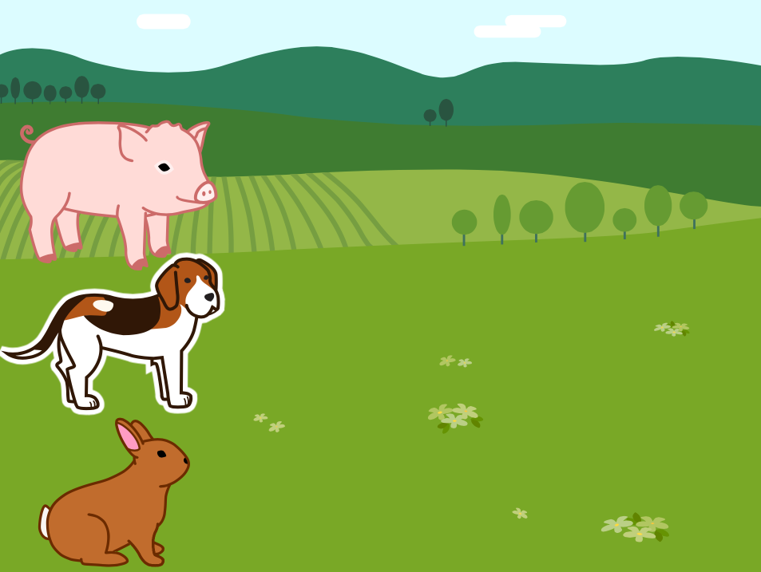
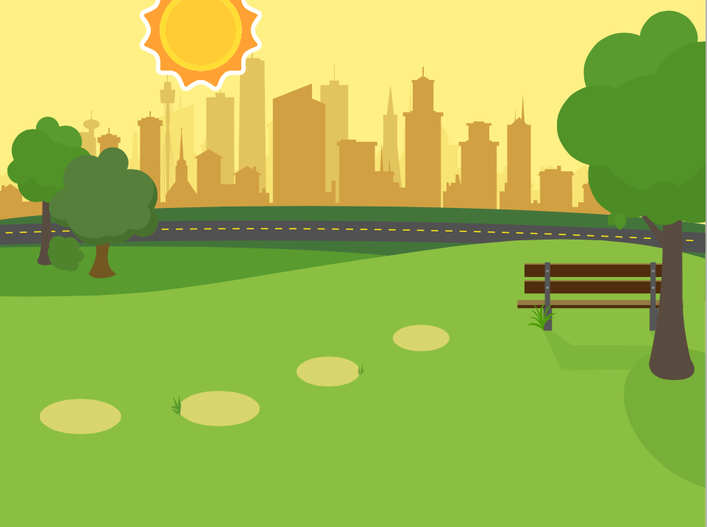
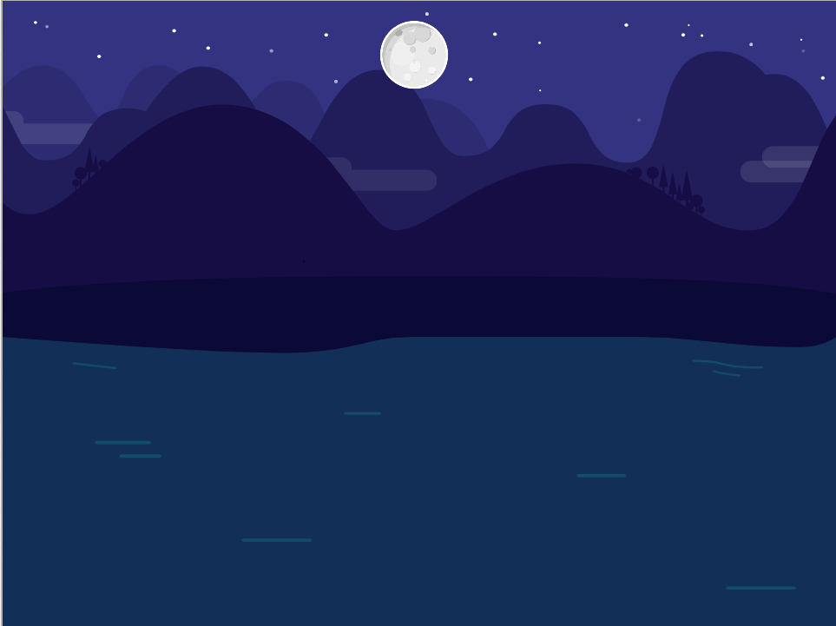
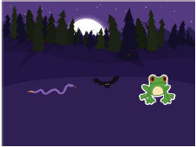
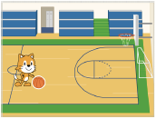
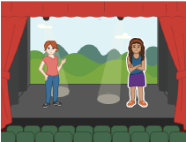
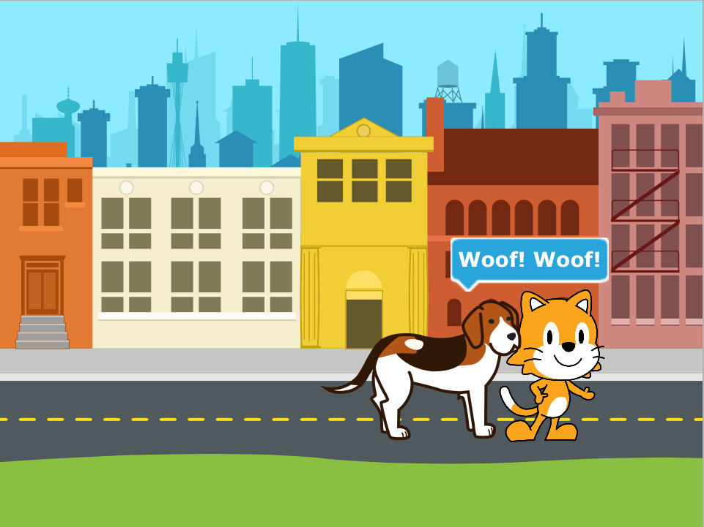
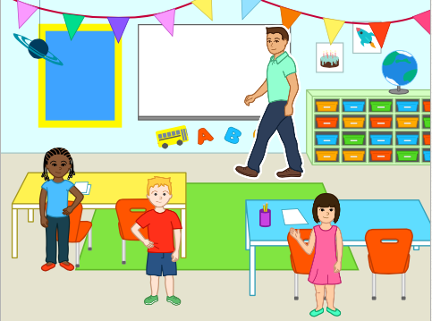
SITE ScratchJr.org
Drive Across the City Run a Race Sunset Moonrise after Sunset Spooky Forest
Dribble a Basketball Dance Party Meet and Greet Conversation

