Slide 1

Mystery Science Alignment with
Texas Essential Knowledge and Skills
2nd Grade Planning Guide
Kindergarten Planning Guide | Grade 1 Planning Guide | Grade 2 Planning Guide
Grade 3 Planning Guide | Grade 4 Planning Guide | Grade 5 Planning Guide
Mystery Science aligns to the Texas Essential Knowledge and Skills (TEKS) for Science. Each lesson (exploration & hands-on lab) is designed to take one hour. Extensions are available for each lesson and offer an opportunity for students to continue their science content learning. They include assessments and a curated collection of additional activity suggestions, online resources, project ideas, and readings. Mini-lessons are 5-minute videos that answer K-5 student questions and can be used as a jumping off point to engage learners for a full lesson planned by the teacher. Each TEKS statement is color-coded to indicate the following:
Identified by TEA as a Readiness Standard of the assessed curriculum
Identified by TEA as a Supporting Standard of the assessed curriculum
Not identified by TEA as part of the assessed curriculum
Table of Contents
Matter & Energy | Earth & Space | Earth & Space | Organisms & Environments | Organisms & Environments
TEKS 2.5 | TEKS 2.7 | TEKS 2.8 | TEKS 2.9 & 2.10 | TEKS 2.9 & 2.10
Material Properties | Earth Materials | Night Patterns | Animal Biodiversity | Plant Adaptations
mysteryscience.com/docs/texas
Last updated September 6, 2022

Slide 2

2nd Grade: Matter & Energy
Material Properties Unit (Material Magic)
 | Topic & Guiding Question | Student Objectives | TEKS Process Standards | TEKS Readiness & Supporting Standards
Lesson 1 | Materials, Properties, & Engineering Why do we wear clothes? | Students investigate different material properties, such as flexibility and absorbency, and use those properties to design and build a hat that protects them from the sun. | 2.2A Ask questions about organisms, objects, and events during observations and investigations. 2.3A Identify and explain a problem and propose a task and solution for the problem. | 2.5A Classify matter by physical properties, including relative temperature, texture, flexibility, and whether material is a solid or liquid. 2.8B Identify the importance of weather and seasonal information to make choices in clothing, activities, and transportation.
Lesson 2 | Classify Materials, Insulators, and Properties Can you really fry an egg on a hot sidewalk? | Students conduct an investigation of conductors and insulators in order to determine which are best suited for allowing people to handle hot items. | 2.2B Plan and conduct descriptive investigations. 2.2D Record and organize data using pictures, numbers, and words. | 2.5B Compare changes in materials caused by heating and cooling. 2.6A Investigate the effects on objects by increasing or decreasing the amounts of light, heat, and sound energy such as how the color of an object appears different in dimmer light or how heat melts butter.
Lesson 3 | Heating, Cooling, & Phases of Matter Why are so many toys made out of plastic? | Student conduct an investigation of different materials in order to determine which are most and least easily melted. | 2.2B Plan and conduct descriptive investigations. 2.2D Record and organize data using pictures, numbers, and words. | 2.5B Compare changes in materials caused by heating and cooling. 2.5C Demonstrate that things can be done to materials such as cutting, folding, sanding, and melting to change their physical properties.
Lesson 4 | Inventions & Engineering What materials might be invented in the future? | Students design a new invention that takes advantage of the unique properties of a futuristic material. | 2.2E Communicate observations and justify explanations using student-generated data from simple descriptive investigations. | 2.5D Combine materials that when put together can do things that they cannot do by themselves, such as building a tower or a bridge, and justify the selection of those materials based on their physical properties.
Lesson 5 | Materials, Properties, & Engineering Could you build a house out of paper? | Students construct an evidence- based account of how a structure built of paper can be disassembled and rebuilt in new ways. | 2.2C Collect data from observations using scientific tools. 2.3A Identify and explain a problem and propose a task and solution for the problem. | 2.5C Demonstrate that things can be done to materials such as cutting, folding, sanding, and melting to change their physical properties. 2.5D Combine materials that when put together can do things that they cannot do by themselves, such as building a tower or a bridge, and justify the selection of those materials based on their physical properties.
Lesson 1
Lesson 2
Lesson 3
Lesson 4
Lesson 5
mysteryscience.com/docs/texas
Page 2 of 7

Slide 3


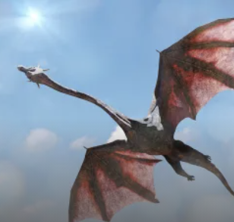
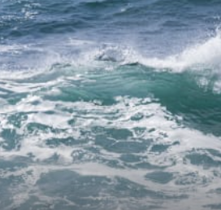
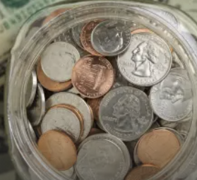
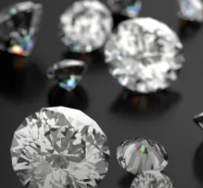
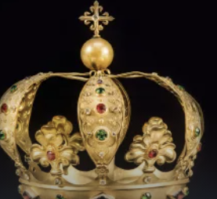
2nd Grade: Earth & Space
Earth Materials Unit (Rocks & Minerals)
 | Topic & Guiding Question | Student Objectives | TEKS Process Standards | TEKS Readiness & Supporting Standards
Lesson 1 | Rocks, Sand, & Erosion Why is there sand at the beach? | Students investigate the effects of rocks tumbling in a river. Based on their observations, they construct an explanation for why rocks on the top of mountains are much bigger than the sand at the beach. | 2.2B Plan and conduct descriptive investigations. 2.2E Communicate observations and justify explanations using student-generated data from simple descriptive investigations. | 2.7A Observe, describe, and compare rocks by size, texture, and color.
Lesson 1
Mini-lesson
Mini-lesson
TEKS 2.7B Why is the ocean salty?
TEKS 2.7C Where does metal come from?
Mini-lesson
Mini-lesson
TEKS 2.7C How are diamonds made?
TEKS 2.7C How is gold made?
mysteryscience.com/docs/texas
Page 3 of 7

Slide 4

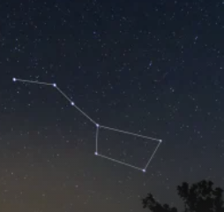
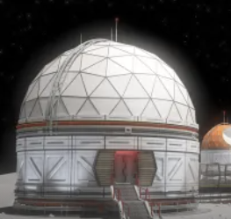
2nd Grade: Earth & Space
Night Patterns Unit (Moon & Stars)
 | Topic & Guiding Question | Student Objectives | TEKS Process Standards | TEKS Readiness & Supporting Standards
Lesson 1 | ✨New!✨ Moon Phases & Patterns When can you see the full moon? | Students record observations of the Moon’s shape using a series of photos collected over the course of four weeks. Using this information, students discover that the Moon follows a cyclical pattern, which they can use to predict when a full moon will appear. | 2.2D Record and organize data using pictures, numbers, and words. 2.3B Make predictions based on observable patterns. | 2.8C Observe, describe, and record patterns of objects in the sky, including the appearance of the Moon.
Lesson 2 | Stars & Daily Patterns Why do stars come out at night? | Students develop and use a model of the Big Dipper in the night sky. After conducting a simple investigation, students construct an explanation for why stars are only visible in the night sky. | 2.2E Communicate observations and justify explanations using student-generated data from simple descriptive investigations. 2.3B Make predictions based on observable patterns. | 2.8C Observe, describe, and record patterns of objects in the sky, including the appearance of the Moon.
Lesson 3 | Stars & Seasonal Patterns Read-Along How can stars help you if you get lost? | Students observe that groups of stars in the sky form a pattern: constellations. Even though the Big Dipper changes its spot in the sky in different seasons, it always points to the North Star. | 2.2A Ask questions about organisms, objects, and events during observations and investigations. | 2.8C Observe, describe, and record patterns of objects in the sky, including the appearance of the Moon.
Lesson 1
Lesson 2
Lesson 3
Mini-lesson
Mini-lesson
TEKS 2.8C Who created the constellations?
TEKS 2.8C What would it be like to live on the Moon?
mysteryscience.com/docs/texas
Page 4 of 7

Slide 5

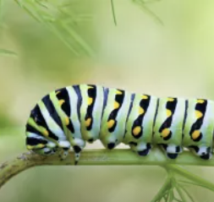
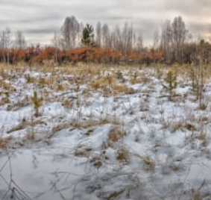
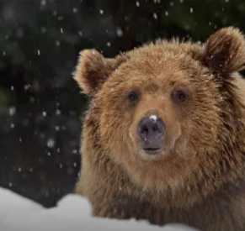
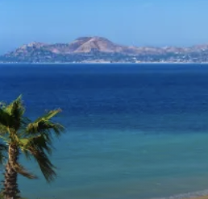
2nd Grade: Organisms & Environments
Animal Biodiversity Unit (Animal Adventures)
 | Topic & Guiding Question | Student Objectives | TEKS Process Standards | TEKS Readiness & Supporting Standards
Lesson 1 | Biodiversity & Classification How many different kinds of animals are there? | Students observe the traits of different animals and use that information to organize them into groups based on their characteristics. | 2.2F Compare results of investigations with what students and scientists know about the world. 2.4B Measure and compare organisms and objects. | 2.10A Observe, record, and compare how the physical characteristics and behaviors of animals help them meet their basic needs.
Lesson 2 | Biodiversity, Habitats, & Species Why do frogs say “ribbit”? | Students identify frogs based on their unique calls and use that information to determine the level of frog species diversity within multiple habitats. | 2.2F Compare results of investigations with what students and scientists know about the world. 2.4B Measure and compare organisms and objects. | 2.10A Observe, record, and compare how the physical characteristics and behaviors of animals help them meet their basic needs..
Lesson 3 | Biodiversity & Engineering How could you get more birds to visit a bird feeder? | Students investigate which kinds of birds are likely to visit a bird feeder based on what they eat and design and build a prototype bird feeder that attracts a specific type of bird. | 2.3A Identify and explain a problem and propose a task and solution for the problem. | 2.9C Compare the ways living organisms depend on each other and on their environments such as through food chains. 2.10A Observe, record, and compare how the physical characteristics and behaviors of animals help them meet their basic needs.
Lesson 1
Lesson 2
Lesson 3
Mini-lesson
Mini-lesson
TEKS 2.10C Are butterflies the only animals that start out as caterpillars?
TEKS 2.9B Where do bugs go in winter?
Mini-lesson
Mini-lesson
TEKS 2.9B Why do bears hibernate?
TEKS 2.9B Why do animals come back after going to warm places in the winter?
mysteryscience.com/docs/texas
Page 5 of 7

Slide 6


2nd Grade: Organisms & Environments
Plant Adaptations Unit (Plant Adventures)
 | Topic & Guiding Question | Student Objectives | TEKS Process Standards | TEKS Readiness & Supporting Standards
 | Pollination & Plant Reproduction Why do plants grow flowers? | Students model the structure and function of flower parts that are responsible for creating seeds. | 2.2B Plan and conduct descriptive investigations. | 2.10B Observe, record, and compare how the physical characteristics of plants help them meet their basic needs such as stems carry water throughout the plant.
 | Seed Dispersal & Plant Life Cycle Why do plants give us fruit? | Students explore the function of fruits in plants and practice classification. | 2.2A Ask questions about organisms, objects, and events during observations and investigations. | 2.10B Observe, record, and compare how the physical characteristics of plants help them meet their basic needs such as stems carry water throughout the plant.
 | Seed Dispersal How did a tree travel halfway around the world? | Students observe how different types of plants produce different types of seeds in the process of reproduction. | 2.2A Ask questions about organisms, objects, and events during observations and investigations. | 2.9A Identify the basic needs of plants and animals. 2.10B Observe, record, and compare how the physical characteristics of plants help them meet their basic needs such as stems carry water throughout the plant.
Lesson 1
Lesson 2
Lesson 3
Lesson 4
Part 1 of 2
mysteryscience.com/docs/texas
Page 6 of 7

Slide 7
2nd Grade: Organisms & Environments
Plant Adaptations Unit (Plant Adventures)
 | Topic & Guiding Question | Student Objectives | TEKS Process Standards | TEKS Readiness & Supporting Standards
 | Water, Sunlight, & Plant Growth Could a plant survive without light? | Students conduct an investigation to determine that plants need water and light to grow. | 2.2B Plan and conduct descriptive investigations. 2.2E Communicate observations and justify explanations using student-generated data from simple descriptive investigations. | 2.9A Identify the basic needs of plants and animals. 2.10B Observe, record, and compare how the physical characteristics of plants help them meet their basic needs such as stems carry water throughout the plant.
 | Light, Leaves, & Competition Why do trees grow so tall? | Students observe that plants require light in order to fully grow and be healthy. | 2.3B Make predictions based on observable patterns. | 2.9B Identify factors in the environment, including temperature and precipitation, that affect growth and behavior such as migration, hibernation, and dormancy of living things.
 | Adaptations & Habitat Should you water a cactus? | Students observe that different plants require different amounts of light and water. | 2.3B Make predictions based on observable patterns. | 2.9B Identify factors in the environment, including temperature and precipitation, that affect growth and behavior such as migration, hibernation, and dormancy of living things.
 | Adaptations & Habitat Where do plants grow best? | Students practice thinking like gardeners, considering what plants need and how a simple habitat can change over time. | 2.2A Ask questions about organisms, objects, and events during observations and investigations. | 2.9B Identify factors in the environment, including temperature and precipitation, that affect growth and behavior such as migration, hibernation, and dormancy of living things.
Lesson 4
Lesson 5
Lesson 6
Lesson 7
Lesson 5
Part 2 of 2
mysteryscience.com/docs/texas
Page 7 of 7

