Slide 1
Mystery Science Alignment with
Texas Essential Knowledge and Skills
5th Grade Planning Guide
Kindergarten Planning Guide | Grade 1 Planning Guide | Grade 2 Planning Guide
Grade 3 Planning Guide | Grade 4 Planning Guide | Grade 5 Planning Guide
Mystery Science aligns to the Texas Essential Knowledge and Skills (TEKS) for Science. Each lesson (exploration & hands-on lab) is designed to take one hour. Extensions are available for each lesson and offer an opportunity for students to continue their science content learning. They include assessments and a curated collection of additional activity suggestions, online resources, project ideas, and readings. Mini-lessons are 5-minute videos that answer K-5 student questions and can be used as a jumping off point to engage learners for a full lesson planned by the teacher. Each TEKS statement is color-coded to indicate the following:
Identified by TEA as a Readiness Standard of the assessed curriculum
Identified by TEA as a Supporting Standard of the assessed curriculum
Not identified by TEA as part of the assessed curriculum
Table of Contents
Matter & Energy | Force, Motion, & Energy | Earth & Space | Earth & Space | Earth & Space | Organisms & Environments | Organisms & Environments | Organisms & Environments
TEKS 5.5 | TEKS 5.6 | TEKS 5.7 | TEKS 5.8 | TEKS 5.8 | TEKS 5.9 | TEKS 5.9 | TEKS 5.10
Matter & Mixtures | Light, Heat, & Electricity | Erosion & Land Formation | Climate & The Water Cycle | Earth’s Rotation | Ecosystems & The Food Web | Fossils | Inherited Traits
Last updated September 6, 2022

Slide 2

5th Grade: Matter & Energy
Matter & Mixtures Unit (Chemical Magic)
 | Topic & Guiding Question | Student Objectives | TEKS Process Standards | TEKS Readiness & Supporting Standards
 | Chemistry & Conservation of Matter Are magic potions real? | Students observe that a salt and vinegar solution will turn a dull penny shiny again indicating that substances can change other substances. | 5.2A Describe, plan, and implement simple experimental investigations testing one variable. | 5.5C Identify changes that can occur in the physical properties of the ingredients of solutions such as dissolving salt in water or adding lemon juice to water.
 | Dissolving & Particulate Nature of Matter Could you transform something worthless into gold? | Students coat a steel nail in copper by placing it into the solution that dissolved bits of the penny. Students realize that substances can change to become particles too small to be seen, but they still exist. | 5.2A Describe, plan, and implement simple experimental investigations testing one variable. | 5.5C Identify changes that can occur in the physical properties of the ingredients of solutions such as dissolving salt in water or adding lemon juice to water.
 | Acids, Reactions, & Properties of Matter What would happen if you drank a glass of acid? | Students figure out that acids are very reactive substances. Students investigate reactions between different substances to determine how known acids react with other materials. | 5.3A Analyze, evaluate, and critique scientific explanations by using evidence, logical reasoning, and experimental and observational testing. | 5.5A Classify matter based on measurable, testable, and observable physical properties, including mass, magnetism, physical state (solid, liquid, and gas), relative density (sinking and floating using water as a reference point), solubility in water, and the ability to conduct or insulate thermal energy or electric energy.
 | Chemical Reactions What do fireworks, rubber, and Silly Putty have in common? | Students combine different substances together to discover that chemical reactions can create new substances. | 5.2A Describe, plan, and implement simple experimental investigations testing one variable. 5.2D Analyze and interpret information to construct reasonable explanations from direct (observable) and indirect (inferred) evidence. | 5.5A Classify matter based on measurable, testable, and observable physical properties, including mass, magnetism, physical state (solid, liquid, and gas), relative density (sinking and floating using water as a reference point), solubility in water, and the ability to conduct or insulate thermal energy or electric energy.
 | Gases & Particle Models Why do some things explode? | Students investigate and model the reaction between baking soda and vinegar. They figure out that gases are made of particles too small to be seen. | 5.2A Describe, plan, and implement simple experimental investigations testing one variable. 5.3B Draw or develop a model that represents how something that cannot be seen works or looks. | 5.5A Classify matter based on measurable, testable, and observable physical properties, including mass, magnetism, physical state (solid, liquid, and gas), relative density (sinking and floating using water as a reference point), solubility in water, and the ability to conduct or insulate thermal energy or electric energy.
Lesson 1
Lesson 2
Lesson 3
Lesson 4
Lesson 5
mysteryscience.com/docs/texas
Page 2 of 9

Slide 3



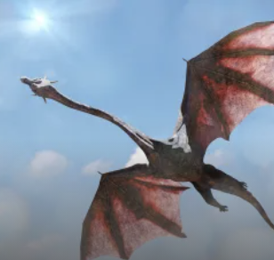
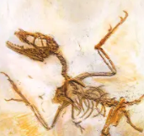
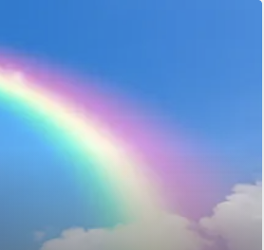
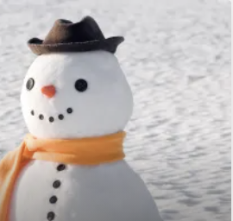
5th Grade: Force, Matter, & Energy
Light, Heat, & Electricity Unit (Light & Heat)
 | Topic & Guiding Question | Student Objectives | TEKS Process Standards | TEKS Readiness & Supporting Standards
 | Light, Eyes, & Vision What do people who are blind see? | Students develop a working model of an eye. They use the model to reason about how light reflects off an object and into the eye, helping an organism process information from the environment. | 5.3A Analyze, evaluate, and critique scientific explanations by using evidence, logical reasoning, and experimental and observational testing. 5.3B Draw or develop a model that represents how something that cannot be seen works or looks. | 5.6C Demonstrate that light travels in a straight line until it strikes an object and is reflected or travels through one medium to another and is refracted.
 | Structure & Function of Eyes How can some animals see in the dark? | Students use their eye model to discover that the pupil controls the amount of light let into the eye. In the dark, pupils get larger to let in more light. | 5.3A Analyze, evaluate, and critique scientific explanations by using evidence, logical reasoning, and experimental and observational testing. 5.3B Draw or develop a model that represents how something that cannot be seen works or looks. | 5.6C Demonstrate that light travels in a straight line until it strikes an object and is reflected or travels through one medium to another and is refracted.
 | Electrical Energy What if there were no electricity? | Students design a flashlight with an on/off switch, using batteries, flights, and tin foil. Students figure out that electricity can be transformed to other forms of energy, such as movement, light, and heat. | 5.2E Demonstrate that repeated investigations may increase the reliability of results. 5.3A Analyze, evaluate, and critique scientific explanations by using evidence, logical reasoning, and experimental and observational testing. | 5.6B Demonstrate that the flow of electricity in closed circuits can produce light, heat, or sound.
 | Heat Energy & Energy Transfer How long did it take to travel across the country before cars and planes? | Students build a paper spinner and conduct an investigation to explain how heat makes things move. Students realize that heat energy can be transformed into motion energy using a turbine. | 5.2A Describe, plan, and implement simple experimental investigations testing one variable. 5.2E Demonstrate that repeated investigations may increase the reliability of results. | 5.6A Explore the uses of energy, including mechanical, light, thermal, electrical, and sound energy. 5.6D Design a simple experimental investigation that tests the effect of force on an object.
Lesson 1
Lesson 2
Lesson 3
Lesson 4
Mini-lesson
Mini-lesson
TEKS 5.6C How is a rainbow made?
TEKS 5.6C Why is snow white?
mysteryscience.com/docs/texas

Slide 4
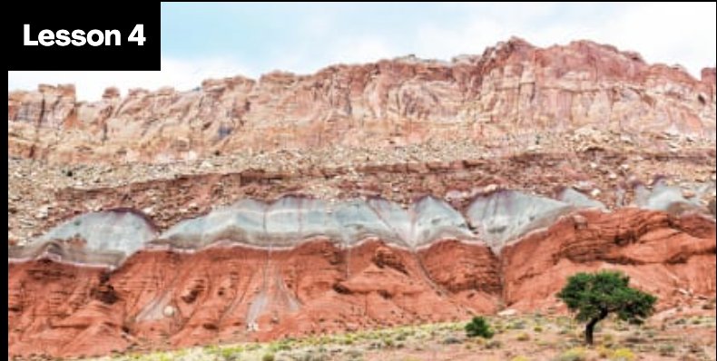

5th Grade: Earth & Space
Erosion & Land Formation Unit (Layers of Land)
 | Topic & Guiding Question | Student Objectives | TEKS Process Standards | TEKS Readiness & Supporting Standards
 | ✨New ✨ Sedimentary Rock & Fossils What did your town look like 100 million years ago? | Students create a model canyon and use the pattern of fossils found in each rock layer to support the explanation that the landscape has changed many times over millions of years. | 5.3A Analyze, evaluate, and critique scientific explanations by using evidence, logical reasoning, and experimental and observational testing. 5.3B Draw or develop a model that represents how something that cannot be seen such as formation of sedimentary rock works or looks. | 5.7A Explore the processes that led to the formation of sedimentary rocks and fossil fuels. 5.9D Identify fossils as evidence of past living organisms and the nature of the environments at the time using models.
Lesson 1 | Erosion, Earth’s Surface, & Landforms What’s strong enough to make a canyon? | Students create a model landform and investigate how some Earth events can occur quickly, while others occur slowly. | 5.3A Analyze, evaluate, and critique scientific explanations by using evidence, logical reasoning, and experimental and observational testing. 5.3B Draw or develop a model that represents how something that cannot be seen such as formation of sedimentary rock works or looks. | 5.7B Recognize how landforms such as deltas, canyons, and sand dunes are the result of changes to Earth’s surface by wind, water, or ice.
Lesson 2 | Erosion & Engineering How can you stop a landslide? | Students compare multiple solutions for preventing erosion. | 5.3B Draw or develop a model that represents how something that cannot be seen works or looks. | 5.7B Recognize how landforms such as deltas, canyons, and sand dunes are the result of changes to Earth’s surface by wind, water, or ice.
Lesson 1
Lesson 2 Lesson 3
Mini-lesson
TEKS 5.7A What’s the best place to look for dinosaur fossils?
mysteryscience.com/docs/texas
Page 4 of 9

Slide 5


5th Grade: Earth & Space
Climate & The Water Cycle Unit (Watery Planet)
 | Topic & Guiding Question | Student Objectives | TEKS Readiness & Supporting Standards
Lesson 1 | Climate, Geography, & Global Weather Patterns Why are some places always hot? | Students obtain and combine information to describe the different climate regions of the world. | 5.8A Differentiate between weather and climate.
Lesson 2 | ✨New!✨ Mixtures & Solutions How much salt is in the ocean? | Students create a model ocean to observe how salt seems to completely vanish when dissolved in water. Students measure and graph quantities to provide evidence that the salt is still in the solution, even though we can’t see it. | 5.5B Demonstrate that some mixtures maintain physical properties of their ingredients such as iron filings and sand and sand and water. 5.5C Identify changes that can occur in the physical properties of the ingredients of solutions such as dissolving salt in water or adding lemon juice to water.
Lesson 3 | Water Cycle Can we make it rain? | Students create a model of the ocean and sky to investigate how temperature influences evaporation and condensation. Students figure out that higher ocean temperatures lead to more evaporation, thus leading to more rain. | 5.8B Explain how the Sun and the ocean interact in the water cycle.
Lesson 4 | Natural Disasters & Engineering How can you save a town from a hurricane? | Students define the problem that a town needs protection from flooding. They design solutions using different types of flood protection. They realize flooding is caused by severe rainfall generated by hurricanes. Hurricanes are created where ocean temperatures are warm. | 5.8B Explain how the Sun and the ocean interact in the water cycle.
Lesson 1
Lesson 2
Lesson 3
Lesson 4
Lesson 5
mysteryscience.com/docs/texas
Page 5 of 9

Slide 6

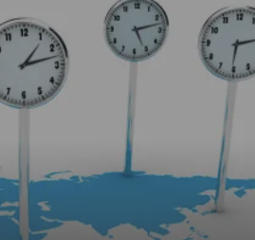
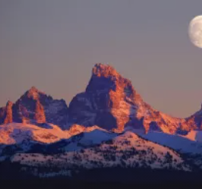
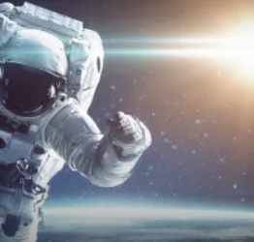
5th Grade: Earth & Space
Earth’s Rotation Unit (Spinning Earth)
 | Topic & Guiding Question | Student Objectives | TEKS Process Standards | TEKS Readiness & Supporting Standards
 | Day, Night, & Earth’s Rotation How fast does the Earth spin? | Students model the rotation of the Earth and investigate why the Sun looks like it’s moving across the sky. Using evidence they gathered in the investigation, students build a model that explains how the Earth’s rotation around its own axis causes the Sun to appear to rise and set. | 5.3B Draw or develop a model that represents how something that cannot be seen works or looks. | 5.8C Demonstrate that Earth rotates on its axis once approximately every 24 hours causing the day/night cycle and the apparent movement of the Sun across the sky.
 | Earth’s Rotation & Daily Shadow Patterns Who set the first clock? | Students make a shadow clock (sundial) and investigate how the direction and length of shadows change with the position of the light shining on the sundial. Students realize that the Sun’s position in the sky can be used to tell the time of day. | 5.2D Analyze and interpret information to construct reasonable explanations from direct (observable) and indirect (inferred) evidence. | 5.8C Demonstrate that Earth rotates on its axis once approximately every 24 hours causing the day/night cycle and the apparent movement of the Sun across the sky.
Lesson 1
Lesson 2
Mini-lesson
Mini-lesson
TEKS 5.8C Why do places have different times?
TEKS 5.8D What is the Moon made of?
Mini-lesson
TEKS 5.8D How close could an astronaut get to the Sun?
mysteryscience.com/docs/texas
Page 6 of 9

Slide 7

5th Grade: Organisms & Environments
Ecosystems & The Food Web Unit (Web of Life)
 | Topic & Guiding Question | Student Objectives | TEKS Process Standards | TEKS Readiness & Supporting Standards
 | Food Webs & Flow of Energy Why did the dinosaurs go extinct? | Students develop a model of a dinosaur food web. Students realize that blocking the sun’s energy would have disastrous effects on the organisms that rely on this energy in the food web and cause the extinction of some entire species. | 5.3A Analyze, evaluate, and critique scientific explanations by using evidence, logical reasoning, and experimental and observational testing. 5.3B Draw or develop a model that represents how something that cannot be seen works or looks. | 5.9B Describe the flow of energy within a food web, including the roles of the Sun, producers, consumers, and decomposers.
 | Decomposers & Matter Cycle Where do fallen leaves go? | Students conduct an investigation to test how mold grows under different conditions to decompose food. Students realize that decomposers, like mold, break down and consume dead plant material. | 5.2A Describe, plan, and implement simple experimental investigations testing one variable. 5.2E Demonstrate that repeated investigations may increase the reliability of results. | 5.9A Observe the way organisms live and survive in their ecosystem by interacting with the living and nonliving components.
 | Decomposers, Nutrients, & Matter Cycle Do worms really eat dirt? | Students make observations of worms to realize that worms act as decomposers to eat dead matter in an ecosystem and cycle nutrients into the soil. | 5.2A Describe, plan, and implement simple experimental investigations testing one variable. 5.2E Demonstrate that repeated investigations may increase the reliability of results. | 5.9A Observe the way organisms live and survive in their ecosystem by interacting with the living and nonliving components.
 | Ecosystems & Matter Cycle Why do you have to clean a fish tank but not a pond? | Students develop a model of a pond ecosystem and realize that interrelationships exist between decomposers, plants, and animals. Students discover that each organism must be in balance for the pond ecosystem to function. | 5.3B Draw or develop a model that represents how something that cannot be seen works or looks. | 5.9A Observe the way organisms live and survive in their ecosystem by interacting with the living and nonliving components. 5.9C Predict the effects of changes in ecosystems caused by living organisms, including humans, such as the overpopulation of grazers or the building of highways.
Lesson 1
Lesson 2
Lesson 3
Lesson 4
mysteryscience.com/docs/texas
Page 7 of 9

Slide 8
5th Grade: Organisms & Environments
Fossils Unit (Animals Through Time)
 | Topic & Guiding Question | Student Objectives | TEKS Process Standards | TEKS Readiness & Supporting Standards
 | Habitats, Fossils, & Environments Over Time Where can you find whales in a desert? | Students explore the idea that the rock under our feet sometimes contains fossils, and investigate how these fossils reveal changes in habitats through time. | 5.3A Analyze, evaluate, and critique scientific explanations by using evidence, logical reasoning, and experimental and observational testing. 5.3B Draw or develop a model that represents how something that cannot be seen works or looks. | 5.9D Identify fossils as evidence of past living organisms and the nature of the environments at the time using models. 5.10A Compare the structures and functions of different species that help them live and survive in a specific environment such as hooves on prairie animals or webbed feet in aquatic animals.
 | Fossil Evidence & Classification How do we know what dinosaurs looked like? | Students learn how we can infer what the outside of an animal looked like by using clues about their skeleton. | 5.3A Analyze, evaluate, and critique scientific explanations by using evidence, logical reasoning, and experimental and observational testing. | 5.9D Identify fossils as evidence of past living organisms and the nature of the environments at the time using models.
 | Fossil Evidence, Trace Fossils, & Animal Behavior Can you outrun a dinosaur? | Students learn how fossilized animal tracks can tell us a great deal about the animals that left them. | 5.2A Describe, plan, and implement simple experimental investigations testing one variable. | 5.9D Identify fossils as evidence of past living organisms and the nature of the environments at the time using models.
Lesson 1
Lesson 2
Lesson 3
Mini-lesson
TEKS 5.9D Were dragons ever real?
mysteryscience.com/docs/texas
Page 8 of 9

Slide 9

5th Grade: Organisms & Environments
Inherited Traits Unit (Fates of Traits)
 | Topic & Guiding Question | Student Objectives | TEKS Process Standards | TEKS Readiness & Supporting Standards
 | Trait Variation, Inheritance, & Artificial Selection What kinds of animals might there be in the future? | Students analyze the traits of parent dogs and their offspring, constructing an explanation about which traits a puppy gets from each parent. | 5.3A Analyze, evaluate, and critique scientific explanations by using evidence, logical reasoning, and experimental and observational testing. | 5.10B Differentiate between inherited traits of plants and animals such as spines on a cactus or shape of a beak and learned behaviors such as an animal learning tricks or a child riding a bicycle.
 | Trait Variation, Natural Selection, & Survival Can selection happen without people? | Students compare the structures of lizards that live on an island. They simulate multiple generations of these lizards, and analyze and interpret the data to understand how these structures aid in their survival. | 5.3A Analyze, evaluate, and critique scientific explanations by using evidence, logical reasoning, and experimental and observational testing. 5.3B Draw or develop a model that represents how something that cannot be seen works or looks. | 5.10A Compare the structures and functions of different species that help them live and survive in a specific environment such as hooves on prairie animals or webbed feet in aquatic animals. 5.10B Differentiate between inherited traits of plants and animals such as spines on a cactus or shape of a beak and learned behaviors such as an animal learning tricks or a child riding a bicycle.
 | Animal Groups & Survival Why do dogs wag their tails? | Students observe animals that live in groups in order to obtain, evaluate, and communicate information about animal social behavior. Students use evidence to show how animals form groups to help them survive. | 5.2F Communicate valid conclusions in both written and verbal forms. | 5.10B Differentiate between inherited traits of plants and animals such as spines on a cactus or shape of a beak and learned behaviors such as an animal learning tricks or a child riding a bicycle.
 | Traits & Environmental Variation How long can people (and animals) survive in outer space? | Students measure and compare their own physical traits (arm strength, balance, and height) and analyze the information to construct an explanation for how the environment can influence traits. | 5.3A Analyze, evaluate, and critique scientific explanations by using evidence, logical reasoning, and experimental and observational testing. | 5.10A Compare the structures and functions of different species that help them live and survive in a specific environment such as hooves on prairie animals or webbed feet in aquatic animals.
Lesson 1
Lesson 2
Lesson 3
Lesson 4
mysteryscience.com/docs/texas
Page 9 of 9

