Slide 1
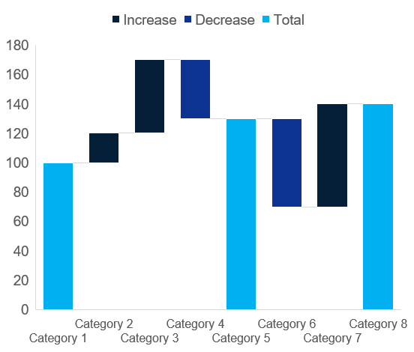
Waterfall / Stacked Line
Click to edit Header text styles
Click to edit Header text styles
Source: Complete if required

