Slide 1


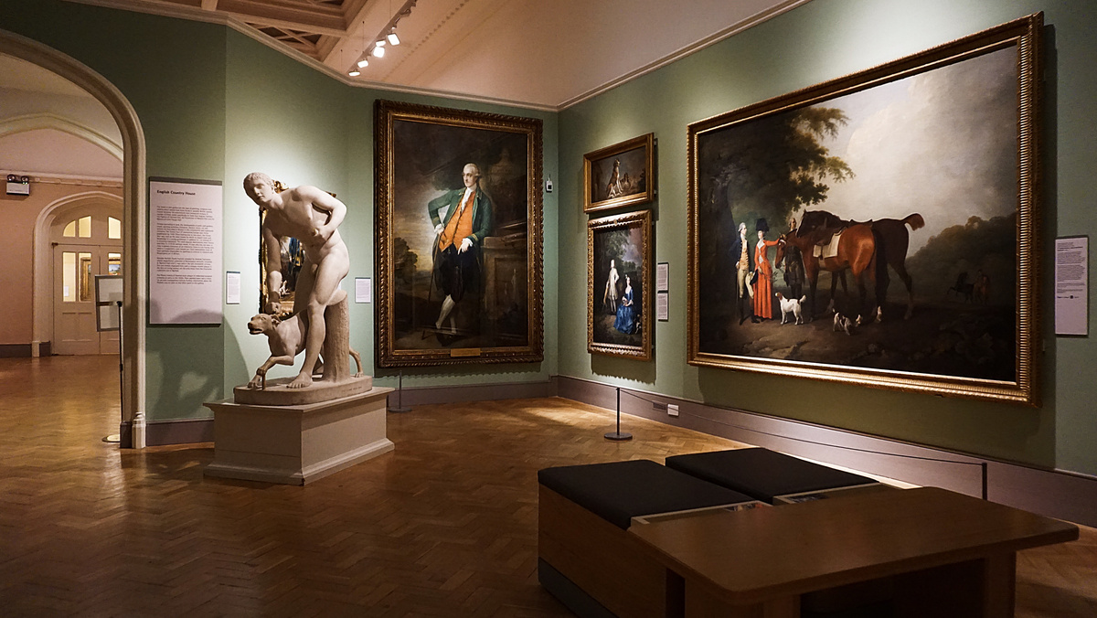

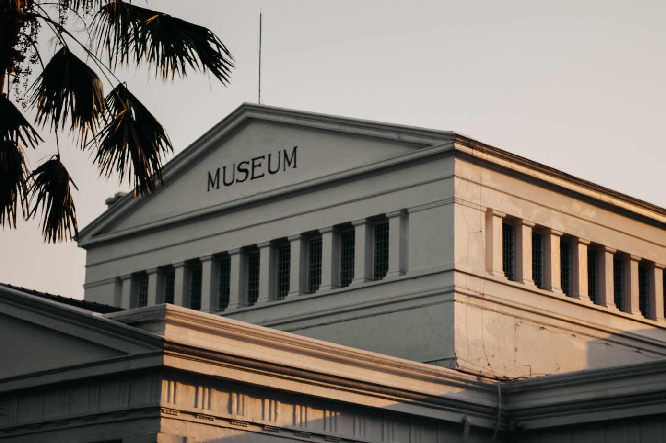
WARNER & SPENCER
MUSEUM
Vintage Style
VINTAGE
Presentation
Start Presentation
www.reallygreatsite.com

Slide 2

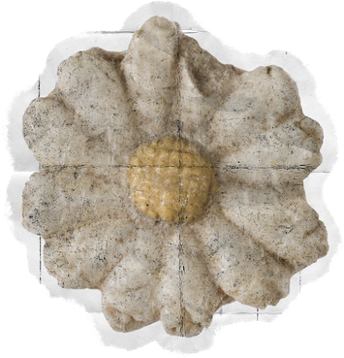
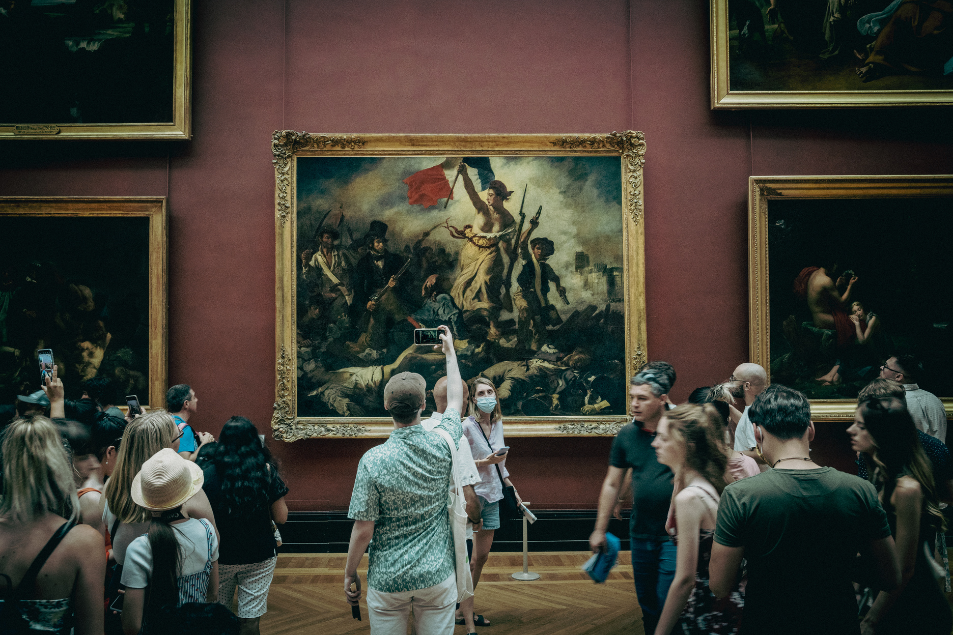
WARNER & SPENCER
WWW.REALLYGREATSITE.COM
Introduction to the Museum Vintage
Concept of a Vintage Museum
A Vintage Museum is a space that collects, preserves, and exhibits artifacts from bygone eras to showcase human creativity and craftsmanship. The goal is to bridge generations—allowing visitors to appreciate the elegance, design, and culture of previous centuries.
See More

Slide 3
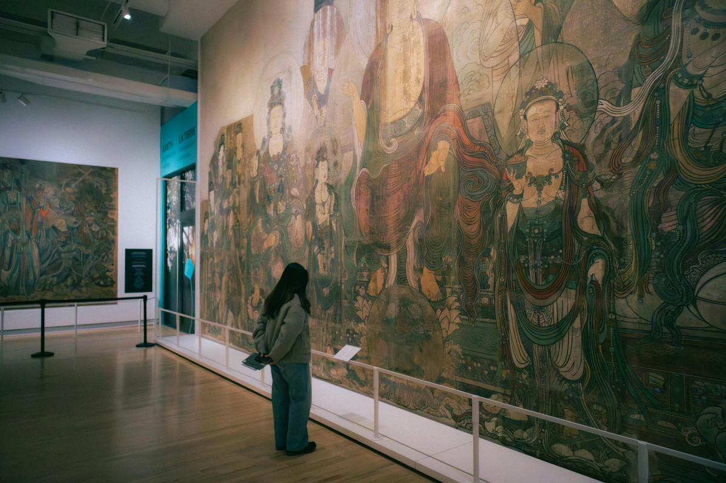
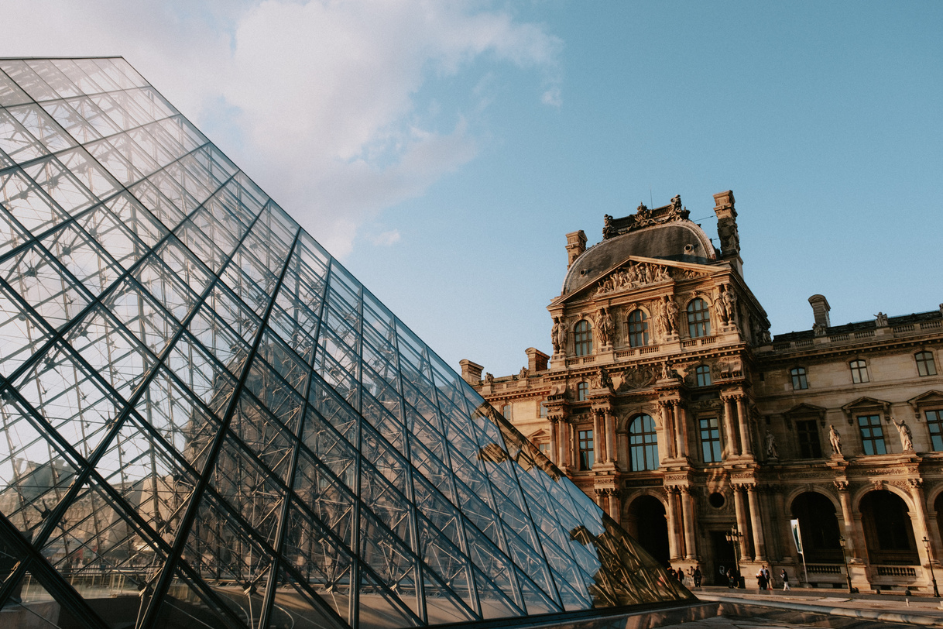
WARNER & SPENCER
WWW.REALLYGREATSITE.COM
The Best Evolution of Vintage Culture
From Utility to Art
Important Point
Vintage culture emerged as people began valuing craftsmanship over mass production.
Items once seen as old-fashioned gained new appreciation for their uniqueness and quality.
The Art Deco movement (1920s–1930s)—known for its geometric shapes and luxury materials—illustrates how design eras shape what we now consider “vintage.”

Slide 4
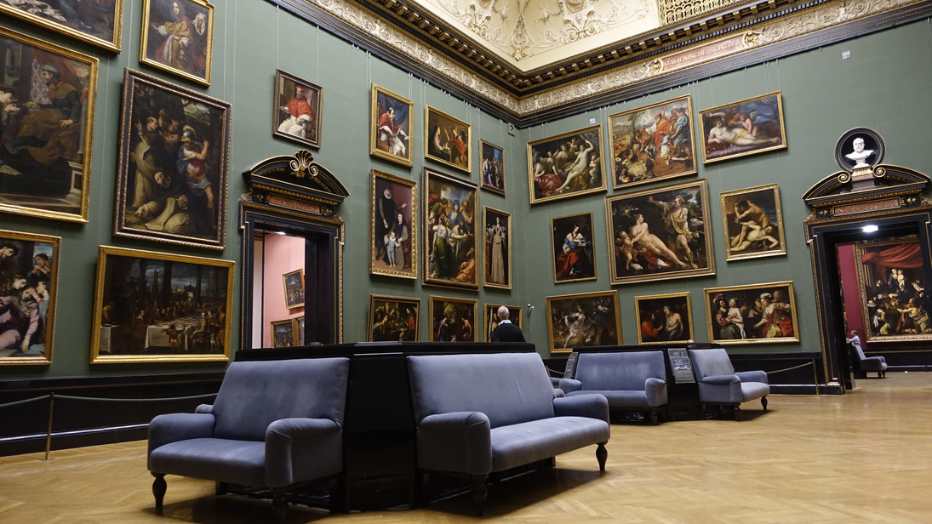
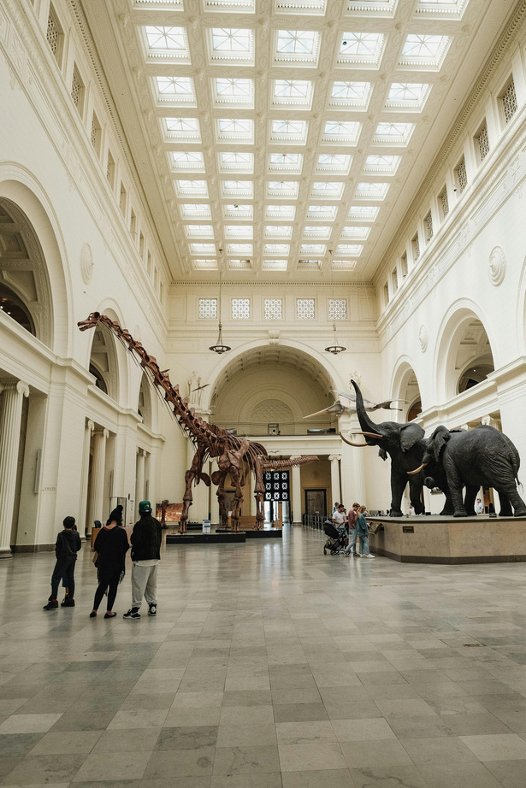
WARNER & SPENCER
WWW.REALLYGREATSITE.COM
Architecture of the Museum
The architecture of a vintage museum often mirrors the era it represents. Classic façades, stained glass, and marble columns evoke nostalgia.
Blending Classic and Modern Styles
Interior designs prioritize natural light and open spaces to create a calm, reflective environment.
Blending Classic and Modern Styles

Slide 5


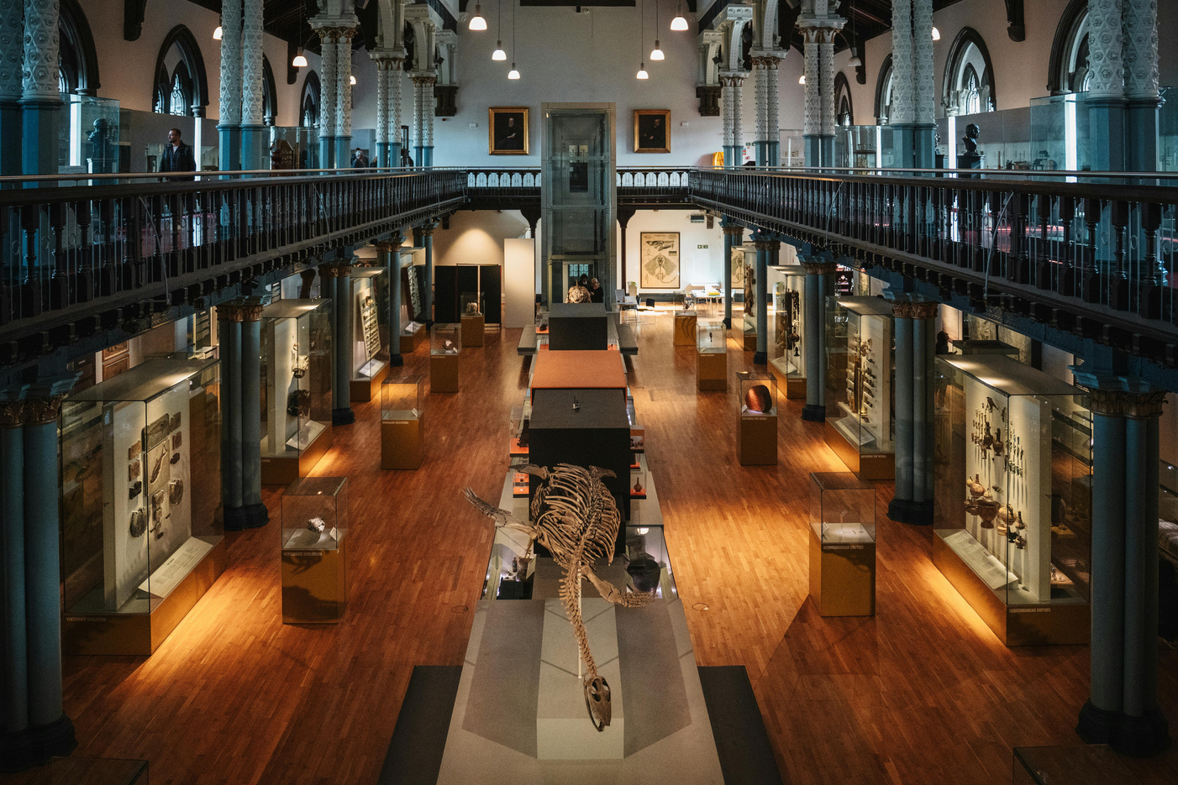
WARNER & SPENCER
WWW.REALLYGREATSITE.COM
Curating Vintage Collections
Item Preservation Techniques
Research and Authentication
Curators group artifacts by themes, such as “Post-War Design” or “Early 20th Century Innovation.”
Curating a collection requires deep research and authentication to ensure each item’s historical integrity.
Collection 01
Collection 02

Slide 6
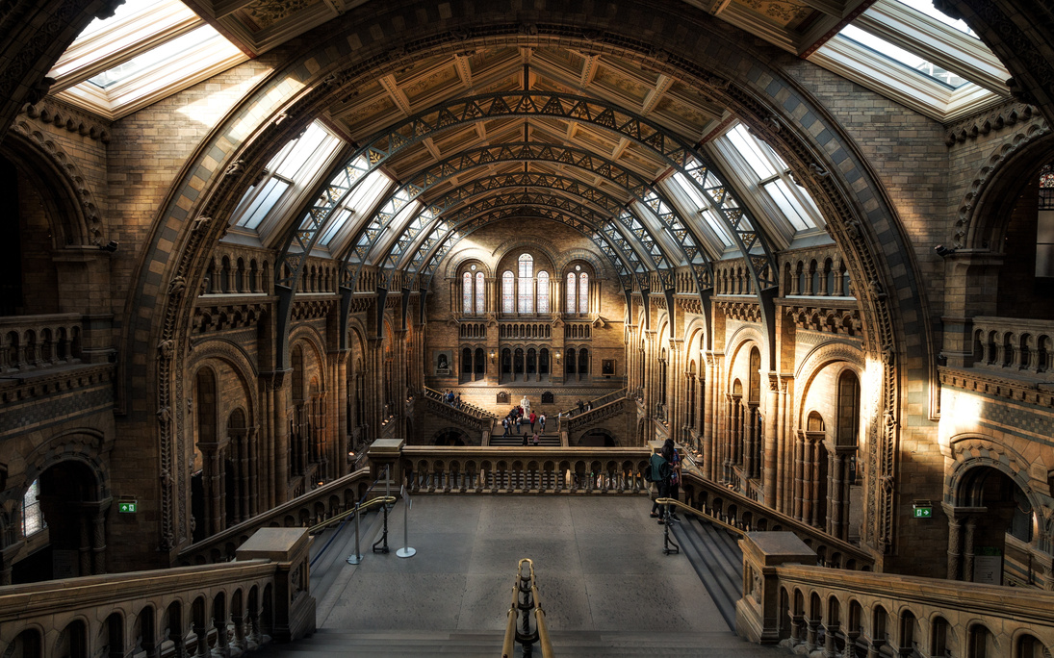
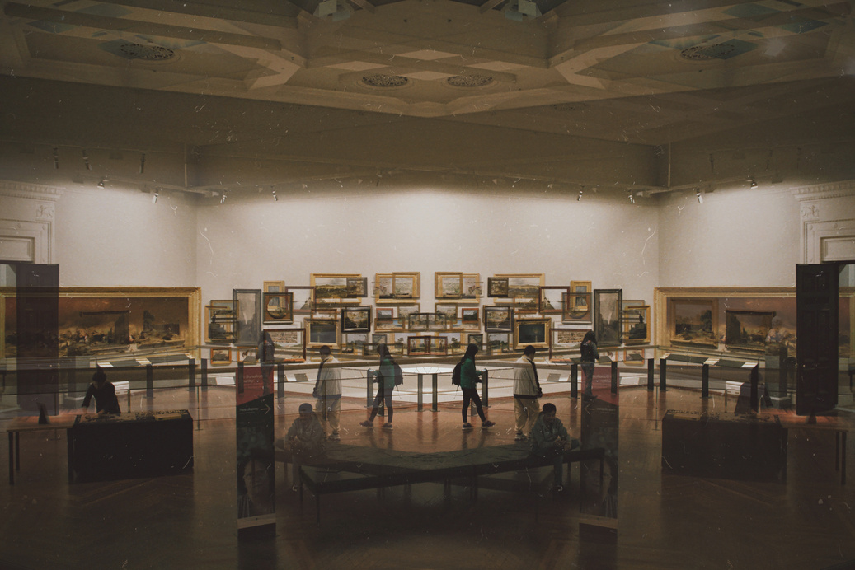
WARNER & SPENCER
WWW.REALLYGREATSITE.COM
01.
Evolution of Clothing Trends
The Vintage Fashion
and Style
02.
Influence of Social Class
Vintage fashion displays the artistry of tailoring and design that shaped identity and culture.
03.
Materials and Textiles the Past
Next Slide

Slide 7
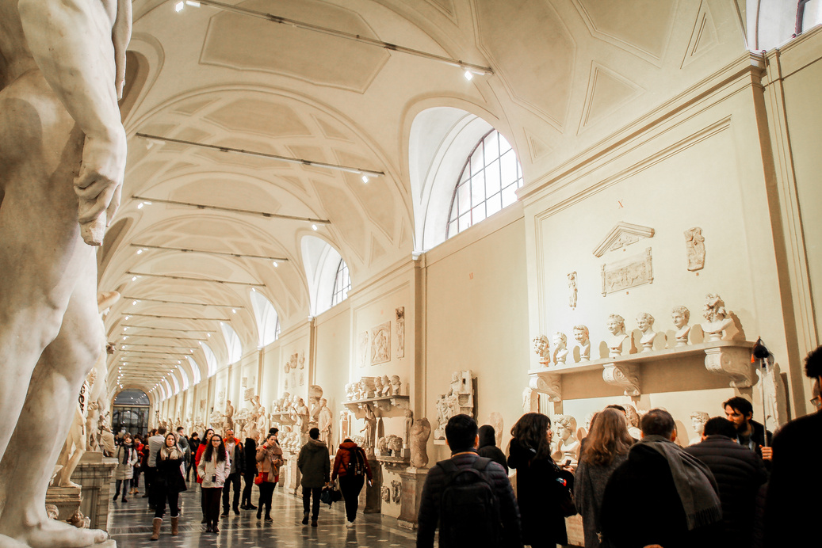
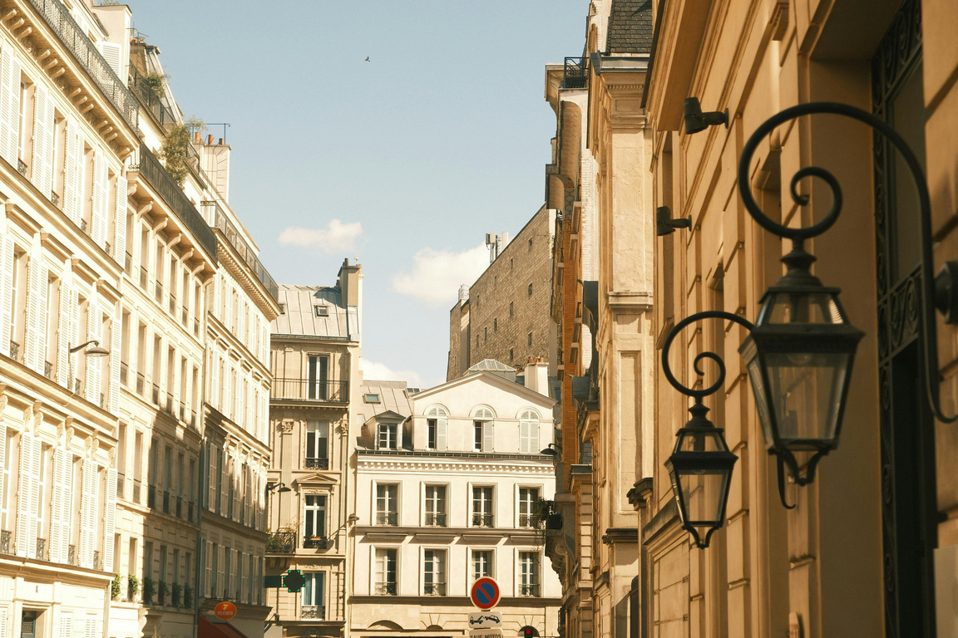
WARNER & SPENCER
WWW.REALLYGREATSITE.COM
1920
Classic Automobiles and Transportation
Early Engineering Marvels
Classic vehicles represent the innovation and beauty of mechanical design. Museums often feature fully restored automobiles like the 1960 Jaguar E-Type,
Design Evolution
Important Point
These exhibits not only celebrate technology but also narrate
shaped modern life from horse drawn carriages to early electric

Slide 8
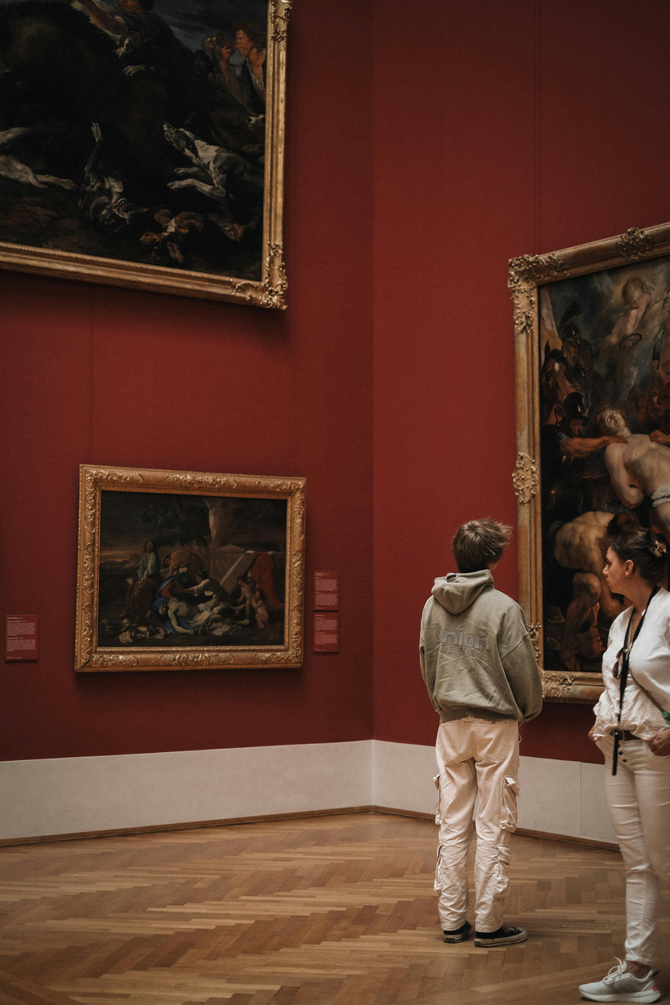
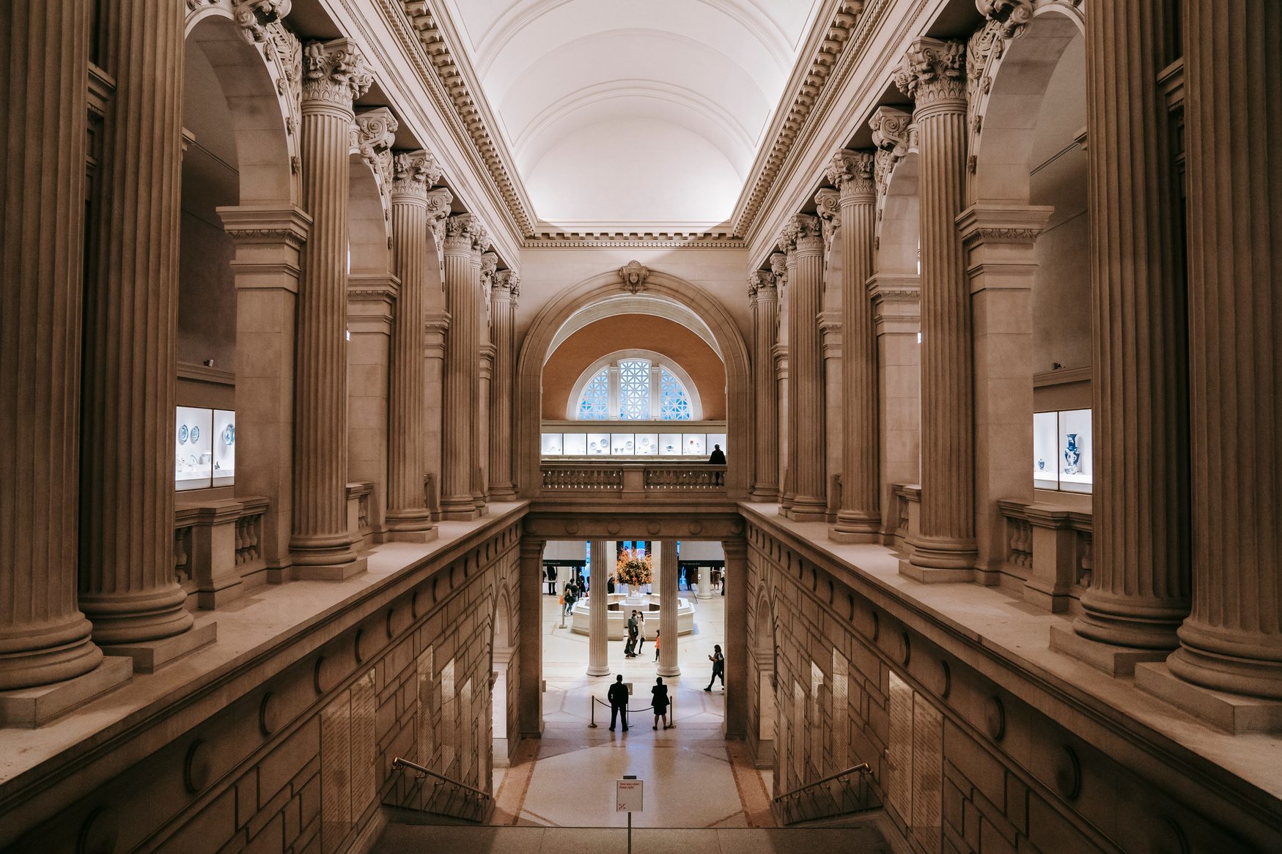
WARNER & SPENCER
WWW.REALLYGREATSITE.COM
Vintage Art and Paintings
Art in vintage museums spans centuries of emotion and expression. Paintings and prints are carefully preserved to retain their colors and detail.
A
known for his intricate patterns and floral motifs, represent the harmony between nature and design, highlighting how aesthetics evolve yet remain timeless.
B

Slide 9
WARNER & SPENCER
WWW.REALLYGREATSITE.COM
Vintage Technology and Innovation
01
02
03
Mechanical Inventions
Early Electrical Devices
Communication Tools
Old technology exhibits celebrate human creativity before the digital age.
Typewriters, telephones, and radios remind us of how innovation built our modern world.
. For example, showcasing the evolution of typewriters—from Remington’s 1873 model

Slide 10
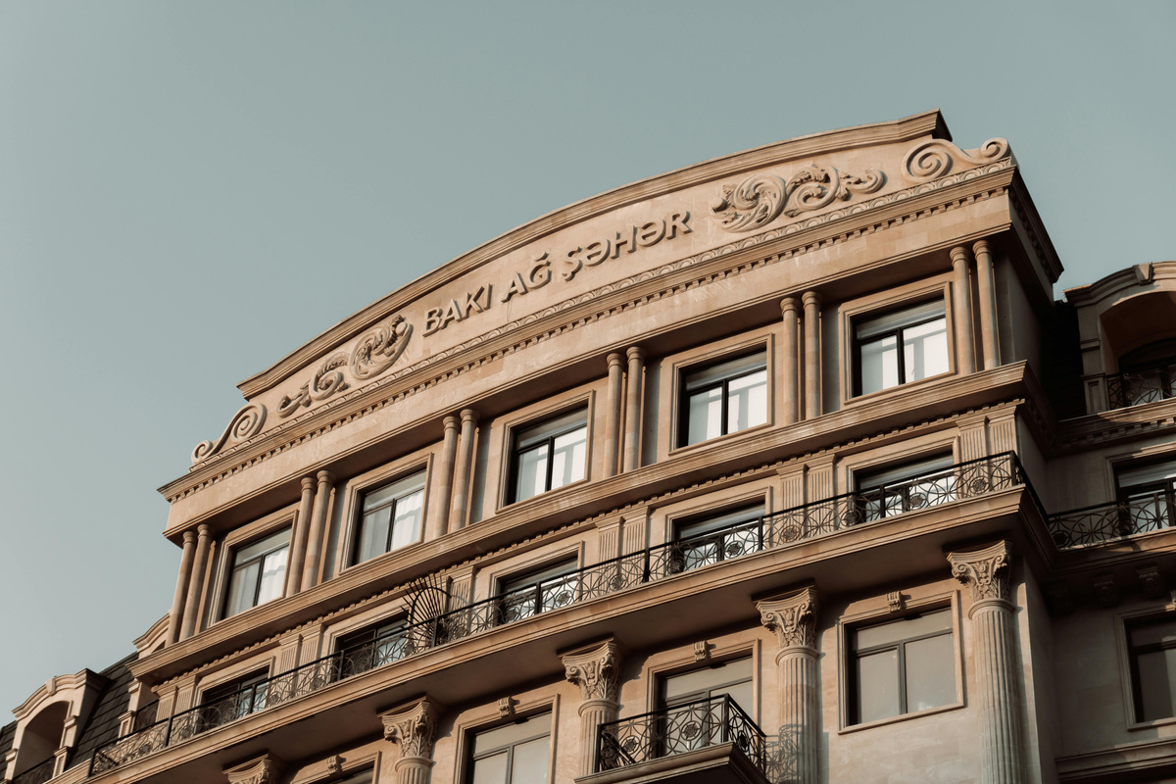
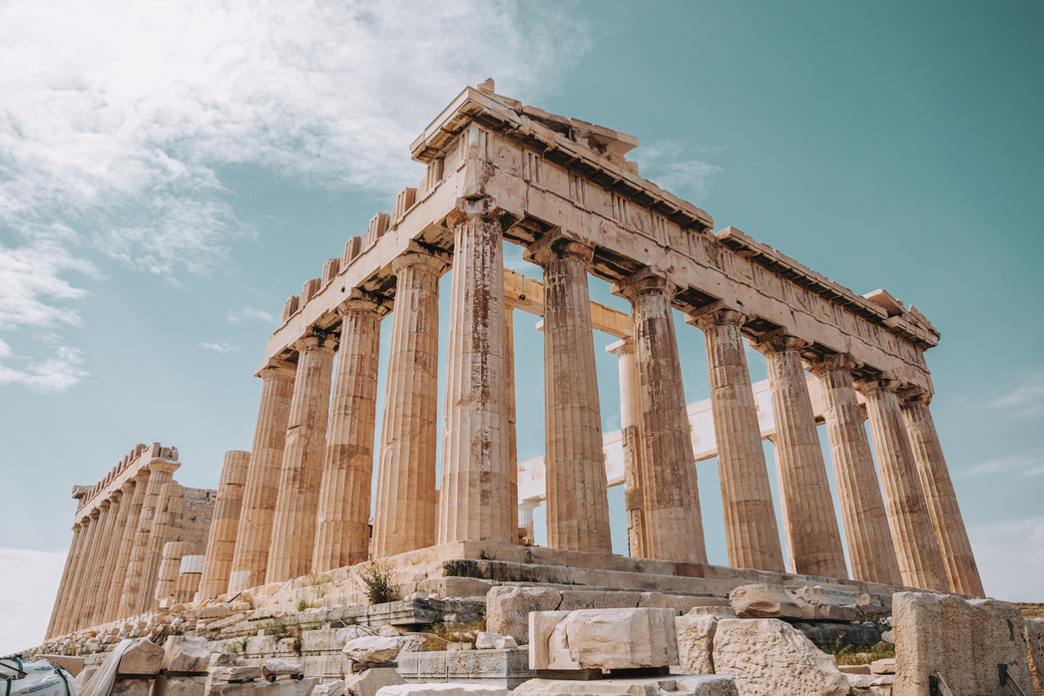
WARNER & SPENCER
WWW.REALLYGREATSITE.COM
Learning from the Past
Through exhibits, stories, and memories, museums remind us that the beauty of vintage lies not in age, but in timeless meaning.
See More
Conclusion: The Timeless Value of Vintage
A vintage museum is more than a display—it’s a dialogue between eras.
Next Slide

Slide 11

WARNER & SPENCER
WWW.REALLYGREATSITE.COM
MUSEUM PRESENTATION
THANK YOU
Vintage Style
See You Next Time
“EVERY PIECE IN A MUSEUM TELLS A TIMELESS STORY.”
PRESENTED BY : SAMIRA

