Slide 1


Affirmative form
I will travel tomorrow.
you will travel tomorrow.
She will travel tomorrow.
He will travel tomorrow.
It will travel tomorrow
we will travel tomorrow.
you will travel tomorrow.
They will travel tomorrow.
Travel

Slide 2
Negative form
I will not travel tomorrow.
you will not travel tomorrow.
She will not travel tomorrow.
He will not travel tomorrow.
It will not travel tomorrow
we will not travel tomorrow.
you will not travel tomorrow.
They will not travel tomorrow.
Travel
will not = won’t

Slide 3
Time expressions:
Next week/ month/ year: I will play a football match next week.
In 10 years: In 10 years, I will be a doctor.
In the future: In the future, there will be swimming cars.

Slide 4
Exercise 1: correct the mistakes:
❌ She will goes to school tomorrow.
2.❌ I will to help you.
3.❌ He will not to come.
4.❌ I will watch the movie yesterday.
✅ She will go to school tomorrow.
✅ I will help you.
✅ He will not come.
✅ I will not watch the movie tomorrow..

Slide 5
Exercise 2: Conjugate the verbs in the brackets.
1. My brother __________ (not watch) TV tonight.❌ (negative)
2. I __________ (call) you when I get home.✅ (affirmative)
3. They __________ (not arrive) before 9 PM.❌ (negative)
4. We __________ (have) pizza for dinner.✅ (affirmative)
5. She __________ (not take) the bus to school.❌ (negative)
6. You __________ (meet) your new teacher tomorrow.✅ (affirmative)
7. Tom and Lucy __________ (not play) football today.❌ (negative)
8. The train __________ (leave) at 6:30.✅ (affirmative)

Slide 6
Exercise 2: Write four activities that you will do next weekend :
For example:
Next weekend, I will play a football match

Slide 7
Affirmative form
Negative form
I will travel tomorrow
You will travel tomorrow.
She will travel tomorrow.
He will travel tomorrow.
It will travel tomorrow
we will travel tomorrow.
you will travel tomorrow.
They will travel tomorrow.
I will not travel tomorrow
you will not travel tomorrow.
She will not travel tomorrow.
He will not travel tomorrow.
It will not travel tomorrow
we will not travel tomorrow.
you will not travel tomorrow.
They will not travel tomorrow.
will not = won’t

Slide 8
Interrogative form
I will travel tomorrow
will I travel tomorrow?
will you travel tomorrow?
will she travel tomorrow?
will he travel tomorrow?
will it travel tomorrow?
will we travel tomorrow?
will you travel tomorrow?
will they travel tomorrow?
Travel

Slide 9
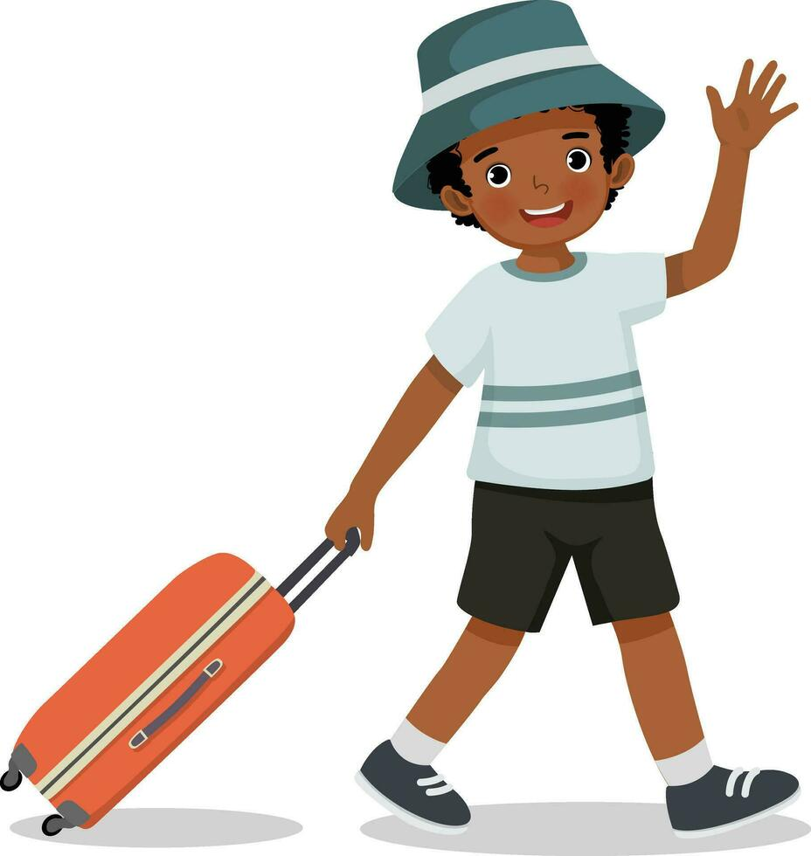
I will travel tomorrow. Goodbye
Will he travel tomorrow?
Yes, he will

Slide 10
Provide positive answers
will I travel tomorrow?
Yes, you will
will you travel tomorrow?
will she travel tomorrow?
will he travel tomorrow?
will it travel tomorrow?
will we travel tomorrow?
will they travel tomorrow?
Yes, I will
Yes, she will
Yes, he will
Yes, it will
Yes, we will
Yes, they will

Slide 11
I will travel tomorrow. Goodbye
Will he travel tomorrow?
Yes, he will
Will he go to school tomorrow?
No, he won’t

Slide 12
Provide negative answers
will I travel tomorrow?
No, you won’t
will you travel tomorrow?
will she travel tomorrow?
will he travel tomorrow?
will it travel tomorrow?
will we travel tomorrow?
will they travel tomorrow?
No, I won’t
No, she won’t
No, he won’t
No, it won’t
No, we won’t
No, they won’t

Slide 13
Question | ✔ Positive answers | ✘ Negative answers
Will I travel tomorrow? | Yes, you will. | No, you won’t.
Will you travel tomorrow? | Yes, I will. | No, I won’t.
Will he travel tomorrow? | Yes, he will. | No, he won’t.
Will she travel tomorrow? | Yes, she will. | No, she won’t.
Will it travel tomorrow? | Yes, it will. | No, it won’t.
Will we travel tomorrow? | Yes, we will. | No, we won’t.
Will they travel tomorrrow? | Yes, they will. | No, they won’t.
.

