Slide 1
One Cent Transportation Surtax
Raises $357 Million/Year
30 Year Referendum Generating $15.6 Billion
Over 30% Paid by Tourists and Visitors

Slide 2
Why a Transportation Surtax was Needed
BCT needed a long-term sustainable funding source for on-going operations and to implement its Community Vision
Transportation programs were funded primarily with gas tax revenues which had not increased in 20 years because more fuel-efficient cars resulted in less gas tax revenue
Many planned Broward transportation projects were deferred during the economic downturn to keep taxes low

Slide 3
Prior Broward County Referendums had Failed
2006 – 1% County-Wide Transportation Surtax Failed with Only 38% of the Vote.
2016 – A Combined Ballot Initiative of ½ % for Transportation Projects and ½ % for Municipal Infrastructure Projects Failed. Both had to Pass to be Enacted, but the Municipal Infrastructure Component was Defeated.
Silver Lining:
  The Transportation Component Passed with 51% of the Vote, Indicating Significant Public Support.

Slide 4
The Problem – Traffic Congestion
Solutions:
Improve Road and Bridge Infrastructure
Enhance Traffic Signal Synchronization
Improve Special Needs Transportation
Identify Rail Corridors
Improve Bus Transportation

Slide 5
2018 “Penny for Transportation” Plan
Collaborative plan with projects in every community
Prioritized connectivity and congestion relief
Dedicated transportation-specific funding; kept in a “locked box” only for that purpose
Independent Oversight Committee manages
Makes us eligible for a larger share of state and federal funds
Minimum of 10% of the tax guaranteed to Municipalities annually
30% of the tax will be provided by visitors

Slide 6
30-Year Transportation Plan Highlights
476 road, traffic, signal, bridge, technology and safety improvements
More than 700 city-requested transportation improvements
Expands the Bus fleet from 355 to 642
Full funding for existing Community Shuttles and expanded service
Full funding for on-demand transportation services for people with disabling conditions (Paratransit)
Designing local transit service intended to offer more reliable, responsive, accessible system
26 miles of light rail and 8 corridors of BRT
East-west and north-south connectivity projects are prioritized, as is the demonstrated ability to reduce congestion

Slide 7
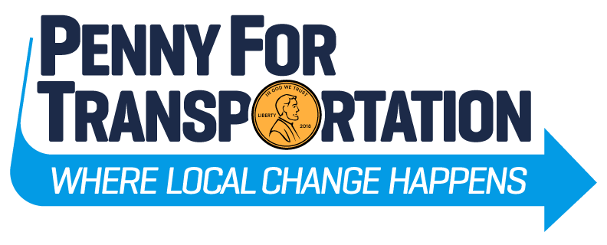
Broward County’s Successful
2018 Surtax Referendum

Slide 8
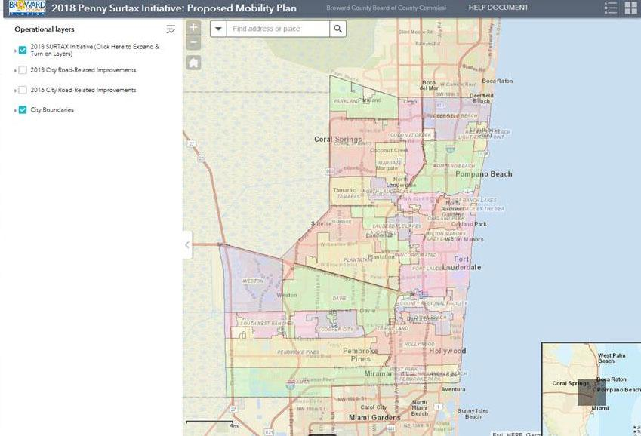
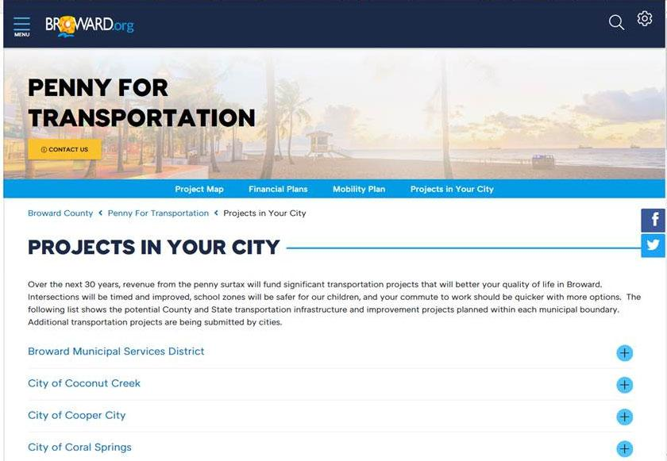
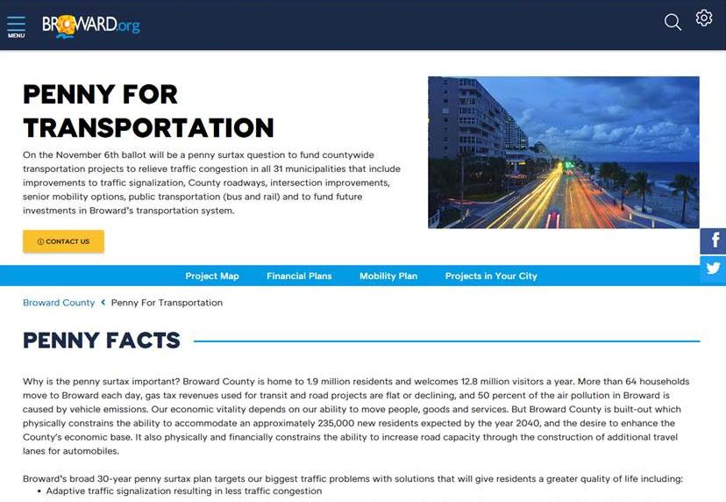
Public
Website

Slide 9
Partnerships
Labor
Faith-Based Community
Homeowners Associations
Broward Workshop (Local Business Alliance) and other Groups formed “Non-Profit” Entities to Fund Advocacy Efforts
Funding Provided for these Efforts from Numerous Local and National Industry Sources
Local Businesses and Organizations Formally Endorsed the Plan

Slide 10
Public Education Efforts
Broward County Staff Participated in a Speaker’s Bureau
Every Participant Received Training on the Educational Message
Centralized Schedule for Speaker’s Bureau Assignments at Community Meetings and Venues
Participation in TV and Radio Shows to “Get the Word Out”
Website “PennyforTransporation.com” Provided Significant Detailed Information on the Investment Plan
Social Media, Videos and Printed Materials focused on the Message
Approximately $300,000 in County Funds invested in the Education Efforts

Slide 11
Protecting the Taxpayer Investment
A 9-member Board (“Oversight Committee”), nominated by 7 independent community entities (“Appointing Authority”), will:
Monitor revenue, expenses, assumptions and forecasts
Evaluate projects for eligibility
Remove politics from the project review process
Track progress milestones
Report on activities and offer transparency to the public

Slide 12
Elements of Success
Public Consensus on the “Problem” – Traffic Congestion
Message – Investments Designed to Mitigate the “Problem”
Detailed Plan of Investments for the Entire Community
Robust Public Education Campaign
Relatively Short Education Period with No Significant Organized Opposition
High Democratic Voter Turnout Bolstered by the Interest in the Gubernatorial and Senatorial Races – Those Same Voters supported Transit and Transportation Improvements
Staffed Voting Sites during Early Voting and on Election Day

