Slide 1


The Purpose and Process for Professional Growth
Principal Professional Learning
Professional Growth and Evaluation Series
September 7, 2022

Slide 2

Shared Norms
Be on time and prepared
Stay engaged
Respect all voices
Assume best intent
Notes:
Time: :30
Presenter Notes: Introduce

Slide 3


Objectives
Provide background information on the new Principal Professional Learning Events
Understanding the purpose and process of PG&E.
Understanding on how PG&E interrelates with coaching and feedback.
Build common vocabulary around professional growth and evaluation.
Notes:
Time:
Presenter Notes: PG&E is often seen as a way of doing/.We want it to be a way of being.

Slide 4
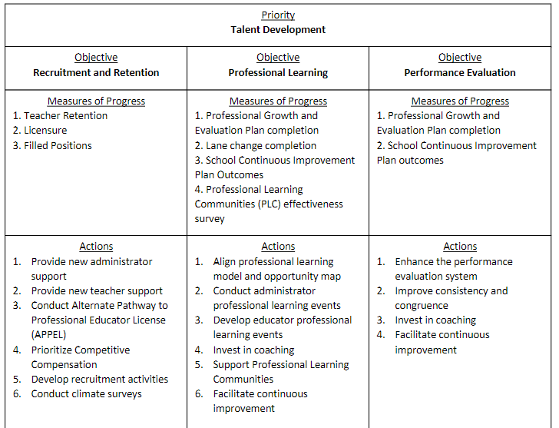
Notes:
Time: 2:00
Presenter Notes:
Connecting Graduate of Granite Strategic plan to the PG&E Principal Professional Learning Series
Importance of Talent Development in building teacher capacity which in turn increases student learning
Investing at all the different levels in coaching
This is the starting point for what we will discuss today.

Slide 5
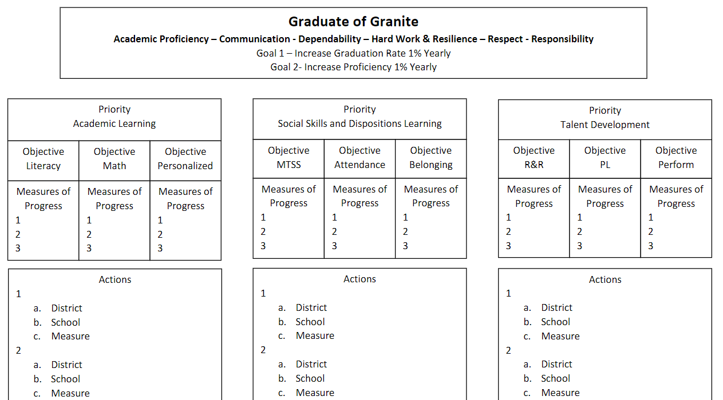
Notes:
Time:3:00
Presenter Notes::
Connecting Graduate of Granite Strategic plan to the PG&E Principal Professional Learning Series - How does this presentation relates to Talent Development focus on the strategic plan

Slide 6
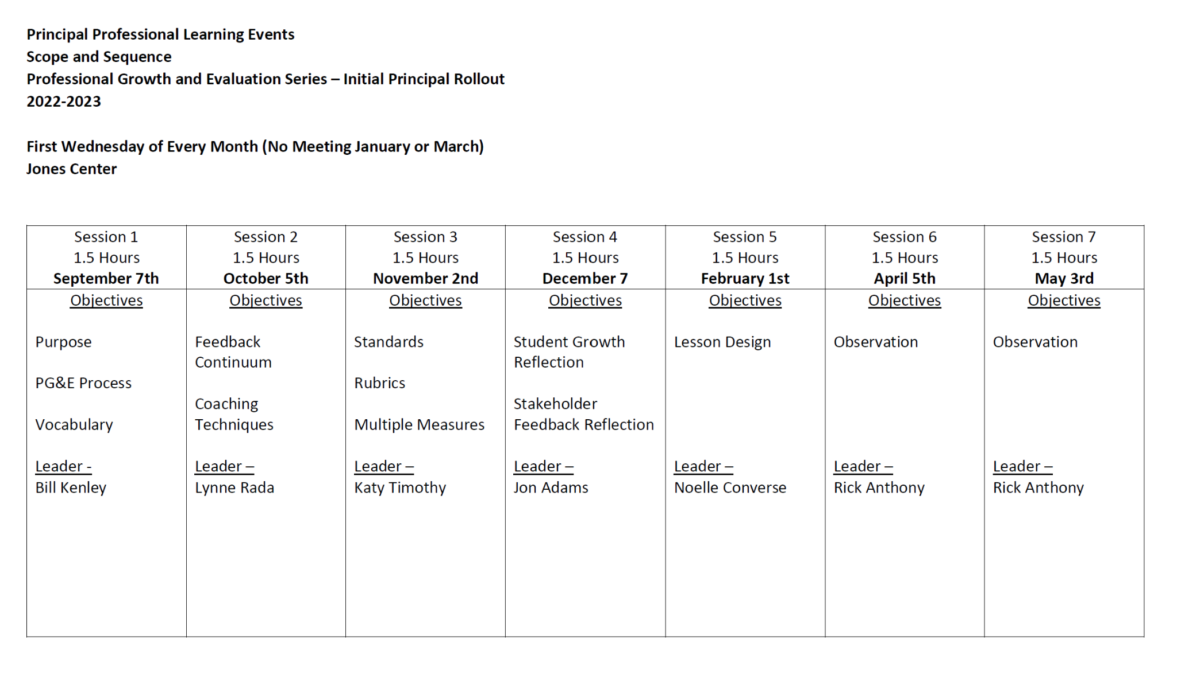

Notes:
Time: 3:00 - 5:00
Notes: This will be the new professional development plan. We have had GWPL. It is not going away. It is a 3rd year sequence. This is a 4th year that will cover our Teacher evaluation process. We have very general standards and because our process is so general it leaves a lot of room for inconsistency. PPL committee has been tasked with looking closely at our evaluation process. It includes someone from each division, GEA Leadership involved. They looked at what other district were doing. Some are to check-list driven and we felt we were to general. We really feel that we need something more specific. The PPL committee decided that these things are the things we need to focus on. Our standards do not really helping us to go into an observation based on those standards. It is just too big.. This new evaluation system will not role out until next year. This is a learning year for Principals and will be introduced to teachers in the spring. So this will take effect in the 23-24 school year.

Slide 7
Domain 2: Collective Commitment to Learning
2A. Continuous Improvement Culture
Builds a professional culture of collaboration, transparency, and responsibility for student learning by encouraging a cycle of planning, performing, analysis of outcomes, and adjusting practice. Personally engages in the improvement cycle by continually deepening understanding and practice related to content standards, assessment, data, capacity building, evaluation, feedback, and professional learning processes.
2B. Human Capital Development
Recruits, hires, places, and retains effective staff members. Builds the capacity of staff through personnel evaluation processes that develop and improve professional practice by providing focus, opportunities to practice, and specific, timely, and actionable feedback.
2C. Instructional Practice
Recruits, hires, places, and retains effective staff members. Builds the capacity of staff through personnel evaluation processes that develop and improve professional practice by providing focus, opportunities to practice, and specific, timely, and actionable feedback.
Leadership Standards
Notes:
Time: 2:00
Presenter Notes::
We really want the activities that revolved around our professional growth process and less about being procedural.

Slide 8
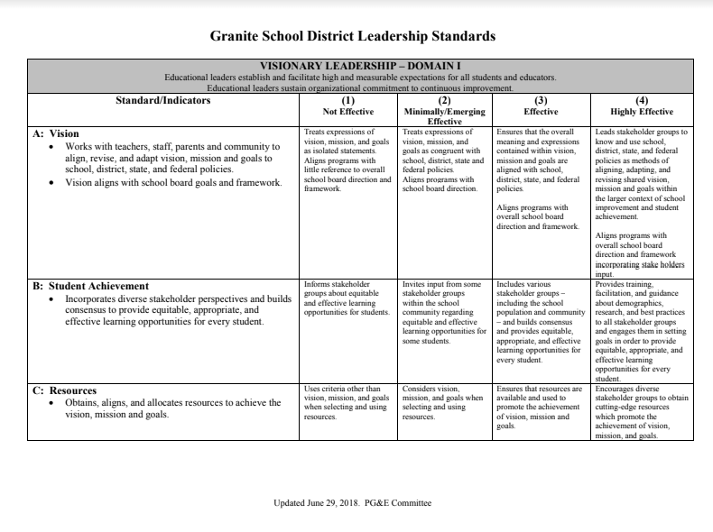
Why do we have standards?
Notes:
Time: 5:00
Presenter Notes: Possible responses:
We as an organization can ensure employees know what is expected of them.
We have indicators to identify when employees need support and what that looks like for them.
Helps us identify the areas of strength and those areas in which we need to focus and grow.

Slide 9
Leadership Standards
Look at the Leadership Standards.
Choose one standard that you feel you are doing really well.
Choose one you could focus on this year to improve and develop.
Be prepared to share with your peers. Please enter your response here
In a group of 4-5 share what you selected and why.
Task 1
Notes:
Time: 8:00
Presenter Notes:
We may want to have highlighters are each table and the Leadership standards.
(Discuss as a whole group - Share results from Google Form)

Slide 10
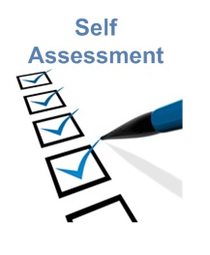
Self Assessment
What do we learn from a self-assessment…
Please enter your responses here on the Padlet
Notes:
Time: 10:00
Presenter Notes: Where our current performance stands in relation to our standards.
Please click on the link and enter your thoughts on why Self-Assessment is an important piece when looking at professional growth.

Slide 11

Develop a Plan …
Notes:
Time: 10
Think of two specific things that you can do to improve your performance. Your plan should focus on utilizing your strength, and improving one area of weakness. What are you going to do to utilize your strength? What would you hope to see if you used this strength to improve your performance? What will you do to improve your area of weakness? What would you hope to see if you were able to improve in this area?
Share your plan with your group.

Slide 12

Taking Action
Add visual
Develop an action plan:
What am I going to do?
What help do I need to to this?
How will I monitor my progress?
How will I prove I have accomplished it?
How will it affect my performance?
Notes:
Time:
Presenter Notes :
Take a minute and reflect on your progress regarding these questions.
What are some things that we do to ensure that we follow through with our action plans we set. Could share examples that are not connected to our role as a school leader? (Diet plans, completing a home improvement project, learning to tile a shower) What gets me to do it?
I told someone I was going to do it. Or I write it down.

Slide 13
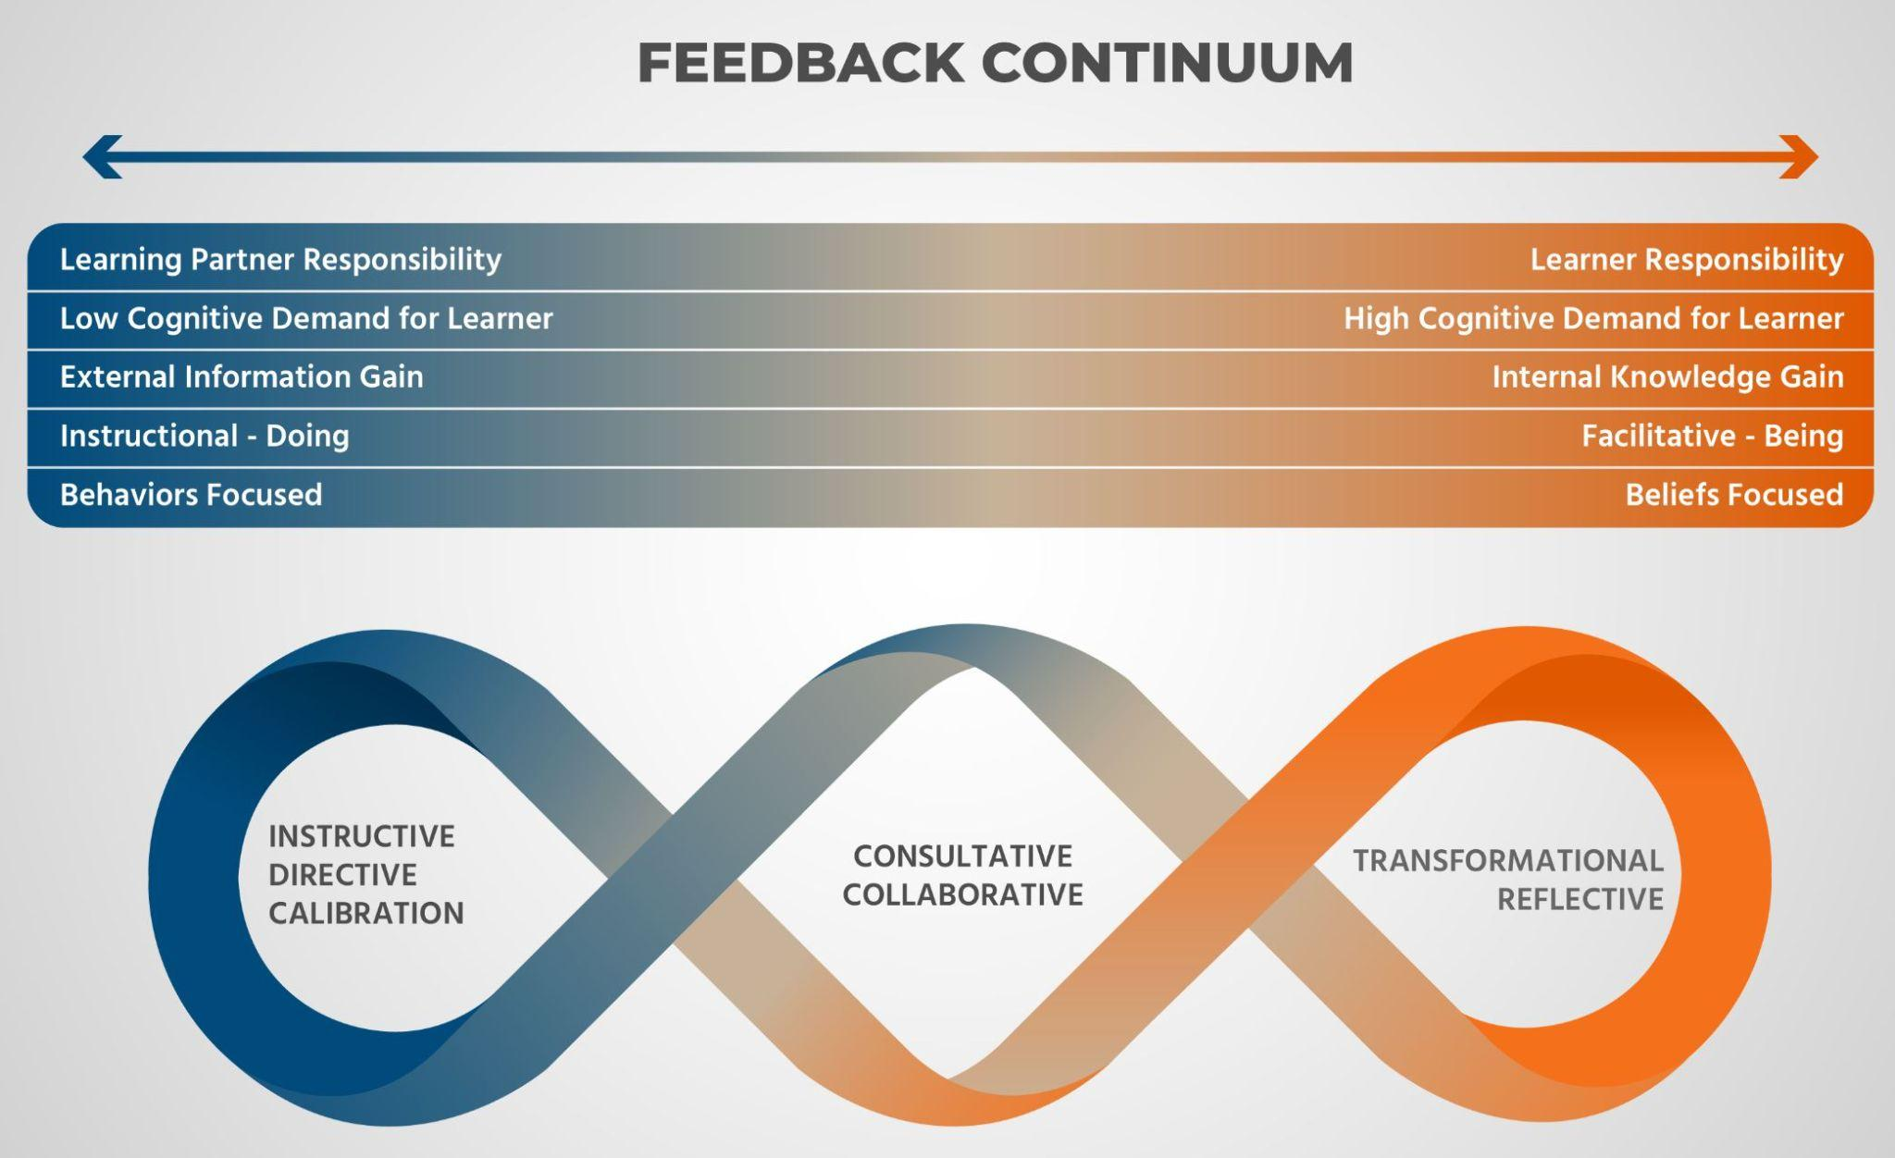
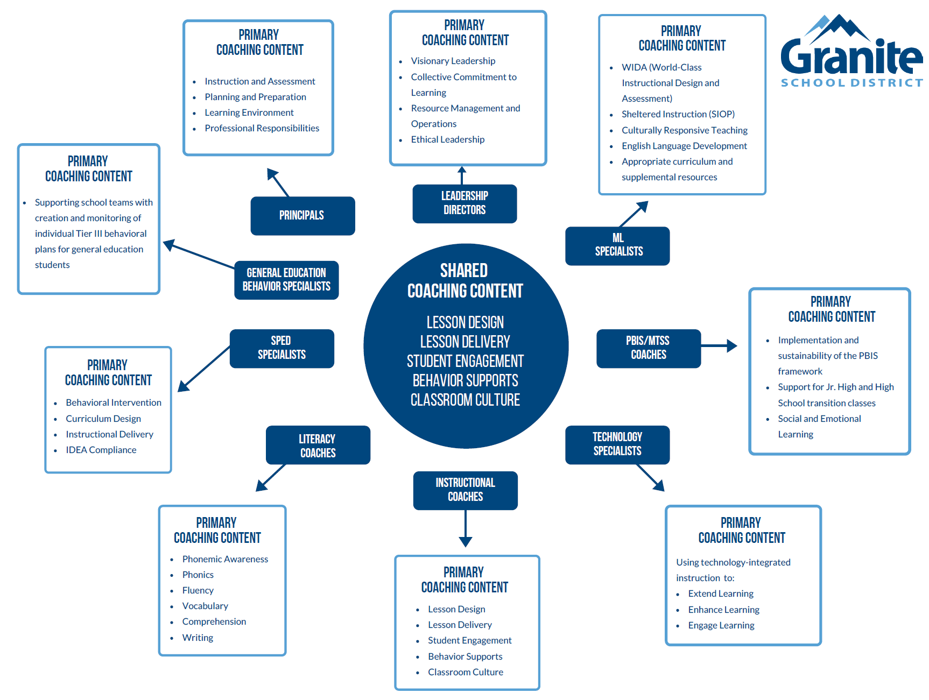
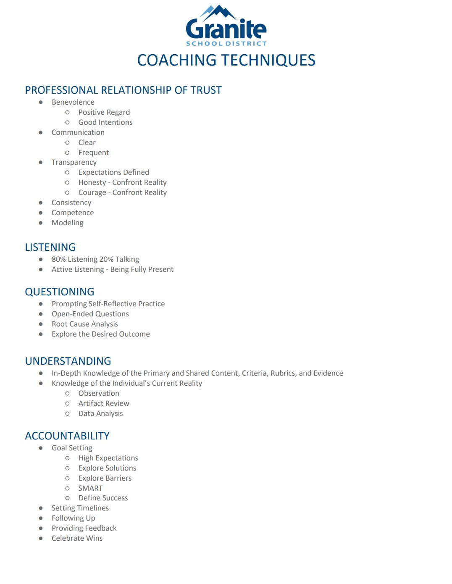
Coaching in Granite
Notes:
Time: 2:00
Presenter notes:
We are going to focus on this coaching piece in more depth during the October Principal Professional Learning session.

Slide 14

Stand, walk, find a partner, share…
Does this process sound like something we do in Granite?
Notes:
Time:
Presenter Notes:

Slide 15
PG&E IS A GROWTH PROCESS!
THIS SHOULD BE A MEANINGFUL PROCESS THAT WILL GUIDE EACH EDUCATOR’S INDIVIDUAL GROWTH.
Notes:
It’s not a thing of doing it is a thing of being.

Slide 16
Beginning of Year
Self-Assessment
Beginning of year meeting with administrator
Coaching Techniques: Relationship of Trust, Listening, Questioning
Create goals in collaboration with your administrator and related to the self-assessment
Coaching Techniques: Relationship of Trust, Listening, Questioning
Determine lines of evidence
Coaching Techniques: Understanding, Accountability
Notes:
We will be going in depth on coaching techniques in October
Stakeholder Goals and student growth reflection will be presented in December

Slide 17
Mid-Year Reflection
Teachers reflects on progress of the goals and enter response into Frontline.
Teacher determines if additional support is needed.
Administrator provides feedback and offers additional supports if needed.
Coaching Techniques: Relationship of Trust, Listening, Questioning, Understanding

Slide 18
End of Year
Compile data and lines of evidence
Coaching Techniques: Understanding & Accountability
Review and conference with the teacher
Utilize Granite Coaching Techniques and Feedback Continuum
Completion of Summative or Formative Evaluation Summary
Notes:
Time: 3:00
Presenter notes:
We are going to want to emphasize that every year there will be evaluation by your administrator. If it is formative, we will meet at the end of the year to complete a end of year evaluation of all of the teaching standards just as we do with summative evaluations. The only difference in the form is that it will not have the two check boxes for continued employment. The end of year formative evaluation form will be added to frontline this year.

Slide 19
May - June
End of year goal review and administrator assessment.
Timeline
January - May
Collect lines of evidence (observations) and feedback on practice
Provisional teachers due March 15
Formative teachers due May 15
August
Self-Assessment
Coach/provide feedback
Collaboratively create goals and action plan
November 15
Provisional evaluations
October -November
Collect lines of evidence (observations) and provide feedback on practice
January
Mid-year reflection
March - May
End of Year formative and summative evaluations
Notes:
Time:
.

Slide 20

Looking at Professional Growth from the lens of others:
Lisa Wells
Jen Johnson

Slide 21
How did I get here?
Sometimes the greatest PD is the teacher down the hall.
–Brian Aspinall
Effect size of Teacher Professional Development-namely observation of classroom methods, microteaching, feedback, and practice–.61
Notes:
As a new admin, Bill led my cadre through this process of completing our PG and E and it radically changed the way I thought about setting goals. Over the course of the year, I reflected on this process and the things I know about motivation and leadership.

Slide 22
Talent Development Priority-85% of non-retiring Granite teachers will be retained.
Our strengths are great resources for increasing our energy and making us feel dynamic. It’s not uncommon to lose track of time when focusing on areas where our strengths shine-it’s an experience you may recall from your youth. Usually, these are remembered as joyful moments. The result of putting our strengths into what we are doing is joy.
So why do we accept the loss of joy?
–Elif Suner, Forbes.com
Notes:
Consider your hobbies and things you like to do. Why don’t you burn out of doing those things? Even if they are hard?

Slide 23
Mindset
Leveraging a strength based approach
Employees see supervisors as resources that bring motivation, success, and life into the workplace
Developing awareness of competencies soaks into culture

Slide 24
At Elk Run We…
Post our strength-based goals outside our doors
The idea is that we can see each other’s strengths and utilize them (Hattie)
Focus on goals during walk-throughs and observations
Teachers have some accountability here, not all responsibility is on admin
Post our goals in public places
School CIP goals and TSI areas are clearly posted
Every adult in the building posts their goals
Are invested in our collective achievement and celebrate it!

