Slide 1
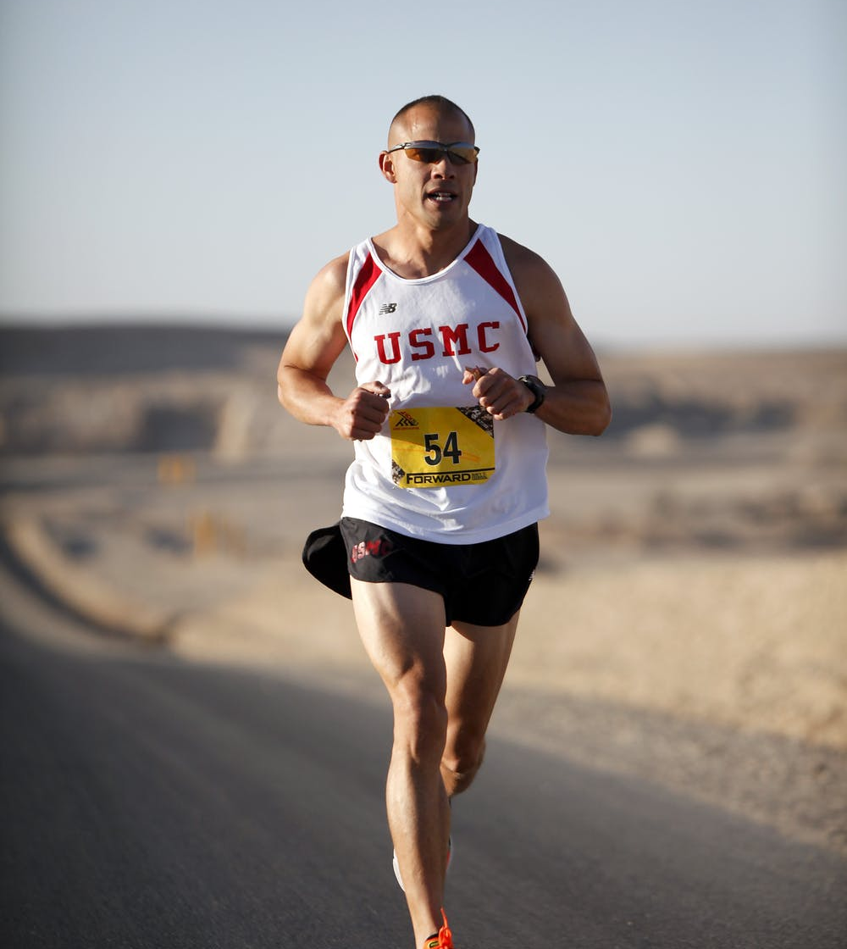
PORTFOLIO
PRESENTATION
MARATHON
Free Template
We Create Quality
Professional PPT Presentation

Slide 2
Table of contents
1
2
3
Bikes
Here you could describe the topic of the section
League of US bicyclists
Here you could describe the topic of the section
Benefits of bicycling
Here you could describe the topic of the section

Slide 3
We'll be celebrating ways to bike
Do you know what helps you make your point clear? Lists like this one:
They’re simple
You can organize your ideas
You’ll never forget to buy milk!
And the most important thing: the audience won’t miss the point of your presentation

Slide 4
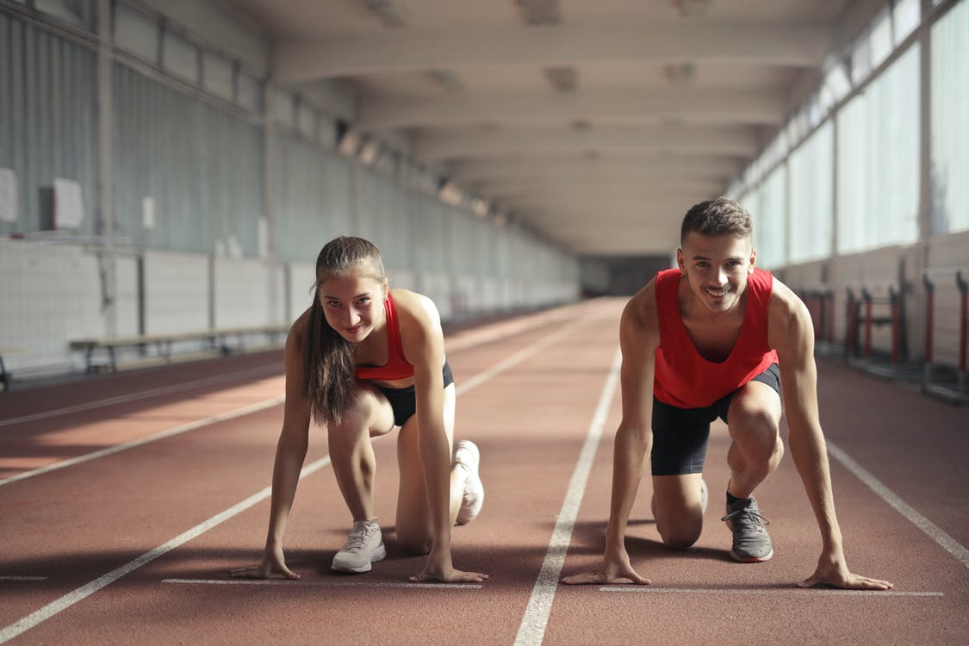
—Someone famous
We'll be celebrating ways to bike
“This is a quote. Words full of wisdom that someone important said and can make the reader get inspired”

Slide 5
Women bike
The initiative
Join our community
Mercury is the closest planet to the Sun and the smallest one in the Solar System
Venus has a beautiful name and is the second planet from the Sun. It’s terribly hot

Slide 6
Whoa!
It could be the part of the presentation where you can introduce yourself. Keep it short and go straight to the point. Your audience will appreciate that

Slide 7
You could use three columns, why not?
Mercury
Mercury is the smallest planet of them all
Venus
Venus has a beautiful name, but it’s very hot
Saturn
Yes, this is the ringed planet. It’s a gas giant

Slide 8
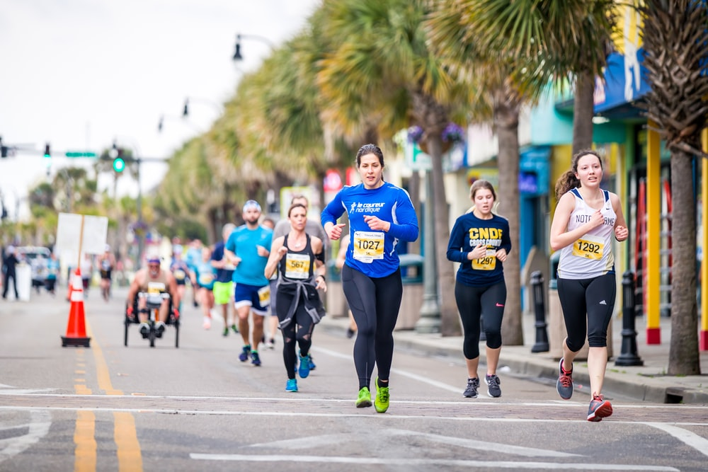
A picture is worth a thousand words

Slide 9
A picture always reinforces the concept
start
End
Images reveal large amounts of data, so remember: use an image instead of long texts

Slide 10

Awesome words
Because key words are great for catching your audience’s attention

Slide 11
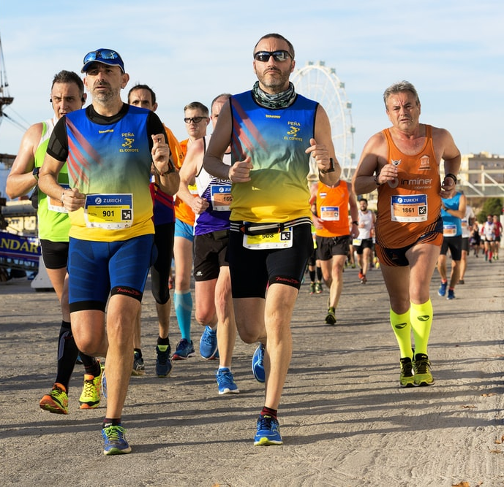
The growth of bike commuting
Non-bicycle communities: 31%
Venus has a beautiful name
All of United States: 62%
Despite being red, Mars is a cold place
Bicycle communities: 105%
Jupiter is the biggest planet

Slide 12
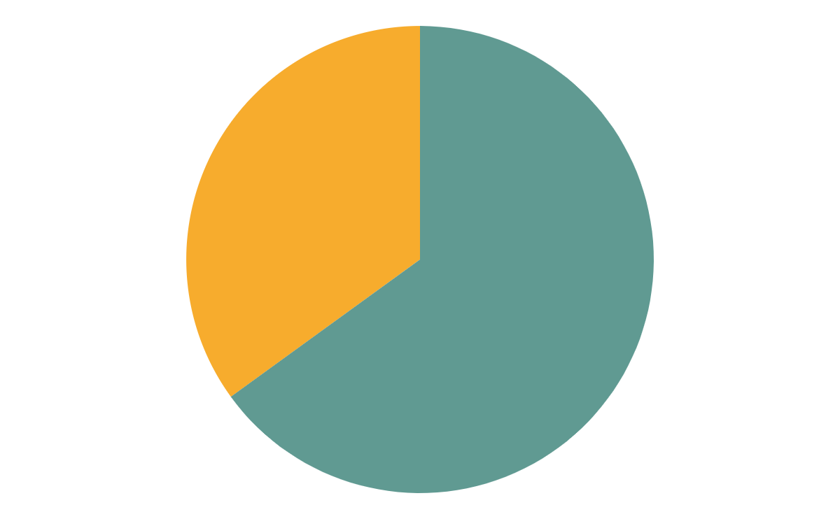
The number of bicyclists is growing rapidly
35%
65%
Non bicyclists
Despite being red, Mars is a cold place
New national users
Mercury is the closest planet to the Sun
If you want to modify this graph, click on it, follow the link, change the data and replace it

Slide 13
How do we do that?
Board
Staff
Operations
Mercury is the closest planet to the Sun
Venus has a beautiful name, but it’s very hot
Despite being red, Mars is a cold place
Communications
Research
Yes, this is the ringed planet. It’s a gas giant
It’s the biggest planet in the Solar System

Slide 14
1
Run
You can enter a subtitle here if you need it

Slide 15
Equity, diversity & inclusion
Diversity
Despite being red, Mars is cold
Equity
Venus has a beautiful name
Inclusion
Diversity
Jupiter is the biggest planet
Despite being red, Mars is cold

Slide 16
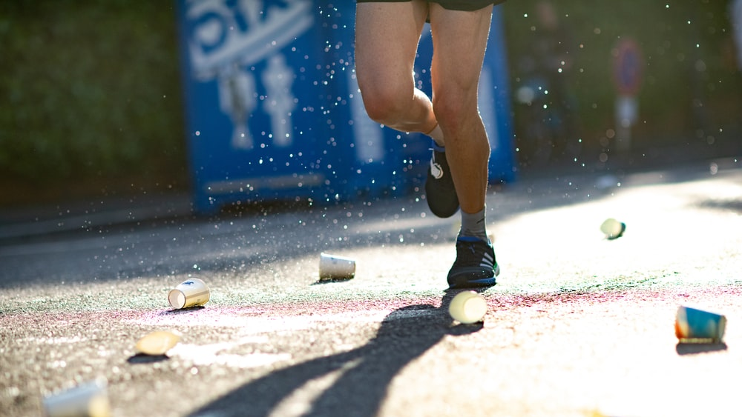
A PICTURE ALWAYS REINFORCES THE CONCEPT

Slide 17
#MARATHONFREE
Mercury is the closest planet to the Sun and the smallest one in the Solar System. The planet's name has nothing to do with the liquid metal, since Mercury was named after the Roman messenger god

Slide 18
A timeline always works fine
1
2
3
4
It’s composed mostly of gases
Earth is the planet we live on
Despite being red, Mars is a cold place
Venus has a beautiful name

Slide 19
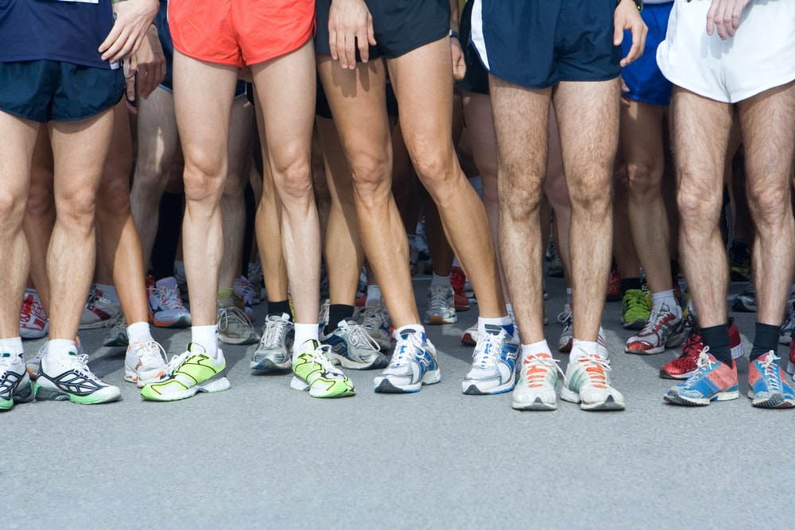
4,498,300,000
Big numbers catch your audience’s attention

Slide 20
333,000.00
24h 37m 23s
386,000 km
Bicycle friendly communities
Hours by bicycle per person
The total distance by bicycle

Slide 21
Our team
John James
Jane Doe
Here you can talk a bit about this person
Here you can talk a bit about this person
Jennifer Patterson
Jack John
Here you can talk a bit about this person
Here you can talk a bit about this person

Slide 22
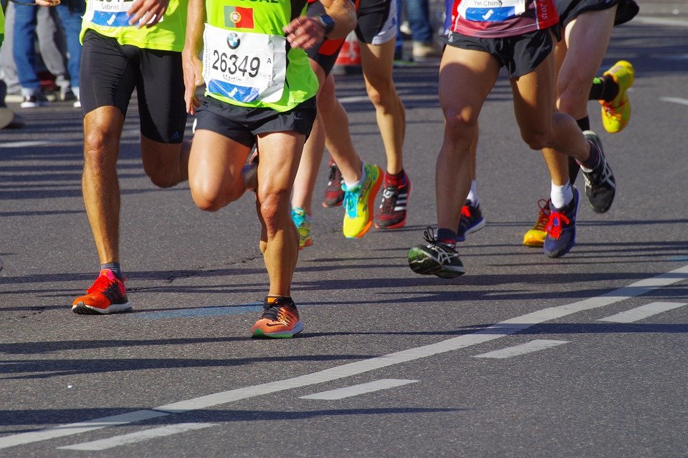
Run Free
Mercury is the closest planet to the Sun and the smallest one in the Solar System

Slide 23
Recommendations
Join our community
Prepare your bicycle with time
Choose your best route to ride
Mercury is the closest planet to the Sun
Venus has a beautiful name, but it’s very hot
Despite being red, Mars is a cold place

Slide 24
How to prepare your bike
1
2
Saddle area
Mercury is the closest planet to the Sun
Wheels
Venus has a beautiful name, but it’s very hot

Slide 25
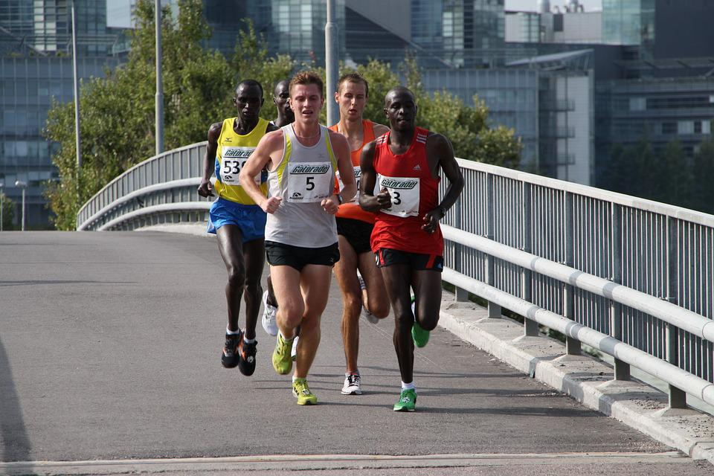
Multimedia
Insert your multimedia content here

Slide 26
Our best experiences
66 Route
Mercury is the closest planet to the Sun
East Coast
Venus has a beautiful name, but it’s very hot

Slide 27
Why being part of our community
Exclusive chat
Dedicated groups
Customized routes
Monthly bicycle checking
National community
Bike accessories
Special discounts

Slide 28
National bicycle communities
San Francisco
Venus has a beautiful name, but it’s very hot
New York
Los Angeles
Mercury is the closest planet to the Sun
Despite being red, Mars is a cold place

Slide 29
Thanks
Do you have any questions?
addyouremail@example.com
+91 620 421 838
Domain.com
Free Template

Slide 30
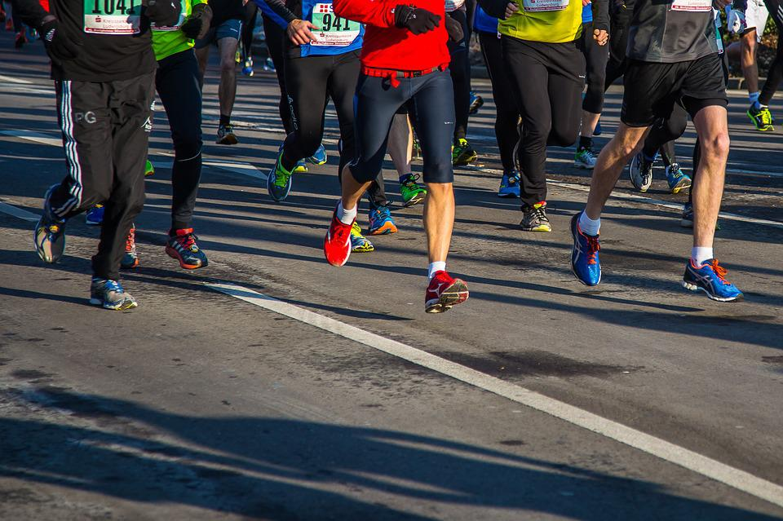
MARATHON
Mercury is the closest planet to the Sun and the smallest one in the Solar System. The planet's name has nothing to do with the liquid metal, since Mercury was named after the Roman messenger god

Slide 31
FUENTE
ELABORADO POR :
plantillaspowerpoint.org
IMAGES :
unsplash.com
pixabay.com
FONTS :
Bree Serif
Kanit Light

Slide 32
RESOURCES

Slide 33
RESOURCES

Slide 34
Fully Editable Icon Sets: A

Slide 35
Fully Editable Icon Sets: B

Slide 36
Fully Editable Icon Sets: C

