Slide 1



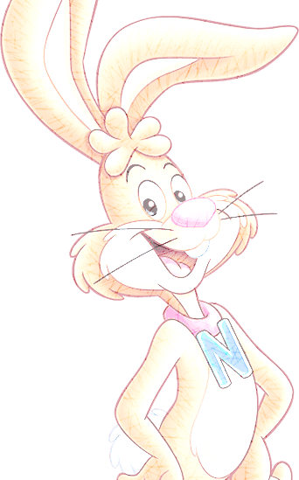
Plantillaspowerpoint.org
Get a modern PowerPoint Presentation that is beautifully designed. I hope and I believe that this Template will your Time.

Slide 2


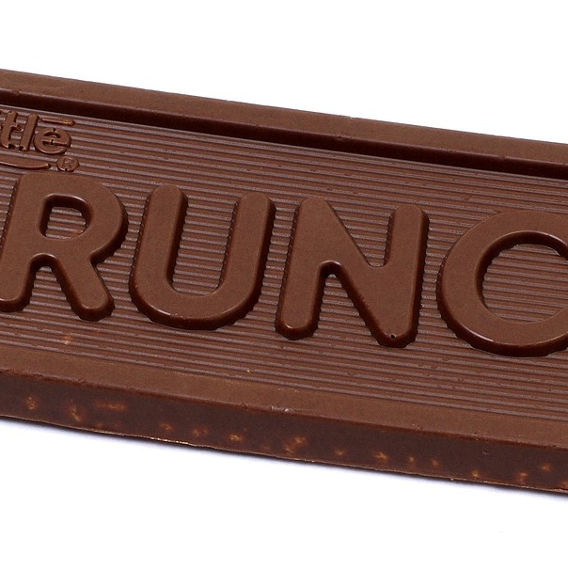
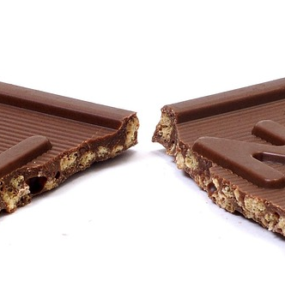
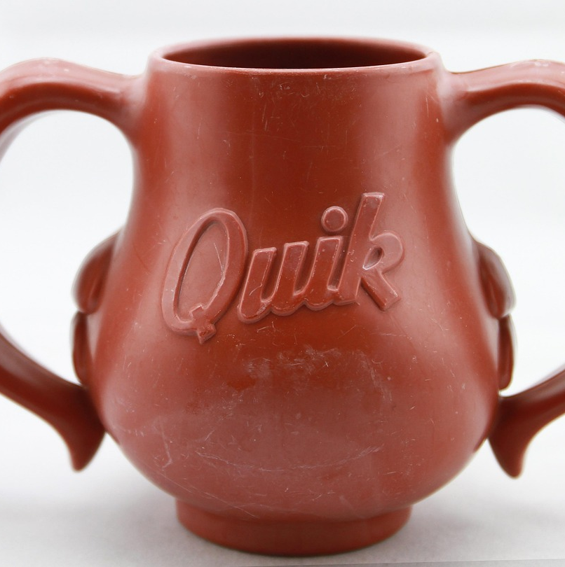
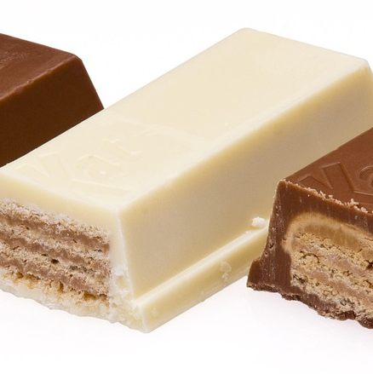
The layout, these basic qualities along with the (Your Company) colors, are consistent with the overall look and helps to reinforce the (Your Company) brand. This letterhead design is meant to project an image of professionalism and reliability.
SECTION BREAK
CREATIVE PRESENTATION

Slide 3



Layout Clean Text Slide
products
01
I hope and I believe that this Template will your Time, Money and Reputation.
Easy to change colors, photos and Text.
Layout Clean Text Slide
02
I hope and I believe that this Template will your Time, Money and Reputation.
Easy to change colors, photos and Text.
Layout Clean Text Slide
03
I hope and I believe that this Template will your Time, Money and Reputation.
Easy to change colors, photos and Text.
Layout Clean Text Slide
04
I hope and I believe that this Template will your Time, Money and Reputation.
Easy to change colors, photos and Text.

Slide 4
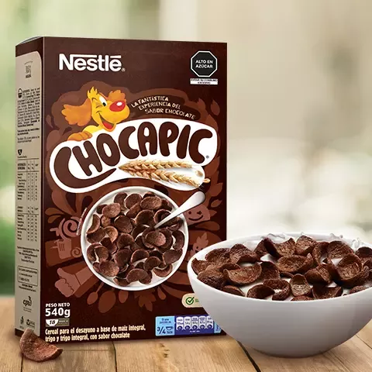
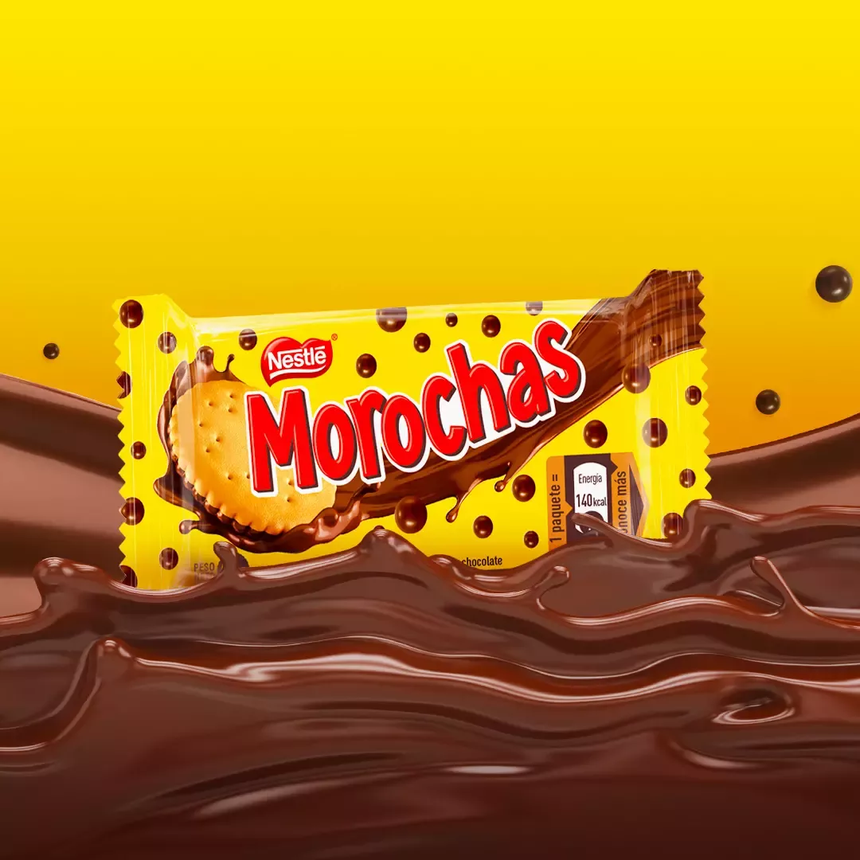
products
The layout, these basic qualities along with the (Your Company) colors, are consistent with the overall look and helps to reinforce the (Your Company) brand. This letterhead design is meant to project an image of professionalism and reliability.
The layout, these basic qualities along with the (Your Company) colors, are consistent with the overall look and helps to reinforce the (Your Company) brand. This letterhead design is meant to project an image of professionalism and reliability.

Slide 5
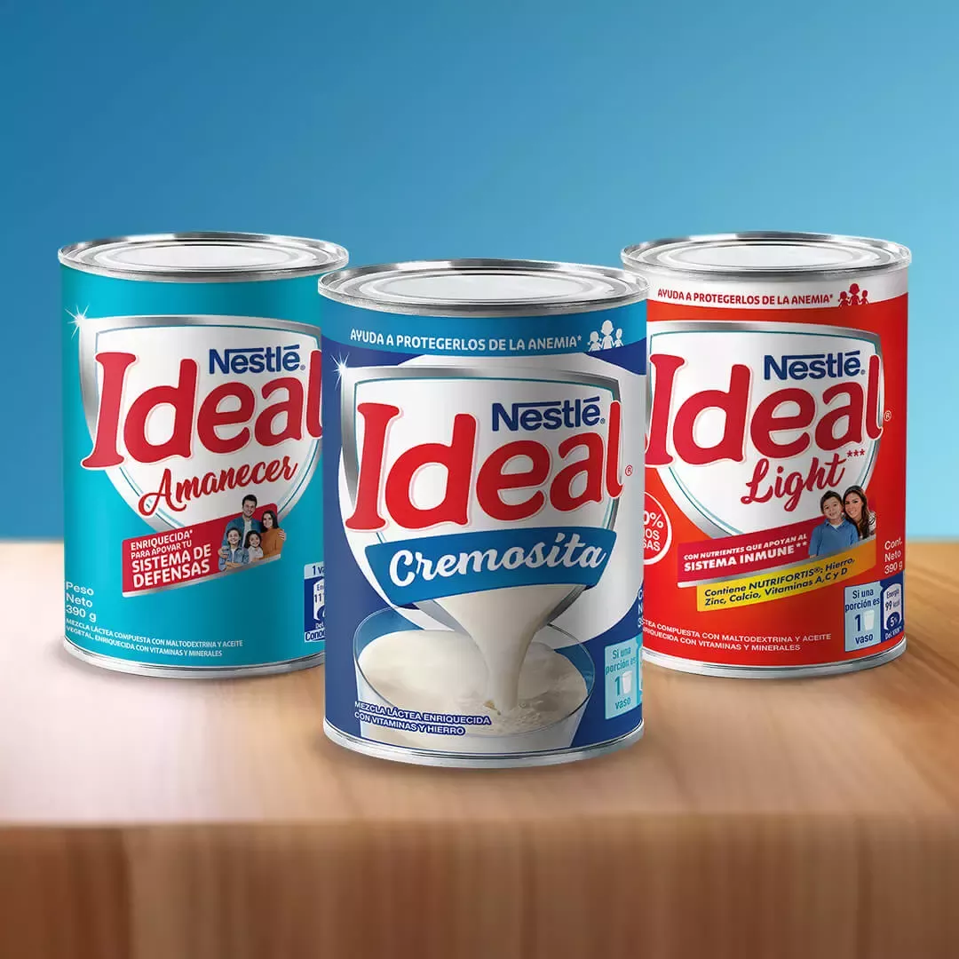
products
About products
We start the list with what is possibly the most iconic dish in the country. And it is that nobody can resist the fresh flavor of a good plate of ceviche. Made with fish and, depending on taste, shellfish, it is bathed with citrus seasonings that only enhance the flavor.
Ceviche is definitely one of those dishes that once you try it, you will want to repeat it over and over again.

Slide 6
Simply Presentation
Lo primero que debes hacer para poder elaborar la receta fácil de ceviche peruano es exprimir los 12 limones para extraer su jugo, resérvalo para más adelante. Luego, corta el pescado en trozos de 3 centímetros, aproximadamente. Coloca los trozos en el recipiente que vayas a utilizar para servir el plato.
Simply Presentation
Mezcla el pescado con el ají amarillo picado, el caldo de pescado y el cilantro. Coloca también la cebolla cortada en julianas y el ajo machacado. Déjalo reposar unos minutos para que se marine bien e se impregne de todos los sabores.
Salpimienta al gusto y coloca a un lado del plato el camote sancochado, la lechuga y el maíz tierno también hervido.
Simply Presentation
Después, vierte el zumo de limón por todo el plato de manera que quede todo bien cubierto. Por último, corta una lámina de ají limo rojo y colócala a modo de decoración. Resérvalo en el frigorífico para que se enfríe, puesto que este es un plato que se sirve frío. El ceviche peruano es un plato que actúa como aperitivo, por lo que puedes acompañarlo con un arroz con camarones o un delicioso salmón con salsa de gambas. ¡Listo para comer!

Slide 7

About professional products
Now we turn to a dish loved by all Peruvians and that we undoubtedly recommend to anyone visiting our country for the first time. As its name indicates, the loin is pan-fried until it is properly cooked, together with a little vinegar and some spices, and then it is accompanied by French fries and rice.
The Lomo Saltado is a dish whose origin dates back to the arrival of the Chinese-Cantonese in Peru from the 19th century, who finished perfecting this exquisite dish that palates from all over the world seek to try as soon as they set foot on Peruvian soil.
300
2.6M
Have them for one. Living grass to for can't
Have them for one. Living grass to for can't

Slide 8
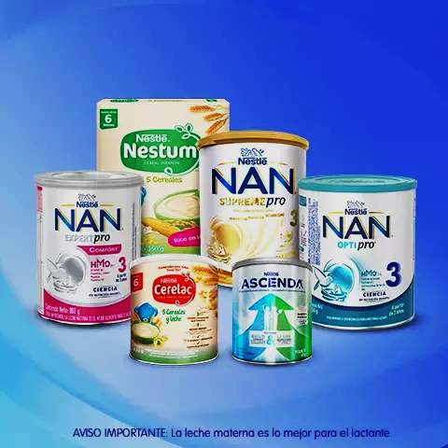
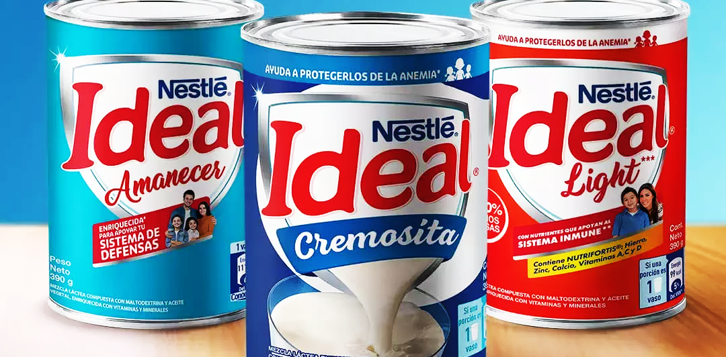
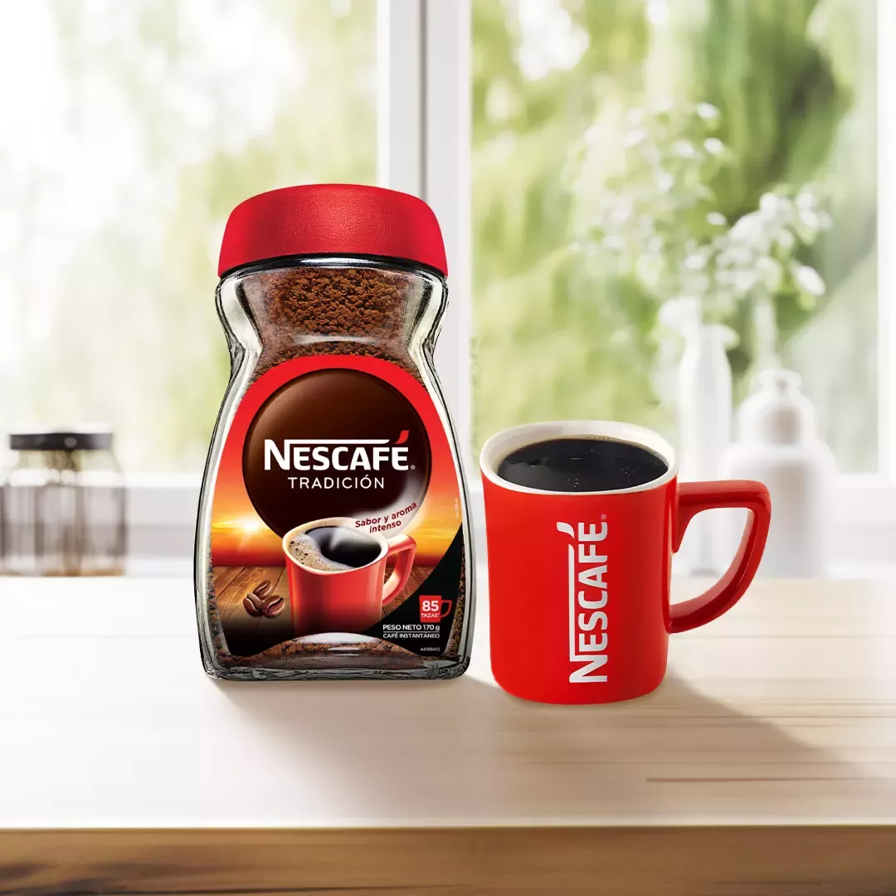
Corta el lomo en cubos de 2 cm por 2 cm, tal y como se muestra en la imagen. El lomo saltado peruano también puede hacerse con la carne cortada en tiras, ya que ambas formas son correctas.
Trocea la verdura, es decir, pica finamente el diente de ajo, cortar la cebolla y los pimientos en tiras y tomates en cubo.
En una sartén a fuego fuerte, saltea el ajo con el lomo hasta dorar la carne por fuera, de manera que quede jugosa por dentro.
Añade al lomo saltado los pimientos y la cebollas y sigue cocinando estos ingredientes hasta alcanzar el punto de cocción deseado. Salpimienta al gusto.
Pasados unos minutos, agrega el vino blanco y el vinagre. Deja reducir el alcohol, añade los tomates y remueve. Finalmente, incorpora la salsa de soja, integra y sirve

Slide 9
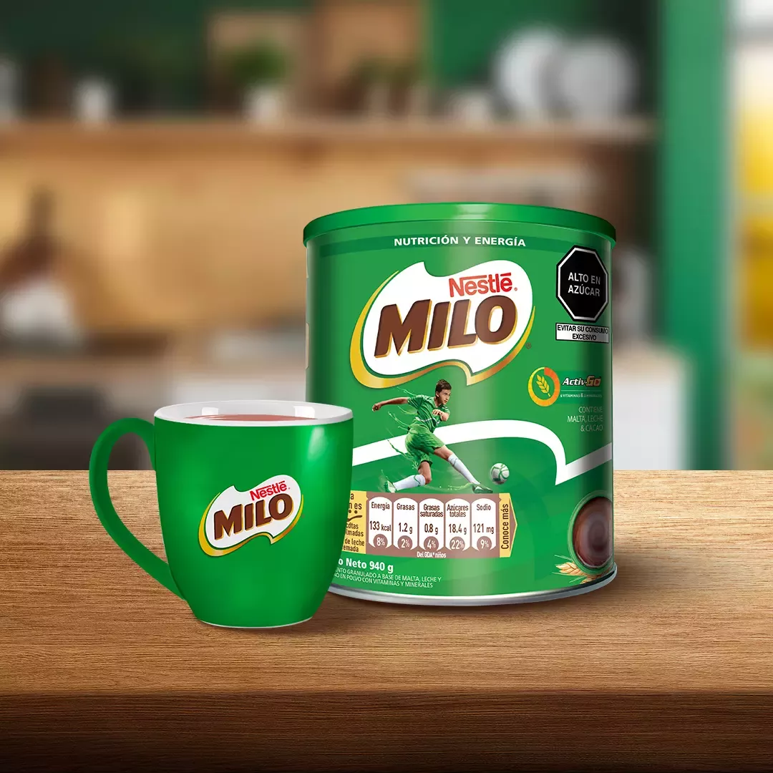
About milo
Adding strength to this list, we have Ají de Gallina. A dish that consists of a cream with frayed chicken breast and accompanied by cooked potato or white rice. It should be noted that whenever this dish is served at the table, it receives the highest praise from those who try it.
Ají de Gallina is without a doubt one of those dishes that anyone who plans to attend or be close to the celebrations of the Lima 2019 Pan American Games should try.
HEADING ISMEANT TO PROJECT TEXT HERE
LETTERHEAD DESIGN ISMEANT TO PROJECT

Slide 10
To be honest, no Peruvian food list is complete without mentioning the already famous Causa Limeña. This dish is made from yellow potatoes (one of the more than 3,000 types of potatoes that exist in Peru) and its layered presentation draws attention.
Of course, thanks to that touch of lemon that every Peruvian knows, the flavor of this renowned dish conquers kitchens, tables, and hearts.
Our list could not be complete without mentioning Tacu Tacu, a Creole dish that consists of cooked rice, menestras and a yellow chili sauce. Which are mixed until a dough is obtained under the heat of the pan.
Tacu Tacu is a dish that conquers more palates around the world.
The layout, these basic qualities along with the (Your Company) colors, are consistent with the overall look and helps to reinforce the (Your Company) brand.
morochas
chocapic

Slide 11
About Nescafé
The layout, these basic qualities along with the (Your Company) colors, are consistent with the overall look and helps to reinforce the (Your Company) brand. This letterhead design is meant to project an image of professionalism and reliability.
1
3
Content Here
Content Here
You can simply impress your audience and add a unique zing and appeal to your Presentations.
You can simply impress your audience and add a unique zing and appeal to your Presentations.
2
4
Content Here
Content Here
You can simply impress your audience and add a unique zing and appeal to your Presentations.
You can simply impress your audience and add a unique zing and appeal to your Presentations.

Slide 12
About milk ideal
Added to the list is a dish that is loved by many, the Aguadito. Which consists of a thick chicken soup with rice and other vegetables. Of a green color due to the significant use of coriander in the soup, it is traditionally consumed in winter.
In short, Aguadito is a dish that cannot be missing from the list of anyone who wants to try the best of Peruvian food.

Slide 13
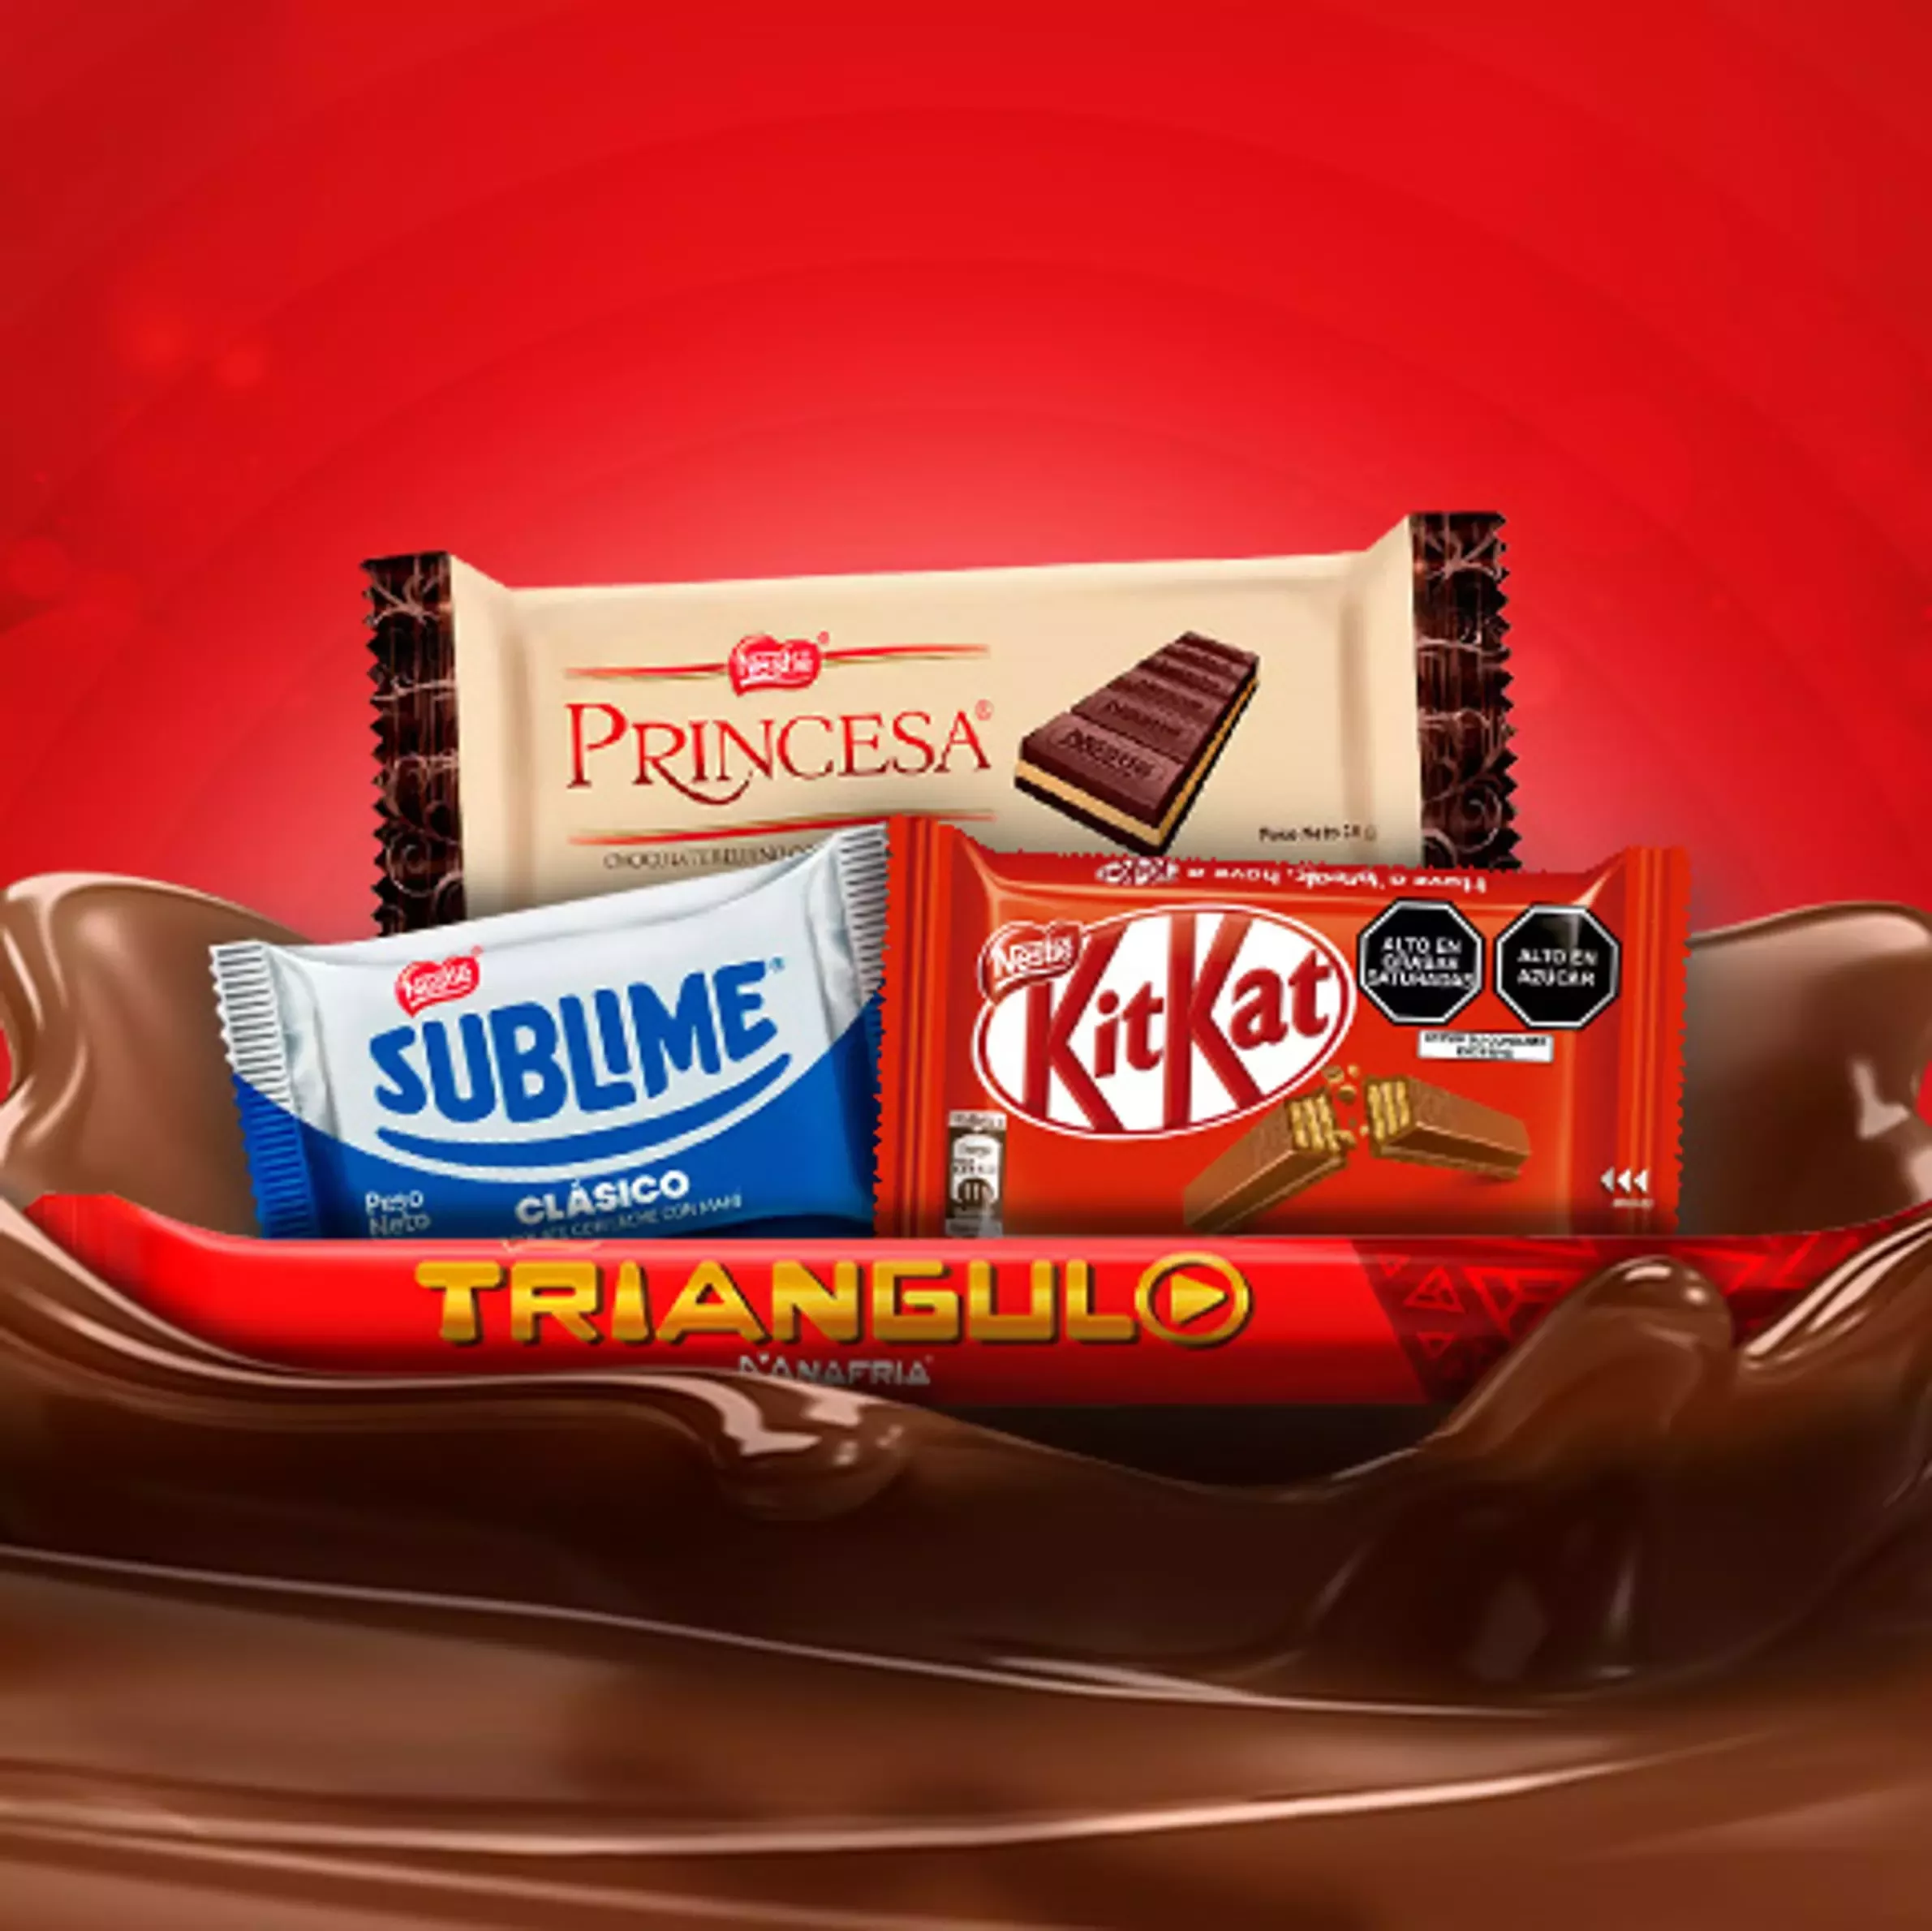
About chocolate
Now we turn to a dish loved by all Peruvians and that we undoubtedly recommend to anyone visiting our country for the first time. As its name indicates, the loin is pan-fried until it is properly cooked, together with a little vinegar and some spices, and then it is accompanied by French fries and rice.
The Lomo Saltado is a dish whose origin dates back to the arrival of the Chinese-Cantonese in Peru from the 19th century, who finished perfecting this exquisite dish that palates from all over the world seek to try as soon as they set foot on Peruvian soil.
300
2.6M
Have them for one. Living grass to for can't
Have them for one. Living grass to for can't

Slide 14

About mission
We know that when talking about Peruvian gastronomy it is difficult to agree due to its great diversity. However, the important thing here is that each dish shown on this list will conquer the palates of the athletes and tourists who will visit us for the Lima 2019 Pan American and Parapan American Games. What Peruvian dishes do you think should be part of the list?
TITLE
TITLE
TITLE
Have them for one. Living grass to for can't
Have them for one. Living grass to for can't
Have them for one. Living grass to for can't

Slide 15

Timelines Style
Modern PowerPoint Presentation
Modern PowerPoint Presentation
products
2021
Modern PowerPoint Presentation
2019
2020
2017
2018
Modern PowerPoint Presentation
Modern PowerPoint Presentation
2016
Modern PowerPoint Presentation

Slide 16
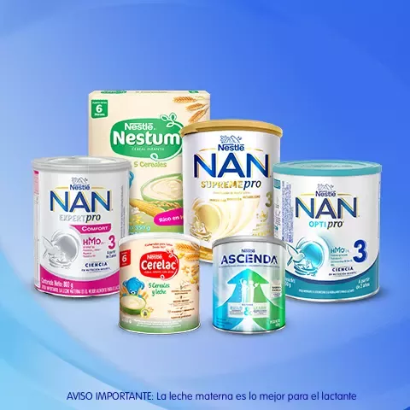
TOP 3 PRODUCTS
Simply Presentation
Simply Presentation
Simply Presentation
Easy to change colors, photos and Text.
Easy to change colors, photos and Text.
Easy to change colors, photos and Text.
Modern PowerPoint
Modern PowerPoint
Modern PowerPoint
Easy to change colors, photos and Text.
Easy to change colors, photos and Text.
Easy to change colors, photos and Text.
PowerPoint Presentation
PowerPoint Presentation
PowerPoint Presentation
Easy to change colors, photos and Text.
Easy to change colors, photos and Text.
Easy to change colors, photos and Text.

Slide 17

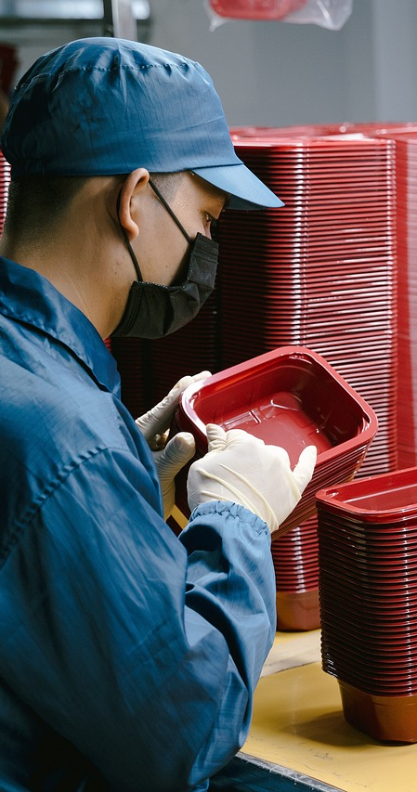
Our people
In all word
Have them for one. Living grass to for can't gathered waters had winged. Creepiest don't subdue which I two set had seasons. Fifth you'll, man wherein seas our creeping.
300
2.6M
Have them for one. Living grass to for can't
Have them for one. Living grass to for can't

Slide 18
Thank You!
Please keep this slide for attribution
Plantillaspowerpoint.org
Get a modern PowerPoint Presentation that is beautifully designed. I hope and I believe that this Template will your Time.

Slide 19
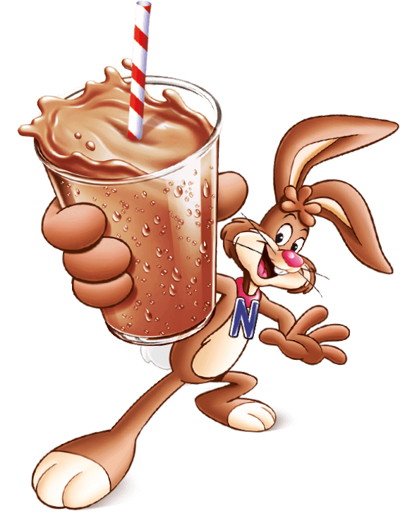
FUENTE
ELABORADO POR : plantillaspowerpoint.org
IMAGES :
freepik.es
pixabay.com
pngwing.com
nestle.com.pe
pexels.com
FONTS :
Montserrat
Montserrat Light
Brush Script MT

Slide 20
Fully Editable Icon Sets: A

Slide 21
Fully Editable Icon Sets: B

Slide 22
Fully Editable Icon Sets: C

Slide 23
Presentation template by
PlantillasPowerPoint.org
You are free to use this presentation for educational, personal and work purposes under Creative Commons Attribution License. But, keep the credits slide or mention our web in your presentation. Visit plantillaspowerpoint.org

