Slide 1
Mitigation of Greenhouse Gas Emissions
David Smith, Texas A&M University
Notes:
Hello and welcome to this lesson on Mitigation of Greenhouse Gas Emissions. My name is David Smith and I’m a Program Specialist with Texas A&M AgriLife Extension in the Department of Biological and Agricultural Engineering at Texas A&M University.

Slide 2
USDA 2011
Notes:
In the previous lesson, we looked at some of the contributions of greenhouse gases from different types of livestock and poultry operations.

Slide 3
Reduced Carbon Footprint
Per gallon of milk
Capper 2009
Notes:
We saw that in the US, animal agriculture has dramatically increased its production efficiency, as it continues to produce more product with fewer resources.

Slide 4
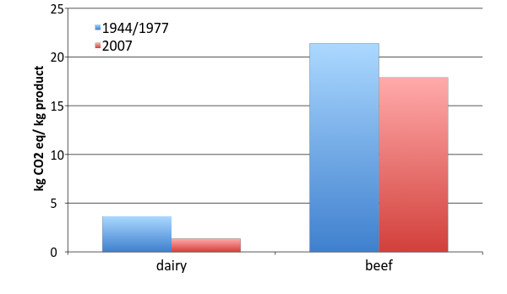
Reduced Carbon Footprint
Capper et al. 2009, 2011

Slide 5
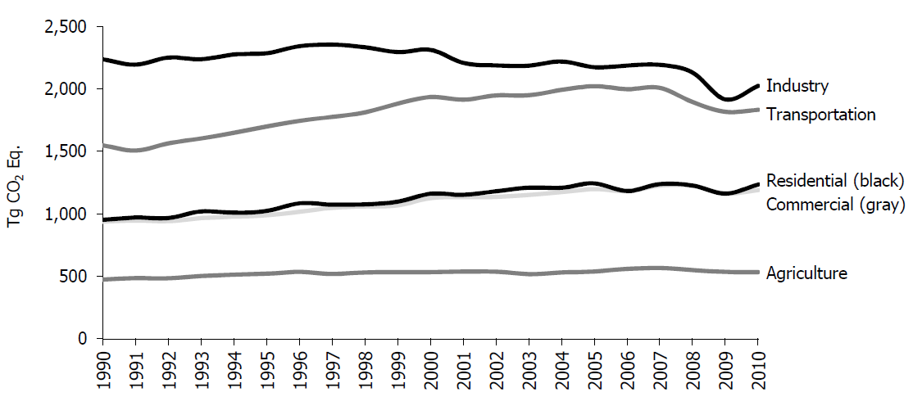
Relative Contribution to US Greenhouse Gas Emissions
EPA 2012
Notes:
We should also now recognize that the overall carbon footprint of agriculture is relatively small compared to other sectors of the economy such as transportation.

Slide 6
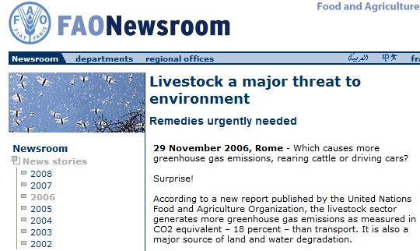
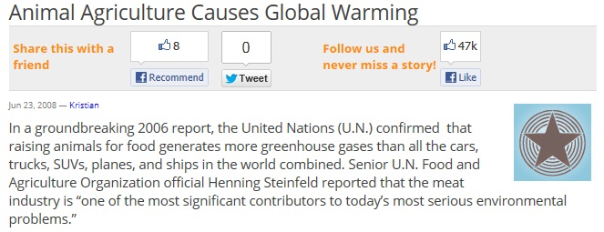
Notes:
While this is true, animal agriculture is often called upon to defend its impact on the environment, and therefore must continually demonstrate its commitment to stewardship. One way to do that is to identify and adopt best management practices that continue to improve production efficiency while at the same time reduce its share of greenhouse gas emissions.

Slide 7
Define ‘mitigation’
Identify species-specific mitigation options
Highlight indirect benefits
Notes:
In this lesson, we will define what we mean by mitigation in the context of greenhouse gas emissions. We will discuss several species-specific mitigation options available to farmers and ranchers. And finally, we will consider how some of these mitigation practices might have other environmental and financial benefits beyond just reducing greenhouse gas emissions.

Slide 8
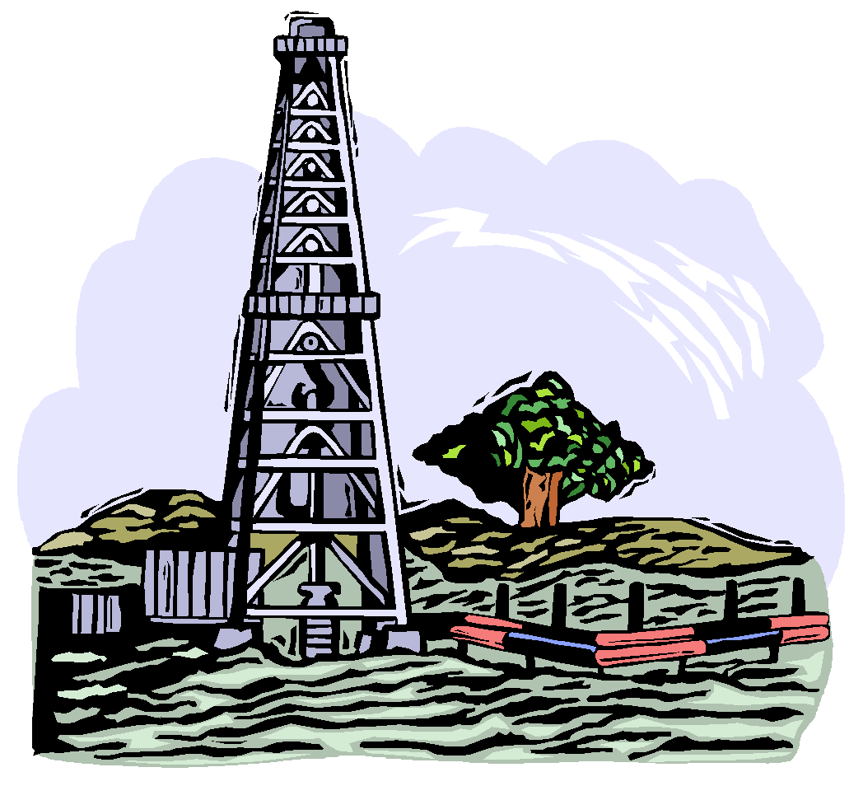
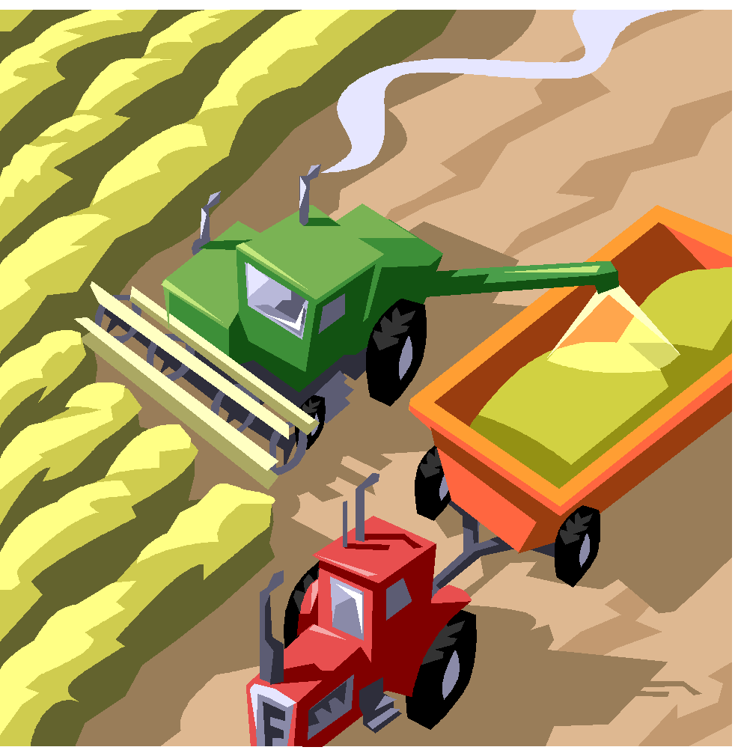
What is ‘mitigation’?
Practices that reduce the net amount of heat trapping gases released into the atmosphere
Fewer air miles
Better fuel efficiency
Carbon capture
Production efficiency
Cleaner burning fuels
Energy conservation
Carbon sequestration
Fertilizer efficiency
Notes:
Let’s start out by defining what we mean by mitigation in the context of this lesson. Mitigation is defined as any practice that reduces the amount of heat trapping gases, called greenhouse gases, from being released into the atmosphere. Let’s take a look at some examples from other industries. In the airline industry, we talk about mitigation in terms of flying fewer miles (by improving flight schedules), or improving the fuel efficiency of airplanes. In the energy sector, mitigation might include cleaner burning fuels (drilling for more natural gas compared to mining more coal), as well as improving energy conservation throughout an electrical grid. Manufacturing facilities might look at carbon capture methods or improving the production efficiency through automation and control. And in agriculture, we might consider soil carbon sequestration and improved fertilizer efficiency, which improves crop production while reducing greenhouse gas emissions.

Slide 9
Mitigation
Production efficiency
Manure management
Energy efficiency
Carbon capture (sequestration)
Notes:
So if you look at animal agriculture from a big picture perspective, there are really four main categories of mitigation practices. First, we can look at production efficiency (producing more output of meat, milk and eggs per unit input). Second, there’s a lot we can do to improve manure management practices that not only reduce greenhouse gas emissions, but at the same time address water and air quality concerns. Third is energy efficiency. As we continue the trend toward more controlled environments within animal production, there is a growing need to be more energy efficient in our lighting, heating and cooling systems. And finally, a win-win for farmers is carbon capture and storage (called carbon sequestration) by increasing organic matter in soils and maintaining cover crops and trees on crop, pasture, and range lands.

Slide 10
Variation in Farm/Ranch Operations
Notes:
One of the challenges in identifying effective mitigation practices for livestock and poultry operations is that animal agriculture is extremely diverse. This is true even within a given animal species.

Slide 11
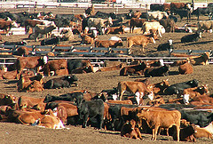
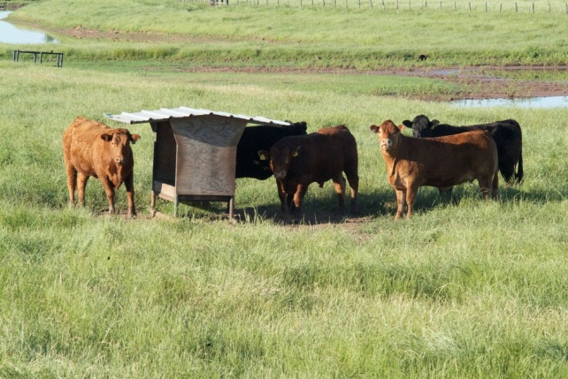
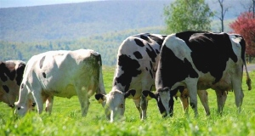
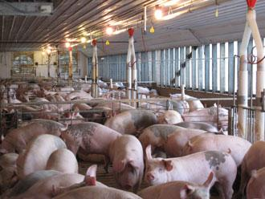
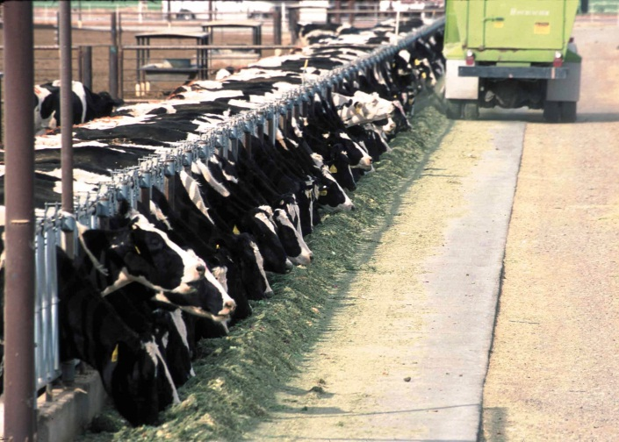
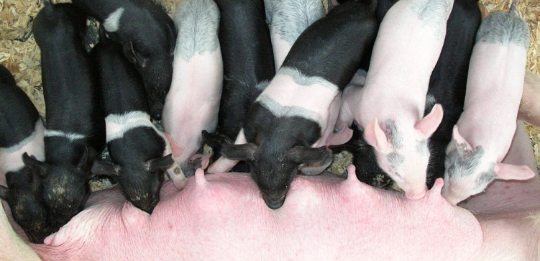
Variation in Farm/Ranch Operations
Notes:
Just look at beef cattle operations. You have confined feeder operations, cow-calf operations, and stocker operations. You also have seedstock and niche markets to consider. With each of these you’re dealing with different environments, from non-vegetative feedlots with high-density stocking, to pasture and rangeland environments with variable stocking rates. Where greenhouse gas emissions occur and what mitigation options are most appropriate will ultimately depend upon the type of operation.

Slide 12
Local climate and environmental concerns
Notes:
Greenhouse gas mitigation options are also somewhat dependent upon location and climate.

Slide 13
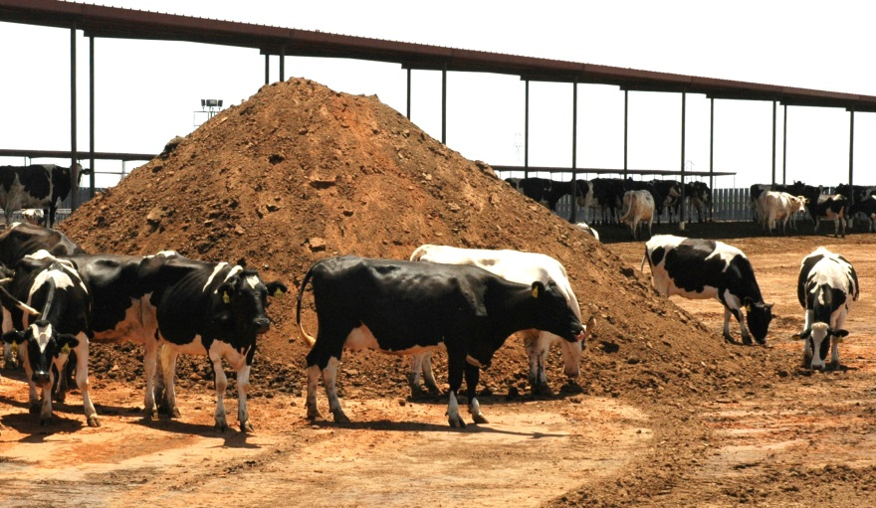
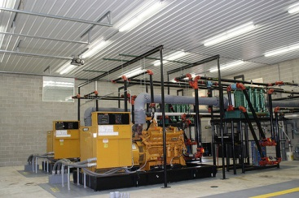
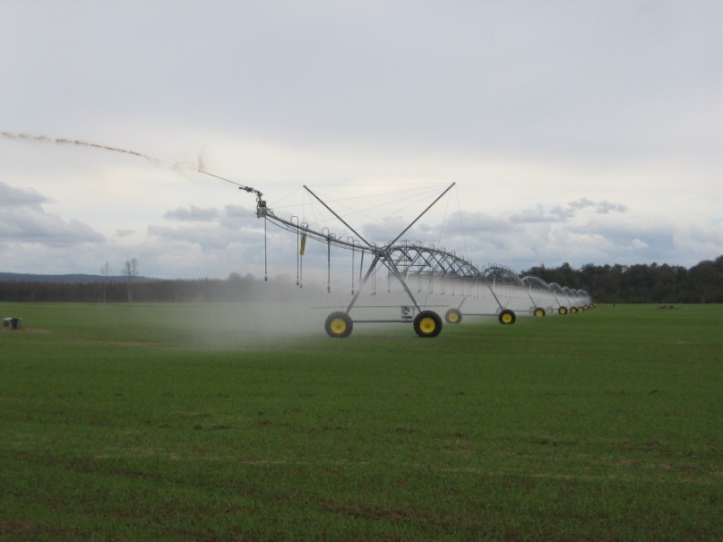
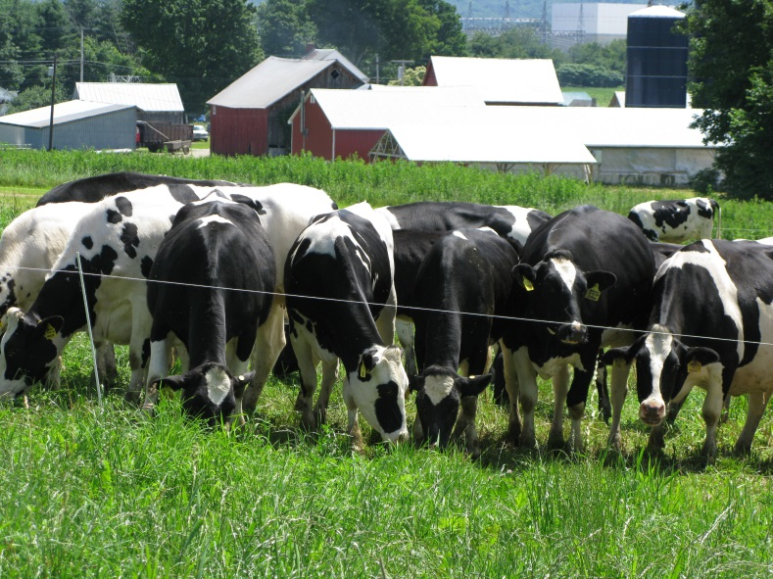
Notes:
Dairy operations in the American southwest, for example, may have access to a greater amount of cropland and pastures and long growing season which provides more flexibility and increased opportunity for land application. In the northeast, where cropland and growing season is limited, mitigation might focus more on manure storage and utilization for energy production. Also, whether a dairy is totally confined, totally pasture-based, or a mix of the two will determine which mitigation options might be appropriate from a dietary standpoint. Each type of operation produces greenhouse gases in different amounts and at different points along the production system.

Slide 14
Beef Cattle
Improve pregnancy rate
Healthier cattle, lower mortality
Faster weight gain
Diet manipulation
Notes:
In beef cattle operations, one of the most effective mitigation strategies is to increase cattle production efficiency. In a cow-calf operation it all starts with improving fertility, pregnancy rate, and successful deliveries through good breeding practices. Maintaining a healthy herd also results in fewer culled cattle and lower mortality rates. This minimizes feed and pasture resources spent on unhealthy cattle and replacements, as well as reducing overall greenhouse gas emissions. Faster weight gain through improved pastures and supplements is something many ranchers already do to increase profitability, but it also can reduce greenhouse gas emissions per unit of beef produced.

Slide 15
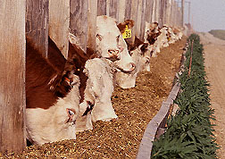
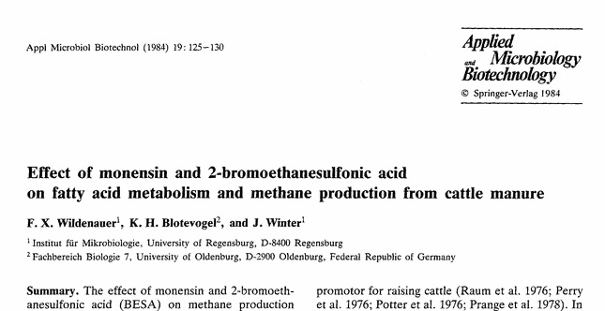
Feed Additives
Notes:
If we look at feeder cattle operations, there’s a lot of ongoing research exploring the potential of dietary additives such as ionophores, oils, and vaccines in reducing enteric methane formation in the rumen.

Slide 16
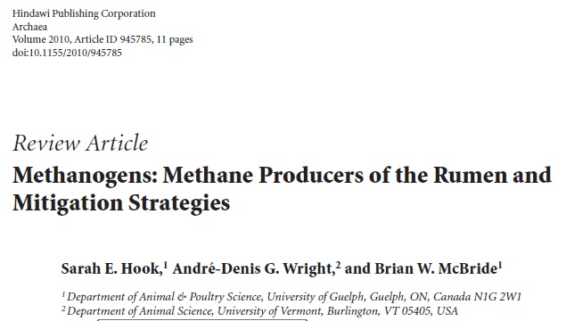
Feed Additives
Notes:
Results thus far show various levels of effectiveness, particularly long-term impacts.

Slide 17
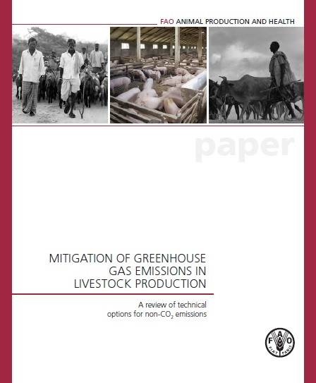
Feed Additives
Notes:
A recent FAO report reviewed several hundred published research studies and found significant inconsistency feed supplements in reducing rumen methane.

Slide 18
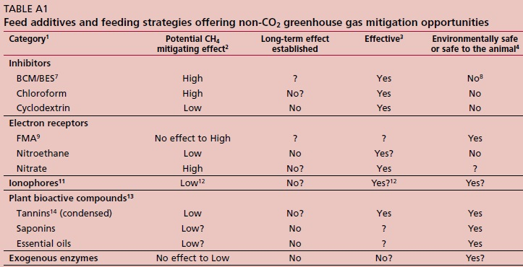
Feed Additives
Notes:
They looked at such things as potential methane mitigating effect and whether the mitigating impact was effective over the long-term. They also considered animal and environmental safety and regional applicability. For many feed additives their mitigating effect was short-lived, depended upon diet composition, and affected by other factors such as feed intake and daily weight gain.
For example, research showed that overall, ionophores, such as monensin, do not appear to have a consistent direct effect on reducing enteric methane production in beef cattle and in cases where a reduction did occur, the effect was short lived.
On the other hand, individual studies do indicate improvement in feed efficiency that may reduce methane emissions per unit of meat. When evaluated on this basis, ionophores may have a methane mitigating effect in ruminants after all.

Slide 19
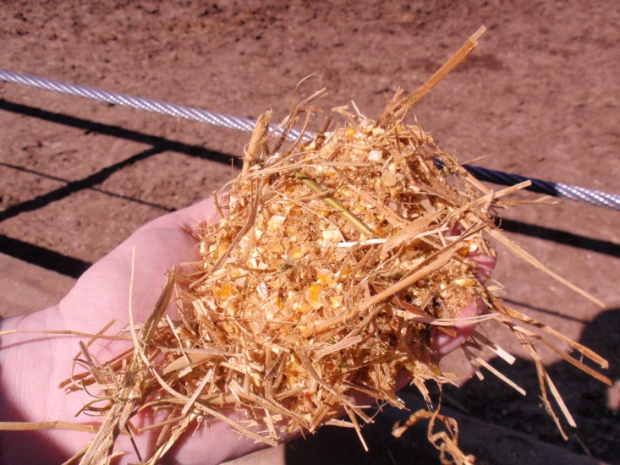
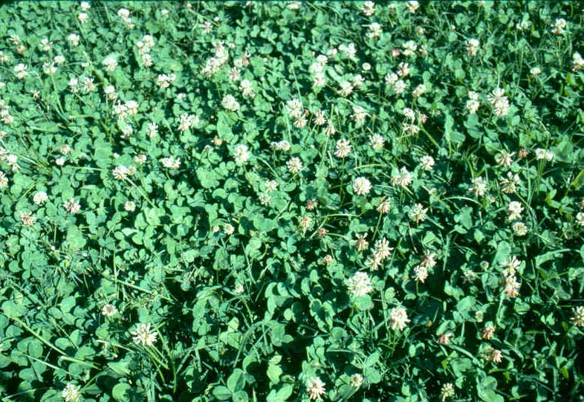
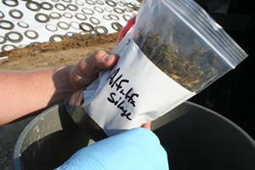
Diet
Inclusion of concentrate feeds
Increasing digestibility of forage
Precision feeding
Notes:
Other diet-related mitigation strategies being studied include inclusion of concentrate feeds, increasing the digestibility of forage, and precision feeding. If you compare methane emission on a per head basis, emissions from grain-fed cattle are typically lower than for cattle on pasture. However, concentrate supplementation is not a very practical substitute for high-quality forage, and in many areas of the world is not an economically feasible or socially acceptable option. Improving forage digestibility by feeding legumes or preserved silage also appears to reduce enteric methane and may also reduce urinary nitrogen losses and, consequently, nitrous oxide emissions from manure deposited on soil. Through feed analysis and precision feeding we can more closely match animal requirements and dietary nutrient needs. This is important for maximizing feed utilization, stabilizing rumen fermentation, improving rumen health, and minimizing nitrogen excretion in manure and urine.

Slide 20
Feedlot Manure
Ammonia (NH₃)
Methane (CH₄)
Nitrous oxide (N₂O)
Notes:
Cattle feedlots also generate a significant amount of ammonia, methane, and nitrous oxide emissions from manure and urine deposited on the ground. The manure is periodically scraped, piled and stored until it is either land applied, used to generate energy, or composted. Later in is this presentation we’ll discuss some of the ways greenhouse gas emissions can be reduced using different manure management methods.

Slide 21
Pasture/Rangeland Sustainability
Proper stocking rates
Genetics compatible to local climate
High input → low or no input
Calving season in sync with forage availability
Notes:
Another approach that’s been practiced throughout history, and is growing in popularity among cow/calf and stocker operators in the US, is rotational grazing (sometimes called controlled or mob grazing). In this system, forage supply and growth is controlled by strategically moving herds of cattle through partitioned paddocks within the ranch. With rotational grazing, along with genetic selection of cattle that conform to local climate conditions, many ranchers are moving from high input operations to a low or no input systems. Using proper stocking rates and adjusting breeding and calving seasons that coincide with forage production cycles, these producers are substantially reducing or totally eliminating supplemental feeding and seeing their profit margins increase. Eliminating inputs such as supplemental hay may also reduce overall greenhouse gas emissions by reducing the use of fuel and fertilizer-related products needed to apply, grow, harvest, and transport the hay.

Slide 22
Dairy Operations
Notes:
The dairy industry in the US has been very successful in increasing milk productivity. While the dairy herd has declined about two million head since 1985, milk production per cow has continued to rise.

Slide 23
Dairy Operations
Notes:
The dairy industry has also made public their goal to reduce greenhouse gas emissions. In January 2009, the Innovation Center for U.S. Dairy announced a voluntary goal to reduce the greenhouse gas emission of a gallon of milk, from farm to retail, by 25 percent by 2020.

Slide 24
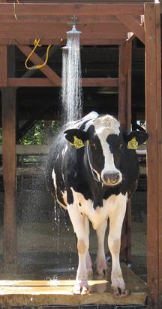
Dairy Operations
Increase production efficiency
Genetic selection
Earlier weaning
Dietary change
Better herd health
Reduce cow stress
Notes:
For dairy operations the key approach to greenhouse gas mitigation is increasing the lifetime production efficiency of the cow, through genetic selection, earlier weaning, dietary changes, improving herd health, and reducing cattle stress.

Slide 25
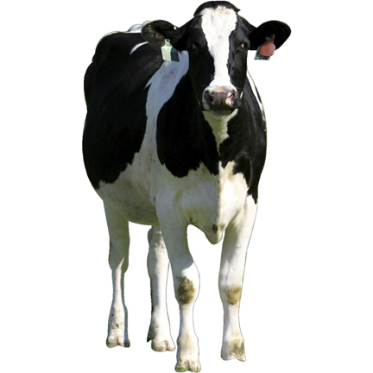
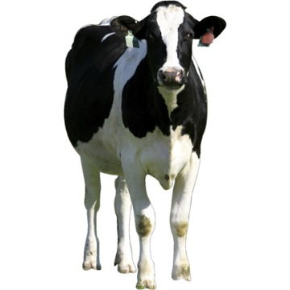
Reducing Methane per Unit of Milk on an Individual Cow Basis
Approach #1
Approach #2
Milk/cow
DMI/cow
Maintain milk/cow
Reduce maintenance energy
CH₄/cow
CH₄/cow
Notes:
On an individual cow basis, methane emission per unit of milk can be reduced using two different approaches. The first approach is to increase milk yield per cow with correspondingly smaller increases in dry matter intake. This “dilutes” the cow’s maintenance energy cost and increases its energy efficiency resulting in less methane produced.
The second approach is to reduce body size without reducing milk yield and milk components. This will reduce the maintenance energy requirements of the cow, and thus the methane produced per cow. Both approaches are based on the fact that maintenance energy requirement is largely a function of body size. Because methane production is proportional to the energy intake of the animal, reducing maintenance energy costs and energy intake while maintaining milk yield would decrease enteric methane, both on a per head per day basis and a per pound of milk basis.

Slide 26
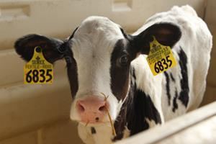
Genetics
Increasing lifetime productivity will indirectly reduce methane emissions per unit of milk
Tradeoffs:
Increased incidence of common diseases
Lower heat stress threshold (Rauw et al., 1998 & Ravagnolo and Miszt, 2000)
Increased energy maintenance needs
Notes:
Improved genetics and artificial insemination of dairy cattle has greatly enhanced our ability to identify and select for breeds genetically superior for milk production. Genetic approaches that increase lifetime productivity, including those that promote better health, disease resistance, reproduction, and heat tolerance lead to improvements in individual and herd productivity, and indirectly reduce methane emissions per unit of milk.
But we’re also recognizing that breeding for increased milk production does have tradeoffs. Genetics selected primarily for milk productivity have shown to increase the incidences of common diseases in dairy cattle (such as ketosis and mastitis) and have low to moderate heritability (Uribe et al., 1995; Zwald et al., 2004). Studies also show heat tolerance to be a heritable trait (Ravagnolo and Miszt, 2000), and the threshold at which cows begin experiencing heat stress is lower in higher producing dairy cows. Since high producing cows generally eat more, energy needed to maintain body function is also increased.

Slide 27
Management and Fertility
Mitigation Strategies
Trends in milk yield (●) and Daughter Pregnancy Rate (○) for US Holsteins.
Improve overall herd health
Reduce death loss, lameness, and diseases
Utilize performance enhancing technologies (rBST)
Improve estrus detection and synchronization
Reduce heat stress
Reduce culled cows due to poor reproduction
Data are from USDA-ARS Animal Improvement Programs Laboratory, February 2007
Source: Hansen, 2008
Notes:
It makes sense that management practices that enhance the ability of an individual cow to increase milk yields and reach its genetic potential will reduce the amount of methane produced per unit of milk of the whole herd. These management approaches include practices to improve herd health, reduce death loss, lameness and diseases, and using performance enhancing technologies such as BST.
If we look over the past 60 years, we see that as milk yield has steadily increased, pregnancy rate has consistently declined. This decline in fertility, with the advent of artificial insemination and genetic selection, is found in all the major dairy breeds in the U.S., but is most pronounced in Holsteins (Lucy, 2001). This trend is often been associated with the selection for increasing milk yield (Lucy, 2001), however there are many management factors that may be responsible for the declines in reproductive efficiency over this time period. Currently, approximately 19% of culling decisions are for reproductive reasons (Hadley et al., 2006). Better estrus detection, estrus synchronization, prevention of early embryonic death, heat stress abatement, and transition cow health would result in improvements in reproduction, and reducing the number of cows culled due to poor reproduction. In turn, reduced culling reduces the need for replacement animals and can reduce whole herd methane emissions.

Slide 28
Swine Operations
Improve feed efficiency
Increase number of piglets weaned over the sow’s lifetime
Improve herd health
Reduce animal stress
Increase energy efficiency
Manure storage and management
Notes:
In swine operations, mitigating greenhouse gas emissions can come from improved feed efficiencies, and increasing the number of piglets weaned per sow over her lifetime. We know that healthier pigs utilize feed more efficiently, so we can continue to improve herd health and reduce animal stress. Since most swine operations use confined housing, we can also reduce energy consumption by using energy efficient cooling and heating systems, and conducting regular fan maintenance. There is also a lot of research being done on handling, storing, and utilizing manure to minimize odor and reduce amount of greenhouse gases being released. Later, we’ll discuss systems specifically designed to capture and utilize manure methane for on and off-farm energy use.

Slide 29
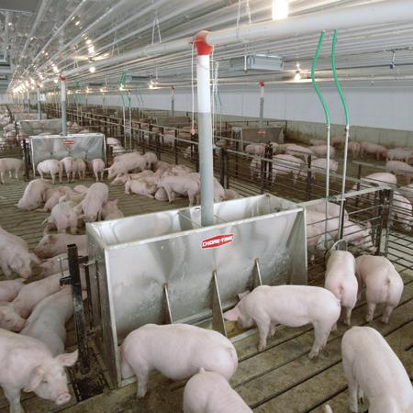
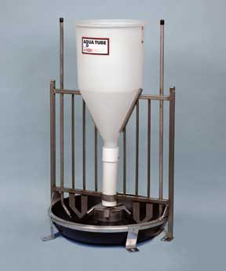
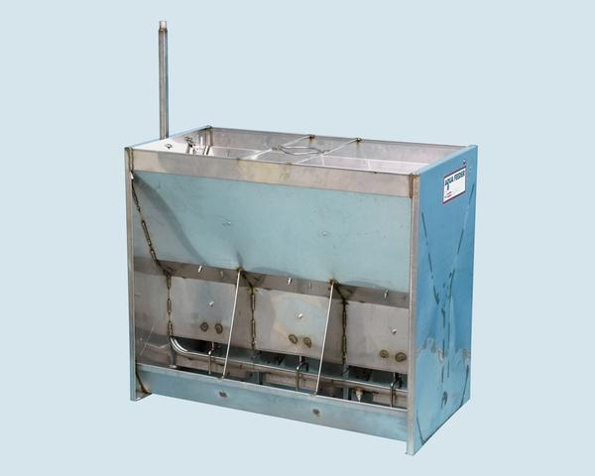
Dry versus Wet/Dry Feeders
Notes:
Much of the attention for reducing greenhouse gas production in swine operation is focused on feeding strategies, such as increasing the average daily gain and minimizing feed waste. One strategy is switching from a dry feed to wet/dry feeders. Several studies have evaluated the effects of conventional dry feeders versus wet/dry feeders on the growth performance of finishing pigs.

Slide 30
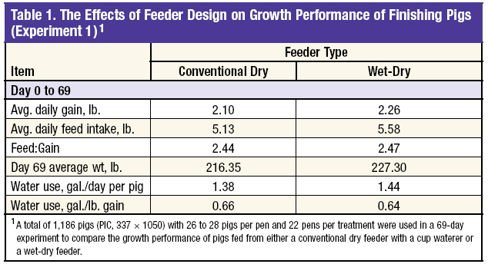
Dry versus Wet/Dry Feeders
Bergstrom, J. R., et al., 2008
Notes:
Research trials conducted at Kansas State University in 2008 showed pigs using the wet-dry feeder had greater average daily gain, higher daily feed intake, and a final weight comparable to pigs using the conventional dry feeder.

Slide 31
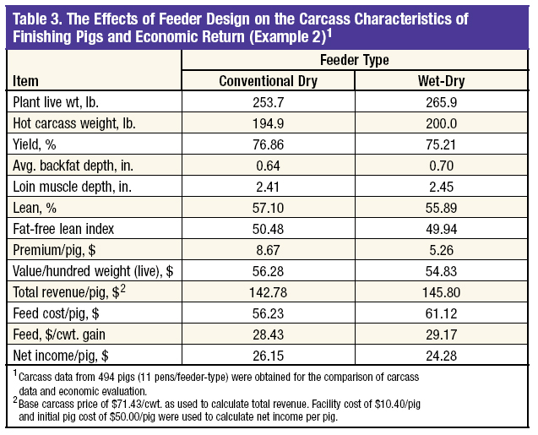
Dry versus Wet/Dry Feeders
Bergstrom, J. R., et al., 2008
Notes:
However, pigs using the wet-dry feeder consumed more feed, had a higher feed to gain ratio, and had a higher feed cost per pig than pigs using the conventional feeder. This study also showed a reduction in net income per pig for pigs fed with the wet-dry feeder.

Slide 32
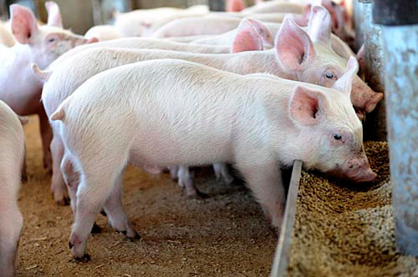
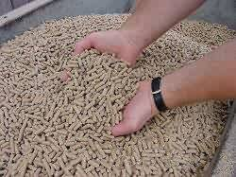
Reducing Crude Protein
Crude protein reduced from 19 to 16%
Fed amino acid supplements
CH₄ was reduced 27.3%
CO₂ reduced 3.8%
(Atakora, et al., 2003)
Notes:
Another mitigation options showing potential for swine operations is use of amino acid supplements to reduce the crude protein content in the diet, which also lowers the amount of manure nitrogen excreted.
In one study, researchers reported a reduction of methane emissions by 27 percent and carbon dioxide emissions by nearly 4 percent when pigs were fed 16 percent crude protein (supplemented with amino acids) diets compared to a diet containing 19 percent crude protein (Atakora et al., 2003).

Slide 33
Reducing Crude Protein
Finisher pigs & sows fed wheat-barely-canola
Crude protein reduced and amino acid supplemented
CO₂-equivalent reduced 14.3 to 16.5%
Atakora et al. (2004)
Notes:
In another study researchers found that by reducing the crude protein diet and supplementing with amino acids on feeder pigs and sows, they were able to reduce greenhouse gas CO2-equivalents by up to 16 percent.

Slide 34
Reducing Crude Protein
20% reduction in dietary protein
Amino acid supplement
Nitrogen excretion reduced 35%
(Möhn and Susenbeth, 1995)
Notes:
And in a third study, researchers showed that a 20 percent reduction in dietary protein with amino acid supplements can reduce nitrogen excretion by as much as 35 percent.

Slide 35
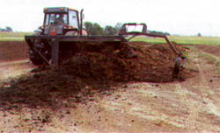
Manure Storage and Management
Swine manure slurry application
Manure solids separator
Swine manure composting
Notes:
For swine facilities, manure management is critical for keeping animals healthy, for reducing nuisance odors, and for controlling greenhouse gas emissions. Proper storage, treatment, and application of manure can help prevent excessive ammonia, hydrogen sulfide, methane and nitrous oxide emissions. Frequent removal of manure from hog facilities helps keep manure methane production to a minimum. Separation of manure into liquid and solids and anaerobically composting the solids has been shown to reduce methane, but may have a variable effect on nitrous oxide emissions, and may even tend to increase ammonia and total manure nitrogen losses.

Slide 36
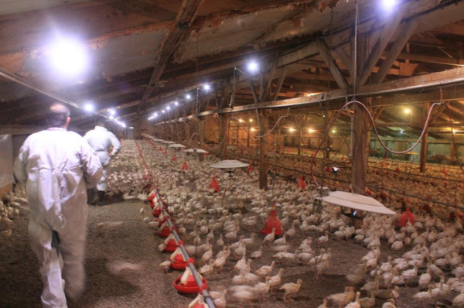
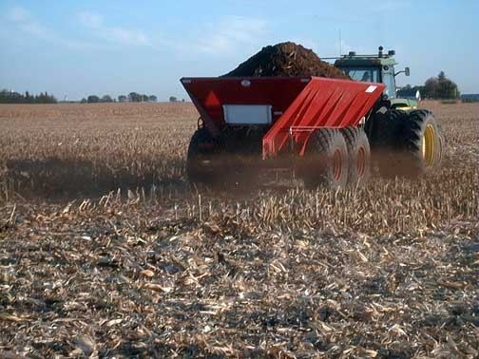
Poultry Operations
Notes:
When compared to beef and dairy cattle and swine, the total amount of greenhouse gas emissions is relatively small. Much of the greenhouse gas contribution from poultry operations is carbon dioxide released during the burning fossil fuels used to produce electricity, power combustion units such as furnaces and incinerators, and to power trucks, tractors and generators used on the farm. Methane and nitrous oxide emissions also occur during manure handling and storage and land application of manure.

Slide 37
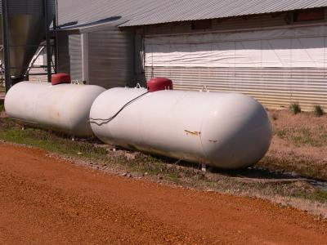
Poultry Operations
Propane Use:
Broiler and pullet farms – 68% of emissions
Breeder farms – 3% of emissions
Reduce heat loss in houses
Insulated curtains (houses without walls)
Insulate walls and ceilings
(Dunkley, 2011)
Notes:
A recent University of Georgia study found that the greenhouse gas mitigation practices are largely farm dependent, and the relative amounts of greenhouse gas emissions vary considerably with type of poultry operation. For example, the study found that about 68% of emissions from broiler and pullet farms came from propane use, while only 3% of emissions from breeder farms were from propane use. Propane is mainly used for heating purposes.
Reducing heat loss in poultry barns is key to reducing propane use. For houses without walls, insulated curtains help to limit heat loss, while for enclosed houses, walls and ceiling can be insulated.

Slide 38
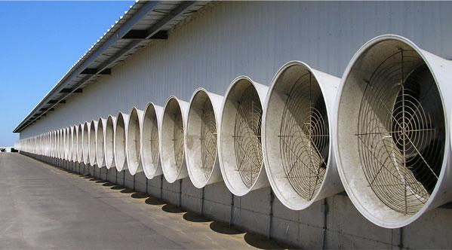
Poultry Operations
Electricity Use:
Breeder farms – 85% of emissions
Reduce electricity use in houses
Improve energy efficiency
exhaust fans
lighting
generators
incinerators
Install circulatory fans to reduce temperature stratification
Use radiant instead of gas heaters for brooding
(Dunkley, 2011)
Notes:
On breeder farms, the same study found that electricity used for lighting and ventilation was responsible for about 85% of greenhouse gas emissions. Improving energy efficiency of exhaust fans, lighting, generators and incinerators can reduce the total amount of electricity used, thus resulting in fewer emissions.
Other energy reduction strategies include installing circulatory fans to prevent temperature stratification inside barns and using radiant instead of propane heaters for brooding operations.

Slide 39
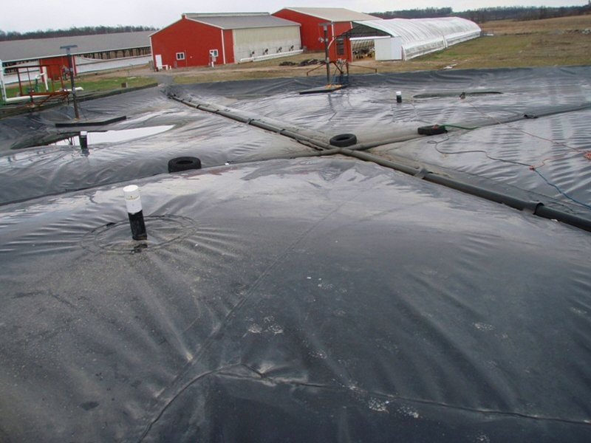
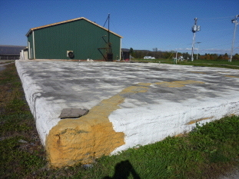
Methane Capture
Manure Storage Covers
Notes:
With all animal production system, managing large quantities of manure poses both a significant challenge and potential opportunity for mitigating greenhouse gas emissions. In the next few slides we will discuss some of these options.
Semi-permeable and impermeable manure storage covers offer many benefits, including odor control and for reducing greenhouse gas emissions as they trap manure gases such as methane, hydrogen sulfide, and ammonia and keep them within the manure liquid, instead of escaping to the atmosphere.

Slide 40
Methane Capture
Converts methane to carbon dioxide
Source of on-farm renewable energy
Notes:
Combusting captured methane under impermeable methane that would otherwise be released into the atmosphere, can be flared off or used to generate on-farm power.

Slide 41
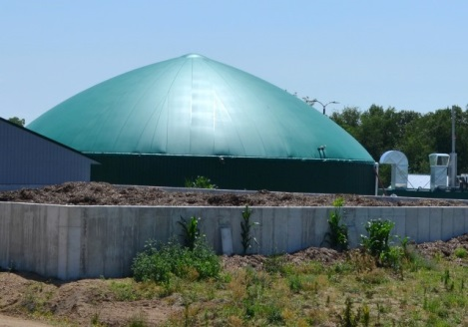
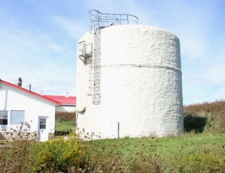
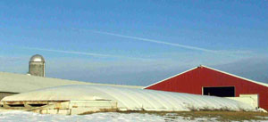
Anaerobic Digestion
Notes:
Like covered manure storage systems, anaerobic digesters provide a means to reduce methane emissions from animal manure that would have been emitted into the atmosphere, and using it to generate power for on-farm and off-farm uses. There are several different types and designs of aerobic digesters that can be customized for different livestock and poultry operations and site-specific conditions, such as plug flow, covered lagoons, and complete mix digesters.

Slide 42
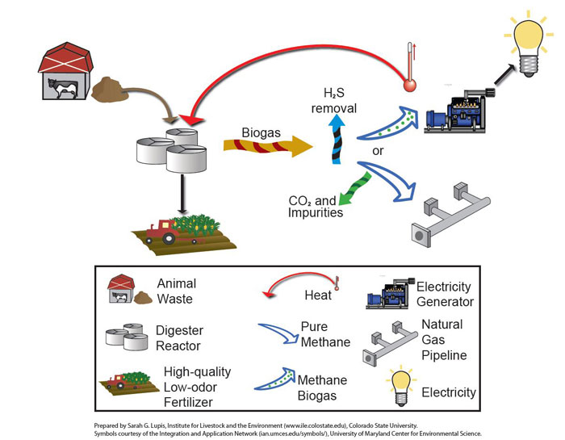
Notes:
Basically the way they work is by separating the biogas (which is mainly methane), from the solids and liquids portion of the manure. The biogas is then conditioned to remove moisture and hydrogen sulfide, and can then be used to power electric generators, boilers, heaters, or chillers. Heat and electricity generated can be used for farm or home use, or in some cases sold to energy companies. The solids and liquids portion of the manure can then be separated. Liquids can be stored in lagoons and used with irrigation as a fertilizer. Solids can be used or sold as organic fertilizer, compost, or bedding material.

Slide 43
Other Benefits
Odor control
Renewable energy generation
Potential revenue source
Pathogen reduction
Improvement in water quality
Conversion of nutrients from organic to inorganic form
Notes:
This technology is still cost prohibitive to many farmers and ranchers, so of course the benefits of aerobic digesters should be weighed against the initial capital costs. Other benefits such as better control of manure odors, renewable energy generation, as well as potential revenue sources which include a reduction in energy purchased, sale of excess electricity or biogas, value-added products such as fertilizers and compost, and the potential value of carbon credits. This system also reduces manure pathogens and improves water quality.

Slide 44
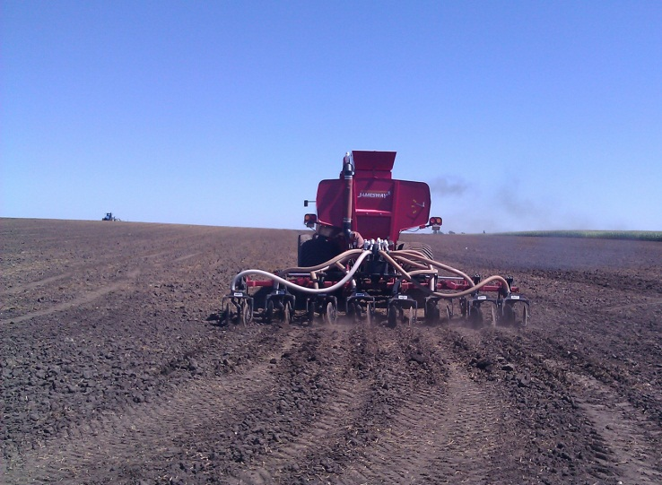
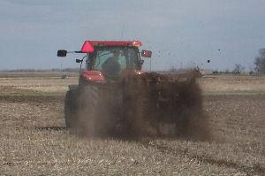
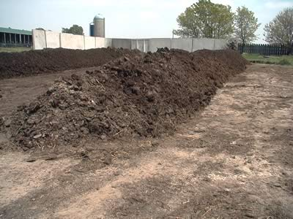
Land Application
Reduce storage time
Biological treatment
Crop nutrient source
Build organic matter
Notes:
Land application of solid and liquid manure offers many management and agronomic benefits including reducing the storage time of manure, and providing advanced biological treatment by soil organisms. It also enables beneficial utilization of manure nutrients such as nitrogen and phosphorus, and helps build soil organic matter.
While surface application techniques are relatively fast and inexpensive compared to other application methods, nitrogen and phosphorus in manure is more susceptible to being lost to runoff and ammonia volatilization. Tilling in, knifing in, or subsurface injection of manure places nutrient under the soil surface where they are less vulnerable to those losses. Soil injection reduces nitrous oxide emissions by minimizing manure nitrogen contact with air and reduces nitrogen losses from leaching and runoff.

Slide 45
Land Application
Mitigation Strategies
Reduce initial N concentration
Avoid application to wet soils
Maintain pH > 6.5
Apply to a growing crop
Balance manure nutrient application with crop needs
Apply or move manure subsurface
Notes:
There are several strategies for reducing loss of greenhouse gas emissions during land application, such as lowering the overall concentration of nitrogen in manure being applied (applying composted manure for example). It’s also important to avoid applying manure to saturated soils, which encourages conditions and maintaining soil pH above 6.5, as these conditions promote release of nitrous oxide. Other recommendations include restricting application to land during the growing season and balancing the quantity of manure with the nutritional requirements of the crop.
While surface application techniques are relatively fast and inexpensive compared to other application methods, nitrogen and phosphorus in manure is more susceptible to being lost to runoff and ammonia volatilization. Tilling in, knifing in, or subsurface injection of manure places nutrient under the soil surface where they are less vulnerable to those losses. Soil injection reduces nitrous oxide emissions by minimizing manure nitrogen contact with air and reduces nitrogen losses from leaching and runoff.

Slide 46
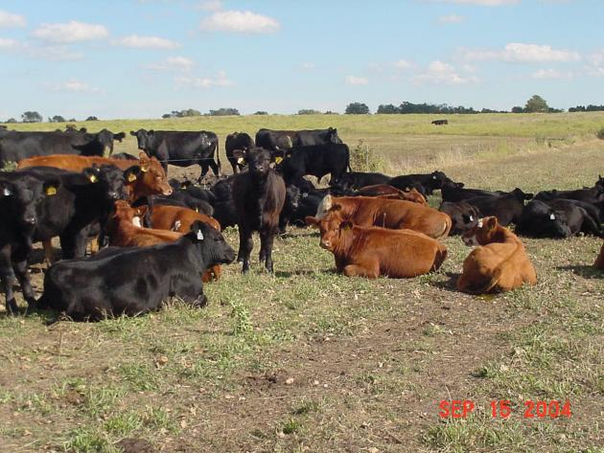
Land & Pasture Management
Maintain vegetation
Plant trees - Silvopasture
Fertilizer application BMP’s
Notes:
For livestock systems on pasture and rangeland, there are several different options that can improve our ability to reduce greenhouse gas emissions as well as sequester carbon in our soils. Grassland systems are one of the most productive systems for sequestering carbon into the soil. One of the most important things ranchers can do, especially with beef cattle, is utilize appropriate stocking density to maintain vegetation that can sequester and utilize carbon. As we mentioned earlier, rotational grazing as part of intensive pasture management is showing promise in maintaining healthy pastures.
In some parts of the country, silvopasture is considered a mitigation option – this is where trees are strategically planted within a pasture system and cattle are allowed to graze among the trees. This gives the benefit of shade to the cattle which tends to increase productivity as well as having a double cropping system on that acreage.
We’ve already discussed the importance of using proper land application strategies to minimize loss of methane and nitrous oxide. Whether you’re applying organic or synthetic fertilizer, you should always start with a soil test to determine baseline levels and nutrient deficiency in the soil, and balance fertilizer application with the appropriate needs of the forage. Other practices include using slow-release forms of the fertilizer which slow the microbial processes leading to nitrous oxide formation, scheduling the timing of fertilization with plant uptake, and placing the fertilizer more precisely into the soil so that its more accessible to plant roots.

Slide 47
Emerging Mitigation Practices
Grazing system changes
Changing from traditional pasture grazing to intensive feedlot system
Feeding strategies
Lipid supplements
Ionophores
Plant compounds
Probiotics and organic acids
Improved genetics
Lower protein diet (swine)
Manure management
Manure compaction
Frequency of spreading
Manure aeration
Solid-liquid separation (swine)
Bedding materials (swine)
(Archibeque et al., 2012)
Notes:
In this lesson, we discussed several greenhouse gas mitigation options available to animal agriculture production. Archibeque and others in 2012 released a report summarizing the current of mitigation alternatives for beef, dairy, and swine operations. In addition to the practices we discussed already, they listed several new and emerging ones where further research is needed before widespread implementation. In their report they looked at such things as changes in grazing systems, feeding strategies and diets, and manure management. The complete report is listed under the Required Reading portion of this lesson. In it you’ll learn more about these emerging mitigation alternatives.

Slide 48
Summary
Mitigation practices reduce the amount of greenhouse gases released into the atmosphere.
Mitigation options vary depending with species, type of operation, and local environment.
Mitigation practices can have additional environmental and financial benefits.
Notes:
So in summary, you should now know that mitigation is any practice that reduces the amount of greenhouse gases released into the atmosphere. The four main categories of mitigation we’ve discussed here are improved production efficiency, manure management, energy efficiency, and carbon sequestration. However, we should remember that every farm and ranch is different, and that mitigation practices should be tailored to the specific species, type of operation and the local environment.
Finally, while we recognize that some mitigation practices are currently cost prohibitive, we should also weight the additional environmental benefits such as odor reduction, improved air and water quality, and reduced pathogens, as well as potential financial benefits such as the ability to produce biogas or electricity to off-farm users, or market manure bi-products, such as compost and organic fertilizers.

Slide 51
Graphic Sources
http://www.usda.gov/oce/climate_change/AFGGInventory1990_2008.htm
Capper, J. L., R. A. Cady and D. E. Bauman (2009) “The Environmental Impact of Dairy Production, 1944 vs 2007.” J. An Sci. 2009.87:2160-2167
Adapted from: Capper, J. L., R. A. Cady and D. E. Bauman. 2009. “The Environmental Impact of Dairy Production, 1944 vs 2007.” J. An Sci. 2009.87:2160-2167, and Capper, J.L. 2011. “The environmental impact of beef production in the United States: 1977 compared with 2007.” J. An Sci. 2011.89:4249-4261
http://www.epa.gov/climatechange/ghgemissions/usinventoryreport.html

Slide 52
Photo Sources
http://www.opposingviews.com/arguments/animal-agriculture-causes-global-warming
http://www.fao.org/newsroom/en/news/2006/1000448/index.html
http://climatecrocks.com/2012/11/11/meatless-monday/
http://www.animalagclimatechange.org

Slide 53
Photo Sources
http://www.flickr.com/photos/sraproject/3239349122/
http://www.flickr.com/photos/agrilife/4581263029/in/set-72157617951702825
http://www.ny.nrcs.usda.gov/news/newsletter/winter_2011.html
http://www.nc.nrcs.usda.gov/technical/
http://commons.wikimedia.org/wiki/File:Suckling_piglets.jpg
http://agbioresearch.msu.edu/spotlight/tackling_disease.html

Slide 54
Photo Sources
http://agnews.tamu.edu/upload/uploaded/77a6d7afbc5432f166a1a2b5e2725c8f.jpg
http://www.agweb.com/assets/1/9/Texas-cotton-.jpg
http://upload.wikimedia.org/wikipedia/commons/8/80/Grain_field_pivot_irrigation_2181.jpg
http://www.uvm.edu/extension/cropsoil/wp-content/uploads/028.jpg
http://organic.tfrec.wsu.edu/compost/Compost%20systems/Rynk%2085mid.jpg

Slide 55
Photo Sources
http://farm6.static.flickr.com/5014/5567999271_a2267f224c.jpg
http://www.in.nrcs.usda.gov/programs/GRP/GRP.html
http://www.ars.usda.gov/Main/docs.htm?docid=16944

Slide 56
Photo Sources
http://paleodietnews.com/wp-content/uploads/2012/02/Cattle_eatingcorn-UDSA.jpg
http://link.springer.com/static-content/lookinside/681/art%253A10.1007%252FBF00302453/000.png
http://www.journalofanimalscience.org/content/73/8/2483.full.pdf+html
http://www.hindawi.com/journals/arch/2010/945785/abs/
http://www.fao.org/docrep/018/i3288e/i3288e.pdf
http://www.fao.org/docrep/018/i3288e/i3288e.pdf

Slide 57
Photo Sources
http://www.precisionnutrition.com/wordpress/wp-content/uploads/2010/06/feedlot-day-a-corn-based-feed1.jpg
http://www.tarleton.edu/Departments/range/New%20Photo%20Slides/Photo%20Slides%201-137/white%20clover%20colony.jpg
http://www.agweb.com/assets/1/9/NewsMainImage/Nutrition-Forages%20at%20dairy%204-23-12%20113%20-%20Copy.JPG
http://www.agweb.com/assets/1/9/NewsMainImage/pC8-Take-the-Risk-Out-of-Manure-Fertilizer.jpg
http://farm3.static.flickr.com/2677/5733884797_06a02cafb5.jpg

Slide 58
Photo Sources
http://www.nrcs.usda.gov/Internet/FSE_MEDIA/nrcs142p2_004761.gif
http://blogs.oregonstate.edu/abouck/files/2011/09/milk-production.jpg
http://www.environmentalleader.com/2009/12/16/u-s-dairy-industry-plans-25-ghg-emissions-cut-by-2020/
http://www.dateline.ucdavis.edu/dl_detail.lasso?id=10566&fu=080808
http://www.ma.nrcs.usda.gov/news/news_Grass-based_Dairy_Tour.html

Slide 59
Photo Sources
http://www.ars.usda.gov/is/graphics/photos/may12/d1189-2i.jpg
http://pested.ifas.ufl.edu/newsletters/2010-09/dairy%20cow%20large.jpg
http://www1.extension.umn.edu/agriculture/dairy/reproduction-and-genetics/trends-in-dairy-cattle-breeding-and-genetics/img/trends-in-dairy-cattle-breeding-and-genetics.jpg
http://en.engormix.com/MA-dairy-cattle/genetic/articles/improving-dairy-cow-fertility-t1196/103-p0.htm
http://photogallery.nrcs.usda.gov/netpub/server.np?find&catalog=catalog&template=detail.np&field=itemid&op=matches&value=279&site=PhotoGallery

Slide 60
Photo Sources
http://www.ctbinc.com/images/_V1L8748adj2web.jpg
http://www.gillisag.com/hog/images/aqua_1.jpg
http://www.gillisag.com/hog/aqua_tube.php (aquatube)
http://nationalhogfarmer.com/site-files/nationalhogfarmer.com/files/archive/nationalhogfarmer.com/images/effects-feeder-design.jpg
http://nationalhogfarmer.com/site-files/nationalhogfarmer.com/files/archive/nationalhogfarmer.com/images/carcass-characteristics.jpg

Slide 61
Photo Sources
http://www.aussiepigfarmers.com.au/media/4084/young-growing-pigs-have-free-access-to-feed-when-needed.jpg
http://www.ukagriculture.com/livestock/images/Dsc00033.jpeg
http://www3.abe.iastate.edu/homestudy/Image115.gif
http://corn.osu.edu/newsletters/2013/2013-05/topdressing-wheat-with-liquid-swine-manure/image
http://www.ianrpubs.unl.edu/epublic/live/g1315/build/graphics/g1315-1.jpg

Slide 62
Photo Sources
http://minnesotaproject.files.wordpress.com/2012/11/led-lamp-before-and-after.png?w=600&h=398
http://www.nrcs.usda.gov/Internet/FSE_MEDIA/stelprdb1097025_tn.jpg
http://www2.ca.uky.edu/poultryprofitability/_images/broiler_houses.png
http://www.ipm.iastate.edu/ipm/icm/files/images/turkey-manure.jpg
http://afspoultry.ca.uky.edu/files/IMAGES/P1020467.JPG

Slide 63
Photo Sources
http://www.al.nrcs.usda.gov/technical/photo/anim.html
http://www1.extension.umn.edu/dairy/facilities/fan-care-for-efficient-ventilation/index.html
Photo courtesy of Liz Whitefield, Washington State University, 2012.
Photo courtesy of Liz Whitefield, Washington State University, 2012.
http://www.ny.nrcs.usda.gov/news/images/eqip_anaerobic_digester_lg_nrcsny.jpg

Slide 64
Photo Sources
http://www.vt.nrcs.usda.gov/technical/Energy/BSF%20Digester%20web.jpg
http://www.ext.colostate.edu/pubs/livestk/liveimg/01227f1.jpg
http://farm6.static.flickr.com/5014/5567999271_a2267f224c.jpg
http://www.agrinews-pubs.com/Images/Images/7463.jpg
http://www.nrcs.usda.gov/Internet/FSE_MEDIA/nrcs144p2_026752.jpg

Slide 65
Photo Sources
http://www1.extension.umn.edu/dairy/manure/manure-application-considerations/
http://www.extension.iastate.edu/Pages/communications/EPC/Fall04/nutrientrecovery.html
http://www.extension.org/pages/14879/environmental-benefits-of-manure-application
http://www.extension.org/pages/13270/grazing-during-drought
http://smallfarms.oregonstate.edu/sfn/f07agroforestry

Slide 66
Photo Sources
http://www.ia.nrcs.usda.gov/news/successstories/DeCook.html

Slide 67
References
Archibeque et al., 2012. Greenhouse gas mitigation opportunities for livestock management in the United States. NI B 12-01. July 2012. Policy Brief – Nicholas Institute for Environmental Policy Solutions. Duke University. Accessed 2/20/2012. http://nicholasinstitute.duke.edu/ecosystem/land/greenhouse-gas-mitigation-opportunities-for-livestock-management-in-the-united-states
Atakora, JKA, S Möhn and RO Ball 2003b Low protein diets maintain performance and reduce greenhouse gas production in finisher pigs.Adv Pork Production 14: A17.
Atakora JKA, S. Möhn, and R.O. Ball. 2004. Effects of dietary protein reduction on greenhouse gas emission from pigs Advances in Pork Production. Volume 15, Abstract #30.

Slide 68
References
Bergstrom J. R., Nelssen J. L.,Tokach M. D., Dritz S. S., Goodband R. D., DeRouchey J. M.. 2012. The effects of two feeder designs and adjustment strategies on the growth performance and carcass characteristics of growing-finishing pigs. J. Anim. Sci. 90(90):4555–4566.
Bergstrom, J. R., Tokach, M. D., Dritz, S. S., Nelssen, J. L., DeRouchey, J. M., and Goodband, R. D.. Effects of Design on Growth Performance and Carcass Characteristics of Finishing Pigs. http://www.asi.k-state.edu/doc6306.ashx
Capper, J. L., R. A. Cady and D. E. Bauman, 2009. The environmental impact of dairy production, 1944 vs 2007. J. An Sci. 2009.87:2160-2167
Capper, J.L., 2011. The environmental impact of beef production in the United States: 1977 compared with 2007. J. An Sci. 2011.89:4249-4261

Slide 69
References
Dunkley, Claudia S., 2011. Global Warming: How does it relate to poultry? UGA Cooperative Extension Bulletin 1382. Accessed 12/4/2012. http://www.caes.uga.edu/applications/publications/files/pdf/B%201382_1.PDF
EPA. 2012. Inventory of U.S. greenhouse gas emissions and sinks: 1990-2010. Accessed Dec 17, 2012. http://www.epa.gov/climatechange/ghgemissions/usinventoryreport.html
Lucy, 2001 - http://www.sciencedirect.com/science/article/pii/S0022030201701580
Möhn, S. and A. Susenbeth. 1995. Influence of dietary protein content on efficiency of energy utilization in growing pigs. Archives of Animal Nutrition. 47:361-372.

Slide 70
References
USDA, 2011. U.S. Agriculture and Forestry Greenhouse Gas Inventory: 1990-2008. Accessed Dec 17, 2012. http://www.usda.gov/oce/climate_change/AFGGInventory1990_2008.htm

