Slide 1


Initiation to Scratch
Beginner
Translated and adapted by the RÉCIT from a document created by Julie Robidoux, RÉCIT, CSS des Chênes, made available according to the Creative Commons Licence.

Slide 2
What is Scratch?
01

Slide 3

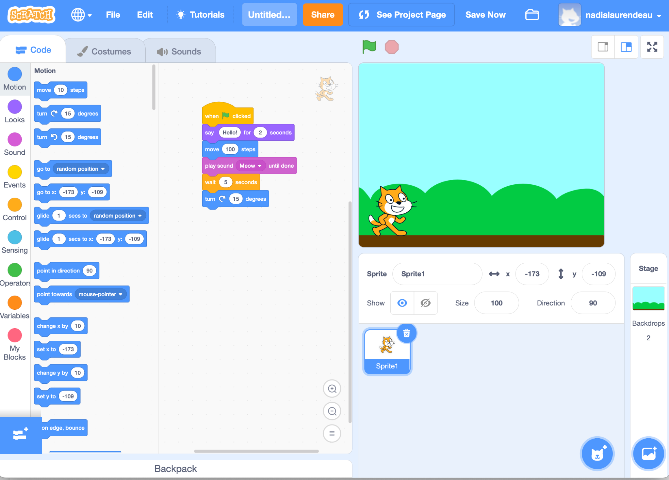
Presentation of Scratch
1
Do you know Scratch?
Look at the image.
What do you think we
can do with Scratch?
2
3

Slide 4
The Scratch Interface
02

Slide 5
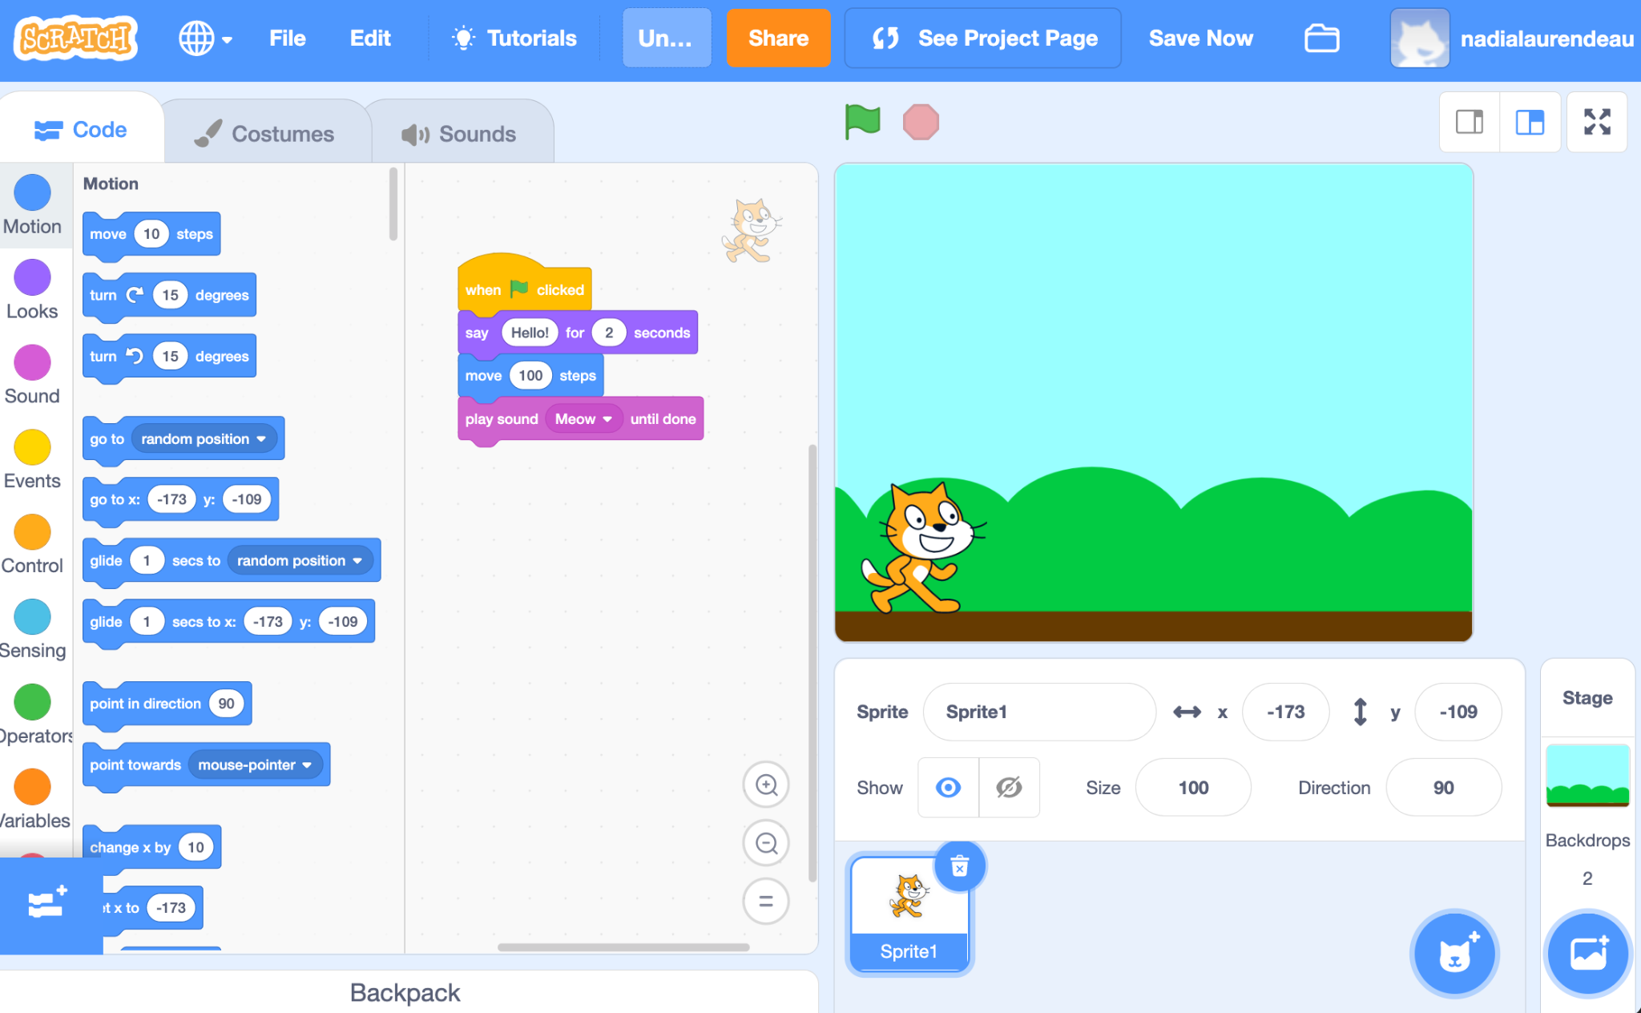

Costumes
Sounds
Stage Area
Programming Blocks
Script Area
Backdrops
Sprites
🔍 Find the green flag! What do you think it does?

Slide 6
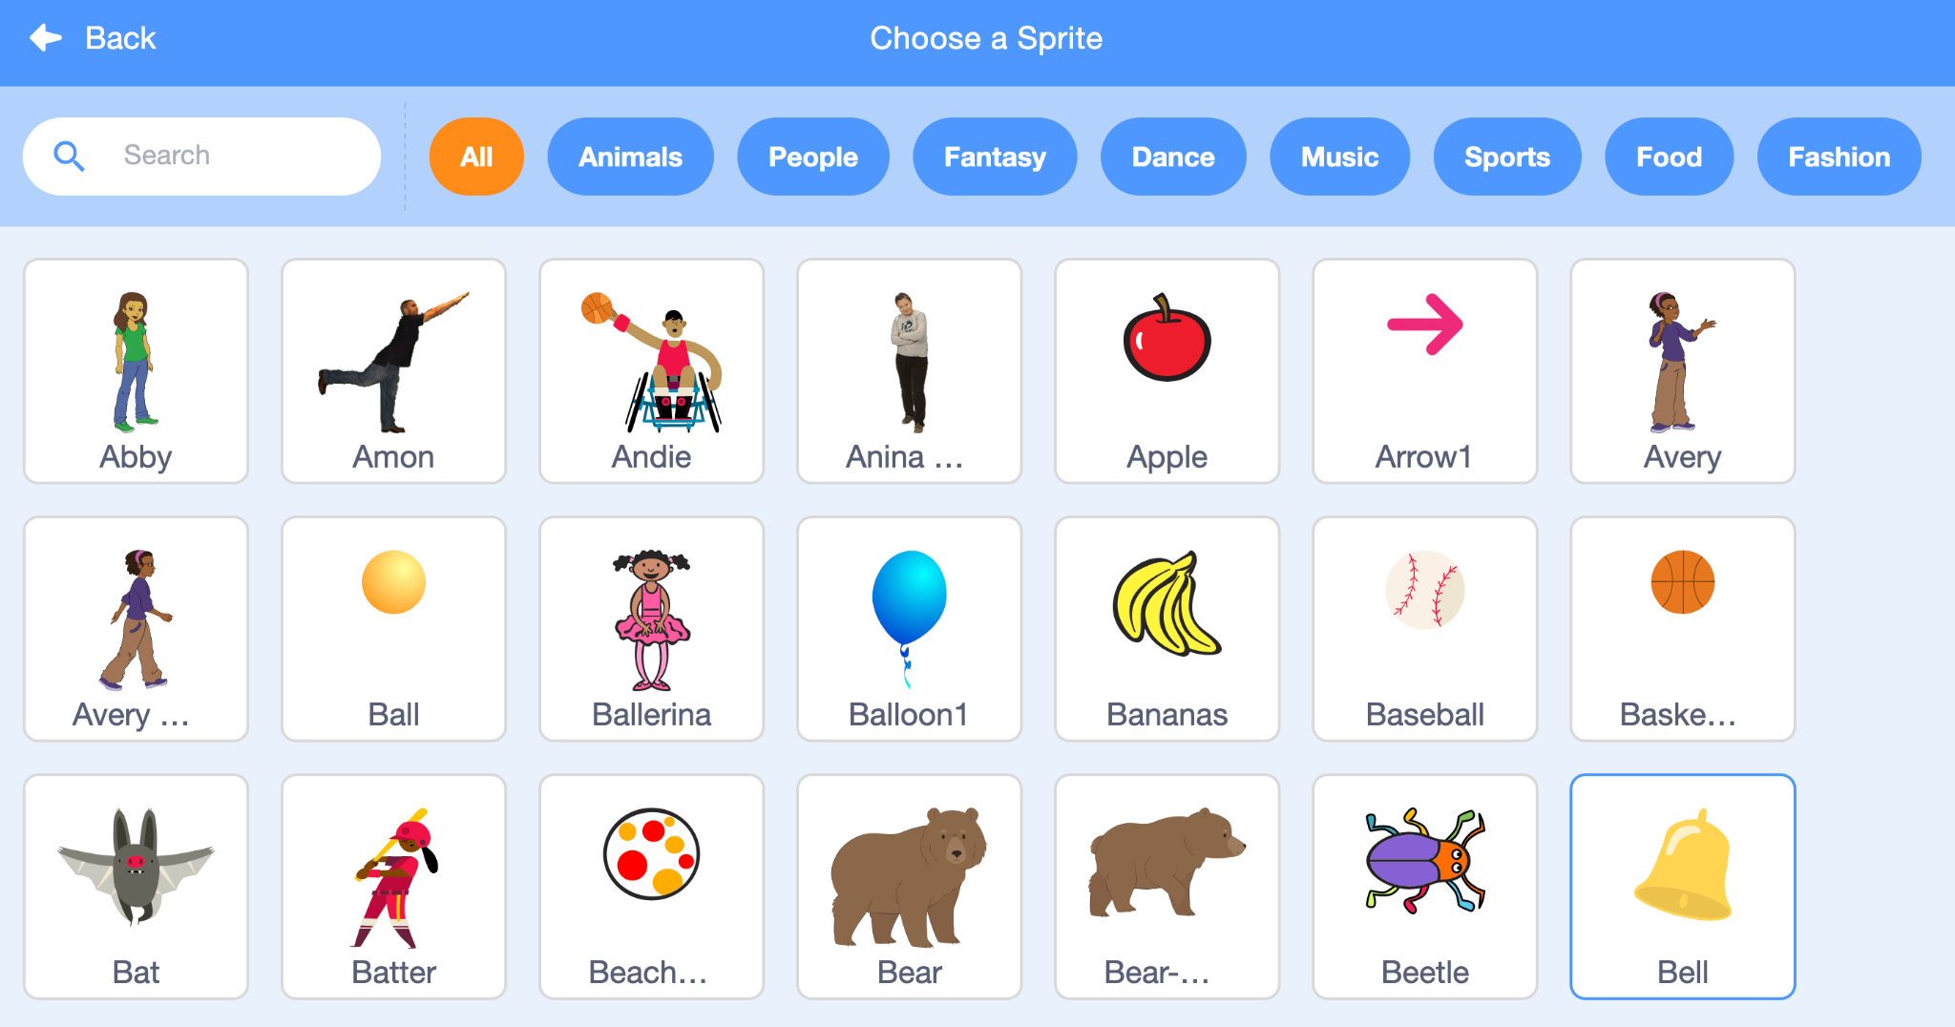
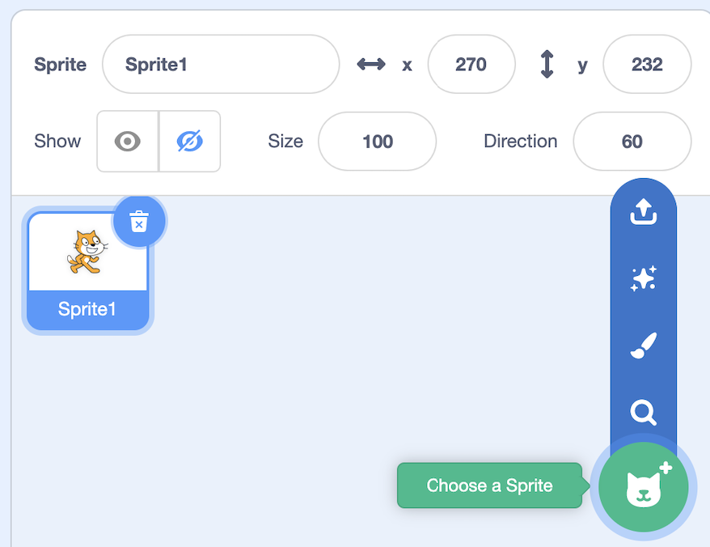
Sprites
🗑️ To delete
➕ To add

Slide 7
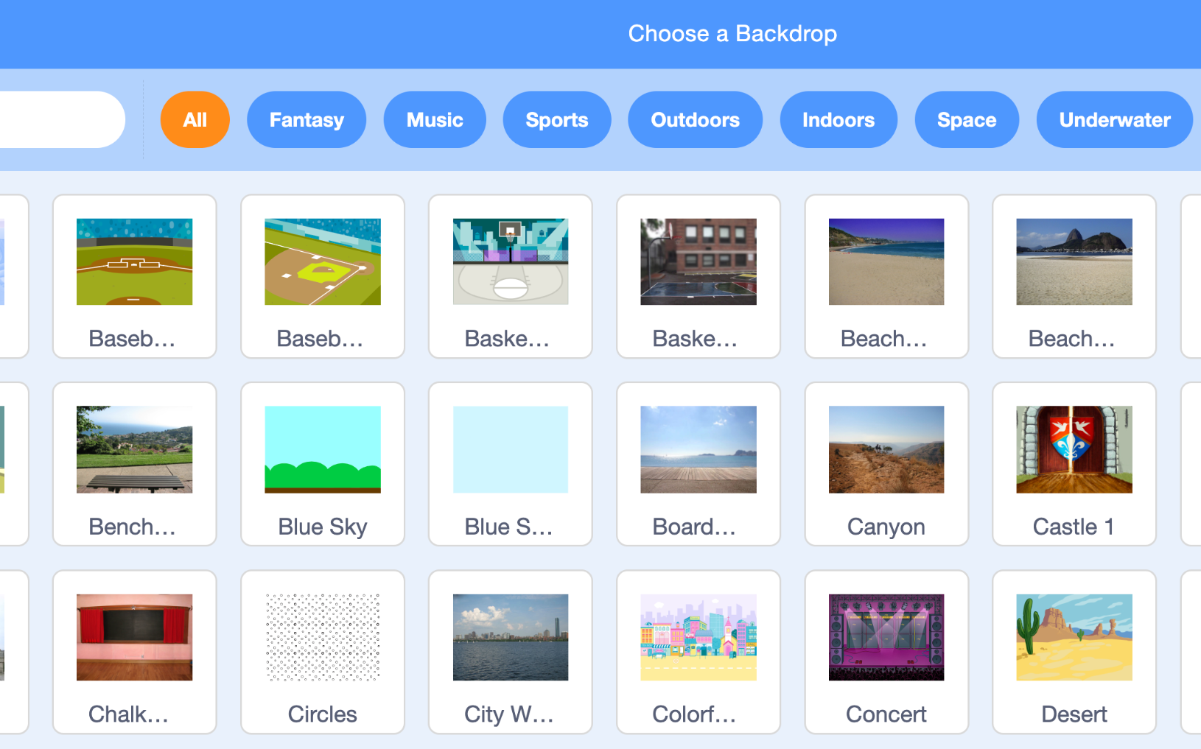
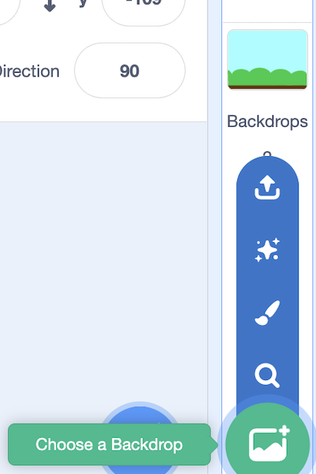
Backdrops
➕ To add

Slide 8
Coding in Scratch
03

Slide 9

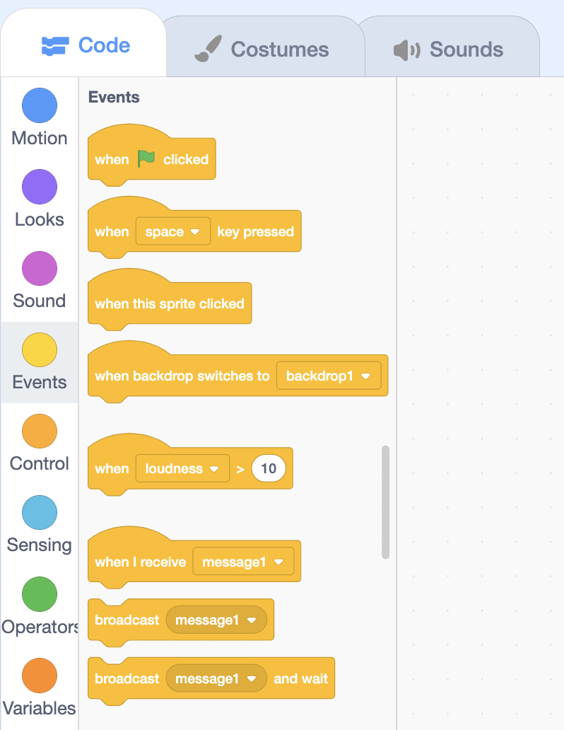
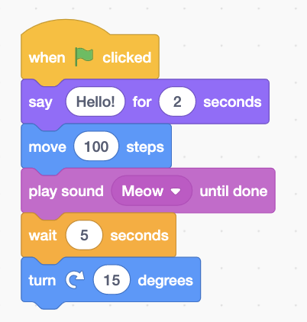
< Events >
To start a
program…

Slide 10
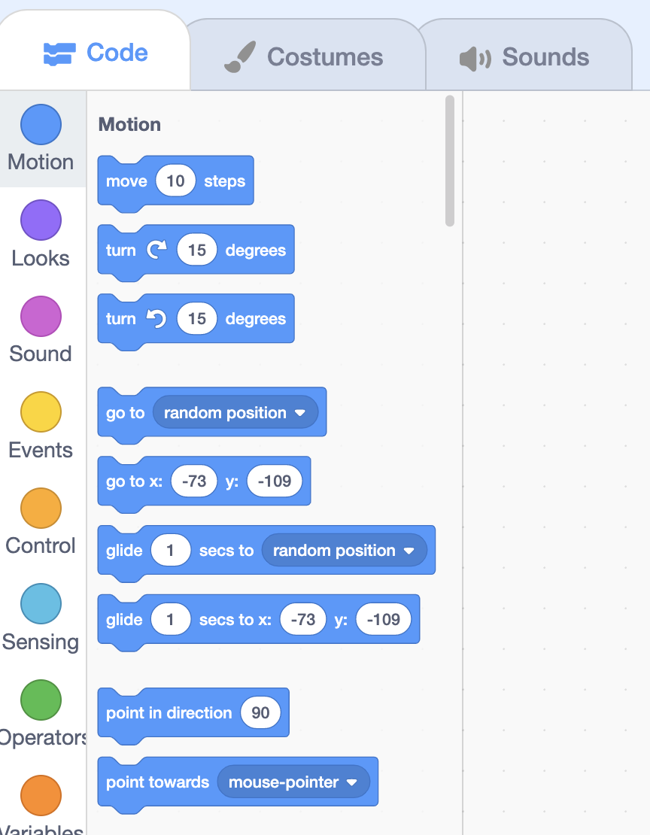
< Motion >
To make a sprite move.

Slide 11
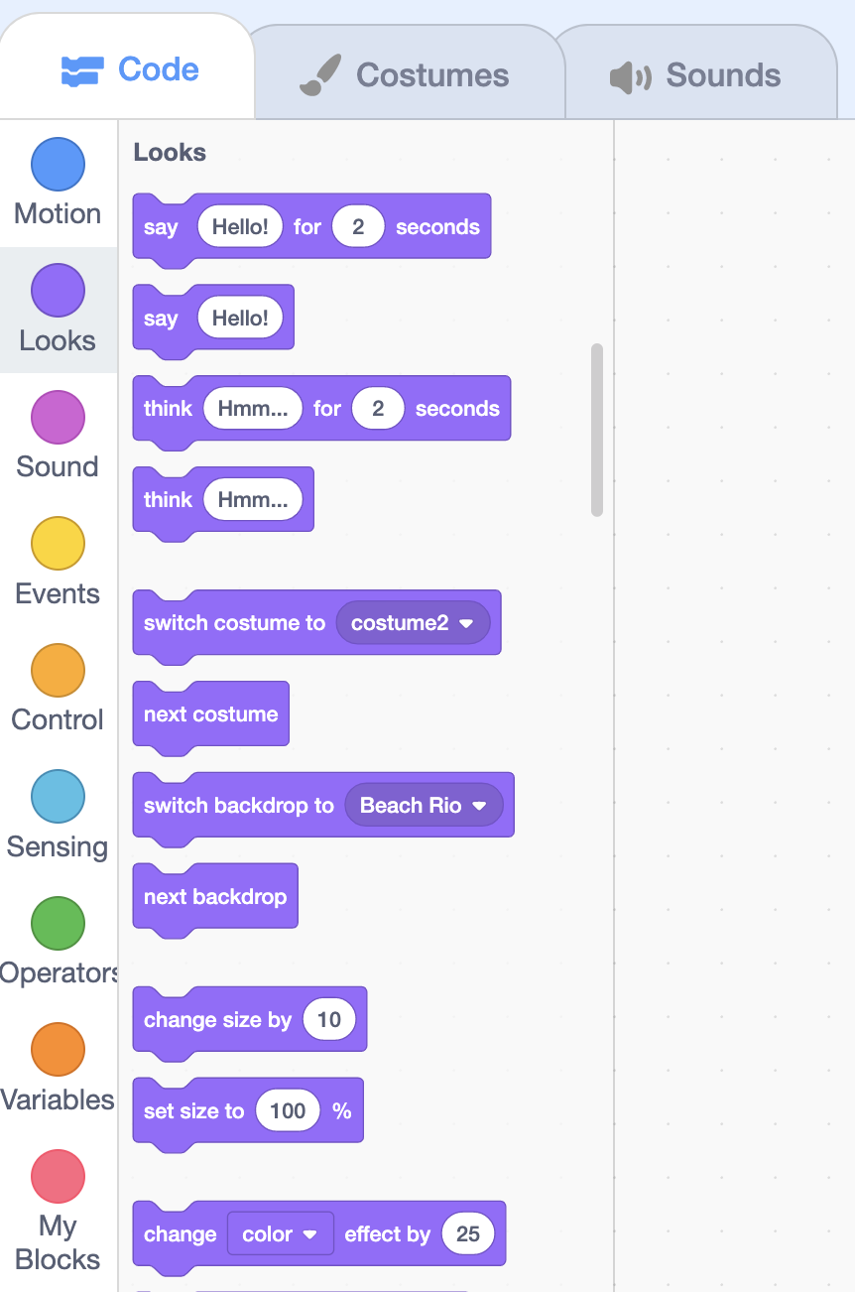
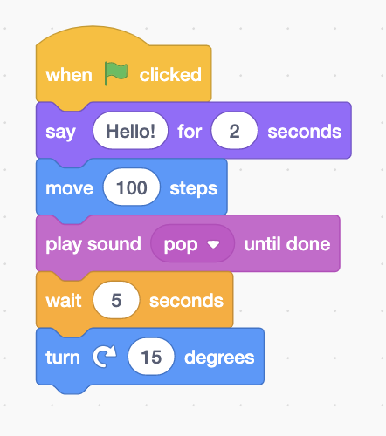
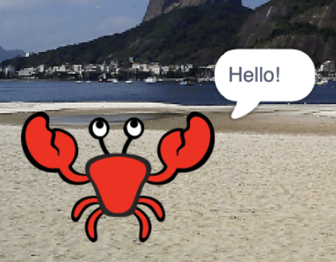

< Looks >
In this program, the crab says:
“Hello!”
In your opinion… What do the other blocks do?
Notes:
The "say" block allows you to put text in a speech bubble.
The block "think" allows you to put text in a thought bubble.
The block "switch costume to" allows you to change the image (costume) of the sprite. Some sprites already have several costumes. By modifying them, you can animate them.
The block "switch backdrop to" allows you to change the image of the backdrop. This way we can move our sprite to another "world".
The block "set size to" allows you to change the size of the sprite.
Other blocks are not shown on this page.

Slide 12
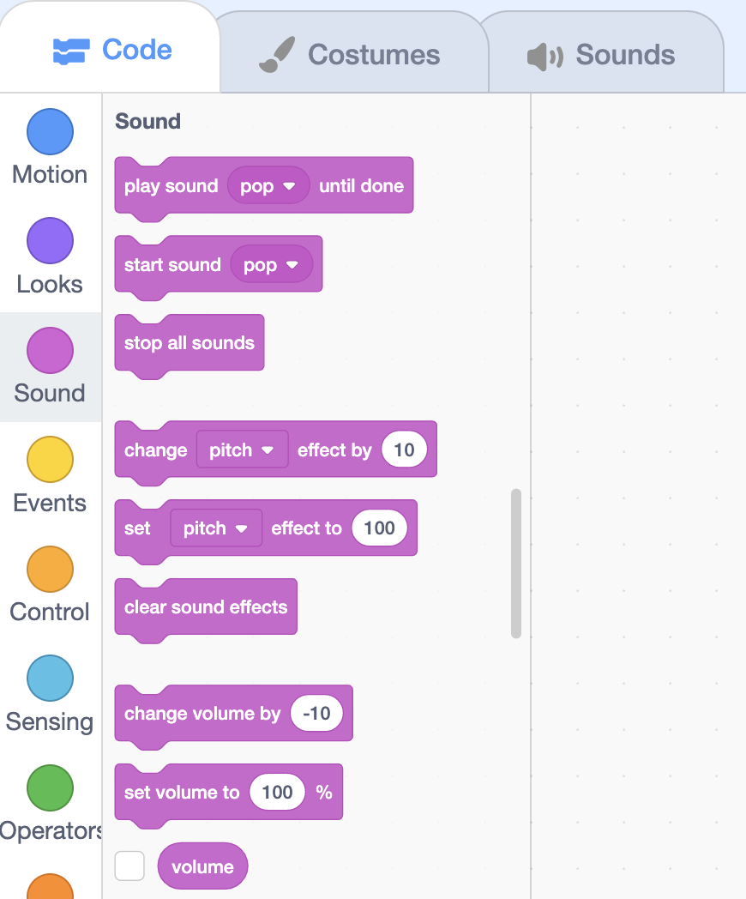

< Sound >
To play a sound…

Slide 13
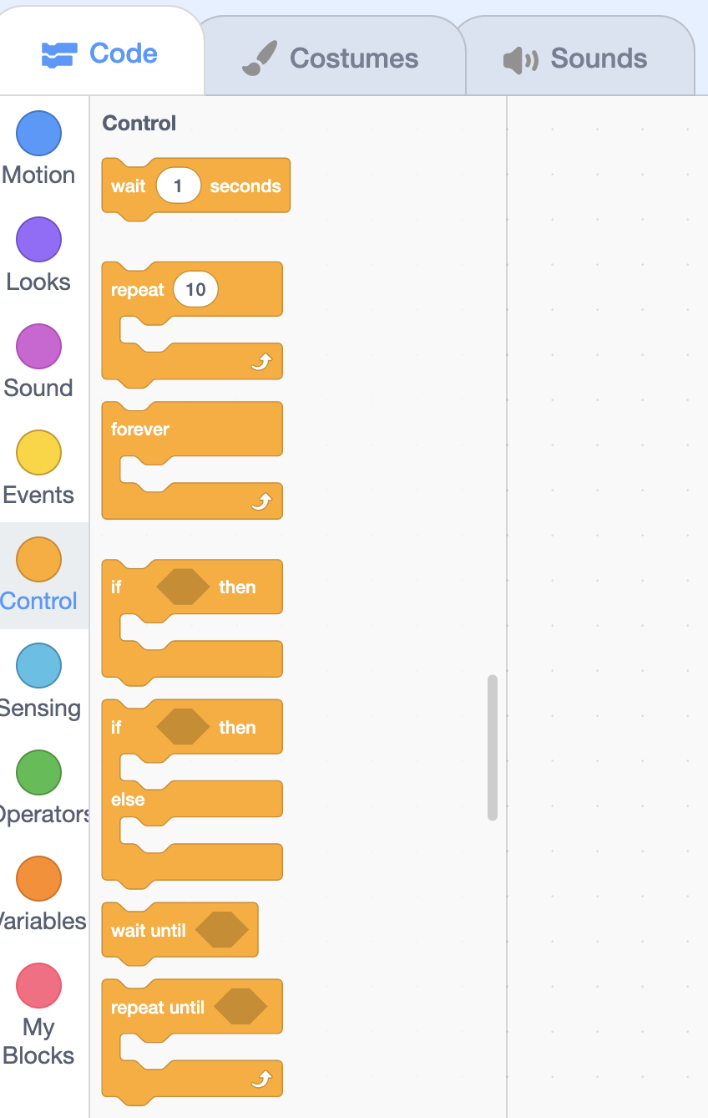
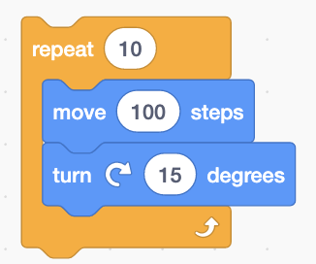
< Control >
In this program, the “ wait ” block allows for a delay before the next block.
In your opinion… What does the block: “repeat 10 times” mean?
Notes:
The “repeat” block allows the blocks contained within it to be executed (repeated) a certain number of times.

Slide 14
Let’s Review !
04

Slide 15


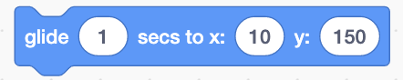
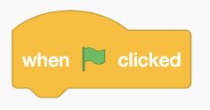
Which block should I use if I want to…
-
O
X
A
1. Start the program.
2. Make my sprite move forward.
3. Make my sprite think.
4. Play a sound.
B
C
D

Slide 16
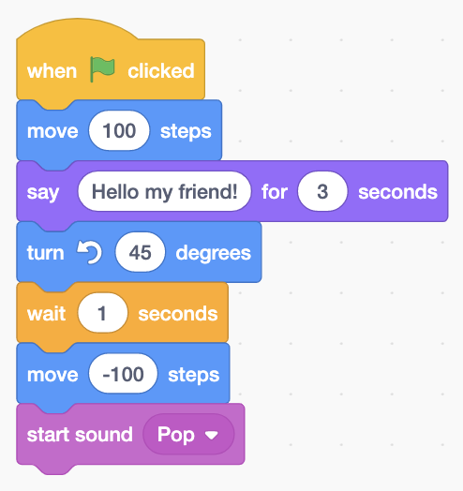
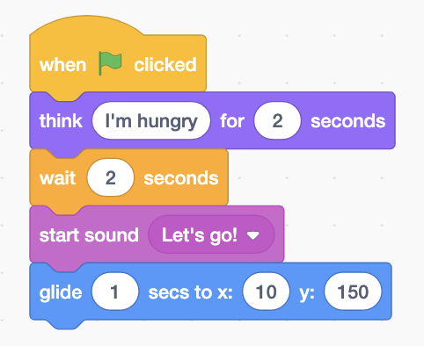
What will these programs do ?

Slide 17
Your Turn !
05

Slide 18
Create a program that…
A
Contains 2 sprites and a backdrop.
Makes the sprites talk together (use the “say” block).
Makes the sprites move.
Plays a sound.
B
C
D

Slide 19
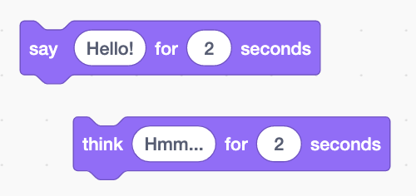
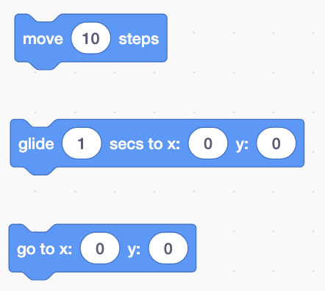
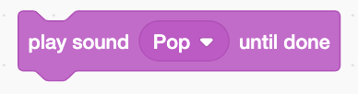
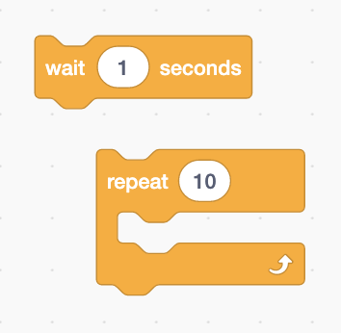
Blocks used in this program

Slide 20
kreocode.ca

