Slide 1
2 Digital Design Slides by Dr Mila Duncheva, Alasdair Reid, Victor Henquel, Dr Andrew Livingstone and Dr Jon Stinson (Edinburgh Napier University), Juan A Ferriz-Papi, Patrick Nolan and Shelley Doolan (University of Wales Trinity Saint David)

Slide 2
2A Digital skills, information management and communication

Slide 3
2A.1 Understand relevant design codes and standards
To successfully implement a Building Information Model (BIM), it is important to consider the whole life cycle of a built asset. In doing so, you should consider the following:
strategic planning
initial design
engineering
development
documentation and construction
day-to-day operations
maintenance
refurbishment, repair and end-of-life

Slide 4
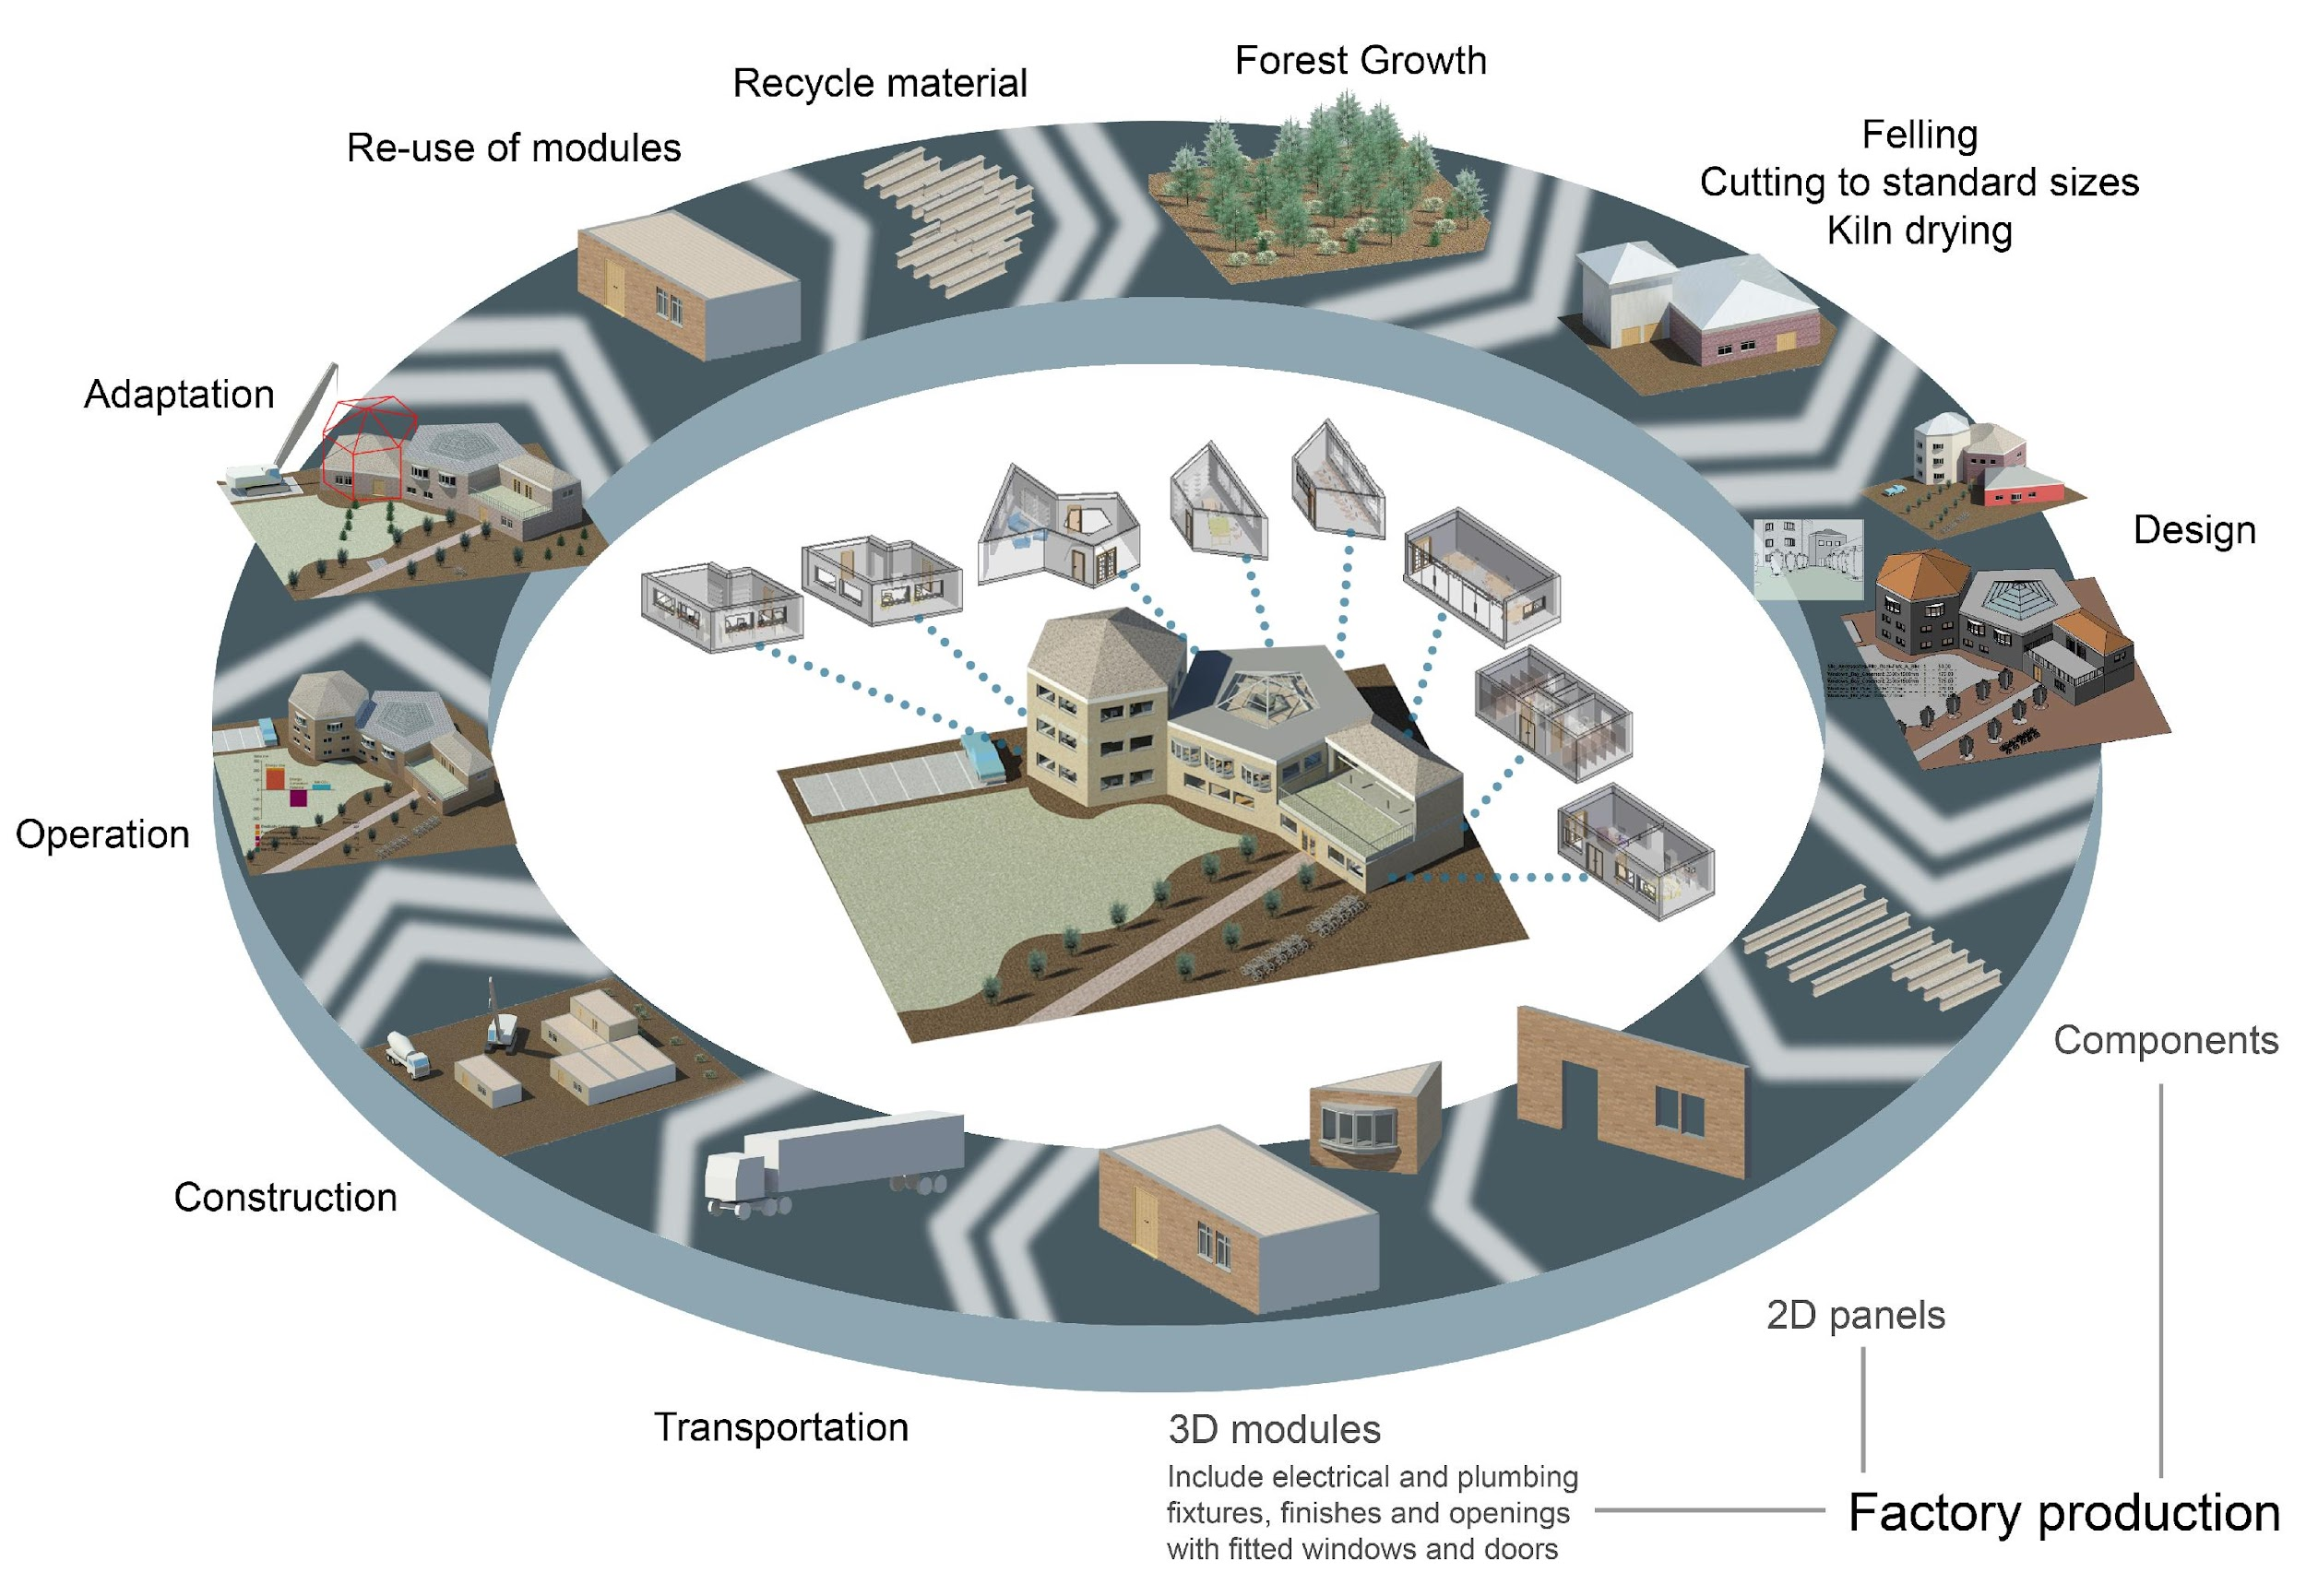
Image courtesy of Dr Mila Duncheva

Slide 5
2A.1 Understand relevant design codes and standards
In determining the whole life cycle of a built asset, there are a variety of standards and guidance documents to assist us in this task. These include:
British Standards (denoted by “BS”)
International Standards (denoted by “BS EN ISO”) are those that have been adopted as a European Standard
Publicly Available Specifications (denoted by “PAS”), are rapidly-developed standards, specifications, codes of practice or guidelines.

Slide 6
2A.1 Understand relevant design codes and standards
Standards:
PD 19650-0:2019 | Transition guidance to BS EN ISO 19650
BS EN ISO 19650-1:2018 | Concepts and principles Organization and digitization of information about buildings and civil engineering works, including building information modelling (BIM). Information management using building information modelling.
BS EN ISO 19650-2:2018 | Delivery phase of the assets Organization and digitization of information about buildings and civil engineering works, including building information modelling (BIM). Information management using building information modelling.
PAS 1192-3:2014 | Specification for information management for the operational phase of assets using building information modelling
BS 1192-4:2014 | Collaborative production of information. Fulfilling employer’s information exchange requirements using COBie. Code of practice
PAS 1192-5:2015 | Specification for security-minded building information modelling, digital built environments and smart asset management
PAS 1192-6:2018 | Specification for collaborative sharing and use of structured Health and Safety information using BIM
BS 8536-1:2015 | Briefing for design and construction. Code of practice for facilities management (Buildings infrastructure)
BS 8536-2:2016 | Briefing for de sign and construction. Code of practice for asset management (Linear and geographical infrastructure)

Slide 7
2A.1 Understand relevant design codes and standards
Guidance:
Guidance Part 1 | Concepts. Information management according to BS EN ISO 19650 Brief and high level and is aimed at a broad audience. It explores the general requirements of the ISO 19650 series alongside the case for building information modelling and digital transformation. ukbimframework.org
Guidance Part 2 | Processes for project delivery Explores the requirements of ISO 19650-2 in increasing detail, resource summary and associated resource map has been included along with content covering information requirements generally and content considering the purpose and requirements of the BIM execution plan. Note: This guidance document will be subject to quarterly updates. ukbimframework.org
Governments Soft Landings | Governments Soft Landings: Revised guidance for the public sector on applying BS8536 part 1 and 2, updated for ISO 19650

Slide 8
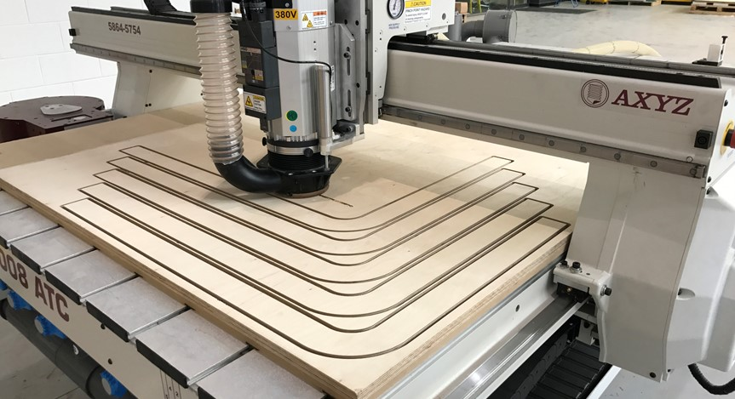
2A.2 Apply IT tools / digital design software use
Digital tools can enhance the design of offsite elements:
Computer Aided Design and Computer Aided Manufacturing (CAD/CAM)
Building Information Modelling (BIM)
Computer Numerical Control (CNC)
Successful offsite manufacture is based on effective information exchange between supply chains and BIM is part of this success.
Image courtesy of Construction Scotland Innovation Centre

Slide 9
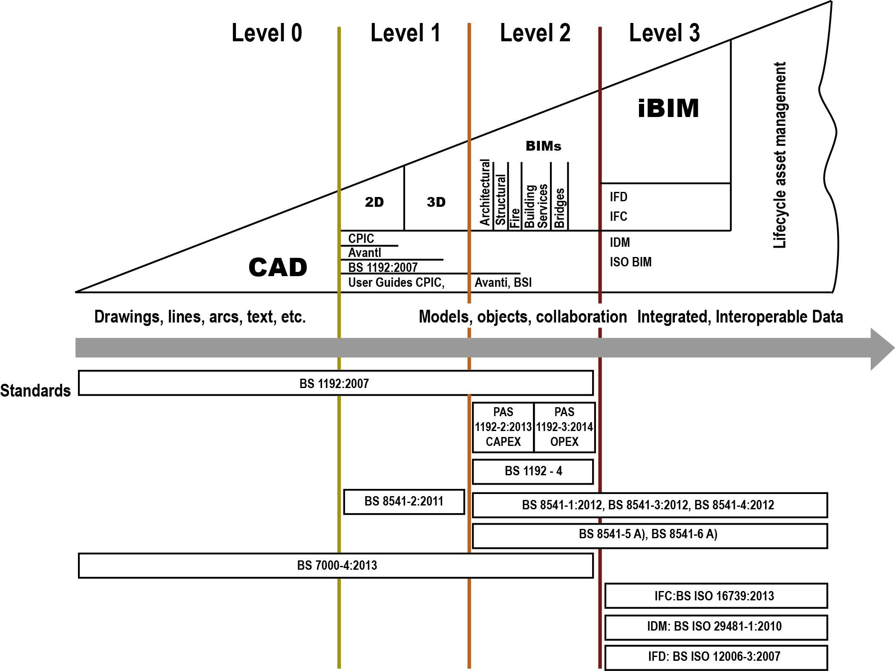
Bew-Richards BIM maturity model
Image Courtesy of Dr Mila Duncheva and Prof Robert Hairstans

Slide 10

2A.3 Understand the full range of materials and products used
Materials characteristics and data relates to the specification and performance of a given material. This includes dimensions, structural resistance and fire performance.
These characteristics can be sourced from the person creating the material within the software - or simply downloaded from any BIM library online.
Image courtesy of Offsite Awards - REHAU

Slide 11
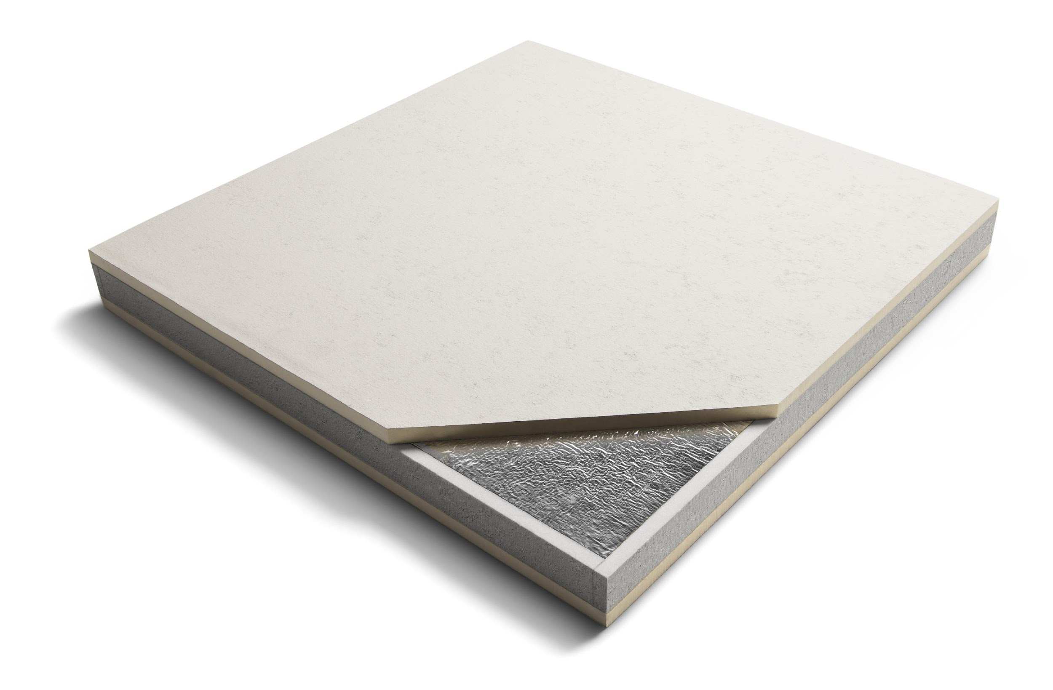
2A.3 Understand the full range of materials and products used
Materials maintenance data does not always relate to BIM objects and can be sourced as structured asset data throughout the construction phase using Construction Operations Building Information Exchange (COBie).
COBie is a standardised approach that allows the incorporation of essential information in the BIM process to support the operations, maintenance and management of assets by the owner and/or property manager.
Image courtesy of Offsite Awards - Recticel Insulation

Slide 12
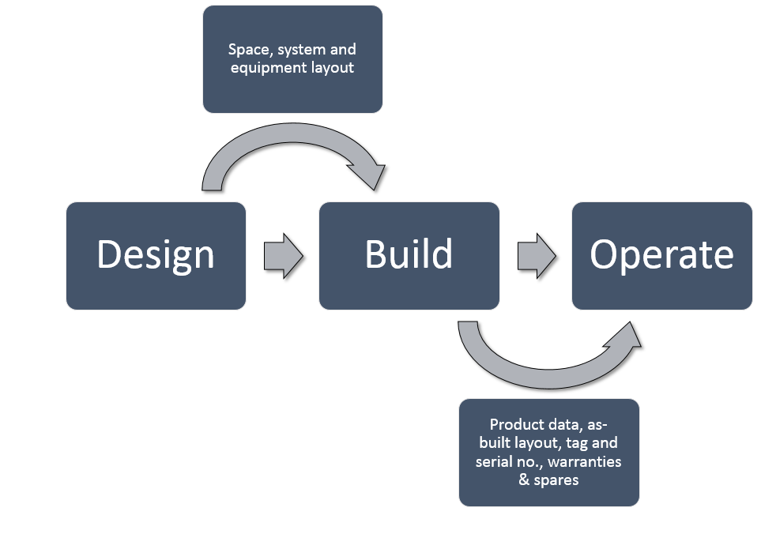
COBie process from RICS guidance on the international BIM implementation.
Image courtesy of Victor Henquel.

Slide 13
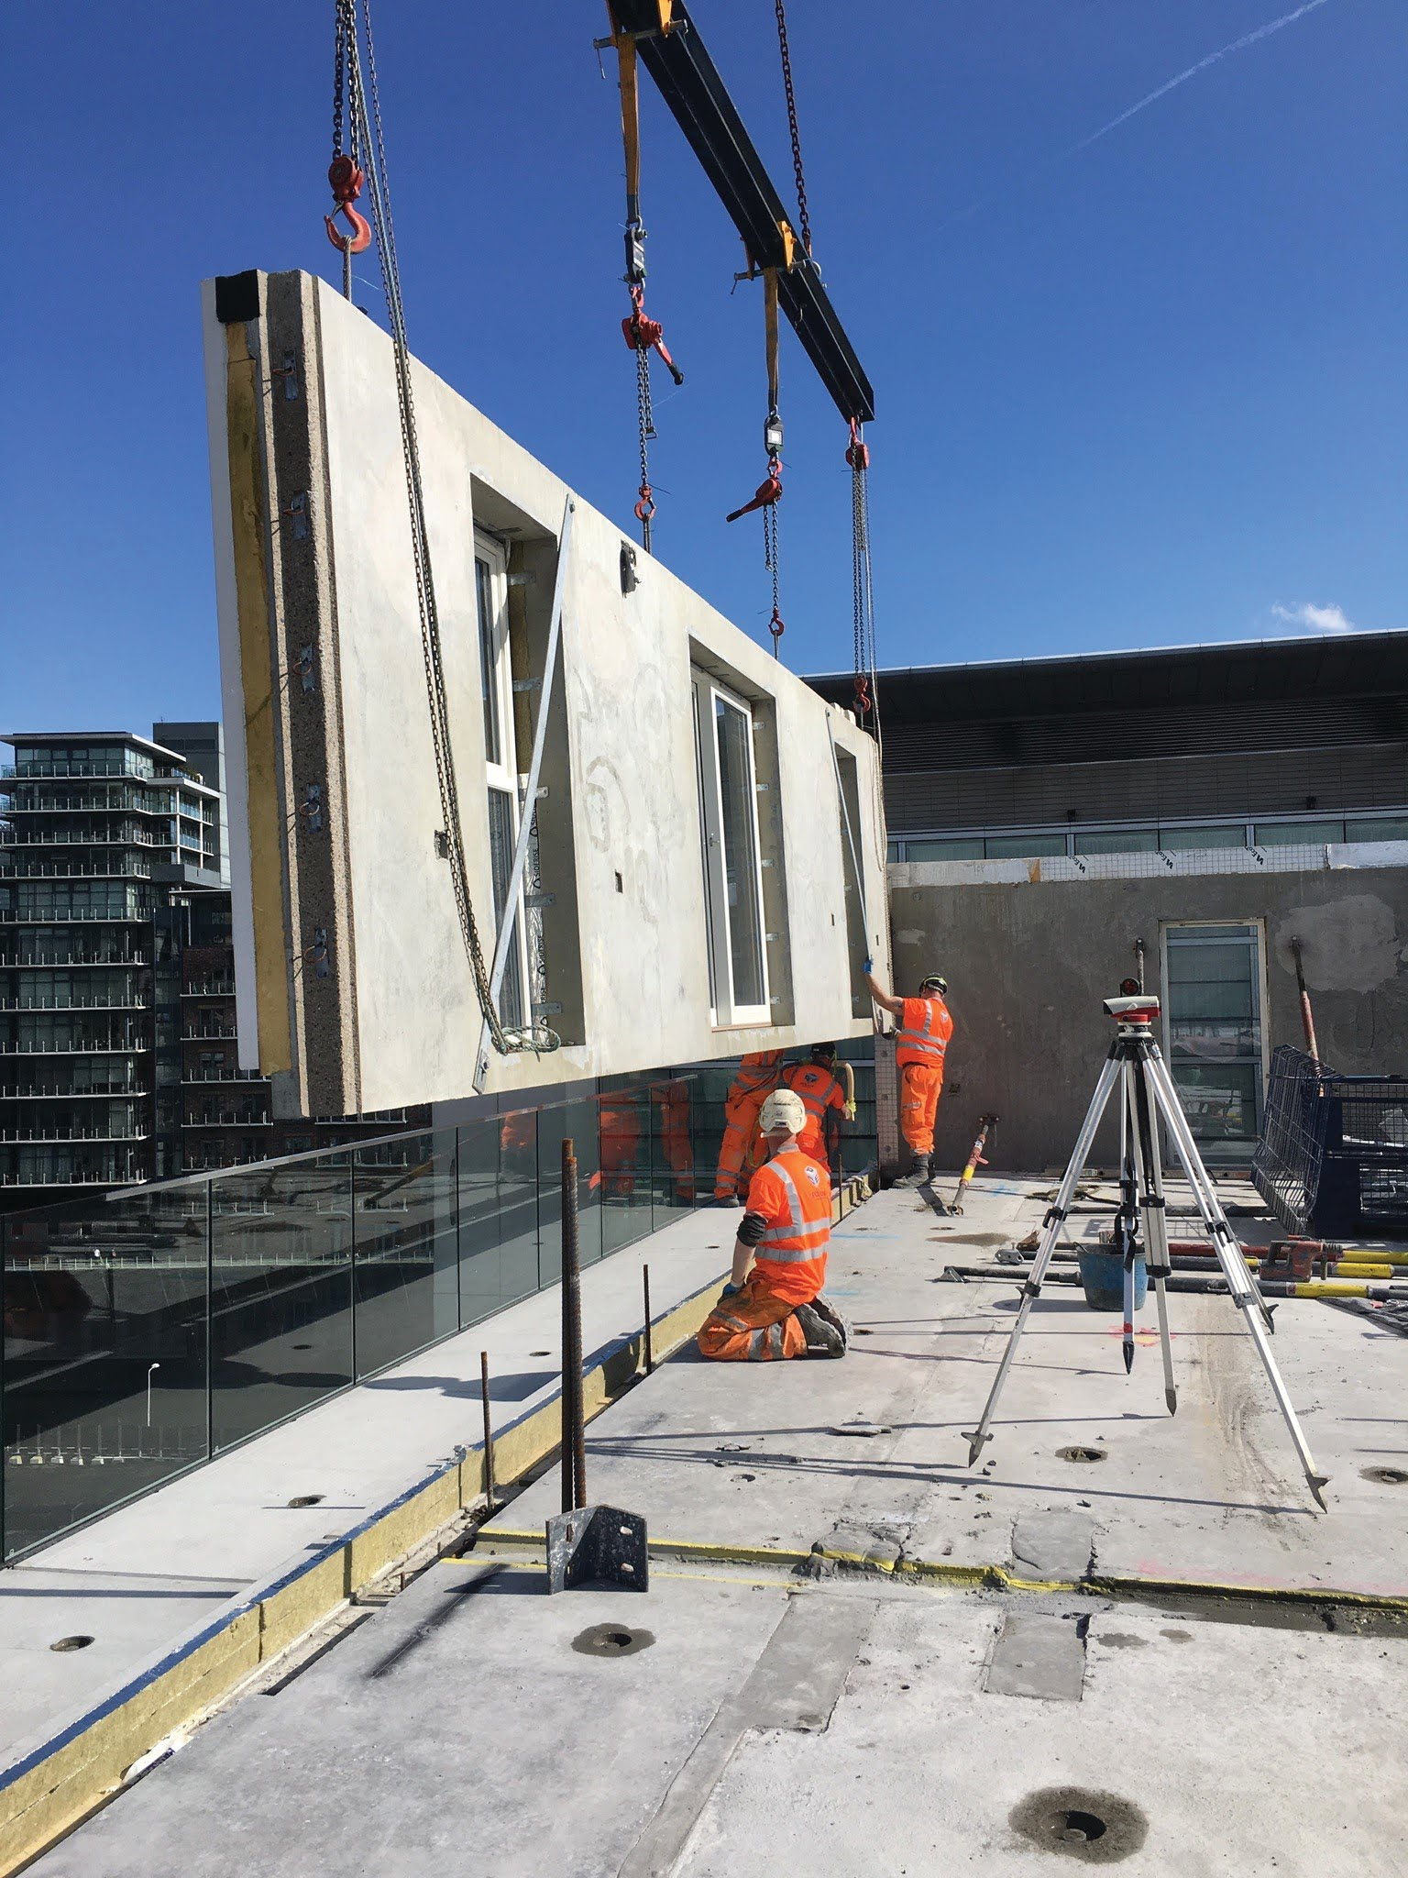
2A.3 Understand the full range of materials and products used
It is also important to:
understand the compatibility between systems,
be able to assess different design options or materials configuration, and demonstrate how such options can impact costs and/or sustainability.
understand the benefits of using prefabricated elements and offsite methods of construction.
Image courtesy of Offsite Awards - Chapman Taylor

Slide 14
2A.4 Create BIM enabled 3D model
Creating a BIM enabled 3D model allows designers in the first phase of the project to visualise the impact of geometry, material or building configuration changes on the performance of the building.
Parametric modelling allows the changes to be incorporated into the model.
Using a BIM enabled 3D model in an offsite context improves the coordination of the design, enables the detection of clashes between offsite elements and other building elements.
Key benefits include improved productivity, quality and accuracy.

Slide 15
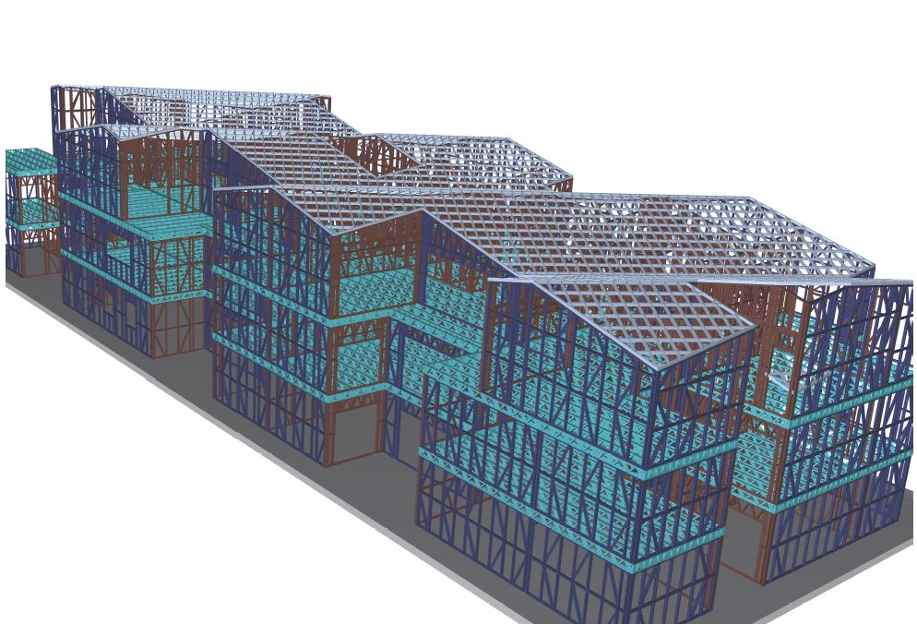
Image courtesy of Offsite Awards - Steel Frame Buildings

Slide 16
2A.5 Interpret assembly drawings (skilled worker)
Assembly drawings are made to communicate the design of a building, and are created by the design team
The task for the skilled workers and joiners in the factory is to interpret and understand as accurately as possible the assembly drawings.
You should be able to understand:
the purpose of technical details
the intention of the design team
the impact one specification can have on other offsite elements
and be able to visualise your finished building

Slide 17
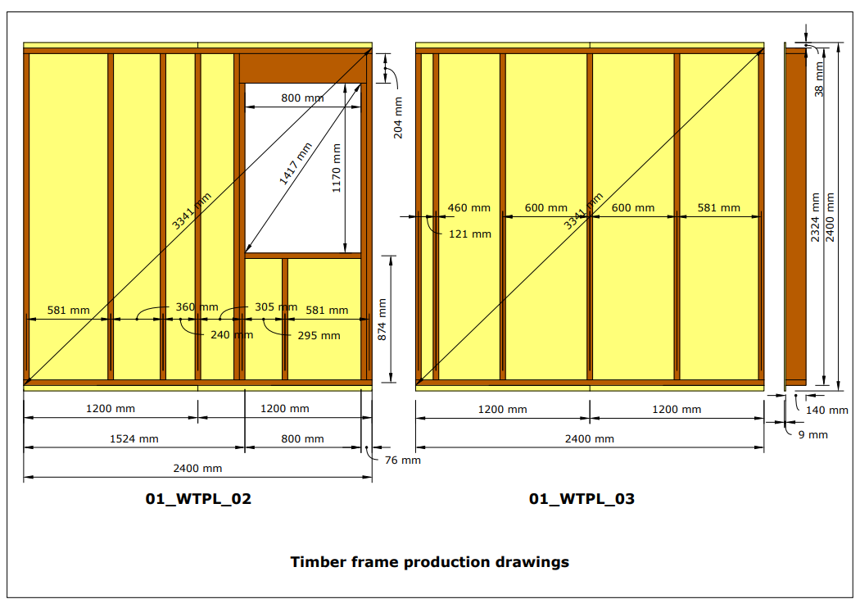
Timber frame production drawings.
Image courtesy of Victor Henquel
Notes:
Emphasise on the need to provide clear dimensions in production drawings.

Slide 18
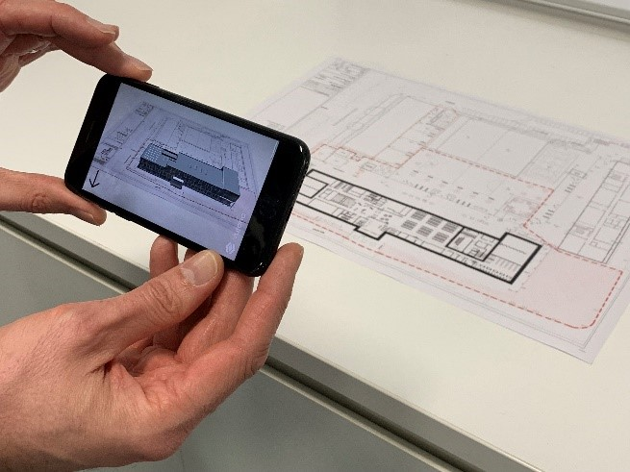
2A.6 Create and modify BIM objects, 2D technical drawings, 3D models (supervisor)
As well as creating BIM objects, the design team has to create 3D models with parametric components from BIM-enabled design software.
Using different software solutions, you can produce and modify detailed BIM objects at the required level of information for the manufacture and assembly of offsite components in the factory.
Image courtesy of Offsite Awards - MID Group

Slide 19
2B Procurement, tendering and contracts

Slide 20
2B.1 Calculate quantities and estimate costs from 3D models
BIM-enabled 3D models can be used to create bills of quantities and cutting lists during the procurement phase, by linking the model with pricing software.
Within the software, the cost is linked to the type of material / components used in the design as well as the type of offsite system used.
In using the software, you always have an up to date bill of quantities - thus avoiding any mistakes during costing and procurement.

Slide 21
2B.2 Analyse designs based on lean waste and value-added (supervisor)
As a supervisor you should be able to make design decisions based on lean wastes. As a reminder, there are three types of activities:
Value-adding
Necessary non-value adding
Waste (or ‘muda’ in lean terminology originating from Japanese)
To identify how your and your colleagues’ design impacts lean waste, you should think about the interconnection between design, manufacturing and onsite placement and assembly in offsite construction.

Slide 22
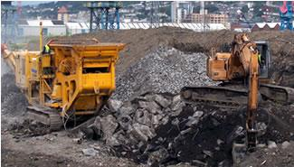
Concrete case study 1
The volume of waste that the construction industry produces is outrageous. There is the need to reintroduce aggregates waste in the system and produce new construction materials.
The application of offsite construction to coastal defence is very beneficial. It can develop big, heavy blocks with different shapes that interlock and create surfaces and volumes that protect the coast from erosion. Similar solutions can also be designed for river banks and flood prevention/protection.
Image courtesy of Juan A Ferriz-Papi and Shelley Doolan

Slide 23
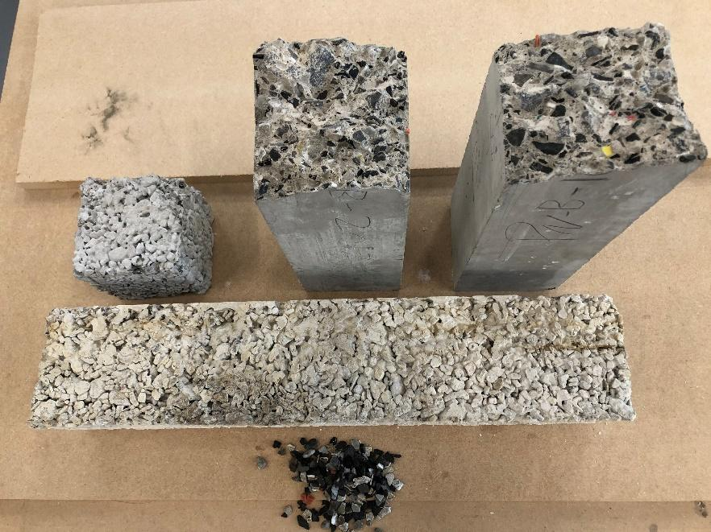
Concrete case study 2
Recycled plastics can be used as a replacement of aggregates. This solution shows potential benefits if it is applied to offsite construction elements.
Lighter concrete products can be obtained, as well as other potential improvements in thermal and acoustic insulation.
This could benefit offsite construction, e.g. reducing weight of cladding elements and reducing cost of transport and lifting.
Image courtesy of Juan A Ferriz-Papi

Slide 24
2C Health and safety

Slide 25
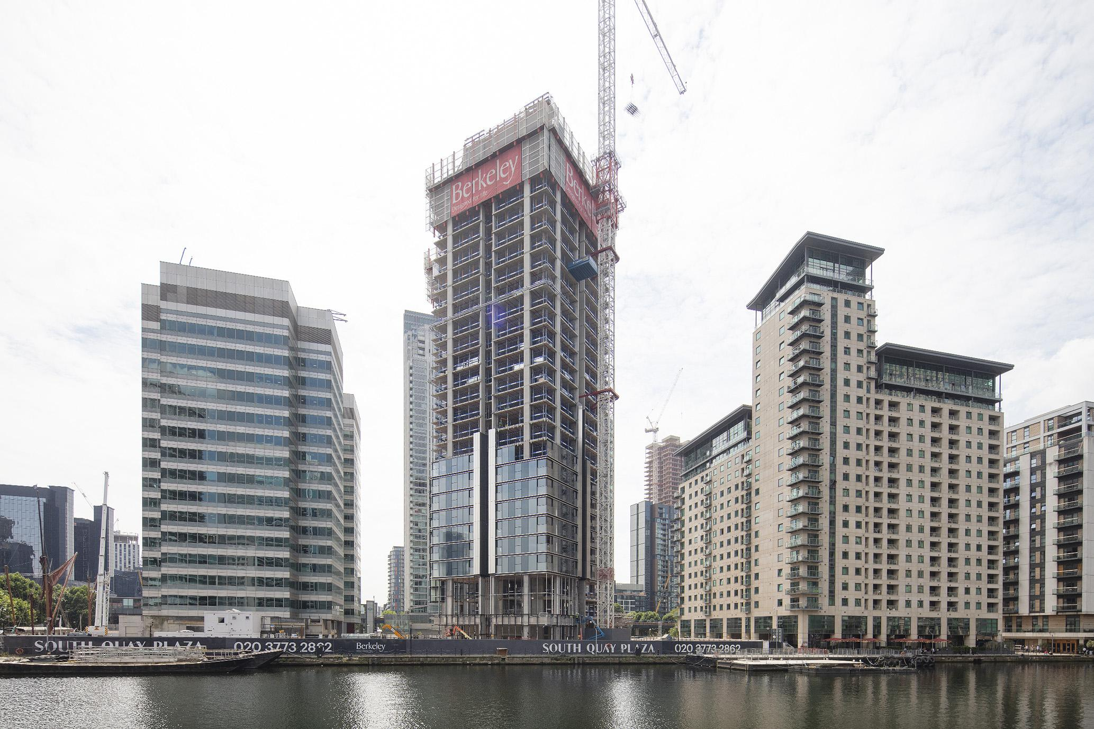
2C.1 Understand the full range of materials and products used
During the offsite construction process each stage requires a detailed evaluation of health and safety issues.
The early design phase thus needs to:
adapt the size of sections
think about the transportation
consider lifting and assembly of modules, units or panels.
Image courtesy of Offsite Awards - Berkeley Homes

Slide 26

2C.1 Understand the full range of materials and products used
Further prefabrication improvement exists where cladding panels are fitted with windows and doors during the manufacturing stage in the factory.
This reduces the time spent working at height during the assembly.
An example of this are precast cladding panels.
Image courtesy of Offsite Awards - Kier

Slide 27
2C.2 Analyse digital rehearsals (4D) for health and safety
Both 3D and 4D models can significantly help reduce health and safety risks.
A 3D model combined with a 3D scan of the site provides information for the planning team.
4D object data corresponds to the planning data incorporating the construction phase information. In simulating the transport and assembly of the project, the potential risks and hazards are visible allowing assembly teams to be prepared.

Slide 28

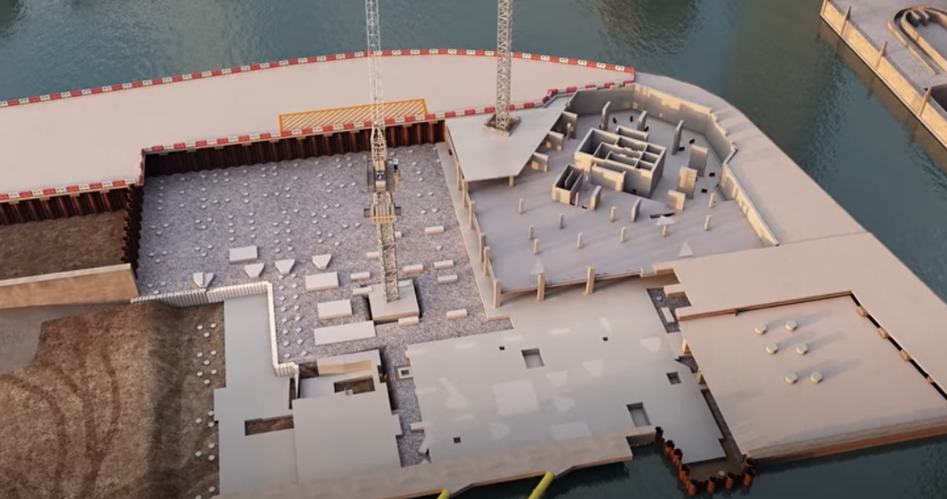
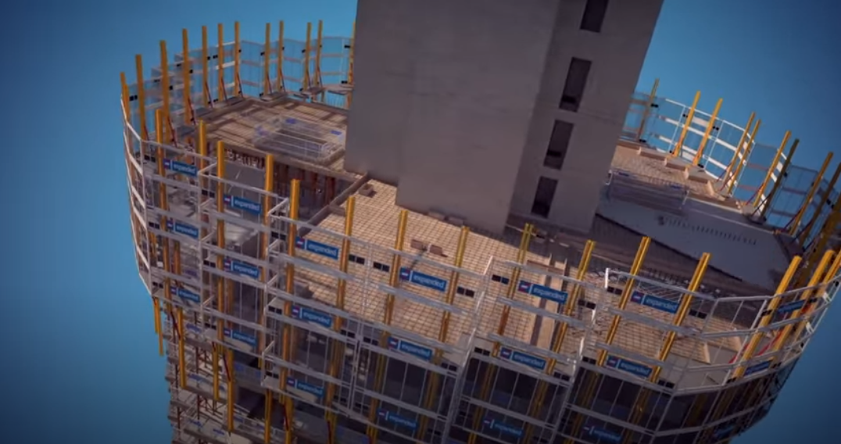
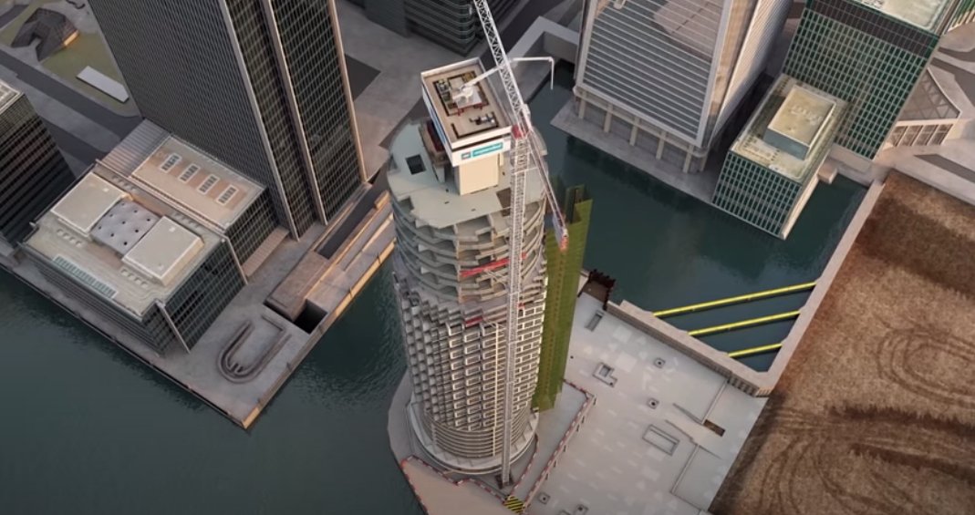
2C.2 Analyse digital rehearsals (4D) for health and safety
Images courtesy of Laing O'Rourke

Slide 29
2C.3 Apply digital skills to health and safety (supervisors)
By using three-dimensional digital models, this can provide greater opportunities to identify and design out foreseeable risk at an early stage, as a result of better planning of the design and construction phases.
Additionally, 4D animations can be used to review and better communicate the:
Construction sequences
Access
Construction options
Hazards and risks.

Slide 30
2D Management and planning

Slide 31
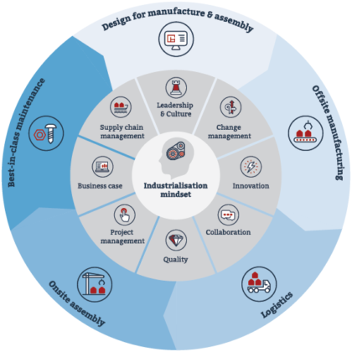
2D.1 Apply lean methodologies and order of sequence to offsite digital design
Through each of the projects stages, value is generated to the customer and lean wastes are reduced by applying an industrialisation mindset in this approximate order:
Leadership & Culture
Change management
Innovation
Collaboration
Quality
Project management
Business case
Supply chain management
Image courtesy of the Supply Chain Sustainability School

Slide 32
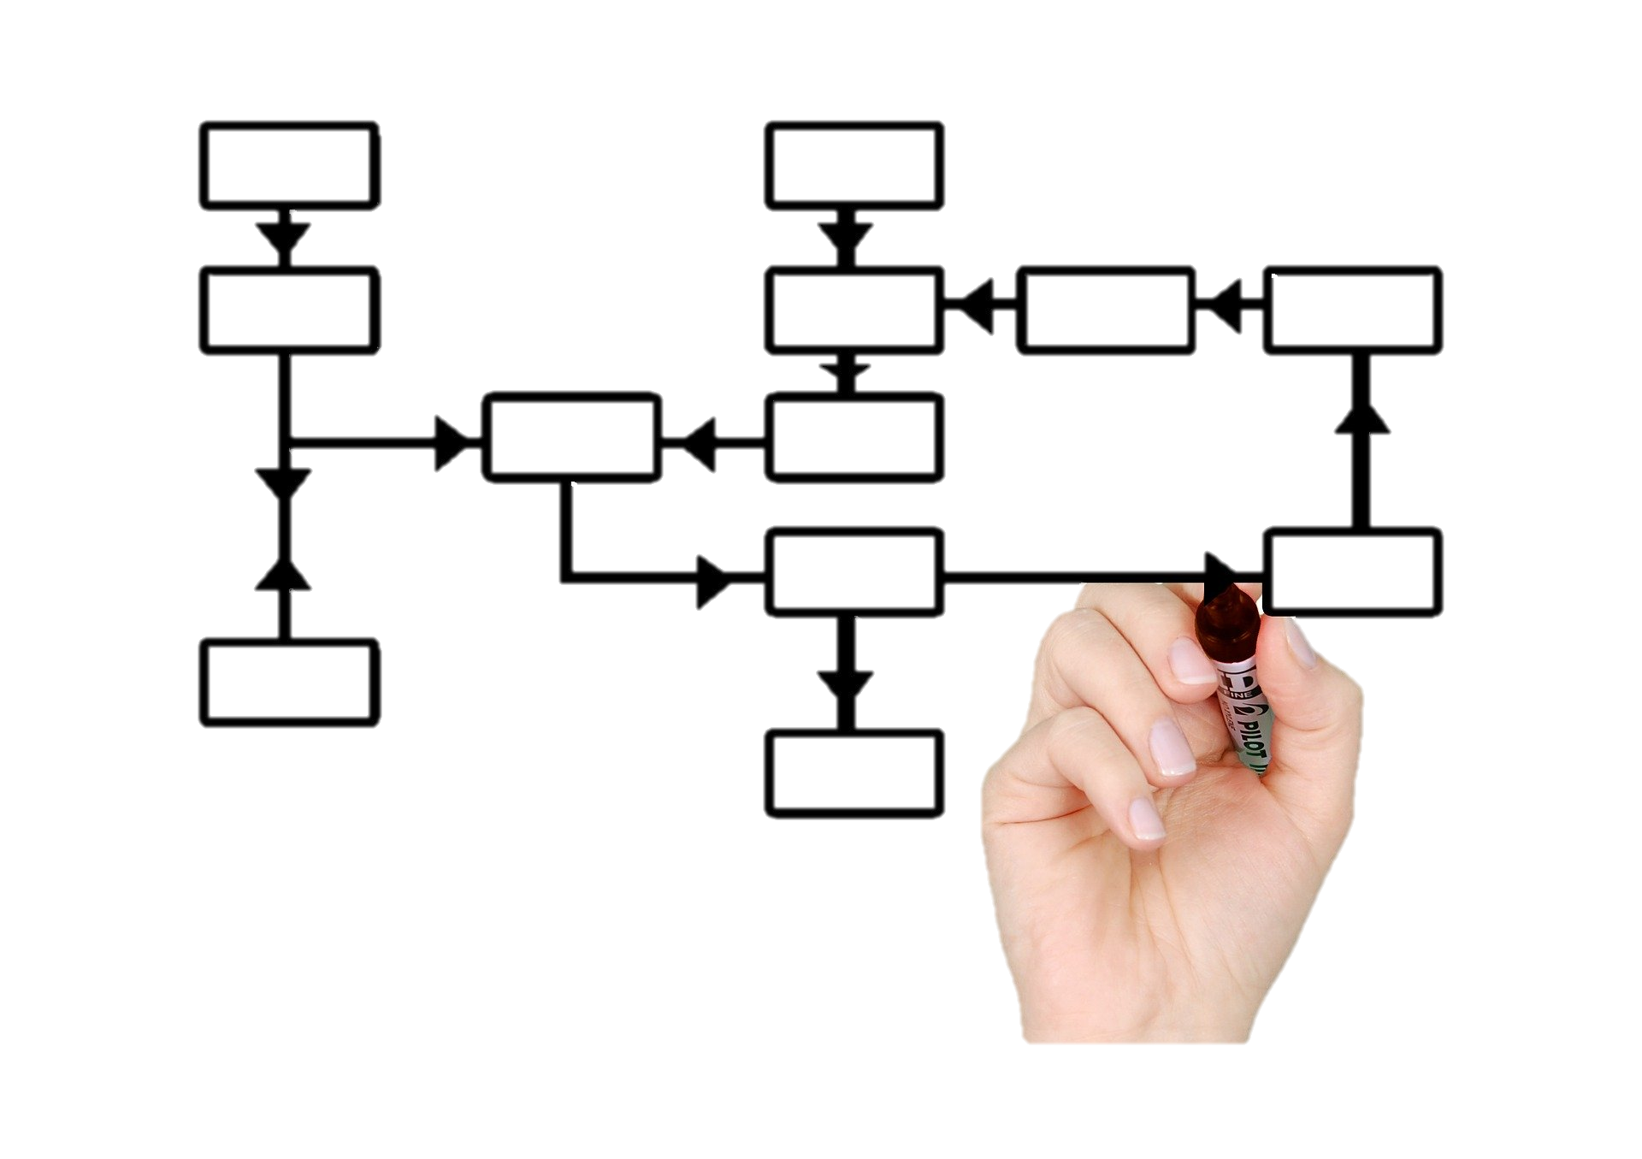
2D.1 Apply lean methodologies and order of sequence to offsite digital design
In lean thinking, it is important to create a consistent flow of activities driven by clients’ requirements. This is often referred to as a ‘value stream’ and can help to reduce lead-in times whilst creating value for the end user. Try to:
map the whole value stream for your project from start to completion
see how your work can create maximum value for the downstream processes
and how you can reduce non-value adding activities

Slide 33
2D.2 Apply IT tools
The way of managing and planning projects is changing.
Today, many technologies assist in the planning of offsite construction projects
New digital tools tend to focus on the collaborative aspect of working – enabling improved communication between the project stakeholders
Key benefits include time and cost savings.

Slide 34
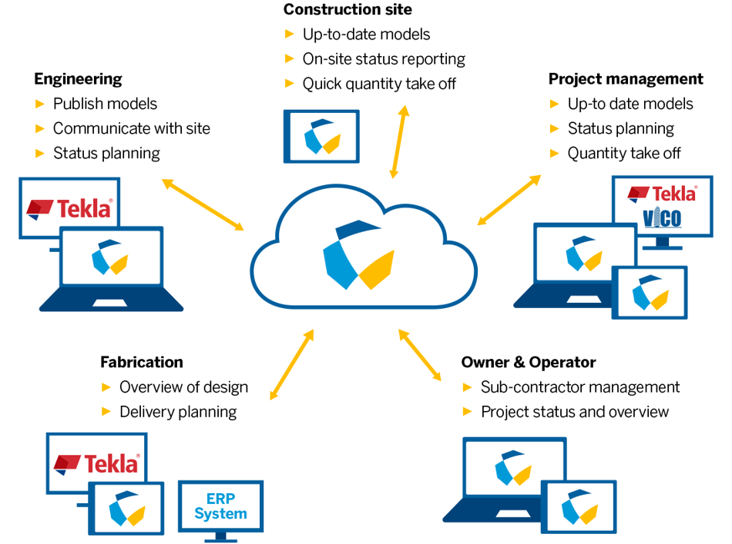
2D.2 Apply IT tools
Image courtesy of Trimble Connect

Slide 35

2D.3 Understand early engagement
The early engagement of stakeholders in the design is often identified as a key component in the success of an offsite construction project.
By engaging the different stakeholders as soon as possible in the design, it creates a larger panel of experts hence a better expertise on all aspects of the project.
By working in a collaborative manner the communication is also improved, thus there is a better anticipation of problems.

Slide 36
2D.4 Understand the RIBA plan of works
The DfMA overlay of the RIBA plan of work highlights aspects to be considered to successfully complete a project using modern methods of construction. In 2020 the RIBA plan of works was updated to include manufacturing and construction in stage 5, making more offsite-friendly.
Through BIM, designers can create creating highly detailed, data-rich, fabrication quality models which can be implemented into all the project stages, from stage 1 to 7.
Stage 0. Strategic definition
Stage 1. Preparation and brief
Stage 2. Concept design
Stage 3. Spatial coordination
Stage 4. Technical design
Stage 5. Manufacturing and construction
Stage 6. Handover
Stage 7. Building use

Slide 37
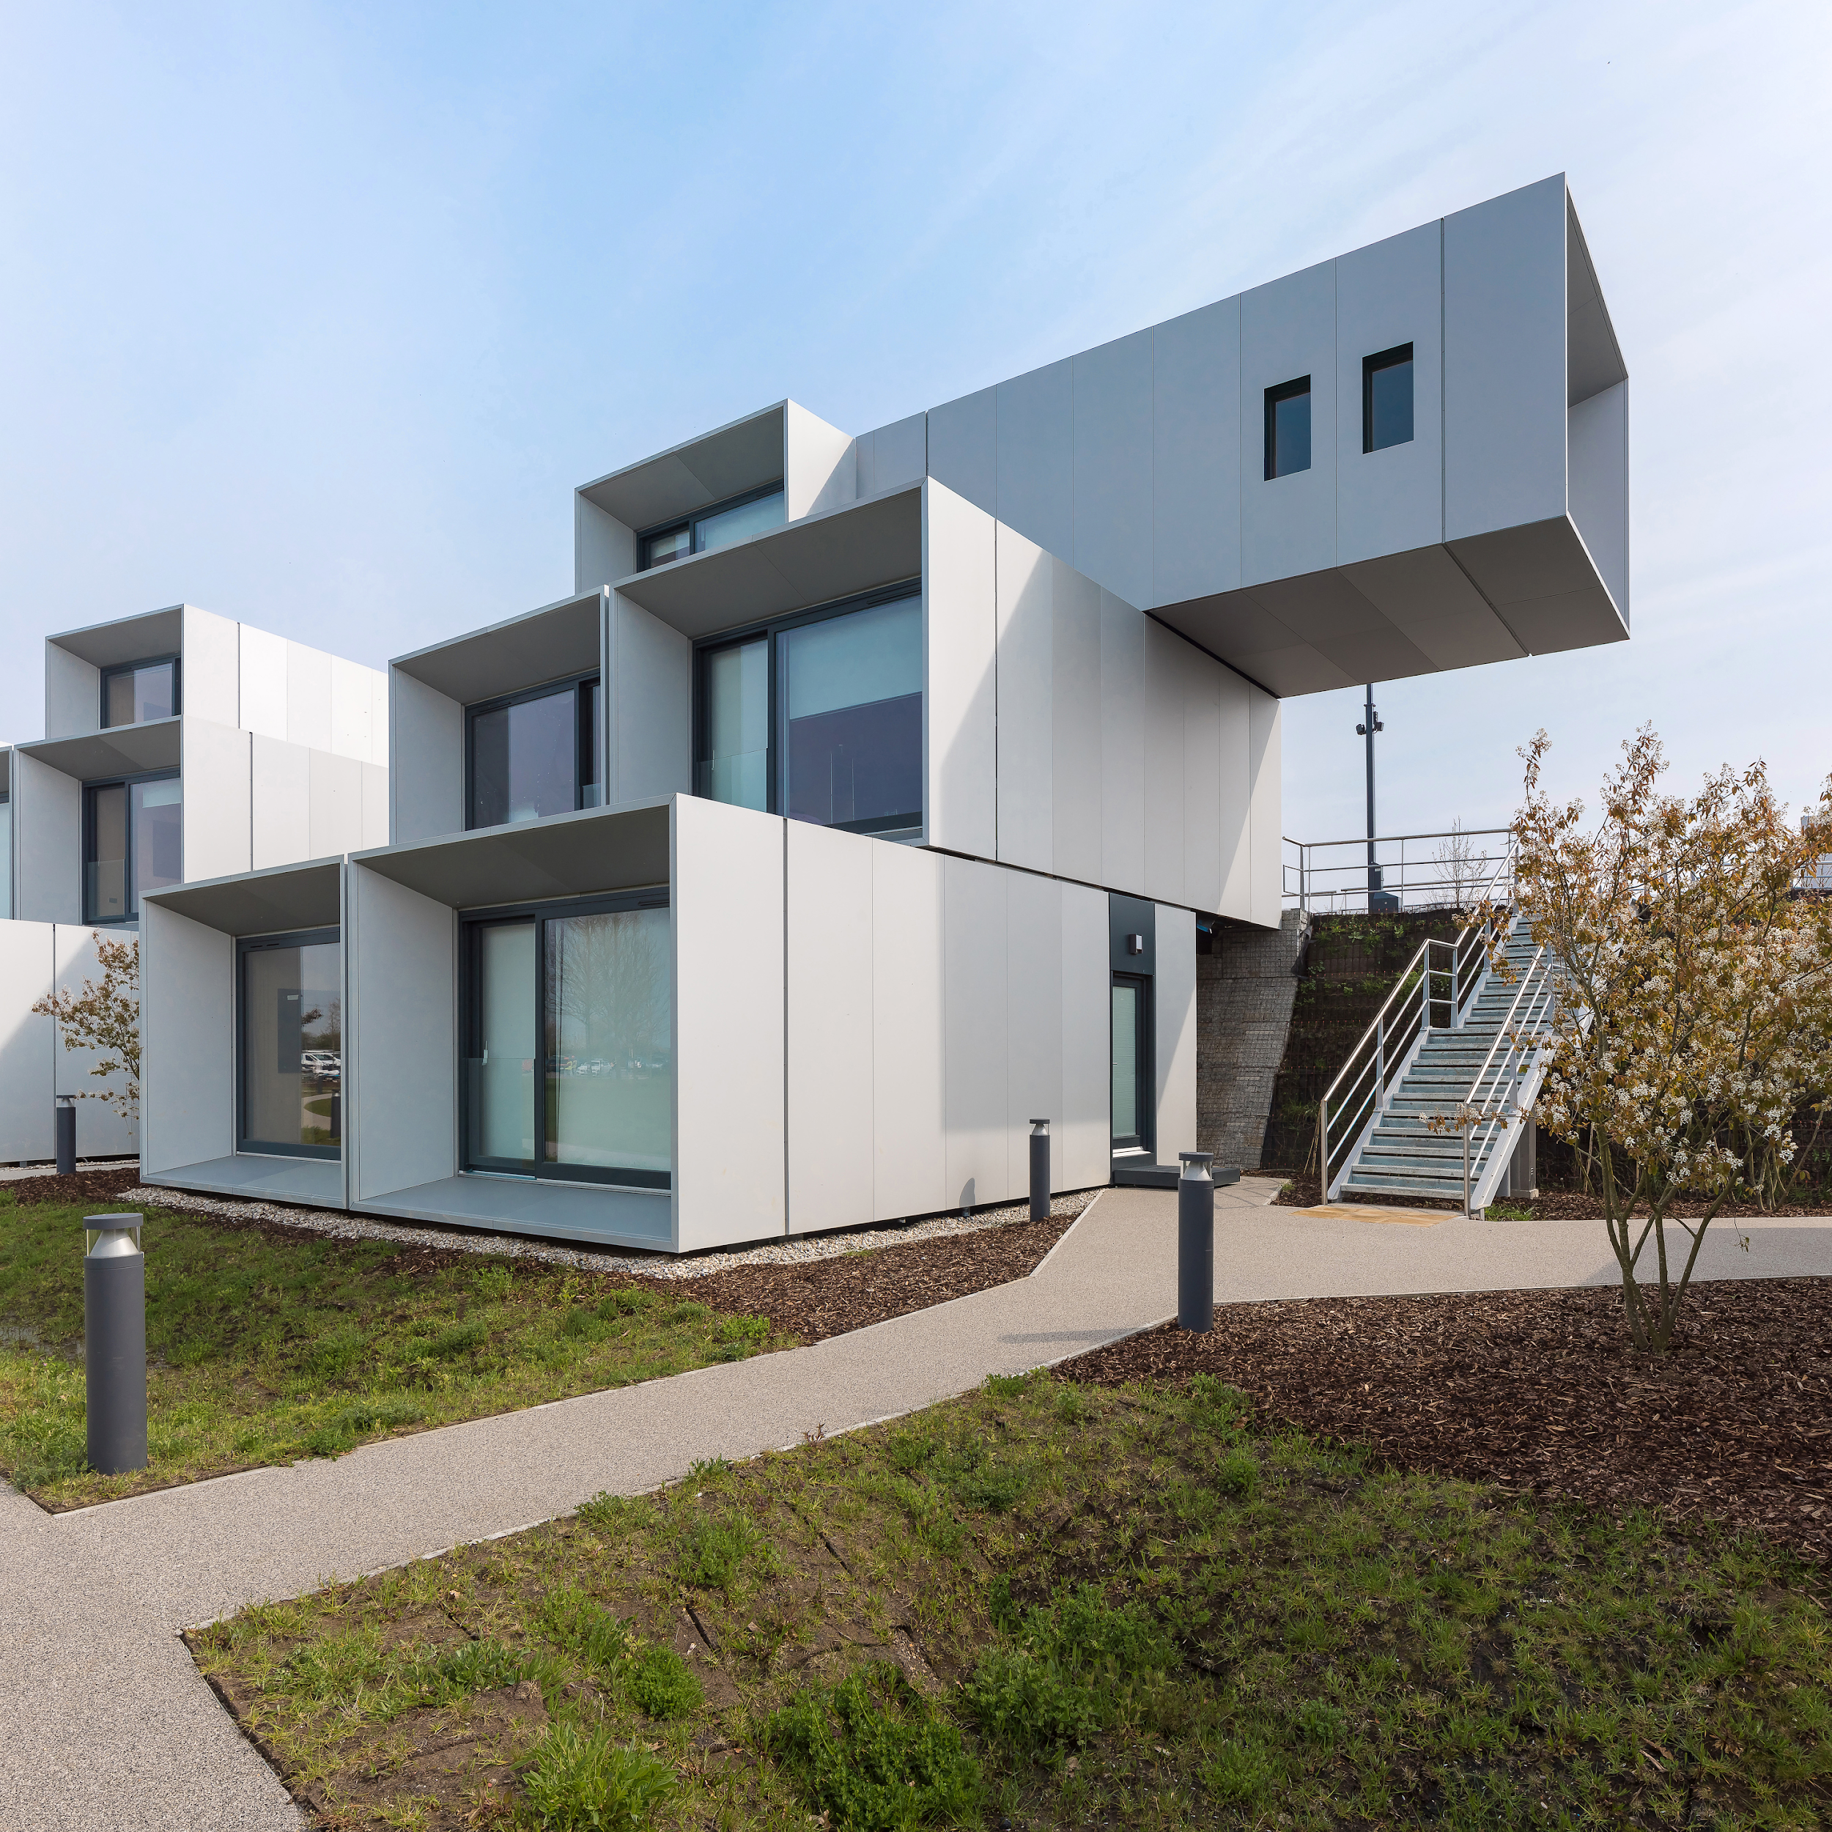
2D.5 Apply order of sequence (supervisor)
Sequencing data can be attached to BIM objects.
By having the data embedded in the BIM model, every aspect the project can be tested and rehearsed before work starts on site.
Image courtesy of Carbon Dynamic

Slide 38
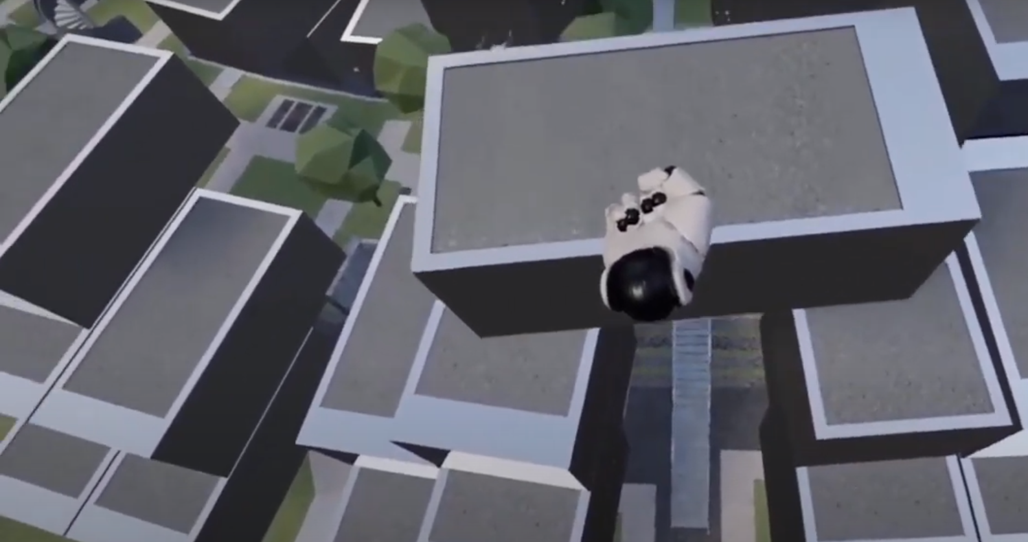
2D.5 Apply order of sequence (supervisor)
Image courtesy of Carbon Dynamic

Slide 39
2E Factory operations

Slide 40
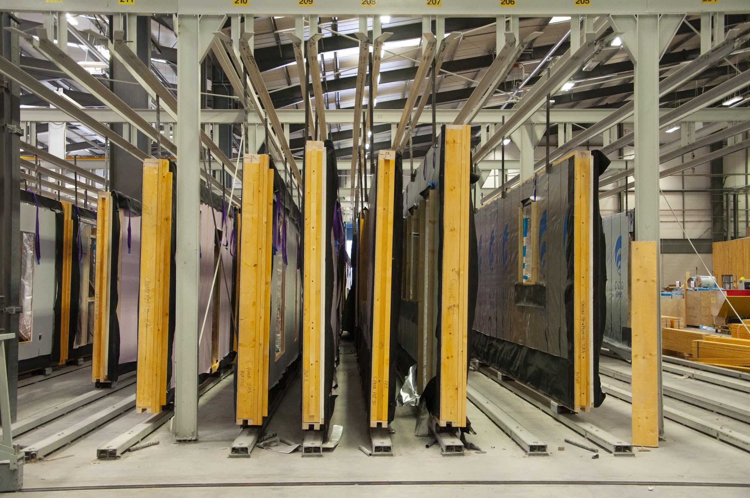
Image courtesy of CCG OSM

Slide 41
2E.1 Understand current and emerging technologies
New technologies such as CNC and robotics increase the speed and quality of manufactured components.
Automated processes tend to combine CAD/CAM software with stations within the factory
Degrees of automation also exist in the production of the material and building systems.
These technologies are increasingly being combined with augmented and virtual reality (AR/VR).

Slide 42
2E.2 Analyse design tolerances for factory operations
One of many benefits of offsite manufacturing is the possibility to operate in a factory environment.
In an enclosed and safe environment, factory operations tend to produce better quality products and components.
However, whilst digital datasets are adopted, there is still room for human error.
It is therefore important to set up quality checks before, during and after the manufacture of components.

Slide 43
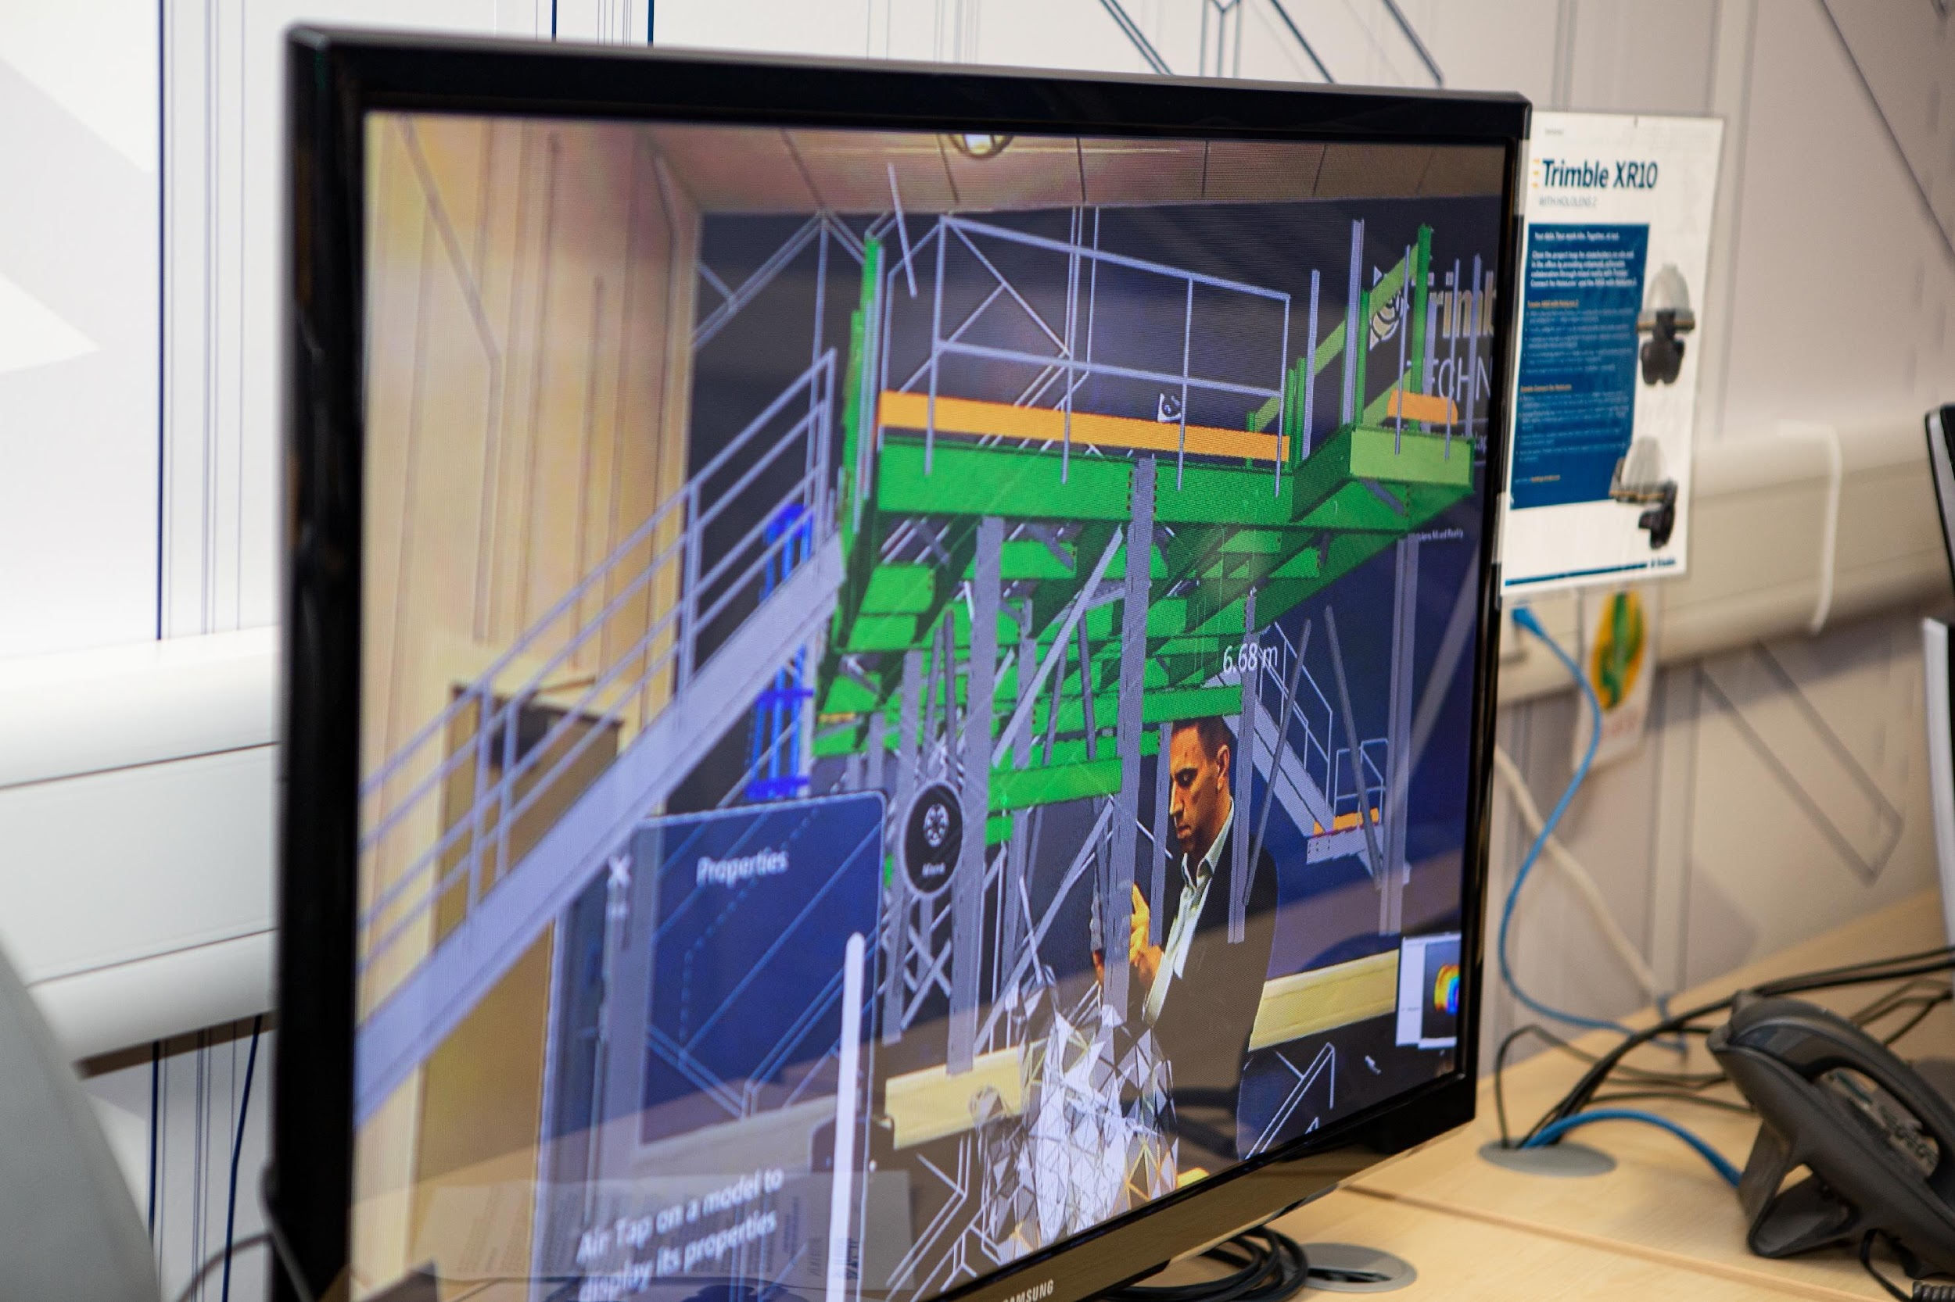
2E.3 Apply effective communication
In offsite construction projects the medium of communication, the type of information and the number of communicators are often complex and interconnected.
There are many software solutions that aim to increase the efficiency of communication between digital design and factory operations. One of these is Trimble Connect, which allows users to view a large array of file formats, overlay models by different disciplines, perform clash detection, set a list of to-do tasks and message each other.
Image courtesy of Trimble Technology Lab

Slide 44
2F Site operations

Slide 45
2F.1 Understand current and emerging technologies
Digital technologies are increasingly being incorporated into the offsite sector.
This includes the use of technologies such as:
laser scanners,
VR/AR
sensors.
drones
Increasingly, wearable technology is also being adopted on site.

Slide 46
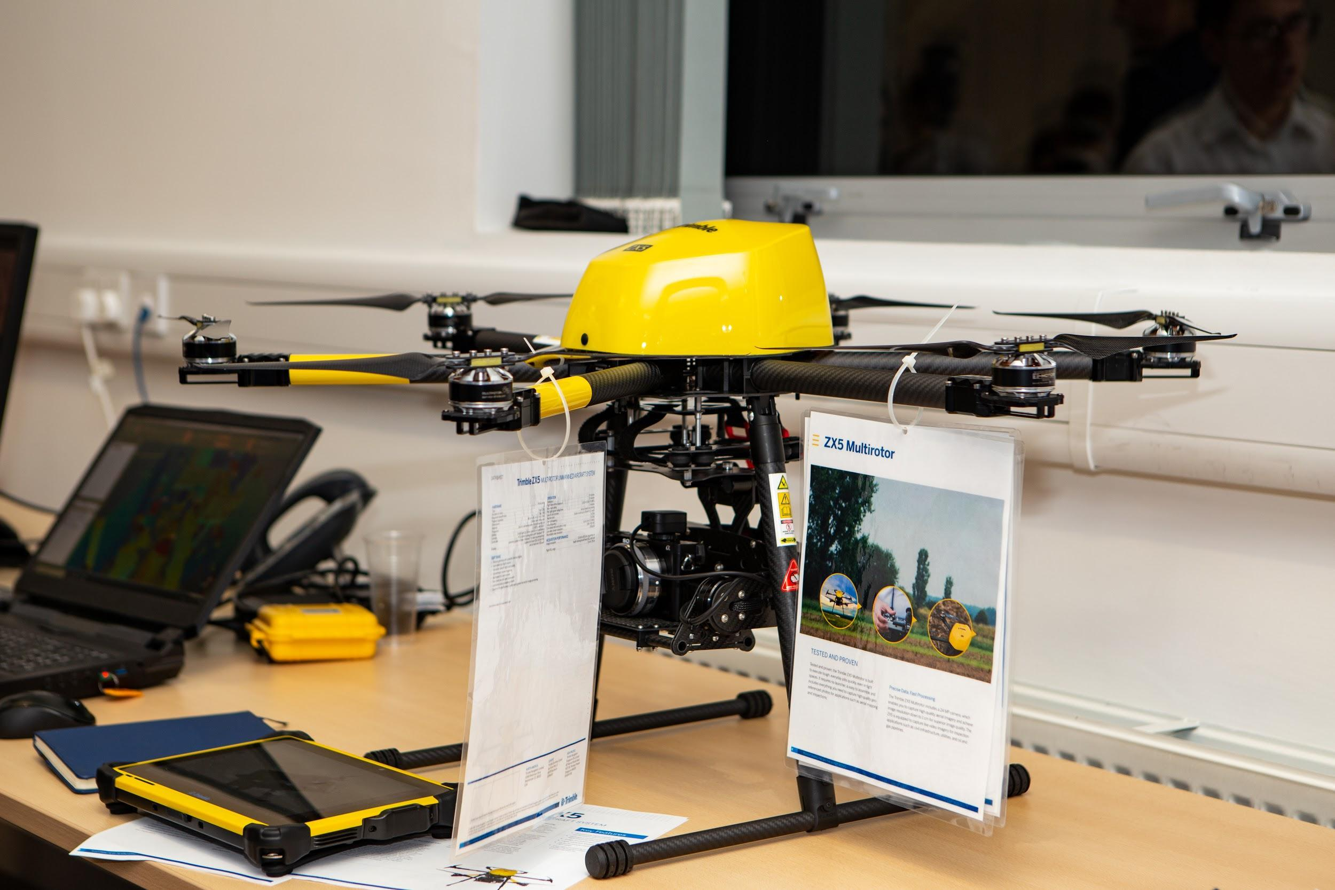
Trimble ZX5 drone for site surveying
Image courtesy of Trimble Technology Lab

Slide 47
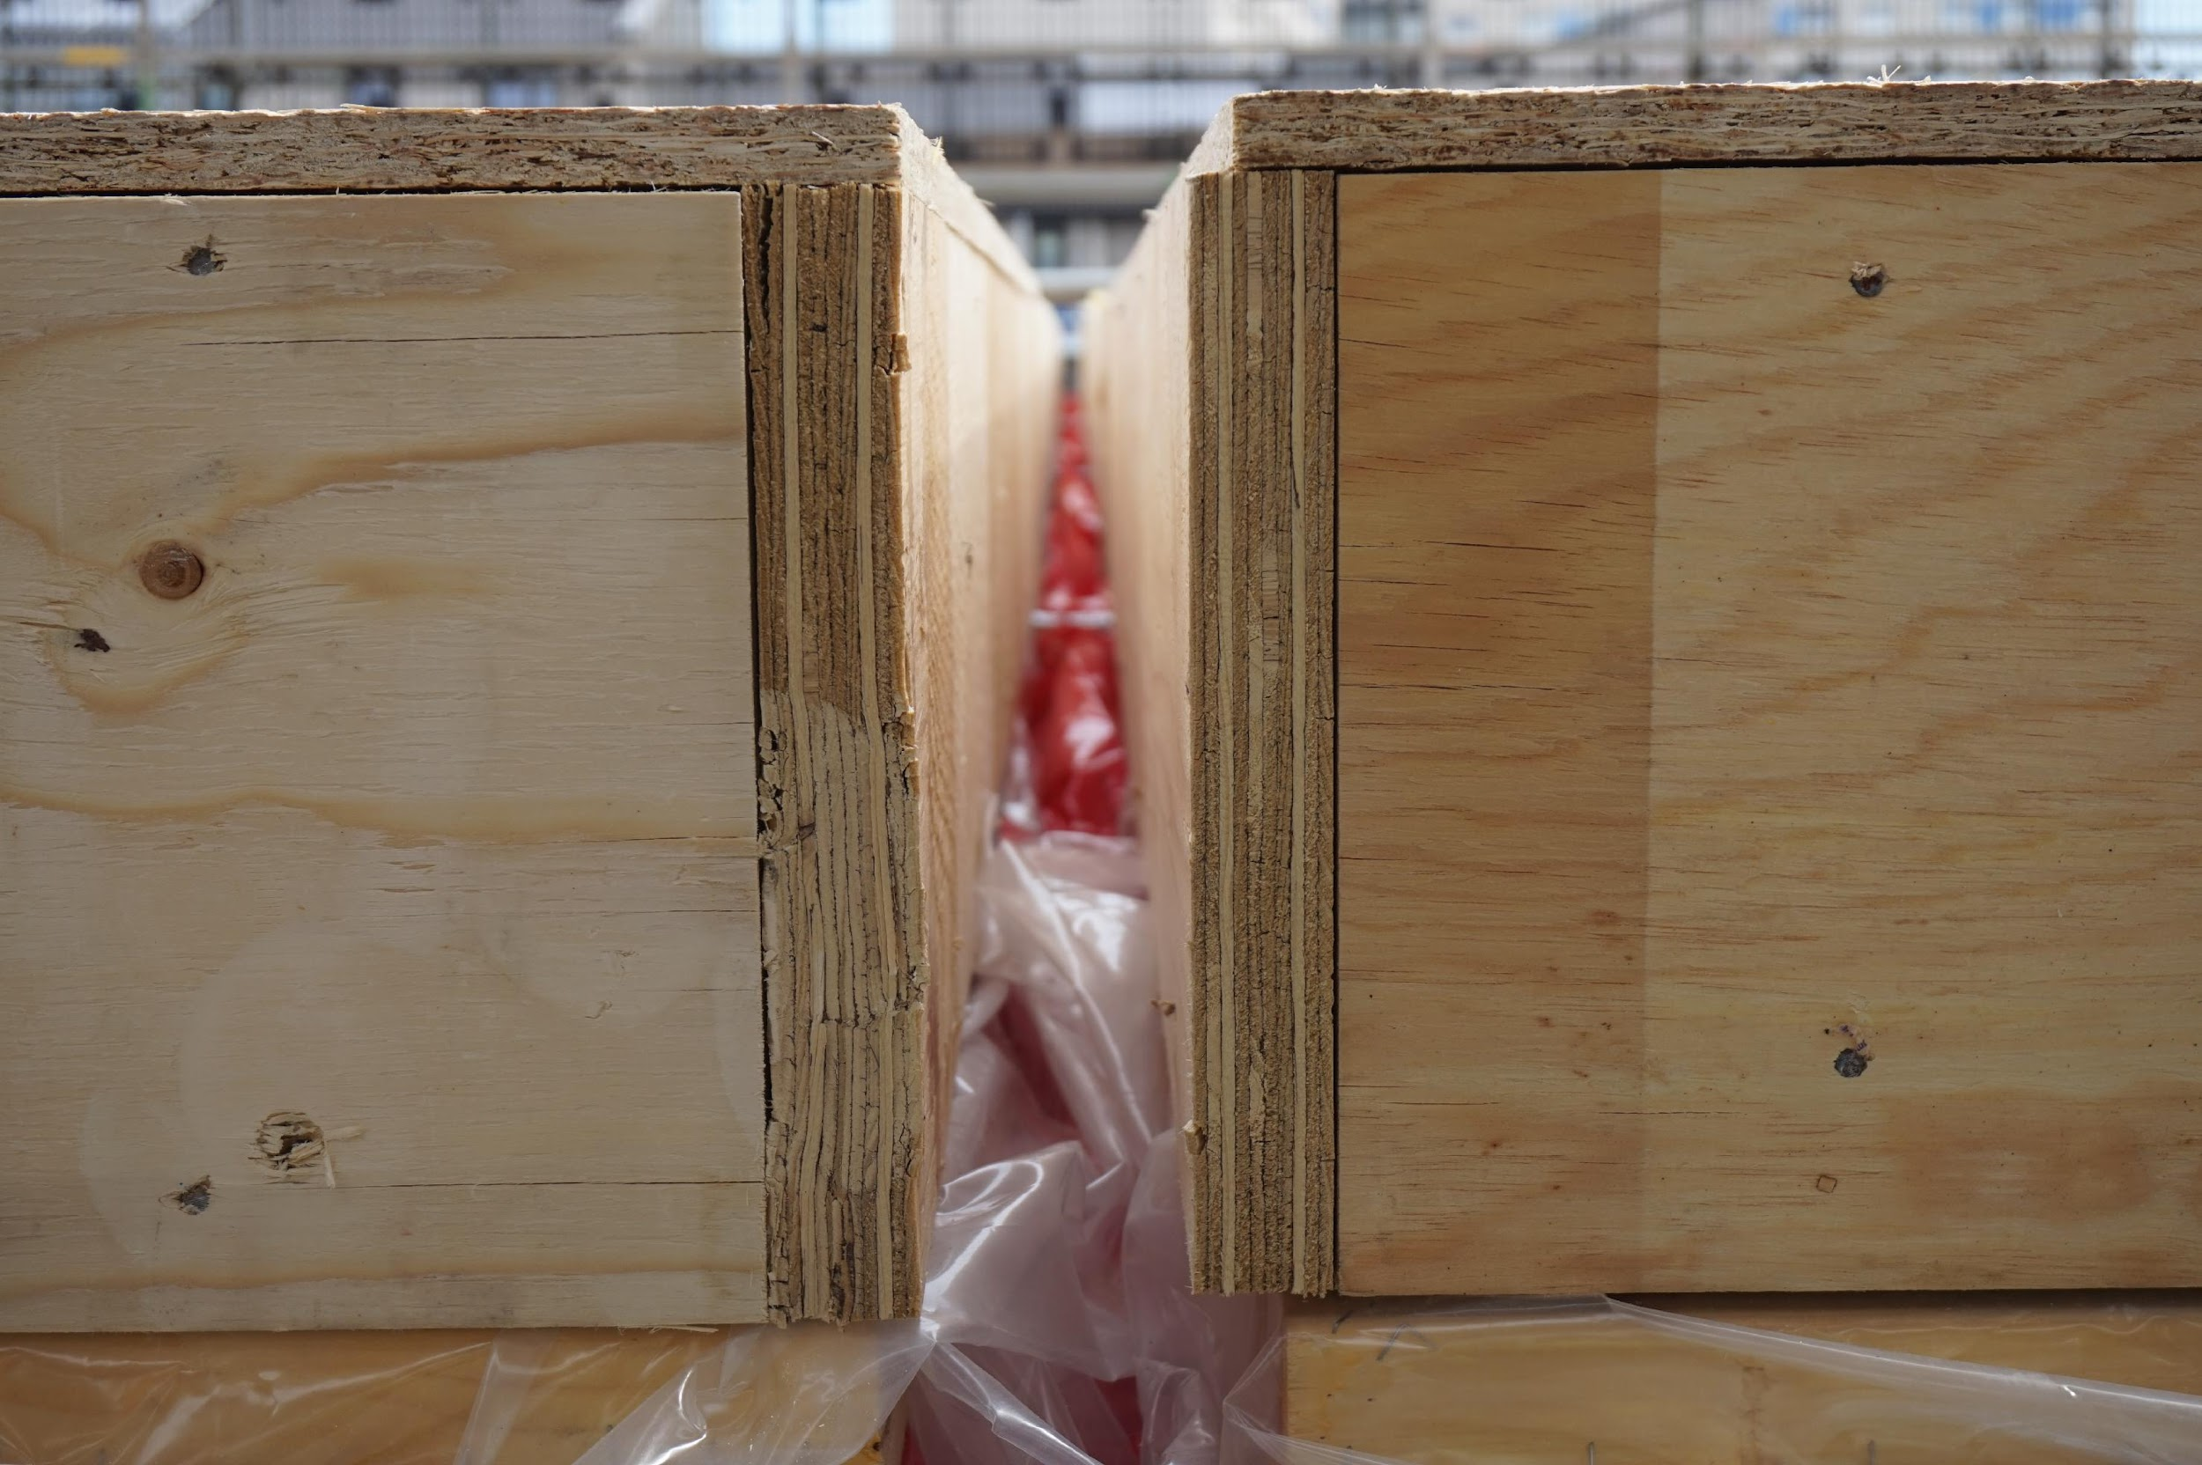
2F.2 Analyse design tolerances for factory operations
One issue related to the accuracy of offsite components during the assembly process, is the difference between the “as-designed” and “as-built”.
In order optimise quality-control processes, it is necessary to pay particular attention to details and design tolerances. By incorporating 3D models in a BIM environment, accuracy is improved.
Image courtesy of Dr Mila Duncheva and CCG (Scotland) Ltd

Slide 48

2F.3 Apply effective communication
Even with the best software solutions, communication between designers and site managers still relies on people and their interpersonal skills. It is important to apply a few key principles in communication with others to avoid misunderstandings:
Use as few acronyms and jargon as possible
Listen carefully to others or read their work carefully
At the start of communications, briefly set out the main themes
Give everyone the chance to contribute and ask questions
Summarise the key decisions made at the end

Slide 50

2 DIGITAL DESIGN by DR MILA DUNCHEVA, ALASDAIR REID, VICTOR HENQUEL, DR ANDREW LIVINGSTONE, DR JON STINSON, JUAN A FERRIZ-PAPI, PARTICK NOLAN and SHELLEY DOOLAN is licensed under a Creative Commons Attribution-NonCommercial-ShareAlike 4.0 International License

