Slide 1
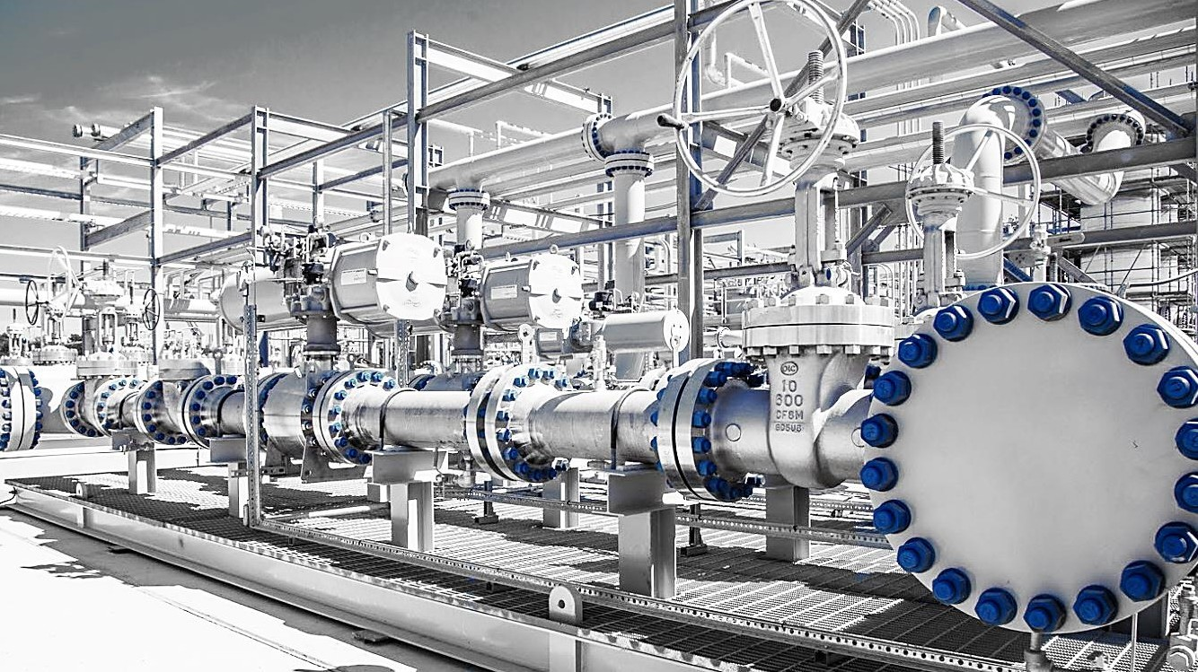


J.P. Morgan 2017 Energy Equity Conference
June 26, 2017
NYSE: DNR www.denbury.com 1
www.denbury.com
NYSE: DNR

Slide 2
Cautionary Statements
Forward-Looking Statements: The data and/or statements contained in this presentation that are not historical facts are forward-looking statements, as that term is defined in Section 21E of the Securities Exchange Act of 1934, as amended, that involve a number of risks and uncertainties. Such forward-looking statements may be or may concern, among other things, financial forecasts, future hydrocarbon prices and timing and degree of any price recovery versus the length or severity of the current commodity price downturn, current or future liquidity sources or their adequacy to support our anticipated future activities, our ability to further reduce our debt levels, possible future write-downs of oil and natural gas reserves, together with assumptions based on current and projected oil and gas prices and oilfield costs, current or future expectations or estimations of our cash flows, availability of capital, borrowing capacity, future interest rates, availability of advantageous commodity derivative contracts or the predicted cash flow benefits therefrom, forecasted capital expenditures, drilling activity or methods, including the timing and location thereof, estimated timing of commencement of carbon dioxide (CO₂) flooding of particular fields or areas, dates of completion of to-be-constructed industrial plants and the initial date of capture of CO₂ from such plants, timing of CO₂ injections and initial production responses in tertiary flooding projects, acquisition plans and proposals and dispositions, development activities, finding costs, anticipated future cost savings, capital budgets, interpretation or prediction of formation details, production rates and volumes or forecasts thereof, hydrocarbon reserve quantities and values, CO₂ reserves and supply and their availability, potential reserves, barrels or percentages of recoverable original oil in place, potential increases in regional or worldwide tariffs or other trade restrictions, the likelihood, timing and impact of increased interest rates, the impact of regulatory rulings or changes, anticipated outcomes of pending litigation, prospective legislation affecting the oil and gas industry, environmental regulations, mark-to-market values, competition, long-term forecasts of production, rates of return, estimated costs, changes in costs, future capital expenditures and overall economics, worldwide economic conditions and other variables surrounding our estimated original oil in place, operations and future plans. Such forward-looking statements generally are accompanied by words such as “plan,” “estimate,” “expect,” “predict,” “forecast,” “to our knowledge,” “anticipate,” “projected,” “preliminary,” “should,” “assume,” “believe,” “may” or other words that convey, or are intended to convey, the uncertainty of future events or outcomes. Such forward-looking information is based upon management’s current plans, expectations, estimates, and assumptions and is subject to a number of risks and uncertainties that could significantly and adversely affect current plans, anticipated actions, the timing of such actions and our financial condition and results of operations. As a consequence, actual results may differ materially from expectations, estimates or assumptions expressed in or implied by any forward-looking statements made by us or on our behalf. Among the factors that could cause actual results to differ materially are fluctuations in worldwide oil prices or in
U.S. oil prices and consequently in the prices received or demand for our oil and natural gas; decisions as to production levels and/or pricing by OPEC in future periods; levels of future capital expenditures; effects of our indebtedness; success of our risk management techniques; inaccurate cost estimates; availability of and fluctuations in the prices of goods and services; the uncertainty of drilling results and reserve estimates; operating hazards and remediation costs; disruption of operations and damages from well incidents, hurricanes, tropical storms, or forest fires; acquisition risks; requirements for capital or its availability; conditions in the worldwide financial, trade and credit markets; general economic conditions; competition; government regulations, including changes in tax or environmental laws or regulations; and unexpected delays, as well as the risks and uncertainties inherent in oil and gas drilling and production activities or that are otherwise discussed in this presentation, including, without limitation, the portions referenced above, and the uncertainties set forth from time to time in our other public reports, filings and public statements including, without limitation, the Company’s most recent Form 10-K.
Note to U.S. Investors: Current SEC rules regarding oil and gas reserves information allow oil and gas companies to disclose in filings with the SEC not only proved reserves, but also probable and possible reserves that meet the SEC’s definitions of such terms. We disclose only proved reserves in our filings with the SEC. Denbury’s proved reserves as of December 31, 2015 and December 31, 2016 were estimated by DeGolyer and MacNaughton, an independent petroleum engineering firm. In this presentation, we may make reference to probable and possible reserves, some of which have been estimated by our independent engineers and some of which have been estimated by Denbury’s internal staff of engineers. In this presentation, we also may refer to estimates of original oil in place, resource or reserves “potential”, barrels recoverable or technically recoverable, or other descriptions of volumes potentially recoverable, which in addition to reserves generally classifiable as probable and possible (2P and 3P reserves), include estimates of resources that do not rise to the standards for possible reserves, and which SEC guidelines strictly prohibit us from including in filings with the SEC. These estimates, as well as the estimates of probable and possible reserves, are by their nature more speculative than estimates of proved reserves and are subject to greater uncertainties, and accordingly the likelihood of recovering those reserves is subject to substantially greater risk.

Slide 3
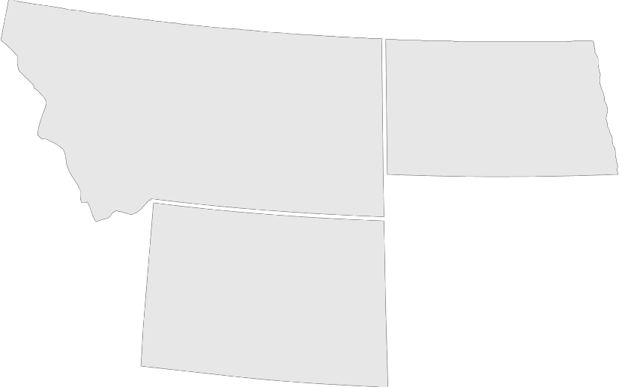



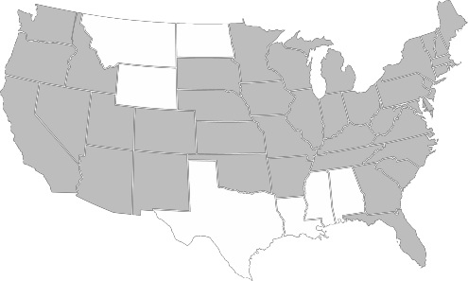



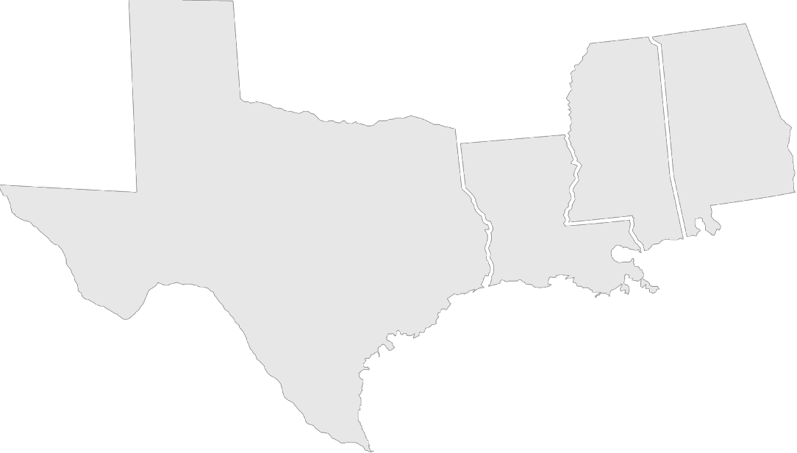





A Different Kind of Oil Company
CO₂ enhanced oil recovery (“CO₂ EOR”) is our core focus
We have uniquely long-lived & lower-risk assets with extraordinary
resource potential
Owning and controlling the CO₂ supply and infrastructure provides our strategic advantage
“We bring old oil fields back to life!”
Rocky Mountain Region
OPERATING AREAS
Reserves YE 2016 | Proved: 254 MMBOE (58% CO₂ EOR, 97% Oil) Proved + EOR Potential: ~900 MMBOE
CO₂ Supply | Proved Reserves: 6.5 Tcf Plus significant quantities of industrial-sourced CO₂
Production 1Q17 | • 59,933 BOE/d (62% CO₂ EOR, 97% Oil)
CO₂ Pipelines | • >1,100 miles
Experience | Nearly 2 decades of CO₂ EOR Production Produced over 155 million gross barrels from CO₂ EOR
Headquarters
Gulf Coast Region

Slide 4






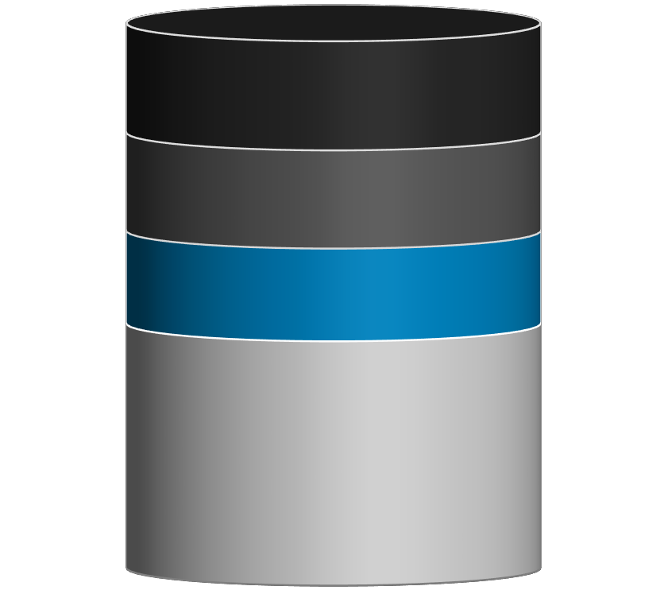


CO₂ EOR Process
CO₂ Injection Well
CO₂ Pipeline
Production Well
CO₂ EOR can produce about as much oil as primary or secondary recovery⁽¹⁾
Primary ~ 20%
Secondary _{~18%}
(Waterfloods)
Oil Formation
Recovery of Original Oil in Place
(“OOIP”)
CO₂ EOR
(Tertiary)
~17%
CO₂ moves through formation mixing with oil, expanding and moving it toward producing wells
1) Based on OOIP at Denbury’s Little Creek Field

Slide 5
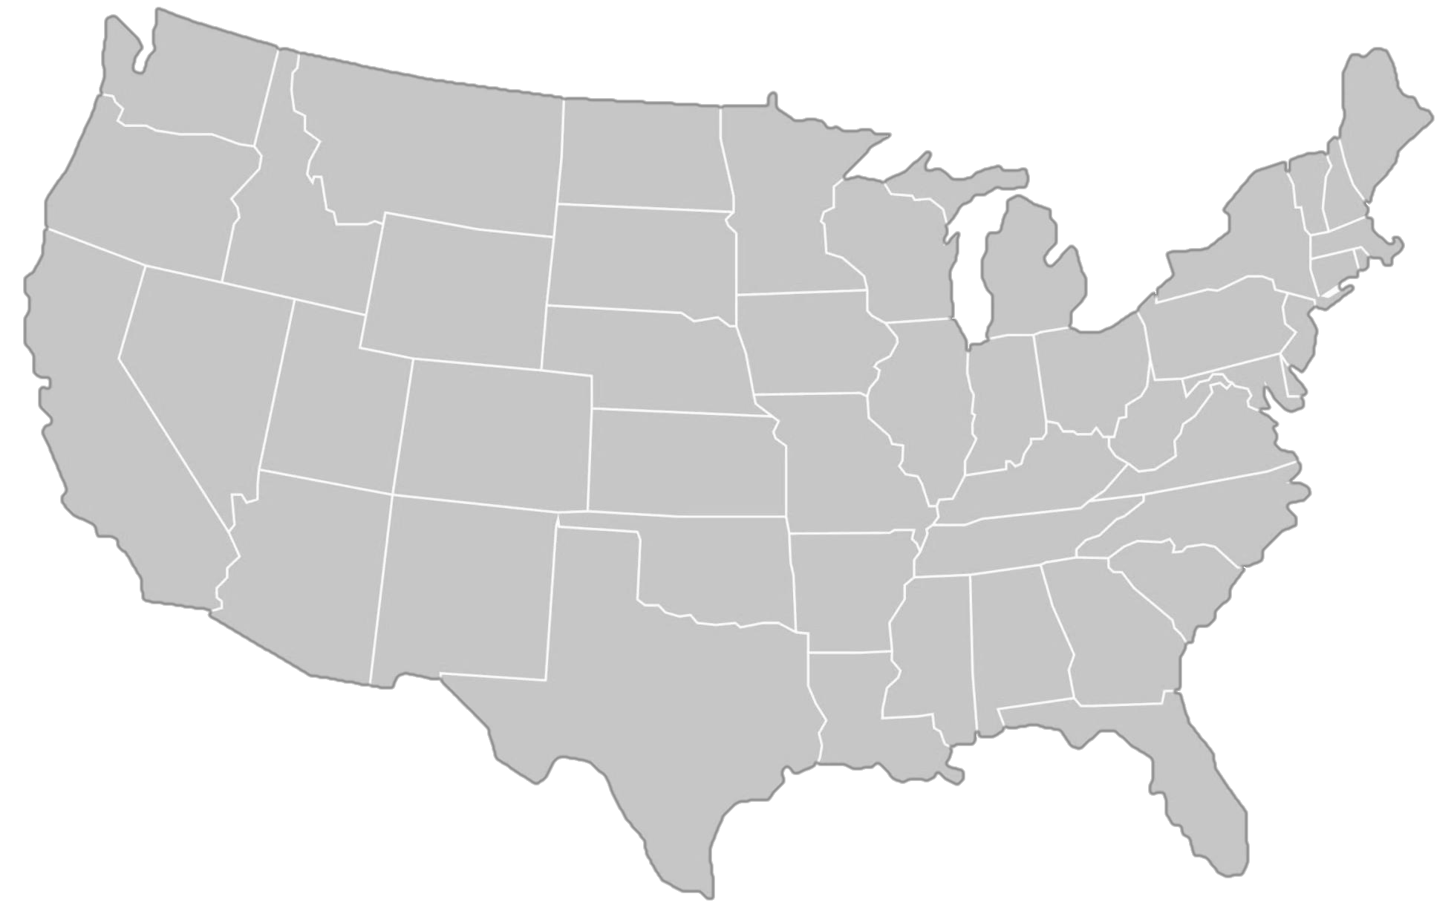
U.S. Lower-48 CO₂ EOR Potential
Up to 83 Billion Barrels of Technically Recoverable Oil⁽¹⁾⁽²⁾
33-83 Billion of Technically Recoverable Oil^{(1,2)} (amounts in billions of barrels)
Permian | 9-21
East & Central Texas | 6-15
Mid-Continent | 6-13
California | 3-7
South East Gulf Coast | 3-7
Rockies | 2-6
Other | 0-5
Michigan/Illinois | 2-4
Williston | 1-3
Appalachia | 1-2
Source: 2013 DOE NETL Next Gen EOR.
Total estimated recoveries on a gross basis utilizing CO₂ EOR.

Slide 6

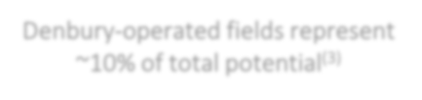


Up to 16 Billion Gross EOR Barrels Recoverable⁽¹⁾ in Our Two Core Operating Areas
2.8 to 6.6
Billion Barrels
Estimated Recoverable in Rocky Mountain Region⁽²⁾
MT
ND
WY
Denbury-operated fields represent
~10% of total potential⁽³⁾
Existing Denbury CO₂ Pipelines Planned Denbury CO₂ Pipelines Denbury owned oil fields
MS
AL
Existing or Proposed CO₂ Source
Owned or Contracted
TX
LA
3.7 to 9.1
Billion Barrels
Estimated Recoverable in Gulf Coast Region⁽²⁾
Total estimated recoveries on a gross basis utilizing CO₂ EOR, based on a variety of recovery factors.
Source: 2013 DOE NETL Next Gen EOR.
Using approximate mid-points of ranges, based on a variety of recovery factors.

Slide 7
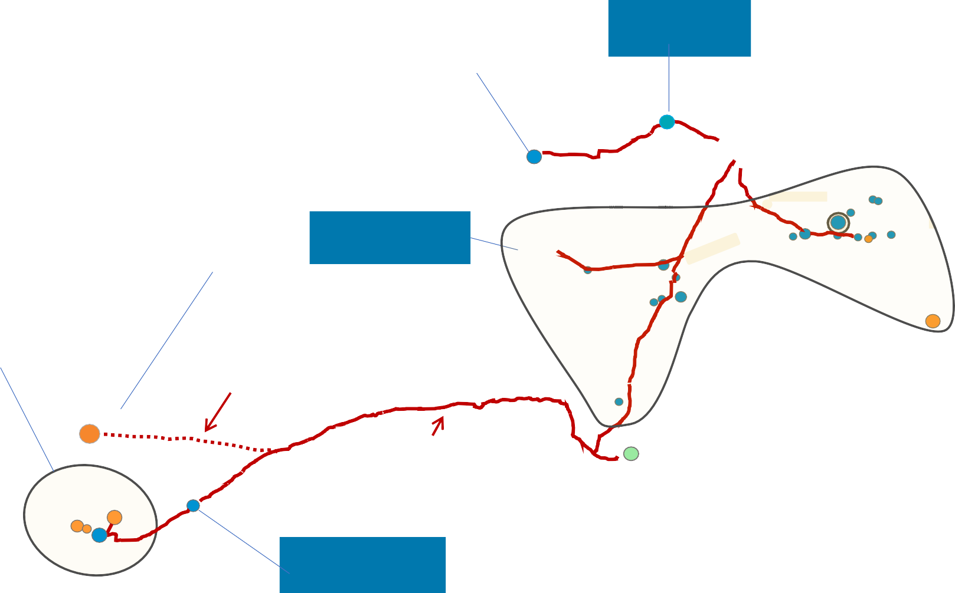

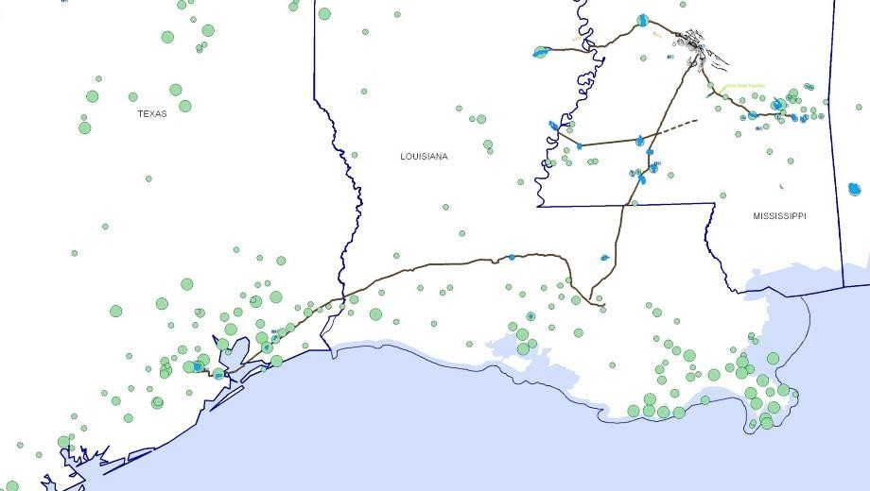
Gulf Coast Region
Vast CO₂ Supply and Distribution Capacity in Texas, Louisiana & Mississippi
NYSE: DNR
Tinsley⁽³⁾ 25 MMBbls
Reserves Summary⁽¹⁾
Tertiary Reserves:
Proved | 130
Potential | 320
Non-Tertiary Reserves:
Proved | 22
Total MMBOE⁽²⁾ | 472
Delhi⁽³⁾ 30 MMBOEs
West Yellow Creek 5 -10 MMBbls
(3)
TX
Tinsley
Jackson Dome
AL
LA
Delhi
(2)
Mature Area⁽³⁾ 60 MMBbls
Heidelberg
Houston Area⁽³⁾
~100 - 200 MMBbls
Hastings 30 - 70 MMBbls
Webster 40 - 75 MMBbls
Thompson 20 - 40 MMBbls
Manvel 8 - 12 MMBbls
Conroe⁽³⁾
130 MMBbls
Martinville
Soso
Eucutta
Yellow Creek
Pipelines
Cranfield
Brookhaven
Mallalieu Olive
Denbury Operated Pipelines Denbury Planned Pipelines
Little Creek
MS
Citronelle
McComb
Cumulative Production
15 – 50 MMBOE
50 – 100 MMBOE
> 100 MMBOE
Denbury Owned Fields – Current CO₂ Floods Denbury Owned Fields – Potential CO₂ Floods Fields Owned by Others – CO₂ EOR Candidates
~90 Miles Cost: ~$220MM
Heidelberg⁽³⁾ 30 MMBbls
Lockhart
Crossing
Conroe
Green Pipeline
~325 Miles
Webster Thompson
Manvel
Hastings
Proved tertiary and non-tertiary oil and natural gas reserves based upon year-end 12/31/16 SEC pricing. Potential includes probable and possible tertiary reserves estimated by the Company as of 12/31/16 (with the exception of West Yellow Creek, estimated as of 3/31/17), using the
mid-point of ranges, based upon a variety of recovery factors and long- term oil price assumptions, which also may include estimates of resources that do not rise to the standards of possible reserves. See slide 2, “Cautionary Statements” for additional information.
Total reserves in this table represent total proved plus potential tertiary reserves, using the mid-point of ranges, plus proved non-tertiary reserves, but excluding additional potential related to non-tertiary exploitation opportunities.
Field reserves shown are estimated proved plus potential tertiary reserves.
Oyster Bayou
Oyster Bayou⁽³⁾
20 MMBbls
www.denbury.com
7

Slide 8
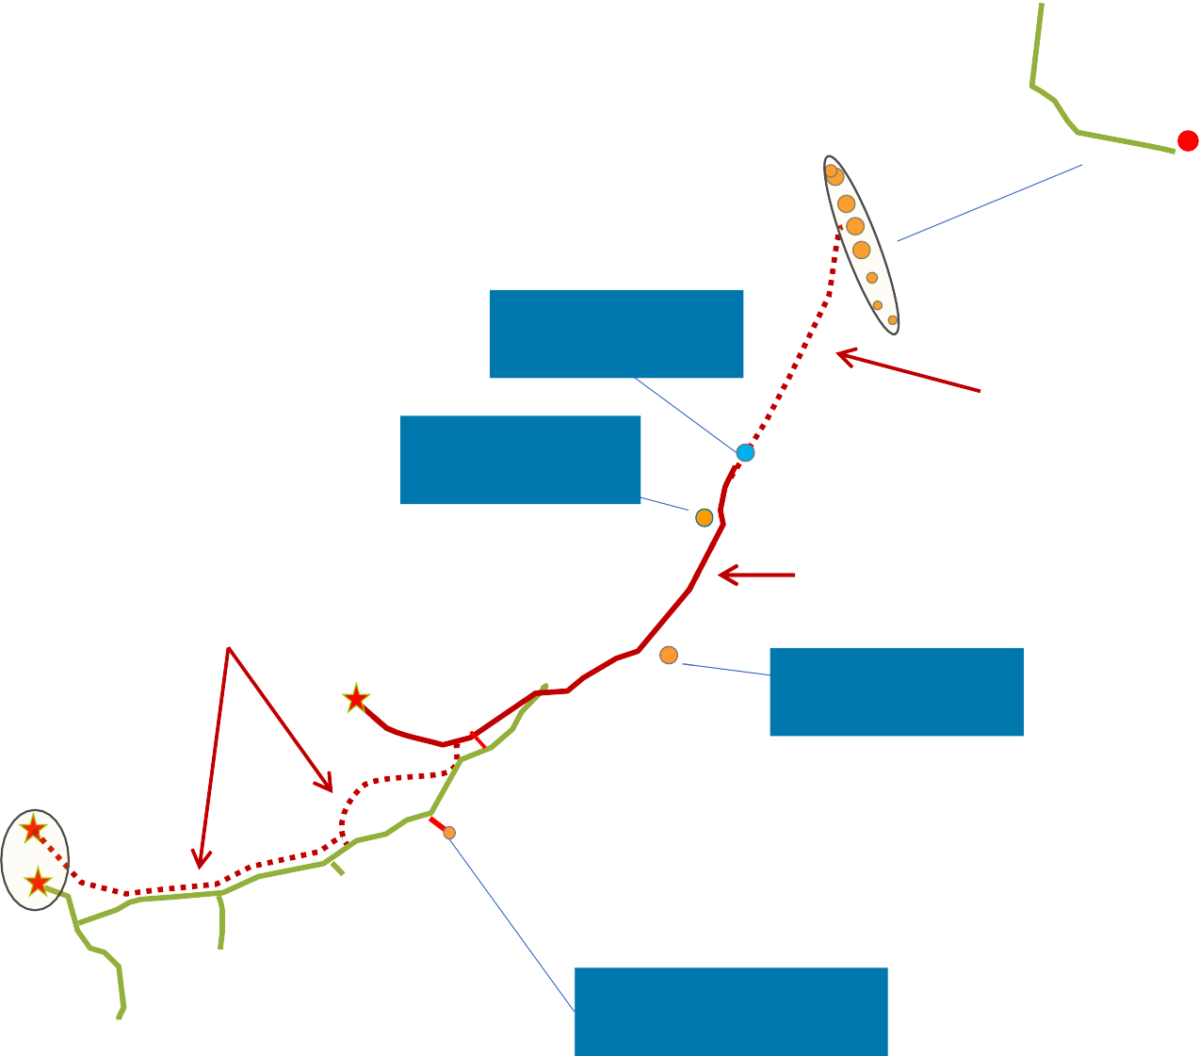
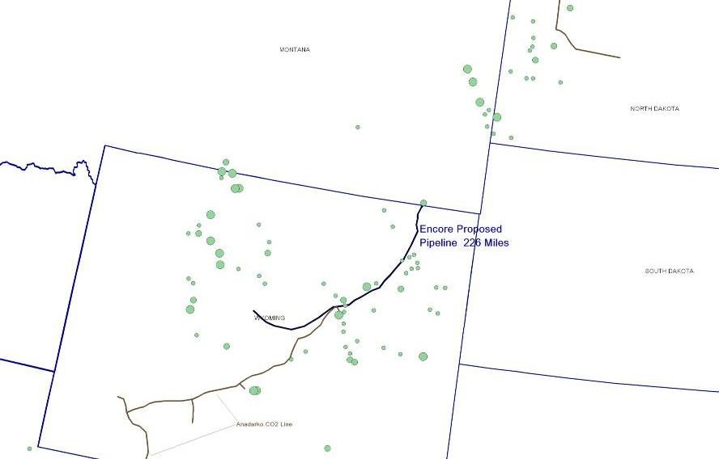
Rocky Mountain Region
Control of CO₂ Sources & Pipeline Infrastructure Provides a Strategic Advantage
NYSE: DNR
Reserves Summary⁽¹⁾
Tertiary-Reserves: Proved Potential
DGC Beulah
Cedar Creek Anticline Area⁽³⁾ 260 - 290 MMBbls
MONTANA
19
336
MT
Non-Tertiary Reserves:
Proved
NORTH DAKOTA
ND
84
Total MMBOE⁽²⁾ 439
Bell Creek⁽³⁾
20 - 40 MMBbls
Pipelines & CO₂ Sources
Elk Basin
~110 Miles Cost:~$150MM
Denbury Pipelines Denbury Planned Pipelines Pipelines Owned by Others
Existing or Proposed CO₂ Source - Owned or Contracted
Gas Draw⁽³⁾
10 MMBbls
WY
Cumulative Production
15 – 50 MMBOE
50 – 100 MMBOE
> 100 MMBOE
Greencore Pipeline 232 Miles
~250 Miles Cost:~$400MM
SD
Lost Cabin (COP)
Denbury Owned Fields – Current CO Floods
Hartzog Draw⁽³⁾ 30 - 40 MMBbls
2
Denbury Owned Fields – Potential CO₂ Floods
Fields Owned by Others – CO₂ EOR Candidates
Proved tertiary and non-tertiary oil and natural gas reserves based upon year- end 12/31/16 SEC pricing. Potential includes probable and possible tertiary reserves estimated by the Company as of 12/31/16, using the mid-point of ranges, based upon a variety of recovery factors and long-term oil price assumptions, which also may include estimates of resources that do not rise to the standards of possible reserves. See slide 2, “Cautionary Statements” for additional information.
Total reserves in this table represent total proved plus potential tertiary reserves, using the mid-point of ranges, plus proved non-tertiary reserves, but excluding additional potential related to non-tertiary exploitation opportunities and excluding Salt Creek Field potential reserves to be acquired.
Field reserves shown are estimated proved plus potential tertiary reserves.
Acquisition pursuant to definitive agreement to acquire 23% non-operated working interest in the field. Expected to close in late June, subject to due diligence and customary closing conditions. Field reserves shown are estimated proved plus potential tertiary reserves.
Riley Ridge
Salt Creek⁽⁴⁾
25 - 35 MMBbls
Shute Creek (XOM)
Expected to close June 2017
NE
Grieve⁽³⁾ 5 MMBbls
www.denbury.com
8

Slide 9








2017 Priorities
Stabilize production and resume growth
Maintain and enhance efficiencies gained through the down-cycle
Pursue opportunities to increase or accelerate growth
$
Continue to improve
balance sheet
9

Slide 10
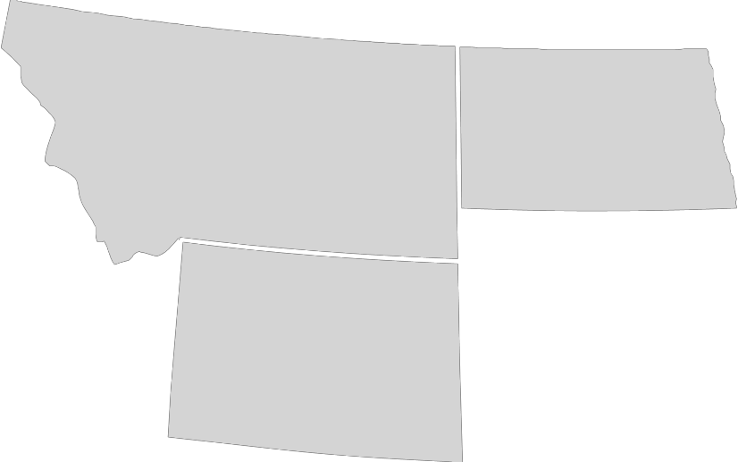


Building Scale in Our Core Operating Areas
Salt Creek
Combined
Proved reserve additions expected to replace Denbury’s full-year 2017 production
All-in F&D costs, including acquisition costs, estimated at ~$7/Bbl
Estimated 2018 production of 3,000 – 3,500 Bbls/d
Initially funded by bank line; potential to offset with sale of non-productive surface acreage in Houston area
Rocky Mountain Region
PDP reserves: ~9 MMbls
Estimated PUD reserves⁽¹⁾: ~9 MMbls
Proved + Potential: 25-35 MMbls
Current production: ~2,100 Bbls
Acquisition cost: $71.5 million
Accretive to near-term credit metrics based on 2018 estimated cash flow
Minimal capital spend anticipated for 2017 & 2018
Expected to close late June 2017
Salt Creek
WY
West Yellow Creek
West Yellow Creek
MS
Potential reserves: ~5 MMBbls
First production: est. late 2017 or early 2018
Acquisition cost: $16 million
Estimated 2017 capital: <$10 million
Contract for Denbury to sell CO₂ to the operator, providing additional cash flow
Gulf Coast
Region
1) Reserves based on current development plans. See “Cautionary Statements” for additional information.
10

Slide 11
2017 Capital Budget & Production Guidance
2017 Development Capital Budget⁽¹⁾
Primarily focused on expanding existing CO₂ floods and other infill opportunities
Tertiary Projects
DEVELOPMENT CAPITAL BUDGET
(in millions)
$55
Development at Hastings, Heidelberg, Delhi and Bell Creek
Expand compression capacity at Oyster Bayou
Conformance work
~$300 Million Total
$10
$175
$60
Non-Tertiary Projects
Cedar Creek Anticline
Other exploitation opportunities
2017 Production Guidance
Tertiary Non-Tertiary CO2 Sources & Other
CONTINUING PRODUCTION (BOE/D)⁽³⁾
Capitalized Items ⁽²⁾
Expect 2017 full-year production to be relatively flat with 2016 exit rate on capital spending of ~$300 million
62,998
~60,000
58,000 - 62,000
 | FY2016 |  | 2016 Exit Rate |  | 2017E
Anticipate slight production growth for 2018 based on current assumptions and expectations
2016 CapEx⁽¹⁾
~$209 MM
2017E CapEx⁽¹⁾
~$300 MM
2016 development capital spending and 2017 estimated development capital budget presented exclude acquisitions and capitalized interest. 2017 capitalized interest currently estimated at $20-$30 million.
Includes capitalized internal acquisition, exploration and development costs and pre-production tertiary startup costs.
Continuing production excludes production from properties sold in 2016. See slide 21 for more detail on continuing production.

Slide 12
Abundant CO₂ Supply & No Significant Capital Required for Several Years
Gulf Coast CO₂ Supply Rocky Mountain CO₂ Supply
Jackson Dome LaBarge Area
Proved CO₂ reserves as of 12/31/16: ~5.3 Tcf⁽¹⁾
Additional probable CO₂ reserves as of 12/31/16: ~1.2 Tcf
Currently producing at less than 60% of capacity
Estimated field size: 750 square miles
Estimated recoverable CO₂: 100 Tcf
Shute Creek - ExxonMobil Operated
Proved reserves as of 12/31/16: ~1.2 Tcf
Denbury has a 1/3 overriding royalty interest and could receive up to ~115 MMcf/d of CO₂ by 2021 at current plant capacity
Industrial-Sourced CO₂
Air Products (hydrogen plant): ~45 MMcf/d
PCS Nitrogen (ammonia products): ~20 MMcf/d
Mississippi Power (power plant): ~160 MMcf/d⁽²⁾
Riley Ridge – Denbury Operated
Future potential source of CO₂: ~2.8 Tcf
Gas processing facility shut-in since mid-2014 due to facility issues and sulfur build-up in gas supply wells
Evaluation of issues and corrective options ongoing
Lost Cabin – ConocoPhillips Operated
– Denbury could receive up to ~40 MMcf/d of CO₂ at current plant capacity
Reported on a gross (8/8th’s) basis.
Estimated startup in 2017. Volumes presented are based upon preliminary projections from Mississippi Power once the power plant is running at full capacity, which is currently estimated to occur in ~2020.

Slide 13



CO₂ Utilization & Cost Summary
979
41%
18%
1,000
762
REDUCTION SINCE 1Q15
REDUCTION SINCE 4Q15
800
678
705
634
576
Total Company Injected Volumes
(MMcf/d)
600
82%
545
459
458
400
Jackson Dome CO₂
74%
200
18%
Industrial-sourced CO₂
2Q15 3Q15
26%
-
1Q15
4Q15
1Q16
2Q16
3Q16
4Q16
1Q17
$4.00
$0.50
$0.40
$0.30
$0.20
$0.10
$-
$3.00
3.03
2.71
2.70
2.86
$2.00
2.40
CO₂ Costs per Mcf of CO₂
CO₂ Costs per BOE
2.17
1.97
2.13
2.17
$1.00
$-
1Q15 2Q15 3Q15
4Q15 ⁽¹⁾
1Q16
2Q16
3Q16
4Q16
1Q17
1) CO₂ costs in 4Q15 include workovers carried out at Jackson Dome of $3 million, or $0.46 per BOE.

Slide 14
Ample Liquidity & Significant Debt Reductions
$ in millions
Bank Credit Facility:
Ample Liquidity & No Near-Term Maturities⁽¹⁾
Borrowing Base
$1,050
$623
$623 million in liquidity as of 3/31/17
$385 million basket for
additional junior lien debt
No near-term covenant concerns at current strip prices
Undrawn & Available
LC’s
$773
$615
5.50%
$622
9%
4.625%
Drawn
$215
$355
6.375%
Maturity Date
2017 2018 2019
Sr. Secured Bank Credit Facility
2021
2022 2023
Sr. Subordinated Notes
2020 2021
Sr. Secured Second Lien Notes
$ in millions
$484 Million – Total Debt Principal Reduction since YE15
$3,571
Debt Reductions (as of 3/31/17):
$3,310
$46
15% reduction in total debt principal since YE15
21% reduction in total debt principal since YE14
$2,780
$2,826
12/31/14
Total Debt
Principal
12/31/15
Total Debt
Principal
12/31/16
Total Debt
Principal
Change in Bank Revolver & Other
3/31/17
Total Debt
Principal⁽²⁾
1) All balances presented as of 3/31/17.
2) Excludes $229 million of future interest payable on the 9% Senior Secured Second Lien Notes due 2021 accounted for as debt for financial reporting purposes.

Slide 15
Increased Flexibility in Recent Bank Amendment
Item | Updates | Revised Financial Covenants and Pricing Grid
Commitments & Borrowing Base | Reaffirmed at $1.05 billion | 2017 | 2018 |  |  |  | 2019
 |  |  | Q1 | Q2 | Q3 | Q4
Total Net Debt to EBITDAX (max) | Eliminated covenant | N/A
Senior Secured Debt⁽¹⁾ to EBITDAX (max) | 3.0x ratio extended through Q1 2018 2.5x ratio added through remaining term of facility | 3.0x |  | 2.5x
EBITDAX to Interest Charges (min) | Extended through remaining term of facility | 1.25x
Pricing Grid | Increased by 50 bps | Utilization Based Libor margin (bps) ABR margin (bps) X >90% 350 250 >=75% X <90% 325 225 >=50% X <75% 300 200 >=25% X <50% 275 175 X <25% 250 150
1)
Based solely on bank debt.

Slide 16
Oil Hedge Protection
 | Detail as of May 31, 2017 |  | 2Q17 | 3Q17 | 4Q17 | 1Q18 | 2Q18 | 3Q18 | 4Q18
Swaps | WTI NYMEX Fixed-Price Swaps | Volumes Hedged (Bbls/d) | 22,000 | — | — | 3,000 | 3,000 | 3,000 | 3,000
 |  | Swap Price⁽¹⁾ | $43.99 | — | — | $50.20 | $50.20 | $50.20 | $50.20
 | Argus LLS Fixed-Price Swaps | Volumes Hedged (Bbls/d) | 7,000 | — | — | — | — | — | —
 |  | Swap Price⁽¹⁾ | $45.35 | — | — | — | — | — | —
Collars | WTI NYMEX Collars | Volumes Hedged (Bbls/d) | — | — | 1,000 | — | — | — | —
 |  | Floor/Ceiling Price⁽¹⁾ | — | — | $40/$70 | — | — | — | —
 | WTI NYMEX 3-Way Collars | Volumes Hedged (Bbls/d) | — | 14,500 | 11,000 | 3,000 | 3,000 | 3,000 | 3,000
 |  | Sold Put Price/Floor/Ceiling _{Price}(1)(2) | — | $30/$40/$69.09 | $30/$40/$69.67 | $37.50/$47.50/$56.45 | $37.50/$47.50/$56.45 | $37.50/$47.50/$56.45 | $37.50/$47.50/$56.45
 | Argus LLS Collars | Volumes Hedged (Bbls/d) | — | — | — | — | — | — | —
 |  | Floor/Ceiling Price⁽¹⁾ | — | — | — | — | — | — | —
 | Argus LLS 3-Way Collars | Volumes Hedged (Bbls/d) | — | 2,000 | 1,000 | — | — | — | —
 |  | Sold Put Price/Floor/Ceiling _{Price}(1)(2) | — | $31/$41/$69.25 | $31/$41/$70.25 | — | — | — | —
 | Total Volumes Hedged |  | 29,000 | 16,500 | 13,000 | 6,000 | 6,000 | 6,000 | 6,000
Averages are volume weighted.
If oil prices were to average less than the sold put price, receipts on settlement would be limited to the difference between the floor price and sold put price.

Slide 17





Key Takeaways
Stabilize production and resume growth as oil prices improve
Continue to improve balance sheet
Maintain and enhance efficiencies gained through the down-cycle
Pursue opportunities to increase or accelerate growth
Looking
Ahead
Long-Term Visibility
Low decline, long-lived and low risk assets
Tremendous resource potential
Capital Flexibility
Relatively low capital intensity
Adaptable to the oil price environment
Competitive Advantages
Large inventory of oil fields
Strategic CO₂ supply and over 1,100 miles of CO₂ pipelines
Our
Advantages

Slide 18
Appendix

Slide 19
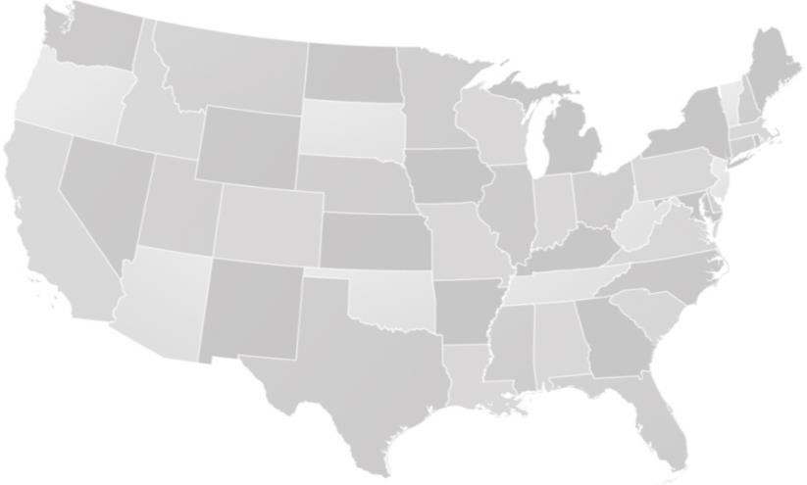
CO₂ EOR is a Proven Process
Significant CO₂ EOR Operators by Region
Gulf Coast Region
» Denbury Resources
Permian Basin Region
» Occidental | » Kinder Morgan
Rocky Mountain Region
» Denbury Resources » Devon | » FDL » Chevron
Canada
» Cenovus | » Apache
Significant CO₂ Supply by Region
Gulf Coast Region
» Jackson Dome, MS (Denbury Resources) » Port Arthur, TX (Denbury Resources) » Geismar, LA (Denbury Resources) » Mississippi Power (Denbury Resources)
Permian Basin Region
» Bravo Dome, NM (Kinder Morgan, Occidental) » McElmo Dome, CO (ExxonMobil, Kinder Morgan) » Sheep Mountain, CO (ExxonMobil, Occidental)
Rocky Mountain Region
» LaBarge, WY (ExxonMobil, Denbury Resources) » Lost Cabin, WY (ConocoPhillips)
Canada
» Dakota Gasification (Cenovus, Apache)
CO₂ EOR Oil Production by Region⁽¹⁾
Gulf Coast/Other Mid-Continent Rocky Mountains Permian Basin
300
250
200
MBbls/d
150
100
50
0
1986 1988 1990 1992 1994 1996 1998 2000 2002 2004 2006 2008 2010 2012 2014
DGC
Lost Cabin
LaBarge
McElmo Dome
Sheep Mountain Bravo Dome
MS Power⁽²⁾
Jackson Dome
Naturally Occurring CO₂ Source
Port Arthur
Geismar
Industrial-Sourced CO₂
Source: Advanced Resources International
Estimated startup in 2017.

Slide 20
Senior Secured Bank Credit Facility Info
Commitments & borrowing base | $1.05 billion
Scheduled redeterminations | Semi-annually – May 1st and November 1st
Maturity date | December 9, 2019
Permitted bond repurchases | Up to $225 million of bond repurchases (~$148 million remaining as of 3/31/2017)
Junior lien debt | Allows for the incurrence of up to $1 billion of junior lien debt (subject to customary requirements) (~$385 million remaining as of 3/31/2017)
Anti-hoarding provisions | If > $250 million borrowed, unrestricted cash held in accounts is limited to $225 million
Pricing grid | Utilization Based |  | Libor margin (bps) |  | ABR margin (bps) |  | Undrawn pricing (bps)
 | X >90% | 350 |  |  | 250 |  | 50
 | >=75% X <90% |  | 325 |  | 225 |  | 50
 | >=50% X <75% |  | 300 |  | 200 |  | 50
 | >=25% X <50% |  | 275 |  | 175 |  | 50
 | X <25% |  | 250 |  | 150 |  | 50
Financial Performance Covenants | 2017 | 2018 |  |  |  |  |  |  | 2019
 |  | Q1 |  | Q2 |  | Q3 |  | Q4
Senior secured debt⁽¹⁾ to EBITDAX (max) | 3.0x |  |  | 2.5x
EBITDAX to interest charges (min) | 1.25x
Current ratio (min) | 1.0x
1)
Based solely on bank debt.

Slide 21
Production by Area
Average Daily Production (BOE/d)
Field | 2014 | 2015 | 1Q16 | 2Q16 | 3Q16 | 4Q16 | 2016 | 1Q17
Mature area⁽¹⁾ | 11,817 | 10,830 | 9,666 | 9,415 | 8,653 | 8,440 | 9,040 | 8,111
Delhi | 4,340 | 3,688 | 3,971 | 3,996 | 4,262 | 4,387 | 4,155 | 4,991
Hastings | 4,777 | 5,061 | 5,068 | 4,972 | 4,729 | 4,552 | 4,829 | 4,288
Heidelberg | 5,707 | 5,785 | 5,346 | 5,246 | 5,000 | 4,924 | 5,128 | 4,730
Oyster Bayou | 4,683 | 5,898 | 5,494 | 5,088 | 4,767 | 4,988 | 5,083 | 5,075
Tinsley | 8,507 | 8,119 | 7,899 | 7,335 | 6,756 | 6,786 | 7,192 | 6,666
Bell Creek | 1,248 | 2,221 | 3,020 | 3,160 | 3,032 | 3,269 | 3,121 | 3,209
Total tertiary production | 41,079 | 41,602 | 40,464 | 39,212 | 37,199 | 37,346 | 38,548 | 37,070
Gulf Coast non-tertiary | 9,138 | 8,526 | 7,370 | 5,577 | 5,735 | 6,457 | 6,284 | 6,170
Cedar Creek Anticline | 18,834 | 17,997 | 17,778 | 16,325 | 16,017 | 15,186 | 16,322 | 15,067
Other Rockies non-tertiary | 3,106 | 2,743 | 2,070 | 1,862 | 1,763 | 1,696 | 1,844 | 1,626
Total non-tertiary production | 31,078 | 29,266 | 27,218 | 23,764 | 23,515 | 23,339 | 24,450 | 22,863
Total continuing production | 72,157 | 70,868 | 67,682 | 62,976 | 60,714 | 60,685 | 62,998 | 59,933
2016 property divestitures | 2,275 | 1,993 | 1,669 | 1,530 | 819 | — | 1,005 | —
Total production | 74,432 | 72,861 | 69,351 | 64,506 | 61,533 | 60,685 | 64,003 | 59,933
1) Mature area includes Brookhaven, Cranfield, Eucutta, Little Creek, Lockhart Crossing, Mallalieu, Martinville, McComb, and Soso fields.

Slide 22
NYMEX Oil Differential Summary
Crude Oil Differentials
$ per barrel 2014 2015 1Q16 2Q16 3Q16 4Q16 2016 1Q17
Tertiary Oil Fields
Gulf Coast Region | $2.11 | $0.60 | $(1.95) | $(0.98) | $(0.82) | $(0.81) | $(1.35) | $(1.58)
Rocky Mountain Region | (11.10) | (2.74) | (3.09) | (2.43) | (2.01) | (1.74) | (2.16) | (1.74)
Gulf Coast Non-Tertiary | (0.28) | (0.19) | (1.95) | (3.16) | (0.36) | (0.79) | (1.89) | (0.42)
Cedar Creek Anticline | (9.78) | (5.49) | (4.82) | (3.77) | (2.90) | (2.04) | (3.77) | (2.08)
Other Rockies Non-Tertiary | (12.03) | (8.12) | (8.90) | (7.66) | (6.33) | (3.44) | (8.63) | (3.41)
Denbury Totals | $(2.21) | $(1.55) | $(3.02) | $(2.18) | $(1.57) | $(1.22) | $(2.29) | $(1.64)

Slide 23
Analysis of Total Operating Costs
Total Operating Costs $/BOE
 | 2014 | 2015 | 1Q16 | 2Q16 | 3Q16 | 4Q16 | 2016 | 1Q17
CO₂ Costs | $3.79 | $2.66 | $1.97 | $2.13 | $2.17 | $2.40 | $2.16 | $2.86
Power & Fuel | 5.93 | 5.59 | 5.26 | 5.02 | 5.39 | 5.53 | 5.29 | 5.93
Labor & Overhead | 5.44 | 5.31 | 5.09 | 5.22 | 5.44 | 5.95 | 5.41 | 6.34
Repairs & Maintenance | 1.45 | 1.33 | 0.80 | 0.73 | 0.98 | 0.83 | 0.84 | 0.95
Chemicals | 1.37 | 1.14 | 0.97 | 0.90 | 1.18 | 1.06 | 1.02 | 1.15
Workovers | 4.23 | 2.40 | 1.22 | 1.99 | 2.02 | 2.33 | 1.87 | 2.65
Other | 1.89 | 1.38 | 0.92 | 1.05 | 1.05 | 0.88 | 0.97 | 1.23
Total Normalized LOE⁽¹⁾ | $24.10 | $19.81 | $16.23 | $17.04 | $18.23 | $18.98 | $17.56 | $21.11
Special or Unusual Items⁽²⁾ | (0.26) | (0.51) | — | — | — | — | — | —
Thompson Field Repair Costs⁽³⁾ | — | 0.07 | — | — | 0.59 | — | 0.15 | —
Total LOE | $23.84 | $19.37 | $16.23 | $17.04 | $18.82 | $18.98 | $17.71 | $21.11
Oil Pricing
NYMEX Oil Price | $92.95 | $48.85 | $33.73 | $45.56 | $45.02 | $49.25 | $43.41 | $51.95
Realized Oil Price⁽⁴⁾ | $90.74 | $47.30 | $30.71 | $43.38 | $43.45 | $48.03 | $41.12 | $50.31
Normalized LOE excludes special or unusual items and Thompson Field repair costs (see footnote 2 and 3 below), but includes $12MM of workover expenses at Riley Ridge during 2014.
Special or unusual items consist of Delhi remediation charges, net of insurance reimbursements ($7MM) in 2014, and a reimbursement for a retroactive utility rate adjustment ($10MM) and an insurance reimbursement for previous well control costs ($4MM), both in 2015.
Represents repair costs to return Thompson Field to production following weather-related flooding in 2Q16 and 2Q15.
Excludes derivative settlements.

Slide 24
Analysis of Tertiary Operating Costs
Tertiary Operating Costs $/Bbl
 | 2014 | 2015 | 1Q16 | 2Q16 | 3Q16 | 4Q16 | 2016 | 1Q17
CO₂ Costs | $6.87 | $4.65 | $3.38 | $3.51 | $3.59 | $3.89 | $3.59 | $4.62
Power & Fuel | 7.46 | 6.72 | 5.98 | 5.62 | 6.08 | 6.15 | 5.96 | 6.52
Labor & Overhead | 5.04 | 4.81 | 4.54 | 4.18 | 4.45 | 4.78 | 4.49 | 4.99
Repairs & Maintenance | 0.90 | 1.02 | 0.71 | 0.77 | 0.83 | 0.75 | 0.76 | 0.97
Chemicals | 1.36 | 1.10 | 0.96 | 1.06 | 1.26 | 1.19 | 1.12 | 1.26
Workovers | 3.15 | 1.85 | 0.85 | 2.04 | 1.55 | 1.94 | 1.59 | 2.13
Other | 0.90 | 0.62 | 0.47 | 0.50 | 0.31 | 0.34 | 0.39 | 0.39
Total Normalized LOE⁽¹⁾ | $25.68 | $20.77 | $16.89 | $17.68 | $18.07 | $19.04 | $17.90 | $20.88
Special or Unusual Items⁽²⁾ | (0.47) | (0.90) | — | — | — | — | — | —
Total LOE | $25.21 | $19.87 | $16.89 | $17.68 | $18.07 | $19.04 | $17.90 | $20.88
Oil Pricing
NYMEX Oil Price | $92.95 | $48.85 | $33.73 | $45.56 | $45.02 | $49.25 | $43.41 | $51.95
Realized Oil Price⁽³⁾ | $94.65 | $49.27 | $31.70 | $44.46 | $44.11 | $48.35 | $41.99 | $50.35
Normalized LOE excludes special or unusual items. See
(2) below.
Special or unusual items consist of Delhi remediation charges, net of insurance reimbursements ($7MM) in 2014, and a reimbursement for a retroactive utility rate adjustment ($10MM) and an insurance reimbursement for previous well control costs ($4MM), both in 2015.
Excludes derivative settlements.

Slide 25
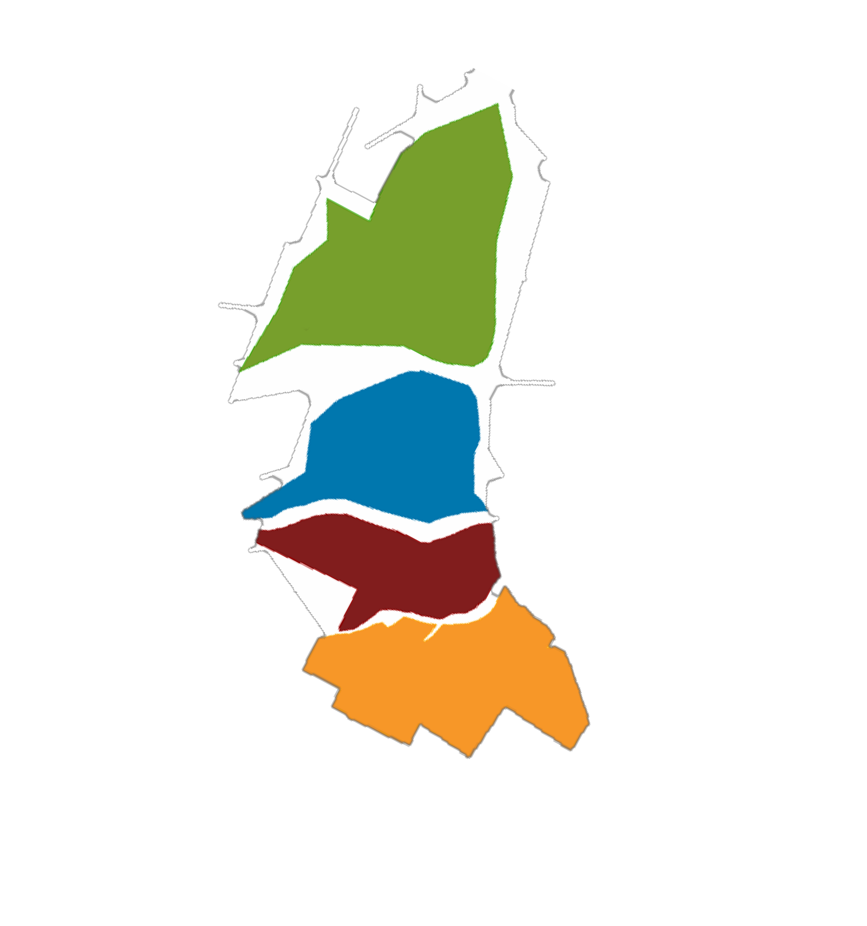
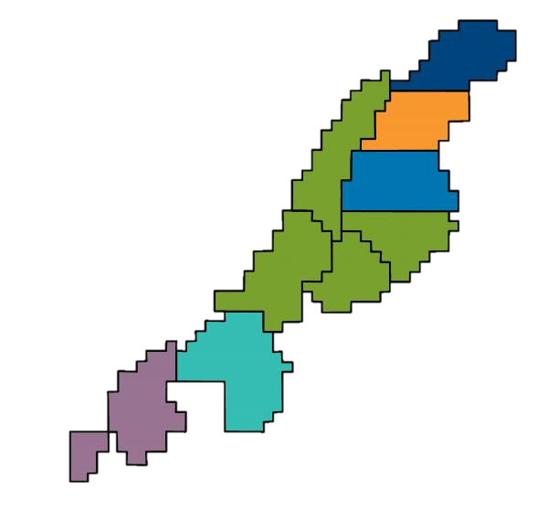
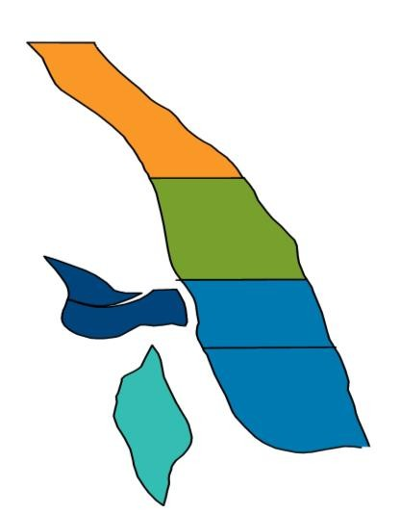


2017 Capital Budget Highlights
Tertiary | $MM
Bell Creek | $25
Heidelberg | $30
Hastings | $30
Tinsley | $20
Delhi | $20
Other | $50
Total | $175
Non-Tertiary | $MM
Cedar Creek Anticline | $25
Exploitation | $15
Other | $20
Total | $60
Development Capital Budget⁽¹⁾
$55
~$300 MM Total $10
$60
$175
Tertiary
CO2 Sources & Other
Non-Tertiary
Capitalized Items ⁽²⁾
Hastings
Fault Block B/C Upper Frio Development
Bell Creek
Phase 5 CO₂ EOR Development
Phase 7
Heidelberg
Christmas Yellow Sand Phase 1 & 2 Development
Christmas Red & Green
Sand Reconfigurations
Future
Fault Block A
(Current)
2017
Fault Blocks B/C
Phase 6
2017
Phase 5
Phases 1-4 (Current)
Fault Blocks D/E
Future
Fault Blocks G-M
Phase 8
Phase 9
2017 estimated development capital budget presented excludes acquisitions and capitalized interest.
Includes capitalized internal acquisition, exploration and development costs and pre-production tertiary startup costs.
Future

Slide 26
CO₂ Cost & NYMEX Oil Price
$0.55 |  |  |  |  |  |  |  |  |  |  |  |  |  |  |  |  |  |  |  |  |  |  |  |  |  |  |  |  |  |  |  |  |  |  |  |  |  |  |  |  |  |  |  |  |  |  |  |  |  |  | $110
$0.50 |  |  |  |  |  |  |  |  |  |  |  |  |  |  |  |  |  |  |  |  |  |  |  |  |  |  |  |  |  |  |  |  |  |  |  |  |  |  |  |  |  |  |  |  |  |  |  |  |  |  | $100
$0.45 |  |  |  |  |  |  |  |  |  |  |  |  |  |  |  |  |  |  |  |  |  |  |  |  |  |  |  |  |  |  |  |  |  |  |  |  |  |  |  |  |  |  |  |  |  |  |  |  |  |  | $90
$0.40 |  |  |  |  |  |  |  |  |  |  |  |  |  |  |  |  |  |  |  |  |  |  |  |  |  |  |  |  |  |  |  |  |  |  |  |  |  |  |  |  |  |  |  |  |  |  |  |  |  |  | $80
$0.35 |  |  |  |  |  |  |  |  |  |  |  |  |  |  |  |  |  |  |  |  |  |  |  |  |  |  |  |  |  |  |  |  |  |  |  |  |  |  |  |  |  |  |  |  |  |  |  |  |  |  | $70
$0.30 |  |  |  |  |  |  |  |  |  |  |  |  |  |  |  |  |  |  |  |  |  |  |  |  |  |  |  |  |  |  |  |  |  |  |  |  |  |  |  |  |  |  |  |  |  |  |  |  |  |  | $60
$0.25 |  |  |  |  |  |  |  |  |  |  |  |  |  |  |  |  |  |  |  |  |  |  |  |  |  |  |  |  |  |  |  |  |  |  |  |  |  |  |  |  |  |  |  |  |  |  |  |  |  |  | $50
$0.20 |  |  |  |  |  |  |  |  |  |  |  |  |  |  |  |  |  |  |  |  |  |  |  |  |  |  |  |  |  |  |  |  |  |  |  |  |  |  |  |  |  |  |  |  |  |  |  |  |  |  | $40
$0.15 |  |  |  |  |  |  |  |  |  |  |  |  |  |  |  |  |  |  |  |  |  |  |  |  |  |  |  |  |  |  |  |  |  |  |  |  |  |  |  |  |  |  |  |  |  |  |  |  |  |  | $30
$0.10 |  |  |  |  |  |  |  |  |  |  |  |  |  |  |  |  |  |  |  |  |  |  |  |  |  |  |  |  |  |  |  |  |  |  |  |  |  |  |  |  |  |  |  |  |  |  |  |  |  |  | $20
$0.05 |  |  |  |  |  |  |  |  |  |  |  |  |  |  |  |  |  |  |  |  |  |  |  |  |  |  |  |  |  |  |  |  |  |  |  |  |  |  |  |  |  |  |  |  |  |  |  |  |  |  | $10
$0.00 | Q | 1 13 |  | Q | 2 13 |  | Q | 3 13 |  | Q | 4 13 |  | Q | 1 14 |  | Q | 2 14 |  | Q | 3 14 |  | Q | 4 14 |  | Q | 1 15 |  | Q | 2 15 |  | Q | 3 15 |  | Q | (2) 4 15 Q |  | 1 16 |  | Q | 2 16 |  | Q | 3 16 |  | Q | 4 16 |  | Q | 1 17 |  | $0
Industrial-Sourced CO₂ % |  | 4% |  | 10% |  |  | 12% |  |  | 14% |  |  | 16% |  |  | 16% |  |  | 15% |  |  | 15% |  |  | 18% |  |  | 22% |  |  | 22% |  |  | 23% 23% |  |  |  |  | 25% |  |  | 22% |  |  | 22% |  |  | 26%
(1)
CO₂ Costs / Mcf
NYMEX Crude Oil Price / Bbl
Industrial Sourced
Excludes DD&A on CO₂ wells and facilities; includes Gulf Coast & Rocky Mountain industrial-source CO₂ costs.
CO₂ costs in 4Q15 include workovers carried out at Jackson Dome of $3 million, or $0.05 per Mcf.

