Slide 1
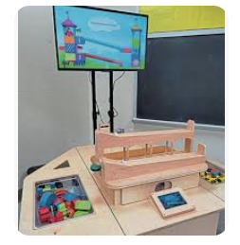

RAMPS
Exploring Effects of Shape, Weight, Potential Energy & Friction
Lesson 6: Using Engineering Design Practice to Build Cars or Objects
SmartRamps
Lesson 6

Slide 2

Welcome Little Scientists!
What is a ramp?
Where do you see ramps?
How are they used?
Lesson 6

Slide 3
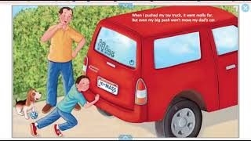
Newton and Me
.
https://youtu.be/PU-pwLMIZKI?si=4rYidXxX4w9hRHHq
Lesson 6

Slide 4
Vocabulary Review
Ramp: A ramp is a surface with one end higher than the other.
Engineer: a person who designs, builds, or maintains engines, machines, or public works
Speed: How fast an object goes
Weight: How heavy something is
Friction: the resistance that one surface or object encounters when moving over another
Design: When you create something on your own
Iterate: To make changes to something that was created
Mass: A measure of how much matter is in an object or how much an object weighs
Potential Energy: A type of energy an object has because of its position
Lesson 6

Slide 5
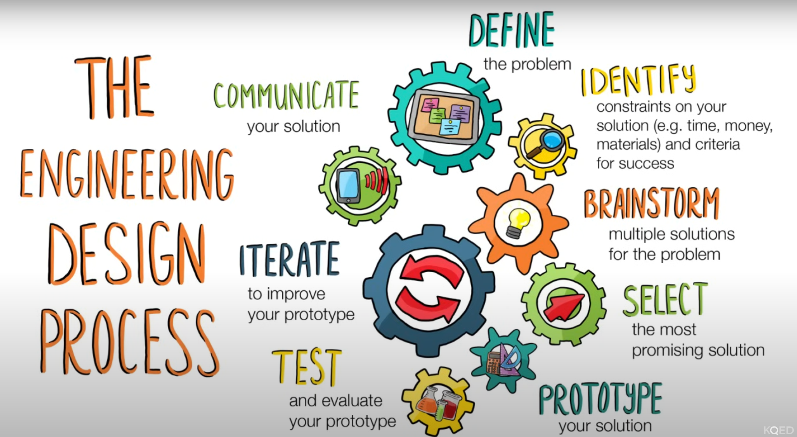
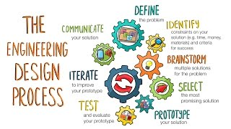
Engineering Design Process
https://www.youtube.com/watch?v=MAhpfFt_mWM
Lesson 6
Notes:
There is a 3:37 minute video on the design process that may be helpful for the kids to watch for review. You may find the graphic helpful on it’s own as this was also shown in the last lessons.

Slide 6
Time to design and experiment
How do you build a car that will go faster on the ramp?
Remember our design concepts
We are going to split into 2 groups. One person from each group will come up to build a vehicle to race.
Make sure to observe the others so you can get ideas about how to improve your design.
Lesson 6

Slide 7
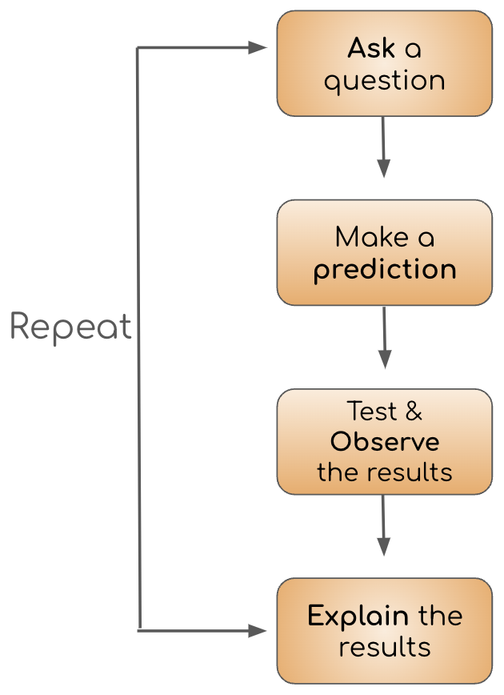
Scientific Method
The scientific method is a process or method of research.
It helps scientists to explain how the world around them works.
Lessons 6

Slide 8

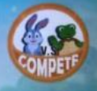
Let’s experiment on NoRILLA!
Lesson 6

Slide 9
Let’s Talk About It
Which cars went the fastest?
Which design concepts went the fastest?
What would you do differently (or the same) the next time you build a car?
Lesson 6

