Slide 1
VITAMINS
OKPAKO, ESEOGHENE

Slide 2
WHAT ARE VITAMINS?
Is an organic compound required by an organism as a vital nutrient in limited amounts
An organic chemical compound (or related set of compounds) when it cannot be synthesized in sufficient quantities by an organism and must be obtained from the diet

Slide 3
CLASSIFICATION OF VITAMINS
Chemical Activity
Biological activity:
Hormone-like functions as regulators e.g. Vit. D
Regulators of cell and tissue growth differentiation e.g. Vit. A
Antioxidants e.g. Vit. A, C and E
Co-factors e.g. vitamin B
Solubility
Fat - soluble vitamins: A, D, E and K
Water- soluble vitamins: B and C

Slide 4
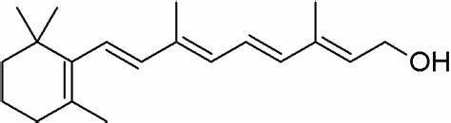
FAT- SOLUBLE VITAMINS
VITAMIN A
Chemical structure
retinol
Others include β- carotene and retinal
Food sources: milk eggs, liver fortified cereals, darkly coloured orange or green vegetables
Properties: stable to heat, partially affected by exposure to air and light
Action: it strengthens the immune system, has anticancer properties, takes care of vision, maintains the skin and mucous membrane in good conditions, prevents hearing loss, necessary for growing up and prevents infertility

Slide 5
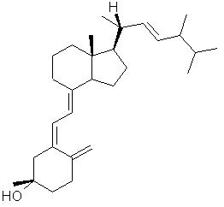
VITAMIN D
Chemical structure
Oth
ergocalciferol
Others include:- calcidiol, calcitriol, vitamin D₃
Food sources: found only in animal sources, can be manufactured by the body on exposure to UV radiation
Properties:- not stable on exposure to air, light and heat
Action and Uses:- it is converted to its active hormone by the liver and kidney, calcidiol and calcitriol respectively. Vitamin D maintains the blood levels of calcium and phosphorus, it is also essential for the absorption of these substances from the small intestine, and also for the mineralization process of the bones

Slide 6
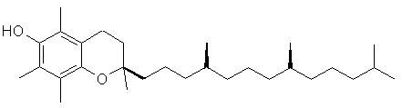
VITAMIN E
Chemical structure
α – tocopherol
Others include: tocotrienols
Food sources : many vegetables and fruits, nuts and seeds
Properties: sensitive to heat, light and oxygen
Action and Uses:
together with vitamins A & C it forms the trio of antioxidant vitamins which are thought to help prevent cancer and CVS dx.
It prolongs the life of red blood cells,
helps the body make the best use of Vitamin A, protecting body membranes and
reproduction

Slide 7
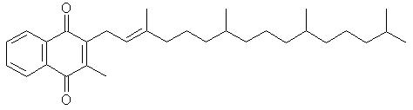
VITAMIN K
Chemical structure
phylloquinone (K₁ )
  Others include: K₂ menaquinones with which phylloquinone are found naturally; K₃ menadione a synthetic compound which is converted to K₂ in the intestine.
  Properties: relatively stable to heat and reducing agents, but are sensitive to acid, alkali, light and oxidising agents
  Food sources: green leafy vegetables, cabbage, soya beans, liver, egg yolks, oats, whole wheat, potatoes, butter, cheese
  Action and uses:
  Essential for blood clotting

Slide 8
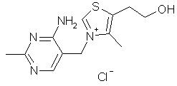
VITAMIN B₁
thiamine
Other names include; thiamine, antiberiberi factor, aneurine and antineuritic factor
Food Sources: pork, yeast, whole grain cereals, vegetables, potatoes, liver, nut, legumes, eggs, fortified bread, cereals, pasta and lean meat
Properties: unstable on exposure to air light and temperatures above 100ºC
Action
It is a co-enzyme in the catabolism of sugars
It is used in the biosynthesis of ACH and GABA
In yeast it is required in the first step of alcoholic fermentation

Slide 9
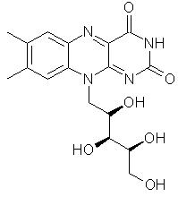
VITAMIN B₂
                Riboflavin
Food sources: diary products, eggs, meat and leafy green vegetables
Properties: it is stable when exposed to heat and air, it is slightly soluble in water and also affected by light when in solution
Action and Uses
Involved in cellular reactions which generate energy from protein, carbohydrate and fat
As coenzymes responsible for the conversion of vitamin B6 and folic acid into their respective active forms
It plays a part in the nutrition of the mucous membrane
Used as a colourant because of its bright yellow colour

Slide 10
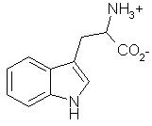
VITAMIN B₃
tryptophan
Others include: niacin (nicotinic acid, nicotinamide)
Properties: stable to heat, light and air
Food sources: yeast extract, liver, meats, oily fish, nuts green leafy vegetables, milk and milk products
Action and Uses:
It is responsible for the generation of energy in cells as a co-enzyme

Slide 11

VITAMIN B₅
panthotenol
Others include: panthotenic acid
Food sources: meat offals, yeast extract, diary products, pulses, legumes, eggs, vegetables and whole grain cereals
Properties: quitev stable in water but easily destroyed by heat
Action and uses:
As coenzyme it is responsible for cellular metabolism and production of sterols, hormones, neurotransmitters, phospholipids, porphyrin and antibodies
A starting material for the synthesis of coenzyme A which is responsible for the synthesis of polyketides, fatty acids terpenoids and steriods

Slide 12
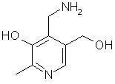
VITAMIN B₆
pyridoxamine
Others include: pyridoxal, pyridoxine, pyridoxamine
Food sources: it is usually bound to protein, as pyridoxol in plants and in animal products as pyridoxal and pyridoxamine; pyridoxine sources include:- nuts, whole grains, few fruits and vegetable, chicken, liver, yeast extract and fish
Properties: it is quite stable to heat but sensitive to air
Action and uses: as a co-enzyme it is necessary for:
Metabolism of amino acids
Cellular metabolism of carbohydrates, protein and fats
Formation of neurotransmitters
Production of nicotinic acid

Slide 13
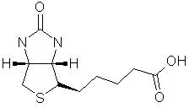
VITAMIN B₇
biotin
Food sources: brewers’s yeast, cooked eggs, sardine, nuts, nut butters, soya beans, legumes, whole grains, bananas and mushrooms
Properties: it is heat stable
Action and uses:
Necessary for cell growth, production of fatty acids, metabolism of fats and amino acids
Plays a role in the citric acid cycle
Maintains blood sugar levels
Recommended for strengthening of hair and nails

Slide 14
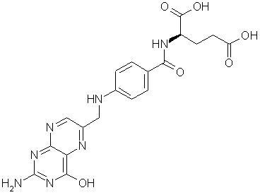
VITAMIN B9
folic acid
Food sources: green leafy vegetables, beans, liver, yeast extract, whole grains, egg yolk, milk and milk products, oranges, orange juice, beets, wholemeal bread, beer
Properties: very unstable, considerable losses occur during short storage and cooking
Action and uses
Essential in the body for the formation of new cells
Involved in the metabolism of RNA and DNA
For normal growth and development and functioning of foetus, nervous system and bone marrow

Slide 15
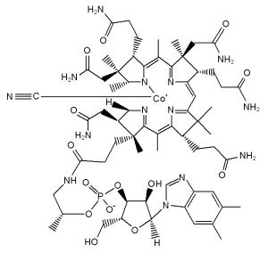
VITAMIN B₁₂
cyanocobalamin
Chemical name: adenosylcobalamin and methylcobalamin are active coenzyme forms, hydroxycobalamin, cyanocobalamin synthetic form that can be converted to the active coenzyme
Food source: animal products
Properties: stable to heat but it is sensitive to light and oxygen
Action and uses:
Involved in the cellular metabolism of carbohydrate, protein and fat
Also involved in the production of blood cells in the bone marrow, nerve sheaths and protein

Slide 16
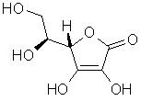
VITAMIN C
ascorbic acid
Food sources: many fruits and vegetables
Properties: can be partially or completely destroyed by overcooking or long periods of storage as it is sensitive to heat, light and oxygen
Action and uses
Vital for the production of collagen
Necessary for the synthesis of bile acids
Maintains skin elasticity, aids iron absorption and improves resistance to infection
Essential for conversion of folic acid to folinic acid
Influences the formation of haemoglobin and maturation of erythrocyte

Slide 17
PURINES AND PYRIMIDINES
OKPAKO, Eseoghene

Slide 18
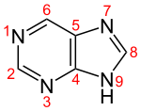
INTRODUCTION
A purine is an heterocyclic aromatic organic compound. It consists of a pyrimidine fused to an imidazole ring.
Purines and pyrimidines make up the two groups of nitrogenous bases including the 2 groups of nucleotide bases
Two of the four deoxyribonucleotides and ribonucleotides, the respective building blocks of RNA and DNA are purines
purine nucleus

Slide 19
Definition of terms
a sugar either a ribose or deoxyribose + nitrogen base = nucleoside. The purine nucleosides end in ” –sine” and the names of pyrimidine nucleosides end in “ – idine” e.g adenosine and thymidine respectively
one or more phosphate + a sugar portion of a nucleoside = nucleotide. E.g AMP and ATP, (they are phosphoric acid esters of the former)
Nucleic acids are polymeric nucleotides (polynucletides)

Slide 20
PROPERTIES OF PURINES AND PYRIMIDINES
PURINES
They are weak acids (pka 2.39)
They are even a weaker base (pka 8.93)
If dissolved in water the Ph will be halfway between these two values
Molecular formula is C₅H₄N₄
PYRIMIDINES
Smaller than purines
They are miscible with water
They are weak acids
It consists of 4 carbon atoms and 2 nitrogen atoms
The molecular formula is C₄H₄N₂

Slide 21
FUNCTIONS OF PURINES & PYRIMIDINES
They are part of DNA & RNA
Cell signalling
Enzyme regulation
Energy storage
The molecules are used to make starch and proteins
As drugs e.g barbiturates for purines and stimulants for pyrimidines

Slide 22
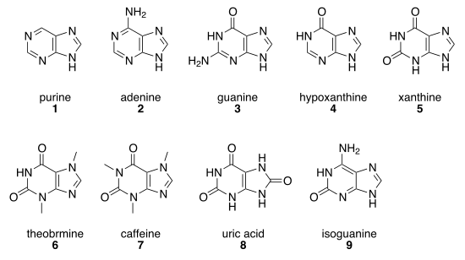
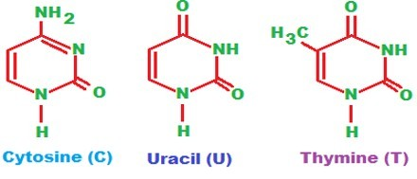
EXAMPLES OF PURINES AND PYRIMIDINES
PURINES
PYRIMIDINES

Slide 23
BIOSYNTHESIS OF PURINES
The major site is the liver
It occurs via three pathways viz:
Salvage
De-novo synthesis
Degradation
SALVAGE PATHWAY
it converts free purine and pyrimidine bases into nucleotides (activated ribose (PRPP) + base= nucleotide)
Nucleosides and nucleotides of a cell are in continual influx e.g DNA & RNA chains are being synthesized in the cell. Even if the overall DNA content of the cell is constant, small stretches are continually being repaired. Part of the repair process is the breakdown of one strand of the DNA double helix into nucleosides, nucleotides and free bases
The free bases and pyrimidines are converted back into nucleoside monomers to be incorporated into DNA
A common step in this pathway is reaction of free bases with phosphoribosyl pyrophosphate (PRPP) to yield nucleotides. PRPP is the general activator of nitrogen ring compounds and is made by activation of ribose-5-phosphate

Slide 24
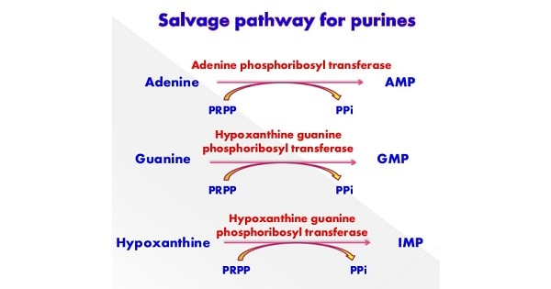
The salvage pathways are a major source of nucleotides for synthesis of DNA, RNA and enzyme co-factors

Slide 25
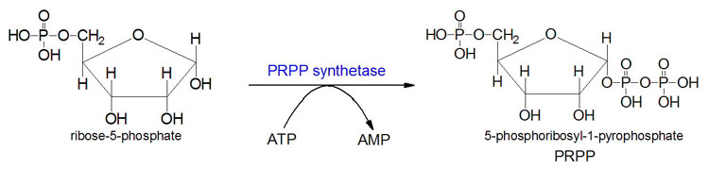
DE-NOVO SYNTHESIS
Synthesis of the purine nucleotides begins with PRPP
and leads to the first fully formed nucleotide, inosine-5-monophosphate (IMP).
the purine base without the attached ribose moiety is known as hypoxanthine

Slide 26
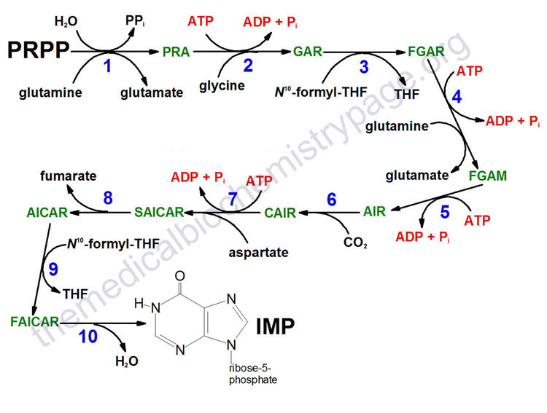

Slide 27
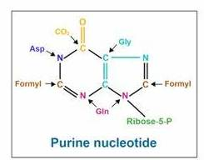
Requirements of De-novo synthesis
5 moles of ATP
2 moles of glutamine
I mole of glycine
1 mole of CO₂
1 mole of aspartate
2 moles of formate
Formyl moieties are carried on tetrahydrofolate, THF
The purine base is built upon the ribose by several amidotransferase and transformylation reactions using the requirements

Slide 28
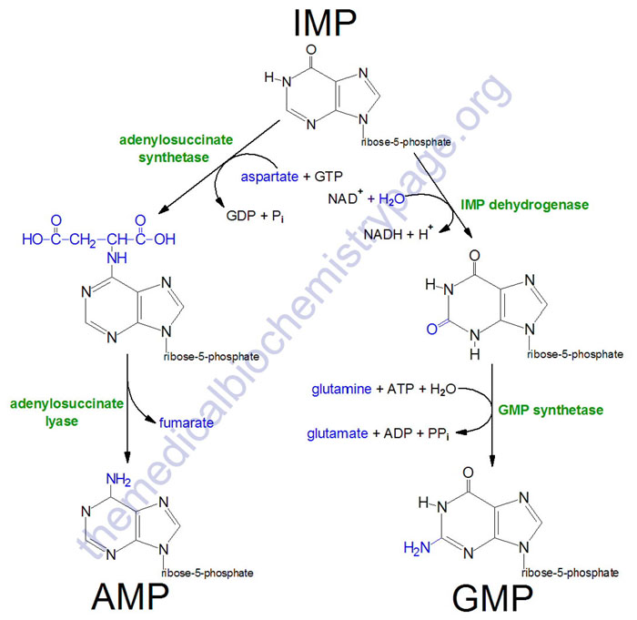
IMP represents a branch point for purine biosynthesis, because it can be converted into either AMP or GMP through two distinct reaction pathways

Slide 29
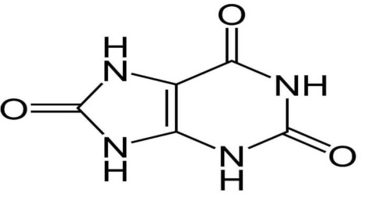
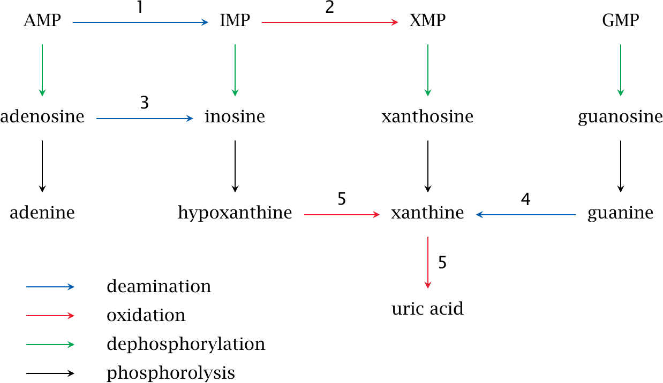
DEGRADATION the purines can be degraded to the oxidised ring compound, uric acid uric acid

Slide 30
BIOSYNTHESIS OF PYRIMIDINES
The major site is the cytosol and mitochondria
It occurs via three pathways viz:
Salvage
De-novo synthesis
Degradation
SALVAGE SYNTHESIS
In pyrimidine salvage reactions, nucleosides and free bases generated by DNA and RNA breakdown are converted back to nucleotide monophosphates, allowing them to re-enter the pathways of pyrimidine biosynthesis and interconversion.
These pathways also involve phosphorylases and kinases compararable to those of purines

Slide 31
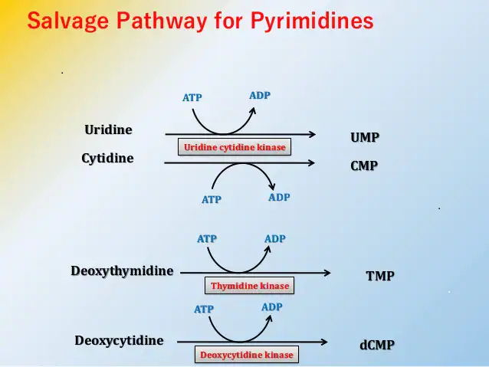

Slide 32
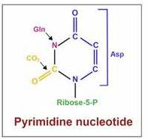
DE-NOVO SYNTHESIS
The pyrimidine nucleotides are cytidine monophosphate (CMP), Uridine monophosphate (UMP) and thymidine monophosphate (TMP)
Unlike the synthesis of purine nucleotides, the pyrimidine ring is made first then attached to the ribose phosphate
Requirements
1 mole of glutamine
1 mole of CO₂
1 mole of aspartate

Slide 33
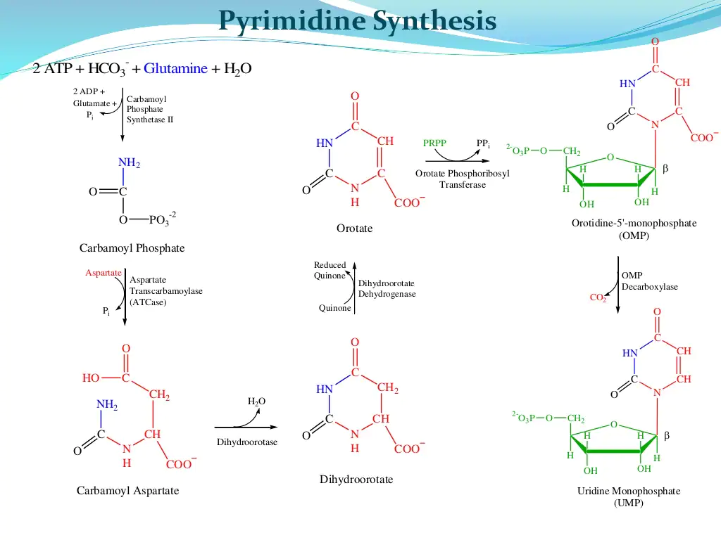

Slide 34
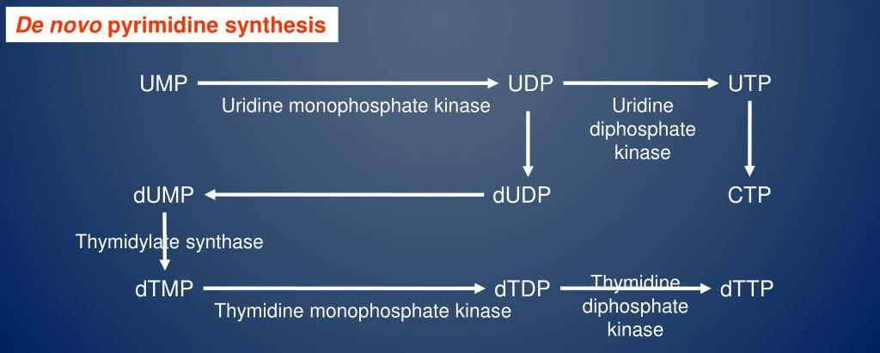

Slide 35
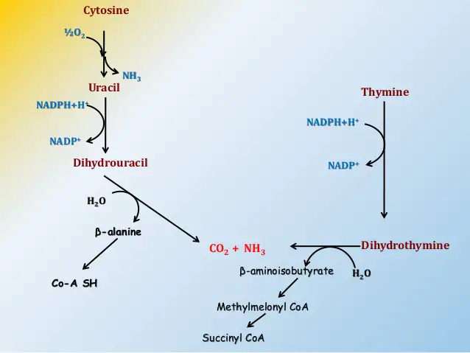
DEGRADATION
Unlike pyrimidines purines are catabolized into sparingly soluble products, uric acid; pyrimidines are catabolized into highly water soluble compounds. These are CO₂, NH₃, β-alanine and β-aminosobutyrate

Slide 36
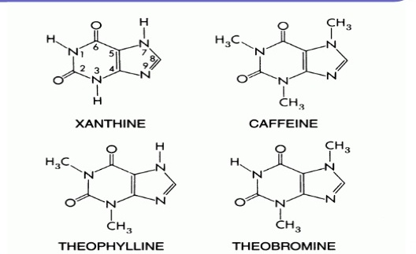
PURINE ALKALOIDS OF NATURAL ORIGIN
Alkaloids that contain a purine skeleton (xanthine) are commonly known as purine alklaoids, e.g. caffeine, theophylline and theobromine.

Slide 37
CAFFIENE
Chemical name: - [1, 3, 7-trimethylxanthine], molecular formula C₈H₁₀N₄O₂,
Botanical source: -
Theine when found in tea leaves; Camellia sinensis (L) Kuntze; Family: Theaceae
coffee beans; Coffea arabica,
Caffeine is sometimes called guaranine when found in guarana; Paullinia cupana Kunth. Family, Sapindaceae
mateine when found in mate; Ilex paraguariensis A. St. Hil. , Family, Aquifoliaceae
Kolanut seeds; Cola accuminata/ nitida (Vent) Schott et Endl. Family, Malvaceae formerly Sterculiaceae.
Seeds of cocoa, Theobroma cacao L. Family, Malvaceae

Slide 38
Description: - It is odourless white needles or powder.
Action and Uses of Caffeine
Caffeine has a stimulating effect on the Central Nervous System (C.N.S) with a weak diuretic action.
Caffeine is used in combination with a number of painkillers. Caffeine is also used with ergotamine in the treatment of migraine and cluster headaches as well as to overcome the drowsiness caused by antihistamines.
Caffeine is found in a number of other plants, where it acts as a natural pesticide

Slide 39
THEOPHYLLINE
Chemical name: - [1, 3- dimethylxanthine], molecular formula C₇H₈N₄0₂
Botanical Source: - same as caffeine
Description: - It is an odourless white crystalline powder with a bitter taste.
Action and Uses: -
It has a diuretic action stronger than that of caffeine with a short duration.
It is a more powerful relaxant of involuntary muscle than caffeine or theobromine.
It has only a slight stimulant action on the cerebrum.
Due to its low solubility it is rarely used but it’s more soluble derivative aminophylline.

Slide 40
THEOBROMINE
Chemical name: - [3, 7 –dimethylxanthine], molecular formula C₇H₈N₄0_{2.}
Botanical Source: - same as caffeine
Description: - An odourless white crystalline powder or rhombic needles with bitter taste.
Action and Uses: -
It has a similar action on the kidney as caffeine.
It has no stimulant effect on the Central Nervous System.
It is used in medicine as a vasodilator.
It is used in combination with phenobarbitone in allaying nervous excitement and insomnia associated with hypertension.

Slide 41
TEST FOR PURINE ALKALOIDS
Caffeine and other purine derivatives can be detected by the Murexide test.
In this test the alkaloids are mixed with a tiny amount of potassium chlorate and a drop of hydrochloric acid and evaporated to dryness, and the resulting residue is exposed to ammonia vapour.
Purine alkaloids produce pink to purple colour in this test.

Slide 42
PREPARE HARD FOR YOUR EXAMINATIONS
THANK YOU

