Slide 1
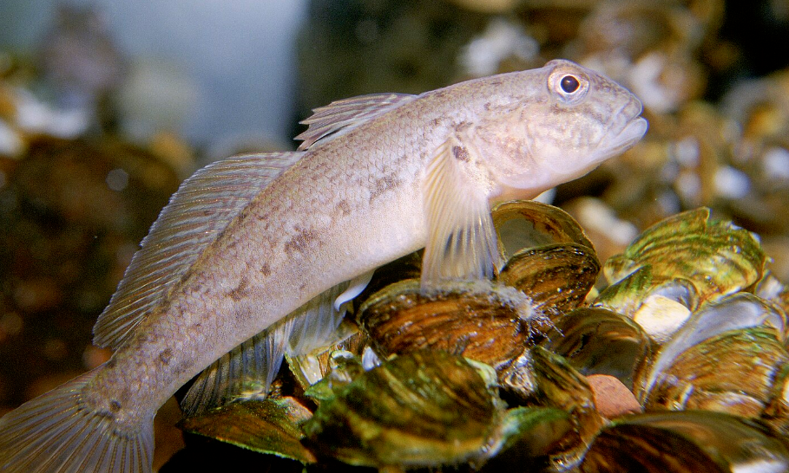


INVADERS OF THE ST. LAWRENCE
I still can’t believe that I get to do research in my own backyard!
Cristina Charette
This Ocean School activity is licensed under CC BY-SA 4.0
Notes:
Image source:
Round goby (cropped) by U.S. Fish and Wildlife Service (licensed under CC Public Domain) on USFWS National Digital Library

Slide 2
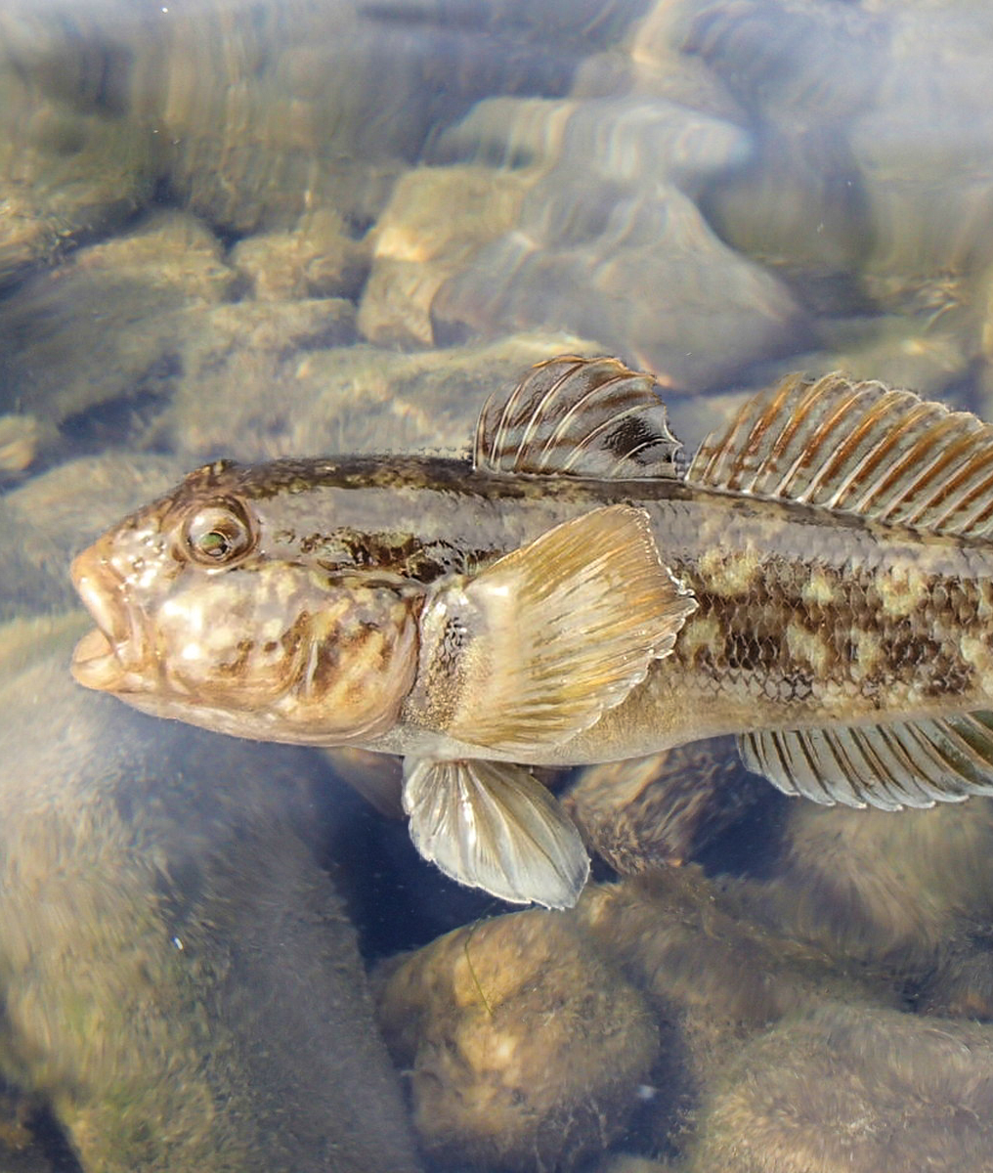
Here’s your challenge:
Debate what to do about an invasive species.
Here’s your to-do list:
Step 1
Learn more about the round goby and other invasive species.
Step 2
Research the pros and cons of the round goby in the Saint Lawrence ecosystem.
Step 3
Decide who will argue to leave the round goby alone and who will argue to control and manage it.
Step 4
Conduct and record your debate.
Notes:
Image source:
Round goby a invasive fish in a lot of countries (cropped) by Peter van der Sluijs (licensed under CC BY-SA 3.0 Deed) on Wikimedia Commons

Slide 3
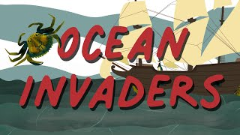
What are invasive species?
Invasive species are plants, animals, or other organisms that are not native to a particular ecosystem or environment.
When non-native species move in, they often compete with local plants and animals for resources like food and homes. This competition can cause some local species to struggle or even disappear all together.
Invasive species might also bring new diseases that local species aren't ready for, causing more problems. This disrupts the balance of nature and can make ecosystems less diverse.
Scientists and conservationists work to stop these invaders and protect the rich variety of life in different habitats.
Boats are still the biggest culprits in the seaward spread of invasives.
-The Hakai Institute

Slide 4
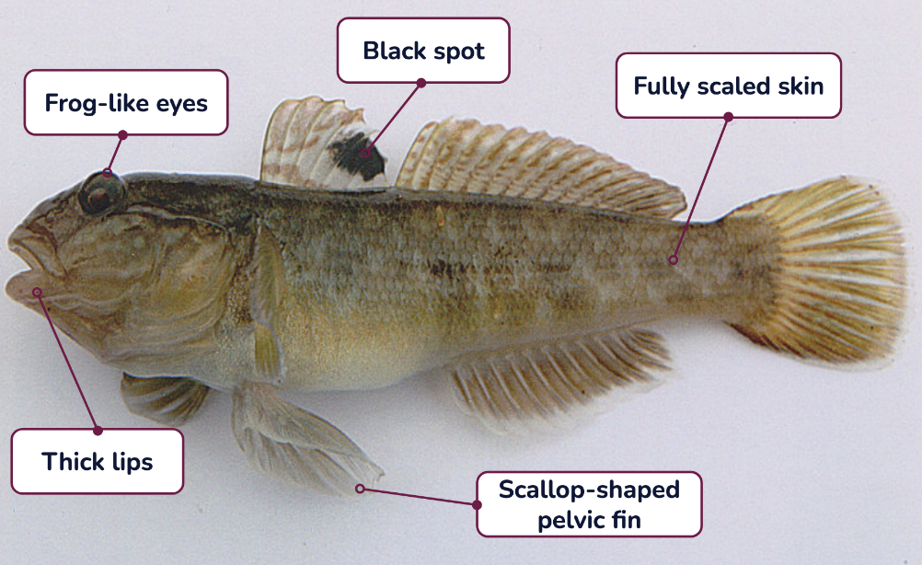
The round goby
The round goby is a small bottom-dwelling fish
from Central Eurasia that was first reported in the
St. Lawrence in 1997.
Since their invasion they have had a huge influence on the St. Lawrence River ecosystem— outcompeting native fish species like darters and sculpins for spawning habitat and food, and eating the eggs of other fish.
However, round gobies have also impacted the ecosystem in other ways. For example, they’re a natural predator of the zebra mussel, which is another extremely devastating invasive species in the St. Lawrence River.
Round gobies have also become a large source of food for smallmouth bass—though scientists aren’t yet sure if they are a healthy source of energy for other fish.
Learn more about the round goby in this species guide.
What you have to understand is that now the round goby is part of the food chain.
Cristina Charette
Notes:
Image source:
A large round goby (Neogobius melanostomus) caught in Netherlands (cropped) by Peter van der Sluijs (licensed under CC BY-SA 3.0 Deed) on Wikipedia

Slide 5
What do experts have to say?
The round goby is an invasive species in the Saint Lawrence River. Two scientists weigh in on what we should do about them:
Prof. GEORGE ALKALI Habitat Restoration Technician
Dr. OCTAVIA NEBULA Marine Biologist
We need to act quickly to control and manage the round goby.
The round goby is an aggressive fish that grows very fast and reproduces often. It eats the food of other fish, takes up the space they call home and where they spawn, and also eats their eggs.
The impacts on aquatic habitats can negatively affect native species of fish.
We brought these invasive species here by far-travelling ships, and we should be responsible for getting rid of them.
We shouldn’t be so fast to eliminate or control the round goby in the area.
Our ecosystems are complex and removing one species may trigger unforeseen consequences.
And is it ok to end a species’ life? Who gets to decide when an invasive species needs to be controlled? Was the community consulted? I think it’s better to let nature take its course and tolerate invasive species.
More human intervention will just cause more problems. We should leave the round goby alone.
Notes:
Images source: avataaars generator. Stanley, P. & Lin, F-P. (n.d.). Retrieved June 9, 2023, from https://getavataaars.com/

Slide 6
The round goby
Research the pros and cons of the eradicating or tolerating the round goby. Use this table to organize and track your sources.
Fact | Pro or con? | Source

Slide 7

The debate!
What is a debate?
A debate is a structured argument.
Two teams take turns speaking.
Each team is given an amount of time they are allowed to speak, and any interruptions are carefully controlled.
What are the rules?
Be respectful and supportive.
Speak only when it’s your turn.
Speak slowly, loudly, and clearly.
Represent your side to the very best of your ability.
Here’s an example of a debate structure.
Notes:
Reference:
Groobles Media. (2016, August 21). How to run a debate. [Video]. YouTube. https://www.youtube.com/watch?v=yi6Im-Sb6Vw

Slide 8
The debate!
“Invasive Invaders: To Fight or Love?"
What now?
Order of the speakers:
Decide who will argue to leave the round goby alone. This will be team “Love the round goby.”
Decide who will argue to control and manage the round goby. This will be team “Fight the round goby.”
Review your notes about the pros and cons of controlling an invasive species (Slide 6).
Each team should prepare an opening statement.
Both teams will take turns making their arguments and offering rebuttals. You can follow the order suggested on the right.
Team Fight the Round Goby.
Opening statement (1-2 min)
Team Love the Round Goby
Opening statement (1-2 min)
Team Fight the Round Goby:
Argument / rebuttal (1-2 min)
Team Love the Round Goby
Argument / rebuttal (1-2 min)
Team Fight the Round Goby:
Closing statement (1 min)
Team Love the Round Goby
Closing statement (1 min)

