Slide 1


Principal Collaboration
Problem Solving PLC Barriers
December

Slide 2


Objective
Principals will explore the problem-solving Leadership Component of each ring of the PLC Bullseye.

Slide 3

Shared Norms
Meeting Norms
Be on time and prepared
Stay engaged
Speak your truth
Assume best intent

Slide 4

Collective Commitments
Clear expectations
Common consensus
Collaborative action
Positive interdependence
Results oriented
Effective feedback
Continuous improvement
Evidence-based practices

Slide 5
Problem Solving the Leadership Component

Slide 6
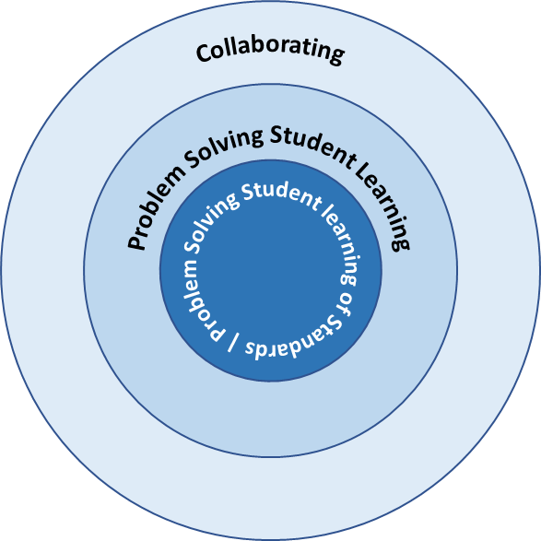
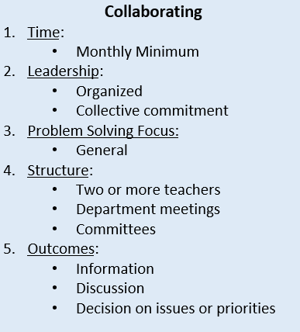
PLC Target - Good - Better - Best
Notes:
Time: 5 Min
Presenter Notes: Also hand out the 1 page bullseye conceptual model.

Slide 7
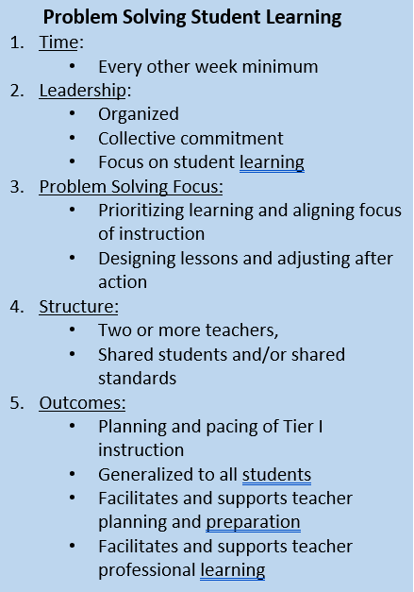
PLC Target - Good - Better - Best
Notes:
Time: 1 Min
Presenter Notes:

Slide 8
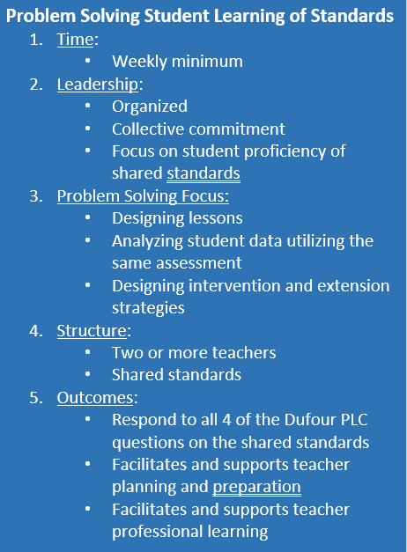
PLC Target - Good - Better - Best
Notes:
Time: 1 Min
Presenter Notes:

Slide 9
Leadership in a PLC
Organized
Collective Commitment
Focus
  Student Learning
  Student Proficiency on Shared Standards
Notes:
Time:
Presenter Notes: At your table take 5 minutes to brainstorm important elements, tools, resources, needed for being organized leading collaborative meetings. Share out? Word Cloud? Need a slick way to collect.

Slide 10
Organized
Shared Digital Collaboration Space
Agenda Management
Communication - Reminders, etc.
Others?
Notes:
Time:
Presenter Notes:

Slide 11
Organized - Digital Space
Shared Digital Collaboration Space
  Google Drive? Microsoft Teams?
    Calendar
    Files/Artifacts/Evidence/Data
    Notes
    Agendas/Minutes
    Action Item List
    Quick links/Resources
Notes:
Time:
Presenter Notes: Accessible to shared leadership. Quick links to resources.

Slide 12
Organized - Agenda Management
Agenda
  Norms
  Timekeeper
  Notetaker
  Action Items
Notes:
Time:
Presenter Notes: What is the template solution for this? How are assignments made to timekeeper, notekeeper, action items. How is it distributed. How are items put on the agenda?

Slide 13
Organized - Agenda Management
Agenda
  What is the digital solution for this?
  How is it distributed?
  How are items put on the agenda?
  How are notes kept?
  How are action items recorded?
Notes:
Time:
Presenter Notes:

Slide 14
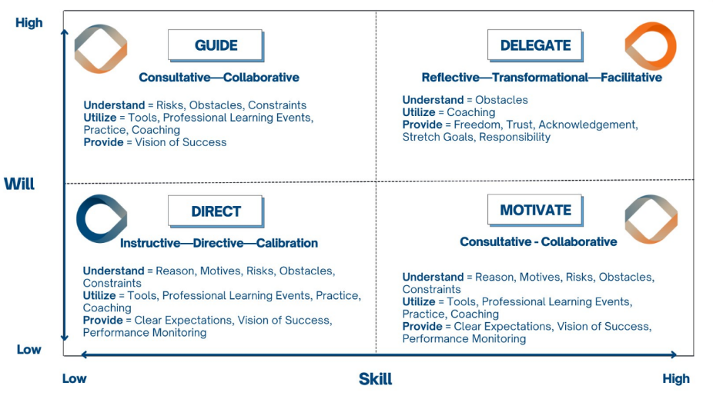
Notes:
Time:
Presenter Notes: Skill and Will Quadrants - As you identify PLC Leaders, the Skill and Will Quardrants Conceptual Model helps you determine what you are going to need to do to support that person. Activity - table talk

Slide 15
Collective Commitment
Adept at Coaching Techniques (December)
Adept at Conflict Resolution aka Negotiation (January)
Notes:
Time:
Presenter Notes: Coaching Techniques and Conflict Resolution Quadrants Review title of this slide.

Slide 16
Coaching Techniques
Professional Relationship of Trust
Listening
Questioning
Understanding
Accountability
Notes:
Time:
Presenter Notes: Coaching Techniques

Slide 17
Coaching Techniques
Professional Relationship of Trust
  Benevolence - Positive Regard, Good Intentions
  Communication - Clear, Frequent
  Transparent - Clear expectations, Honesty, Courage
  Consistency
  Competence
  Modeling
Notes:
Time: 5 Min
Presenter Notes: Table Talk - what does this look like in the context of leading a PLC? How does being organized support these?

Slide 18
Coaching Techniques
Listening
  80% listening 20% talking
  Active listening - being fully present
Questioning
  Prompting self reflection
  Root cause analysis
Notes:
Time: 1 min
Presenter Notes: Share and give an example of where this is applicable for a PLC Leader

Slide 19
Coaching Techniques
Understanding
  In-depth knowledge of content and context
  Knowledge of team members current reality
    Observation
    Artifact review
    Data analysis
Notes:
Time: 1 min
Presenter Notes: Coaching Techniques

Slide 20
Coaching Techniques
Accountability
  Goal setting
  Setting timelines
  Follow up
  Providing feedback
  Celebrating wins
Notes:
Time: 5 min
Presenter Notes: Table Talk - what does this look like in leading a PLC and how does it relate to being organized?

Slide 22
Conflict Resolution
Adept at Coaching Techniques (December)
Adept at Conflict Resolution (January)
Notes:
Time:
Presenter Notes:

Slide 23
Ideas
Define roles for PLC leader and members
Notes:
Optional/recommended

Slide 24
Thanks!

Slide 25
Project completion
-Text
-Words
-Text
Timeline
Date 1
-Text
-Words
-Text
Date 3
-Text
-Words
-Text
Date 5
-Text
-Words
-Text
Date 2
-Text
-Words
-Text
Date 4
-Text
-Words
-Text
Date 6
-Text
-Words
-Text

Slide 26


Logos
Secondary logo: transparent background
Secondary logo: white background
logo: transparent background
Secondary logo: transparent white
Main logo color
Secondary logo color
HEX #00467f
HEX #56a0d3
logo: white background

