Slide 1

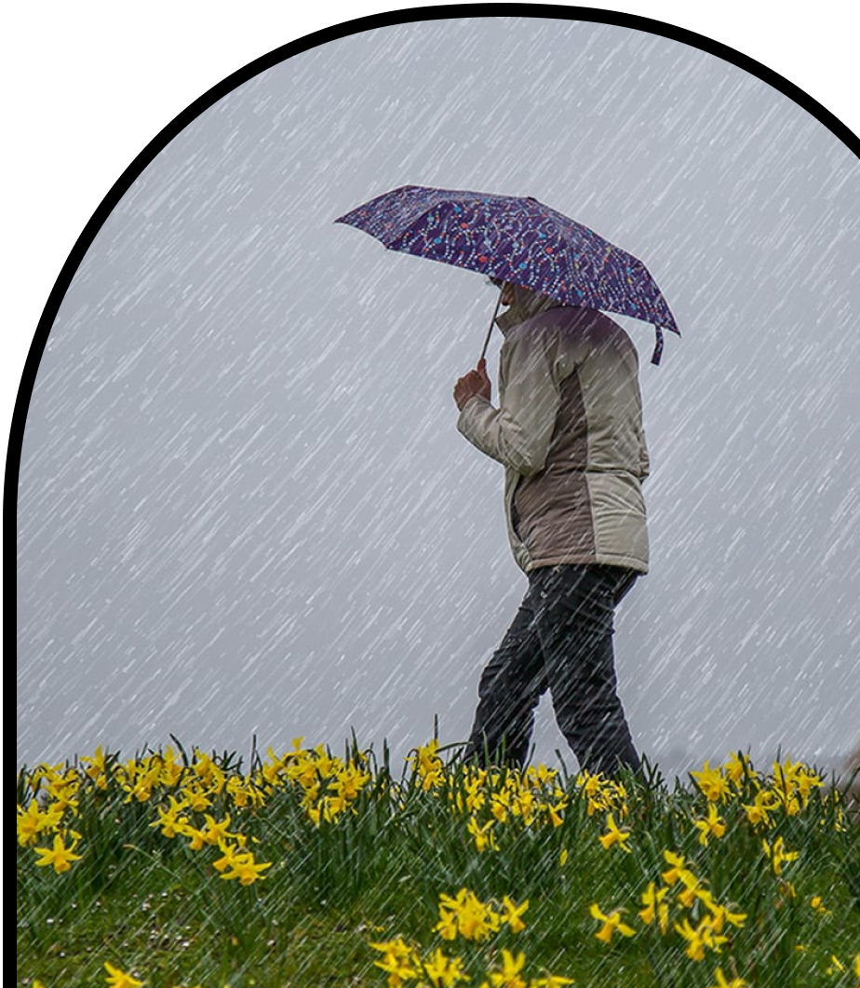
Anchor Layer Teacher Guide
A curriculum companion for Anchor Layer users
Grade K
Severe Weather
Unit Web Link • Pacing Guide • Other Units

Slide 2
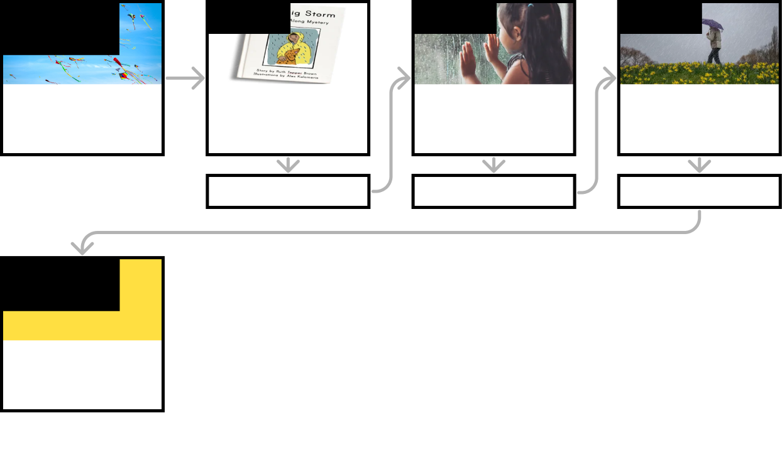
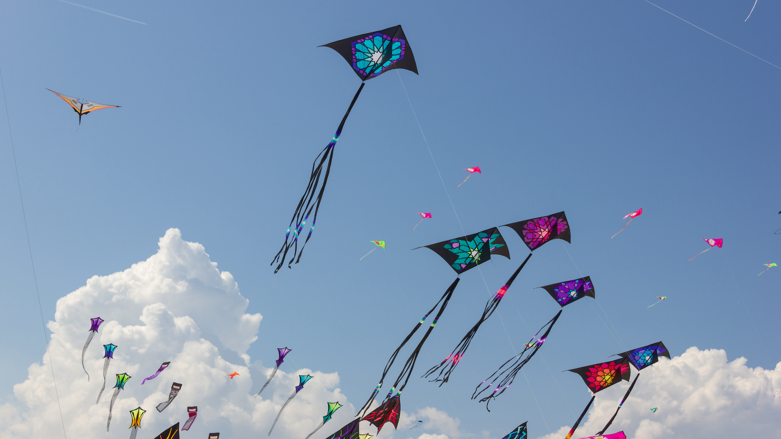
Severe Weather • Grade K
Anchor Layer Teacher Guide
Unit Summary
In this unit, students explore storms and severe weather! They obtain information from weather forecasts to prepare for storms and stay safe. They also practice describing the various characteristics of weather (wind, clouds, temperature, and precipitation) in order to make their own predictions about storms.
Performance Expectations | Science & Engineering Practices | Disciplinary Core Ideas | Crosscutting Concepts
• K-ESS2-1. Use and share observations of local weather conditions to describe patterns over time. • K-ESS3-2. Ask questions to obtain information about the purpose of weather forecasting to prepare for, and respond to, severe weather. | • Obtaining, Evaluating, and Communicating Information • Asking Questions and Defining Problems • Analyzing and Interpreting Data | • ESS3.B: Natural Hazards • ESS2.D: Weather and Climate | • Cause and Effect • Patterns
Anchor Phenomenon
Lesson 1
Lesson 2
Lesson 3
Weather Conditions and Preparation
Flying Kites
Severe Weather & Preparation
How can you get ready for a big storm?
Wind & Storms
Have you ever watched a storm?
Weather Conditions
How many different kinds of weather are there?
Anchor Connection
Anchor Connection
Anchor Connection
Performance Task
Weather Conditions and Preparation
When might we go fly kites?
‹#›

Slide 3

Severe Weather • Grade K
Anchor Layer Teacher Guide
Anchor Phenomenon Background
Which kinds of weather are best for flying a kite?
The weather is something that can have an enormous impact on our daily lives. Good weather conditions make it easier and more fun to do everything from playing outside, to traveling to school or work, to going to the store. At the other extreme, bad weather conditions can be very dangerous. Therefore, it’s important to have a good understanding of what the weather is today, and what it will be in the future.
Different regions may experience very different forms of extreme weather, and children should learn about the forms of extreme weather that they may experience. Some regions may experience extreme drought, while others may experience flooding. Some regions may experience tornadoes or hurricanes, while others may experience snow storms. Different forms of severe weather require different forms of preparation, and children should learn to prepare for the weather that they may experience where they live.
Weather forecasting is very difficult, but weather forecasts are of great value to people living everywhere on Earth. By helping children to understand the value of weather forecasts, we can help them to be prepared for the sorts of conditions they will likely encounter, whether it’s a day at the park flying a kite or a day staying warm and safe inside during a storm!
‹#›

Slide 4

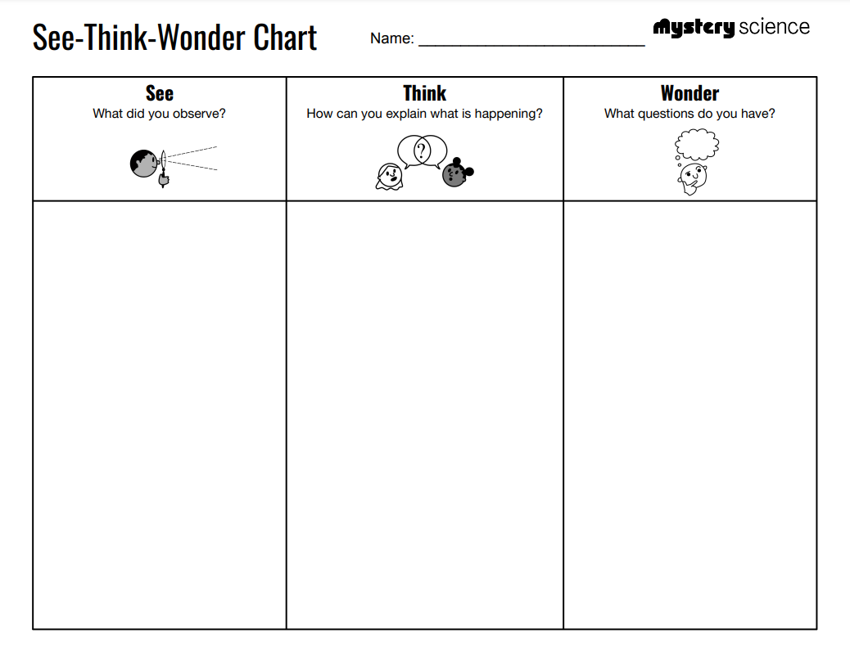
Severe Weather • Grade K
Anchor Layer Teacher Guide
Anchor Phenomenon: Flying Kites
Placeholder
Anchor Phenomenon Lesson Overview
Note: This lesson is part of this unit’s Anchor Layer. If you have the Anchor Layer turned on, we recommend teaching all of the lessons in this unit in order.
The anchor phenomenon for this unit is the fact that weather has a huge impact on our activities. Specifically, the activity of flying kites!
During the introduction, students generate observations and questions about the phenomenon and create a list of possible explanations for the phenomenon.
Anchor Phenomenon 15 mins
Guided Inquiry 20 mins
Student Work Samples & Notes
Students will gather clues during and after each lesson in this unit to help them improve their understanding and explanations. It is important to encourage students to recognize that even if they don't know the perfect answer yet, they are going to learn a lot throughout the unit and will have an opportunity to revisit the phenomenon over time.
Sunshine
It’s daytime
There are some clouds
I think that the wind is blowing
I think that it’s warm
Can you fly a kite in the rain?
Does there have to be wind?
What if there is lightning?
‹#›

Slide 5

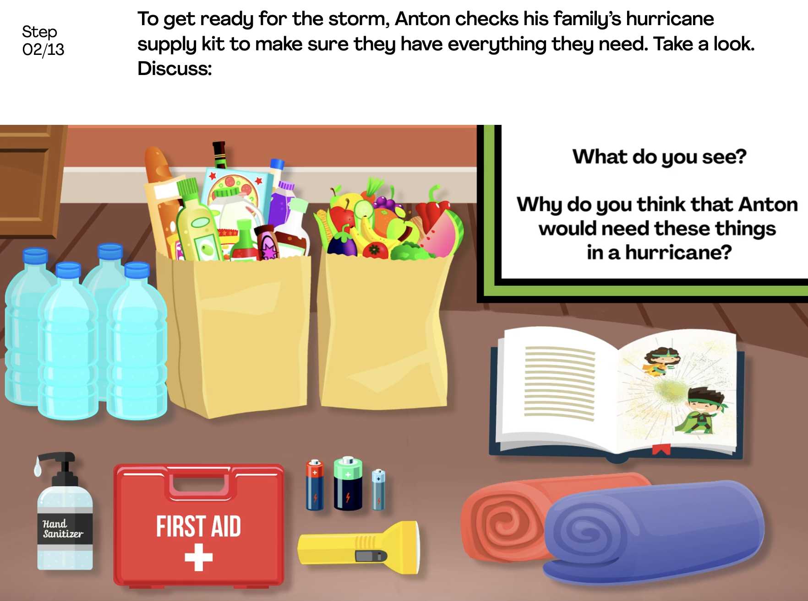
Severe Weather • Grade K
Anchor Layer Teacher Guide
Lesson 1: How can you get ready for a big storm? (pg 1 of 2)
Severe Weather & Preparation
Overview
In this Read-Along lesson, students listen to an illustrated digital storybook with student participation. If you would prefer to read it aloud yourself, you can switch to the non-narrated version. In the story, JJ and his grandfather get ready for a big thunderstorm.
In the activity, Get Ready for a Storm, students learn about other kinds of storms and act out ways to prepare for storms.
Anchor Connection on Next Page
Digital Book W/Audio 15 mins
Hands-On Activity 25 mins
Anchor Connection 10 mins
Activity Notes
This activity does not require supplies.
In the activity, students will be introduced to the idea that the weather report — on a smartphone, on a TV, or on a computer — helps people know when to get ready for a coming storm. You can help prepare your students for this aspect of the lesson by asking them — “What do you think the weather will be like tomorrow.” If you want to show them a weather report that’s appropriate for Kindergarten, we have included a link to a daily “weather report for kids” in the extensions for this lesson.
‹#›

Slide 6
Severe Weather • Grade K
Anchor Layer Teacher Guide
Lesson 1: How can you get ready for a big storm? (pg 2 of 2)
Severe Weather & Preparation
Anchor Connection
In this lesson, students learn that weather forecasts help us to prepare for different kinds of weather. Wind is a very important part of the weather. Sometimes the wind is just right for flying a kite, and sometimes there is way too much wind or not enough wind.
Students revisit the See-Think-Wonder chart that they worked on during the Anchor Phenomenon. They should understand the wind is an important part of the weather when it comes to flying kites. Sometimes there is too much wind, like in a storm. Sometimes there isn't enough wind. But sometimes, the wind is just right.
Connecting Storyline Question
How can we find out how hard the wind is blowing?
Digital Book W/Audio 15 mins
Hands-On Activity 25 mins
Anchor Connection 10 mins
‹#›

Slide 7
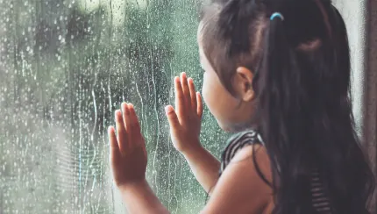
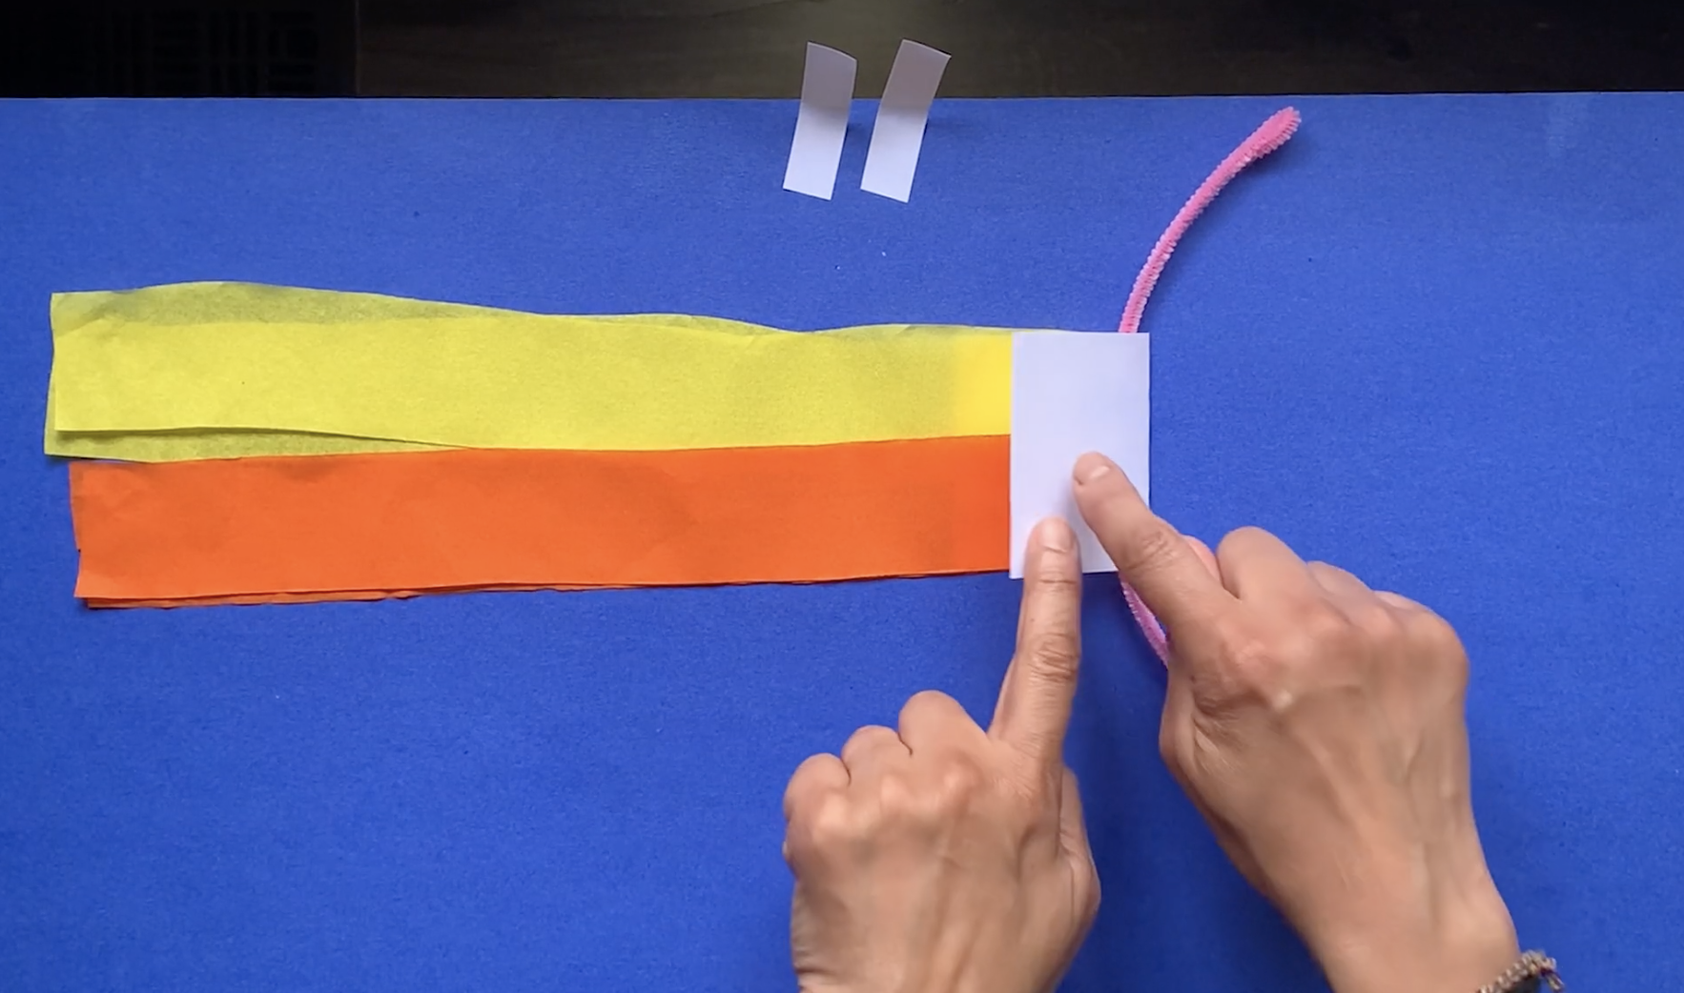
Severe Weather • Grade K
Anchor Layer Teacher Guide
Lesson 2: Have you ever watched a storm?
Wind & Storms
Overview
In this lesson, students observe changes in the weather when a storm is coming.
In the activity, Breeze Buddy, students make a simple tool that lets them see how windy it is.
Anchor Connection
In this lesson, students build a tool called a breeze buddy that helps them observe the wind. This tool can be used to help them determine the strength of the wind, which is useful for determining when conditions are best for flying a kite.
Students revisit the See-Think-Wonder chart that they worked on during the Anchor Phenomenon. They should understand that by observing things like leaves and branches, we can see how strongly the wind is blowing. This can help us know when we can fly a kite.
Connecting Storyline Question
Is wind all that you need to fly a kite?
Exploration 10 mins
Hands-On Activity 30 mins
Anchor Connection 10 mins
Activity Notes
Prep your streamers before class. Cut two 2-foot streamers for each student.
‹#›

Slide 8
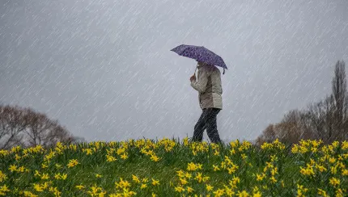
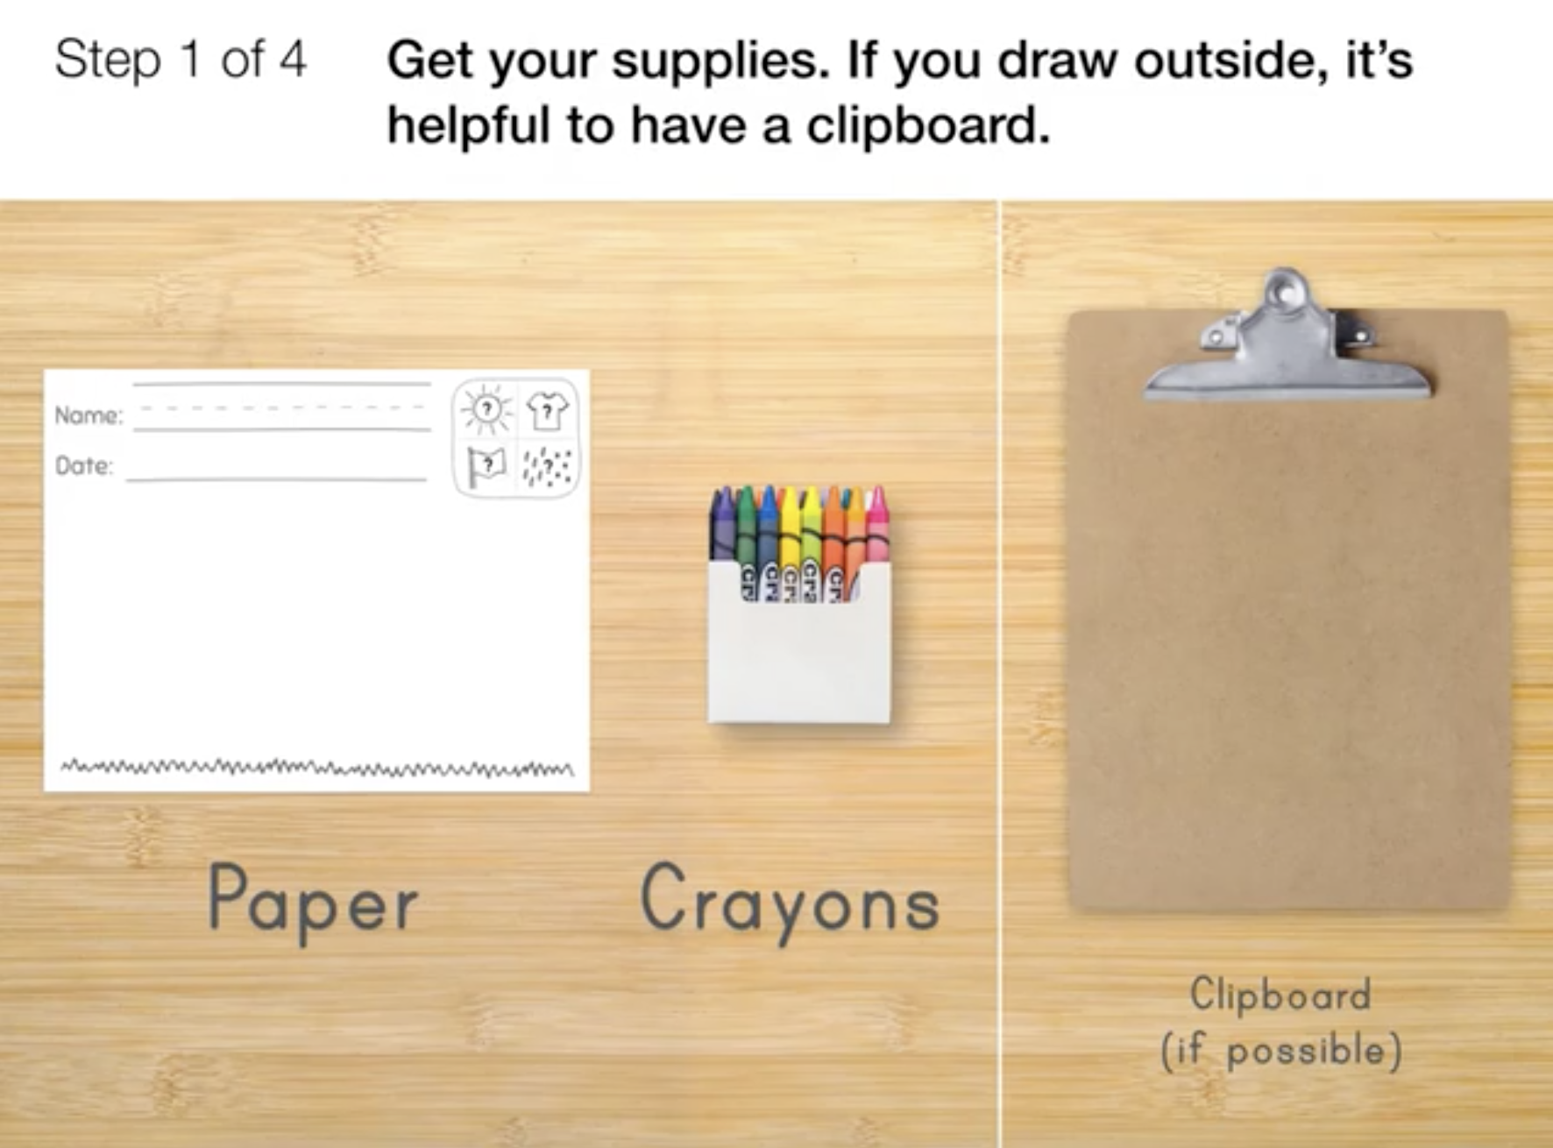
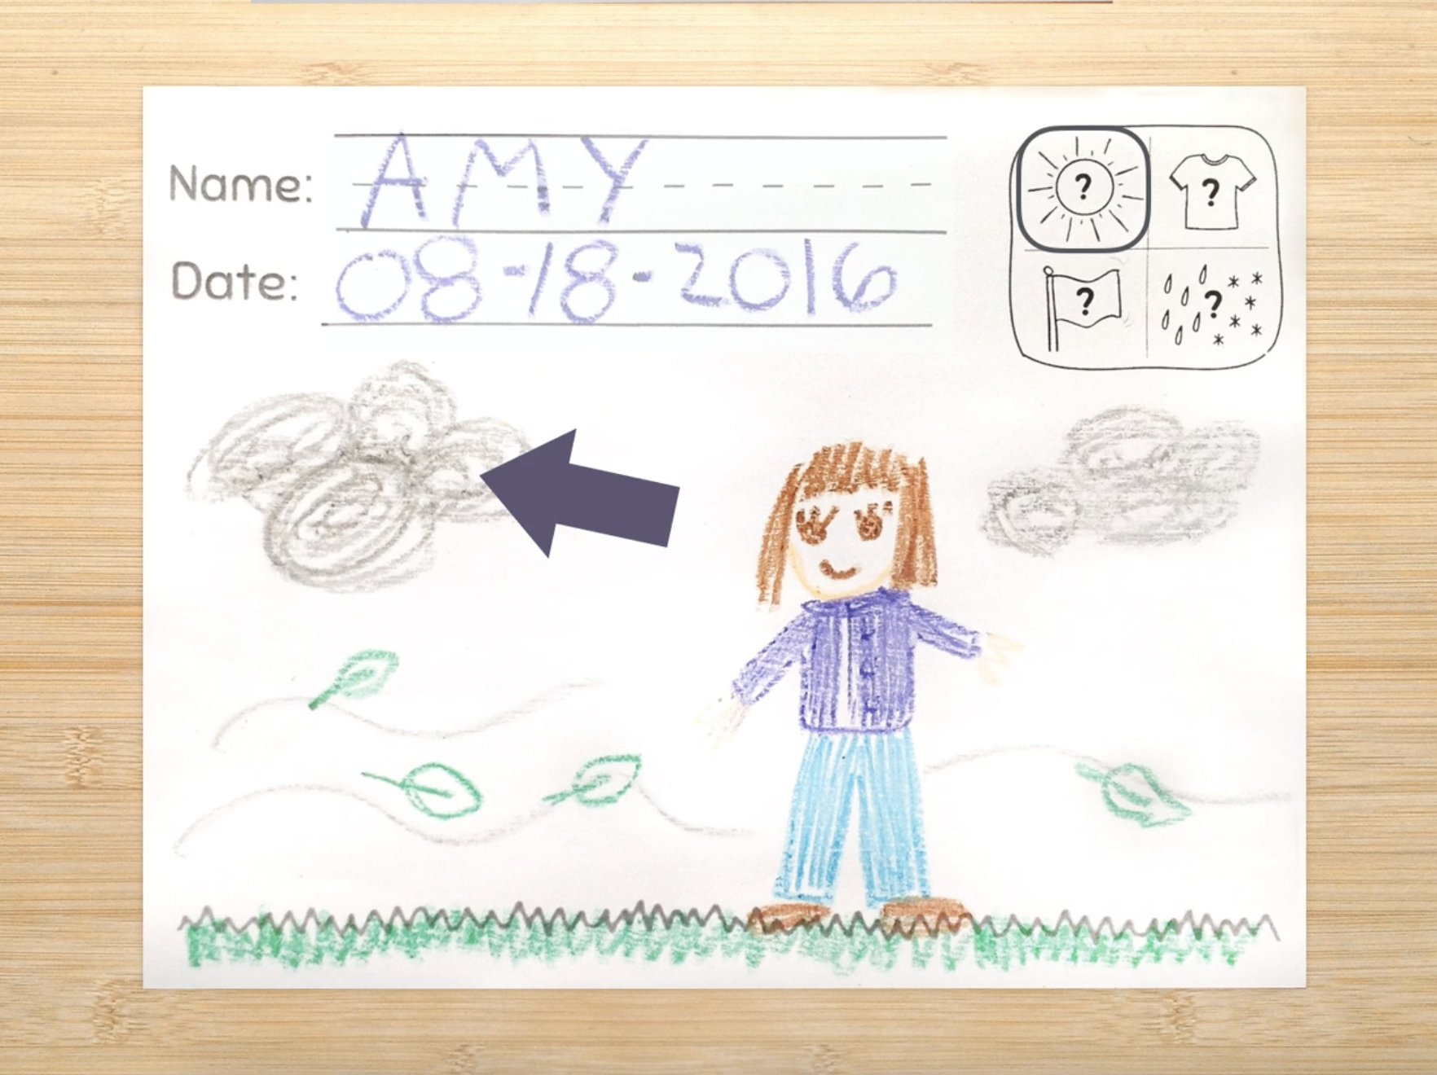
Severe Weather • Grade K
Anchor Layer Teacher Guide
Lesson 3: How many different kinds of weather are there?
Weather Conditions (pg 1 of 2)
Overview
In this lesson, students observe and describe the weather, paying attention to the sun, the temperature, the wind, and precipitation.
In the activity, Be a Weather Watcher, students observe and draw the weather around them.
Exploration 20 mins
Hands-On Activity 30 mins
Anchor Connection 10 mins
Activity Notes
If the weather is nice, take your students for a walk and let them draw while they are outside. If that’s not possible, you’ll need a window that lets them observe the weather while drawing.
When students are drawing, you may need to remind them to pay attention to the four aspects of the weather that are discussed in this lesson: what you see in the sky, the temperature, the wind, and rain/snow. We’ve included icons in the corner of the drawing sheet as a reminder.
Consider having students repeat this activity when the weather changes. Drawing gives them a tool that will help them pay attention to changes in the weather that they may otherwise overlook.
Anchor Connection on Next Page
‹#›

Slide 9
Severe Weather • Grade K
Anchor Layer Teacher Guide
Lesson 3: How many different kinds of weather are there?
Weather Conditions (pg 2 of 2)
Anchor Connection
In this lesson, students observe four aspects of the weather. Wind is one of the four aspects, and the other three aspects also have an impact on whether a given day is good for flying a kite.
Students revisit the See-Think-Wonder chart that they worked on during the Anchor Phenomenon. They should understand that fully describing the weather requires us to describe more than just the wind. And when we want to fly a kite, we have to know more than just how hard the wind is blowing!
Connecting Storyline Question
What's the weather like where I live?
Exploration 20 mins
Hands-On Activity 30 mins
Anchor Connection 10 mins
‹#›

Slide 10
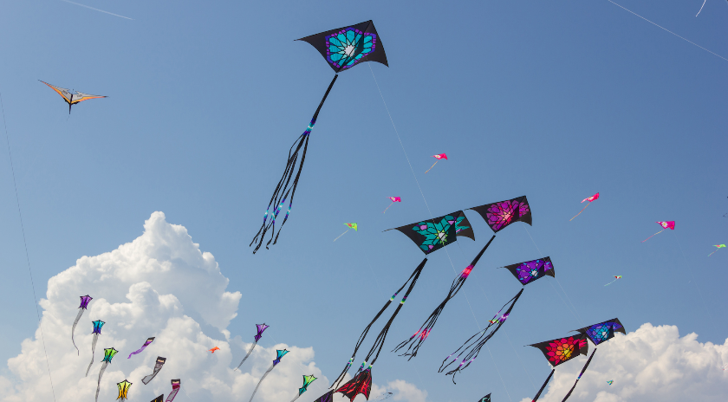
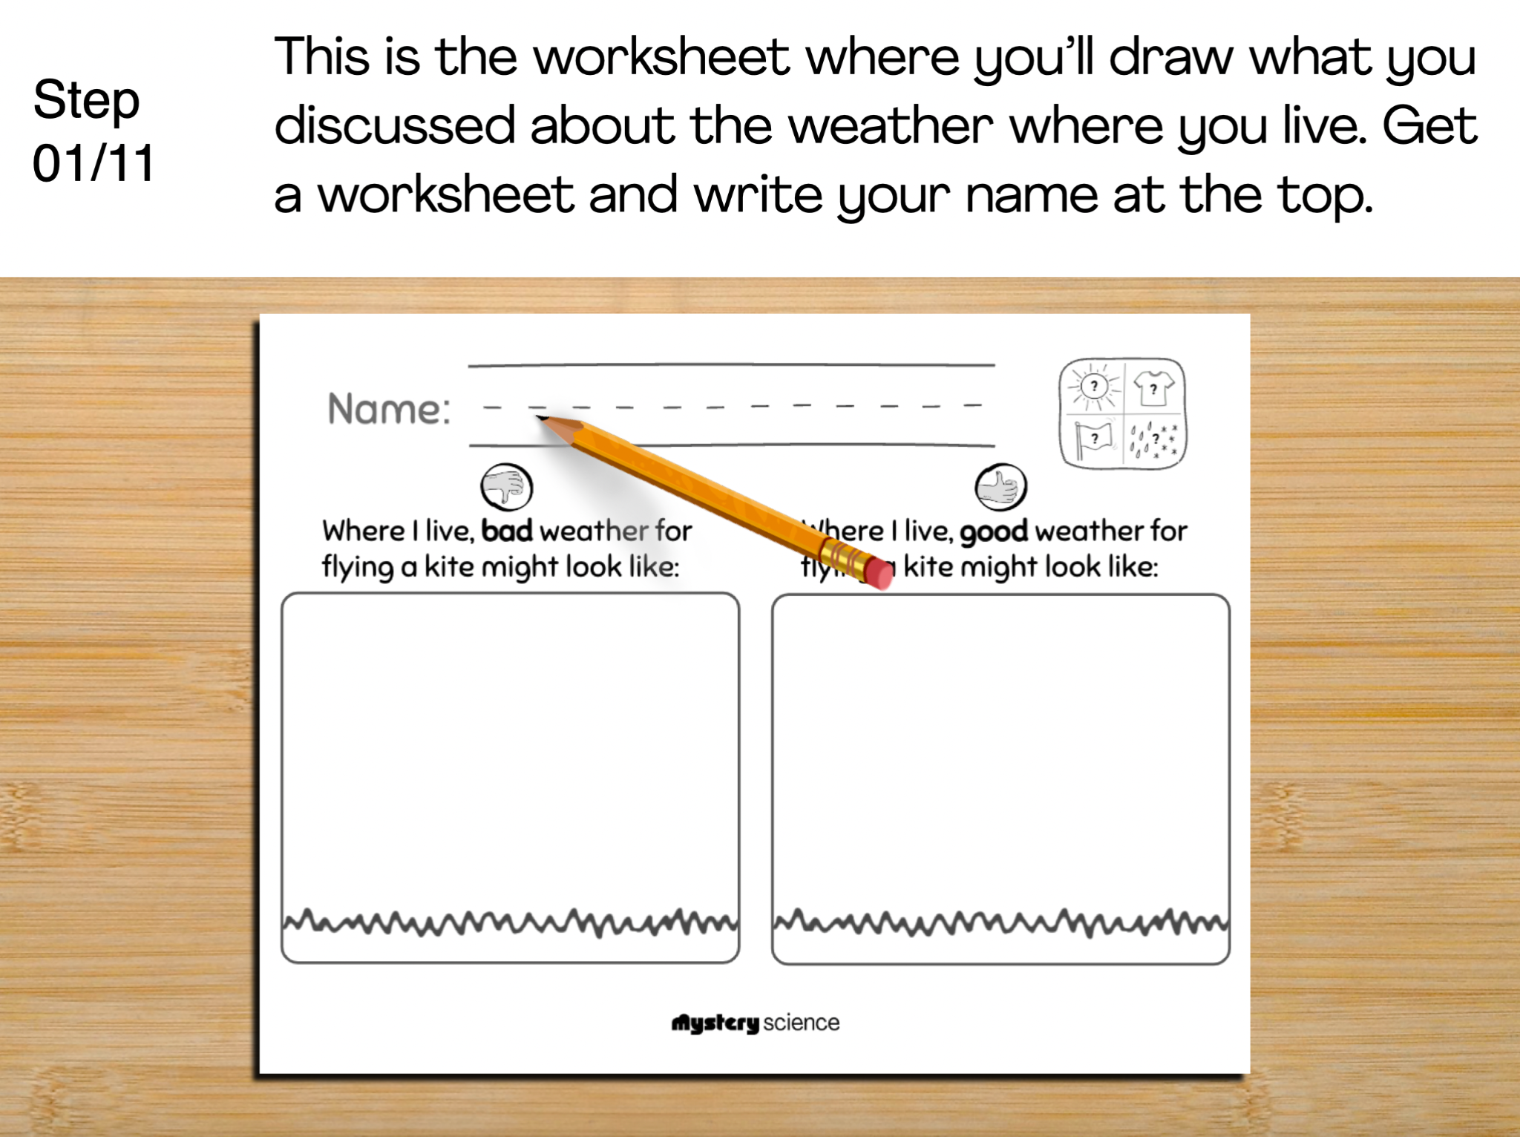
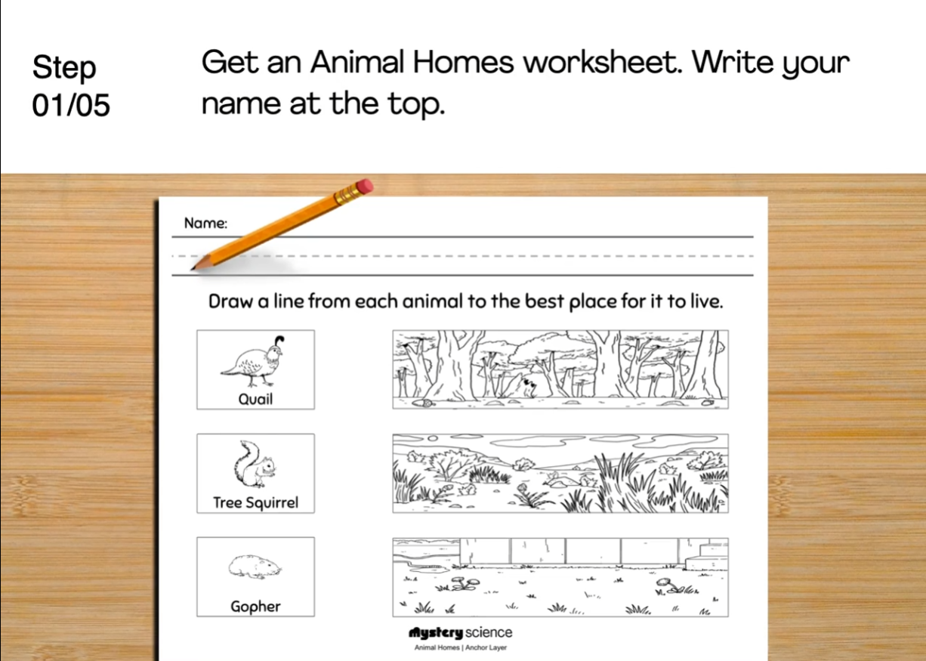
Severe Weather • Grade K
Anchor Layer Teacher Guide
Performance Task: When might we go fly kites?
Weather Conditions & Preparation
Overview
In this performance task, students reflect on how local weather forecasts can help them prepare for both good and bad weather.
After a brief review of the unit, students discuss different types of weather that they might experience, and then describe the weather characteristics that they would likely see in weather forecasts.
Unit Review 10 mins
Hands-On Activity 50 mins
Performance Task Notes
Students can work as a class, in small groups, or individually. Each student will need one copy of the My Kite Weather worksheet.
With your students, begin the lesson. It begins with a brief unit review. Then, move through the activity. The activity includes a step-by-step guide and discussion questions throughout.
Crosscutting Concepts
Cause & Effect: The weather can have a profound effect on our daily lives. Pleasant weather can allow us to safely travel, work, or spend time with loved ones. Severe weather events can be both unpleasant and dangerous. Weather forecasts are incredibly powerful tools that help us to prepare for the weather, no matter what it might be.
‹#›

