Slide 1
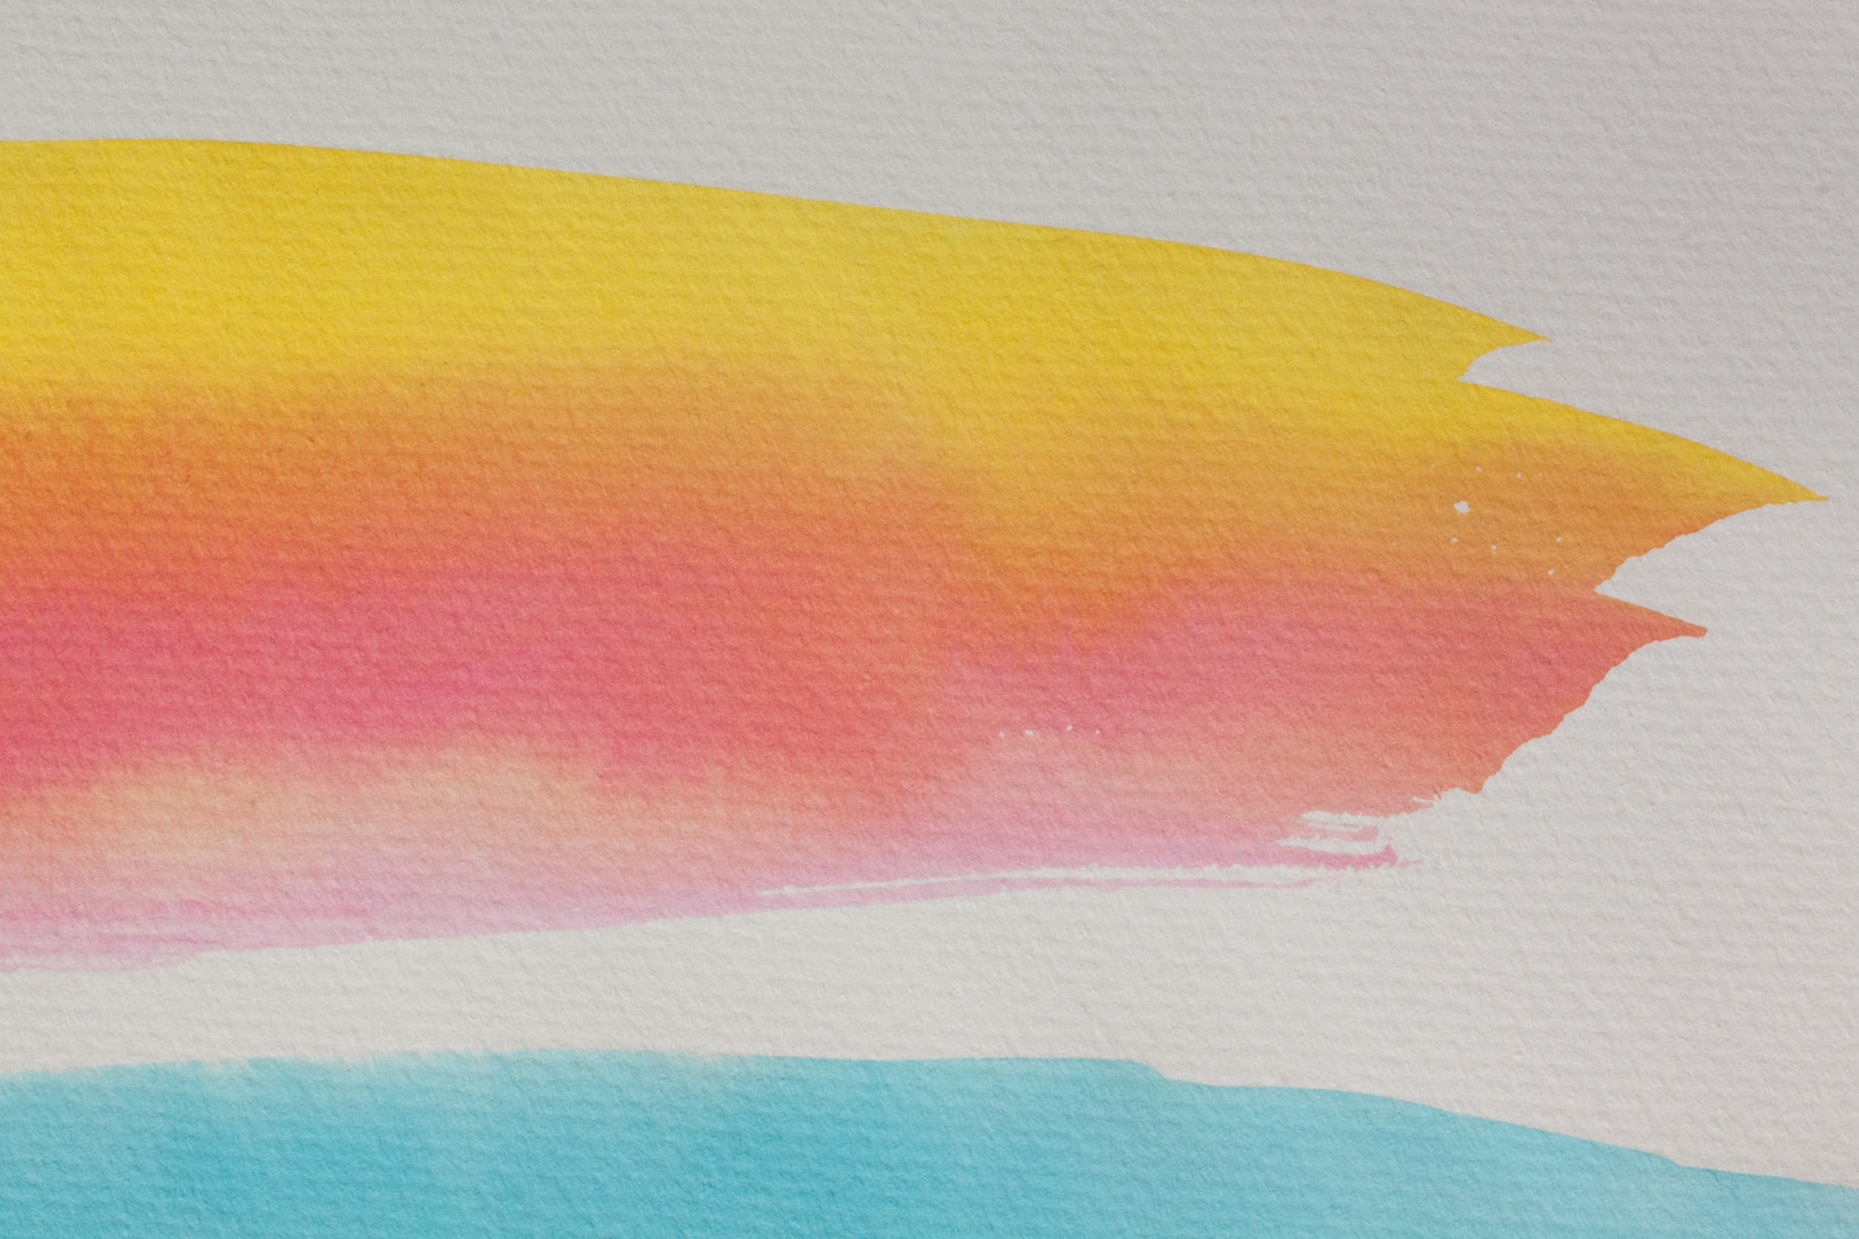
Morning Circle Templates
Here are some fun templates that you can use in your morning circle time (either in the classroom or through digital platforms like Zoom or Google Meet.
Depending on the amount of questions you choose, just copy and paste the templates to make it modified to your liking.
Add your questions into the speech bubbles.
Insert your Bitmoji if you choose!
Have fun!

Slide 2




Question #:
Sample
Let's Share

Slide 3


Question #:
Let's Share

Slide 4
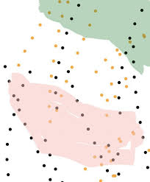
Question #:
Let's Share

Slide 5

Question #:
Let's Share

Slide 6

Question #:
Let's Share

Slide 7

Question #:
Let's Share

Slide 8

Question #:
Let's Share

Slide 9

Question #:
Let's Share

Slide 10

Question #:
Let's Share

Slide 11
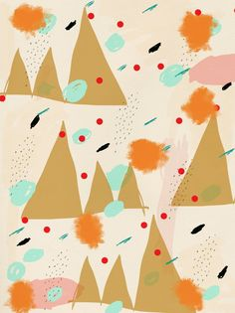
Question #:
Let's Share

Slide 12

Question #:
Let's Share

Slide 13
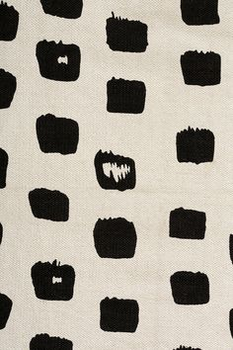
Question #:
Let's Share

Slide 14

Question #:
Let's Share

Slide 15

Question #:
Let's Share

