Slide 1

Build Your Own
UC ANR System Map in PowerPoint

Slide 2
Instructions (Brief)
Start a new blank slide for your map.
Copy-paste the layers you want in your map onto your slide.
  use the 'Send to Back' command to change the stacking order (if needed)
  tip: keep it simple!!
The shapes in each layer are grouped
  change the fill & outline of an entire layer by selecting it and using the format buttons
  to modify individual shapes, select them from within the group, or ungroup the shapes
When you're all done, group everything, resize as needed, and copy-paste into your presentation
For a more detailed tutorial, see https://youtu.be/vd8LcY1G2Jk

Slide 3
state boundary

Slide 4
counties

Slide 5
UCCE

Slide 6
RECs

Slide 7
Intermountain
Sierra
Hopland
Foothill
REC labels
West Side
Kearney
Lindcove
Hansen
South Coast
Desert

Slide 8
campuses - squares

Slide 9
UC Davis
UC Berkeley
campuses - labels
UC Santa
UC Merced
Cruz
UC Santa
Barbara
UC Los
Angeles
UC Riverside
UC Irvine
UC San Diego

Slide 10
campuses - hats

Slide 11
UC Davis
UC Berkeley
UC Merced
UC Santa Cruz
campuses - labels
UC Santa Barbara
UC Los Angeles
UC Riverside
UC Irvine
UC San Diego

Slide 12
UCANR regions

Slide 13
Region 1
Region 2
Region 5
Region 3
UCANR regions - labels
Region 4

Slide 14
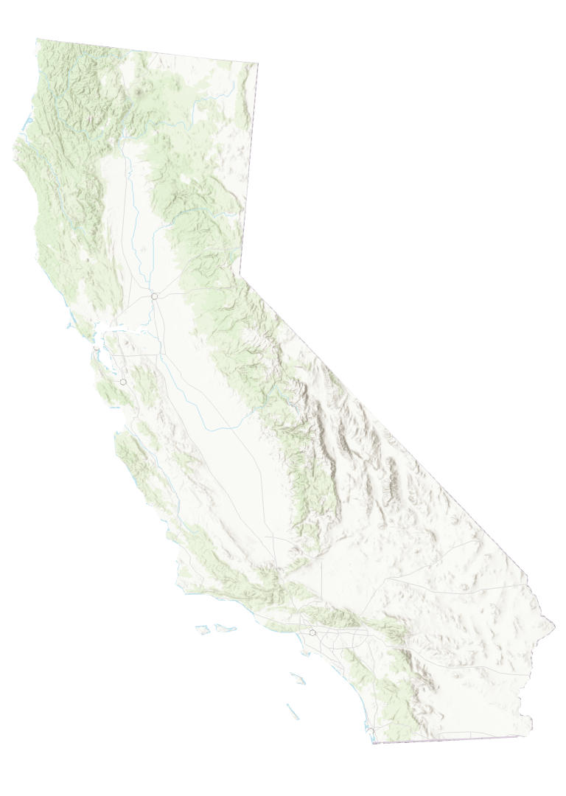
base: topo + hillshade
(transparent background)

Slide 15
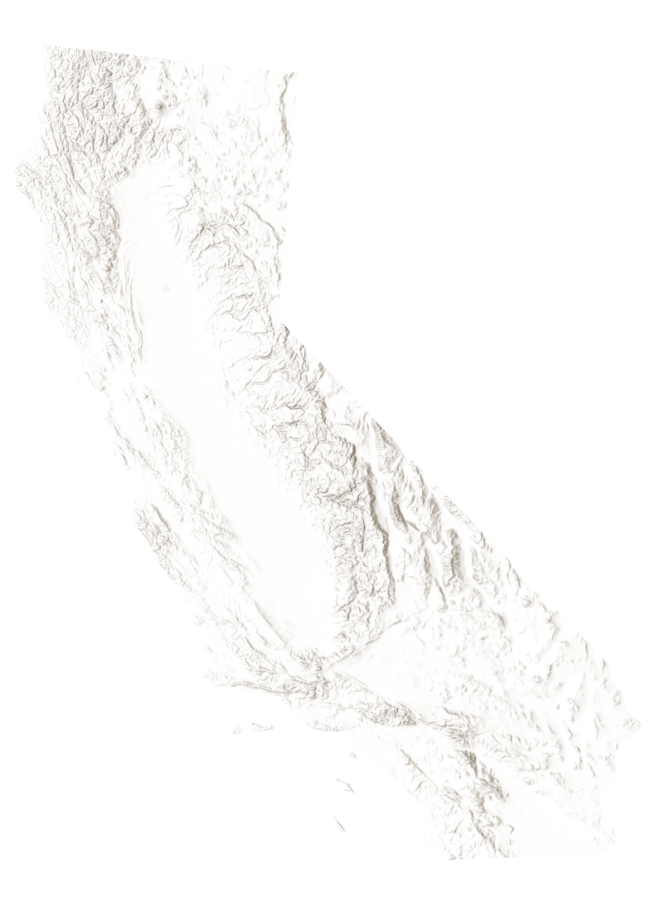
base: hillshade only (transparent background)

Slide 16
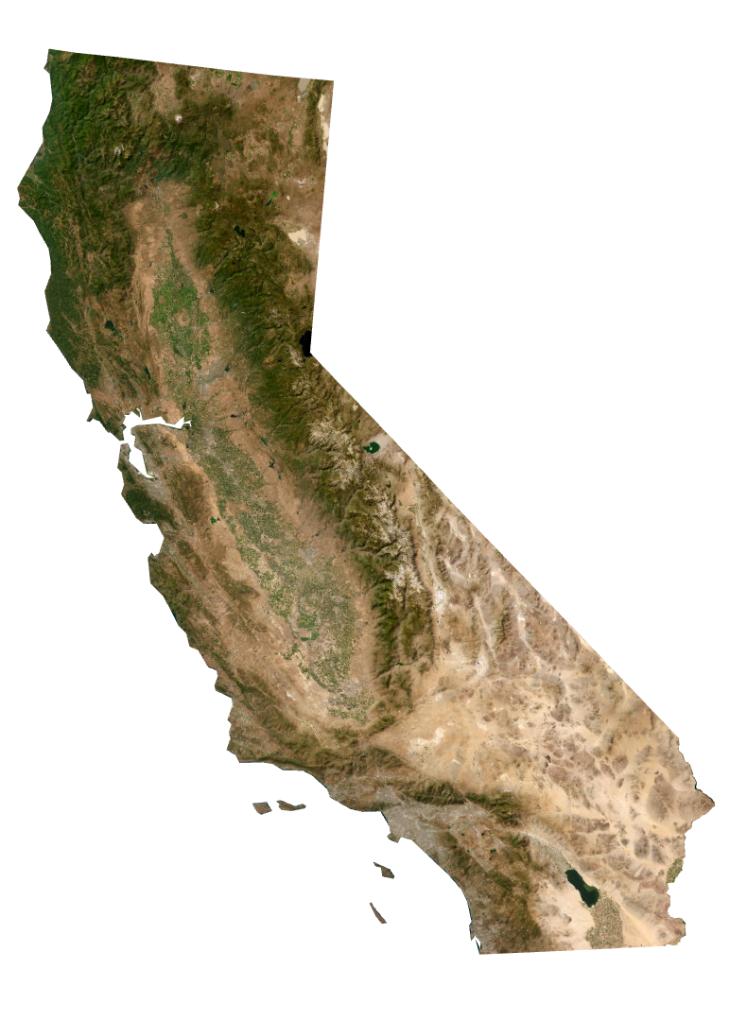
base: world imagery
(transparent background)

Slide 17
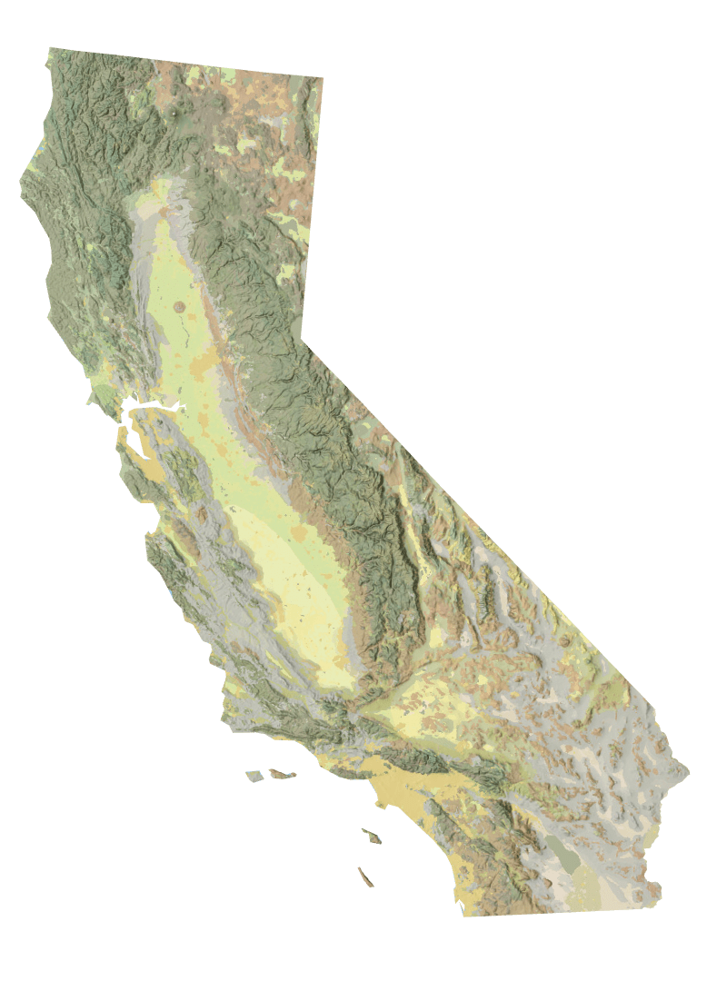
base: nat geo
(transparent background)

