Slide 1




Kreocode_
ScratchJr Beginner Challenge
Responsible Consumption and Production
RÉCIT document made available, with exception, according to the terms of the Creative Commons 4.0 License.

Slide 2


Hi!
Would you like to take on a challenge with my friend ScratchJr and I ?
Let’s go!

Slide 3


Many countries and their leaders have development ideas for their population. International organizations, such as the United Nations, are there to remind us about the 17 sustainable development goals and tell us what we can do to build a better, greener and fairer future!
Notes:
Note to teacher: A video explaining the 17 sustainable development goals defined by the UN.

Slide 4
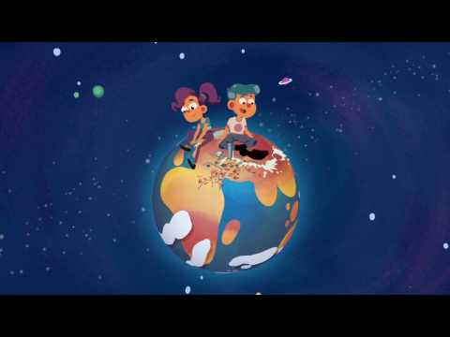

First of all, let’s talk about sustainable development… Those are big words, aren’t they?
Watch this video to understand better.
What is sustainable development?
4 min 40 s
Notes:
Note to teacher : choose one or more videos among the ones suggested on this page and the two next ones.

Slide 5
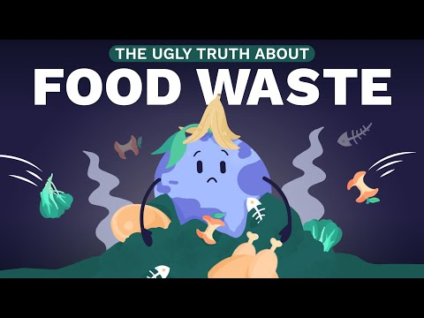
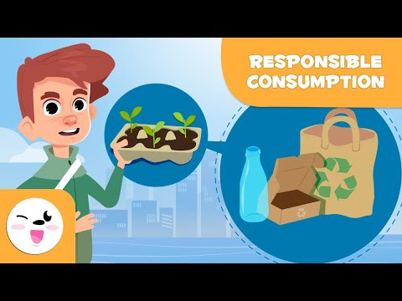
Other suggested videos
What is food waste?
How to reduce waste
Notes:
Note to teacher: Did you choose the video(s) according to your clientele?
More videos:
-Food waste: https://www.youtube.com/watch?v=0eqxgvZNn0I
-Waste reduction: https://www.youtube.com/watch?v=EGzg77rx7Uo

Slide 6
This year, we chose to talk about the 12th sustainable goal: Responsible Consumption and Production.
Notes:
Sustainable goal chosen for this challenge: Responsible Consumption and Production
Note to teacher: A video explaining the 17 sustainable development goals defined by the UN.

Slide 7

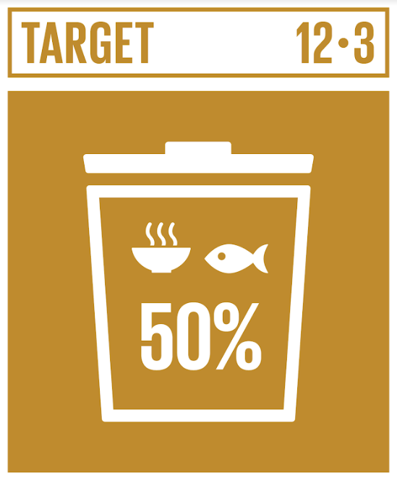
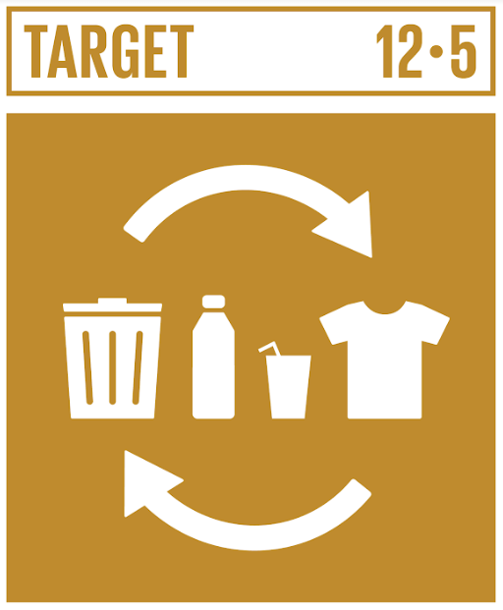
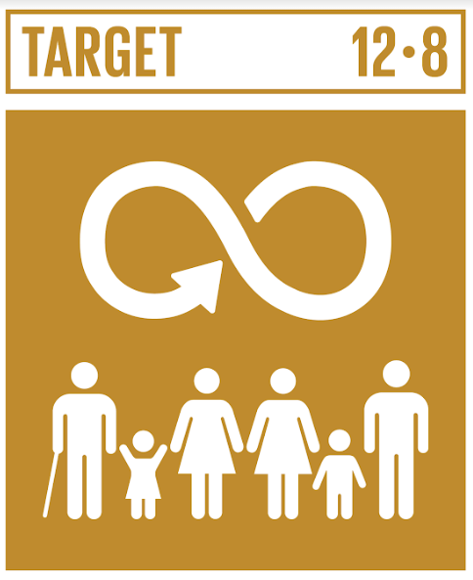
Observe these logos and think about what we can do to have sustainable consumption and production.
Ideas?
Reduce waste :
reduce, recycle and reuse
Raise awareness of sustainable development goals and lifestyle in harmony with nature
Reduce food waste by half
Notes:
Facilitate a discussion for students to share ideas for achieving the goal. Invite students to fill the “My first thoughts” page in the student booklet.
Note to teacher: You can erase the goals that you didn’t do with students.

Slide 8
Note!
To create this project with ScratchJr, you will need to follow certain criteria…

Slide 9
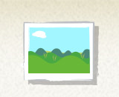
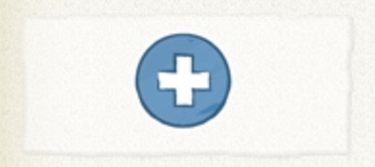
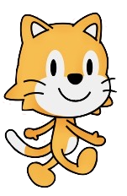

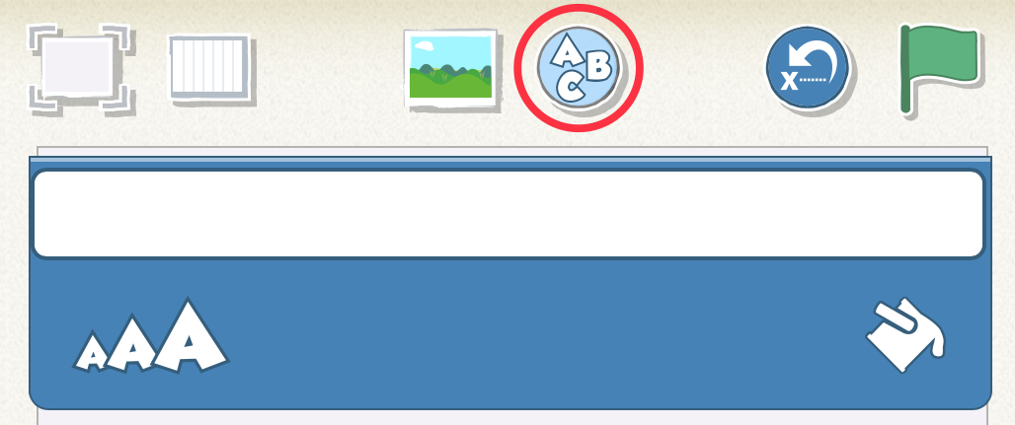
Take on the challenge!
1
2
+
Illustrate an action.
Choose or create a background and a character.
3
4
Modify your background or your character.
Write a title (optional in preschool).
Notes:
Note to teacher: You can erase the challenges that you didn’t do with your students.

Slide 10

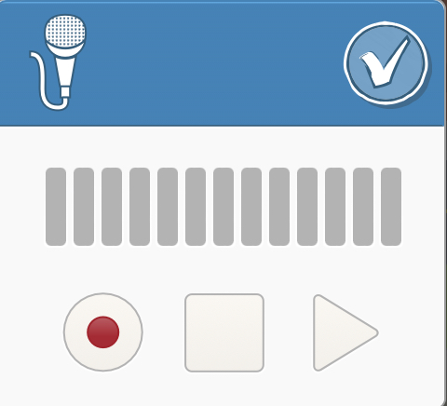
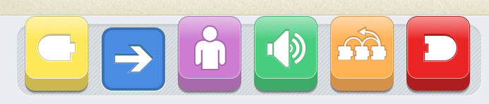
1
Animate at least one character.
Caution! The program must not contain any photos of students or personal information such as the first or last name, their group, or their school.
2
Explain your idea by recording your voice.
3
Use at least 4 of these block types.
4
Make sure your animation is less than 1 minute.

Slide 11
On the following page, you will find pictures of Kreo and the sustainable development goal logos that you can insert in your program.
Teachers, don’t forget to select a few projects and share them using the form on the the Kreocode site!
Thanks for all the great ideas!

Slide 12


