Slide 1
3 Estimating / Commercial Slides by Dr Mila Duncheva, Carola Calcagno, Dr Julio Bros-Williamson, Dr Jon Stinson, Victor Henquel, Louise Rogers, Alasdair Reid (Edinburgh Napier University), Ann Bentley (Global Board Director, Rider Levett Bucknall), Jamie Hillier (Founding Partner, AKERLOF) and Lindsay Richards (Richards Partnership and Construction Wales Innovation Centre)

Slide 2
3A Digital skills, information management and communication

Slide 3
3A.1 Understand basic design rules
Design for Manufacture and Assembly & Disassembly (DfMA+D) is a design approach focused on the ease of manufacture, efficiency of assembly and ultimately, end of life.
Advantages of DfMA+D include:
Improved quality of products
Reduced number of components
Faster construction
More sustainable
Sustainability
The construction and the built environment industries are a driving force in the implementation of methods that comply with circular economy.
Aspect 8, implemented into the Scottish Technical Handbooks Section 7 Sustainability requires a pre-planned approach with regard to “Design for Deconstruction” (DfD)

Slide 4
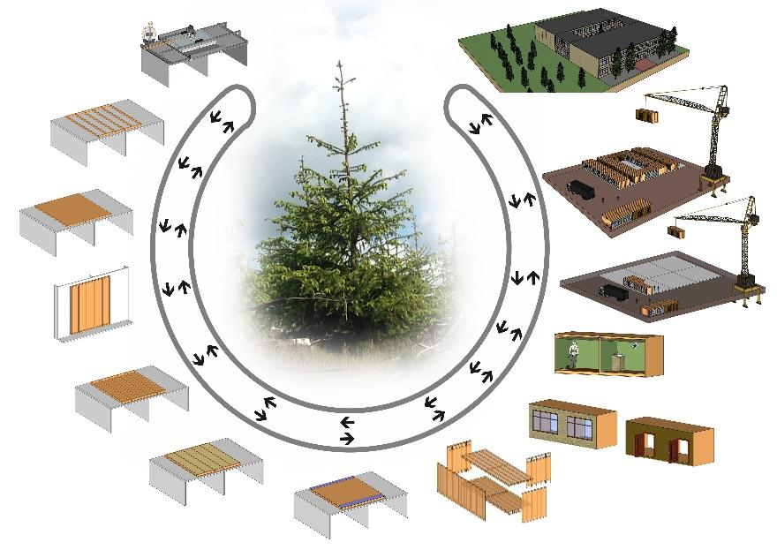
3A.1 Understand basic design rules
Image courtesy of Dr Mila Duncheva

Slide 5
3A.2 Understand the importance of communication with the team
Effective and frequent communication between all stakeholders is key to maximising the benefits of offsite manufacture.
Good communication can help avoid the following problems:
Non-conformance
Schedule slippage
Legal disputes
Contractual issues
It is important that the information being shared is:
Current
Accurate
Unambiguous
Understood by all

Slide 6
3A.3 Apply IT tools
Many IT tools can help to streamline communications, monitoring, analysis, reporting, as well as aiding contract communications and financial control and monitoring.
Listed with increasing levels of functionality:
MS Excel spreadsheets
MS Project
Specialist construction estimation packages such as Trimble Cost Modeller
These tools can be used throughout the project’s lifecycle:
Pre-tender estimates
Tender pricing documents
Contract sum agreed with the contractor
Contract sum breakdown
Final accounting incl. defects liability

Slide 7

3A.4 Understand current and emerging technologies
Technology improves the quality, efficiency and build speed of offsite construction methods.
Many of these technologies aim to automate the manufacture, standardise the design process and speed up the on-site assembly.
These technologies include BIM-enabled software, Augmented Reality (AR) and integrated renewable technologies.
Image courtesy of Trimble Technology Lab

Slide 8
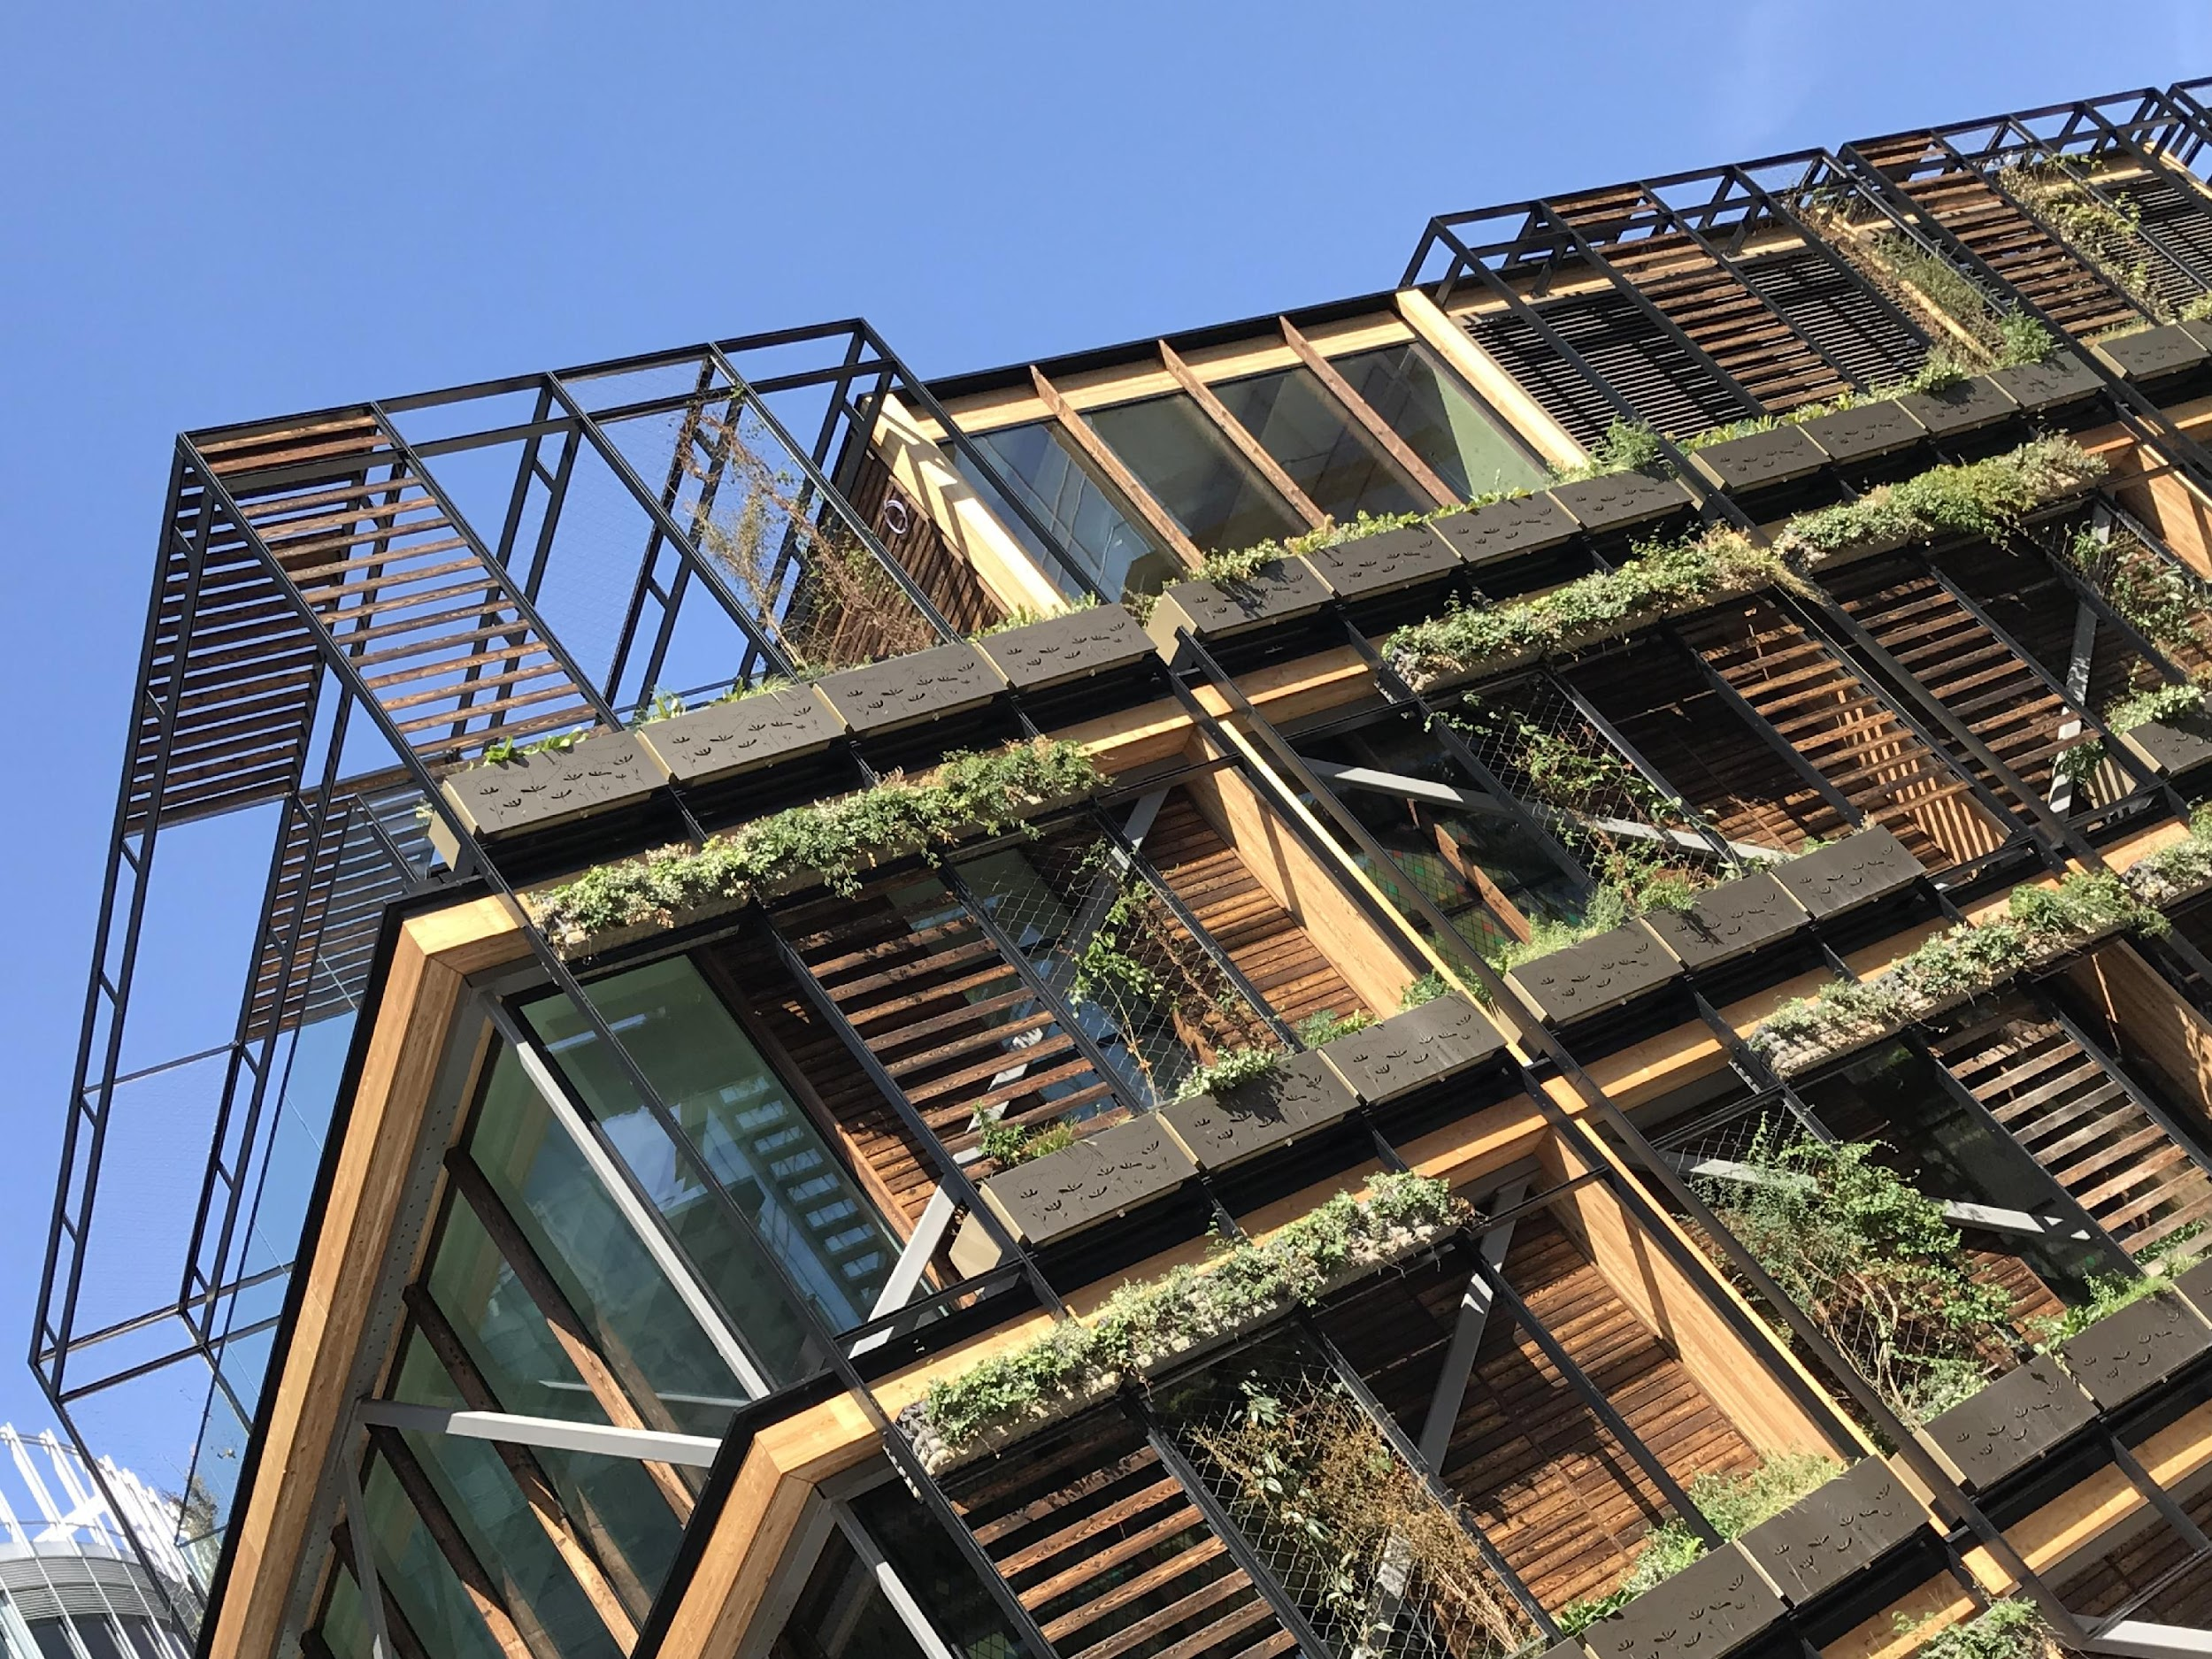
Sustainability
The concept of renewable energy technologies and their integration into pre-manufactured components and offsite construction solutions link in with emerging requirements of Nearly Zero Energy Buildings (nZEB).
The use of BIM data sourcing and management of technology into the manufacturing process of building components has the potential to facilitate designs and plan for adequate maintenance and performance checks, lowering the gap between predicted and actual energy generation.
Image Courtesy of Offsite Awards - B&K Structures

Slide 9
3A.5 Analyse tender documents and contract Ts & Cs (manager)
Risk ownership and liability are the two key topics when analysing contractual T&Cs for offsite construction
Risk ownership: With offsite construction there are typically greater concerns over the financial strength of the offsite provider. Cashflow is a common issue in construction as a whole, and this can be exaggerated where the offsite manufacturer funds materials, labour and plant for a project up-front.
Liability: The second key point in offsite construction contractual Ts and Cs, mainly relevant to the offsite product liability. This can be all-encompassing beyond the typical 12-month warranty for construction works.

Slide 10
3A.6 Create BIM enabled design in conjunction with relevant software packages (senior manager / professional)
BIM enabled design during the procurement phase enables the user to create bills of quantities and cutting lists.
BIM-enabled software links the 3D model to the pricing software, ensuring you always have an accurate bill of quantities, thus avoiding any mistake during the costing and procurement stages.

Slide 11
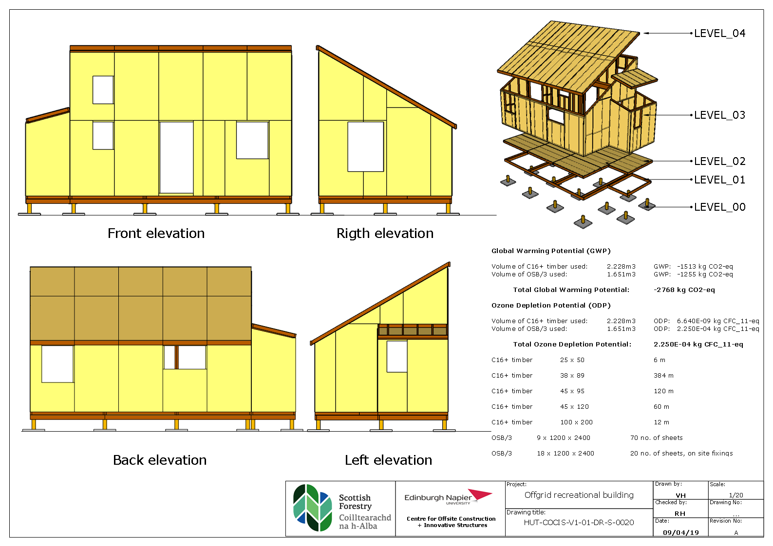
Image courtesy of Dr Andrew Livingstone, Victor Henquel, Scottish Forestry

Slide 12
3B Procurement, tendering and contracts

Slide 13
3B.1 Understand contract law
Procurement approaches, warranty schemes and contractual forms are the key topics to be aware of in offsite construction contract law.
There are several contract types, such as:
NEC4
JCT
PPC2000
Warranties can be provided through:
Local Authority Building Control (LABC)
BOPAS
NHBC
Premier Guarantees and others.
A 2-stage procurement process is defined by Constructing Excellence as:
Stage 1: The contractor is engaged to develop and optimise the design in conjunction with the design team, consider construction planning, and conduct procurement activities that lead up to the physical construction of the work
Stage 2: The contractor is engaged to construct the works (and accept responsibility for the design of the development if using a D&B arrangement).

Slide 14
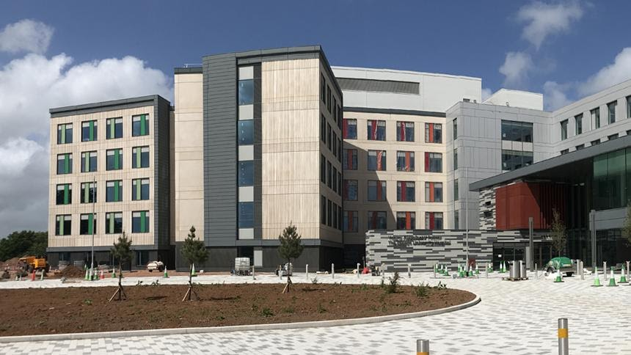
Case study – Grange University Hospital
The Grange University Hospital is a new facility in Newport, Wales, with 560 beds which will provide specialist and critical care services to 600,000 people in south-east wales across Gwent and South Powys.
Due to the Covid-19 pandemic the clients needed the hospital up and running sooner than expected. The offsite manufacturer Laing O’Rourke had an established supply chain, which enabled co-ordination and collaboration between the different trades.
Image courtesy of Laing O’Rourke

Slide 15
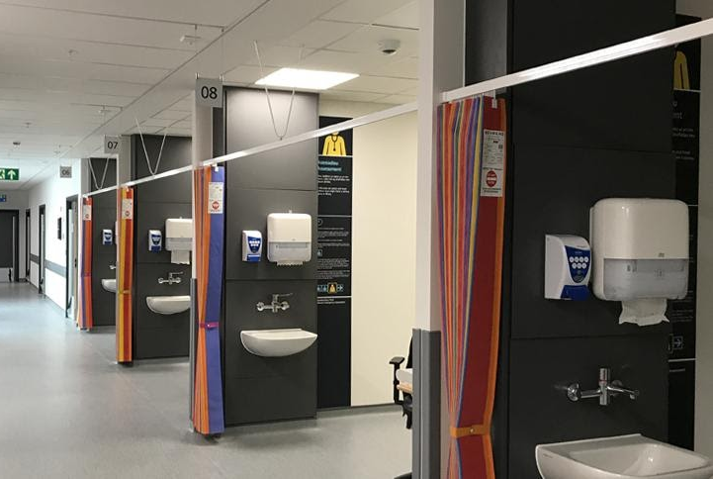
Case study – Grange University Hospital
In the end, the shorter construction programme was achieved with:
70% of the hospital was manufactured offsite
Handed over with zero defects
Beds released 30% earlier than original programme
The DfMA approach saved 237,099 working hours in total
821 precast columns were installed, representing a 85% working hours saving onsite
1200 precast wall modules were installed, representing a 95% working hours saving onsite
Image courtesy of Laing O’Rourke

Slide 16

3B.2 Understand all stages of procurement
Two key things need to be implemented for efficient procurement of offsite projects:
Performance-based tendering
Experienced advisors from the design outset
Architects and designers typically consider the construction system in the detailed design stage. This is one of the main issues in procurement for offsite construction. This can be solved by thinking about offsite construction from the very beginning.
Image courtesy of Offsite Awards - Swan Housing

Slide 17
Sustainability
Key performance indicators for post occupancy evaluation contracts could relate to quantifiable variables as years energy consumption, internal thermal comfort, continuity of the hygrothermal envelope.
BSRIA soft landings documentation is a methodology to provide government approved guidance through the specifics of such contracts.
The key elements of these contracts means ensuring that, before any value engineering is approved the BIM is updated with appropriate use of building performance modelling and simulation software to truly measure the longitudinal effects of the changes.

Slide 18
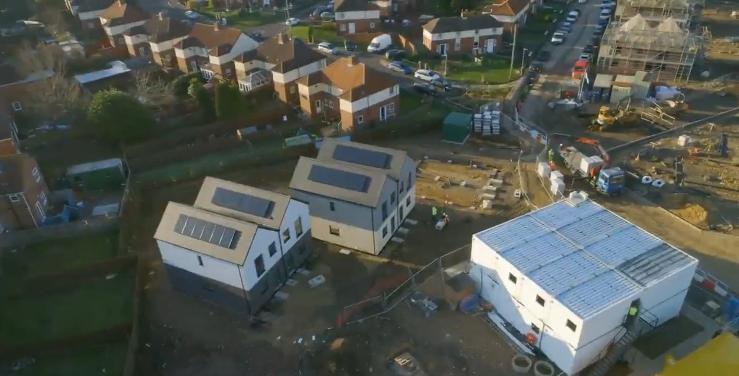
3B.3 Understand the importance of supply chain engagement
Early supply chain engagement is critical to ensuring the buildability of projects within the needed functionality, cost and time.
During the construction stage, disputes and differences can be resolved more easily when the supply chain has been engaged early, and it can also help to mitigate risks in the case of an insolvency.
An in-depth understanding of the supply chain also brings benefits to the client. For example, clients who opt to engage directly with the supply chain have the advantage of being able to negotiate directly.
Image courtesy of Offsite Awards - ilke Homes

Slide 19
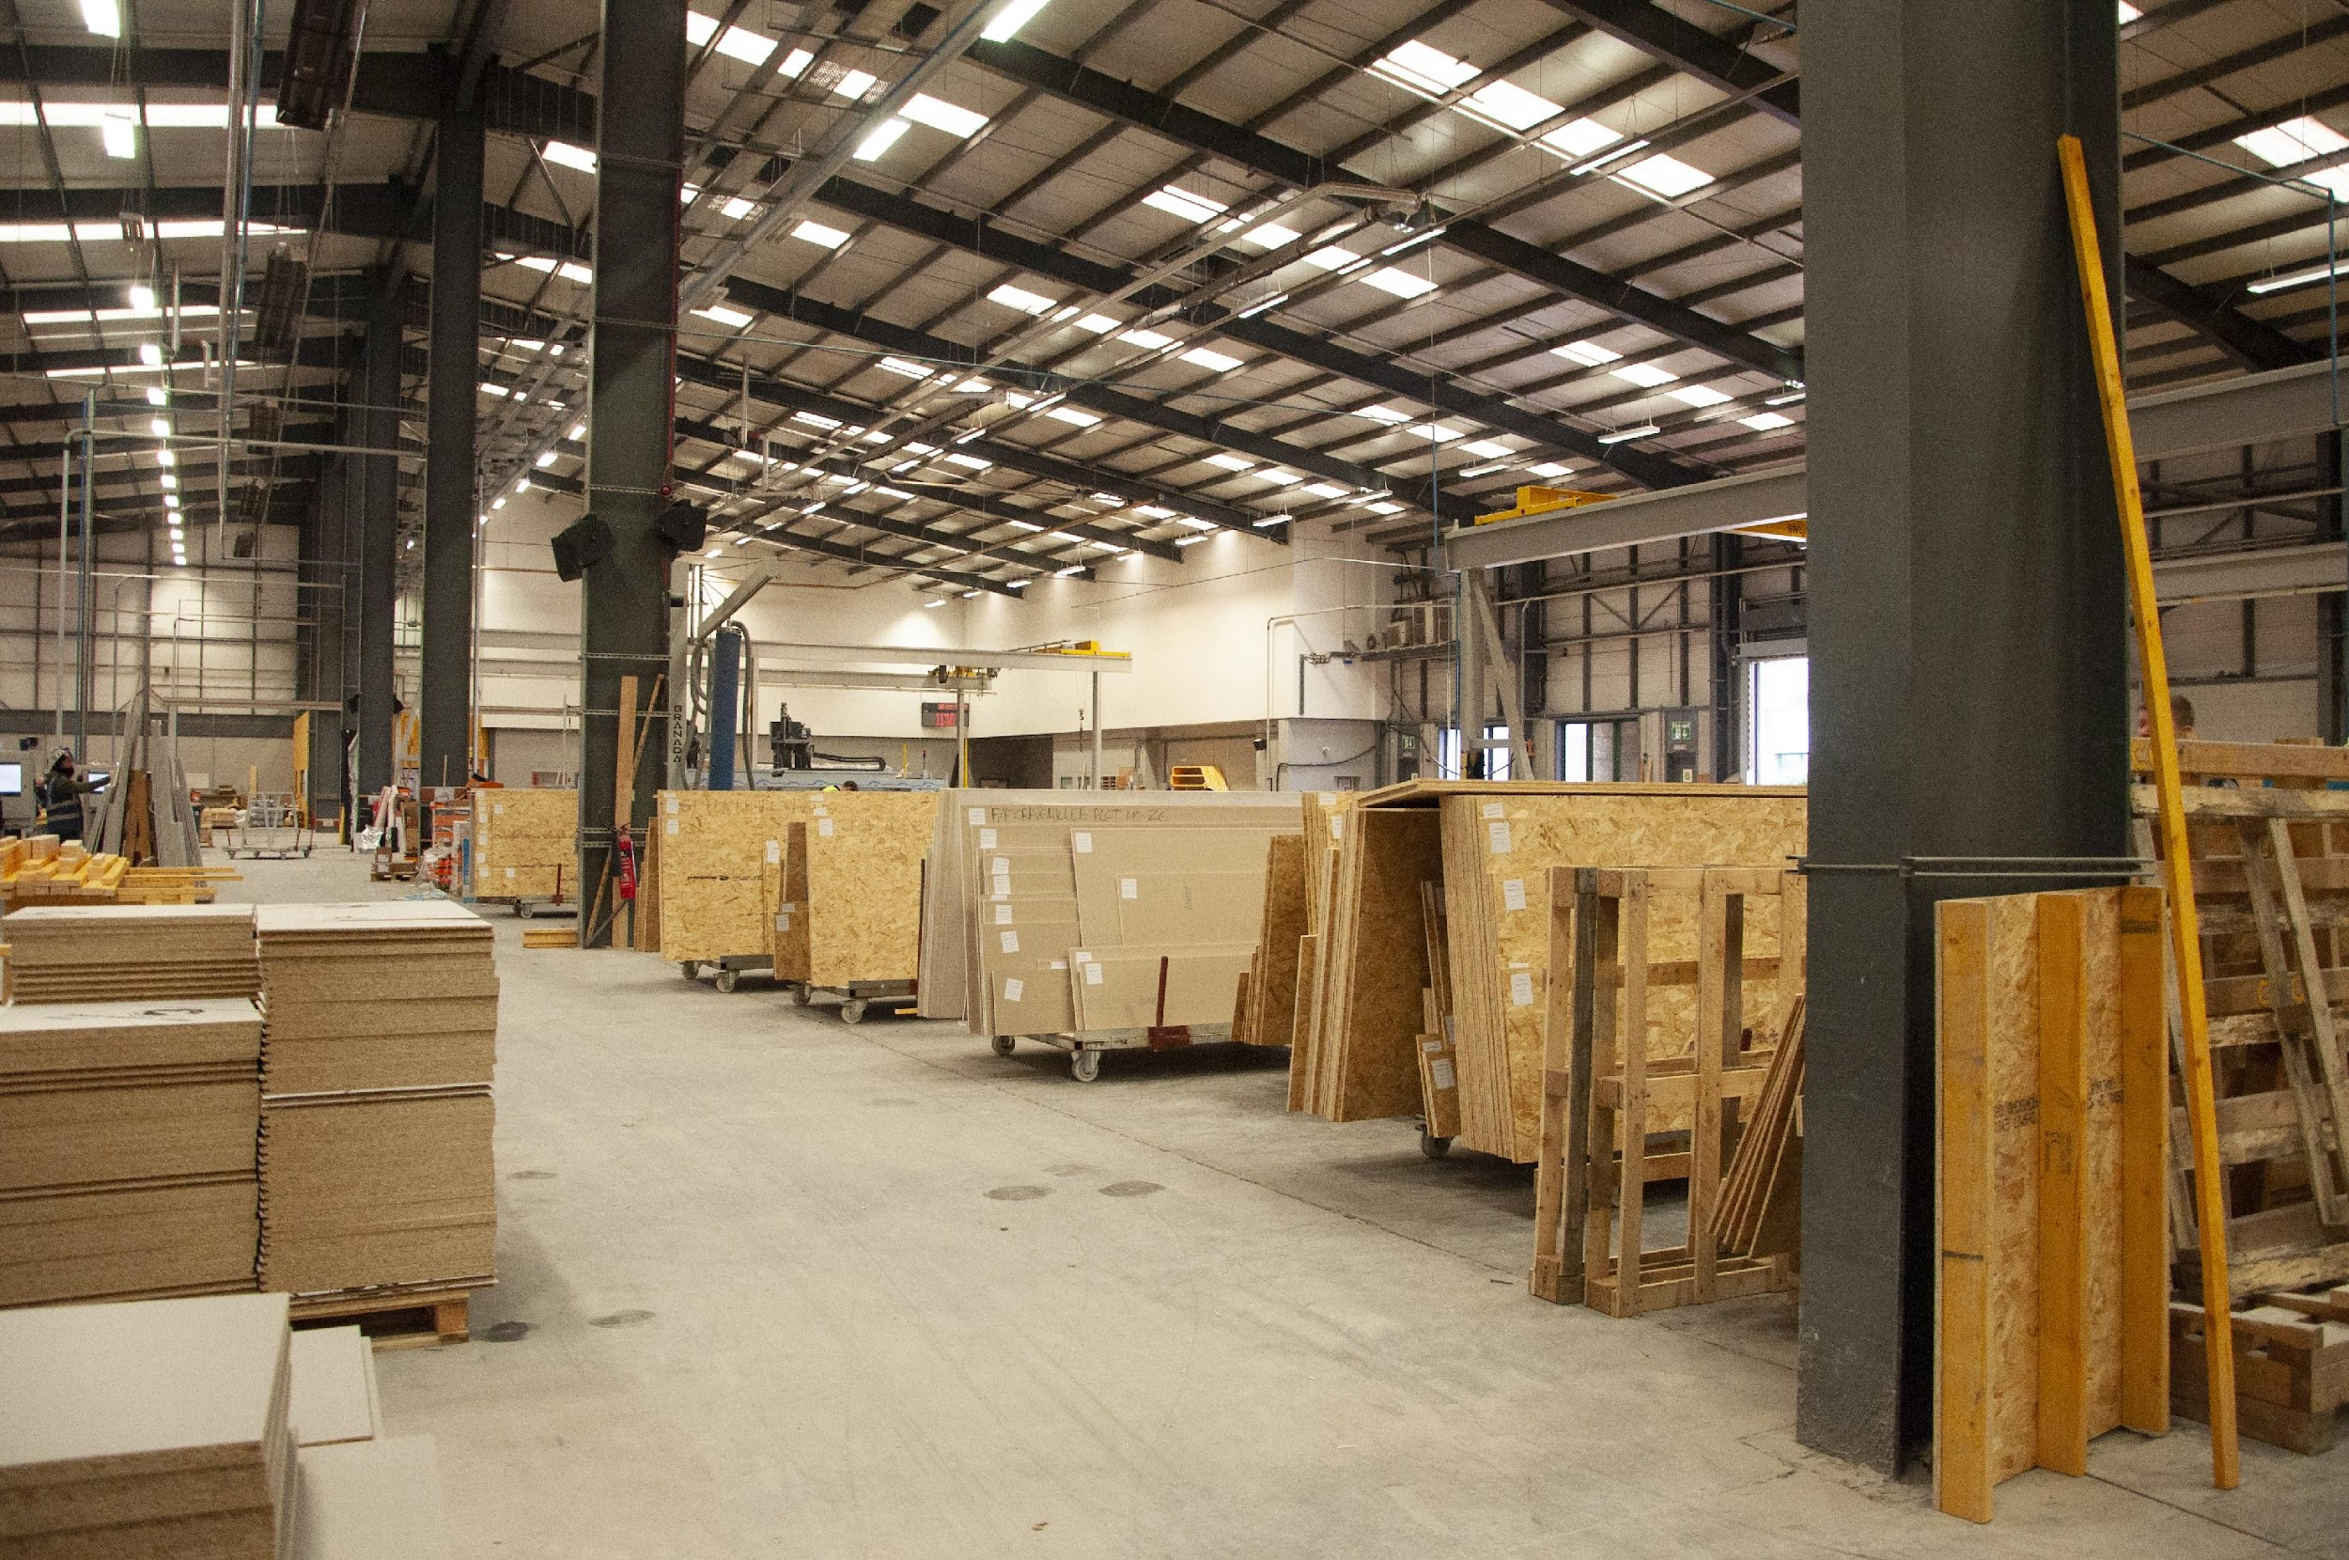
3B.4 Understand payment schedules and ownership
With offsite manufacturing, the more work completed offsite, the more difficult it is to put the payment mechanism in place.
The arrangement for payment schedules and ownership in contracts is connected to risk aversion
In some payment schedules, the manufacturer is paid when the work is completed in the factory, and in other cases the manufacturer is paid after the offsite components have been delivered onsite.
Image courtesy of CCG OSM

Slide 20

3B.5 Develop sub-contract Ts & Cs (manager)
You should be aware of in sub-contract Ts and Cs for offsite construction
In offsite construction there are two additional knowledge prerequisites – the offsite manufacturing and installation processes. This will help you ensure that the factory and site teams comply with commercial policies and procedures.

Slide 21
3B.6 Develop a value proposition (senior manager / professional)
Two typical issues in communicating offsite construction value to clients are accurate estimations for offsite works and higher up-front costs.
For projects with less work completed in the factory, typically historical cost information will be used for cost estimation. For projects with more work completed in the factory, manufacturers tend to use in-house costing information for their systems, generated using digital components.
5 stages should be considered in the development of a value proposition at the procurement stage
Financial
Human
Manufactured
Natural
Social

Slide 22
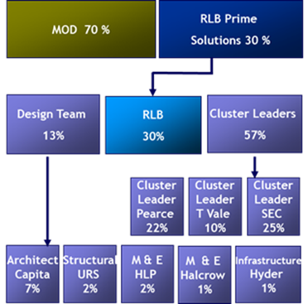
Case study – Andover North Site Redevelopment (Rider Levett Bucknall)
An excellent example of whole life cycle value procurement was the Andover North Site Redevelopment project constructed in the ‘00s for the Ministry of Defence. The tender included not only construction costs, but also maintenance for six years of operation.
The contract included an agreement that any savings from the maintenance costs compared to the bid would be split 50/50 between the contractor and the owner.
Image courtesy Rider Levett Bucknall

Slide 23
3C Health and safety

Slide 24
3C.1 Understand health & safety benefits of offsite
The construction sector is responsible for one-third of all work related fatalities in the UK.
Offsite processes can mitigate or eliminate some of the inherent risks of construction, including:
reduced work at height
reduced noise
less congestion of operatives
elimination of weather-related factors

Slide 25
3C.2 Apply health & safety legislation and building regulations
Legislation protects the health and safety of personnel involved in offsite operations.
Key legislation in the UK is the ‘Health and Safety at Work etc Act 1974’.
It is important that everyone involved understands their own individual responsibilities and duties.
The primary legislation for occupational health, safety and welfare in the UK is the Health and Safety at Work etc Act 1974, while the Construction (Design and Management) Regulations 2015 is specific for the construction industry.

Slide 26
3C.3 Consider risk and liability
Personal injury as well as health and safety failures can cause significant delays and additional costs on construction projects.
Strategic risk management and planning can be used to reduce risk and liabilities relating to health and safety. To limit liability, the responsible parties for each aspect need to be clearly and accurately identified.
Drawing up the list of hazards with employees can help identify the less evident source of risk and promotes the awareness of the workers.

Slide 27
3C.4 Monitor health and safety (manager)
The Construction (Design and Management) Regulations 2015 outline the health and safety responsibilities for specific participants in the construction process, including:
small builders
domestic clients
principal designers
workers
When developing an offsite project, early engagement will allow the coordination and timeous planning of health and safety measures.

Slide 28
3C.5 Understand the health and safety implications of cost management and that health and safety takes precedence over cost (senior manager / professional)
Material specifications identify requirements for installation, testing and handover and are essential to adequately plan health and safety measures.
Specifications form part of the contractual documents and therefore can minimise project risk and provide support should there be any legal disputes.

Slide 29
3D Management and planning

Slide 30
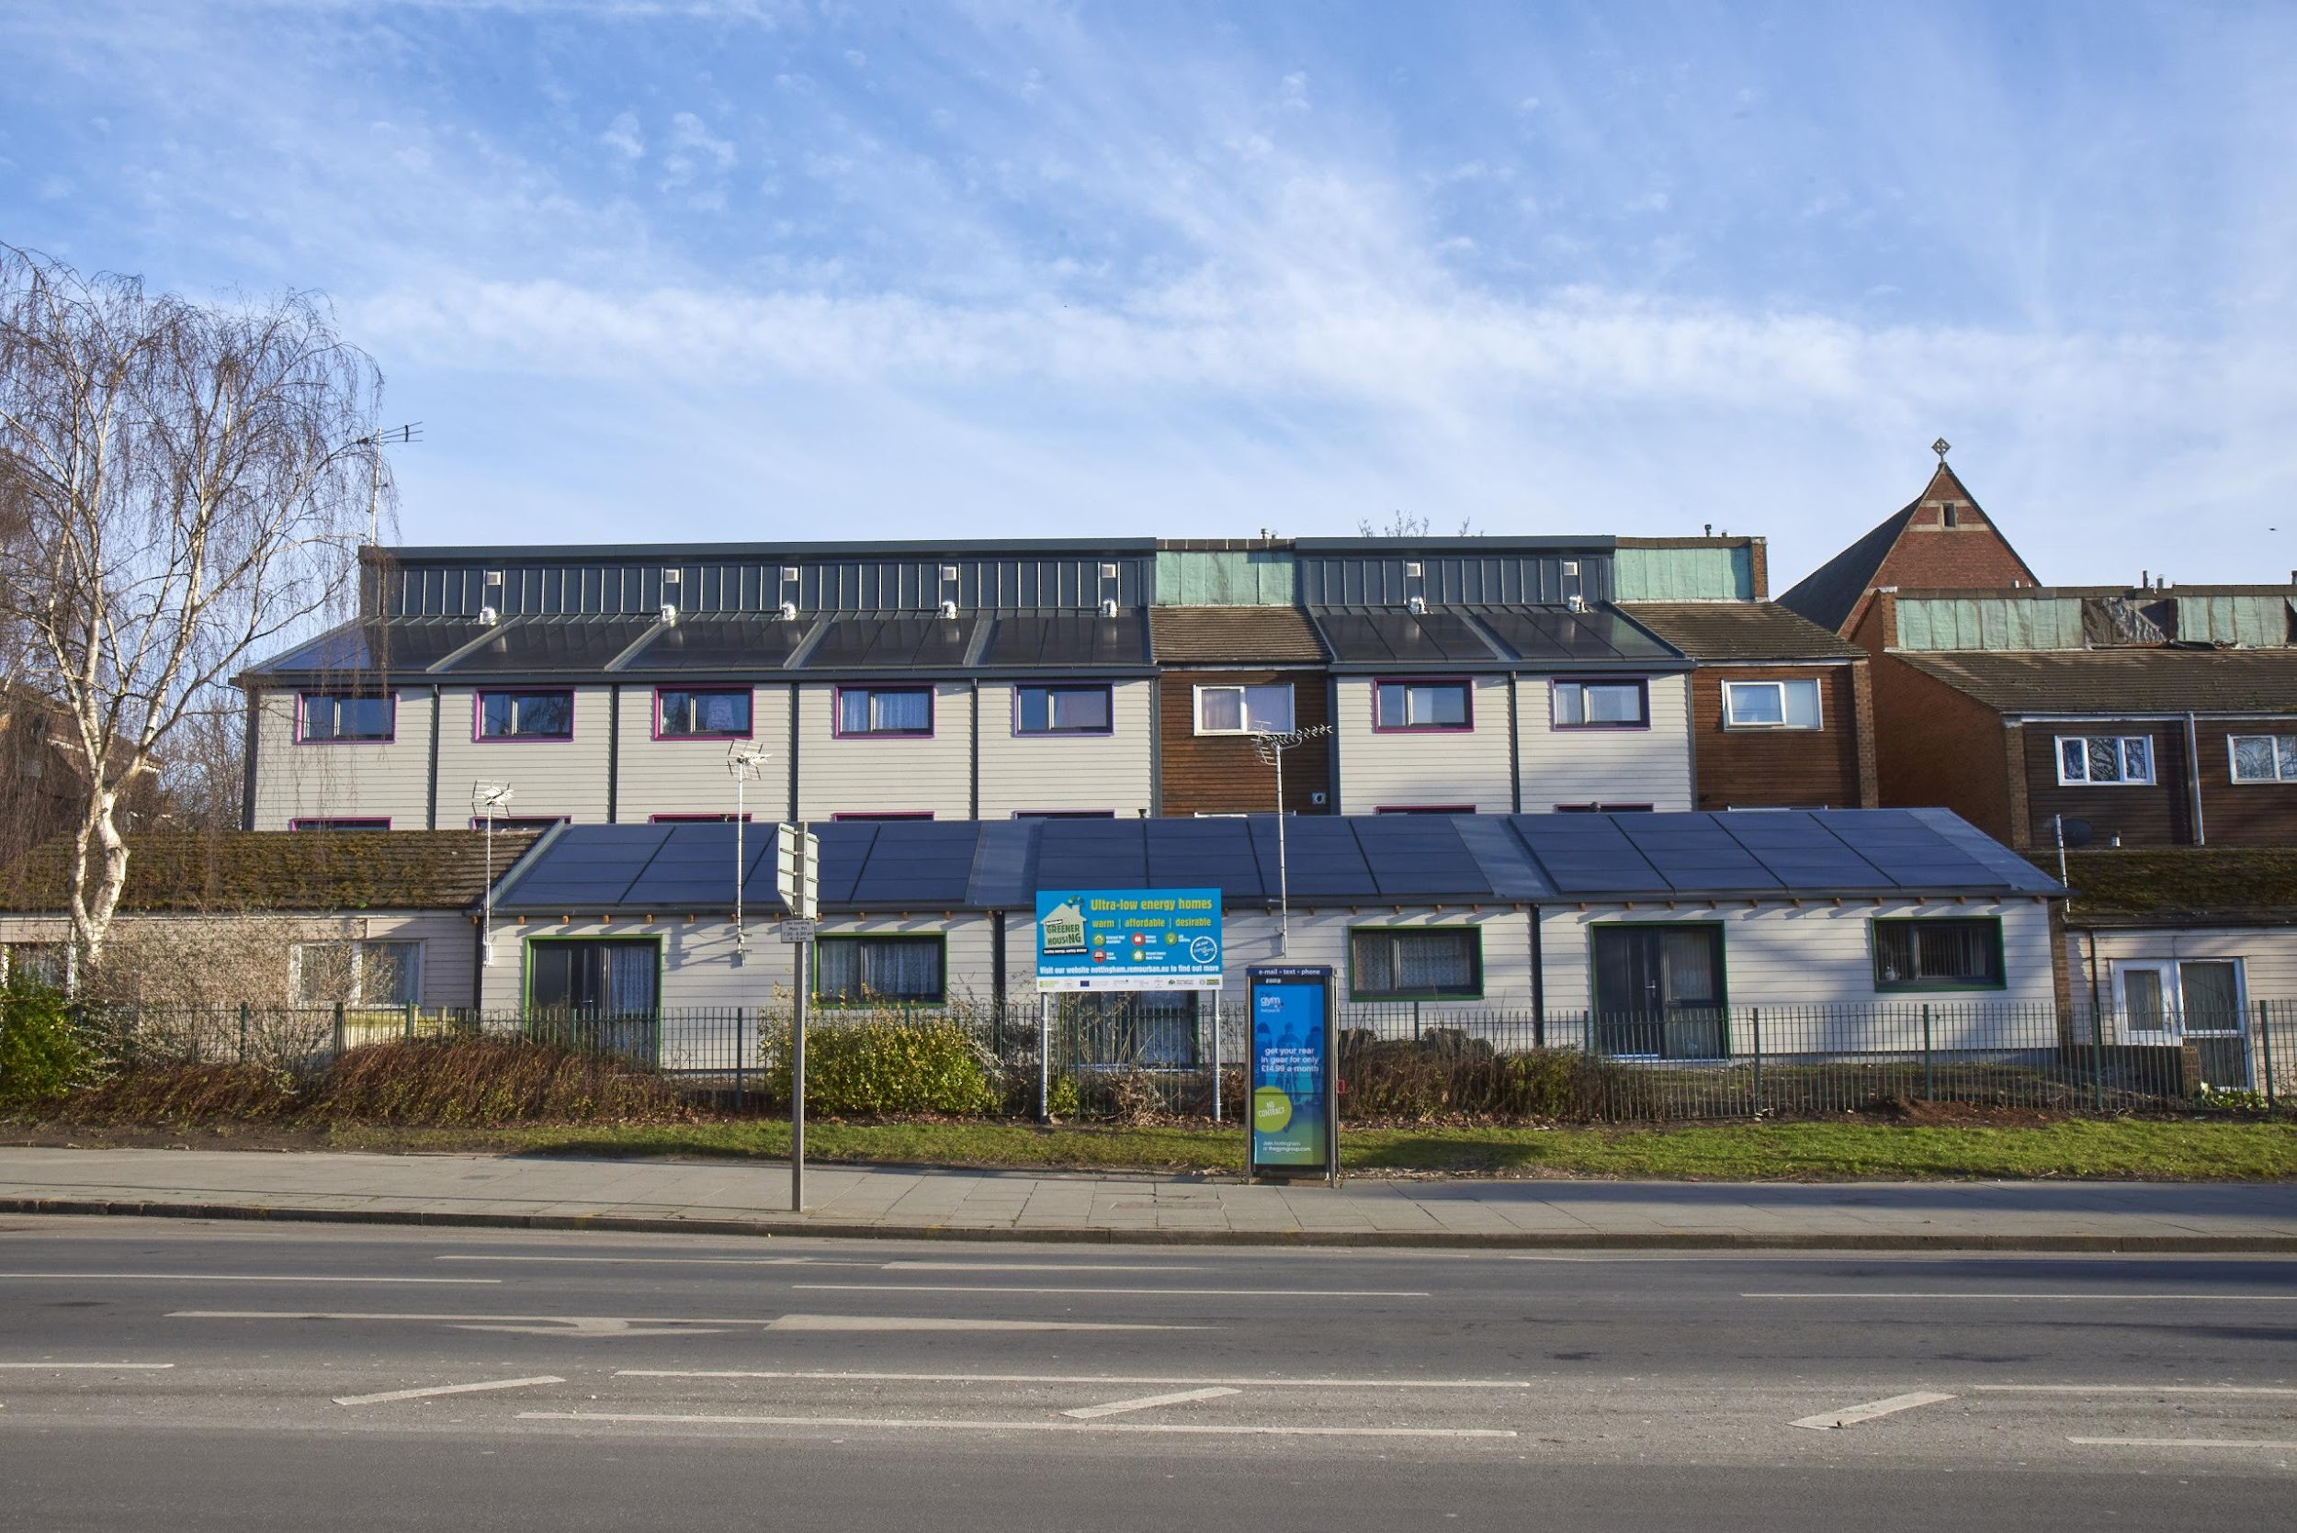
3D.1 Understand the importance of early contractor involvement
Early contractor involvement builds trust between the different businesses, and then reinforcing that trust with payment mechanisms and insurance clauses.
By involving the manufacturer, contractor, supply chain and specialist consultants early on, you can ensure the buildability of the design. As well as the early contractor involvement ensures that the development can be built in accordance with the timescales and cost plan.
Image courtesy of Offsite Awards - Studio Partington

Slide 31
Sustainability
It is essential that an integrated contactor can supervise their own work in line with the aspired building standards and targets.
Other aspects to inspect carefully:
Product substitution onsite without consideration of energy performance
Poor installation of fabric
Poor installation or commissioning of services
For example, the energy related performance targets that are dependent on an integral thermal layer (insulation) without thermal bridging and missing layers.
Additionally, gaps and rips of the airtight layer, often in offsite solutions dependent on the vapour control layer acting as a whole envelope seal.

Slide 32
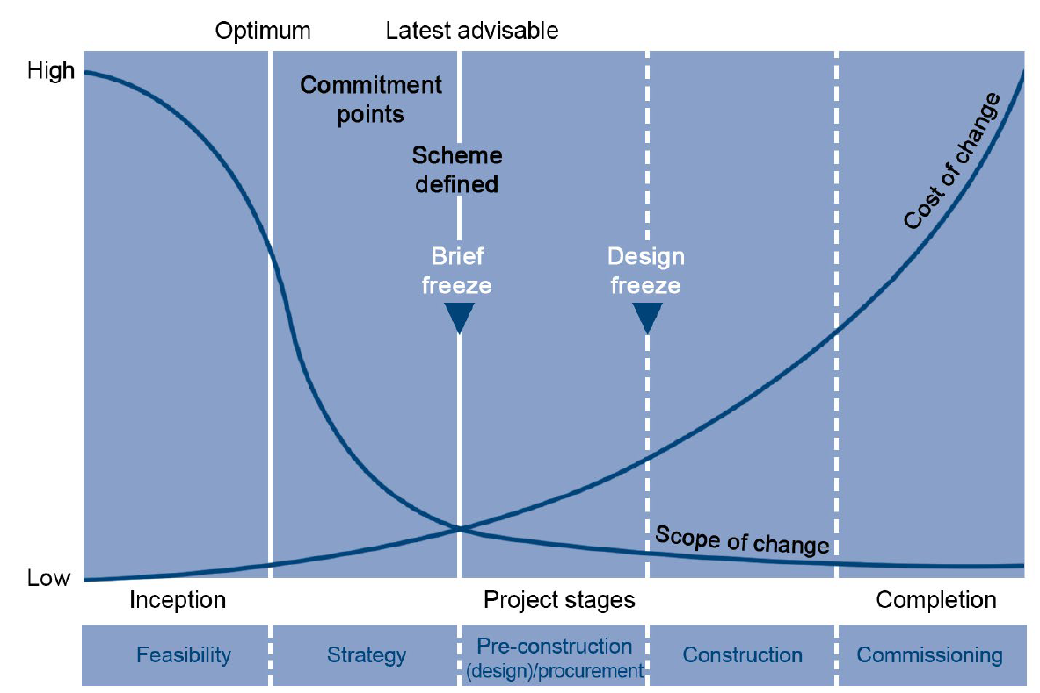
3D.2 Design freeze
A ‘design freeze’ is a term often used to describe the client’s final approved design, after which any changes will result in variations in costs and/or time.
After the design freeze, the review meetings should continue with emphasis on ensuring that no changes have occurred that would have contractual (or commercial) implications
Design freeze and changes. Adapted from CIOB (Lenka Kovacova)

Slide 33
3D.3 Be able to plan work (manager)
“Just in time” and Work Breakdown Structure (WBS) are two concepts that can help plan for offsite construction work. A WBS that can be used across different offsite construction projects was developed by Dr Mila Duncheva and includes the following 1st level sections:
Substructure
Superstructure
Roof
Seal and insulate
External
Internal
Handover
Key plant
Management

Slide 34
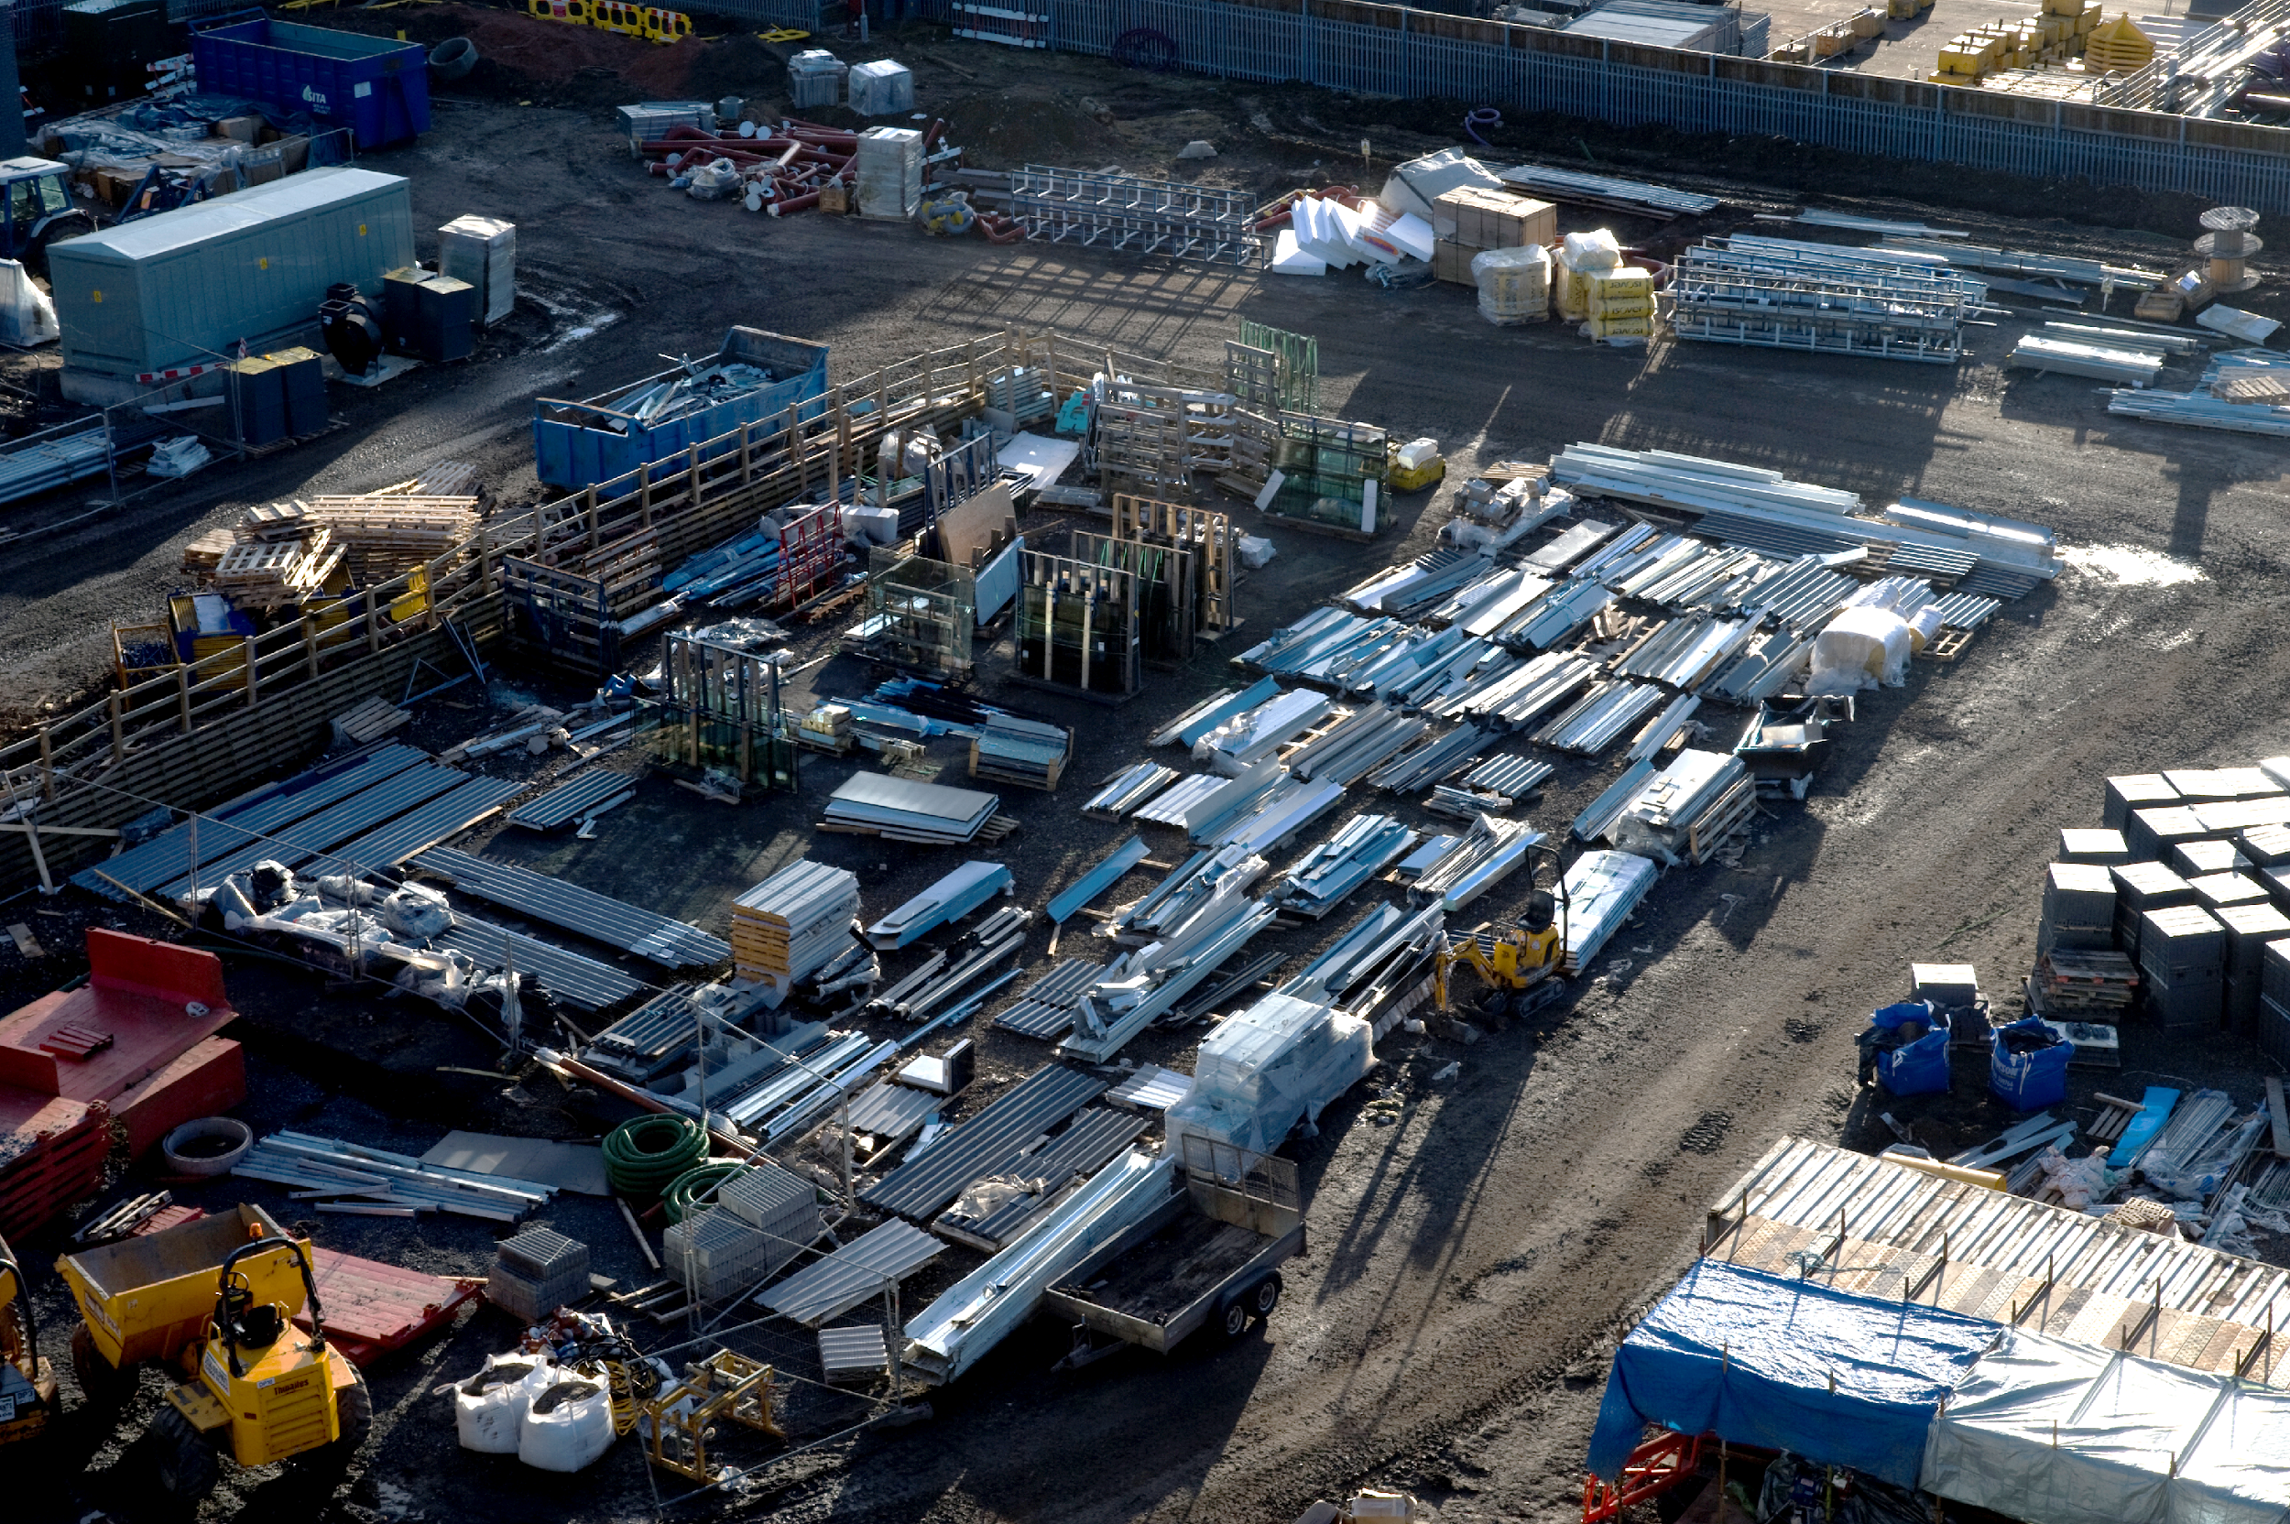
3D.4 Develop a risk assessment (senior manager / professional)
You should be aware of the following when managing offsite constructed project risks so that you avoid slippage and cost over-runs:
Identifying offsite goods
Advance payment bond
Offsite materials bond
Insurance
Ability to inspect
Image courtesy of Edinburgh Napier University

Slide 35
3E Factory operations

Slide 36
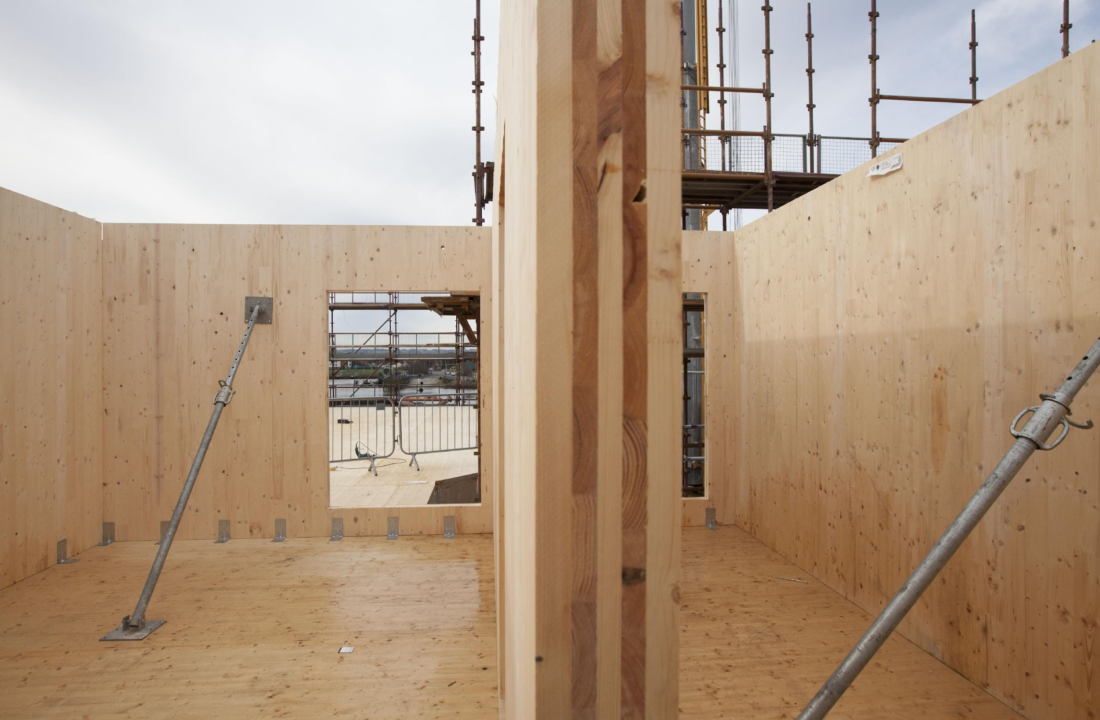
3E.1 Analyse tender documents/contract T&Cs
In standard contract Terms and Conditions (Ts & Cs), such as JCT and NEC, there are strict mechanisms in place for variation change.
Several notices are issued so that all the parties understand the changes and their impact. Dealing with variation in offsite activities because of the design freeze will result in higher costs and significant materials waste.
Image courtesy of CCG (Scotland) Ltd

Slide 37
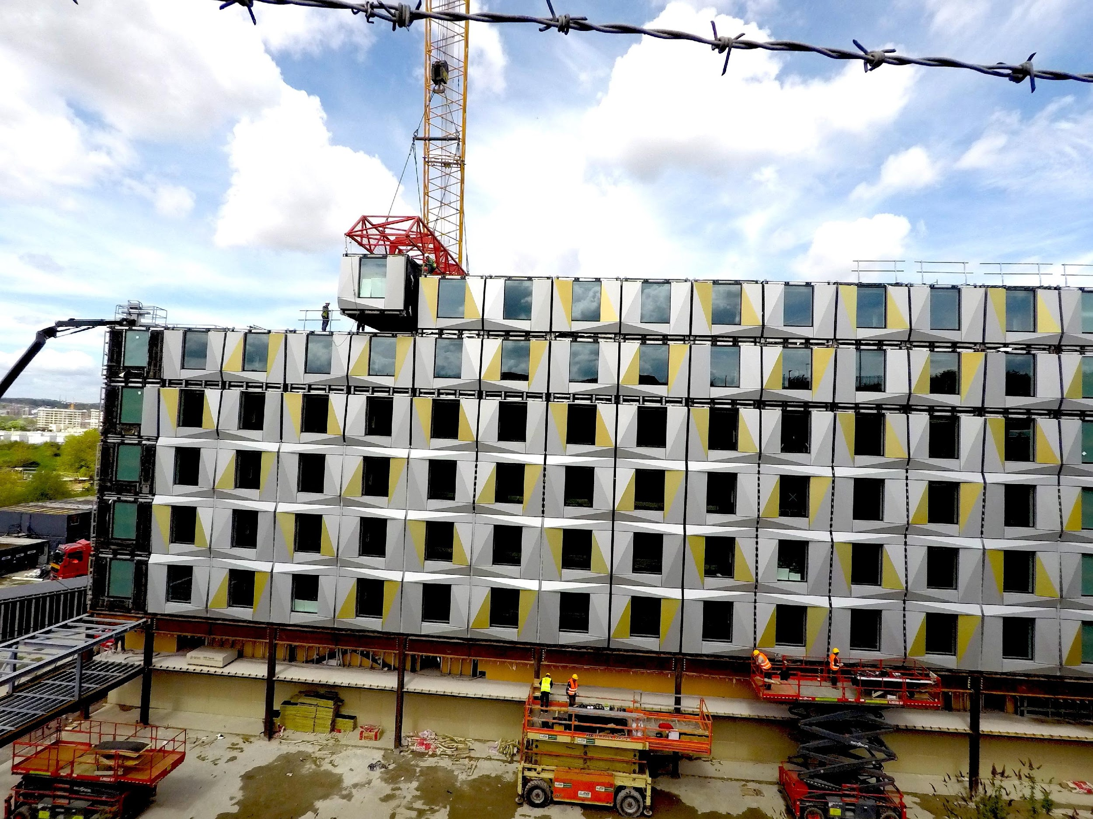
3E.2 Monitor and control resources
Different monitoring and controlling tools you can use to effectively communicate resources utilisation include:
Time monitoring
Milestones
Slip chart
Pareto principle (find the 20% of activities that account for 80% of work)
Cost monitoring
S curve
Earned value analysis
Stage reporting
Status reports are agreed intervals
Trends analysis
Change control register
Image courtesy of Offsite Awards - Peter Dann

Slide 38
Sustainability
Post Occupancy Evaluations (POE) help us to understand the real-life performance of a building and document the perceptions of its occupants.
POE’s can be undertaken in the form of:
surveys
occupant questionnaires
energy related efficiency surveys
monitoring thermal comfort of occupants
Recorded data is re-used to calibrate thermal models originally used at the design stage

Slide 39
3E.3 Deliver inspections (manager)
One of the issues with quality control in offsite construction, is that quality procedures implemented in most manufacturing industries cannot be replicated.
When measured from technical design to handover to the client, nearly 50% of all defects occurred in the factory processes. Be aware of the following potential pitfalls and avoid them as part of your quality control processes:
Bad craftmanship
Structural error
Missing components
Broken materials
Unfinished parts

Slide 40
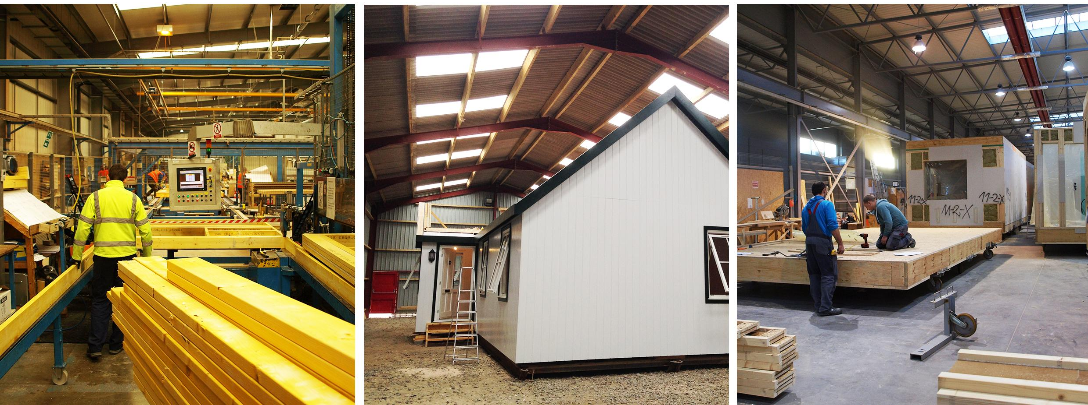
Image courtesy Duncheva, T. and Bradley, F (2019).

Slide 41
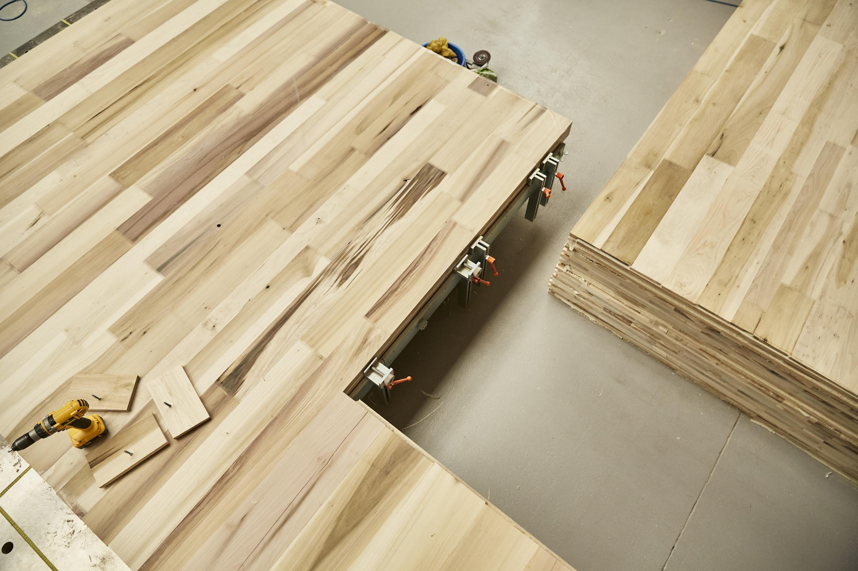
3E.4 Supervise procurement (senior manager / professional)
Offsite construction materials procurement notions lie somewhere between the traditional manufacturing and construction industry.
E-procurement can be implemented by following these steps:
Analyze
Plan
Source
Buy
Monitor
Collaboration
Process control
Procurement intelligence
Image courtesy of MultiPly, AHEC, Waugh Thistleton and Arup

Slide 42
3F Site operations

Slide 43
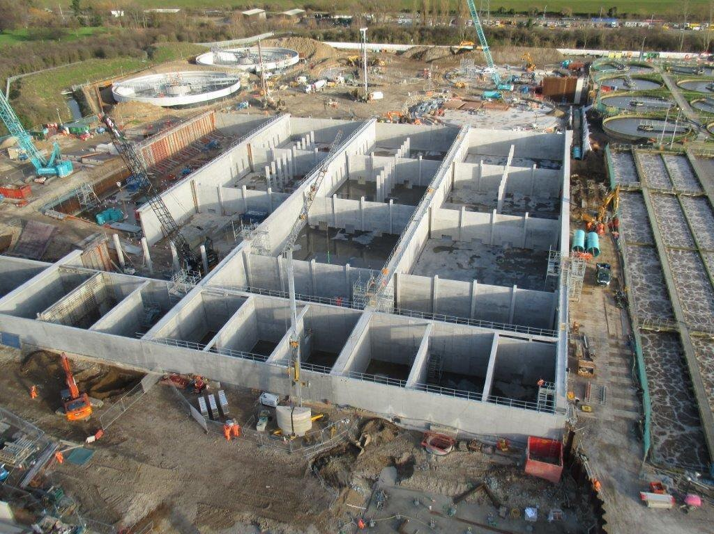
3F.1 Analyse tender documents/contract T&Cs
The interface between the offsite and the onsite activities is critical for the successful delivery of offsite constructed projects and compliance with their contractual terms and conditions.
The interface between the groundworks contractor and the fabricator is critical, because of the possible knock-on effect of delays in the groundworks on the programme for delivery and completion of the offsite components onsite.
Image courtesy of Offsite Awards - Kier Construction

Slide 44
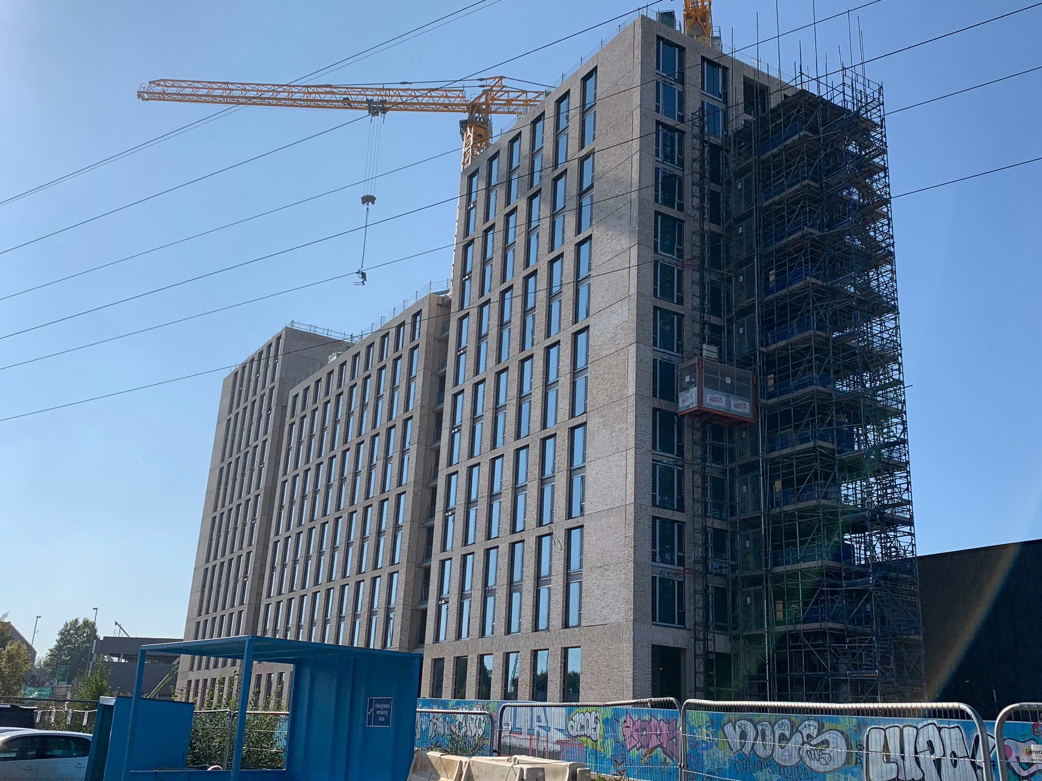
3F.2 Monitor and control resources
Due to the increase in speed of onsite activities offered by offsite construction, the speed and accuracy of collected construction progress data becomes more critical.
Typical monitoring and controlling processes can be implemented:
Quality management system
Schedule management system
Quality control system
Cost monitoring and management system
Health, safety and welfare system
Environmental management system
IT and communication processes
Document management and sharing system
Image courtesy of Offsite Awards - FP McCann

Slide 45
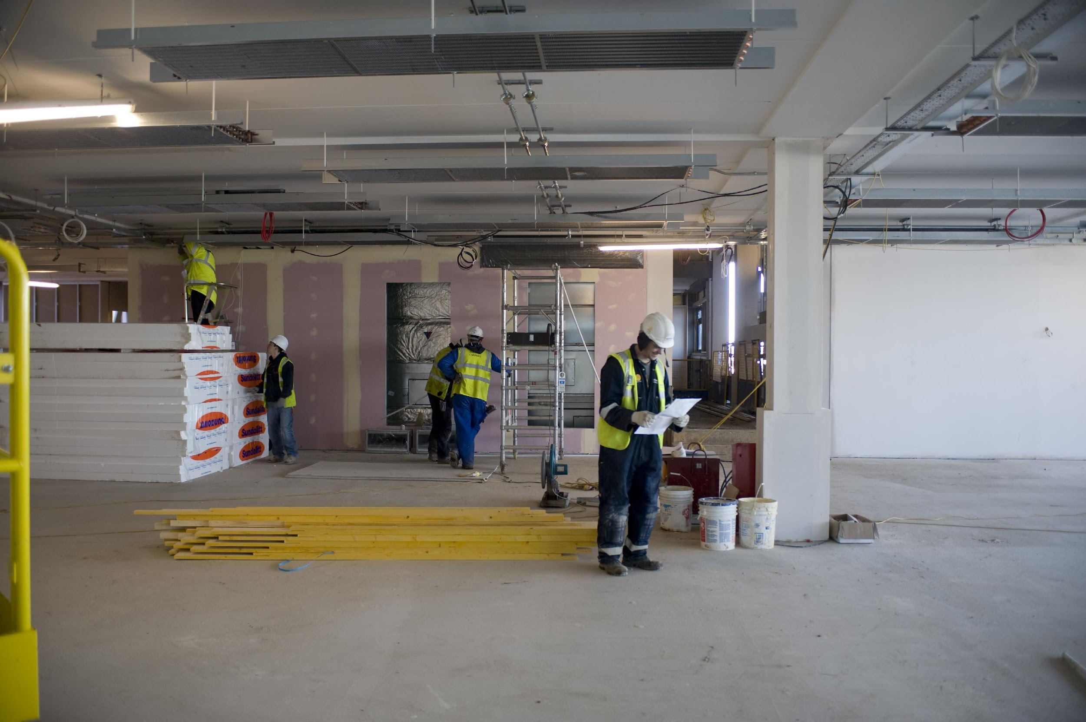
3F.3 Deliver inspections (manager)
In offsite construction, there will be the higher risks for defects in the transportation in lifting operations
Another aspect to pay particular attention to during inspections, is the floor slab and the groundworks. The tolerances for the floor slab will typically be narrower than with traditional construction. Thus they should be included in your Project Quality Plan (PQP).
Image courtesy of Edinburgh Napier University and Balfour Beatty

Slide 46

3F.4 Supervise procurement (senior manager / professional)
Statistical Process Control (SPC) can be useful in offsite constructed projects to undertake and communicate the procurement inspection processes.
SPC can be implemented in four steps:
measuring the process
eliminating variances in the process
monitoring the process
improving the process to its best target value

Slide 48

3 ESTIMATING/COMMERCIAL by DR MILA DUNCHEVA, CAROLA CALCAGNO, DR JULIO BROS-WILLIAMSON, DR JON STINSON, VICTOR HENQUEL, LOUISE ROGERS, ALASDAIR REID, ANN BENTLEY, JAMIE HILLIER AND LINDSAY RICHARDS is licensed under a Creative Commons Attribution-NonCommercial-ShareAlike 4.0 International License

