Slide 1

Teacher Preparation: What We Know and Where We Go From Here
Randy Keyworth
Jack States
The Wing Institute

Slide 2
Today’s Discussion
What We Know About Effective Teaching and Teacher Preparation
Jack States
Teacher Induction: Where the Rubber Meets the Road
Randy Keyworth

Slide 3

30 years studying “research to practice” issues…
from the “practice” side

Slide 4
The Wing Institute
1978 - 2004
operated "research based" special education schools in “real-world” settings…
…implemented data-based decision making systems at every level of the organization: student, staff, and organization
Notes:
Multiple services, disabilities, systems
Research: academic, social/behavioral. progr. eval., staff dev. perf. mgmt.

Slide 5
The Wing Institute
2004 - present
independent, non-profit operating foundation
promote evidence-based education policies and practices
act as a catalyst to facilitate communication, cooperation and collaboration between individuals and organizations currently engaged in evidence based education

Slide 6
The Wing Institute’s Strategic Vision
Identify exemplars in evidence-based education
Develop networks to facilitate collaboration
Provide support for new ideas, research, and publications
Facilitate cross-discipline cooperation
www.winginstitute.org

Slide 7
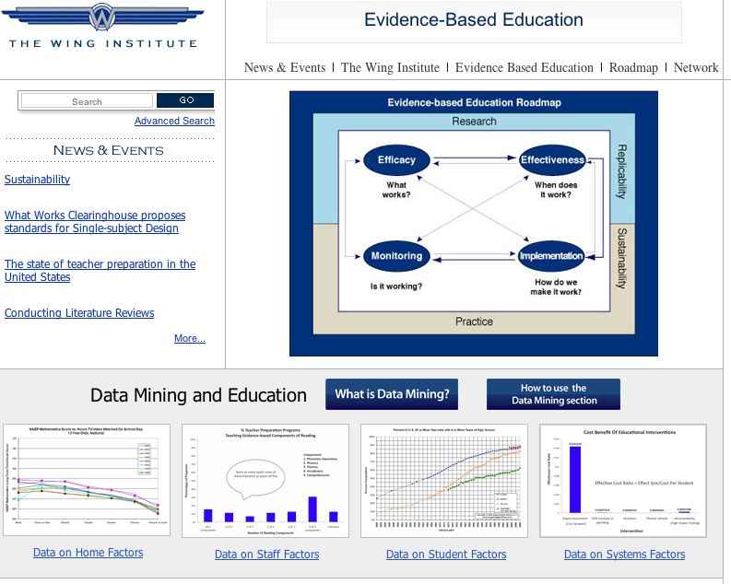

Slide 8
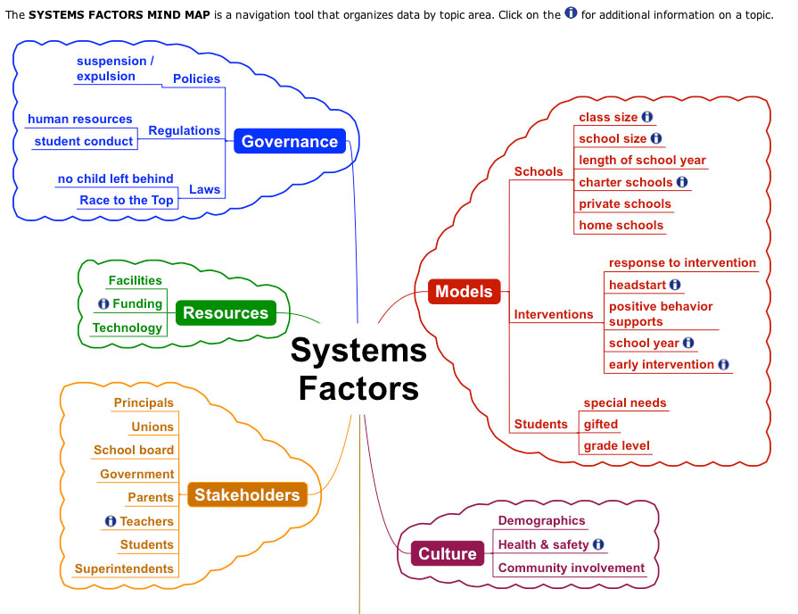

Slide 9


Slide 10
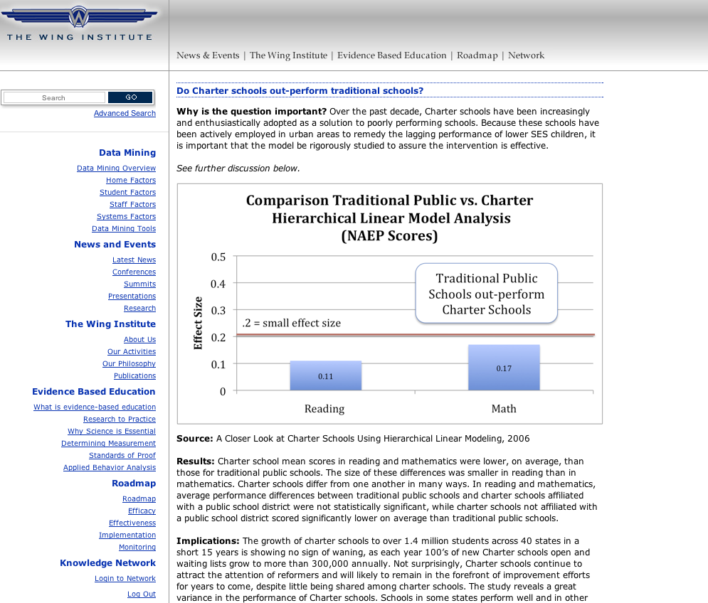

Slide 11
National Assessment of Educational Progress (NAEP)
Only nationally representative and continuing assessment of what America’s students know and can do in: math, reading, science, writing, the arts, civics, economics, geography, and U.S. History.
Common metric for all states
Stays the same each year with carefully documented changes
Administered by National Center for Education Statistics (NCES) within the Institute of Education Sciences within the U.S. Department of Education
Provides a clear picture of student academic progress over time
Tests are continually scrutinized for reliability and validity by panels of technical experts within NCES and by external groups.

Slide 12
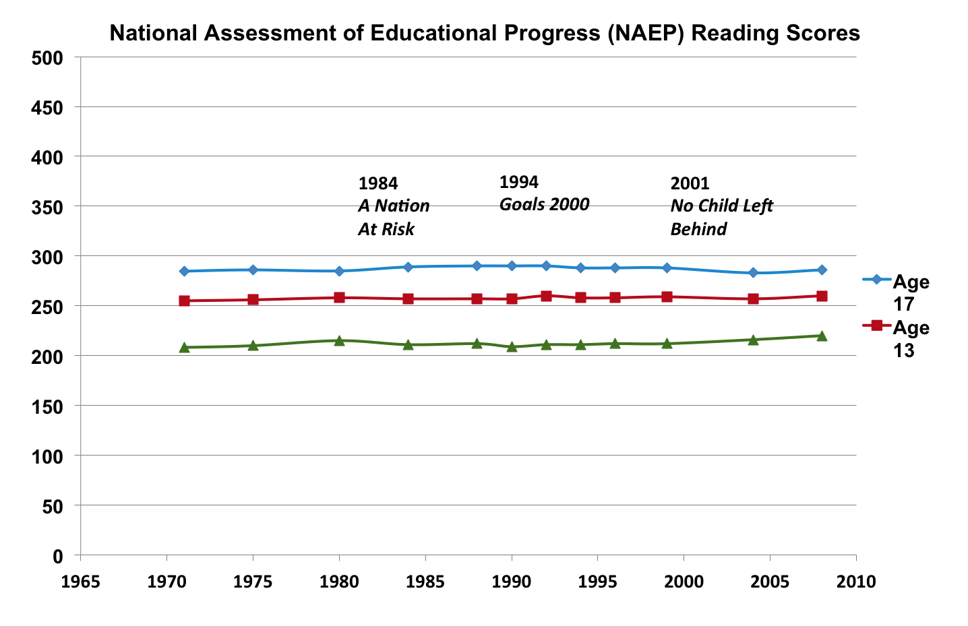
SOURCE: U.S. Department of Education, Institute of Education Sciences, National Center for Education Statistics, National Assessment of Educational Progress (NAEP), 1992, 1994, 1998, 2000, 2002, 2003, 2005, and 2007 Reading Assessments.

Slide 13
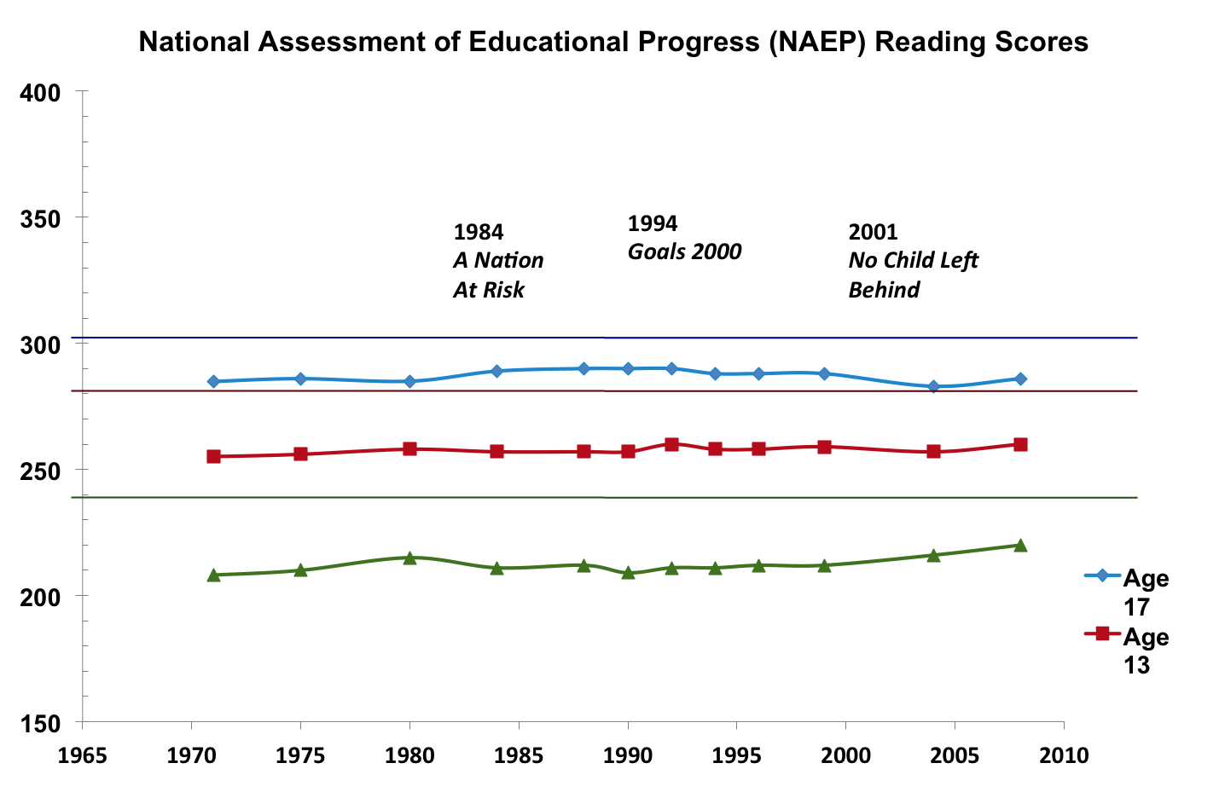
Grade 12
Grade 8
Grade 4
SOURCE: U.S. Department of Education, Institute of Education Sciences, National Center for Education Statistics, National Assessment of Educational Progress (NAEP), 1992, 1994, 1998, 2000, 2002, 2003, 2005, and 2007 Reading Assessments.

Slide 14
National Assessment of Educational Progress (NAEP)
Basic denotes partial mastery of prerequisite knowledge and skills that are fundamental for proficient work at each grade.
Proficient represents solid academic performance. Students reaching this level have demonstrated competency over challenging subject matter.
Advanced represents superior performance.
Grade 4 Grade 8 Grade 12
Basic = 208 Basic = 243 Basic = 265
Proficient = 238 Proficient = 281 Proficient = 302
Advanced = 268 Advanced = 323 Advanced = 346

Slide 15
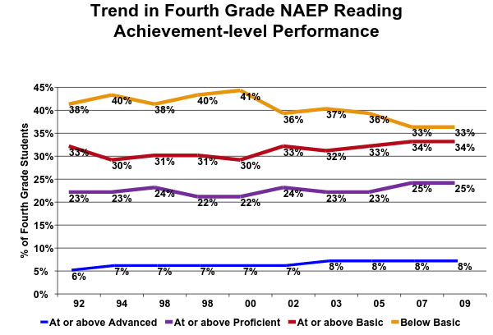
1.2 million students below basic
2.4 million students below proficient

Slide 16
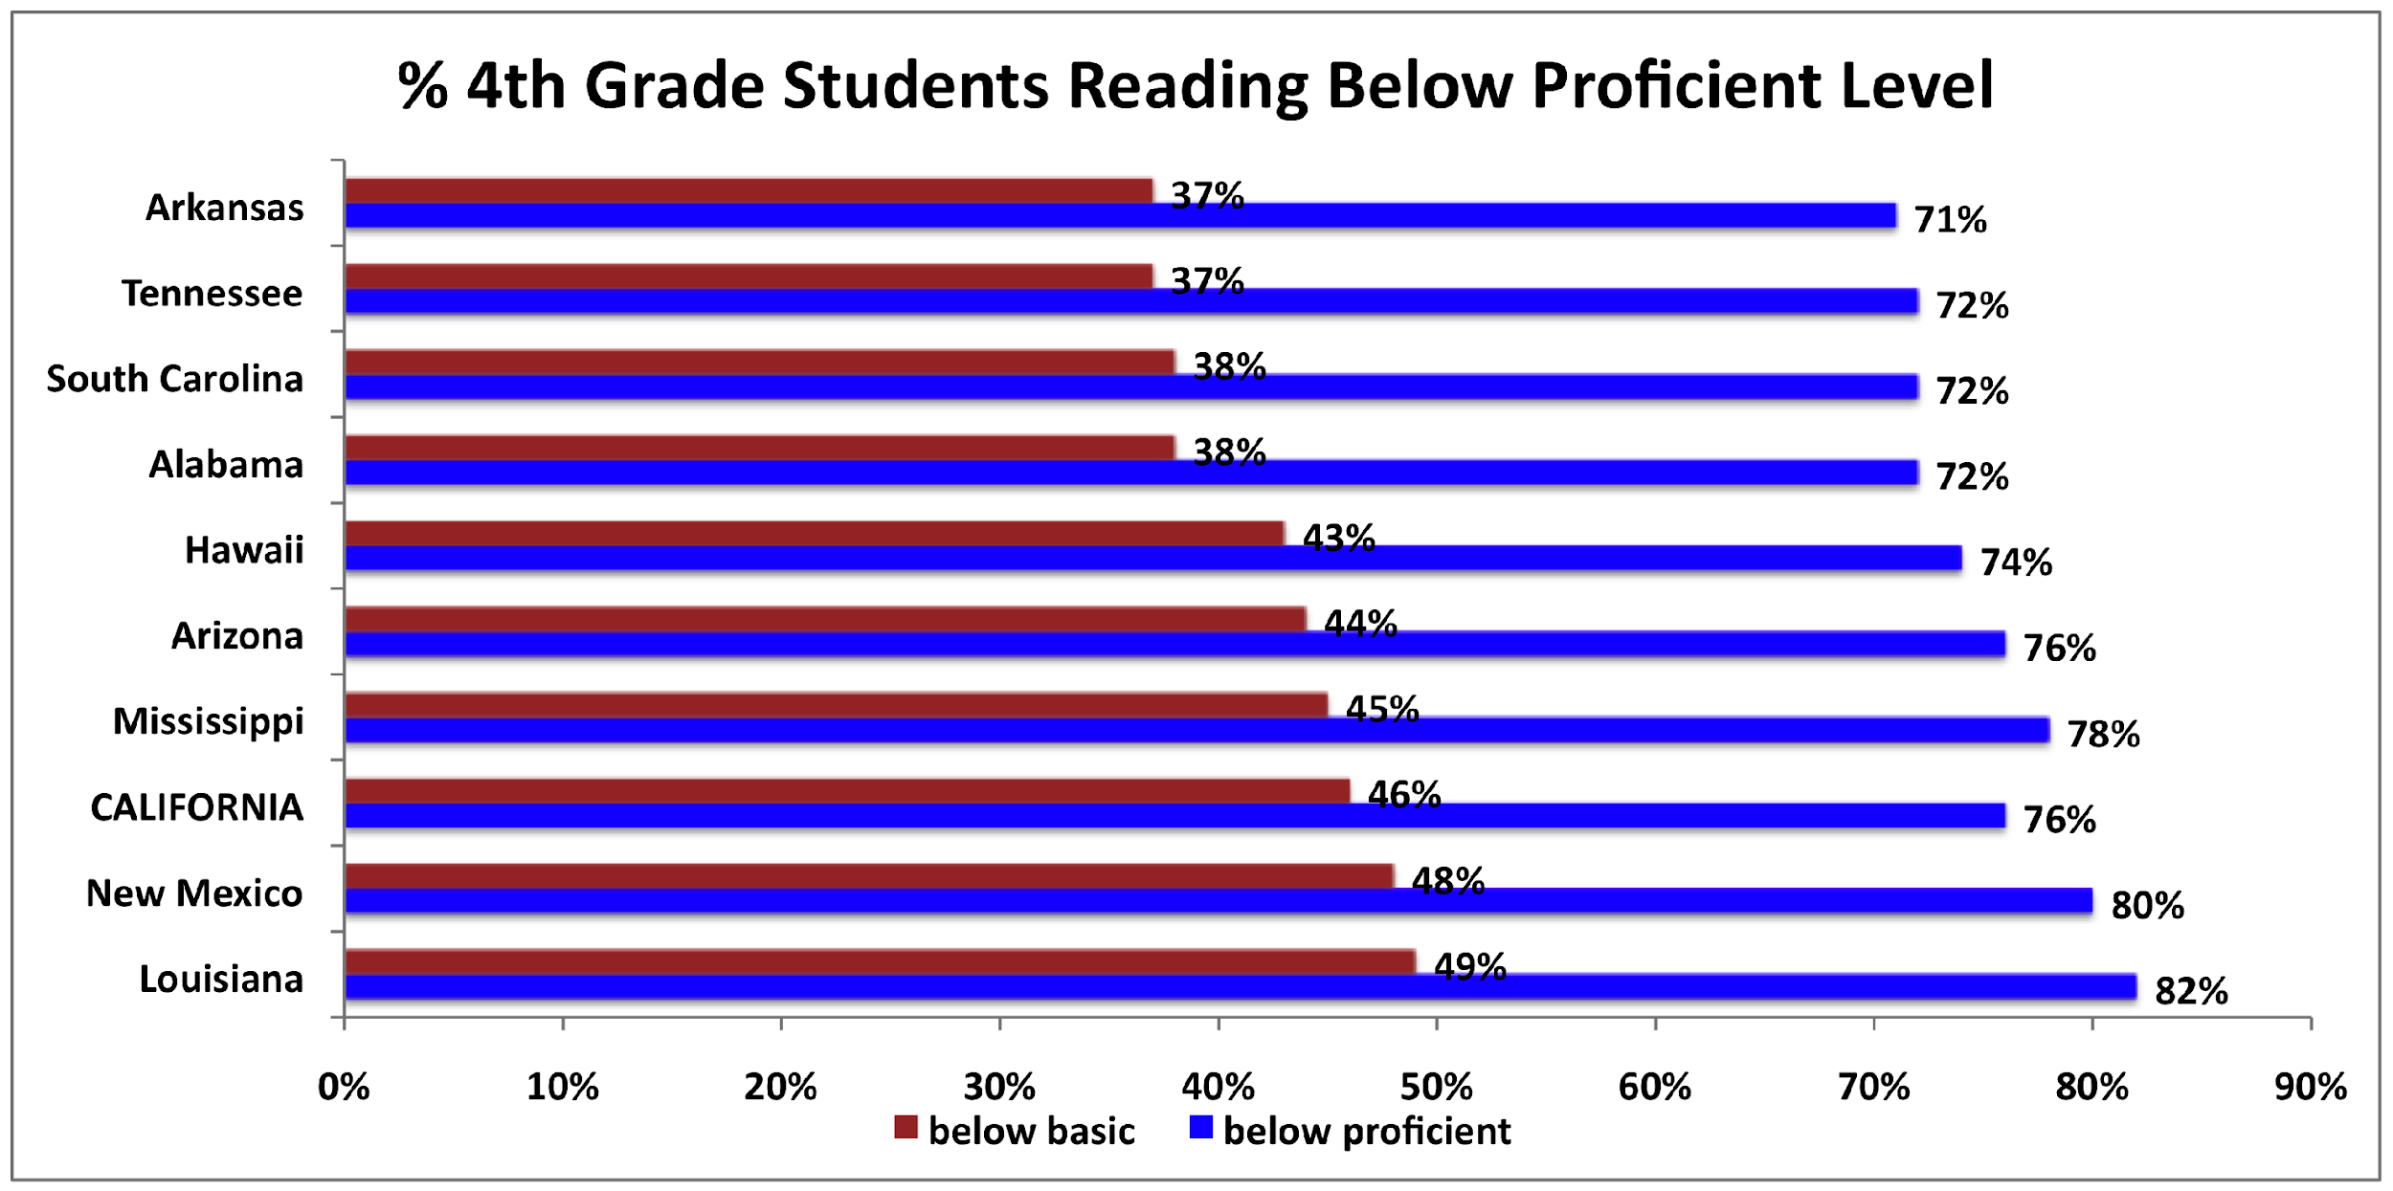

Slide 17
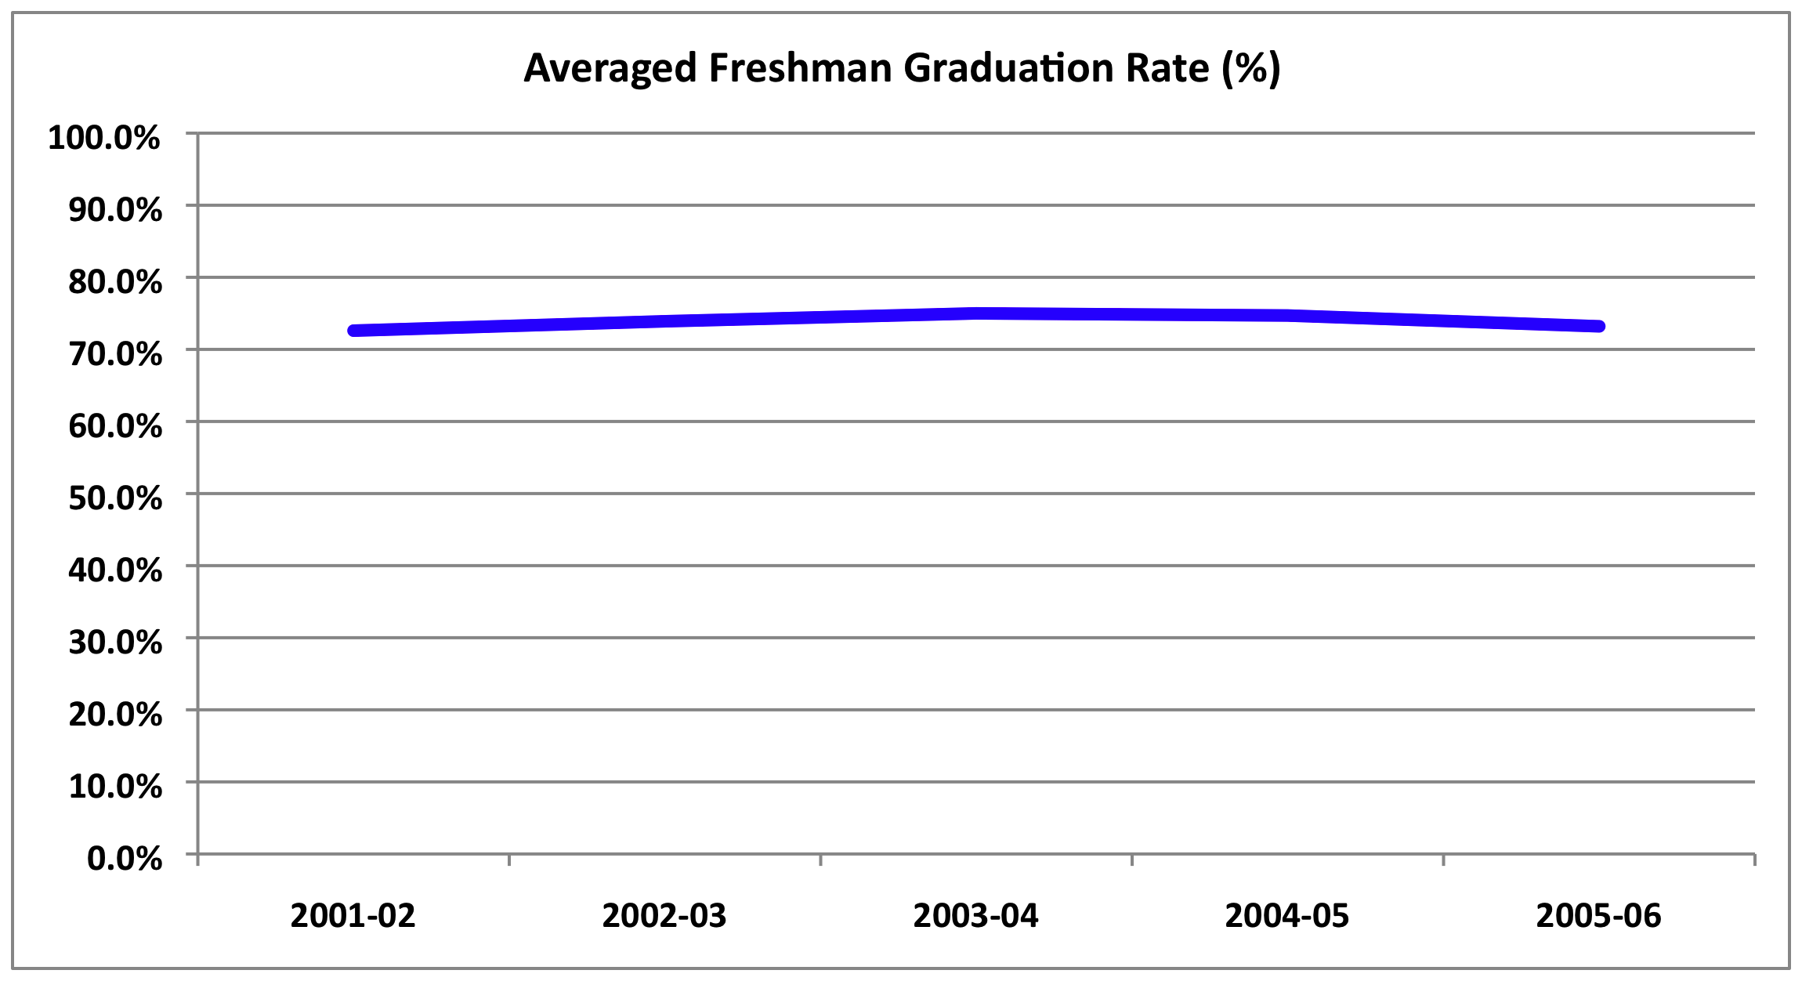
IES, National Center for Education Statistics

Slide 18
Today’s Question:
What’s going on????
Notes:
Who you are:
Public school?
Nonpublic school?
School administrators?
Psychologists, speech therapists, Ots, etc?
Teachers
Parents

Slide 19
Problem: Lack of Effective Student Performance Feedback
No Child Left Behind:
Adequate Yearly Progress (AYP)
graduation rates
state test scores in reading and math
States can establish standards and goals

Slide 20
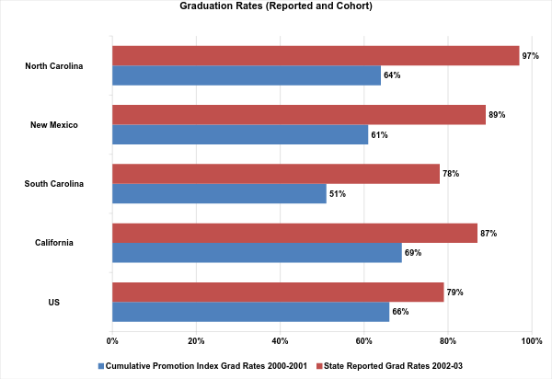
127,292 high school students dropped out....70% were black or hispanic
1,252,396 high school students dropped out....53% were black, hispanic, or native american
The Education Trust (2005)

Slide 21
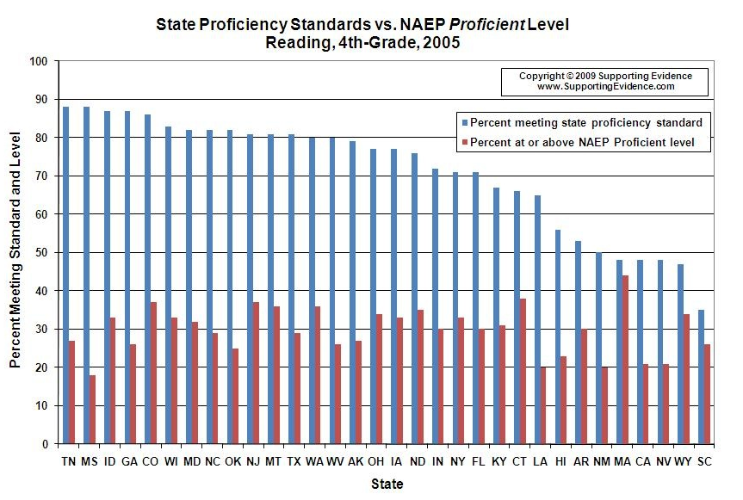

Slide 22
STUDENT PERFORMANCE FEEDBACK
Standardized Graduation Rate calculation
October 2008 DOE amended regulations require states to adopt the “cohort model” by 2010-11:
four-year adjusted cohort graduation rate
disaggregated by subgroups

Slide 23
STUDENT PERFORMANCE FEEDBACK
Standardized Tests
Nation-wide standardized tests
43 States (so far)
2014 - 2015

Slide 24
Problem: Focus on “Structural Fixes”
SCHOOL RESOURCES
increase funding for students
higher pay for teachers
TEACHER QUALITY
more “Highly Qualified Teachers” (NCLB)
more teachers with credentials
more teachers with advanced degrees
more teachers with professional certifications (NBPTS)
comprehensive induction for new teachers
SCHOOL MODELS
smaller class size
school choice
charter schools
SCHOOL REFORM INITIATIVES
A Nation at Risk
Goals 2000
No Child Left Behind

Slide 25
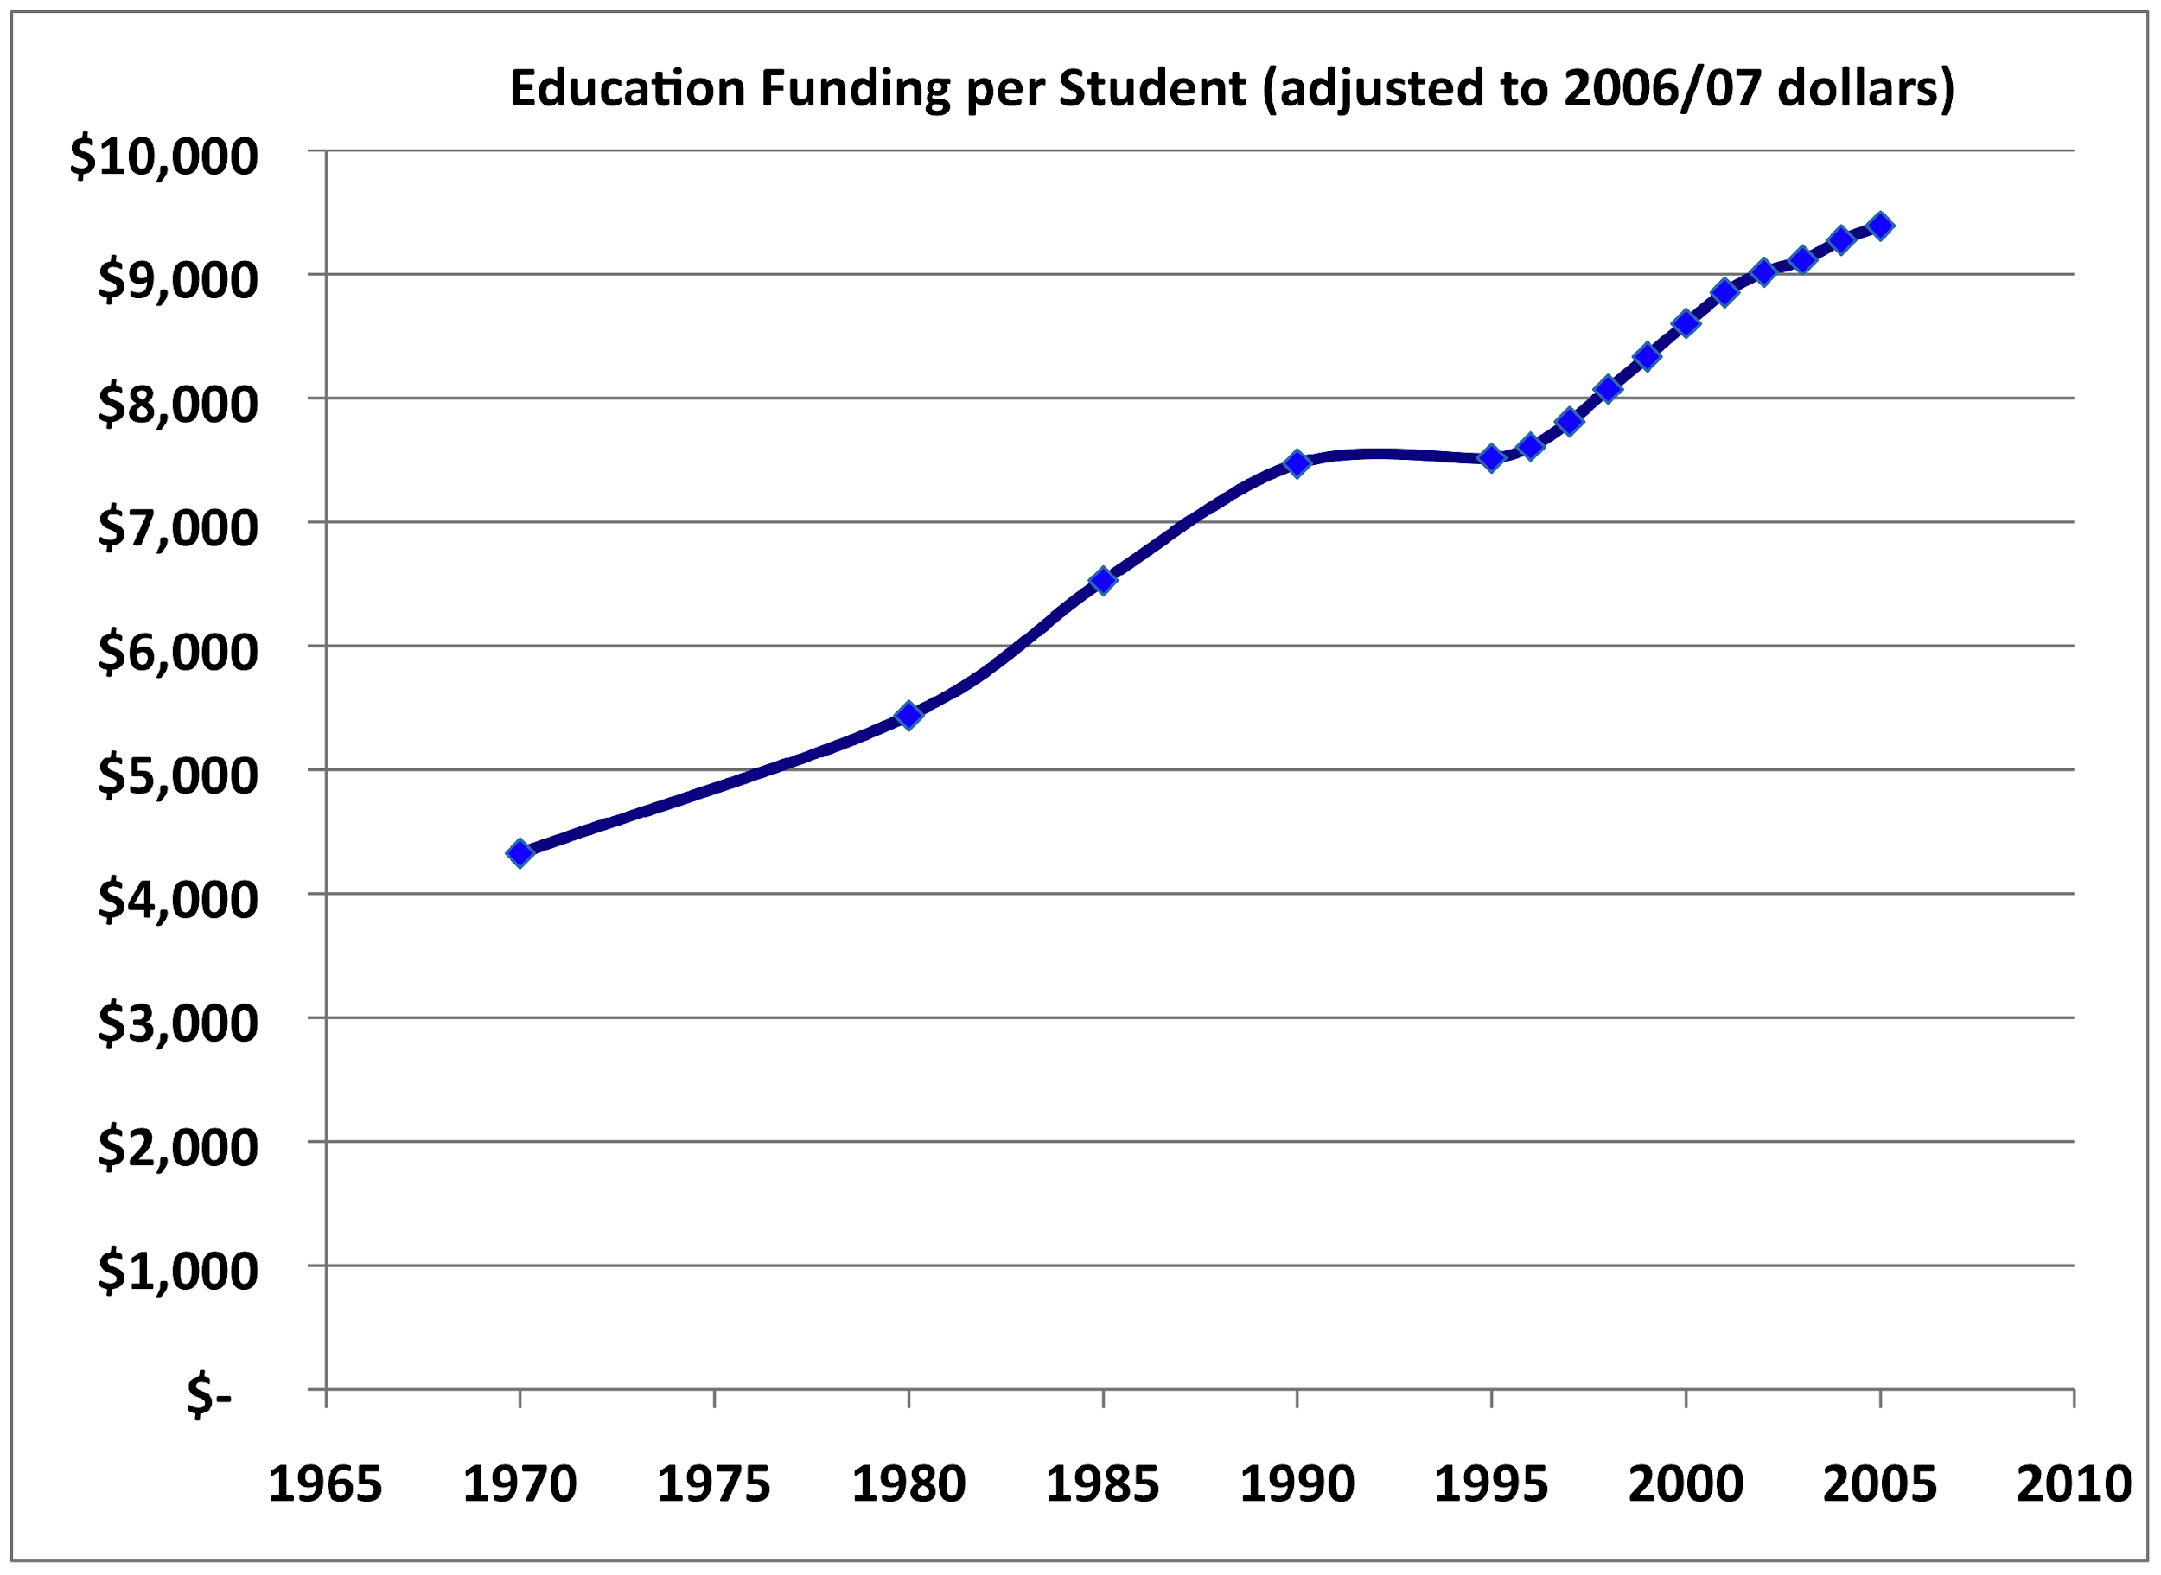
Structural Fix: Increased Funding for Education
SOURCE: U.S. Department of Education, National Center for Education Statistics. (2009). Digest of Education Statistics, 2008 (NCES 2009-020), Chapter 2 and Table 179.

Slide 26
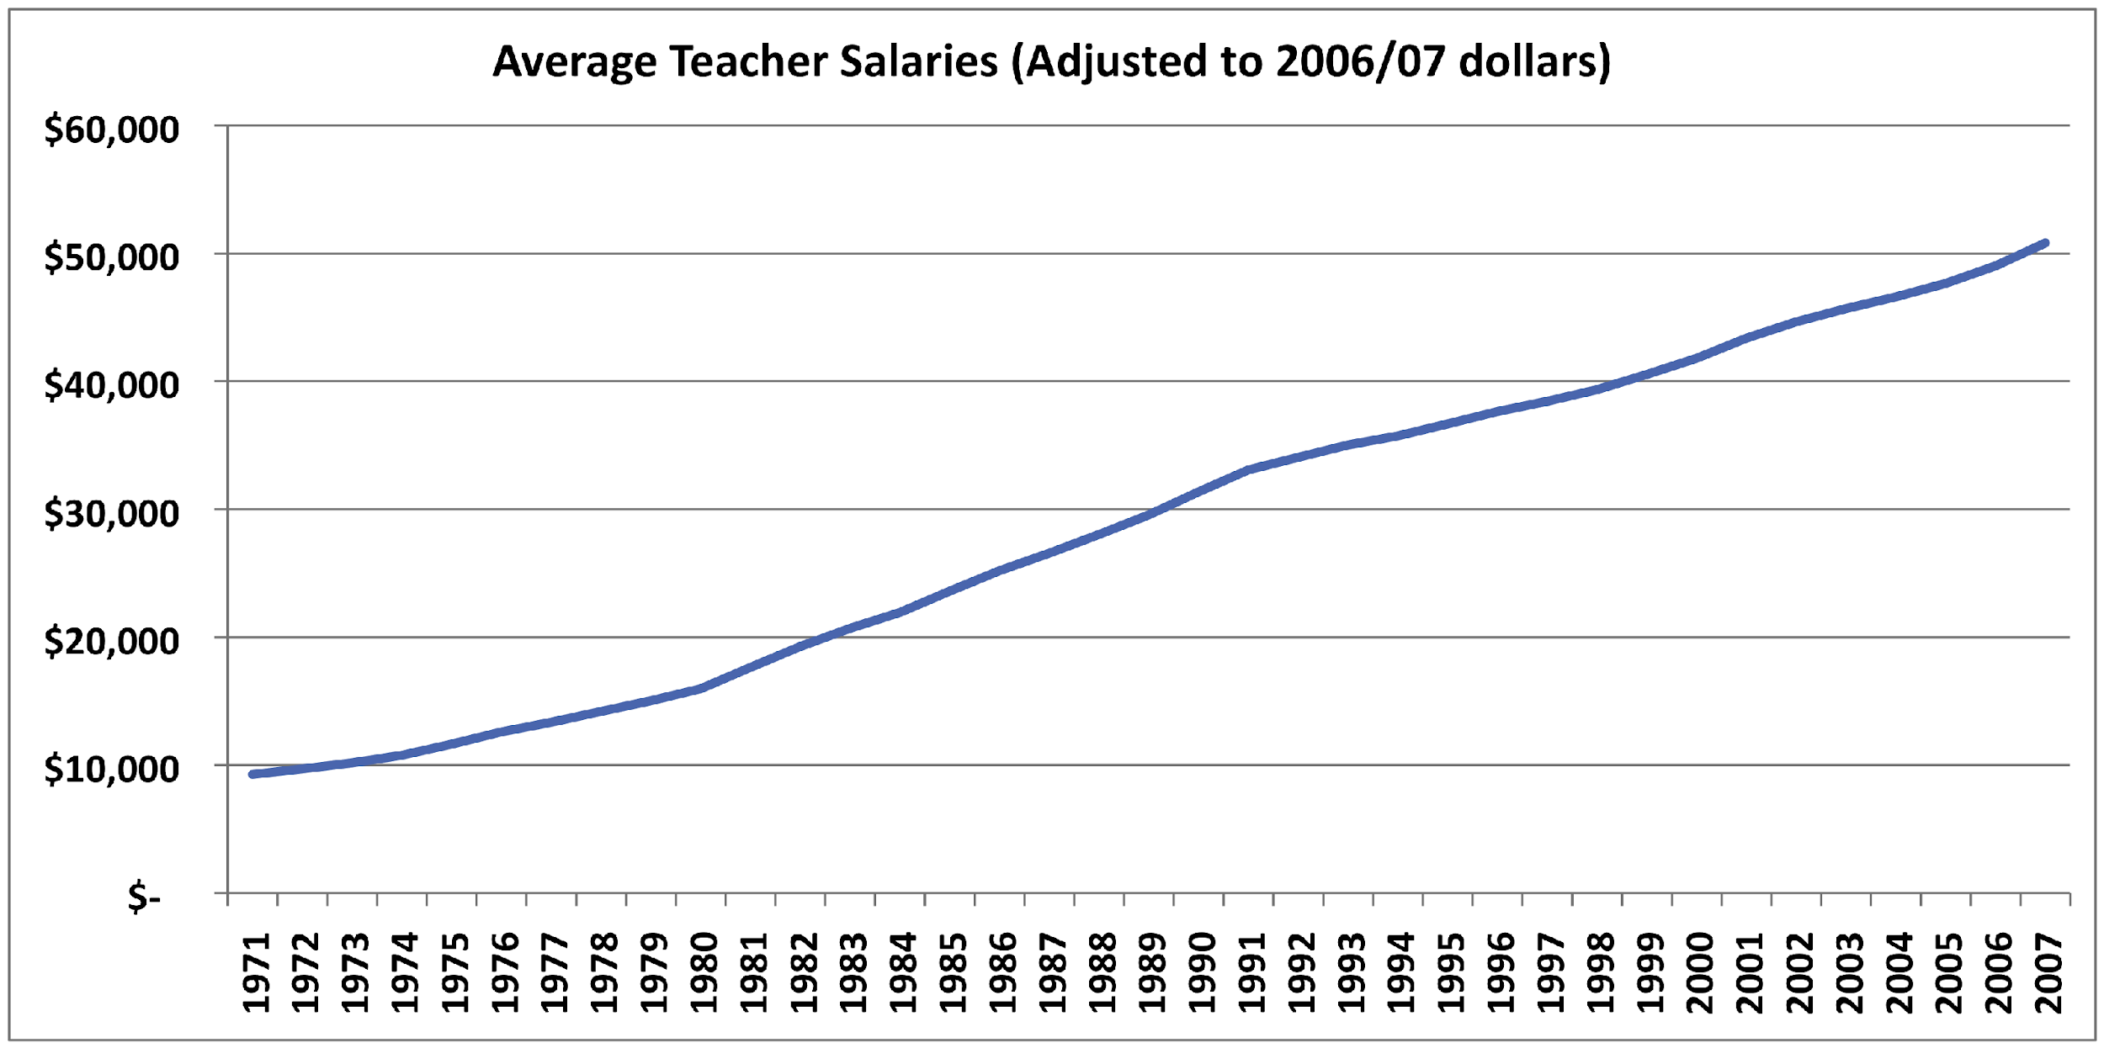
Structural Fix: Increased Pay for Teachers
IES National Center for Education Statistics Digest of Educational Statistics: 2008

Slide 27
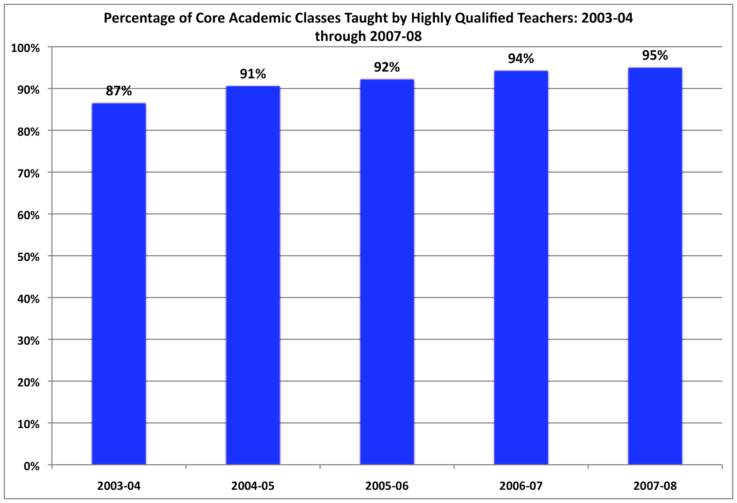
Structural Fix: More Highly Qualified Teachers

Slide 28
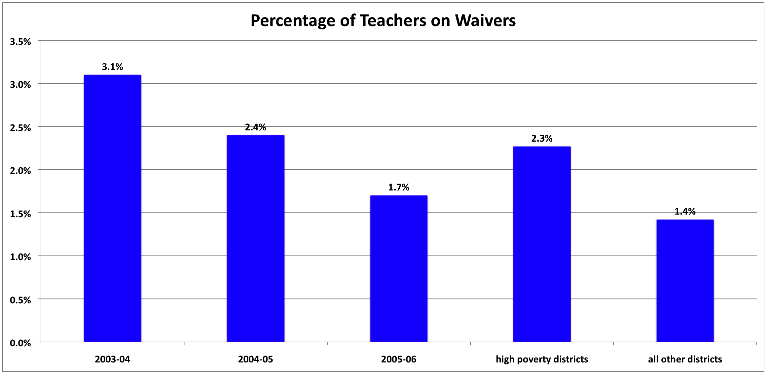
Structural Fix: More “Credentialed” Teachers

Slide 29
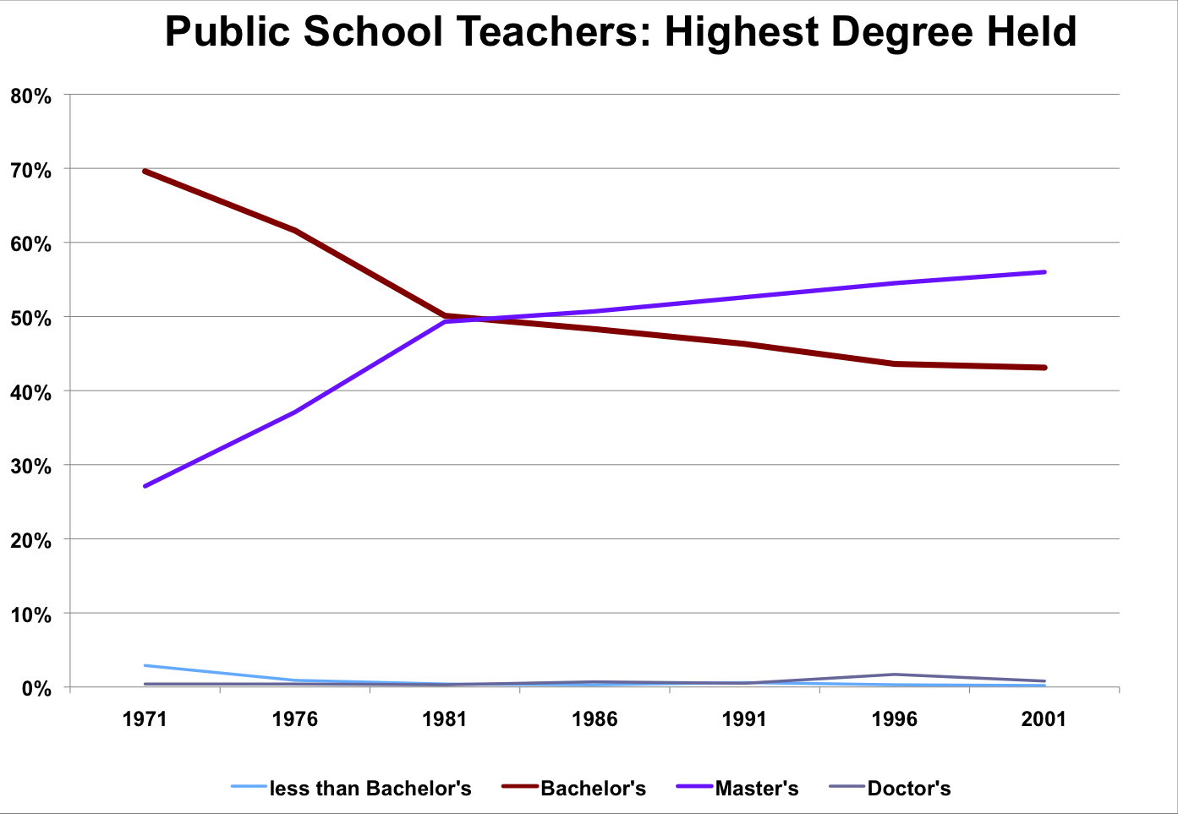
Structural Fix: Advanced Degrees for Teachers
Master’s Degrees
Bachelor’s Degrees
SOURCE: National Education Association, Status of the American Public School Teacher, 2000-01. (This table was prepared August 2003.)

Slide 30
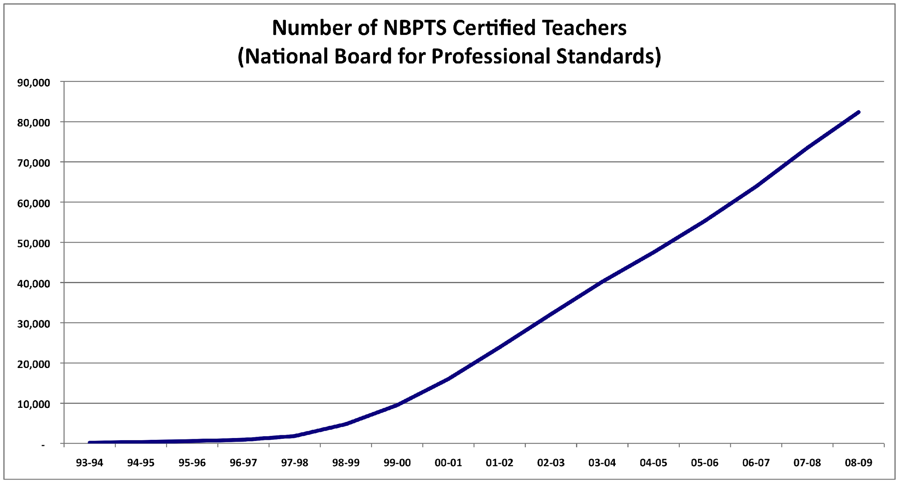
Structural Fix: More Board Certified Teachers

Slide 31
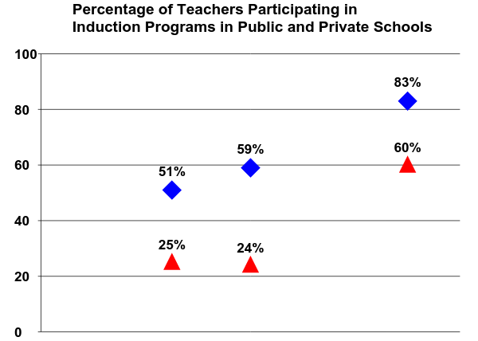
Structural Fix: More Induction Support for Teachers
Public
Private
1993-1994
1999-2000
1990-1991
Smith & Ingersoll, 2004

Slide 32
Structural Fix: Class Size Reduction
32 States now have class size reduction programs in law:
Texas (1983) California (1996)
Tennessee (1989) New York (1997)
Minnesota (1990) Florida (2002)

Slide 33
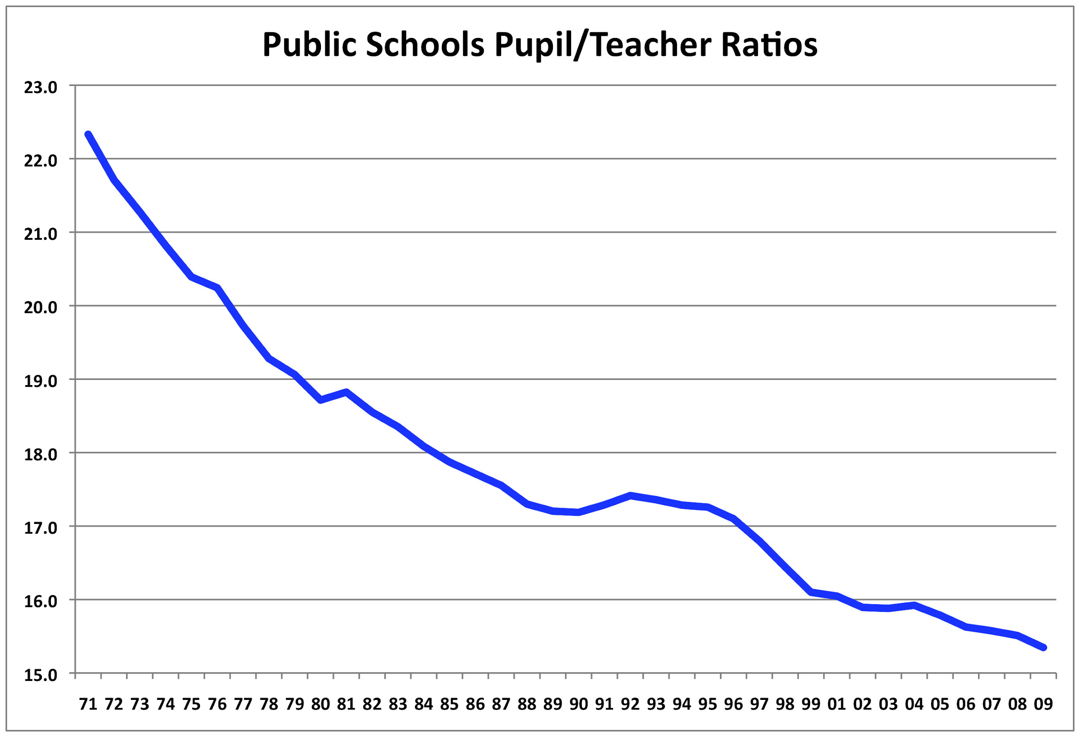
Structural Fix: Class Size Reduction

Slide 34
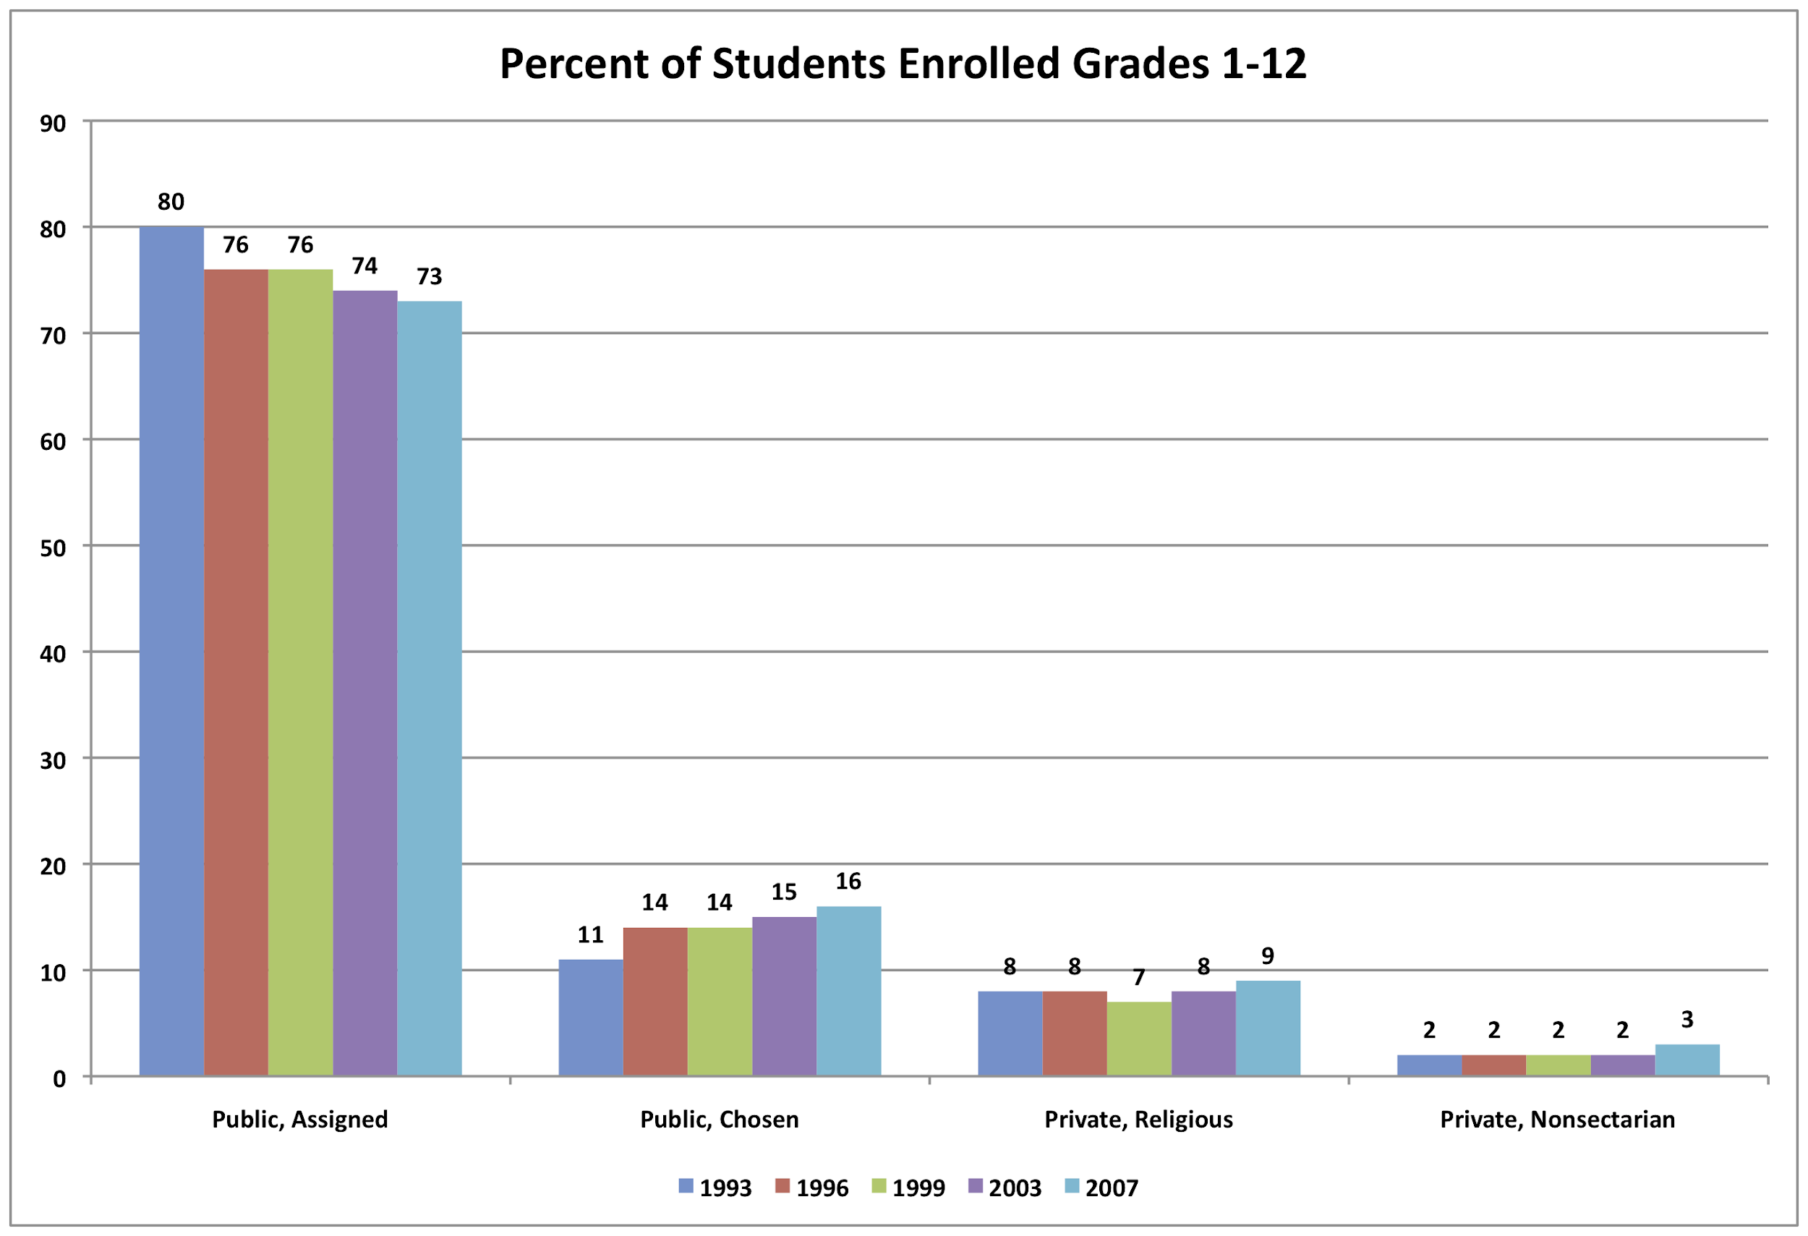
Structural Fix: School Choice
TRENDS IN THE USE of SCHOOL CHOICE: 1993 To 2007, IES

Slide 35
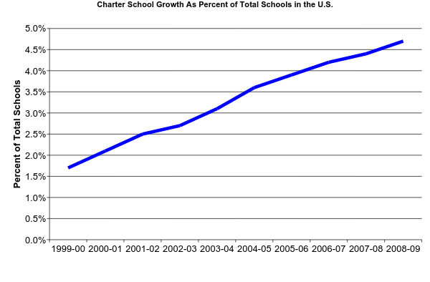
Structural Fix: More Charter Schools
There are currently over 5,000 Charter schools in the United States
U.S. Department of Education, National Center for Education Statistics

Slide 36
SOURCE: U.S. Department of Education, Institute of Education Sciences, National Center for Education Statistics, National Assessment of Educational Progress (NAEP), 1992, 1994, 1998, 2000, 2002, 2003, 2005, and 2007 Reading Assessments.

Slide 37
A History of Structural Fixes
SCHOOL RESOURCES
increase funding for students
higher pay for teachers
TEACHER QUALITY
more “Highly Qualified Teachers” (NCLB)
more teachers with credentials
more teachers with advanced degrees
more teachers with professional certifications (NBPTS)
comprehensive induction for new teachers
SCHOOL MODELS
smaller class size
school choice
charter schools
SCHOOL REFORM INITIATIVES
A Nation at Risk
Goals 2000
No Child Left Behind
✔
✔
✔
✔
✔
✔
✔
✔
✔
✔
✔
✔
✔

Slide 38
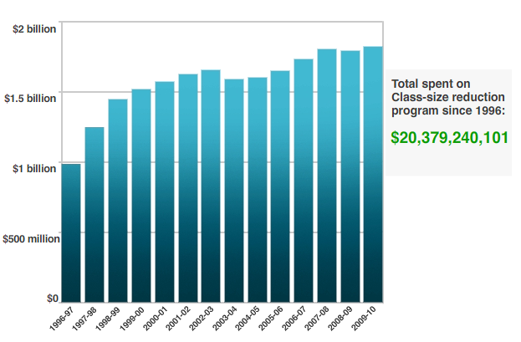
Structural Fix: Class Size Reduction

Slide 39
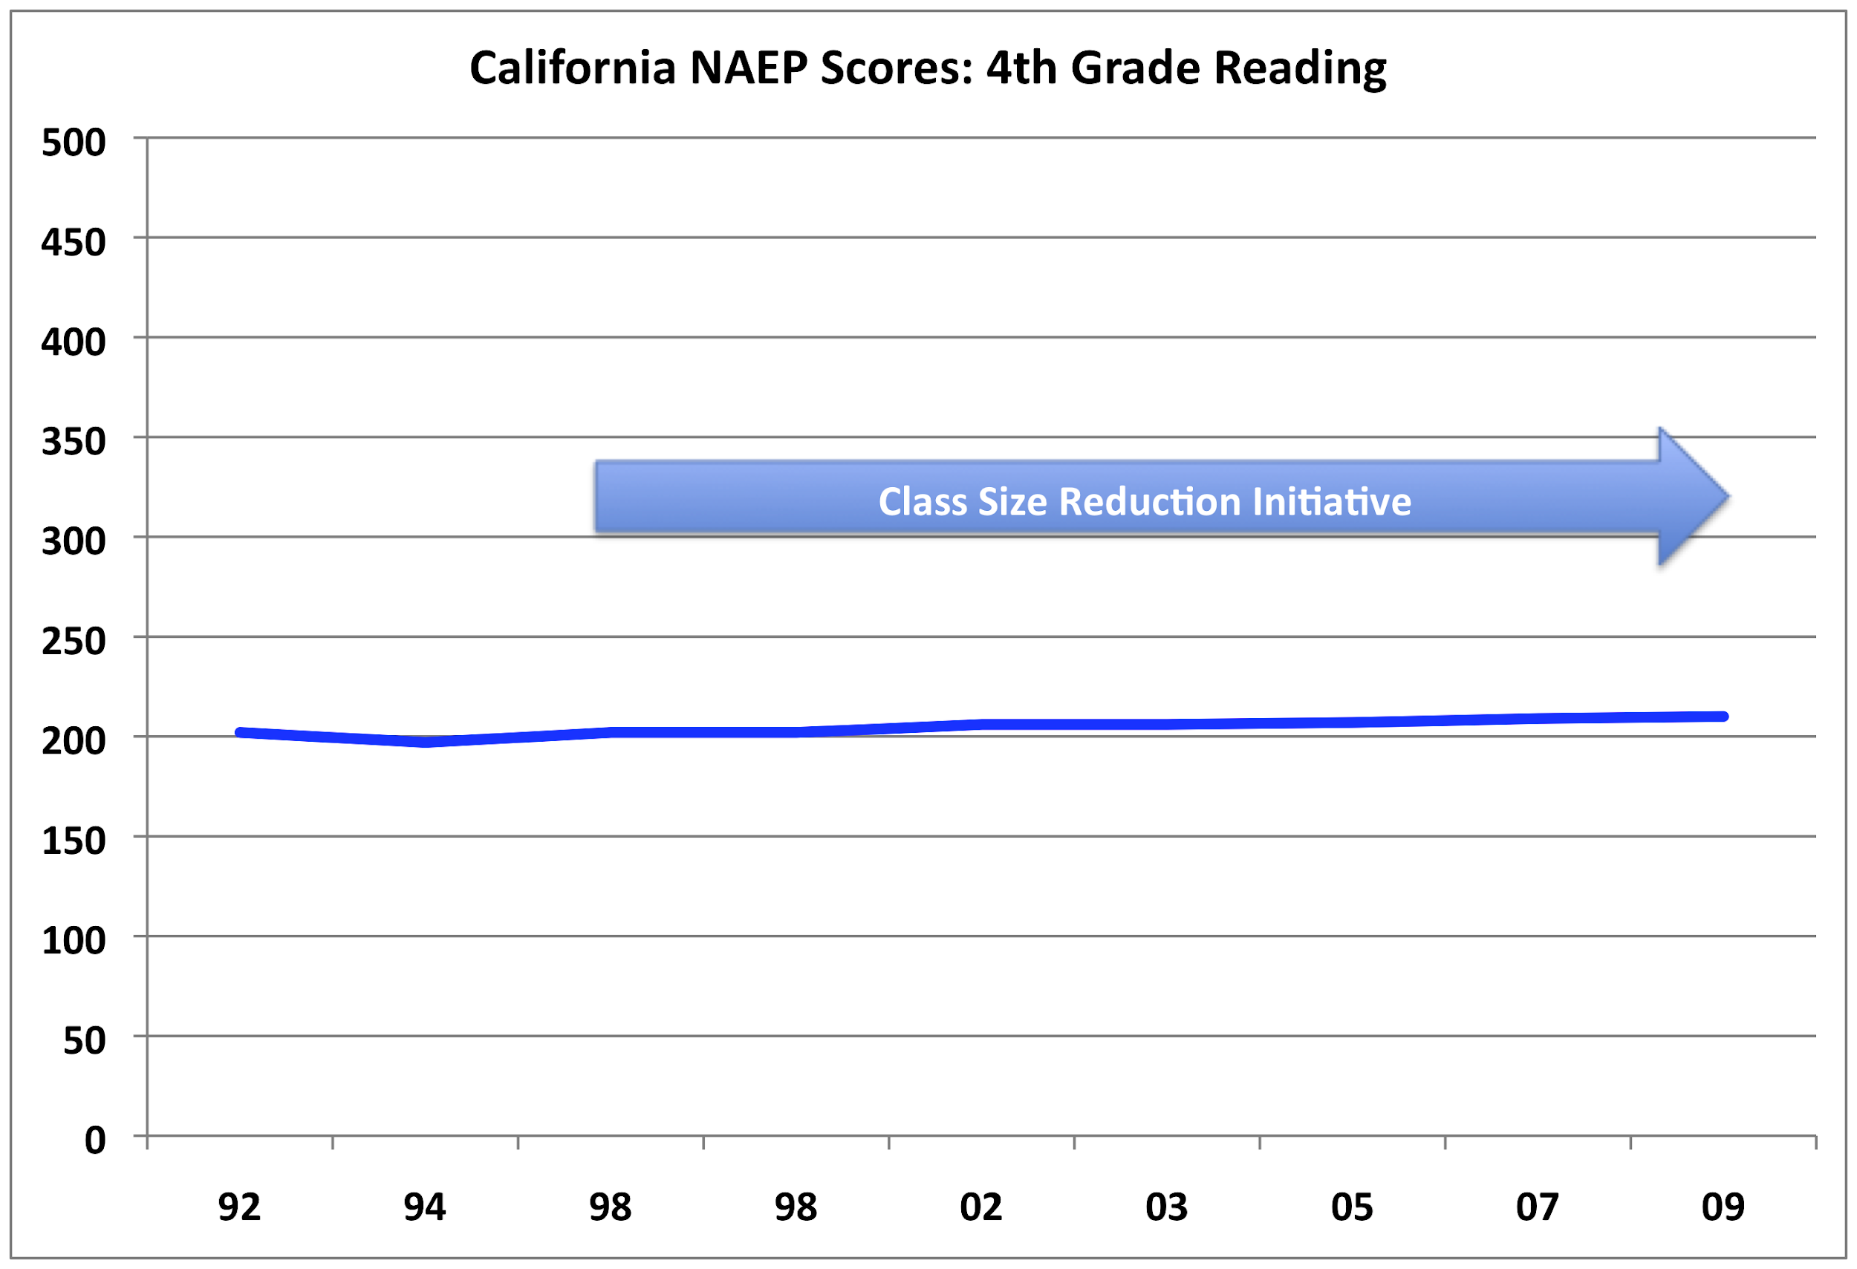

Slide 40
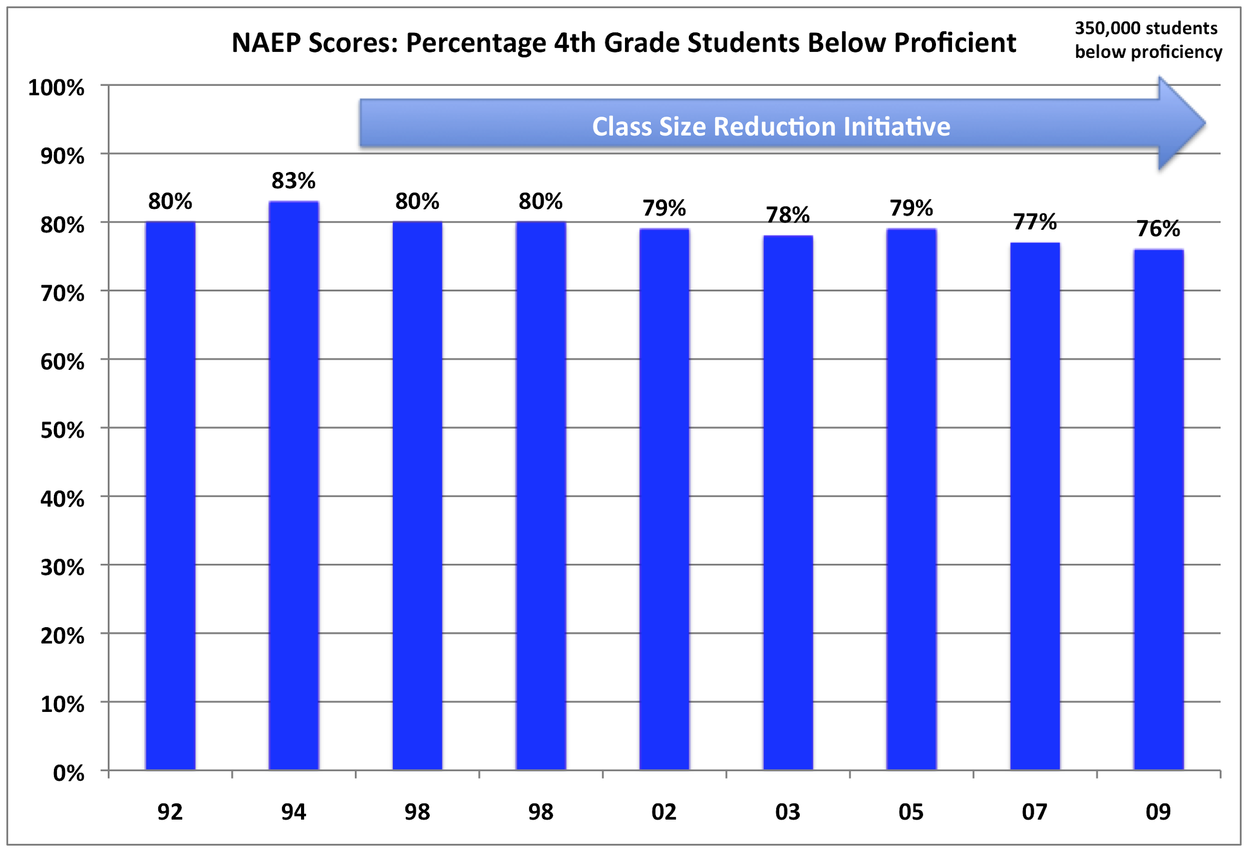

Slide 41
CSR Research Consortium
Legislatively mandated four year comprehensive study.
Major CA research orgs: AIR, RAND, PACE, WestEd, EdSource
Conclusions (Final Report):
The relationship of CSR to student achievement was inconclusive…attribution to any gains in scores to CSR is unwarranted.
Students in CSR received more individual attention, but similar instruction and curriculum.
3. CSR remains very popular with parents and teachers.

Slide 42
Problem: Lack of Effective Teacher Preparation

Slide 43
Teacher Induction:
Where the Rubber Meets the Road
Randy Keyworth

Slide 44
What is Teacher Induction?
on-the-job training and support
provided to beginning teachers
during their first year(s) of teaching
historically interchangeable with “mentoring”

Slide 45
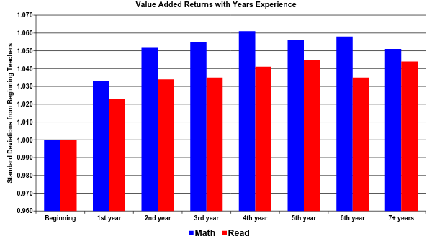
Why is induction important?
Kane, Rockoff, Staiger, 2006

Slide 46
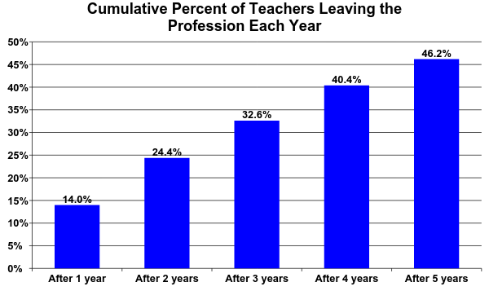
Why is induction important?

Slide 47
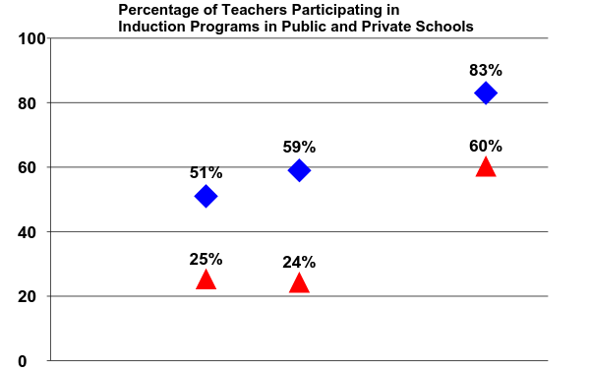
Why is induction important?
Public
Private
1993-1994
1999-2000
Smith & Ingersoll, 2004
1990-1991

Slide 48
What are the components of induction?
Components of teacher induction vary significantly:
Purpose: orientation, training, support, acculturation
Duration: few months to two years
Intensity: initial meeting, # contacts per week / month
Activities: classes, workshops, seminars, mentoring
Assessment: none, reflective logs, surveys, teacher performance, student outcomes
Content: none, reflective logs, surveys, teacher
Mentors: training, background, responsibilities

Slide 49
What does research tell us about induction?
review of 150 empirical studies from 1980 – 2003
only 10 were quantitative with clear evaluation and outcome measures
each of the 10 had design flaws seriously limiting clear conclusions
“the content, duration, and delivery of programs are so
varied from one site to another it is not clear to what extent
general conclusions about mentoring and induction can be
drawn from any given study.”
Ingersoll and Kralik, Education Commission of the States, 2004

Slide 50
What does research tell us about induction?
review of 385 induction studies from 1980 – 2003
296 not empirical
23 reviews of research
22 qualitative research
32 quasi-experimental with inadequate groups & measurement
9 quasi-experimental
3 experimental design calling for random assignment
“The dearth of high quality experimental and quasi-
experimental research in this area precludes us from
pinpointing the most effective induction practices.”
SRI International, Institute for Educational Sciences, 2004

Slide 51
What does research tell us about induction?
Institute for Education Sciences
three-year randomized control study (2007 – 2010)
Evaluate the impact of “comprehensive induction services” (treatment)
for beginning teachers as compared to “existing induction services”
(control).
comprehensive = intensive, structured, sequentially delivered
(mentoring, observation, demonstration, reviewing lesson plans, etc.)
two nationally known comprehensive induction service providers
17 school districts, 13 states, randomized group assignment
Institute of Education Sciences, 2008

Slide 52
Institute of Education Sciences Study (2008-2010)
Well established programs:
Carefully selected and trained full-time mentors
Curriculum of intensive and structured support including orientation, professional development and weekly meetings with mentors
Formative assessment tools that permit evaluation of practice on an ongoing basis
Outreach to district and school-based administrators
Two models: one year induction and two year induction programs

Slide 53
Institute of Education Sciences Study (2008-2010)
What is the impact of comprehensive induction services as compared to current induction services? After one year? After two years?
impact on type and intensity of induction services received
comprehensive provided greater time in various mentor activities
2. impact on teacher’s classroom practices
no statistically positive impact
3. impact on student achievement
no statistically positive impact
4. impact on teacher retention
no statistically positive impact
5. impact on composition of the district’s teaching workforce
no statistically positive impact
WHAT HAPPENED?

Slide 54
What do we know about teaching “teaching”?
CRITICAL FEATURES:
Socially valid training objectives
Objective evaluation measures
Effective teaching strategies
Treatment fidelity
5. Performance management
6. Ongoing feedback and training

Slide 55
1. Socially valid training objectives?
✔
    Formative Assessment (such as curriculum based measurement)
Orderly efficient classroom routines( predictable routines, clear sequence of instruction, etc.)
    Positive, active classroom behavior management
    Active Teaching: (interactive instruction)
✔
✔
✔

Slide 56
2. Objective evaluation measures?
impact on type and intensity of induction services received
teacher surveys (2 / year)
2. impact on teacher’s classroom practices
Vermont Classroom Observation Tool (once)
3. impact on student achievement
student test score data (spring 2005, spring 2006)
4. impact on teacher retention
teacher survey (1 / year)
5. impact on composition of the district’s teaching workforce
teacher survey (once)

Slide 57
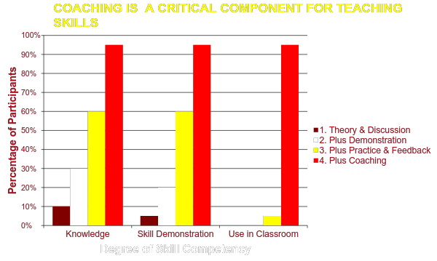
3. Effective Teaching Strategies?

Slide 58
3. Effective Teaching Strategies?
Time spent engaged in following strategies:
% teachers reporting
NON-COACHING ACTIVITIES engaged in activities
Kept written log 40%
Kept portfolio 70%
Worked in study group 68%
Observed others teaching 55%
Meetings w/ mentors, others 71%
COACHING ACTIVITIES # times / month
Teaching observed by mentors 1.3
Feedback on teaching 1.6
Feedback on lesson plans .5
Institute of Education Sciences, 2008

Slide 59
4. Treatment fidelity?
Evidence-based drug education programs were implemented with integrity only 19% of the time.
Hallfors & Godette (2002)
  This may be an overestimate.
  52% reported that programs were modified or adapted.
No reason to believe that other curricula and social interventions are implemented with any better integrity.

Slide 60
Outcome
Positive
Negative
Positive
Negative
High
Continue Intervention
Change Intervention
High
Integrity
Low
Unknown Reason
Unknown Reason
Low
Other life changes?
Unknown intervention?
Intervention is effective?
Intervention problem?
Implementation problem?

Slide 61
4. Treatment fidelity?
Teacher treatment fidelity and mentor treatment fidelity
teacher
mentor
Outcomes
student
teacher
treatment
fidelity
treatment
fidelity
Activities

Slide 62
4. Treatment fidelity?
Independent Variables Treatment Control
% teachers w/ Mentors 93% 75%
Minutes / week engaged in various mentor 95 min/wk 74 min/wk
activities (meetings, observations, lesson
planning, reviewing work, etc.)
NO EVALUATION OF TREATMENT FIDELITY
poor treatment compliance measures (surveys 2 x / year)
no treatment competence measures (only activity measures)
Institute of Education Sciences, 2008

Slide 63
5. Performance Management?
In order for induction to be effective, it needs to shape teachers’ behaviors so that they:
implement
the program
correctly
over time
compliance
competence
sustainability

Slide 64
5. Performance Management?
The most common forms of implementation…
paper implementation: new policies and procedures put in place
process implementation: new operating procedures put in place
information dissemination
training
supervision
have repeatedly been shown to be ineffective
performance implementation: monitoring activities and outcomes and responding to the data
National Implementation Research Network (NIRN)

Slide 65
5. Performance Management?
Time spent engaged in following strategies:
% teachers reporting
INDUCTION ACTIVITIES engaged in activities
Kept written log 40 %
Kept portfolio 70 %
Worked in study group 68 %
Observed others teaching 55 %
Observed others teaching your classroom 51 %
Met w/ principal for feedback 69 %
Met w/ curriculum specialist 77 %
Teachers being offered professional development 99 %
Teachers attending professional development 44 %
Institute of Education Sciences, 2008
61%

Slide 66
6. Ongoing feedback and training?
Kane, Rockoff, Staiger, 2006

Slide 67
6. Ongoing feedback and training?
Kane, Rockoff, Staiger, 2006

Slide 68
6. Ongoing feedback and training?
Immediately following training, treatment integrity begins to decline.
        Mortenson & Witt, 1998
      Noell, Witt, LaFleur, Mortenson, Ranier, & LeVelle, 2000
      DiGennaro, Martens, & McIntyre, 2005

Slide 69
6. Ongoing training and feedback?
1st year
NON-COACHING ACTIVITIES induction
Kept written log 40 %
Kept portfolio 70 %
Worked in study group 68 %
Observed others teaching 55 %
Meetings w/ mentors, others 71 %
1st year
COACHING ACTIVITIES induction
Teaching observed by mentors 1.3 /mo
Feedback on teaching 1.6 /mo
Feedback on lesson plans .5 /mo
2nd year
no induction
27 %
75 %
24 %
33 %
64 %
Change
- 13 %
+ 5 %
- 44 %
- 22 %
- 7 %
2nd year
no induction
0 /mo
.7 /mo
.3 /mo
Change
- 1.3 /mo
- .9 /mo
-.2 /mo
Institute of Education Sciences, 2008

Slide 70
Why did comprehensive induction fail to produce desired outcomes?
CRITICAL TRAINING FEATURES:
Socially valid training objectives
Objective evaluation measures
Effective teaching strategies
Treatment fidelity
5. Performance management
6. Ongoing feedback and training
YES
NO
NO
NO
NO
NO

Slide 71
Need for Ongoing Performance Feedback Systems
Kane, Rockoff, Staiger, 2006

Slide 72
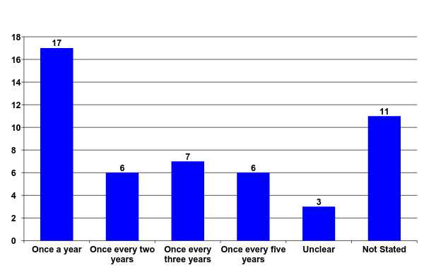
Evaluation Requirements of Tenured Teachers
in the 50 Largest U.S. School System
Hiring, Assignment, and Transfer in Chicago Public Schools Report from The New Teacher Project July 2007

Slide 73
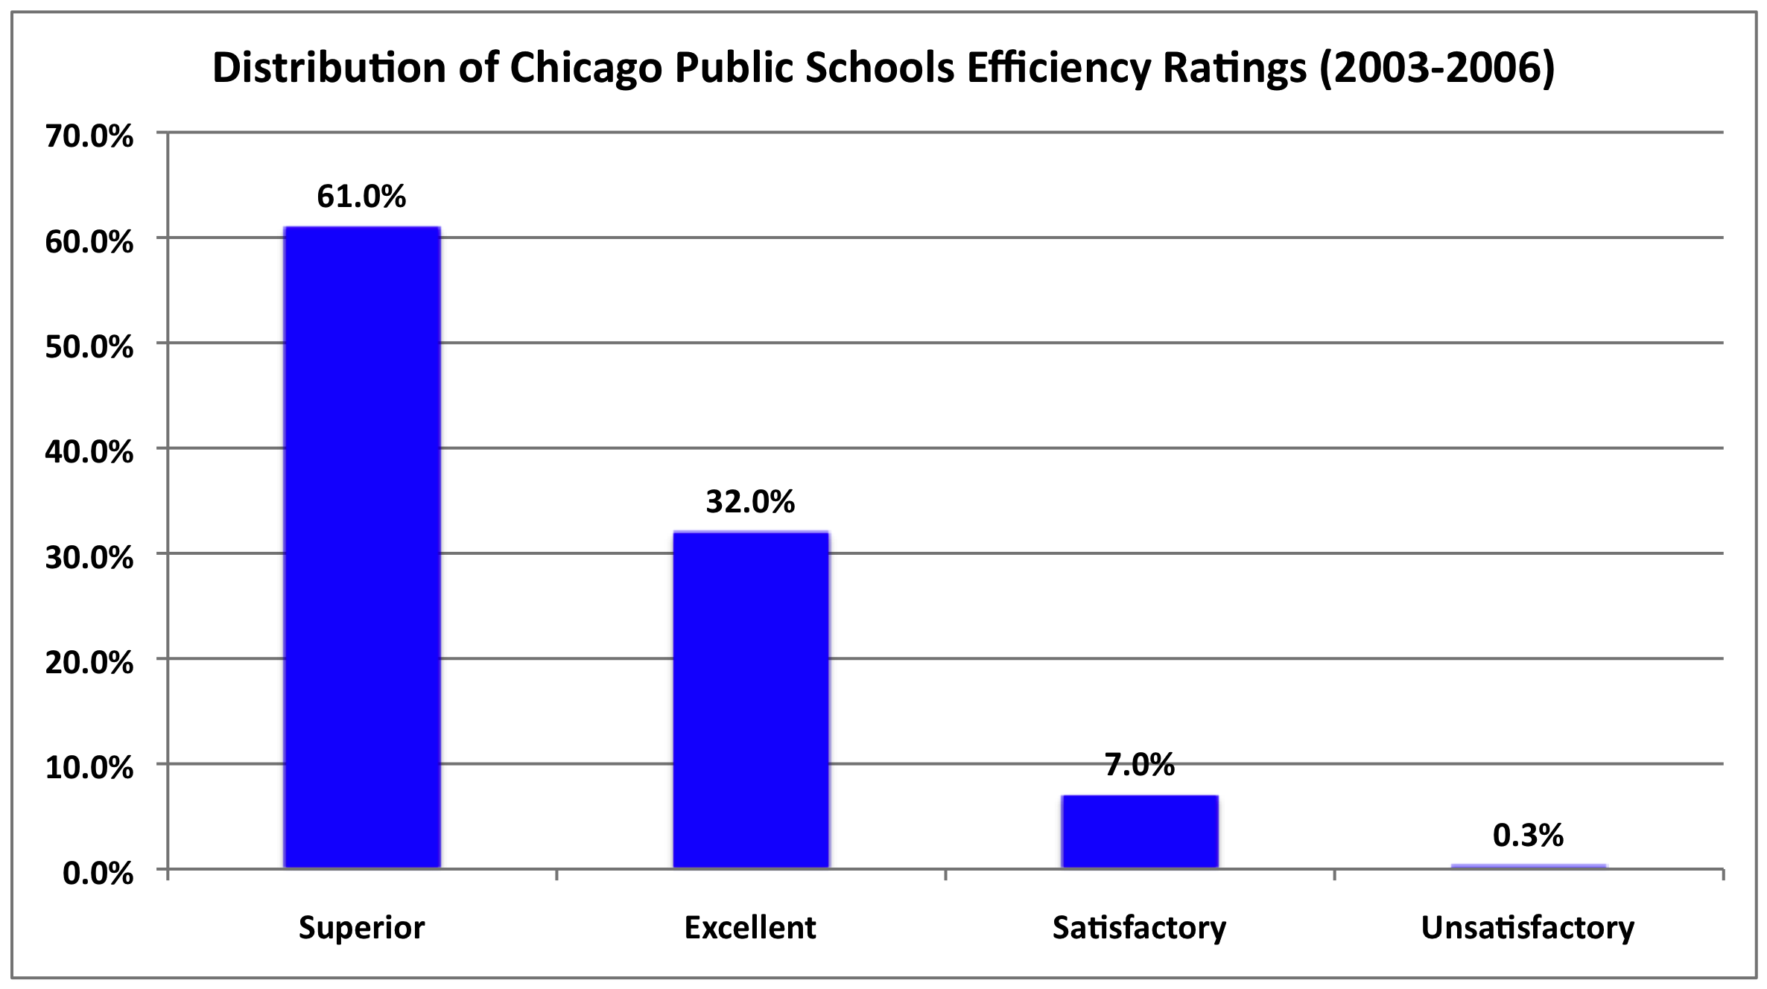
Hiring, Assignment, and Transfer in Chicago Public Schools Report from The New Teacher Project July 2007

Slide 74
93% of teachers received superior or excellent ratings
Only 3 out of 1,000 teachers rated unsatisfactory
Hiring, Assignment, and Transfer in Chicago Public Schools Report from The New Teacher Project July 2007

Slide 75
87 Schools met criteria for being identified as “failing schools”
69 (79%) of these schools did not issue a single “unsatisfactory rating”
Hiring, Assignment, and Transfer in Chicago Public Schools Report from The New Teacher Project July 2007

Slide 76
Building a Performance Feedback Culture
In order for a performance feedback system to be effective, staff must:
implement it
correctly
over time
compliance
competence
sustainability

Slide 77
Performance Feedback Systems compliance / competence
• ask the right questions
• identify appropriate data to collect (validity)
• implement interventions according to plan (treatment integrity)
• collect data accurately (reliability)
• display / analyze data
• interpret data / draw correct conclusions
• give / receive feedback based on the data
• modify interventions based on data

Slide 78
Data-based Decision Making sustainability
• implemented with procedural fidelity and desired outcomes (effectiveness) at the consumer level
maintains over time
maintains over generations of practitioners and decision-makers
operates within existing resources (financial, staff, materials) and existing mandates
becomes institutionalized, routine…
“the way we do business”
National Implementation Research Network (NIRN)

Slide 79
Sustainable Practice
requires:
a social / cultural change process across all levels of an organization
a long term, ongoing, developmental process
respect and accommodation of the uniqueness of every aspect of the culture

Slide 80
Building a
Performance Feedback Culture
All organizations have cultures…
most don’t support data-based decision making

Slide 81
What is an Organizational Culture?
The complex interaction of formal and informal contingencies governing the behavior of all stakeholders, embodied in:
Stakeholders
policy makers
parents
school administrators
classroom staff
students
External Contingencies
laws & regulations
funding
job market
training and ideology
Internal Contingencies
policies
practices
values
resource allocations
data systems feedback systems reporting requirements
program evaluation
recruitment & hiring
initiatives
job expectations
compensation
staff training
staff coaching
staff feedback

Slide 82
Building a
Data-based Decision Making Culture
All organizations have cultures…
most don’t support data-based decision making

Slide 83
Baseline Cultural Obstacles
staff resistance to a performance feedback culture:
long standing mistrust of the purpose of data
educator autonomy, implicit power relationships
cynicism about fads, new ideas, education reform
resistance to performance feedback
data collection is too difficult
data collection causes too much change
desired outcomes take too long to materialize
perceived costs exceed perceived benefits

Slide 84
Building a
Performance Feedback Culture
Data-based decision making cultures deliberately shape all cultural contingencies to reinforce the effective use of data in decision making.
  increase reinforcement for the target behaviors
  decrease aversive consequences for the target behaviors
  decrease reinforcement for competing behaviors
  increase aversive consequences for competing behaviors

Slide 85
Using Performance Management to Build a
Performance Feedback Culture
Performance management strategies are essential to accomplish this goal:
clear, measurable outcomes, goals, measures
effective data feedback system
deliberate, measurable intervention
ongoing monitoring
analysis
adaptation and innovation

Slide 86
Overcoming Baseline Cultural Obstacles: Calibration, Process and Engagement
a “learner centered” culture (calibration)
focus on student learning and educational practices
establishing consensus on standards, definitions, goals
a culture of “inquiry” rather than “compliance” (process)
use of data to answer questions, problem solve
use of data-based decision making at all levels of the organization
not having all of the answers
a culture of “universal participation” (engagement)
wide-spread involvement (ownership, pride, participation)
collaboration across disciplines
giving, receiving, and using feedback
data analysis as positive, non-threatening experience

Slide 87
Overcoming Baseline Cultural Obstacles: Alignment
Alignment of all organizational cultural components so that contingencies consistently support student, staff, and system performance feedback:
policies
practices
values
resource allocations
data systems feedback systems reporting requirements
program evaluation
recruitment & hiring
initiatives
job expectations
compensation
staff training
staff coaching
staff feedback

Slide 88
Using Performance Management for cultural alignment
Goals:
Definitions:
Outcomes:
Increase the number of “Qualified Staff”
staff meet regulatory qualifications
staff share common values about data, accountability, feedback and problem solving
staff have technical skills in instruction, data analysis, problem solving…
staff positions filled by qualified staff
staff retention

Slide 89
Using Performance Management for cultural alignment
Process Measures
Outcome Measures
Strategies
staff training
X
X
X
staff feedback
X
X
X
staff evaluation
X
X
X
recruitment
X
X
X
selection
X
X
X
hiring
X
X
X
policies
X
X
X
practices
X
X
X
resource allocations
X
X
X
job expectations
X
X
X
compensation
X
X
X
initiatives
X
X
X

