Slide 1
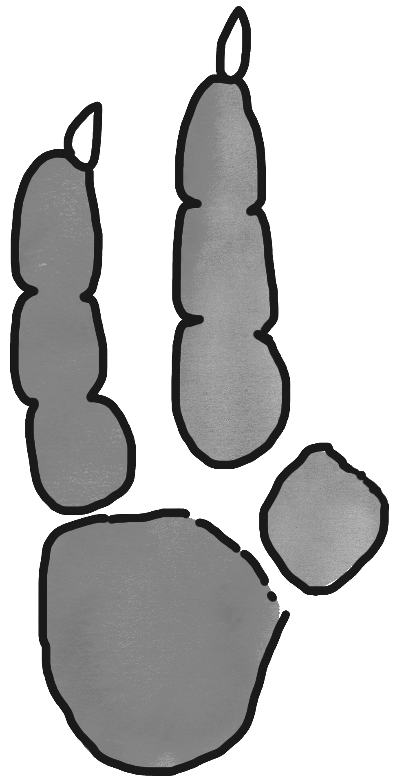
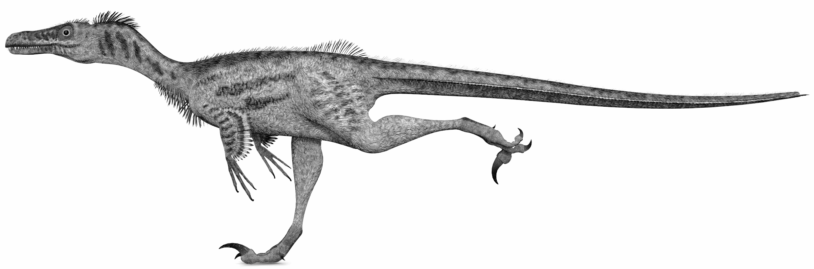

VeeLo
(Velociraptor)
51-cm long legs
Fold tape over (twice)
hole
Tie 68” string
152 cm
-
running step
Can you outrun a dinosaur?

Slide 2
VeeLo’s
sticky note
51-cm
long legs
Fold tape over (twice)
hole
Tie 68” string
152 cm
-
running step
Can you outrun a dinosaur?

Slide 3
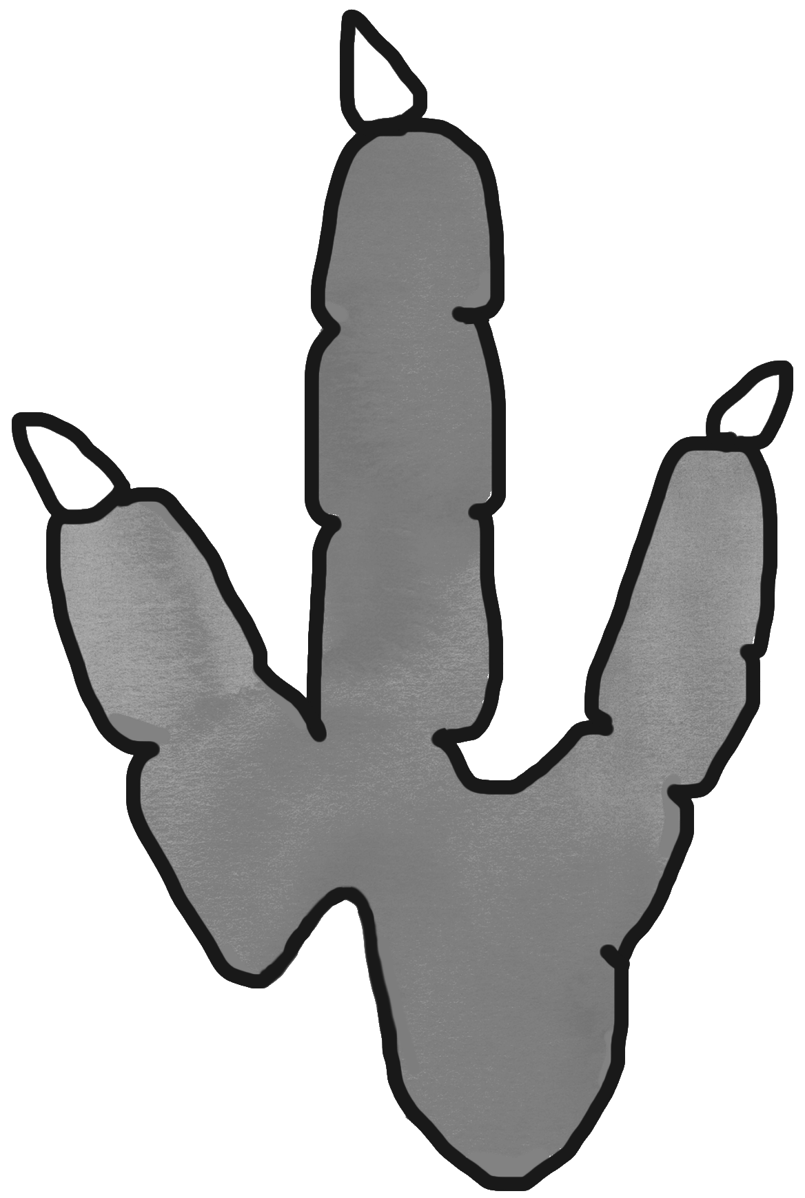
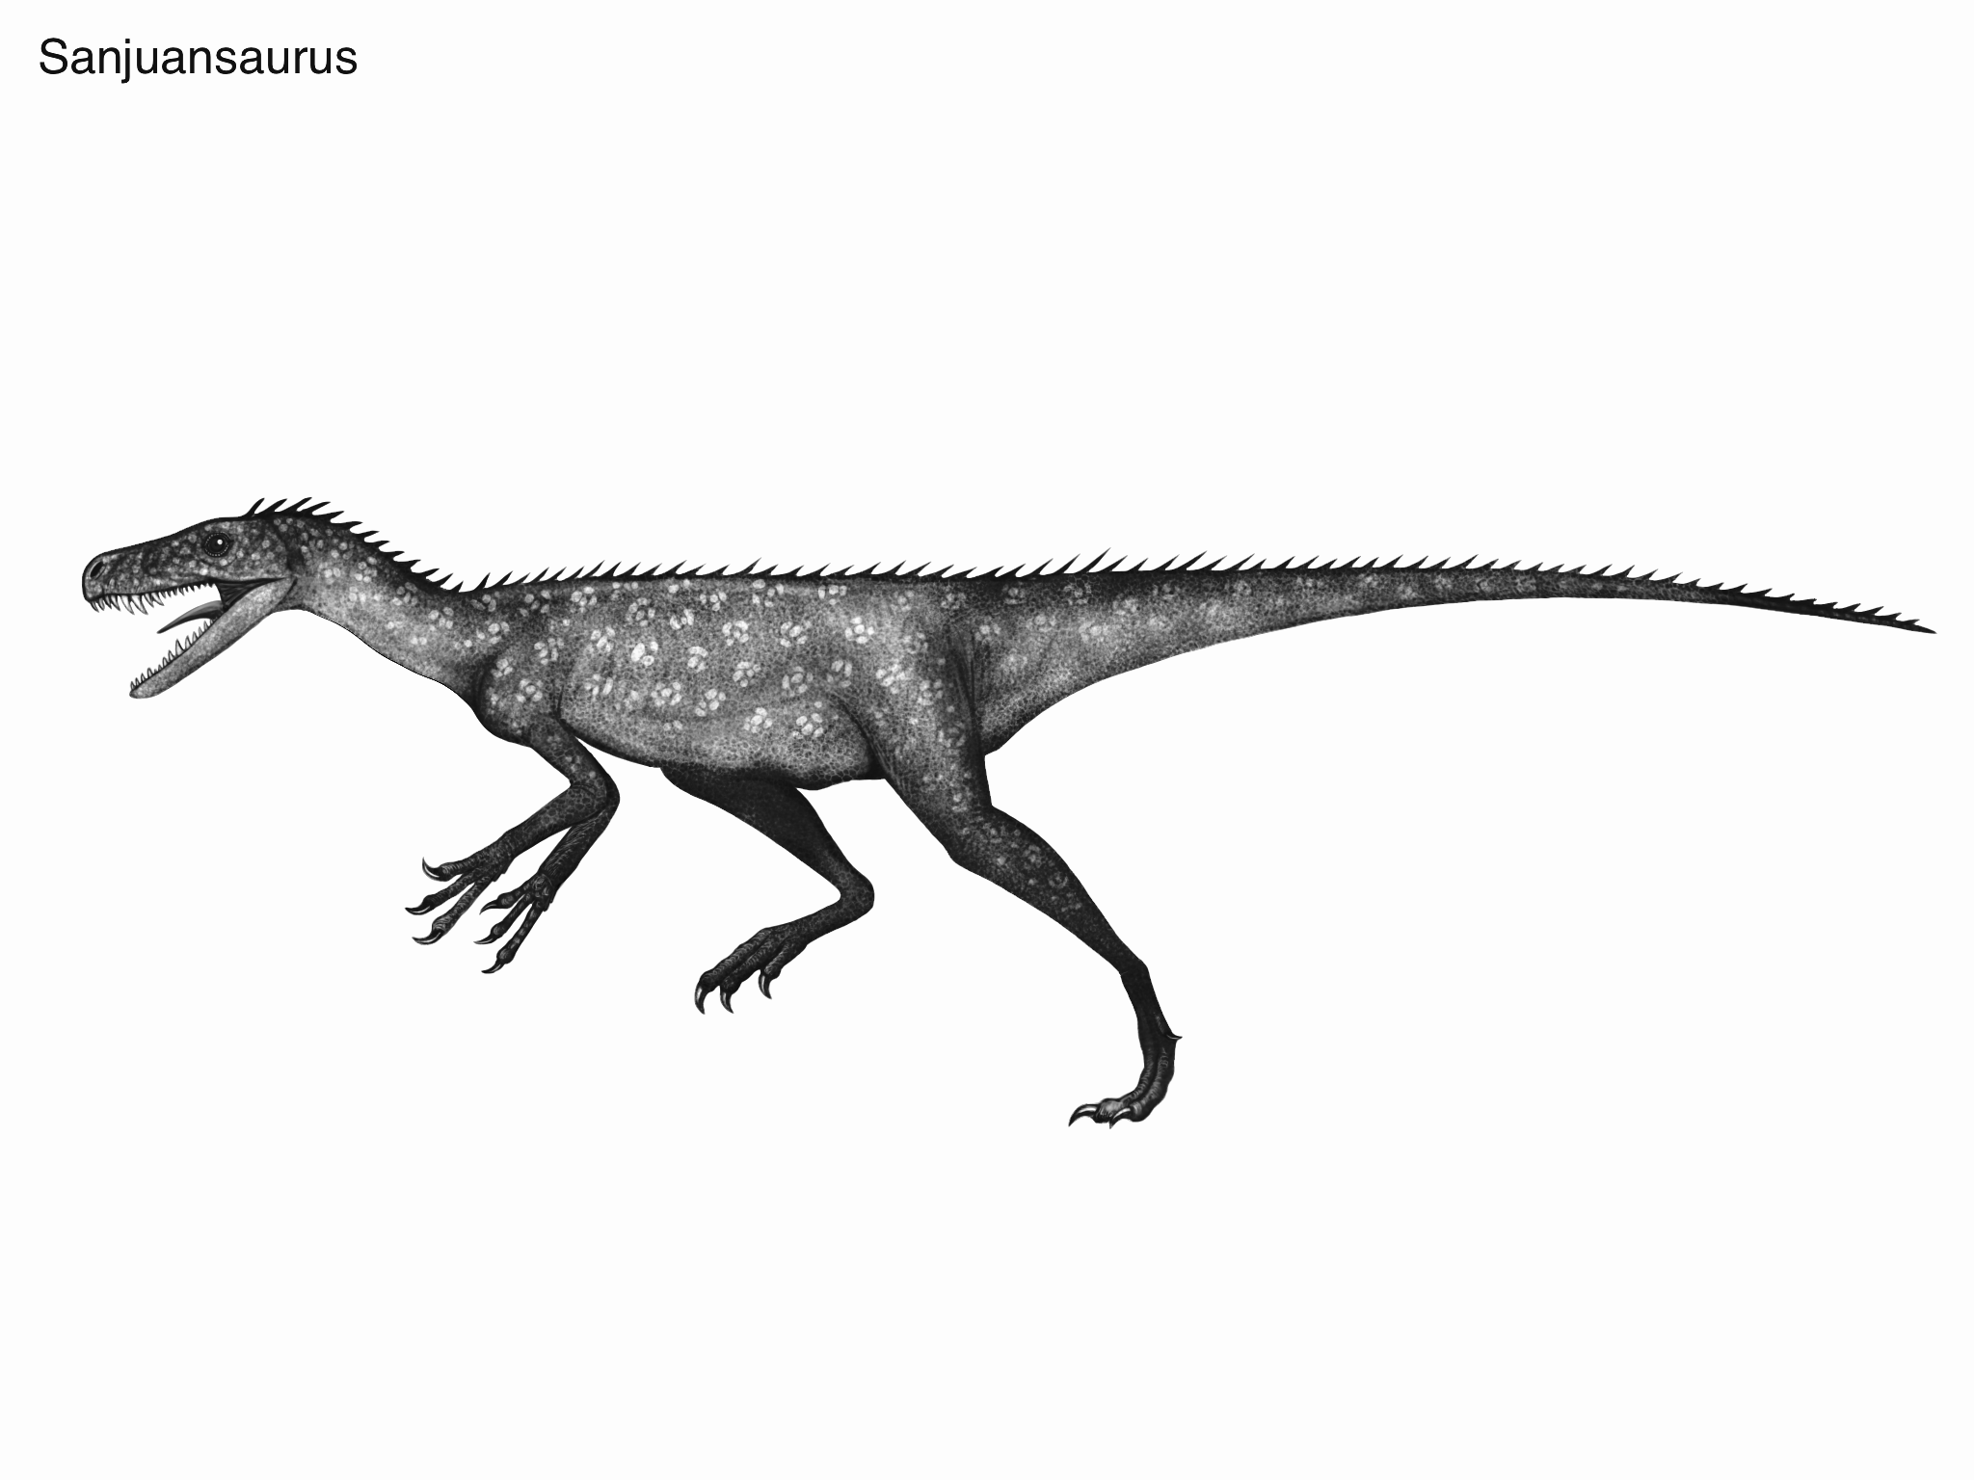
SanJuan
(Sanjuansaurus)
64-cm
long legs
Fold tape over (twice)
hole
Tie 68” string
152 cm
-
running step
Can you outrun a dinosaur?

Slide 4
San Juan’s
sticky note
64-cm long legs
Fold tape over (twice)
hole
Tie 68” string
152 cm
-
running step
Can you outrun a dinosaur?

Slide 5
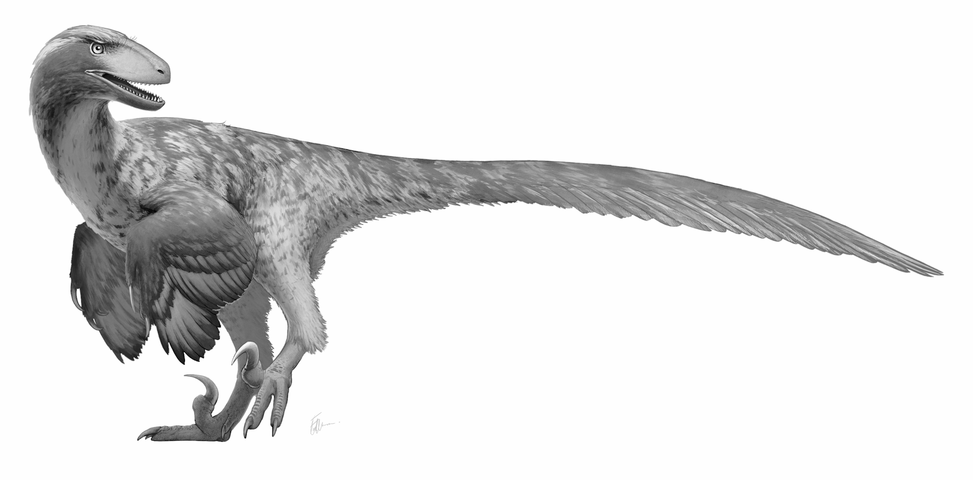

DeeNo
(Deinonychus)
76-cm long legs
Fold tape over (twice)
hole
Tie 78” string
178 cm
-
running step
Can you outrun a dinosaur?

Slide 6
DeeNo’s
sticky note
Fold tape over (twice)
76-cm long legs
hole
Tie 78” string
178 cm
-
running step
Can you outrun a dinosaur?

Slide 7
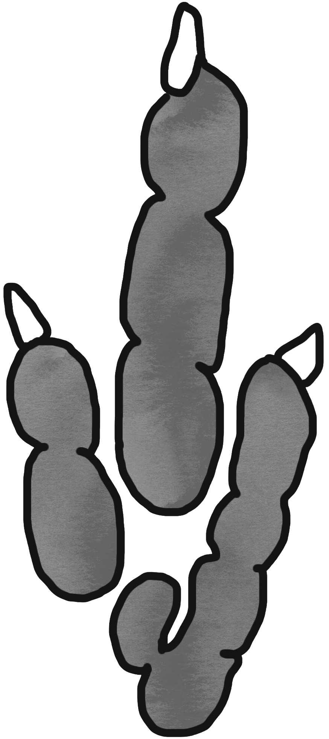
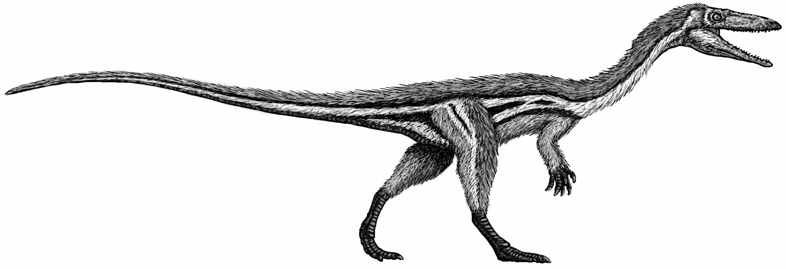
CeeLo
(Coelophysis)
89-cm
long legs
Fold tape over (twice)
hole
Tie 88” string
203 cm
-
running step
Can you outrun a dinosaur?

Slide 8
CeeLo’s
sticky note
89-cm
long legs
Fold tape over (twice)
hole
Tie 88” string
203 cm
-
running step
Can you outrun a dinosaur?

